Slide 1
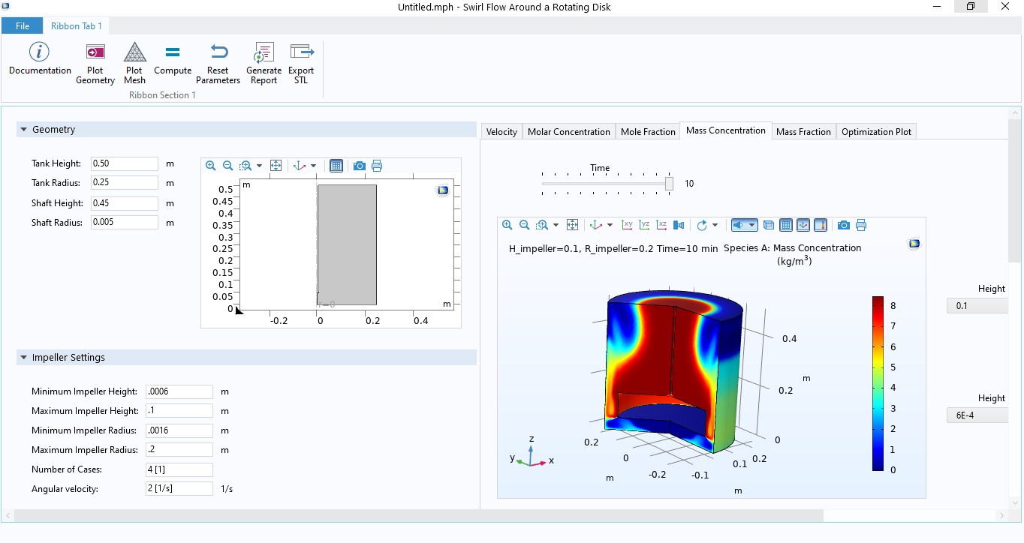
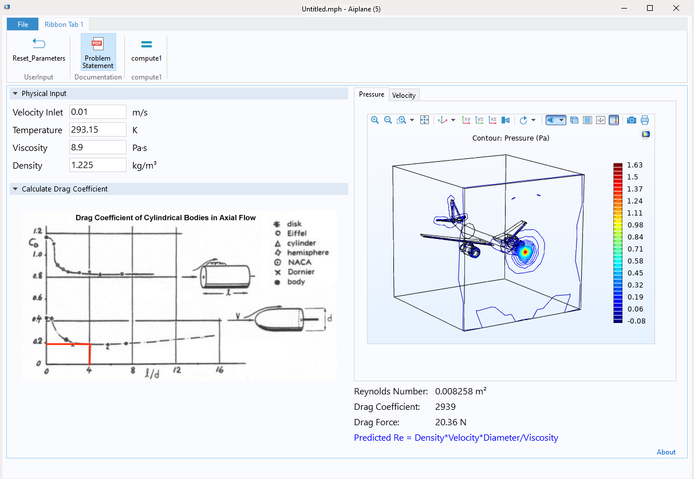
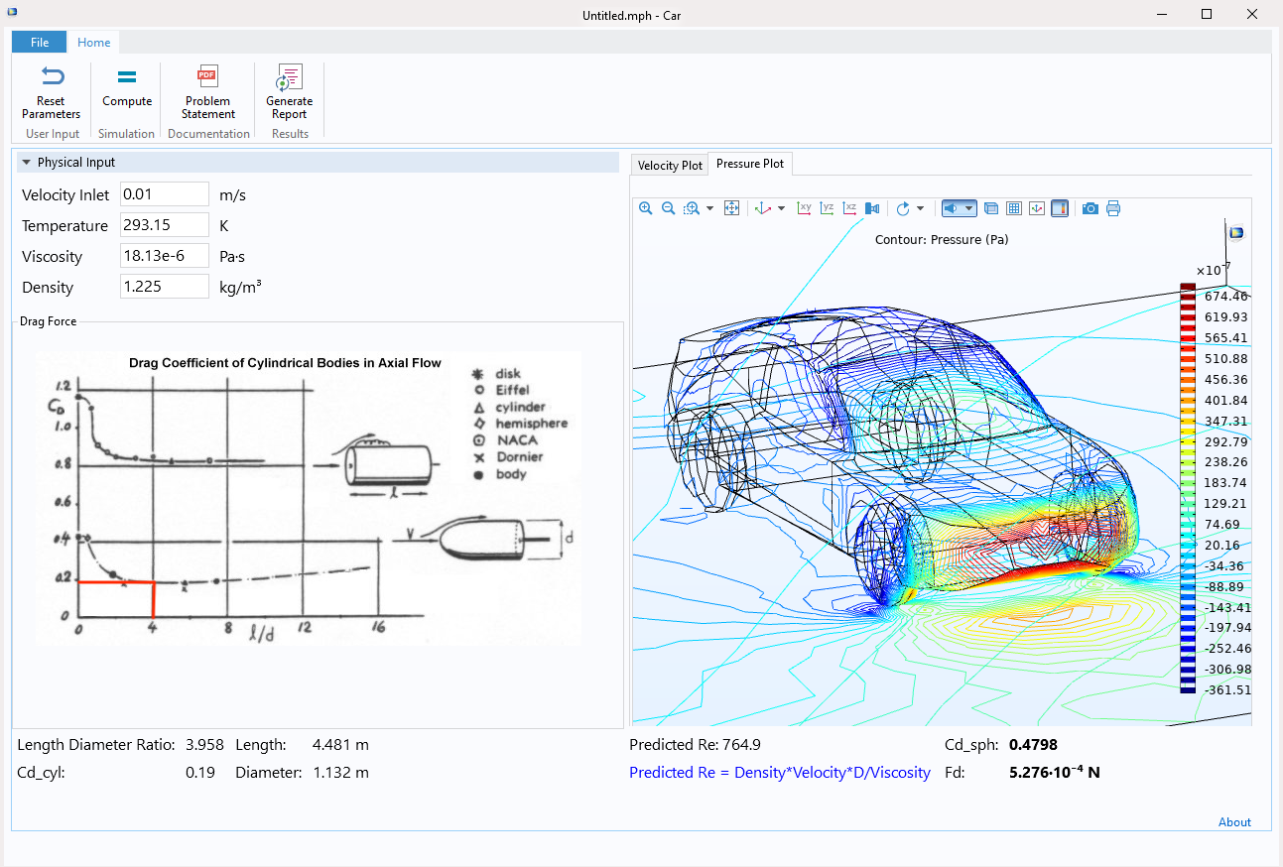
Roman Voronov teaches courses on transport phenomena, heat and mass transfer, and techniques for process simulation.
“As soon as I did one problem in COMSOL®, everybody was like: 'It is so much easier to understand because visually I can actually see what is happening,'" said Voronov.
INNOVATION AT New Jersey Institute of Technology (NJIT)
Simulation Apps in the Classroom
Teachers, lecturers, and professors are tasked with captivating their students’ attention for class periods of 50 to 90 minutes. Standalone simulation apps are a helpful teaching device that students find engaging.
During the COVID-19 pandemic, NJIT professors teaching chemical engineering labs saw a need for apps that modeled experiments they had been performing in the lab up until then.
To supplement or replace in-person lab work, Voronov and his students designed 15 simulation apps to be used in specific engineering courses and labs at NJIT.
”…using simulation apps truly gives students a fundamental understanding of what is happening inside the system they are testing. It gives them a different point of view and a lot of clarity,” said Voronov. Many of his students have gone on to use simulation in their careers — and even win awards.
Bringing Lab Courses to Remote Learning Students with Simulation Applications.
© 2024 COMSOL. Research by Roman Voronov, New Jersey Institute of Technology, New Jersey, USA.
Notes:
Left out, is that okay? “site-specific weather forecasts”

