Slide 1
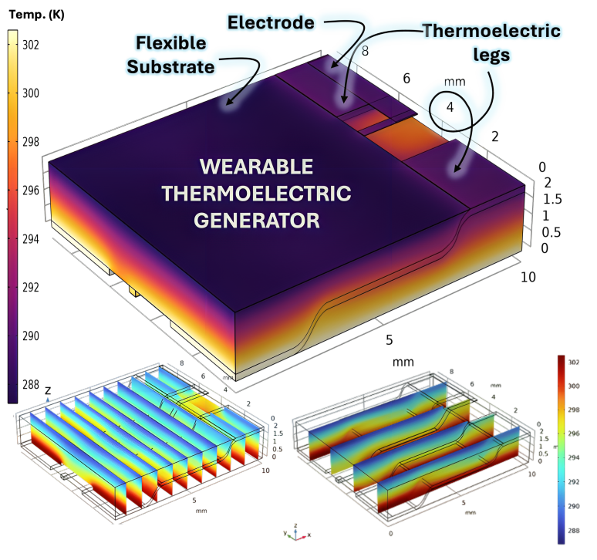
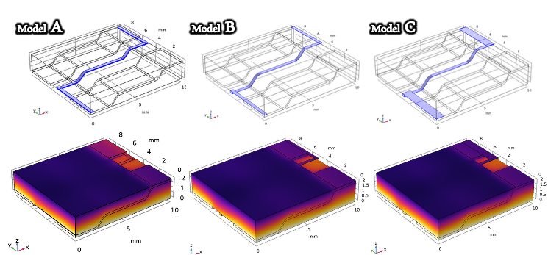
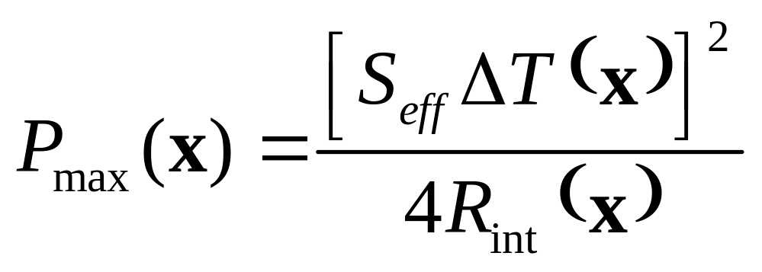
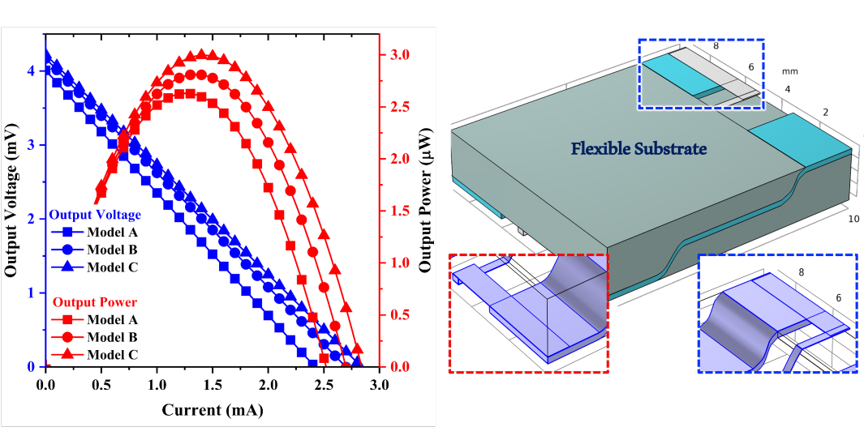

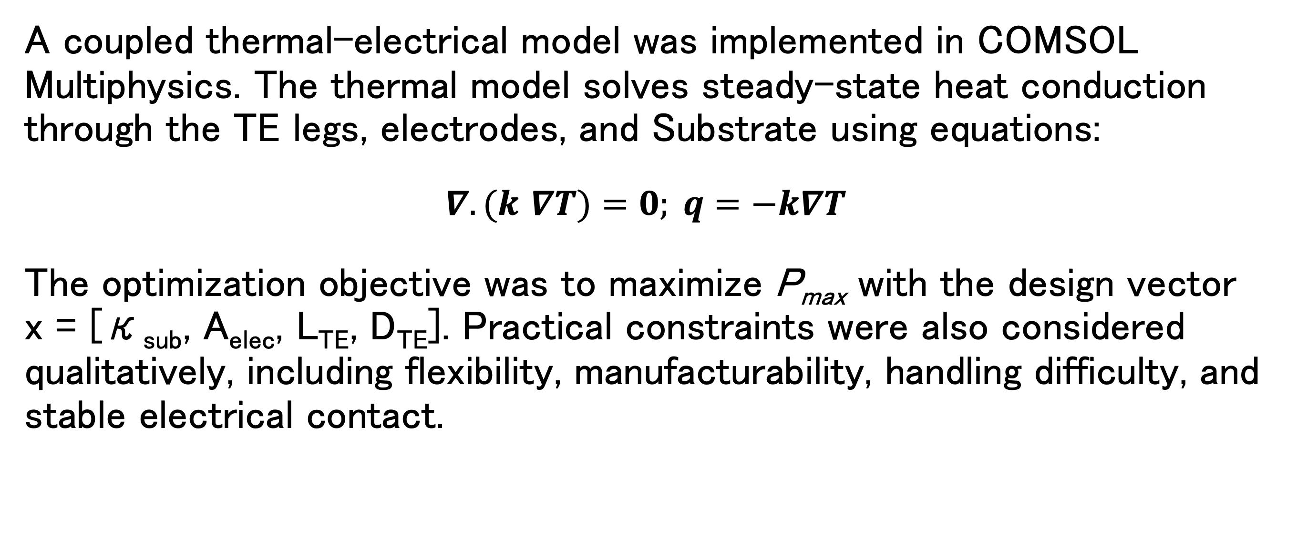
COMSOL-Guided Design of Stair-Shaped Flexible Wearable Thermoelectric Generators
Analyze, redesign, and optimize a stair-shaped WTEG architecture that decouples overall device thickness from the effective heat-transfer path.
Suresh Prasanna C^{1,2}, M. Al Ali³, M. Matsunami^{1,2}, T. Takeuchi^{1,2}
¹Toyota Technological Institute, Nagoya, Aichi, 468-8511, Japan
²MIRAI, JST Agency, Kawaguchi, Saitama, 332-0012, Japan
³The University of Osaka, Suita, Osaka, 565-0871, Japan
Overview
In practical Wearable Thermoelectric Generators (WTEGs), high conformability requires the device to be thin and flexible, but reducing thickness generally shortens the effective heat-transfer path and decreases the temperature difference across the thermoelectric (TE) legs. Here, COMSOL Multiphysics® is used to analyze, redesign, and optimize a stair-shaped WTEG architecture that decouples overall device thickness from the effective heat-transfer path.
A coupled thermal-electrical model was implemented in COMSOL Multiphysics® and the steady-state heat conduction through the TE legs, electrodes, and substrate were studied. By carefully optimizing the substrate thermal conductivity, dimensions of electrode and TE material, structure of contact electrode and positioning of electrode, we obtained an optimum condition to fabricate a highly flexible WTEG which can generate an output power of 2.99 μW at a temperature difference of 12 K.
Calculation Methodology
A coupled thermal-electrical model was implemented in COMSOL Multiphysics. The thermal model solves steady-state heat conduction through the TE legs, electrodes, and Substrate using equations:
$∇.(k$ $∇T)=0; q=−k∇T$
The optimization objective was to maximize P_{max} with the design vector x = [κ_{sub}, A_{elec}, L_{TE}, D_{TE}]. Practical constraints were also considered qualitatively, including flexibility, manufacturability, handling difficulty, and stable electrical contact.
Fig. 1 Schematics and COMSOL Multiphysics® visualizations of heat transport for Models A-C, respectively.
Results & Discussions
Simulations and experiments showed that Replacing Cu-foil electrodes with Cu wire and the Kapton substrate with aerogel substantially increased output power by preserving this temperature difference, despite an increase in internal resistance. Further gains were obtained by relocating the electrode above the TE leg to enhance heat dissipation at the cold junction and by introducing a Z-shaped electrode that combines wide end regions with a narrow heat-restricting passage. The optimized Model C achieved 2.99 µW, nearly six times the output power of the original first-generation device. More broadly, the results establish a simulation-guided design framework in which COMSOL Multiphysics® supports iterative structural refinement of stair-shaped and other geometrically complex WTEG architectures.
Fig. 2 Voltage and power versus applied current for Models A-C. Schematic representation of Model C.
[1] M. Sattar, et. al., “Flexible Thermoelectric Wearable Architecture for Wireless Continuous Physiological Monitoring”, ACS Appl. Mater. Interfaces 16 (2024) 37401–37417.
[2] C. Suresh Prasanna et. al., “Geometric decoupling of thickness and thermal gradient in wearable thermoelectric generators via a stair-shaped architecture”, Chemical Engineering Journal 539, 177006 (2026).

