Slide 1
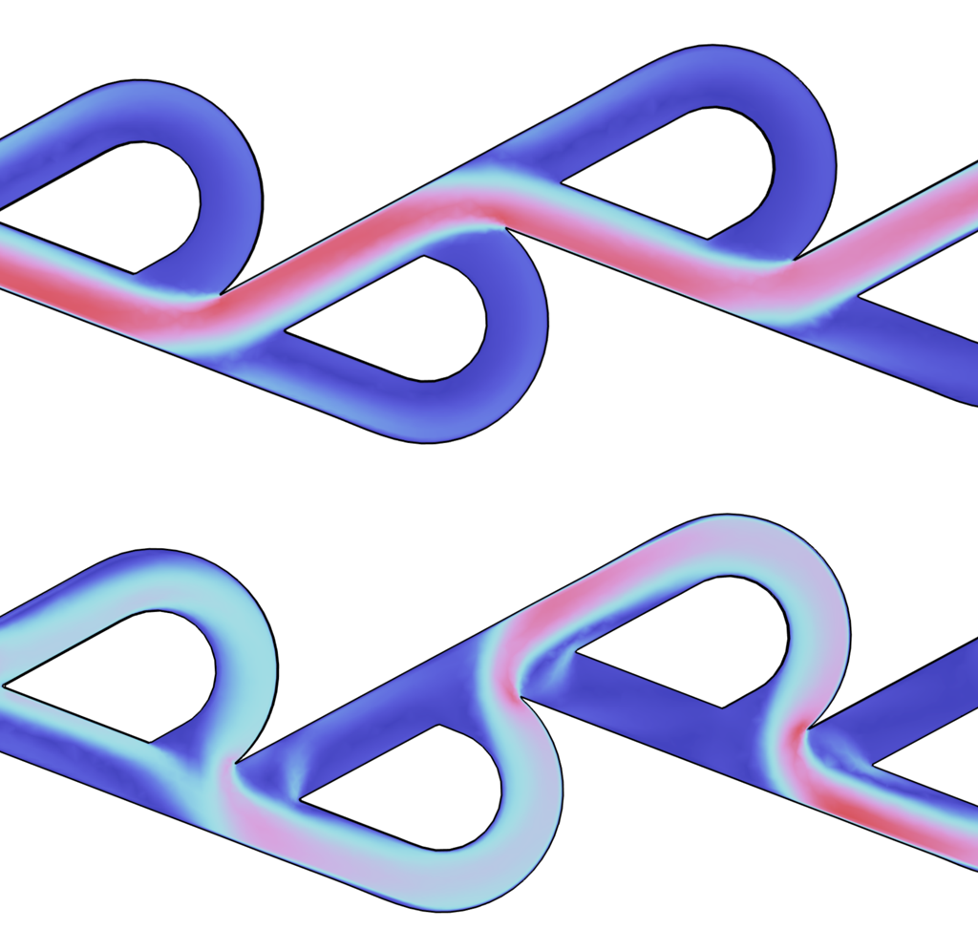
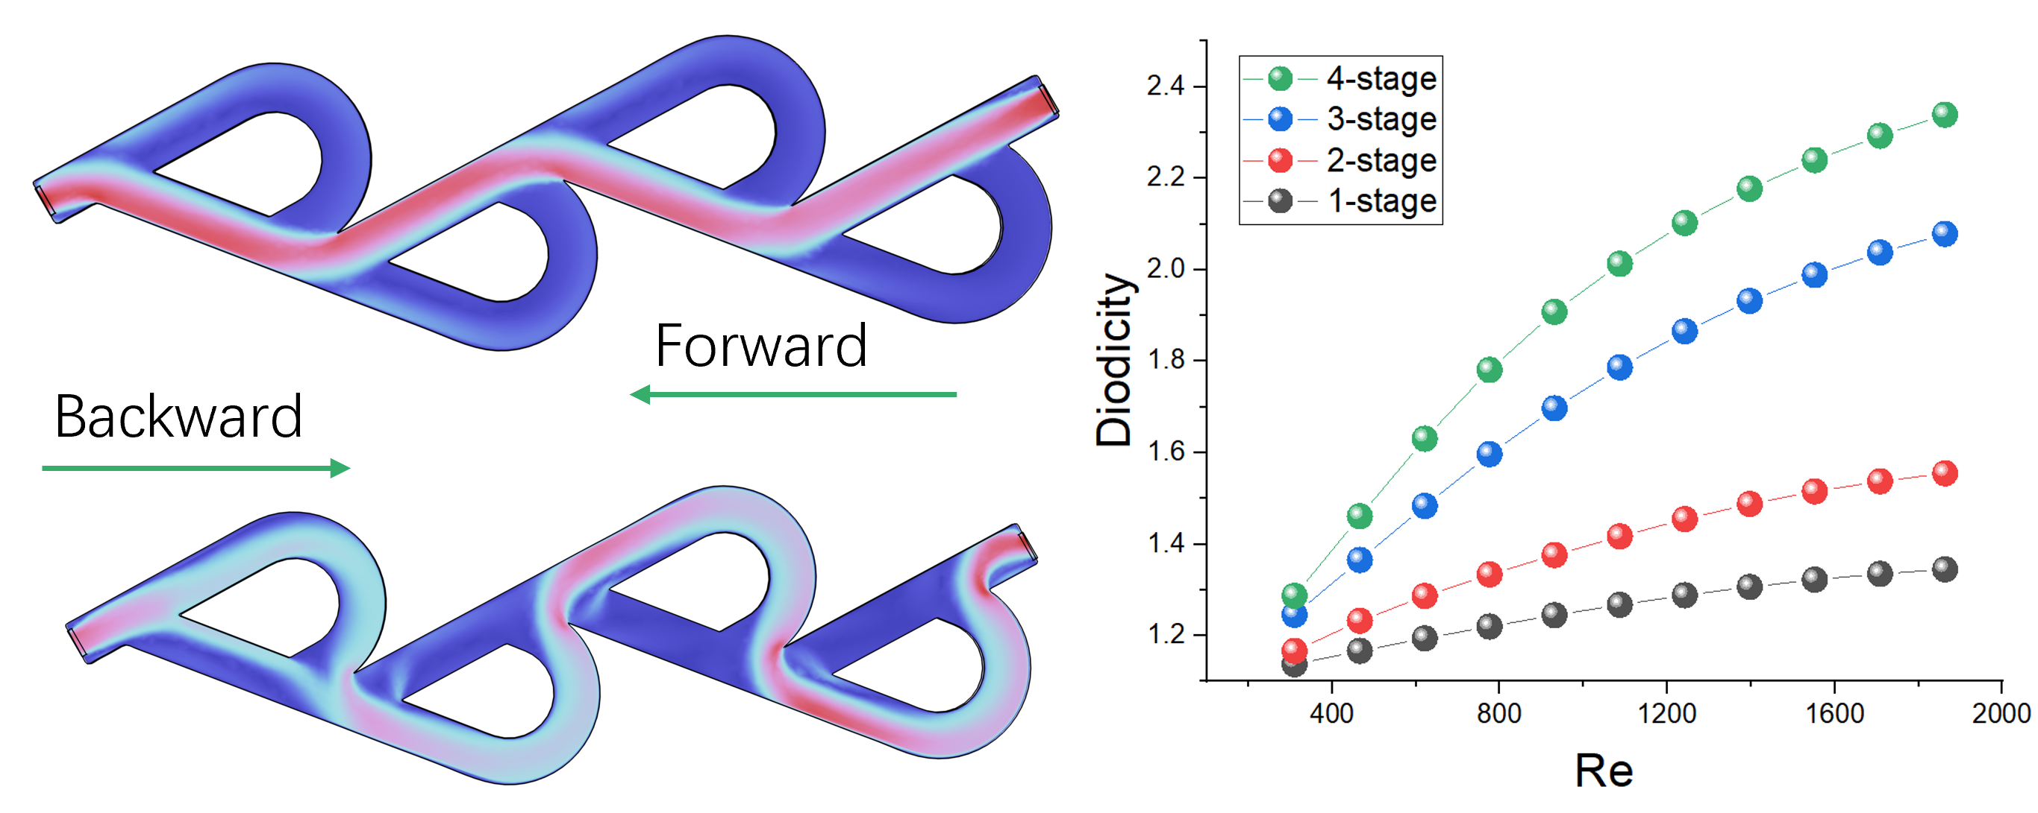
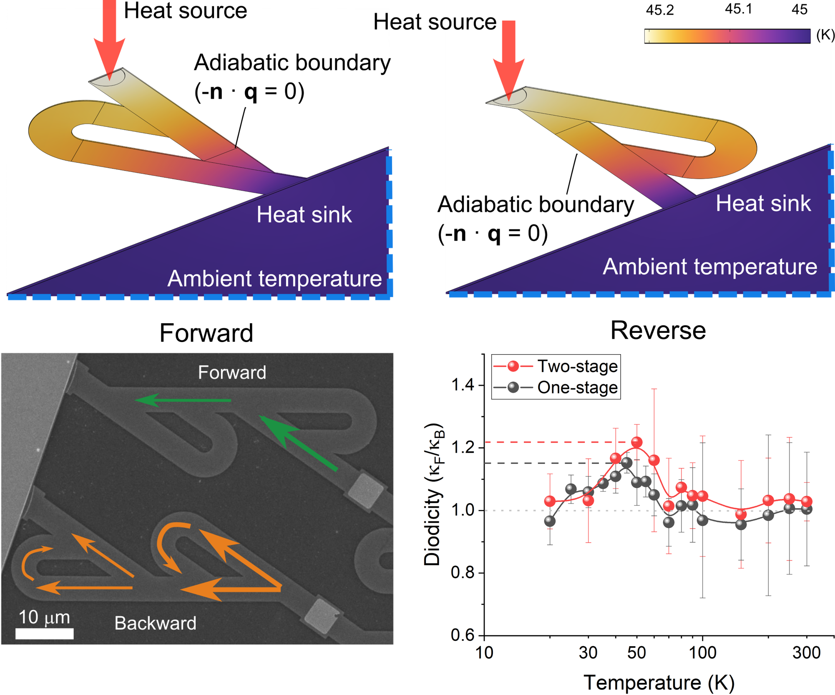

From Fluidic Tesla Valves to Solid-State Phonon Tesla Valves via Phonon Hydrodynamics
COMSOL Multiphysics simulations bridge fluidic Tesla valves with solid-state phonon transport, revealing enhanced diode effect with increasing stages. Guided by the simulations, graphite phonon Tesla valves experimentally achieved diodicity of 1.15 and 1.22 for single- and two-stage designs, respectively.
X. Huang¹, R. Anufriev¹, L. Jalabert¹, K. Watanabe², T. Taniguchi², Y. Guo³, Y. Ni⁴, S. Volz¹ and M. Nomura¹
1. IIS, The University of Tokyo, 2. NIMS, 3. Harbin Institute of Technology, 4. Southwest Jiaotong University
Summary
The Tesla valve is a passive fluidic diode that uses geometric asymmetry to create directional resistance. Using COMSOL Multiphysics, we translated this concept to solid-state phonon heat transport. Laminar Flow simulations showed that increasing valve stages enhances rectification through asymmetric pressure loss and vortex formation. Guided by these results, we designed graphite Tesla valves and modeled their thermal transport with measured conductivities.
Experiments achieved a thermal rectification ratio of 1.15 for a single-stage valve. COMSOL optimization produced a two-stage design, increasing the ratio to 1.22. The simulations captured the asymmetric heat flux and directional thermal resistance responsible for the diode effect. This work demonstrates a multiphysics strategy for developing solid-state thermal devices inspired by fluidic transport.
Fluidic Tesla valve
We first employed the Laminar Flow Module to investigate fluid transport in Tesla valves with different numbers of stages. The simulations reveal a pronounced asymmetry between the forward and reverse flow directions. In the forward direction, the fluid predominantly follows the main channel. In contrast, the reverse flow is redirected into the curved side channels, generating strong flow separation, recirculation, and significantly increase the flow resistance. As the number of Tesla stages increases from one to four, the asymmetric pressure losses accumulate, producing a substantial enhancement in diodicity. It provide an effective strategy for achieving strong directional fluid transport.
Figure 1. Fluidic Tesla valves and diode effect with increasing Tesla valve stages.
Graphite thermal Tesla valve
Inspired by the fluidic simulations, we designed graphite-based solid-state Tesla valves to manipulate phonon transport. Heat conduction was modeled using the Heat Transfer Module, where experimentally measured thermal conductivities were incorporated to reproduce realistic thermal transport. Experimental measurements demonstrated the first realization of thermal rectification based on phonon hydrodynamics in a solid-state Tesla valve, achieving a rectification ratio of 1.15 in a single-stage device. Guided by further COMSOL optimization, a two-stage Tesla valve was subsequently designed, fabricated, and experimentally shown to enhance the rectification ratio to 1.22.
Figure 2. Simulation and experiments on graphite thermal Tesla valves.
Huang, X., Anufriev, R., Jalabert, L. et al. A graphite thermal Tesla valve driven by hydrodynamic phonon transport . Nature 634, 1086–1090 (2024). https://doi.org/10.1038/s41586-024-08052-1

