Slide 1


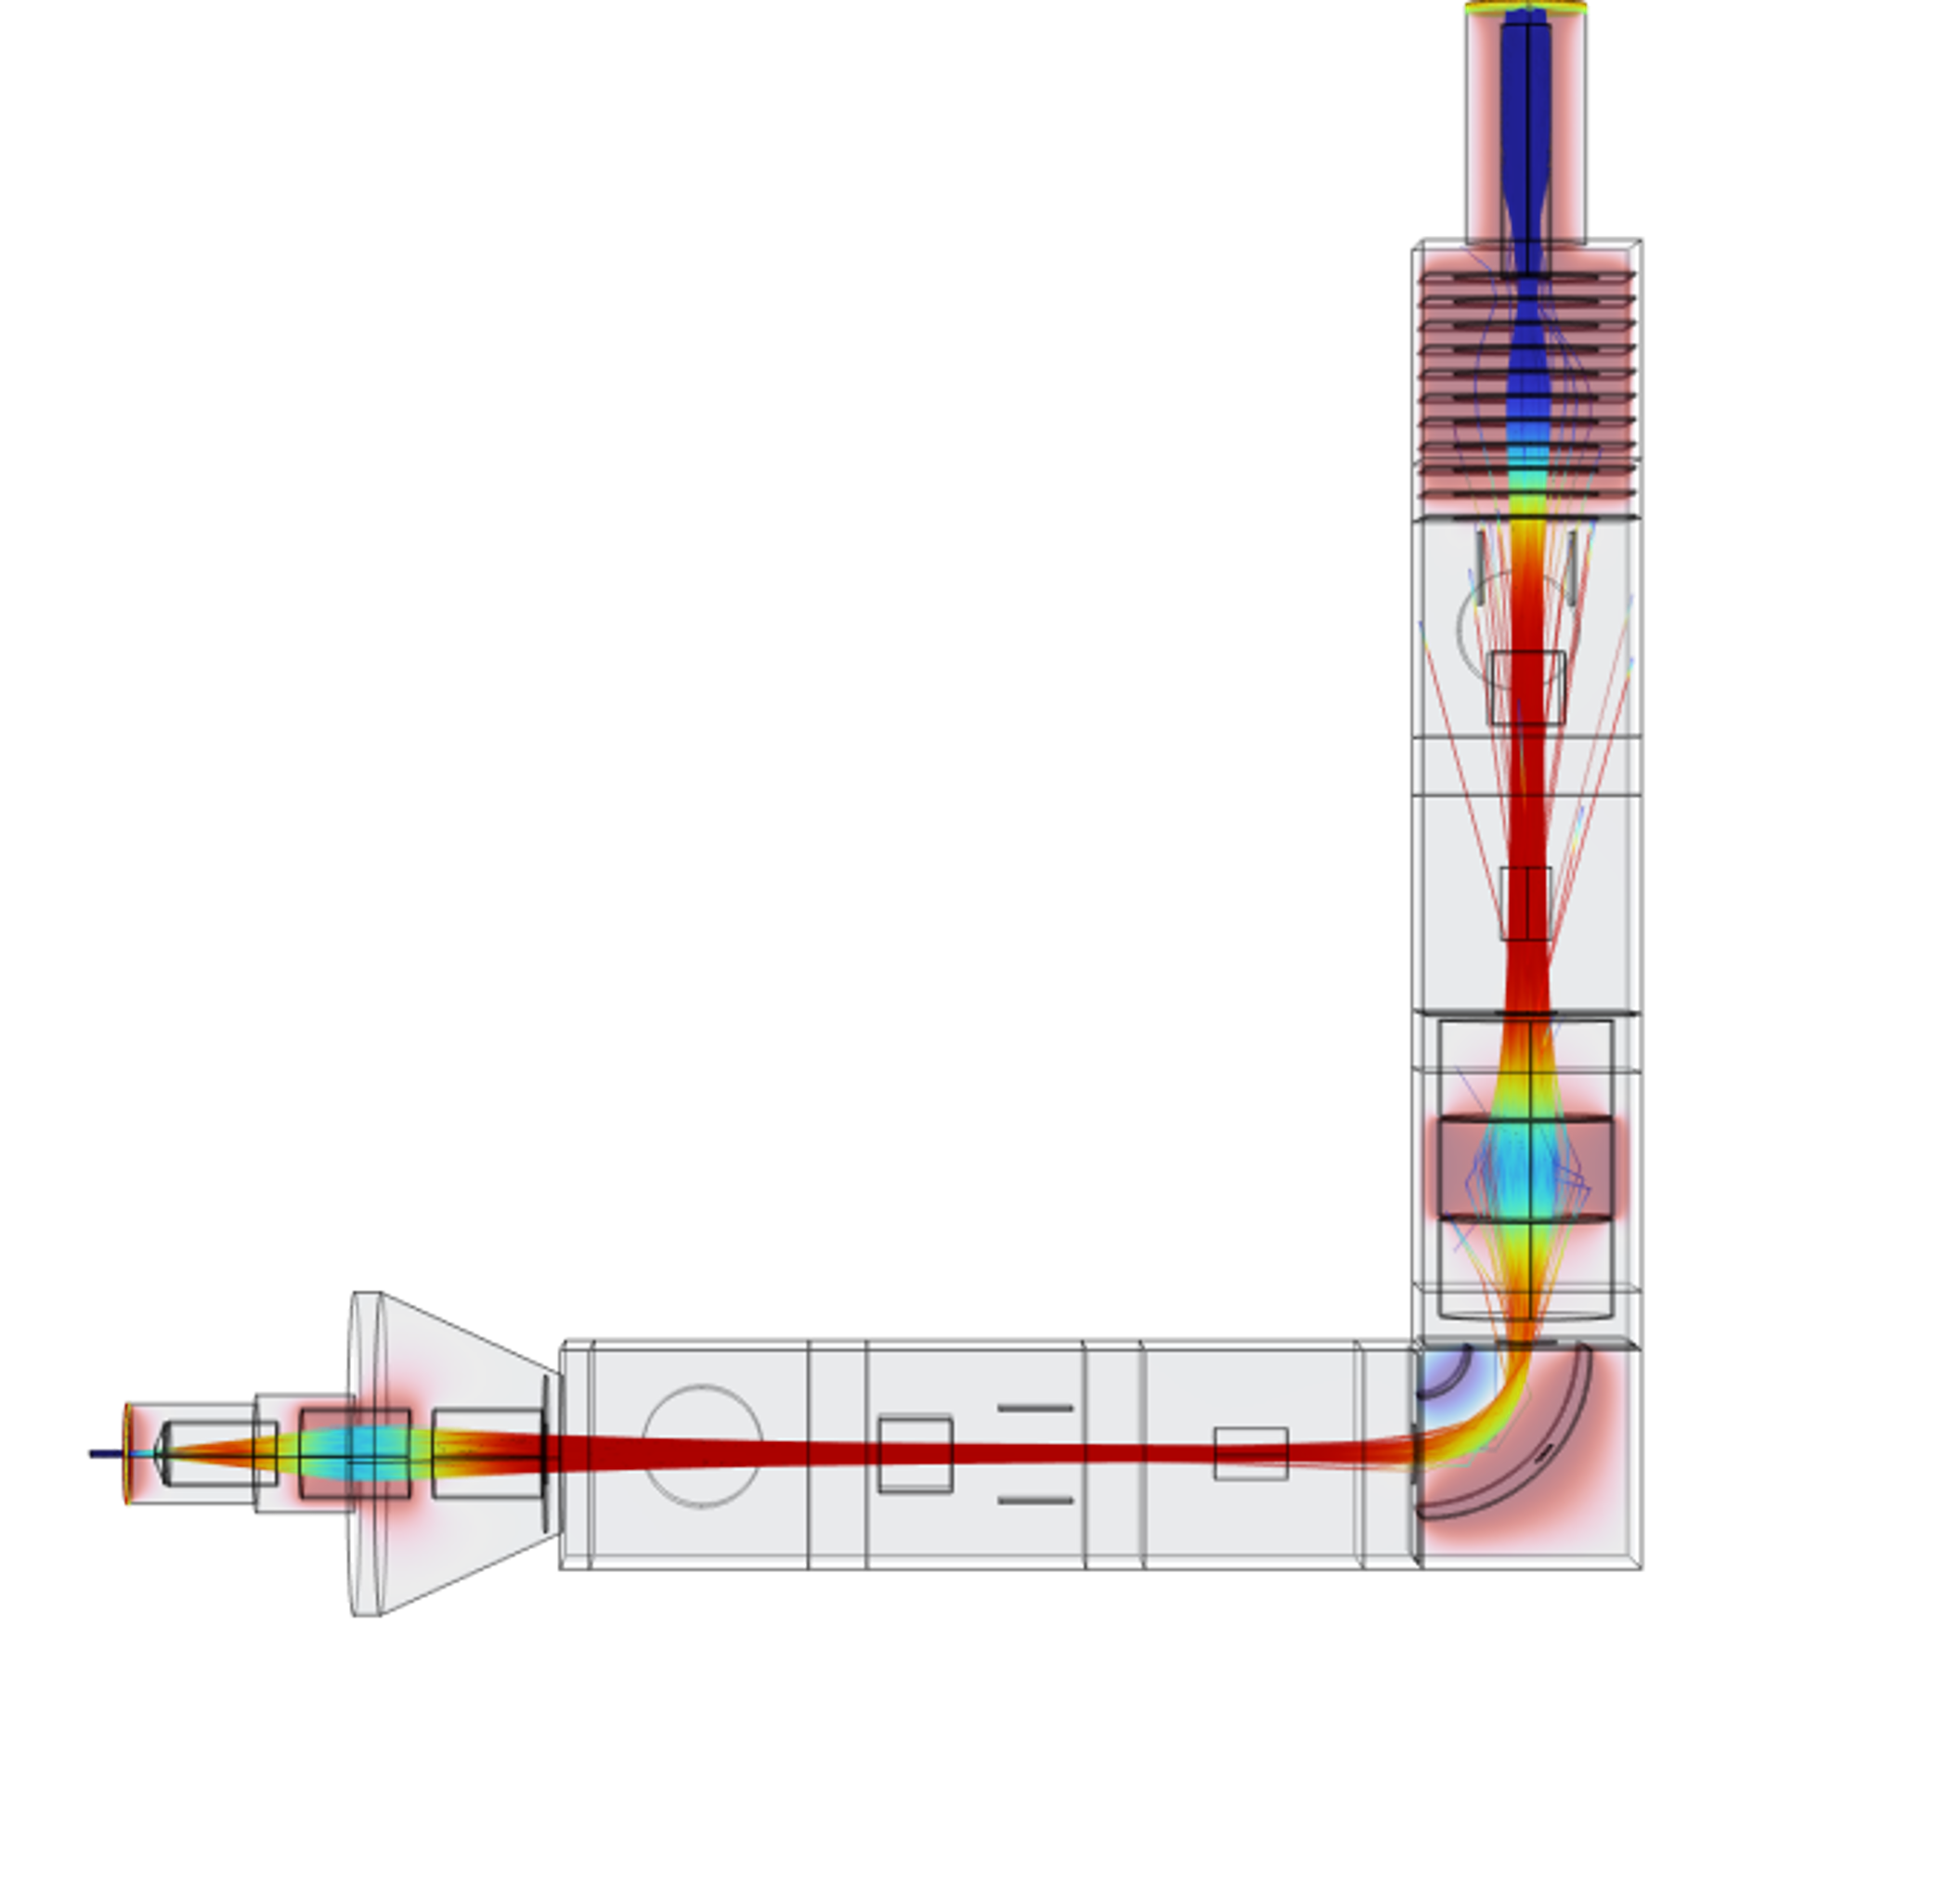

Design of the IOTA Ion Beam Transport System for Nuclear Physics and Medical Applications
A. Zadvornaya | T. Day Goodacre
University of Manchester
$$λ$$
Notes:
Good morning. I will present how we are using COMSOL Multiphysics to design IOTA, a dedicated offline ion-source optimisation and beam-transport facility at the University of Manchester. The main message is that IOTA is not only a beamline. It is a controlled platform for improving several linked efficiency terms, and COMSOL lets us prioritise the design choices before manufacture and commissioning.
[Sources]
AZadornaya-Poster-COMSOL-Conference-2026-Cambridge_2026-09-01.pptx (uploaded poster)

Slide 2
Outline
1
Motivation for offline ion source development
Radioactive isotopes applications, efficiency limitations and online facilities constrains
2
IOTA objectives and beamline design
Purpose, operating principle and layout
3
Integrated COMSOL model
Electrostatics, particle tracing, space charge and vacuum
4
Simulations results so far
Transmission efficiency, energy spread, and vacuum performance
5
What comes next?
Further model refinement and validation during commissioning
Notes:
CERN-MEDICIS provides a useful example of why a dedicated offline separator matters. It receives irradiated materials, heats them to release the isotopes, ionises them and performs mass separation before collection. Importantly, stable-beam development was used to optimise operation. For samarium, stable tests reached separation efficiencies up to 31 percent, and the optimum temperature was then confirmed during radioactive collections. This is the type of systematic development approach that motivates IOTA, although IOTA will focus strongly on ion-source and transport optimisation in a UK laboratory.
[Sources]
C. Duchemin et al., CERN-MEDICIS: A Review Since Commissioning in 2017, Frontiers in Medicine 8 (2021) 693682, uploaded PDF, pp. 4 and 8-9

Slide 3
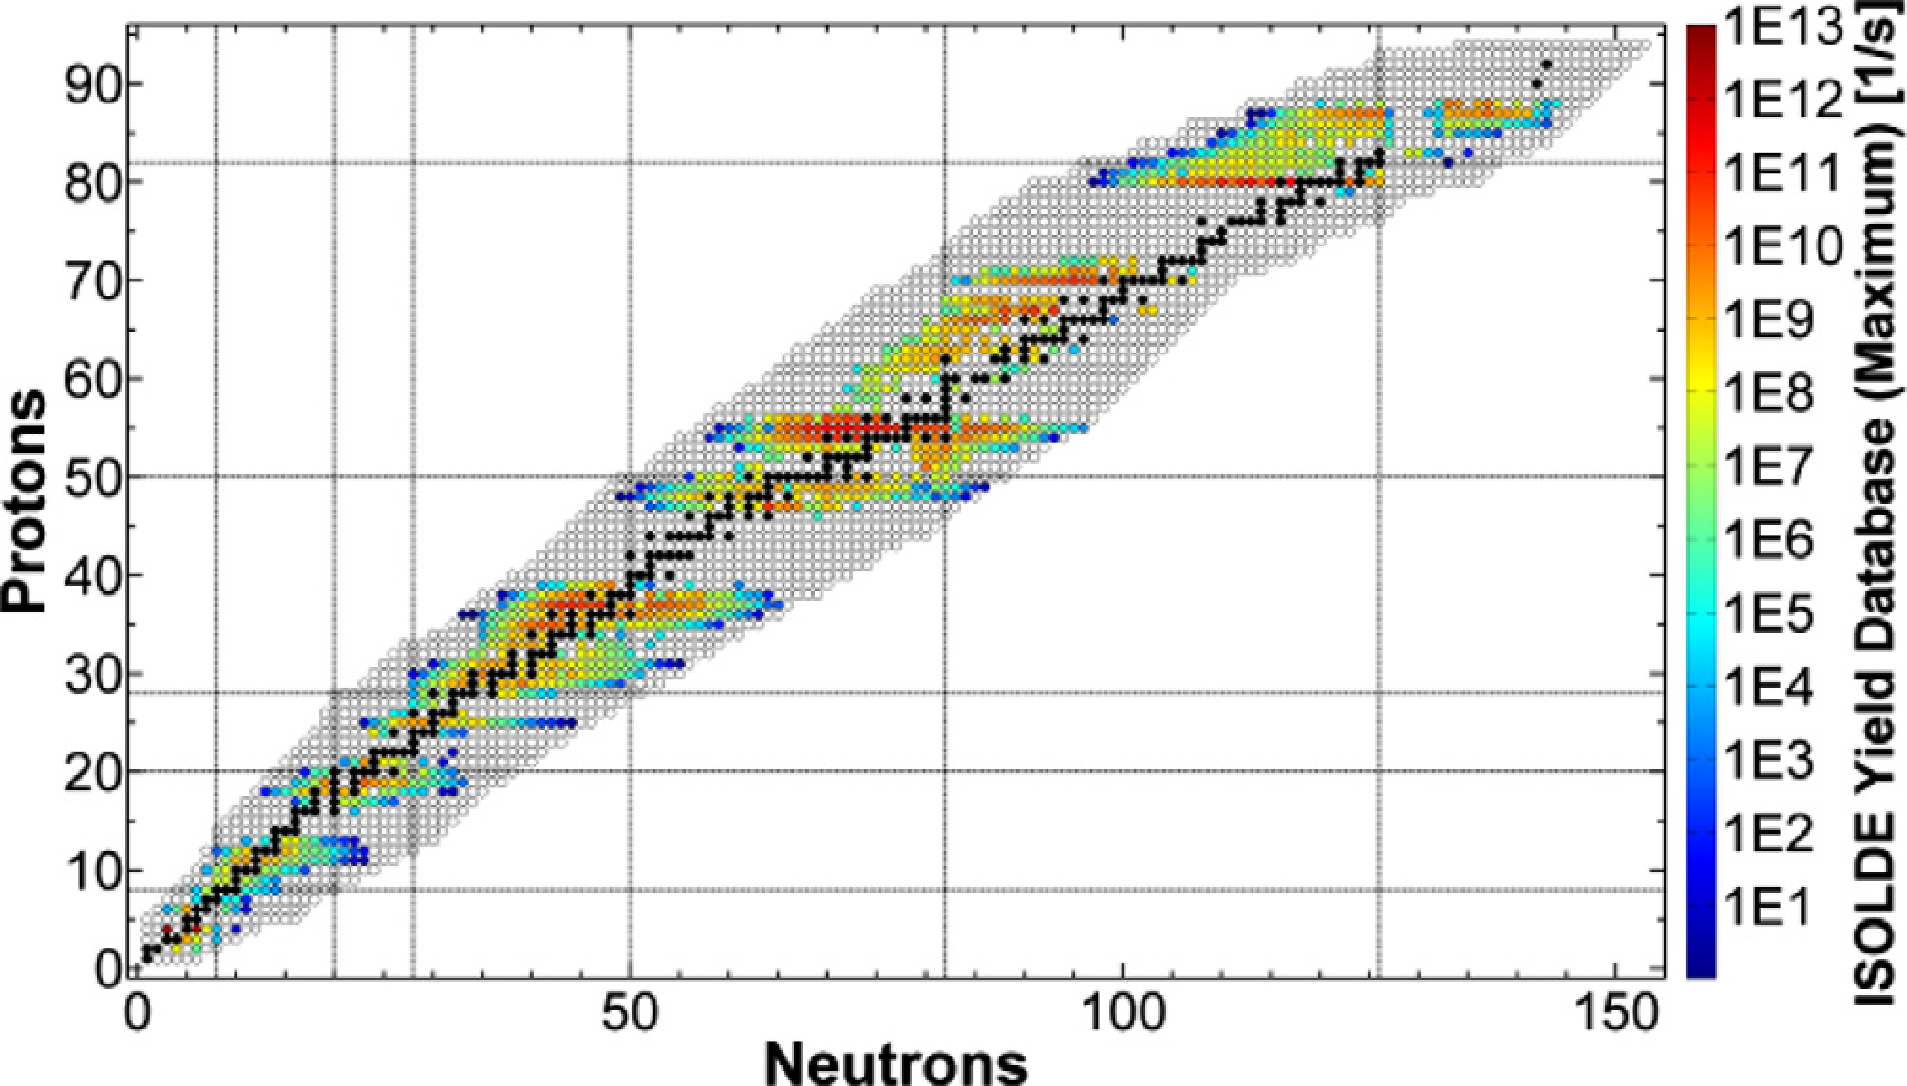
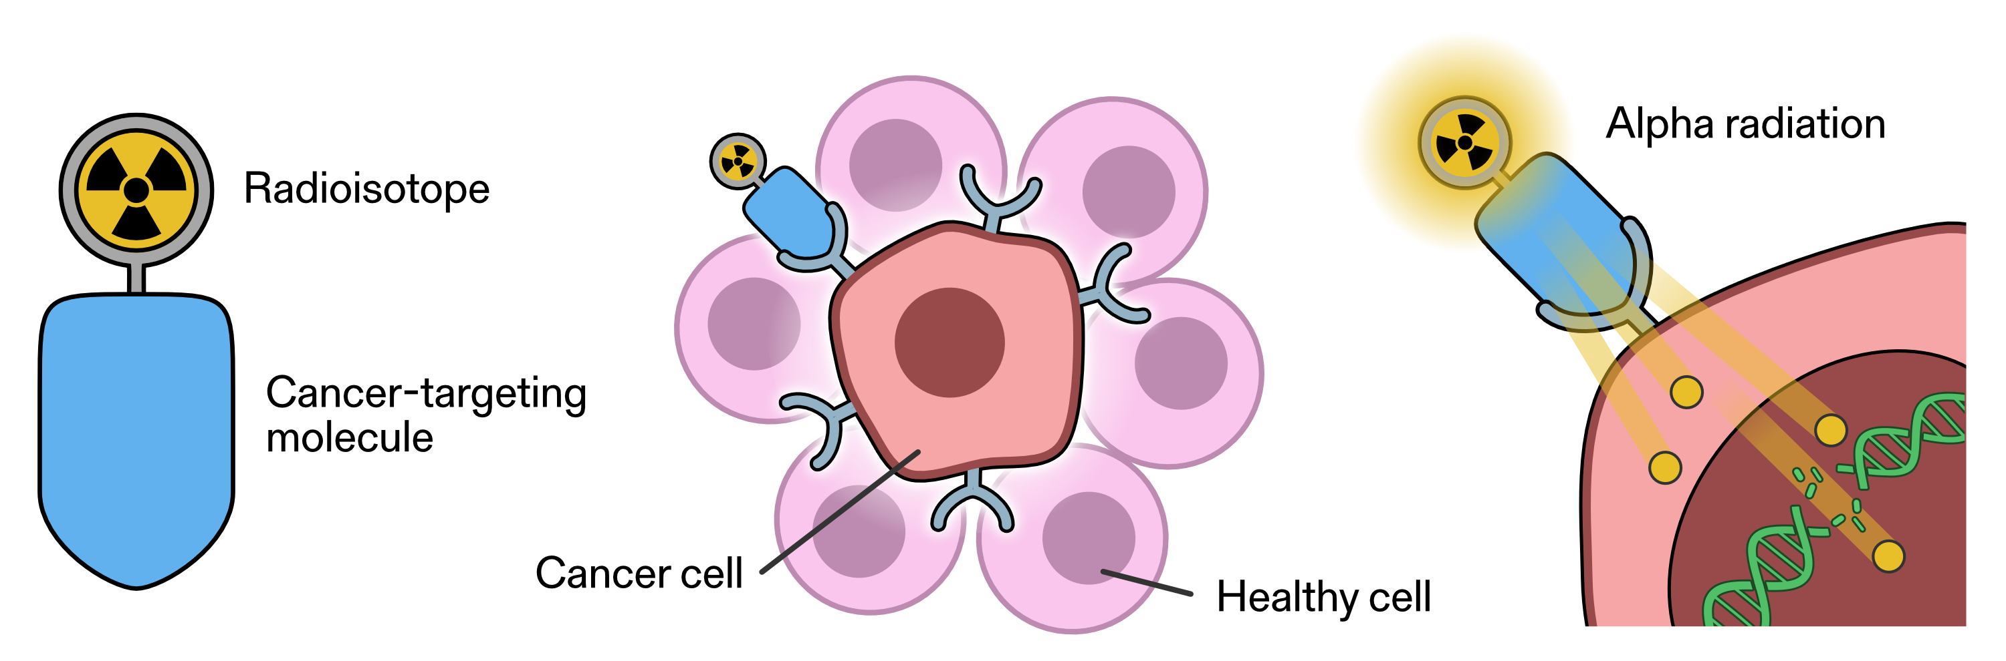
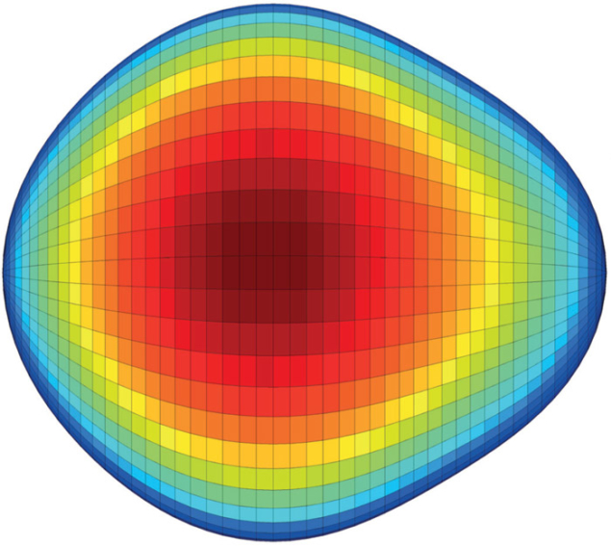
Radioactive isotopes in cancer treatment and fundamental nuclear physics
CANCER TREATMENT
Targeted alpha therapy (TAT)
Alpha-emitters: Ac-225, At-211, Pb-212
FUNDAMENTAL NUCLEAR PHYSICS
Produce and study
short-lived nuclei far
from stability
Benchmark and
improve nuclear models
Dedicated offline facilities enable systematic ion source development without using valuable online beamtime
Credit: S. Kelley/NIST
TRIUMF | Canada
Ra-224
ONLINE
Target and ion source are connected to the accelerator.
OFFLINE DEVELOPMENT
Supports target and ion-source optimization
L. P. Gaffney et al. 2013 Nature 497 199
A. Gottberg, NIM B, 376 (1) 8-15 2016
F. Maldonado Millan et al, NIM B, 542 (2023) 95 - 98
Notes:
CERN-MEDICIS provides a useful example of why a dedicated offline separator matters. It receives irradiated materials, heats them to release the isotopes, ionises them and performs mass separation before collection. Importantly, stable-beam development was used to optimise operation. For samarium, stable tests reached separation efficiencies up to 31 percent, and the optimum temperature was then confirmed during radioactive collections. This is the type of systematic development approach that motivates IOTA, although IOTA will focus strongly on ion-source and transport optimisation in a UK laboratory.
[Sources]
C. Duchemin et al., CERN-MEDICIS: A Review Since Commissioning in 2017, Frontiers in Medicine 8 (2021) 693682, uploaded PDF, pp. 4 and 8-9

Slide 4
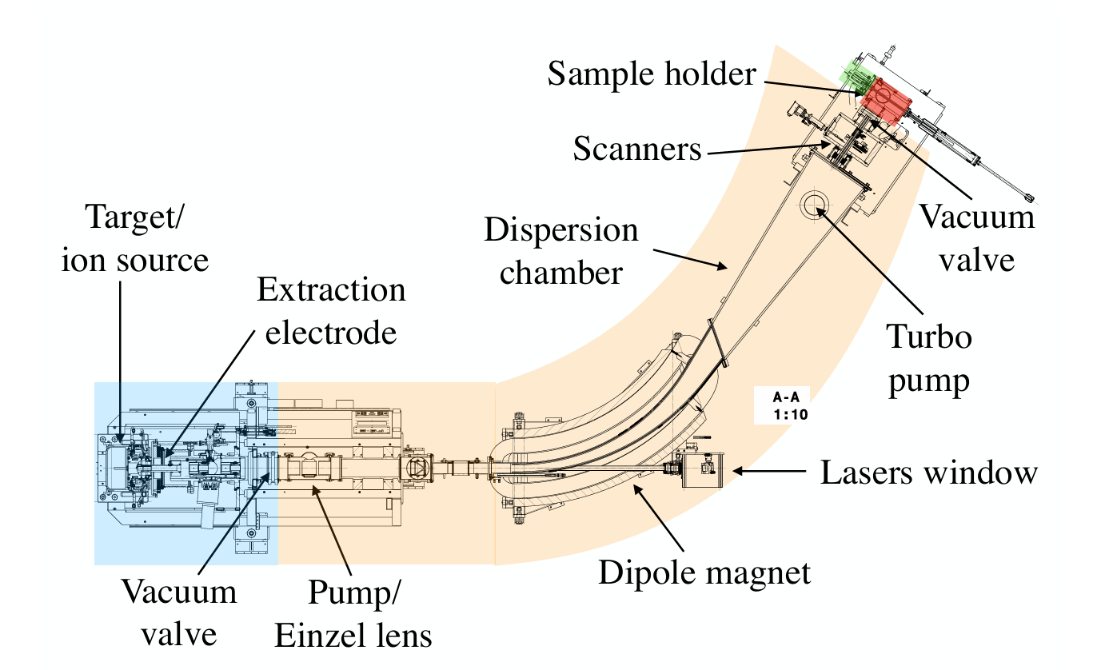
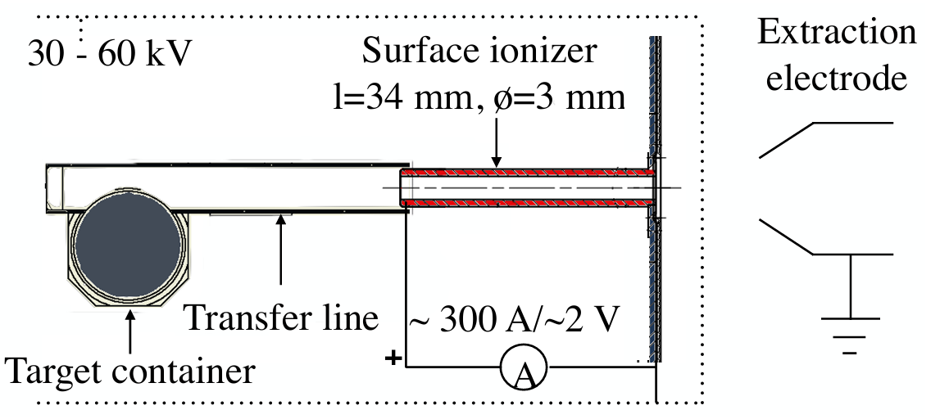

Production and mass separation of radioactive isotopes
CERN-MEDICIS | Switzerland
OFFLINE MASS SEPARATOR
Irradiated material is transported for heating, ionisation, mass separation and collection.
1
Produce
Irradiate target material
Y. Martinez Palenzuela et al., Front. Med. 8, 689281 (2021)
2
Release
3
Transfer
4
Ionize
5
Transport
6
Mass
separate
7
Collect / Measure
→
→
Transport from target container to the ion source
→
→
Ion-optical transport through the beamline system
→
→
Extraction from heated target
Create ions in an ion source
Eff. ~ 0.1% - 90%
Select the isotope
of interest
Eff. ~ 10% - 100%
Deliver ions to the end station
Eff. $≤ {10}^{−6}\%$
A. Gottberg, NIM B, 376 (1) 8-15 2016
Dedicated R&D is essential to improve isotopes availability, beam intensity, purity, stability and efficiency
Notes:
CERN-MEDICIS provides a useful example of why a dedicated offline separator matters. It receives irradiated materials, heats them to release the isotopes, ionises them and performs mass separation before collection. Importantly, stable-beam development was used to optimise operation. For samarium, stable tests reached separation efficiencies up to 31 percent, and the optimum temperature was then confirmed during radioactive collections. This is the type of systematic development approach that motivates IOTA, although IOTA will focus strongly on ion-source and transport optimisation in a UK laboratory.
[Sources]
C. Duchemin et al., CERN-MEDICIS: A Review Since Commissioning in 2017, Frontiers in Medicine 8 (2021) 693682, uploaded PDF, pp. 4 and 8-9

Slide 5
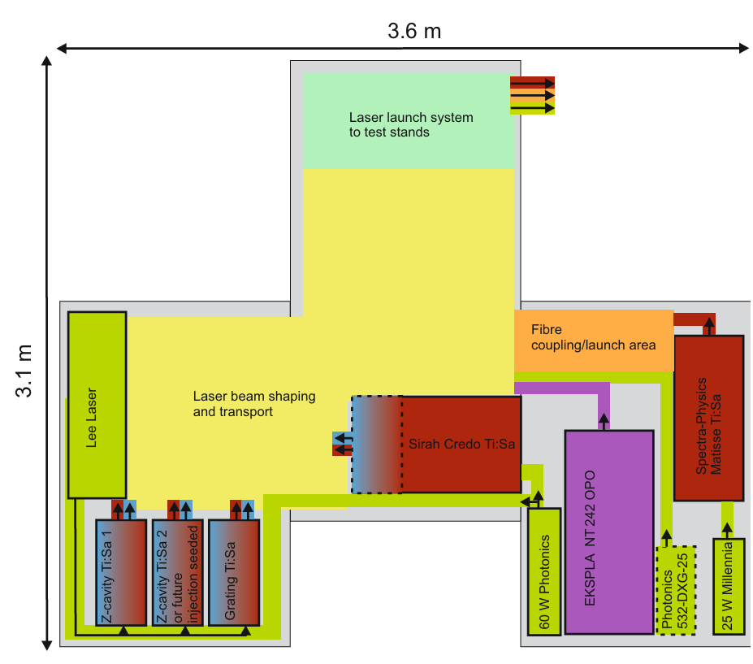

Detector station
IOTA: an offline ion source development laboratory
Objectives:
Increase the extracted ion current
Improve selectivity: enhance the suppression of long-lived species and develop isotope-specific laser ionisation schemes
Ion source development test stand
Resonance Ionization Laser Ion Source
Resonance Ionisation Mass Spectrometry
Prototype UK-based hot offline mass separator
Infrastructure collaboration with TRIUMF (CA)
Ion source collaboration with The Paul Scherrer Institute (CH)
Deacceleration
Einzel lens_2
Einzel lens_1
$$λ$$
2 kV source bias
Selective laser ionization
Notes:
The motivation starts from the radioactive-ion-beam intensity equation. The overall efficiency contains release, transfer, ionisation, transport, separation and any later stages. This means there are many places where targeted development can improve the delivered beam. Large ISOL facilities are oversubscribed and development is constrained by beam time and resources. IOTA provides an offline environment where we can test these steps systematically. In this talk I focus on the transport term, while keeping energy spread and vacuum performance as co-equal design constraints.
[Sources]
A. Gottberg, Nuclear Instruments and Methods in Physics Research B 376 (2016) 8-15, uploaded PDF, pp. 8-9
C. Duchemin et al., Frontiers in Medicine 8 (2021) 693682, uploaded PDF
Slides for Sasha (1).pptx, uploaded background slides

Slide 6
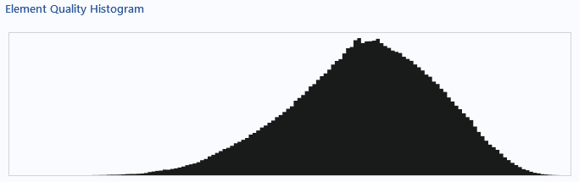
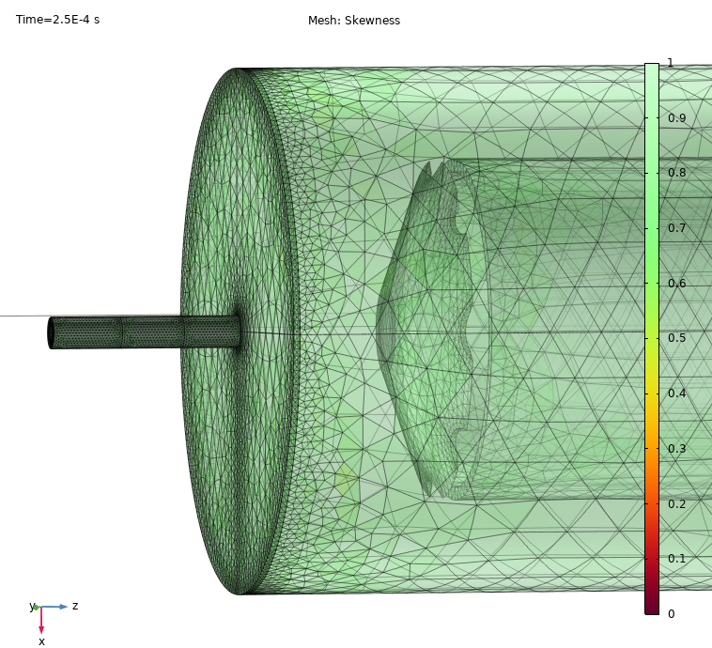
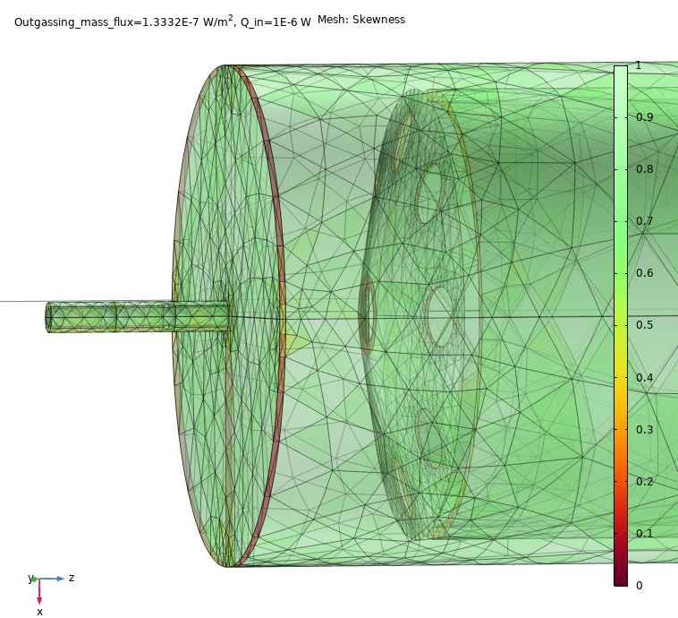
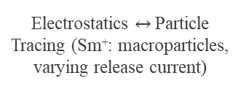
Integrated COMSOL model of the IOTA beamline
Charged Particle tracing
Bidirectionally Coupled Particle Tracing
Free Molecular Flow
1
Electrostatics
2
3
4
5
Post-processing
in Python
›
›
›
›
Calculate a 3D electric field
Track 5,000 Sm⁺ particles
Electrostatics $↔$Particle Tracing (Sm⁺: macroparticles, varying release current)
Vacuum calculations, including vacuum pumps, gas inflow, and outgassing walls
→ efficiency, energy and time-of flight (TOF) profiles
Meshing
Extremely fine
Goal for the optimization
maximize transport efficiency of the ion beam through the beamline while approaching the 10 eV energy-spread target
Coarser
Notes:
The model is deliberately integrated. We first solve the three-dimensional electrostatic field. Charged Particle Tracing then follows 5,000 samarium ion macroparticles. The particle distribution feeds back into the field through bidirectional space-charge coupling. In parallel, Free Molecular Flow evaluates the proposed pumping arrangement. Python post-processing extracts transport efficiency, the 90 percent energy width and time-of-flight distributions. Iteration is continued until the relative change of a global parameter is below one percent.
[Sources]
AZadornaya-Poster-COMSOL-Conference-2026-Cambridge_2026-09-01.pptx, methodology and Figure 1 (uploaded poster)

Slide 7
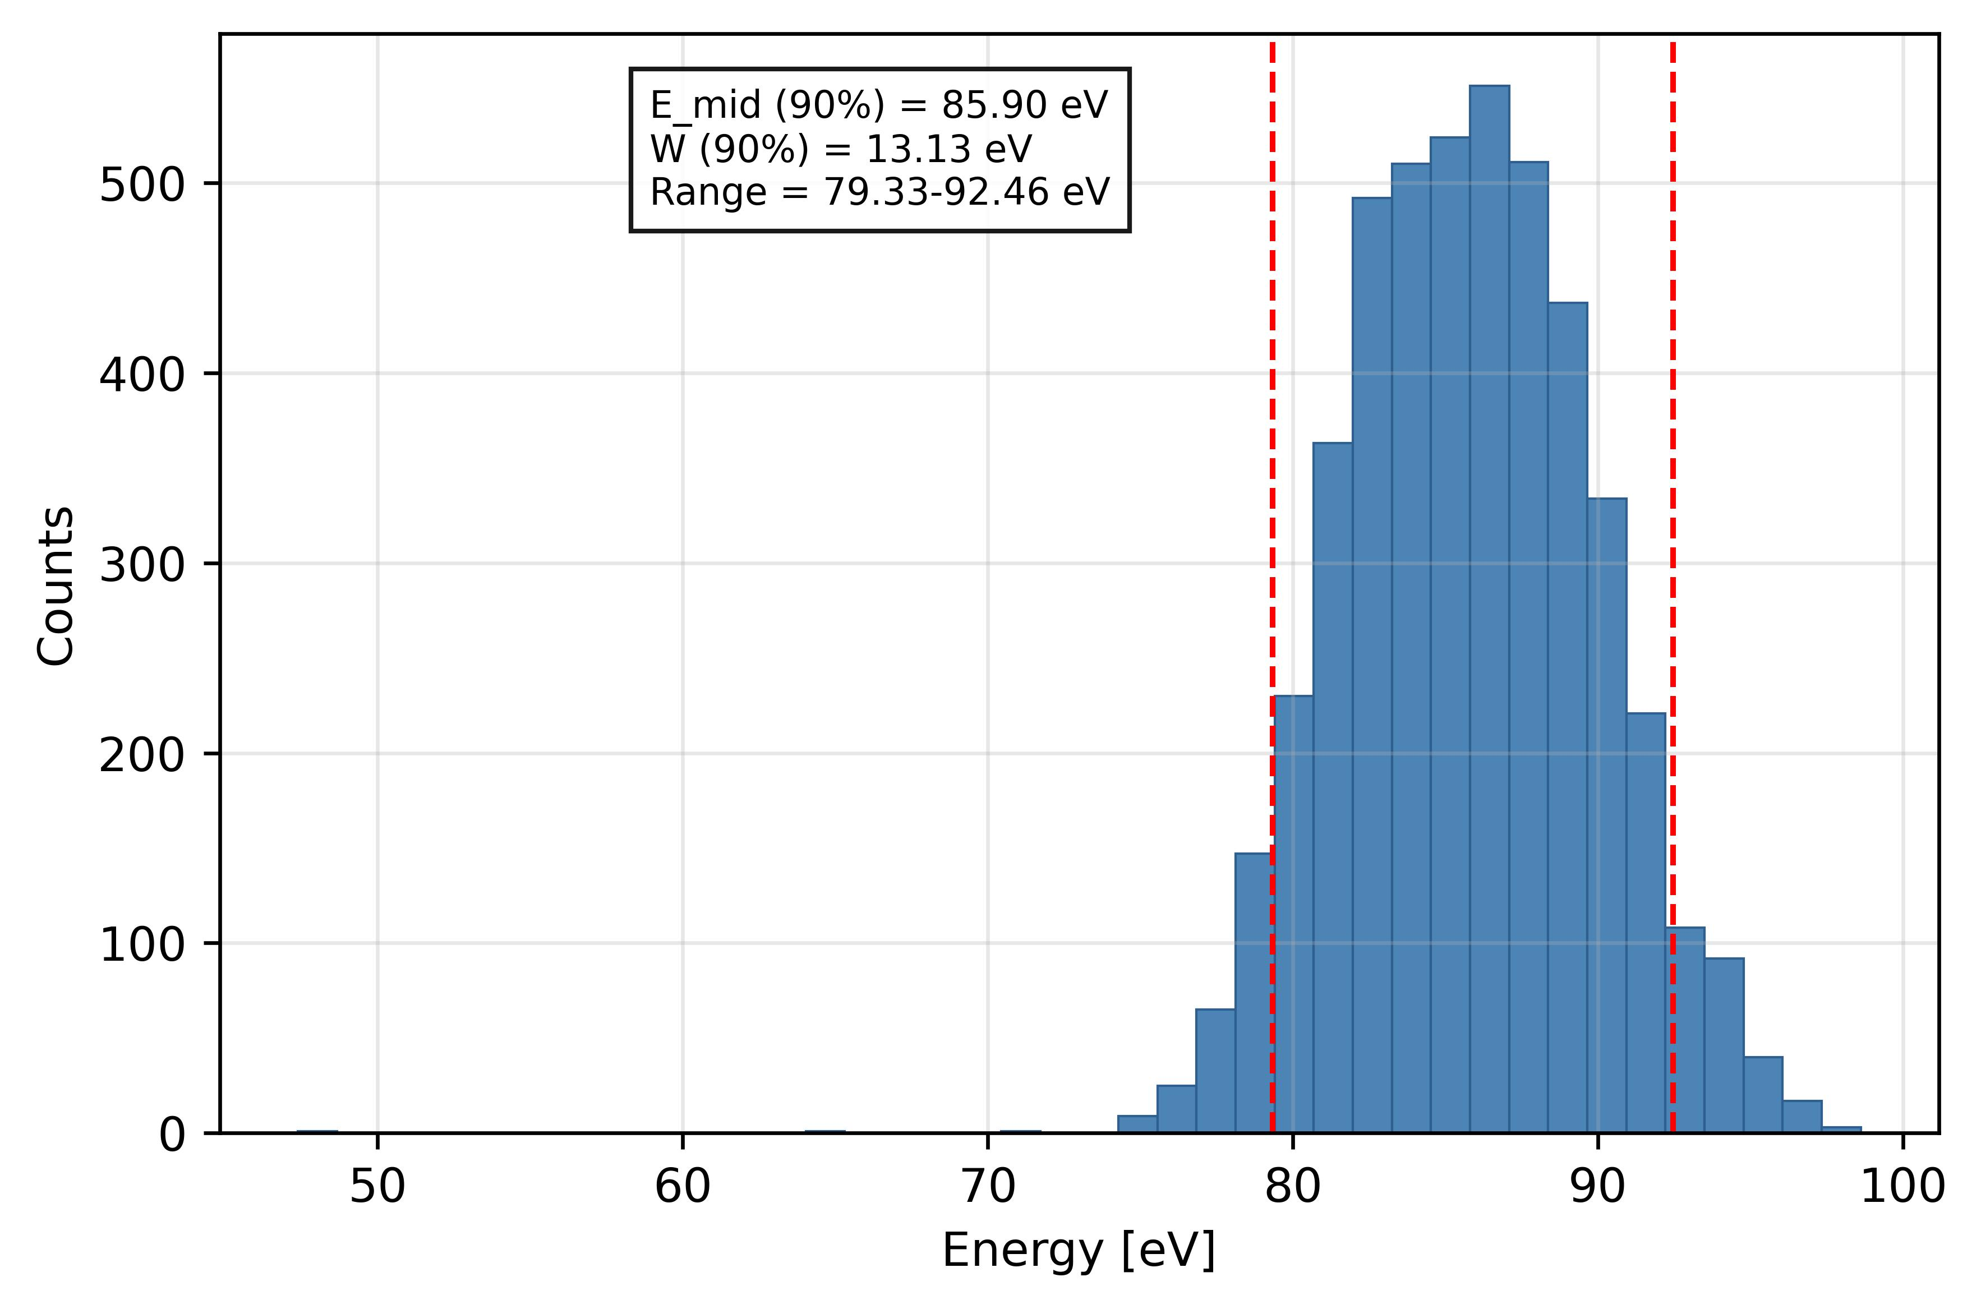
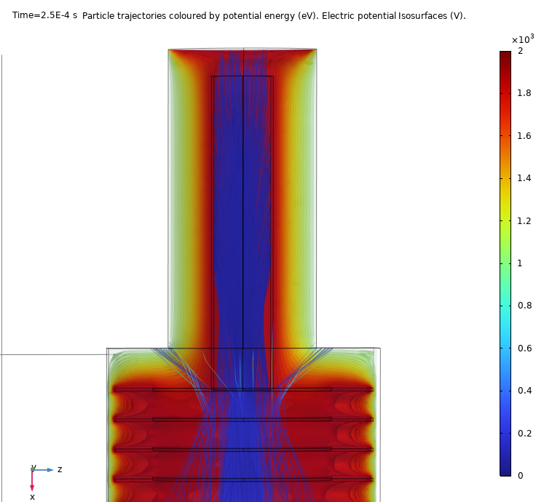
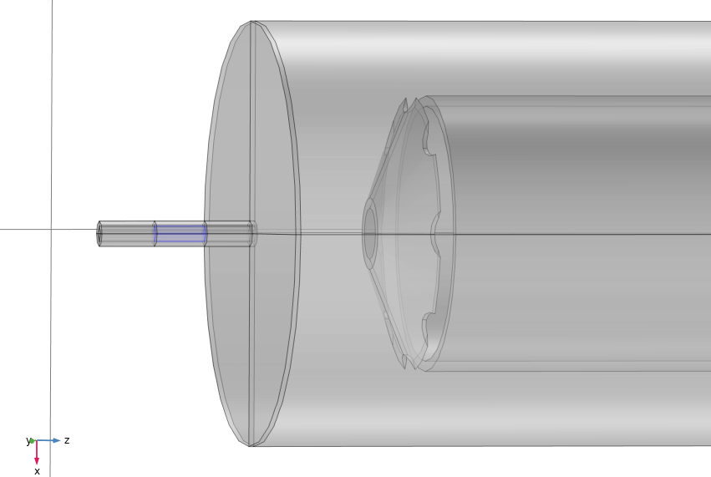
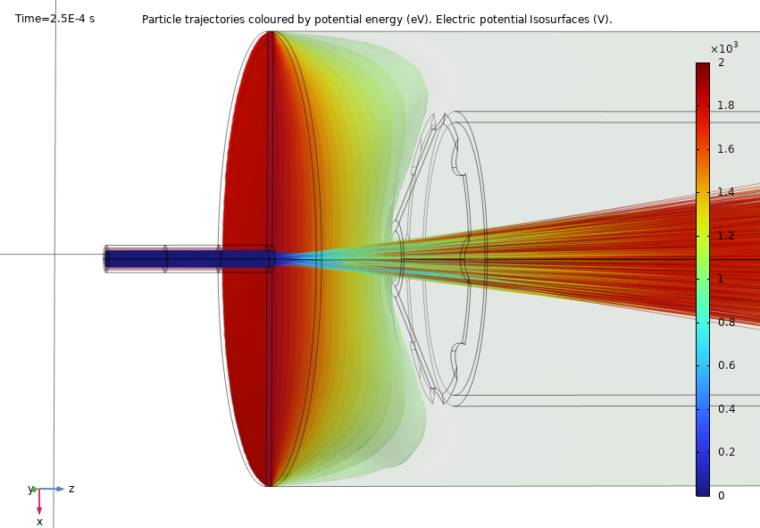
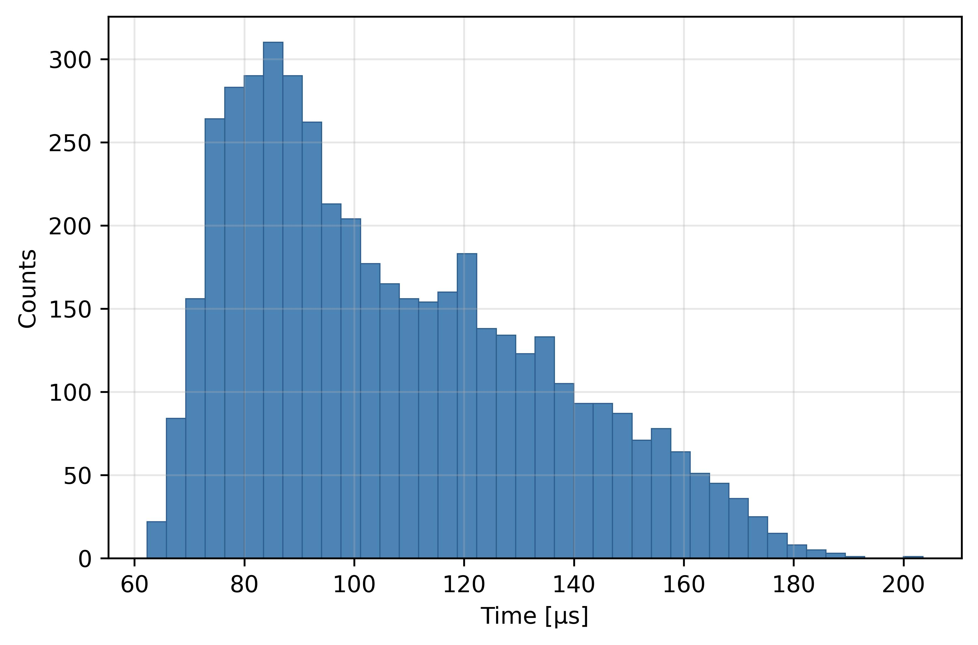
Charged Particle Tracing in Electrostatic Fields (no space charge)
2 kV extraction, 1 uA beam current
End of beamline:
Source
Energy distribution
Maxwell-Boltzman velocity distribution
Uniform angular distribution
0 V: extraction electrode
2 kV source
Time-of-flight (TOF)
94% transport efficiency
13 eV energy spread (centered at 86 eV)
→ high transmission efficiency and small energy spread
Notes:
The model is deliberately integrated. We first solve the three-dimensional electrostatic field. Charged Particle Tracing then follows 5,000 samarium ion macroparticles. The particle distribution feeds back into the field through bidirectional space-charge coupling. In parallel, Free Molecular Flow evaluates the proposed pumping arrangement. Python post-processing extracts transport efficiency, the 90 percent energy width and time-of-flight distributions. Iteration is continued until the relative change of a global parameter is below one percent.
[Sources]
AZadornaya-Poster-COMSOL-Conference-2026-Cambridge_2026-09-01.pptx, methodology and Figure 1 (uploaded poster)

Slide 8
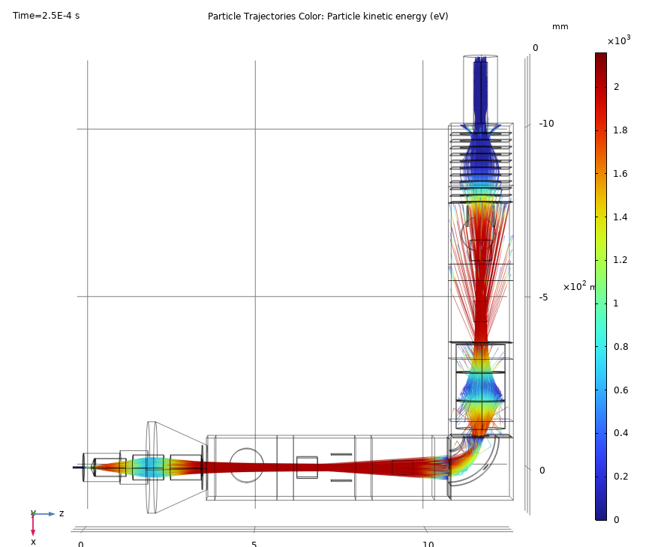
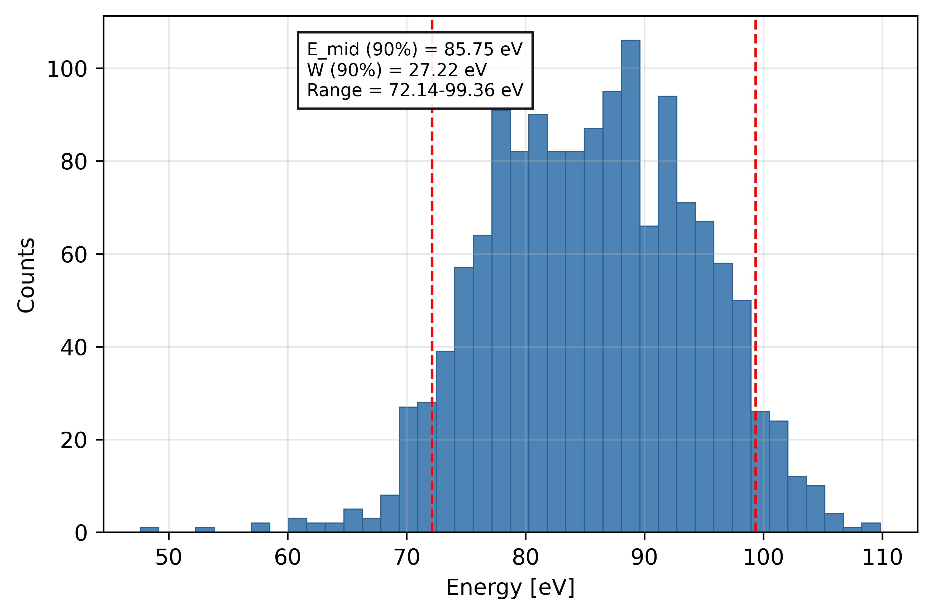
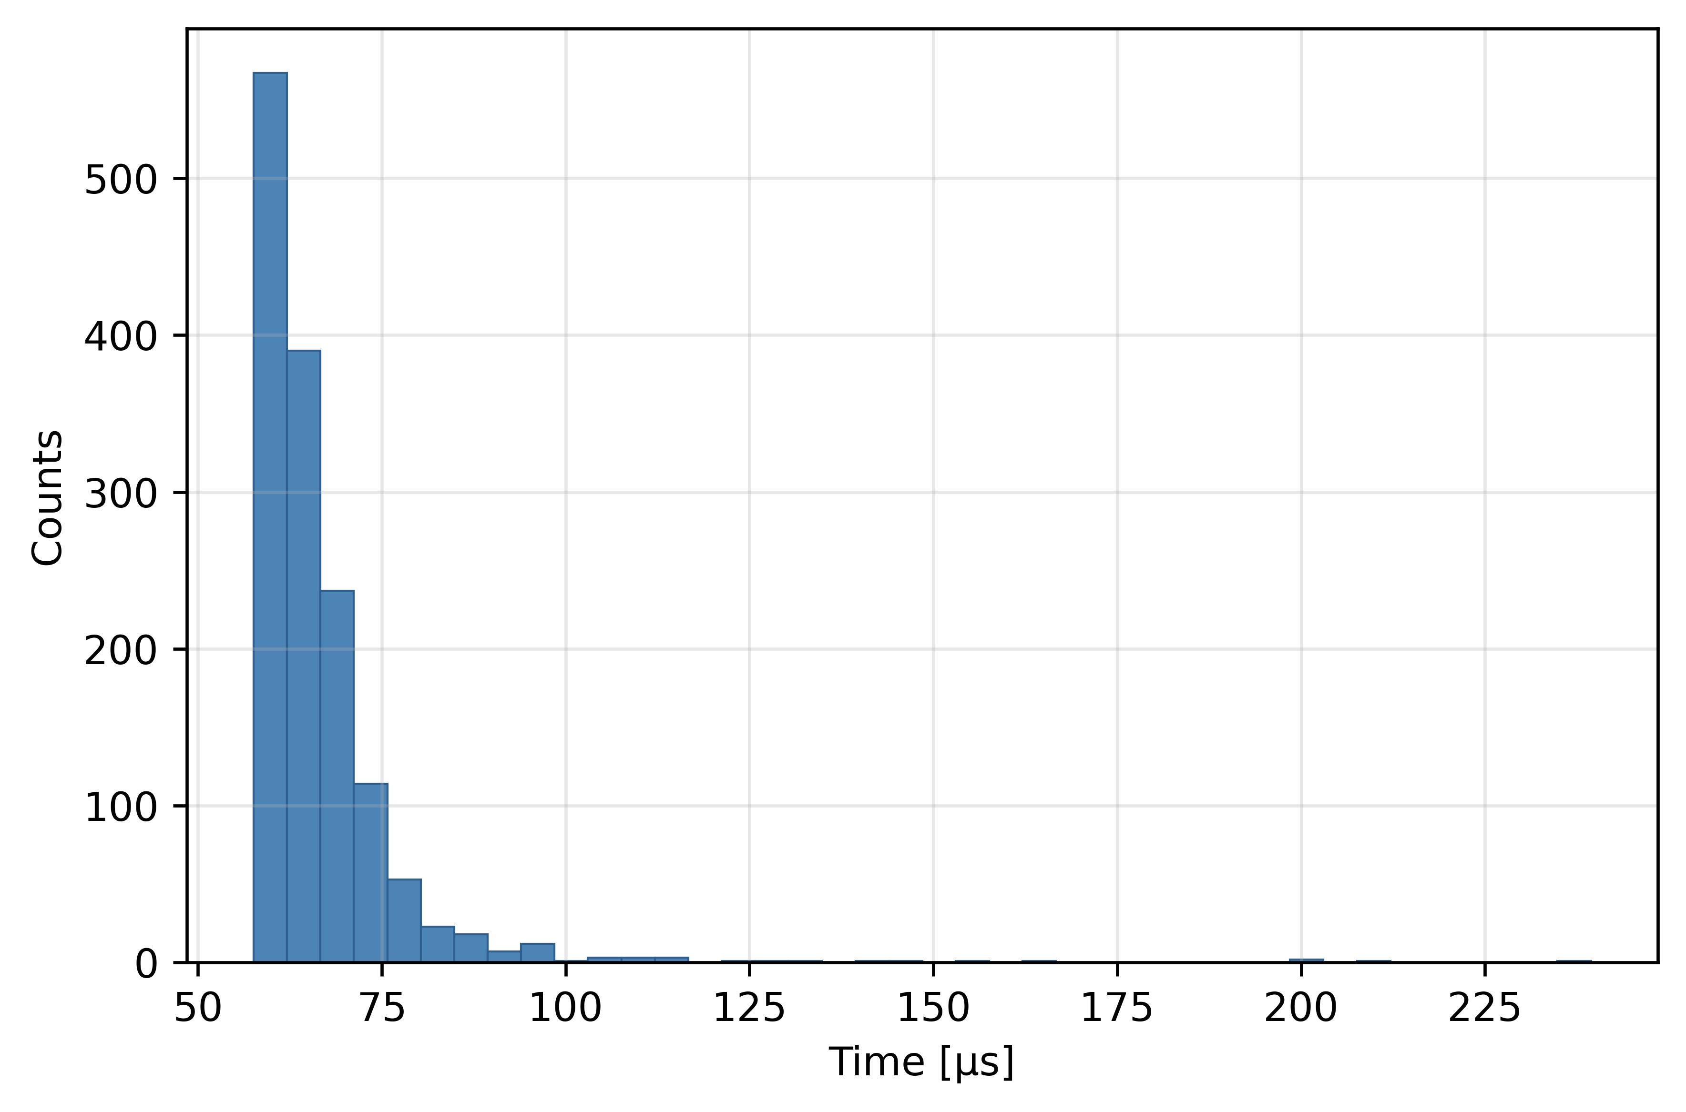
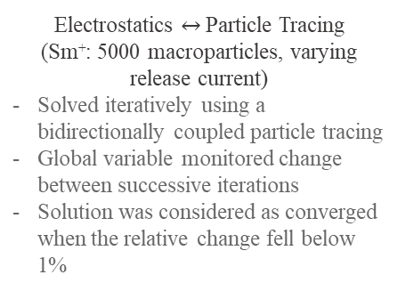
Charged Particle Tracing in Electrostatic Fields (space charge included)
2 kV extraction, 1 uA beam current
Energy distribution
Smaller transport efficiency and larger energy spread:
Space-charge effects
Electrostatics $↔$Particle Tracing
(Sm⁺: 5000 macroparticles, varying release current)
Solved iteratively using a bidirectionally coupled particle tracing
Global variable monitored change between successive iterations
Solution was considered as converged when the relative change fell below 1%
30% transport efficiency
27 eV energy spread (centered at 86 eV) at the end of beamline
Time-of-flight (TOF)
Notes:
The model is deliberately integrated. We first solve the three-dimensional electrostatic field. Charged Particle Tracing then follows 5,000 samarium ion macroparticles. The particle distribution feeds back into the field through bidirectional space-charge coupling. In parallel, Free Molecular Flow evaluates the proposed pumping arrangement. Python post-processing extracts transport efficiency, the 90 percent energy width and time-of-flight distributions. Iteration is continued until the relative change of a global parameter is below one percent.
[Sources]
AZadornaya-Poster-COMSOL-Conference-2026-Cambridge_2026-09-01.pptx, methodology and Figure 1 (uploaded poster)

Slide 9
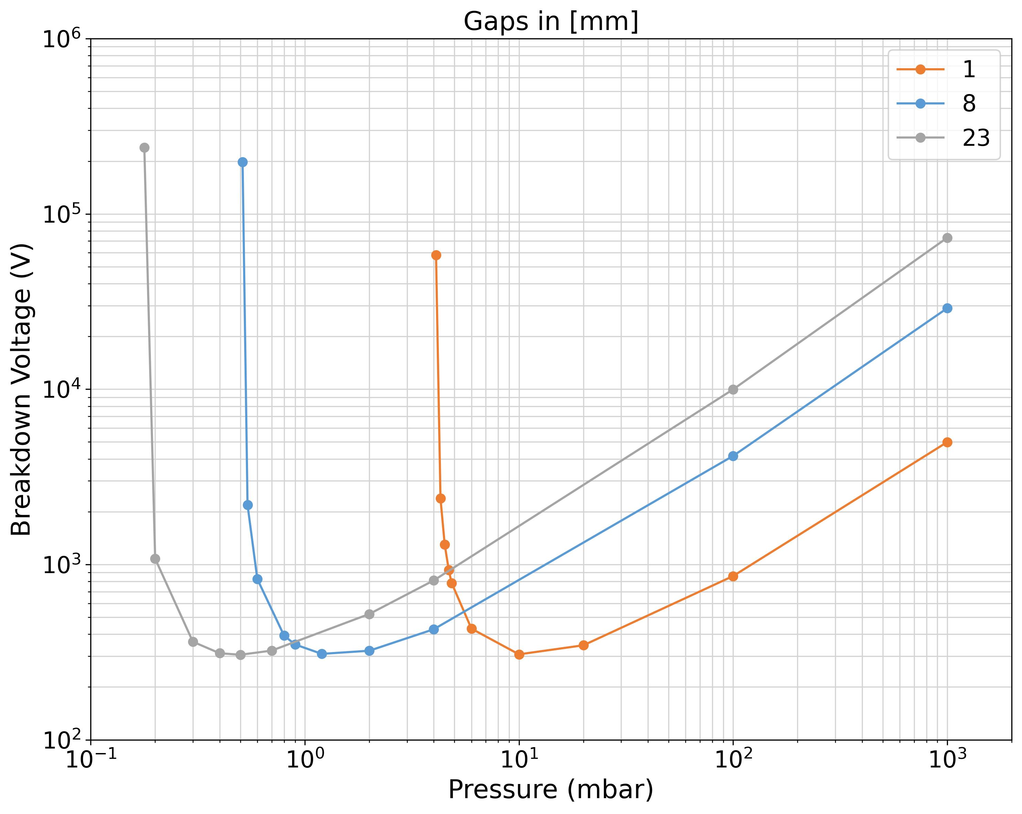
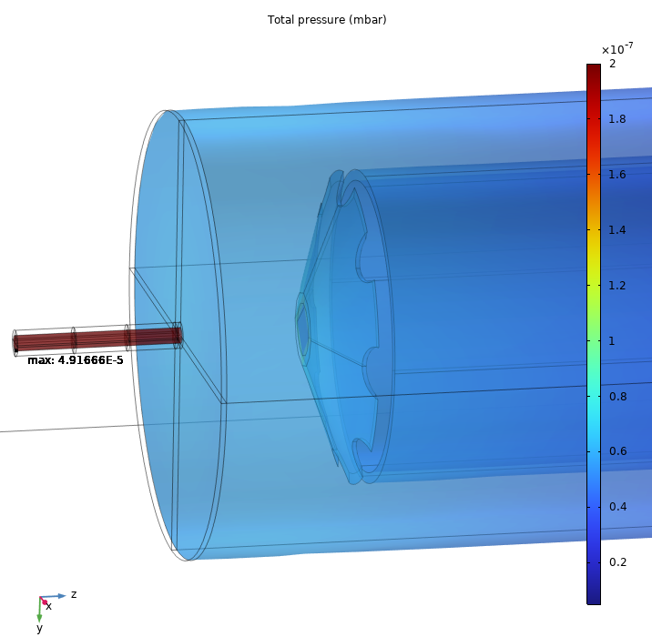

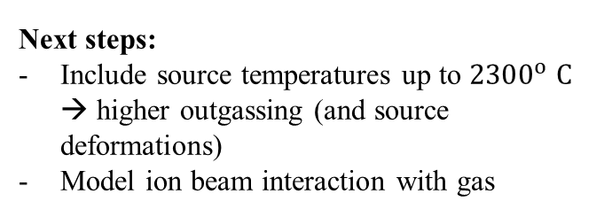
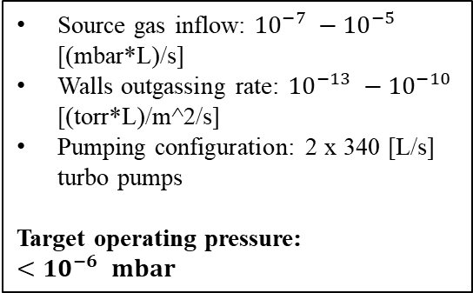
Vacuum performance from Free Molecular Flow simulations
Source gas inflow: ${10}^{−7} −{10}^{−5}$ [(mbar*L)/s]
Walls outgassing rate: ${10}^{−13} −{10}^{−10}$ [(torr*L)/m^2/s]
Pumping configuration: 2 x 340 [L/s] turbo pumps
Target operating pressure: ${<10}^{−6} mbar$
Paschen curves for helium
0 kV: extraction electrode
Gas inflow
Predicted beamline pressure (depending on total gas load):
${10}^{−10} −{10}^{−8}$ mbar
Next steps:
Include source temperatures up to ${2300}^{o} C$ → higher outgassing (and source deformations)
Model ion beam interaction with gas
Notes:
The model is deliberately integrated. We first solve the three-dimensional electrostatic field. Charged Particle Tracing then follows 5,000 samarium ion macroparticles. The particle distribution feeds back into the field through bidirectional space-charge coupling. In parallel, Free Molecular Flow evaluates the proposed pumping arrangement. Python post-processing extracts transport efficiency, the 90 percent energy width and time-of-flight distributions. Iteration is continued until the relative change of a global parameter is below one percent.
[Sources]
AZadornaya-Poster-COMSOL-Conference-2026-Cambridge_2026-09-01.pptx, methodology and Figure 1 (uploaded poster)

Slide 10
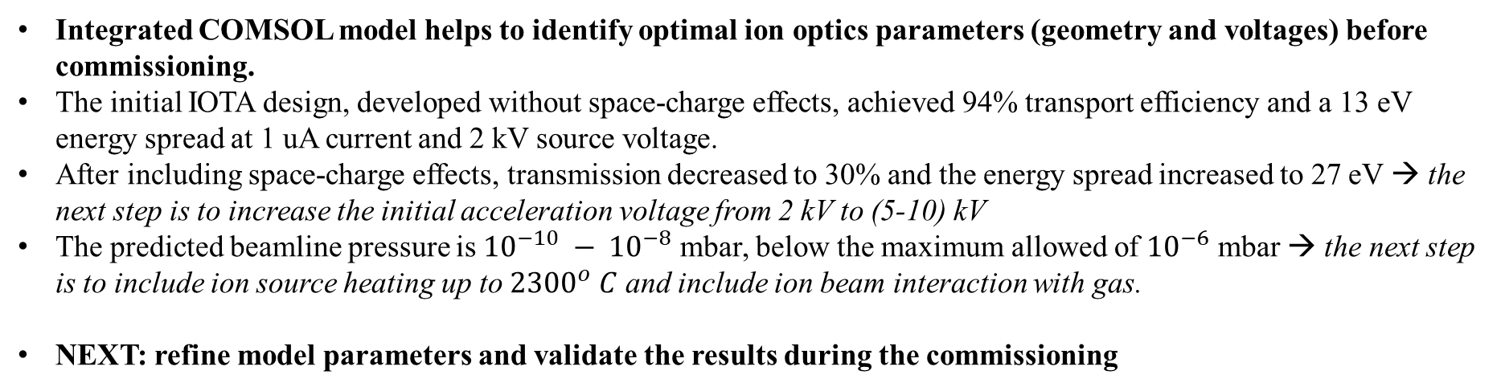
Conclusions
Integrated COMSOL model helps to identify optimal ion optics parameters (geometry and voltages) before commissioning.
The initial IOTA design, developed without space-charge effects, achieved 94% transport efficiency and a 13 eV energy spread at 1 uA current and 2 kV source voltage.
After including space-charge effects, transmission decreased to 30% and the energy spread increased to 27 eV → the next step is to increase the initial acceleration voltage from 2 kV to (5-10) kV
The predicted beamline pressure is ${10}^{−10} − {10}^{−8}$ mbar, below the maximum allowed of ${10}^{−6}$ mbar → the next step is to include ion source heating up to ${2300}^{o} C$ and include ion beam interaction with gas.
NEXT: refine model parameters and validate the results during the commissioning
Thank you | Questions
Notes:
To conclude, the integrated model predicts high low-current transmission, identifies a strong space-charge penalty at higher current, and quantifies both energy and vacuum performance. The value of COMSOL is not only the final numbers. It is the ability to map coupled design trade-offs before manufacture, and then to update the model using commissioning data. Thank you, and I am happy to take questions.
[Sources]
AZadornaya-Poster-COMSOL-Conference-2026-Cambridge_2026-09-01.pptx (uploaded poster)

