Slide 1



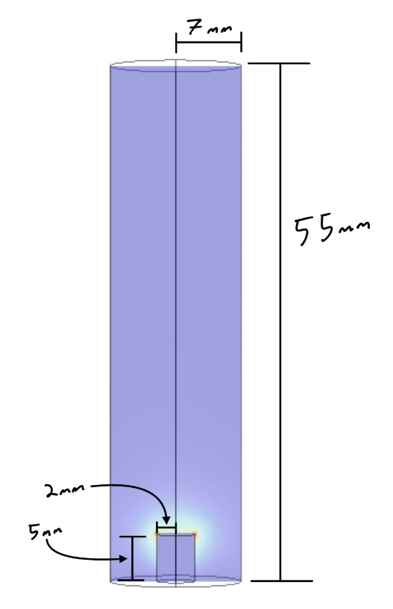
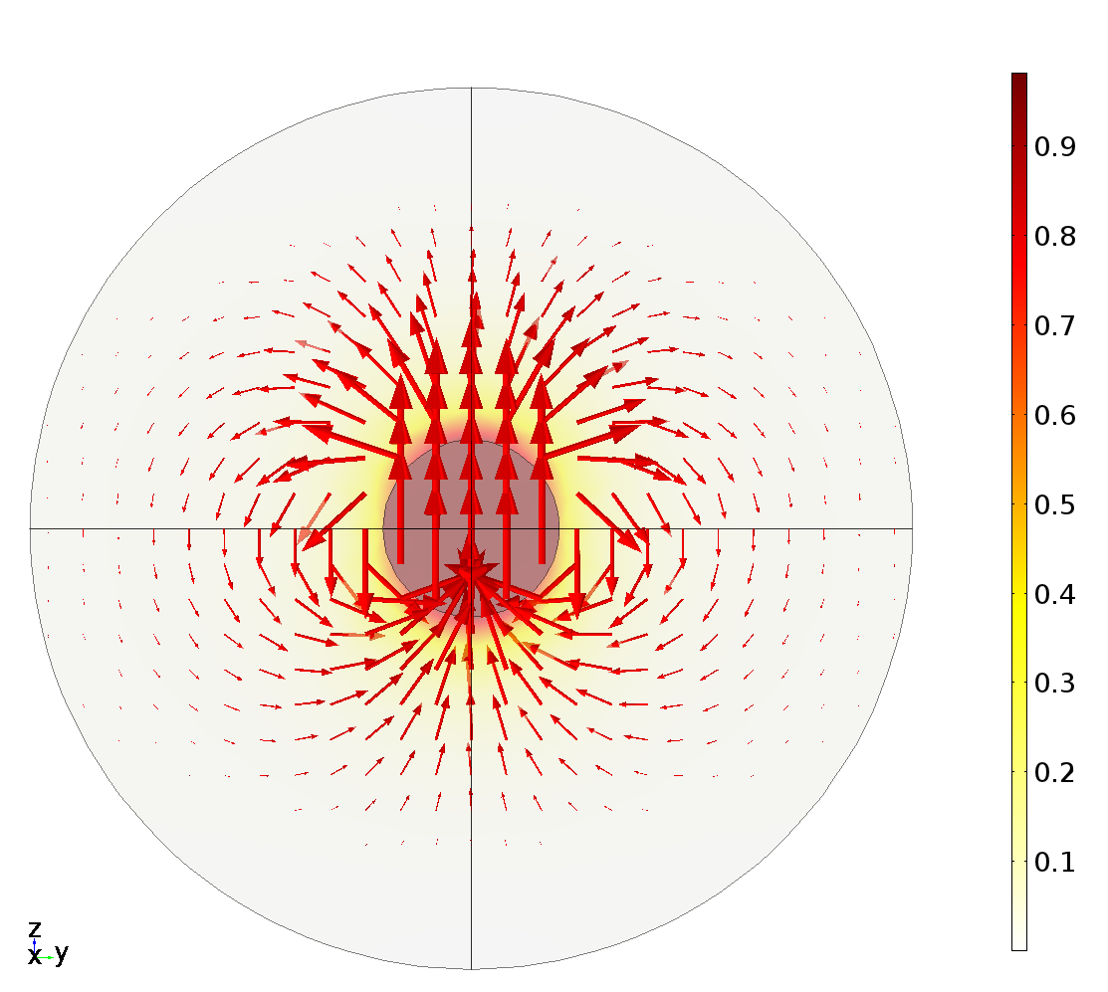
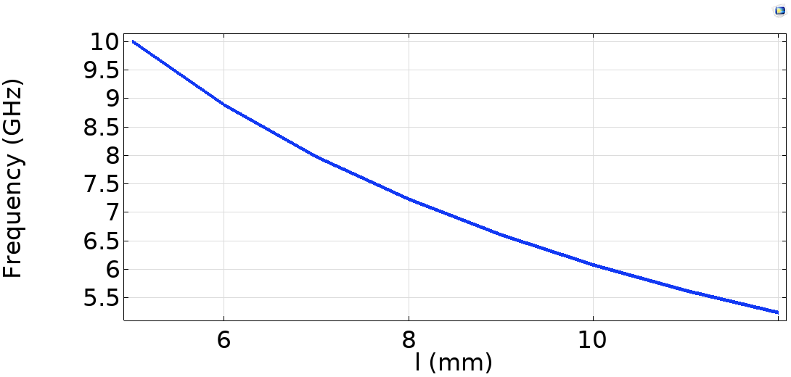
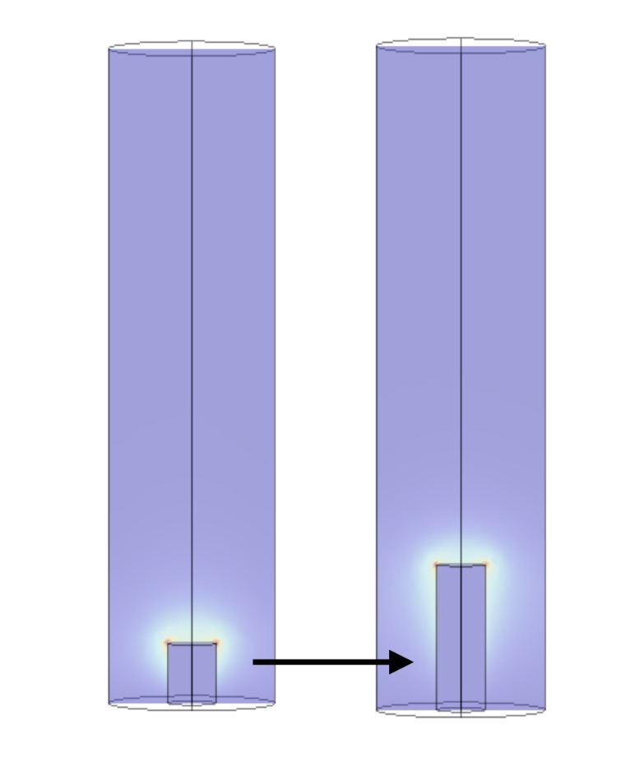
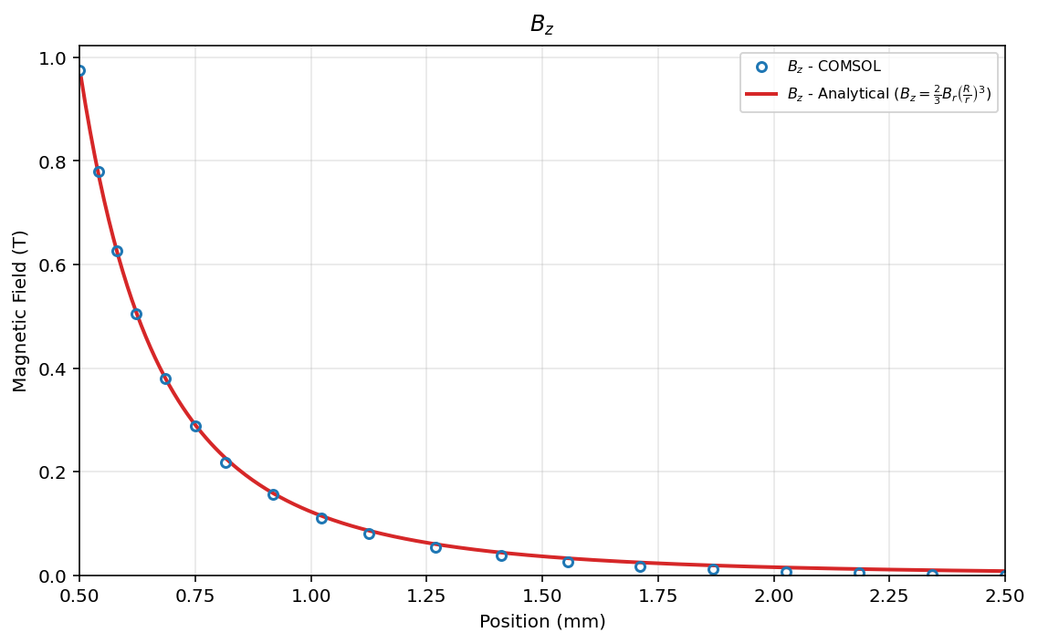
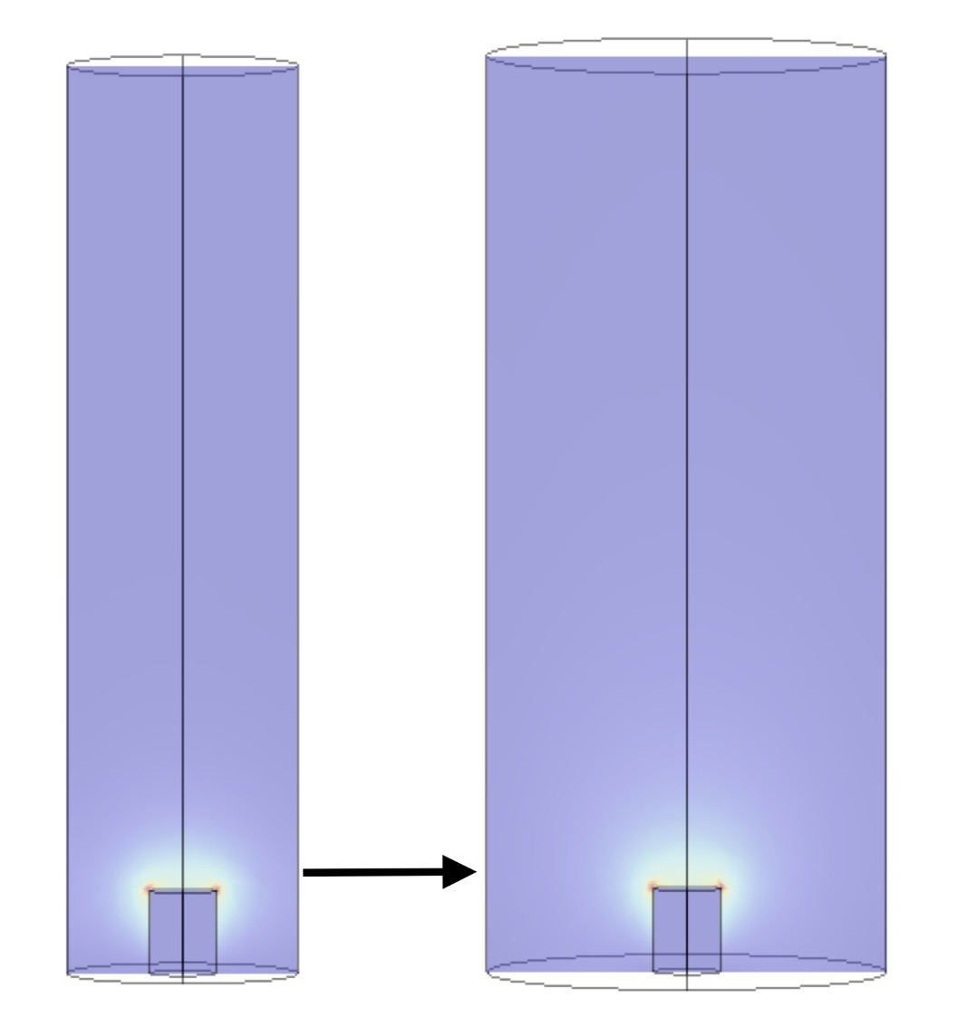
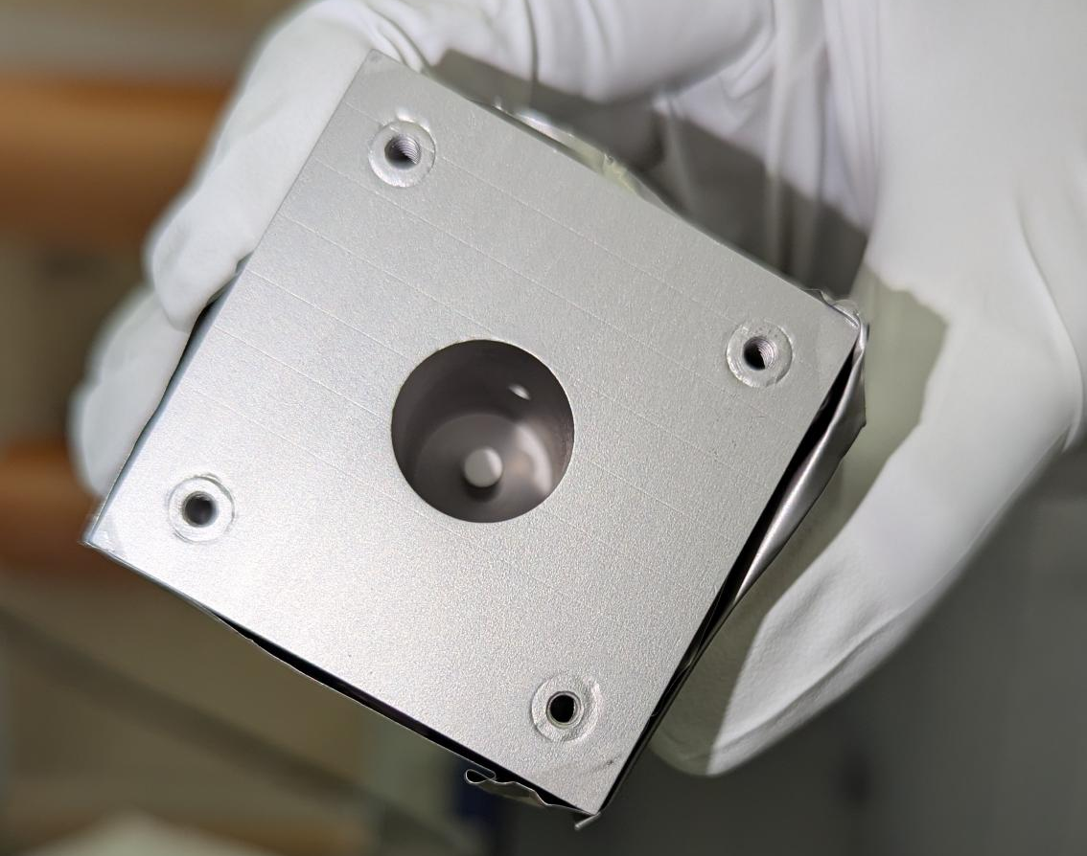
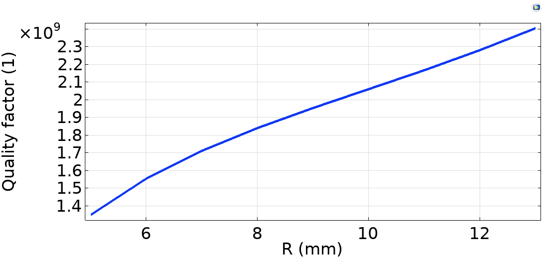
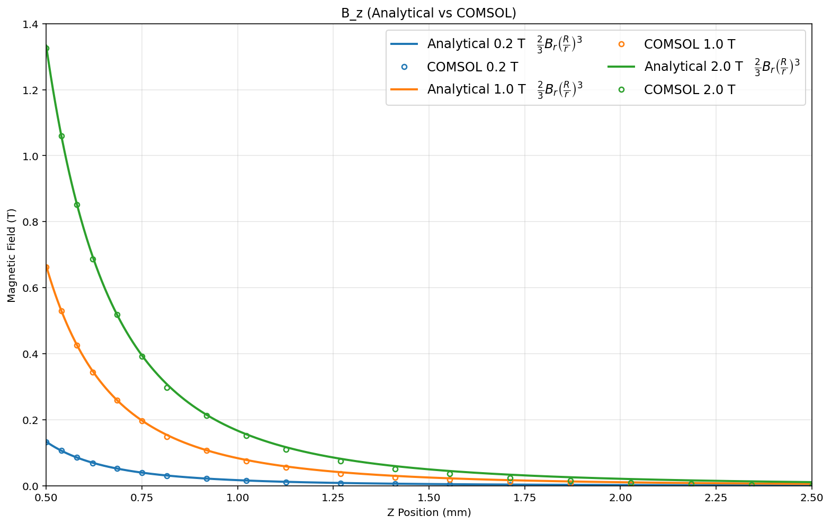
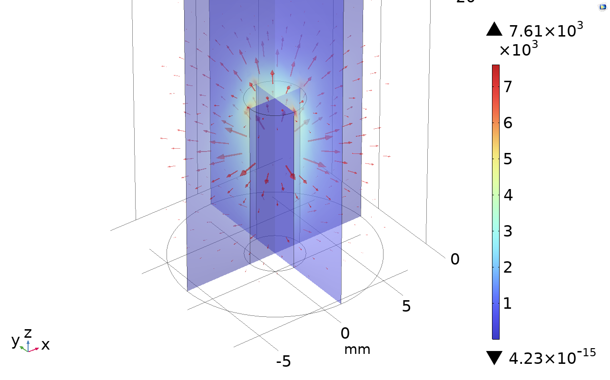
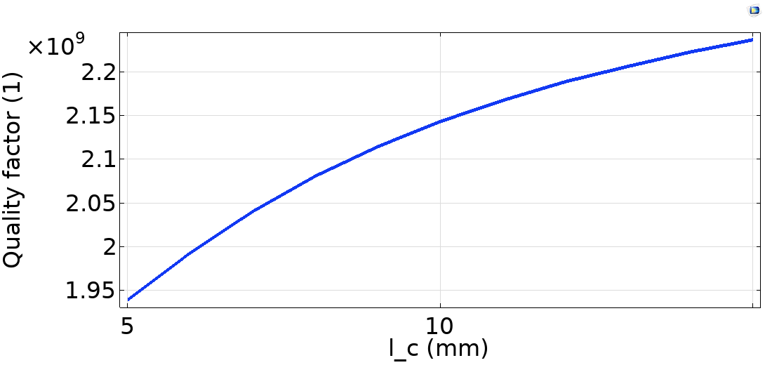
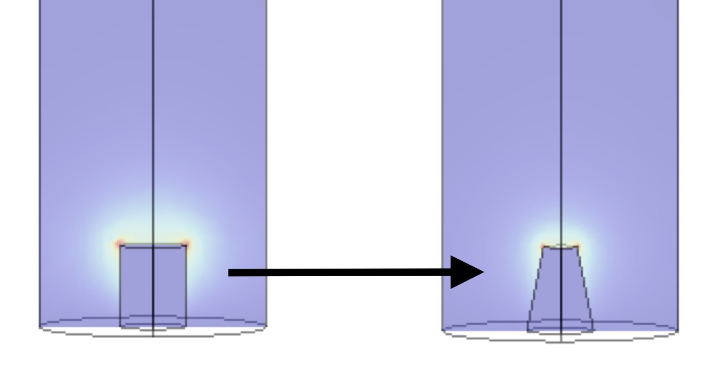
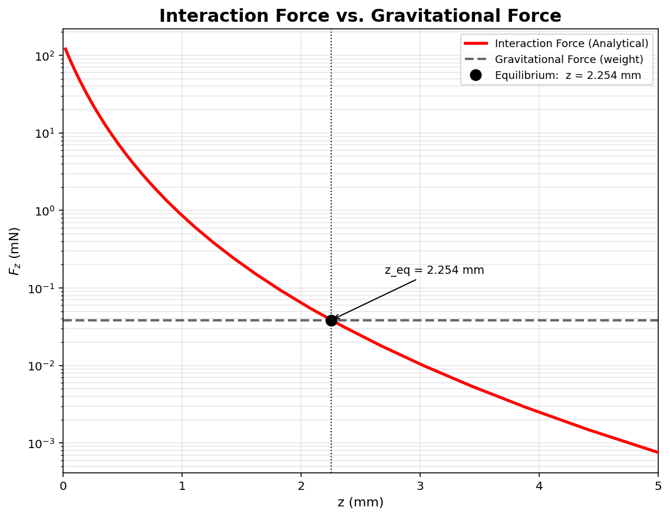
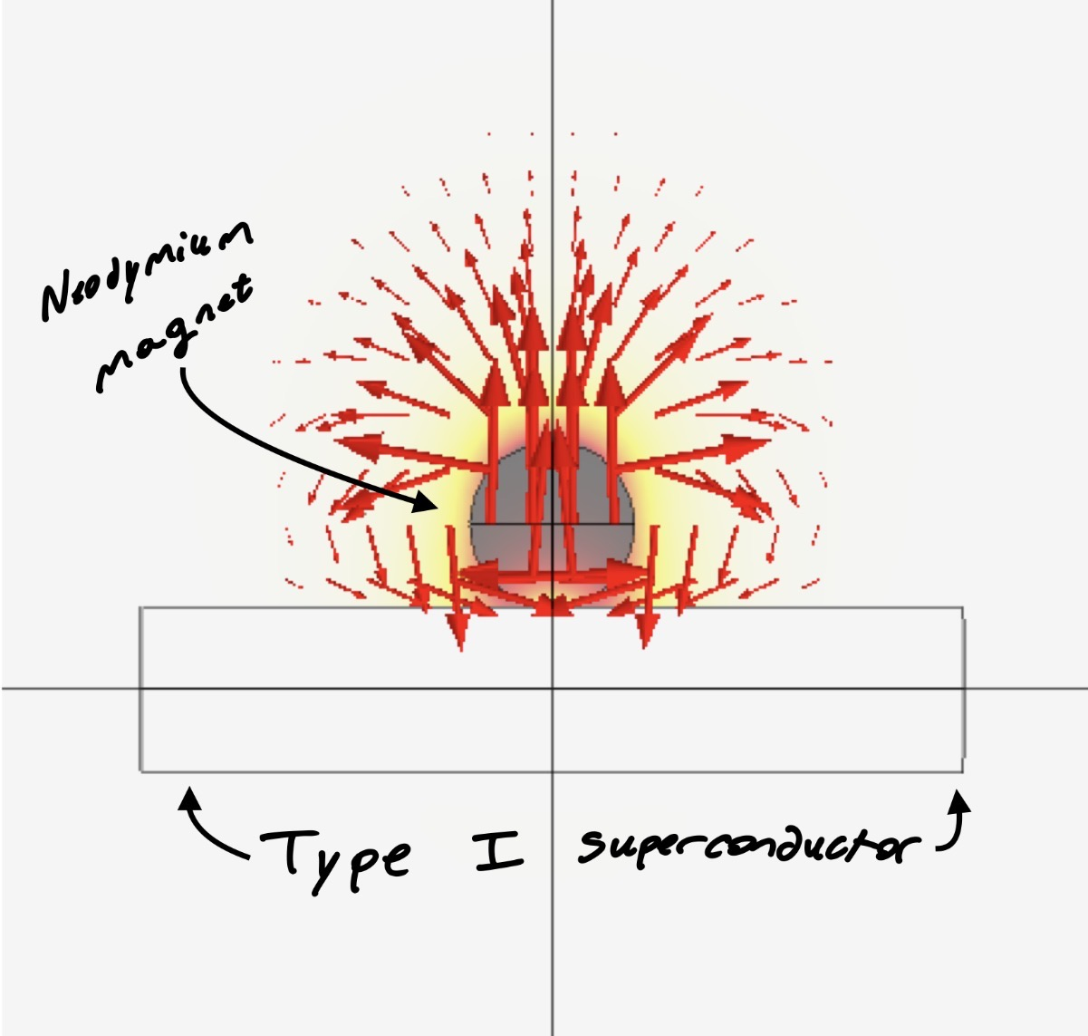
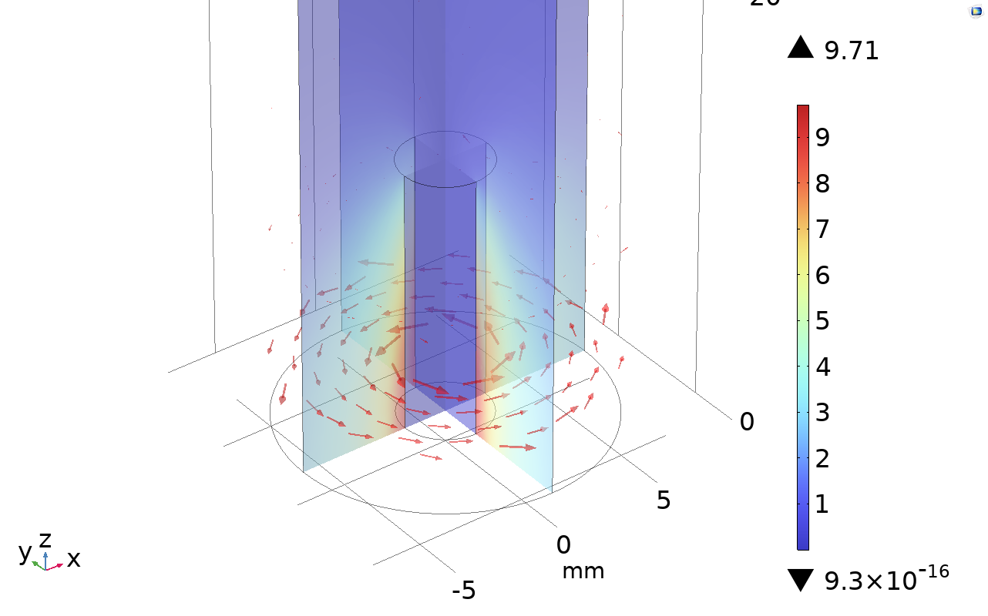
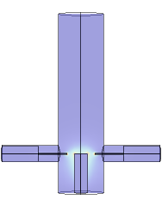
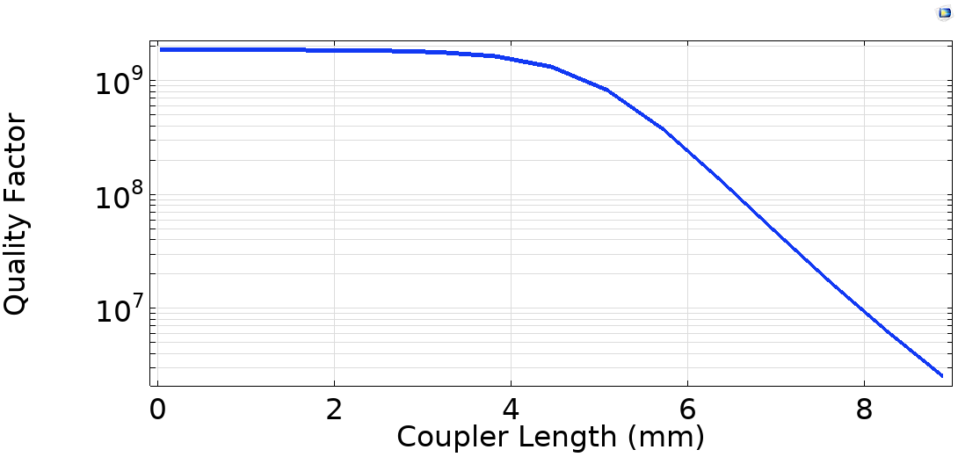
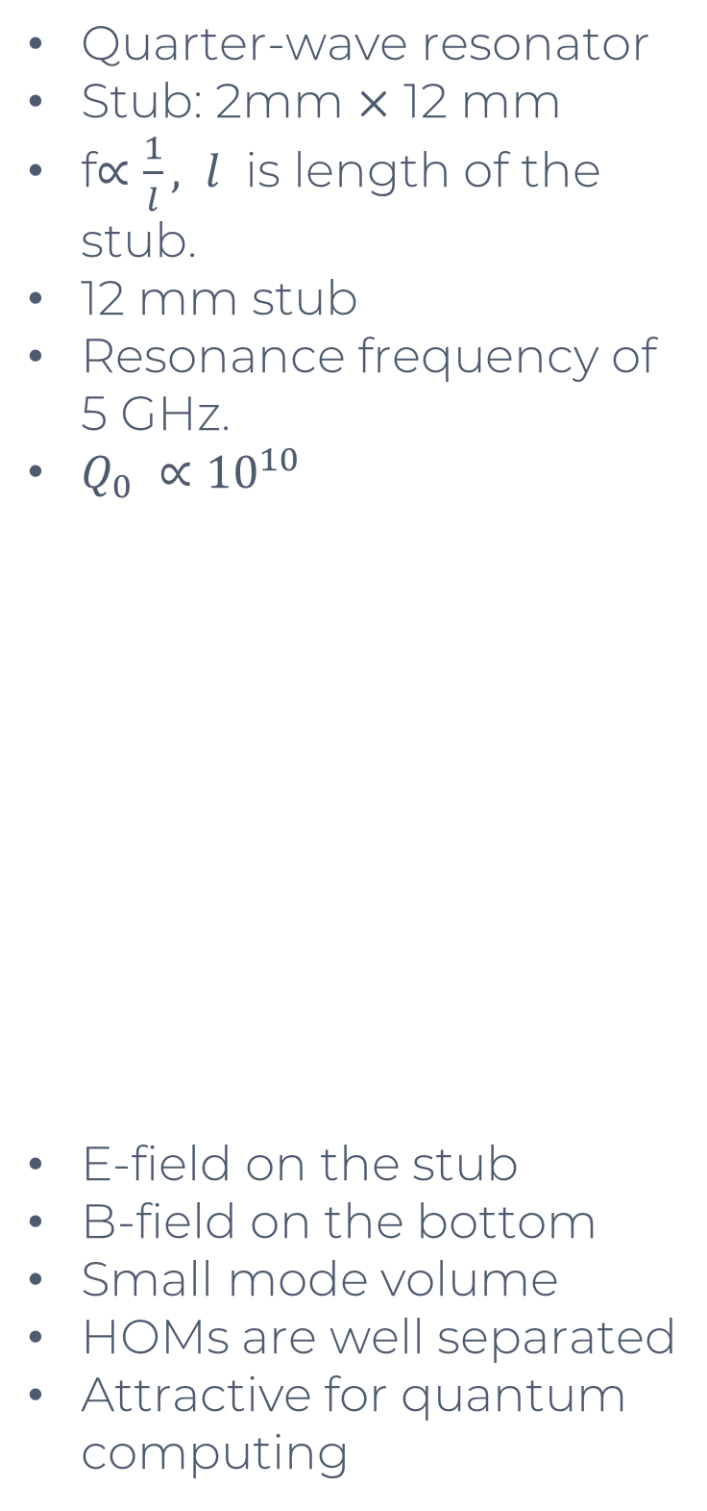
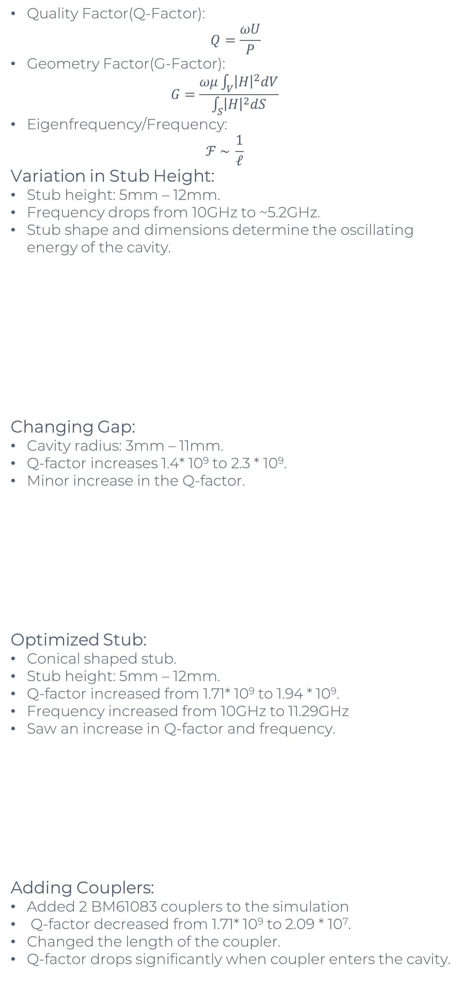
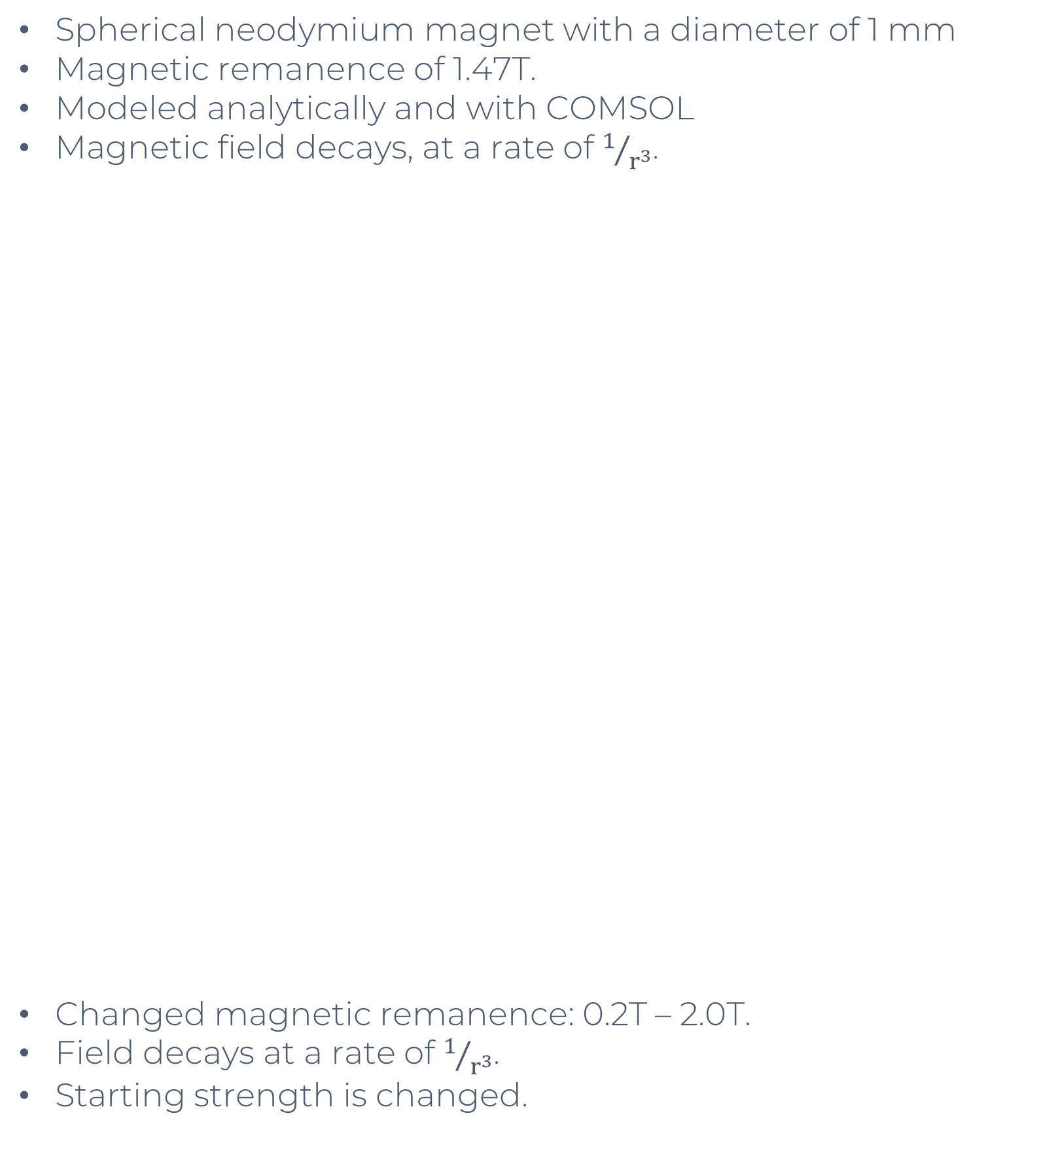
Designing and Optimizing Quarter-Wave Coaxial Cavities for Quantum Applications
Mason Steingrebe¹, Dr. Nabin Raut²
¹Old Dominion University, Norfolk, VA 23529
²Thomas Jefferson National Accelerator Facility, Newport News, VA 23606
Abstract
Quarter Wave Resonator
Magnet Simulations
Future Work
The superconducting radio-frequency (SRF) cavities, with their low surface resistance, unlock high-quality factors. Single-photon coherence times on the order of seconds have been reported for such cavities. The long-lived photon is useful for the storage and manipulation of quantum states as well as for sensing applications. Current quantum memory can hold a qubit coherence time on the order of 10 to 100 microseconds. In this work, we are designing and optimizing a 5 GHz quarter-wave cavity using COMSOL Multiphysics for the purpose of improving the quality factor and advancing sensing applications. The cavity is made out of RRR>300 niobium. The optimized cavity configuration will be implemented for magnetic sensing. We were able to improve the quality factor of the cavity to an order of 10¹¹. Going into this, we were getting a quality factor of 10⁹, so achieving this level of quality factor means that our cavity is extremely energy efficient. Which in turn, will give us a longer coherence time, on the order of a few milliseconds. A longer coherence time means we can pass our qubit through more fidelity gates. The more fidelity gates we can pass qubits through, the more accurate our qubit computations. Having a high accuracy is very important to quantum computing as quantum states are fragile and small errors can escalate rapidly.
Quality Factor(Q-Factor):
$$Q=\frac{ωU}{P}$$
Geometry Factor(G-Factor):
  $$G=\frac{ωμ\int_{V}{{\left|H\right|}^{2}dV}}{\int_{S}{{\left|H\right|}^{2}dS}}$$
Eigenfrequency/Frequency:
  $$ℱ \sim \frac{1}{ℓ}$$
Variation in Stub Height:
Stub height: 5mm – 12mm.
Frequency drops from 10GHz to ~5.2GHz.
Stub shape and dimensions determine the oscillating energy of the cavity.
Changing Gap:
Cavity radius: 3mm – 11mm.
Q-factor increases 1.4* 10⁹ to 2.3 * 10⁹.
Minor increase in the Q-factor.
Optimized Stub:
Conical shaped stub.
Stub height: 5mm – 12mm.
Q-factor increased from 1.71* 10⁹ to 1.94 * 10⁹.
Frequency increased from 10GHz to 11.29GHz
Saw an increase in Q-factor and frequency.
Adding Couplers:
Added 2 BM61083 couplers to the simulation
Q-factor decreased from 1.71* 10⁹ to 2.09 * 10⁷.
Changed the length of the coupler.
Q-factor drops significantly when coupler enters the cavity.
Spherical neodymium magnet with a diameter of 1 mm
Magnetic remanence of 1.47T.
Modeled analytically and with COMSOL
Magnetic field decays, at a rate of $1/{r^{3}}$.
Changed magnetic remanence: 0.2T – 2.0T.
Field decays at a rate of $1/{r^{3}}$.
Starting strength is changed.
Detailed COMSOL study of cavity magnet interaction.
Research behavior of type II superconductor.
Take part on the experiments.
Compare COMSOL simulations to experimental results.
Conclusion
In conclusion, we set out to find an optimal design for our superconducting radio frequency cavity resonators. To evaluate them, multiple factors needed to be considered, including frequency, conductivity, quality, and geometry factors. A big learning experience of this was learning how to use COMSOL and how to create physics simulations. Starting with the cylindrical resonator with the cylinder stub gave a good baseline. Altering the properties of the initial resonator helped show how slight tweaks to the resonator's design can have major effects on what is going on physically. When we moved on to the cone-shaped stub, we really wanted to see how it could improve our resonator design. It was critical to add the dielectric couplers to our simulations to more accurately reflect the real design, which did not change our data drastically. From there, I evaluated the neodymium magnet that was going to go into the cavity. Finding the magnetic field with analytical analysis and creating a COMSOL simulation helped ensure our data was extremely accurate. Adjusting the radius and the strength of the magnet gave us useful information on how to manipulate the magnetic field. From there, we looked at the interaction force between the magnet and a type 1 superconductor, in particular at what height our magnet would float from the Meissner effect. Now we are working towards the next steps of the research in combining the SRF cavity with the neodymium magnet simulations into new, highly accurate simulations. Then, comparing that to the real cavities.
Motivation
Quarter-wave resonator
Stub: 2mm $×$ 12 mm
f$∝\frac{1}{l}, l$ is length of the stub.
12 mm stub
Resonance frequency of 5 GHz.
$Q_{0} ∝{10}^{10}$
E-field on the stub
B-field on the bottom
Small mode volume
HOMs are well separated
Attractive for quantum computing
Superconductor and Magnet Interaction
Spherical neodymium magnet with a diameter of 1 mm
Magnetic remanence of 1.47T.
Type I superconductor, cylindrical with 1mm diameter and 5mm in length
Modeled analytically and with COMSOL
Equilibrium point z = 2.254mm.
Acknowledgements
I want to express my gratitude towards Old Dominion University, Thomas Jefferson National Accelerator Facility, and Department of Energy for providing the facilities to make this project possible I would also like to thank Dr. Pashupati Dhakal and Dr. Balša Terzić for providing me with this experience. I want to finally thank Jalyn Dio Marquette, Lisa Surles-Law, Dr. Ryan Bodenstein, Dr. Volker Ziemann, and Dr. Uttar Pudasaini for providing guidance during this project.

