Slide 1
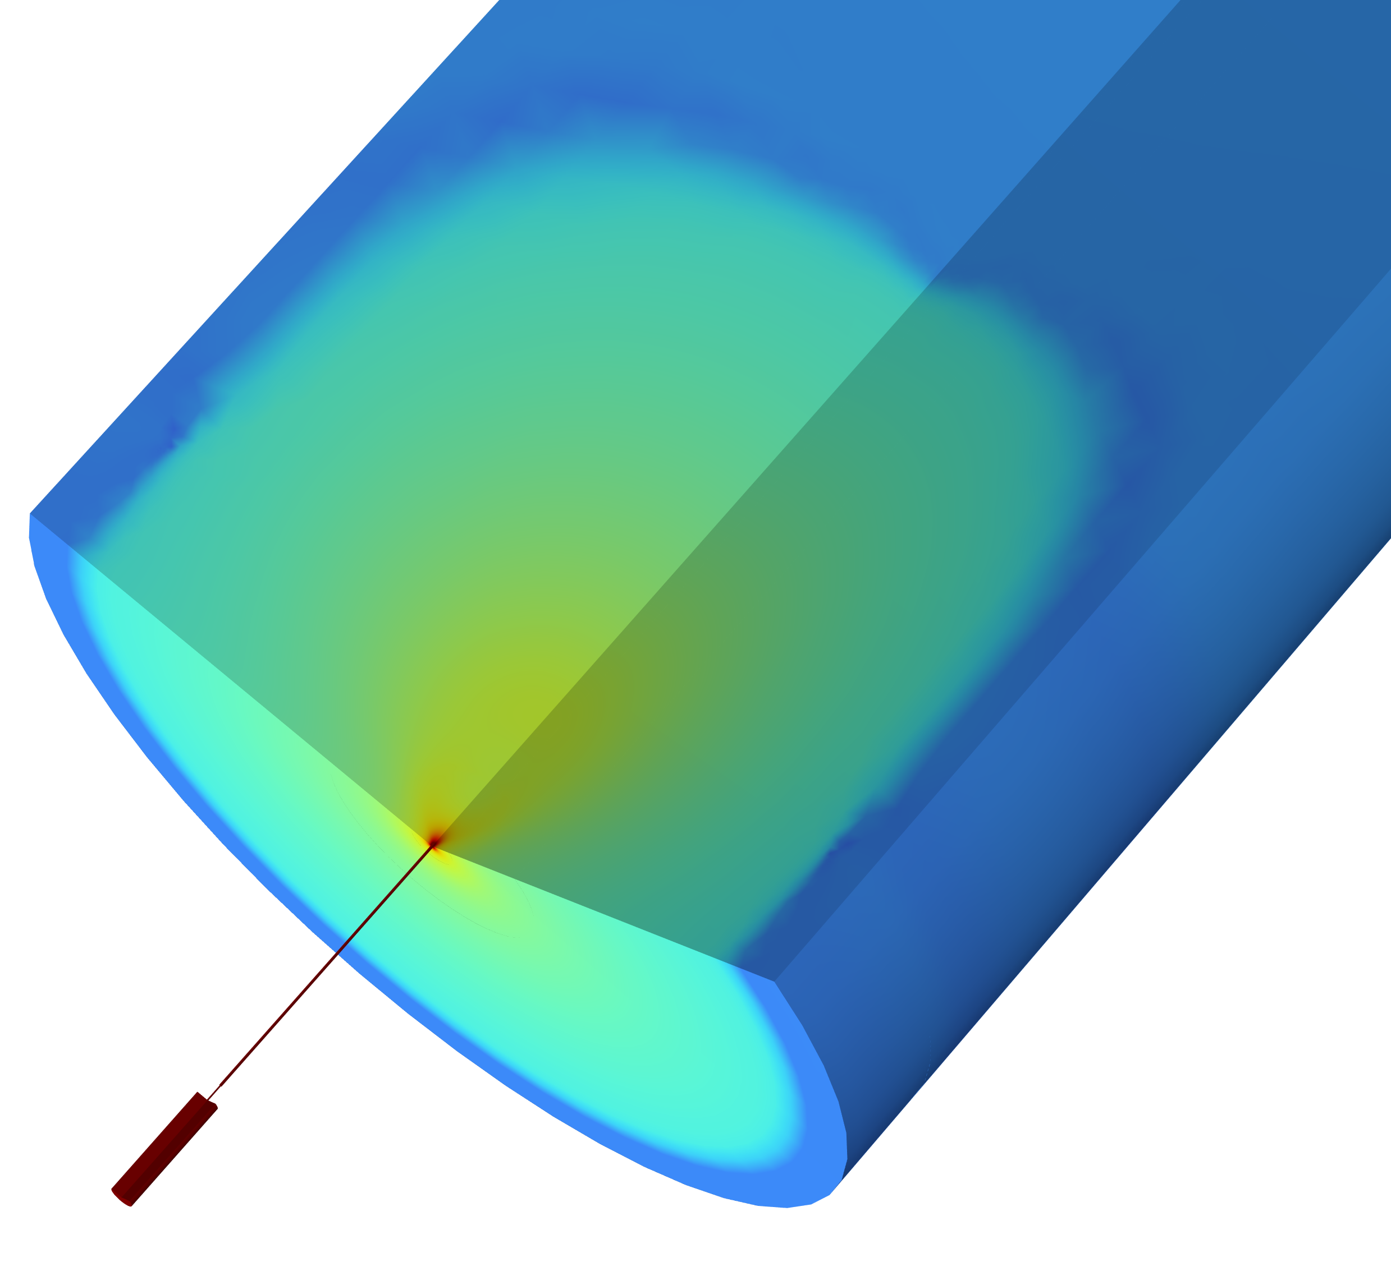
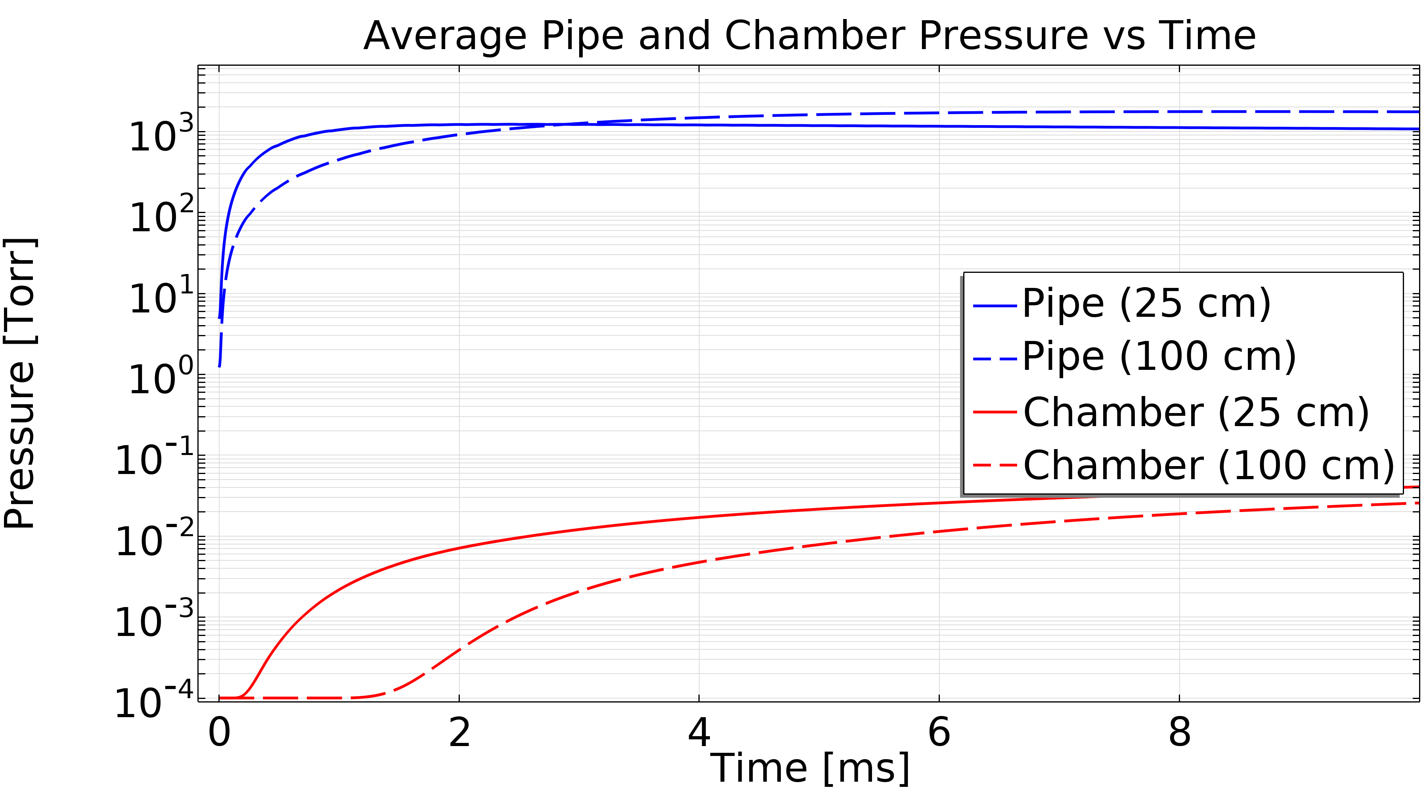
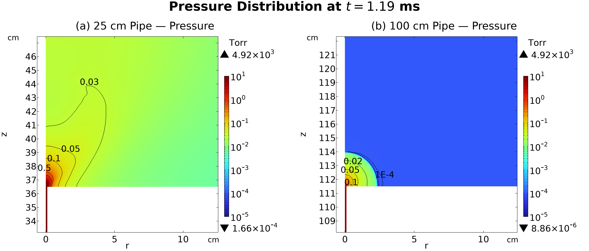

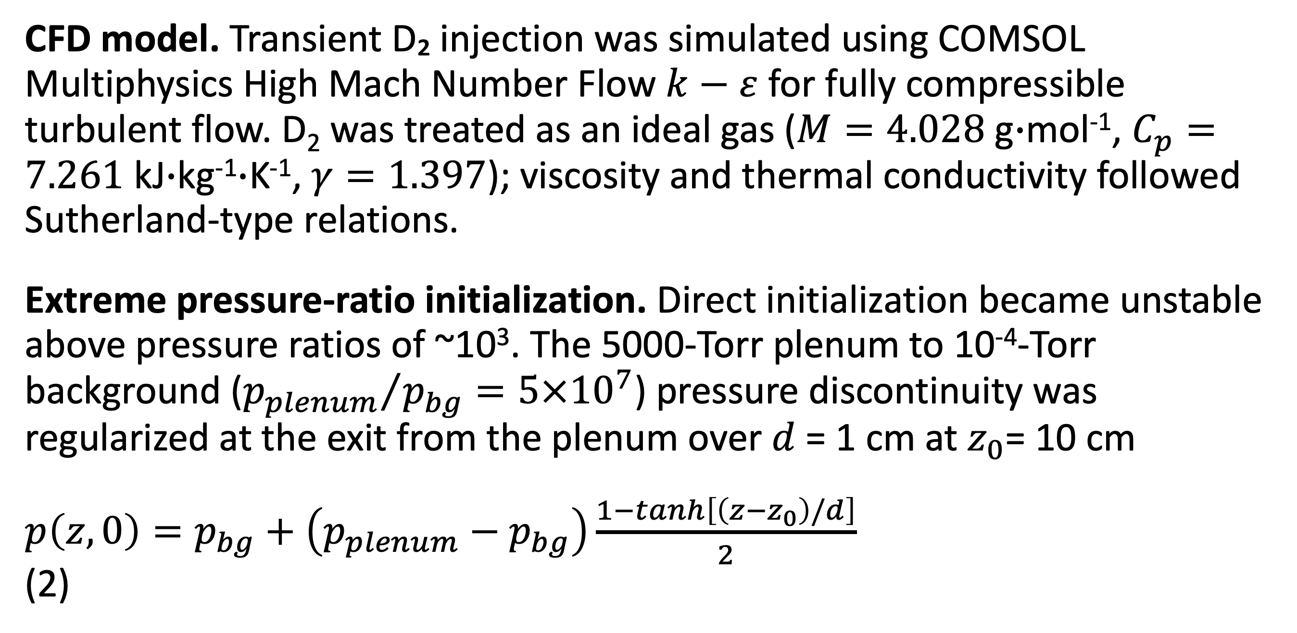
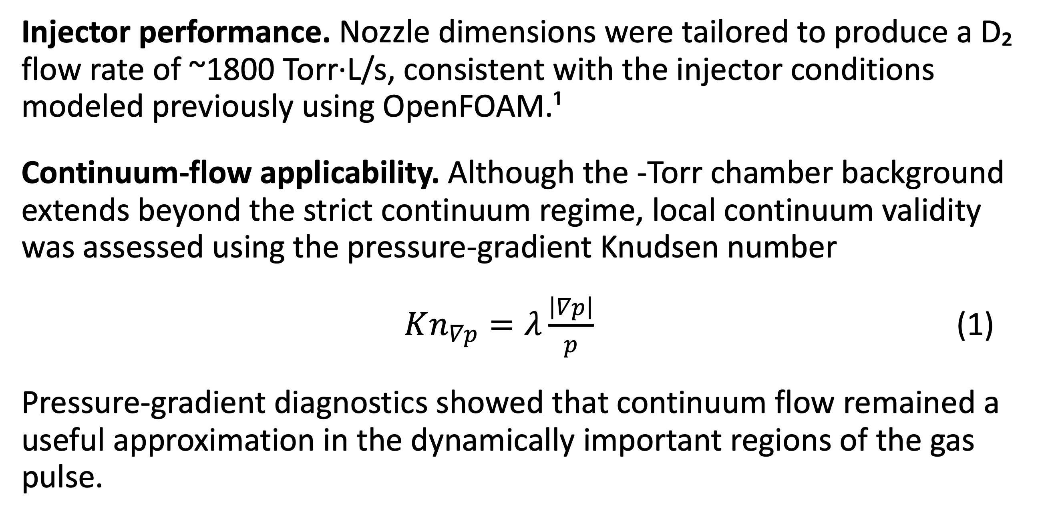
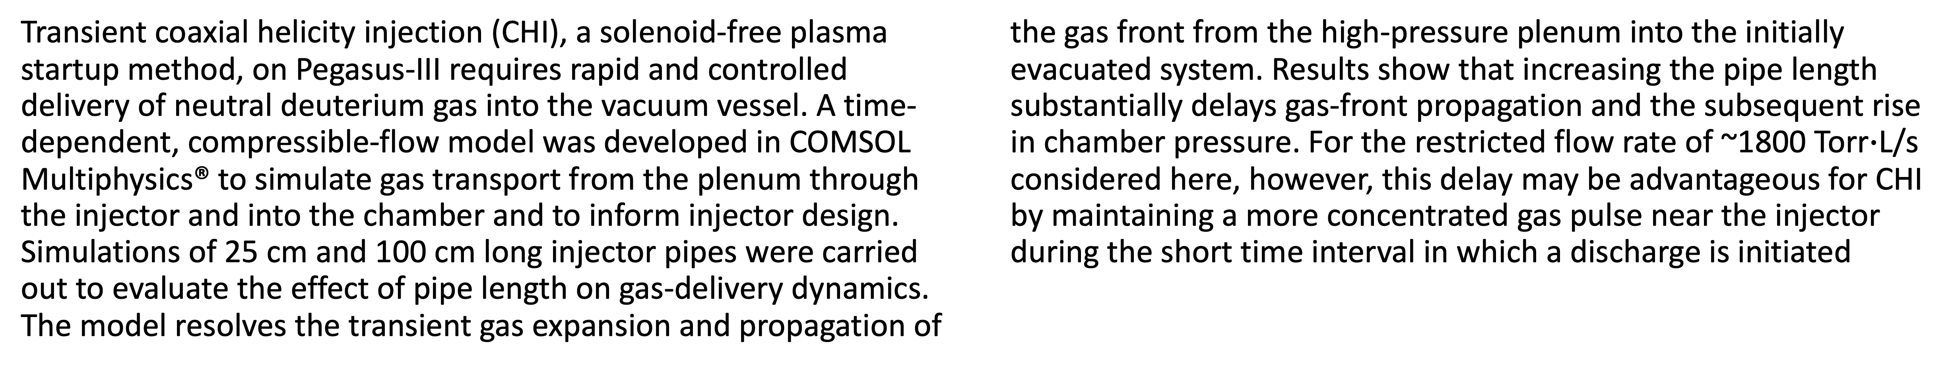
Development of a High-Mach-Number CFD Model for Neutral Gas Injection in Pegasus-III
A COMSOL Multiphysics® CFD model was developed to investigate neutral deuterium transport into the Pegasus-III vacuum vessel and determine how injector geometry influences gas delivery and chamber filling.
C. Billinghamª, R. Ramanª
Dept. of Aeronautics and Astronautics, University of Washington, Seattle, WA, USA
Abstract
Transient coaxial helicity injection (CHI), a solenoid-free plasma startup method, on Pegasus-III requires rapid and controlled delivery of neutral deuterium gas into the vacuum vessel. A time-dependent, compressible-flow model was developed in COMSOL Multiphysics® to simulate gas transport from the plenum through the injector and into the chamber and to inform injector design. Simulations of 25 cm and 100 cm long injector pipes were carried out to evaluate the effect of pipe length on gas-delivery dynamics. The model resolves the transient gas expansion and propagation of the gas front from the high-pressure plenum into the initially evacuated system. Results show that increasing the pipe length substantially delays gas-front propagation and the subsequent rise in chamber pressure. For the restricted flow rate of ~1800 Torr$∙$L/s considered here, however, this delay may be advantageous for CHI by maintaining a more concentrated gas pulse near the injector during the short time interval in which a discharge is initiated
Methodology
CFD model. Transient D₂ injection was simulated using COMSOL Multiphysics High Mach Number Flow $k−ε$ for fully compressible turbulent flow. D₂ was treated as an ideal gas ($M=4.028$ g$∙$mol⁻¹, $C_{p}=7.261$ kJ$∙$kg⁻¹$∙$K⁻¹, $γ=1.397$); viscosity and thermal conductivity followed Sutherland-type relations.
Extreme pressure-ratio initialization. Direct initialization became unstable above pressure ratios of ~10³. The 5000-Torr plenum to 10⁻⁴-Torr background (${p_{plenum}}/{p_{bg}=5×{10}^{7}}$) pressure discontinuity was regularized at the exit from the plenum over $d$ = 1 cm at $z_{0}$= 10 cm
$p\left(z,0\right)=p_{bg}+\left(p_{plenum}−p_{bg}\right)\frac{1−tanh\left[\left(z−z_{0}\right)/d\right]}{2}$ (2)
FIGURE 1. Average pipe and chamber pressure for the 25 cm and 100 cm configurations. The longer pipe delays the chamber pressure rise following gas injection.
Results
Injector performance. Nozzle dimensions were tailored to produce a D₂ flow rate of ~1800 Torr·L/s, consistent with the injector conditions modeled previously using OpenFOAM.¹
Continuum-flow applicability. Although the -Torr chamber background extends beyond the strict continuum regime, local continuum validity was assessed using the pressure-gradient Knudsen number
$Kn_{∇p}=λ\frac{\left|∇p\right|}{p}$ (1)
Pressure-gradient diagnostics showed that continuum flow remained a useful approximation in the dynamically important regions of the gas pulse.
FIGURE 2. Pressure at the chamber entrance at t = 1.19 ms for 25 cm (left) and 100 cm (right) pipes. The longer pipe substantially delays high-pressure gas propagation into the chamber.
C. Billingham, et al. (2026). Considerations for Transient CHI Gas Injection System Design for Pegasus-III. Fusion Science and Technology, 82(6), 1220–1236.
This work is supported by US Dept. of Energy Grant # DE-SC0019415

Slide 2
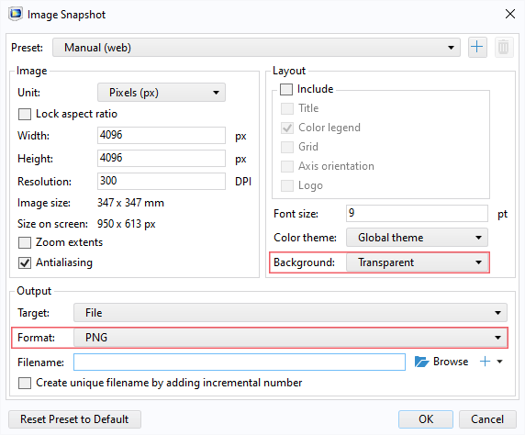
Guidelines
General Notes for Using the Template
Do not adjust the template; work within it. See the examples provided.
Left align text within textboxes, and do not justify your text.
Titles are the largest font on the slide (90–120 pt.), then subtitles (70–80 pt.). Captions, references, and affiliation are the smallest text (18–40 pt.).
Titles and subtitles are bold; any other use of bold should be for emphasis.
Text is either black or grey and should only be adjusted for diagrams.
Images can be adjusted and fitted into the boxes using the Crop feature. (In PowerPoint: Format tab → Size section on the right → Crop.)
Please keep in mind:
The solid red lines are the 3 mm that will be cut off during printing.
The dotted lines represent a small margin that may or may not be cut off during printing.
Exporting an Image for the Header
The settings shown on the right export the highest quality image with a transparent background.
The most important settings to use are the two outlined in pink. This will export an image that can be placed in the blue space of the header.

