Slide 1
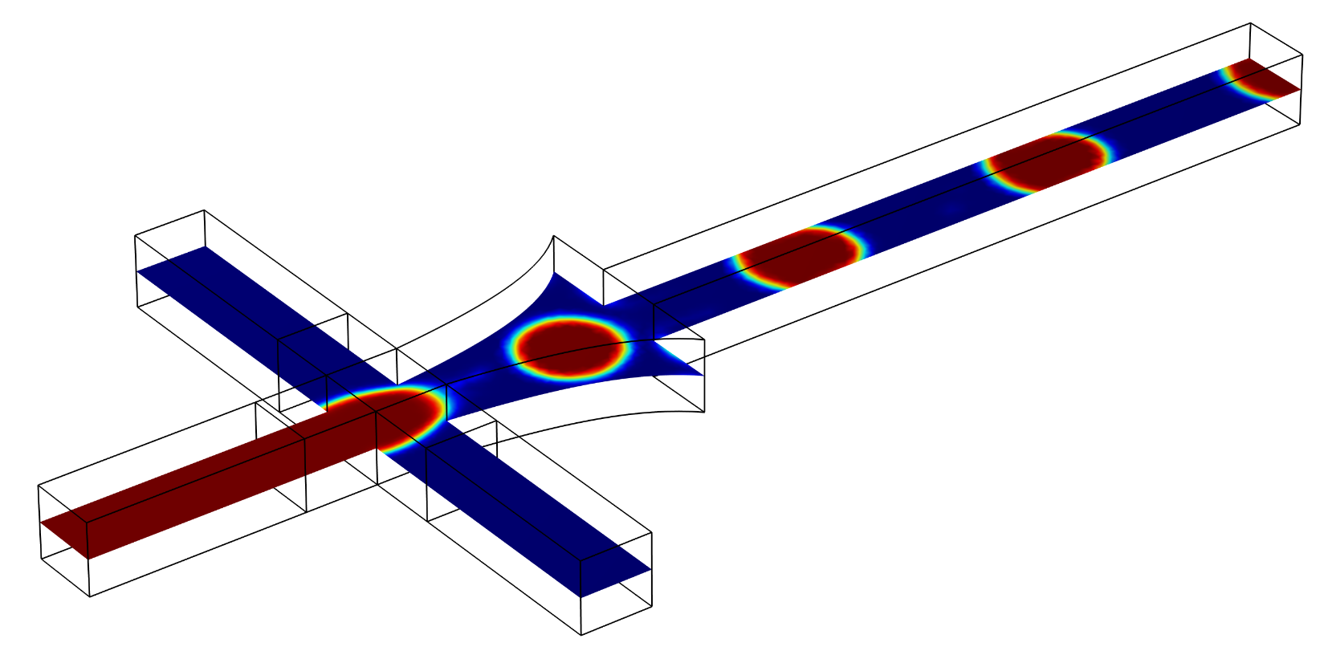
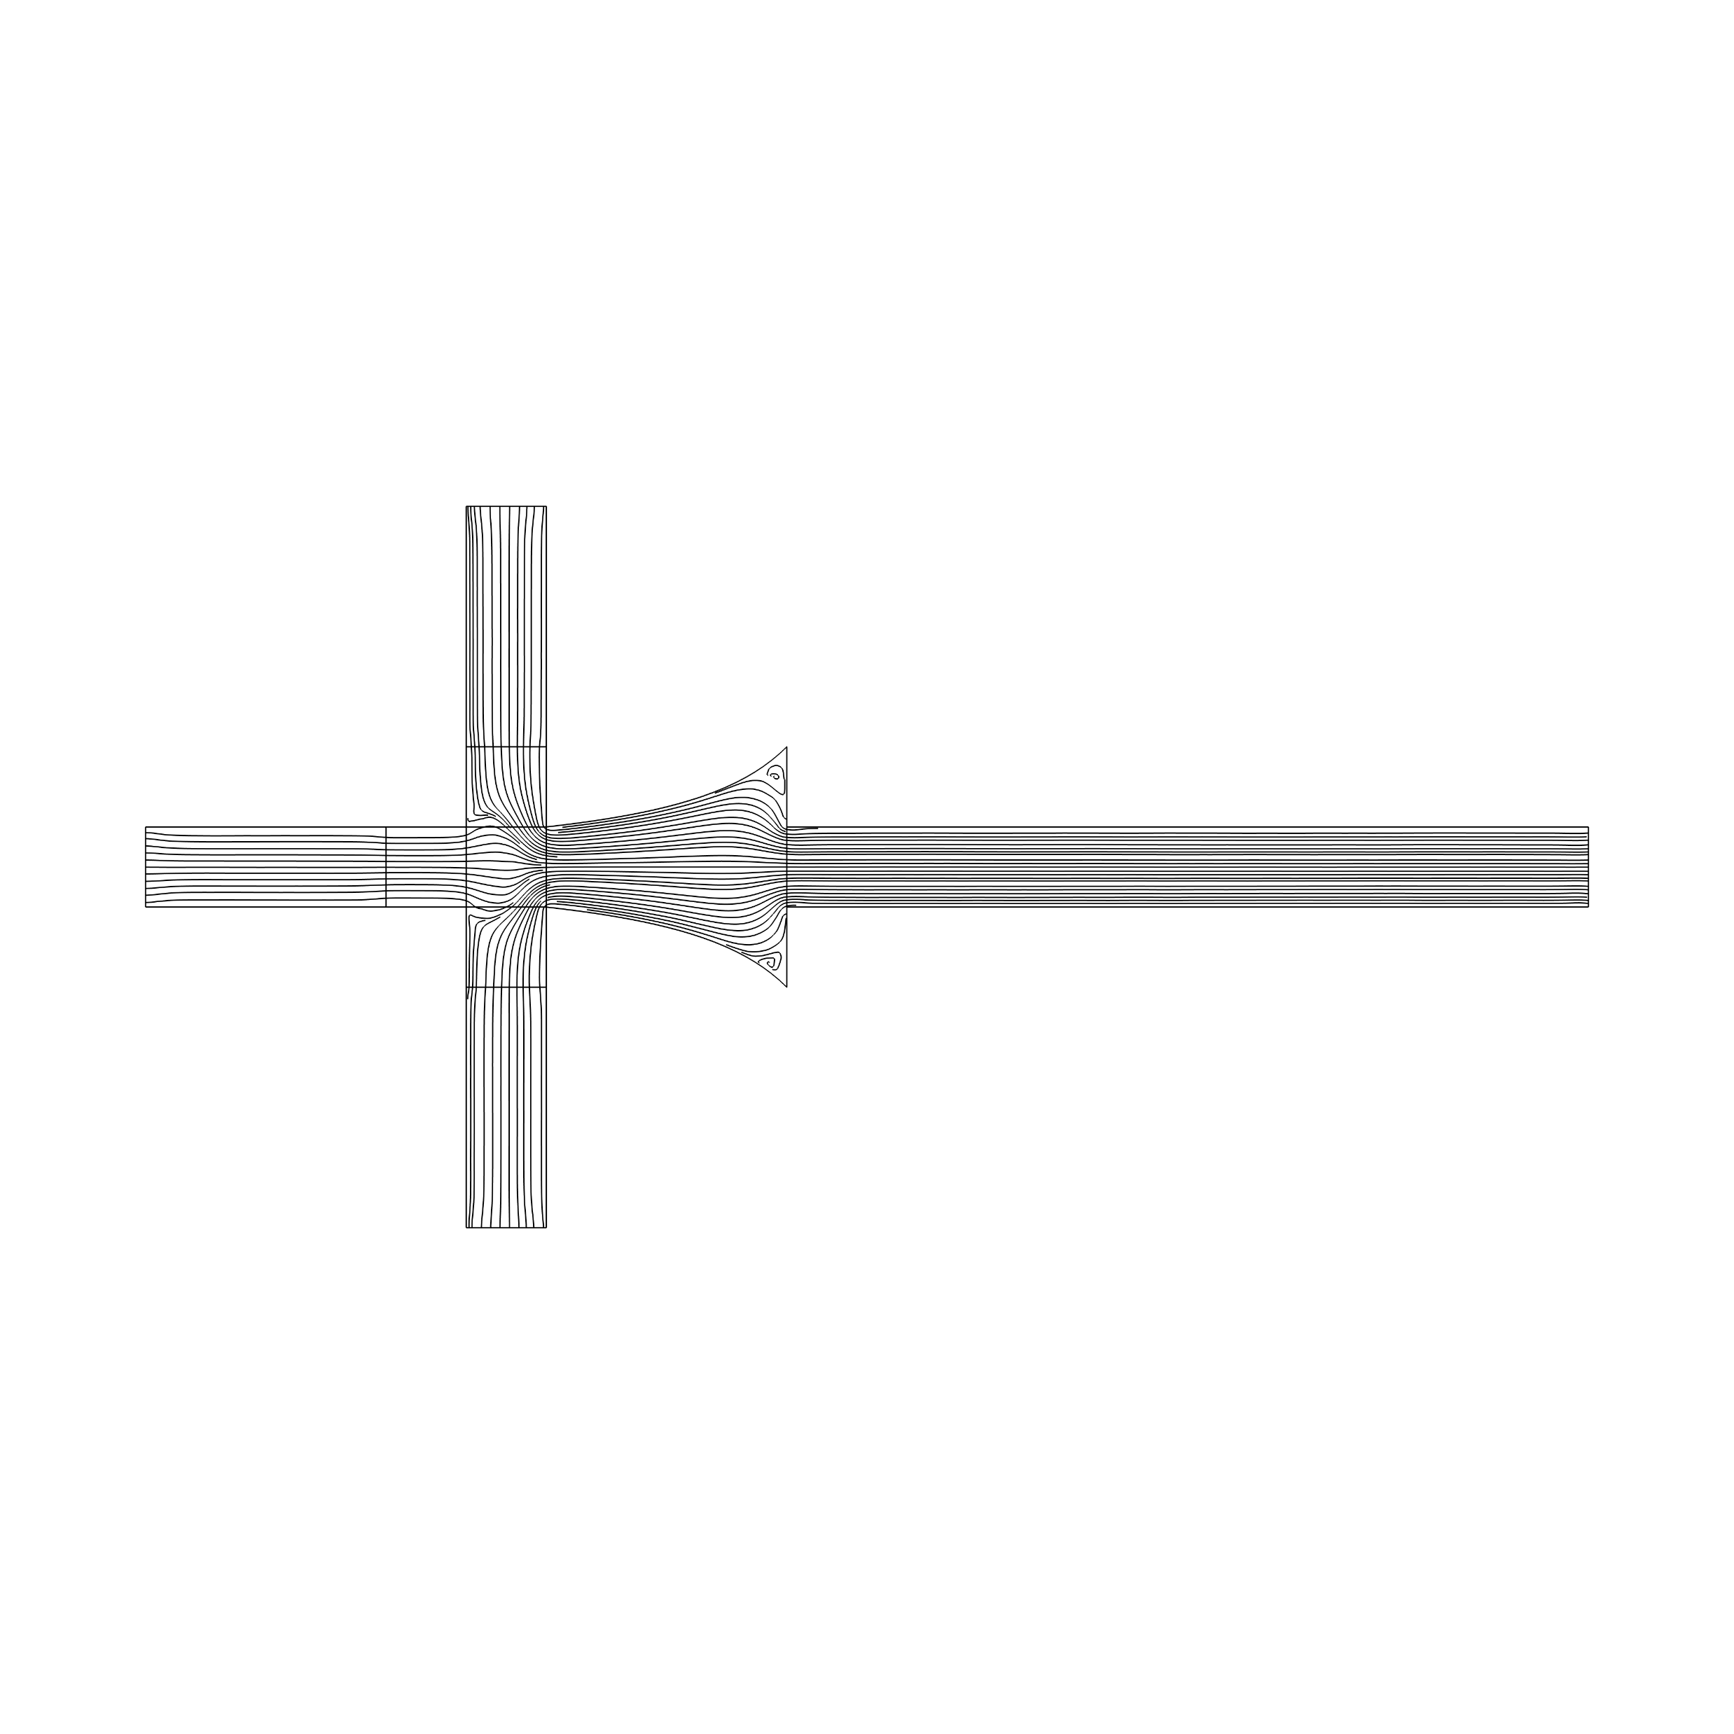
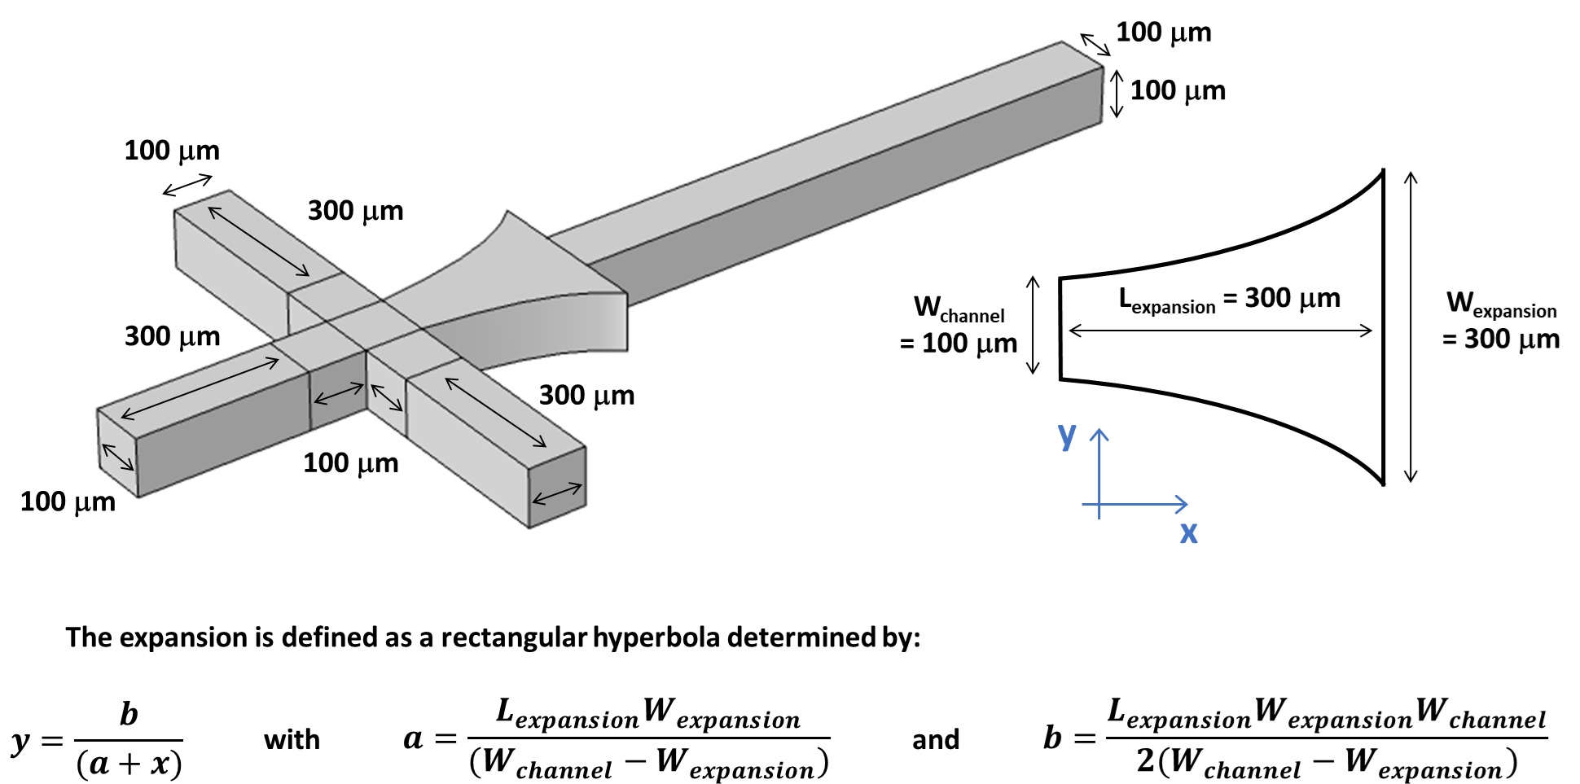
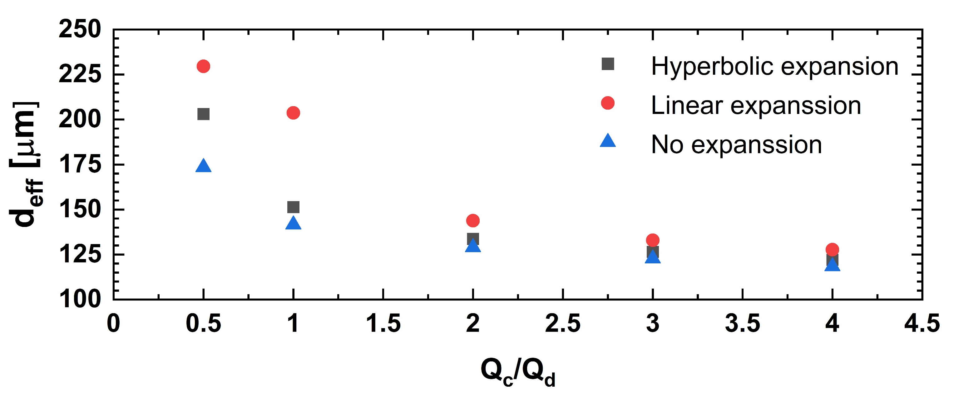
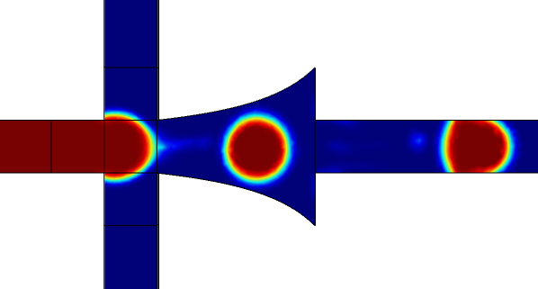
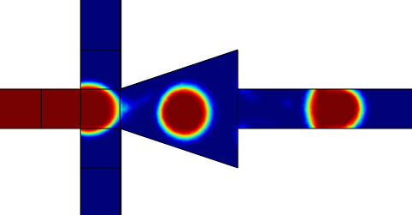
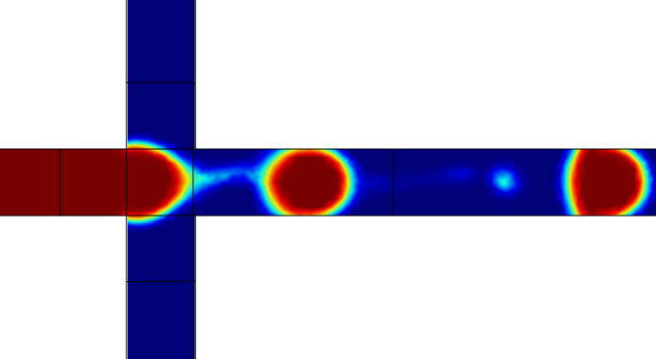

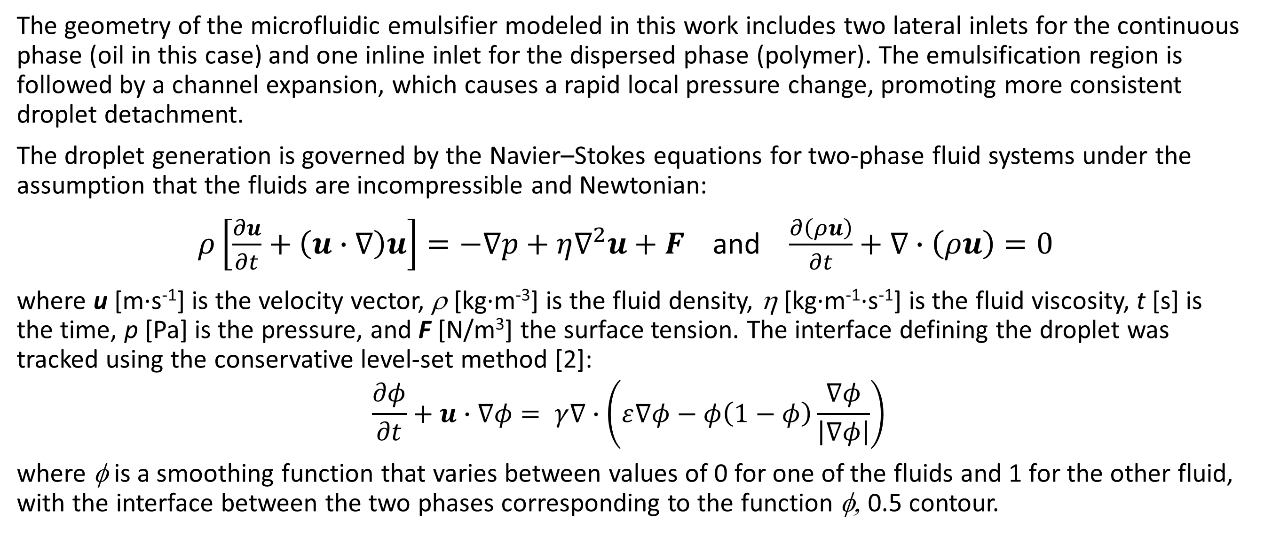
Droplet Generation Modeling in Microfluidic Emulsifying Devices with Expansion Regions
Investigate the use of hyperbolic expansion regions, that maximize the elongational components of the flow, in the design of microfluidic devices for droplet generation in two-phase systems.
Samuel N. Osei¹, Petru. S. Fodor¹
1. Department of Physics, Cleveland State University, Cleveland, USA
Introduction
The generation of monodisperse droplets using microfluidic emulsification devices has emerged as a powerful platform supporting broad applications in biomedical engineering, drug delivery encapsulation, materials synthesis, and chemical processing [1]. However, optimizing the performance of these systems remains challenging due to the presence of multiple flow regimes and the strong sensitivity of both the droplet size as well as size uniformity to operating parameters. To address these challenges, we are developing computational models that allow the mapping of the emulsifying regimes as a function of the controlling parameters, and enable more efficient prototyping of emulsifying devices. In particular, we are exploring the effect on the droplet formation and uniformity, when expansion sections are used to control the shear rates in the emulsifying region where droplet formation and breakup occurs.
Methodology
The geometry of the microfluidic emulsifier modeled in this work includes two lateral inlets for the continuous phase (oil in this case) and one inline inlet for the dispersed phase (polymer). The emulsification region is followed by a channel expansion, which causes a rapid local pressure change, promoting more consistent droplet detachment.
The droplet generation is governed by the Navier–Stokes equations for two-phase fluid systems under the assumption that the fluids are incompressible and Newtonian:
$ρ\left[\frac{∂u}{∂t}+\left(u∙∇\right)u\right]=−∇p+η∇^{2}u+F$ and $\frac{∂\left(ρu\right)}{∂t}+∇∙\left(ρu\right)=0$
where u [m∙s⁻¹] is the velocity vector, ρ [kg∙m⁻³] is the fluid density, η [kg∙m⁻¹∙s⁻¹] is the fluid viscosity, t [s] is the time, p [Pa] is the pressure, and F [N/m³] the surface tension. The interface defining the droplet was tracked using the conservative level-set method [2]:
$$\frac{∂φ}{∂t}+u∙∇φ= γ∇∙\left(ε∇φ−φ\left(1−φ\right)\frac{∇φ}{\left|∇φ\right|}\right)$$
where φ is a smoothing function that varies between values of 0 for one of the fluids and 1 for the other fluid, with the interface between the two phases corresponding to the function φ, 0.5 contour.
FIGURE 1. Geometry of the microfluidic emulsifier modeled, together with the design parameters for the hyperbolic expansion region.
Results
Computational fluid dynamics using the COMSOL Multiphysics package and its CFD module is used to investigate the effect of the geometry of the emulsifying region on the droplet formation. While all the designs shared a typical cross-junction design used in microfluidic devices, some of them include an expansion region immediately after the junction between the continuous phase (oil) and dispersed phase (polymer). Specifically, we are exploring the use of an expansion region that is defined by a rectangular hyperbola (Figure 1). This type of geometry maximizes extensional flows along the center of the junction where the droplet break-off is located and also ensures that the deformation energy goes purely into stretching the fluid rather than creating turbulence. The lack of abrupt velocity changes in this type of geometries, avoids the generation of secondary flows near the break-off point, which helps avoid inconsistencies in the separation dynamics between different droplets, as well as the possible formation of secondary droplets [1].
The CFD simulations allow the mapping of the droplet effective diameter as a function of both the geometry used, as well as the ratio between the flow rate of the continuous phase Q_{c} and the flow rate of the dispersed phase Q_{d} (the later fixed at 9 microliters/minute for the simulations shown). For all the flow ratios modeled in this work, the emulsification occurs within the dripping regime, with similar droplet sizes at large flow ratios. Importantly, both designs including an expansion region (hyperbolic or linear) show much less susceptibility to the formation of undesirable satellite droplets.
FIGURE 2. (Top) Droplet effective diameter dependence on the flow ratio and geometry; (Top) Droplet formation under different expansion geometries.
T. Moragues, D. Arguijo, T. Beneyton, C. Modavi, K. Simutis, A. R. Abate, J.-C. Baret, A. J. deMello, D. Densmore, and A. D. Griffiths , “Droplet-based microfluidics”, Nature Reviews Methods Primers 3, 32 (2023).
E. Olsson and G. Kreiss, “A conservative level set method for two phase flow”, J. Comput. Phys. 210, 225-246 (2005).

