Slide 1
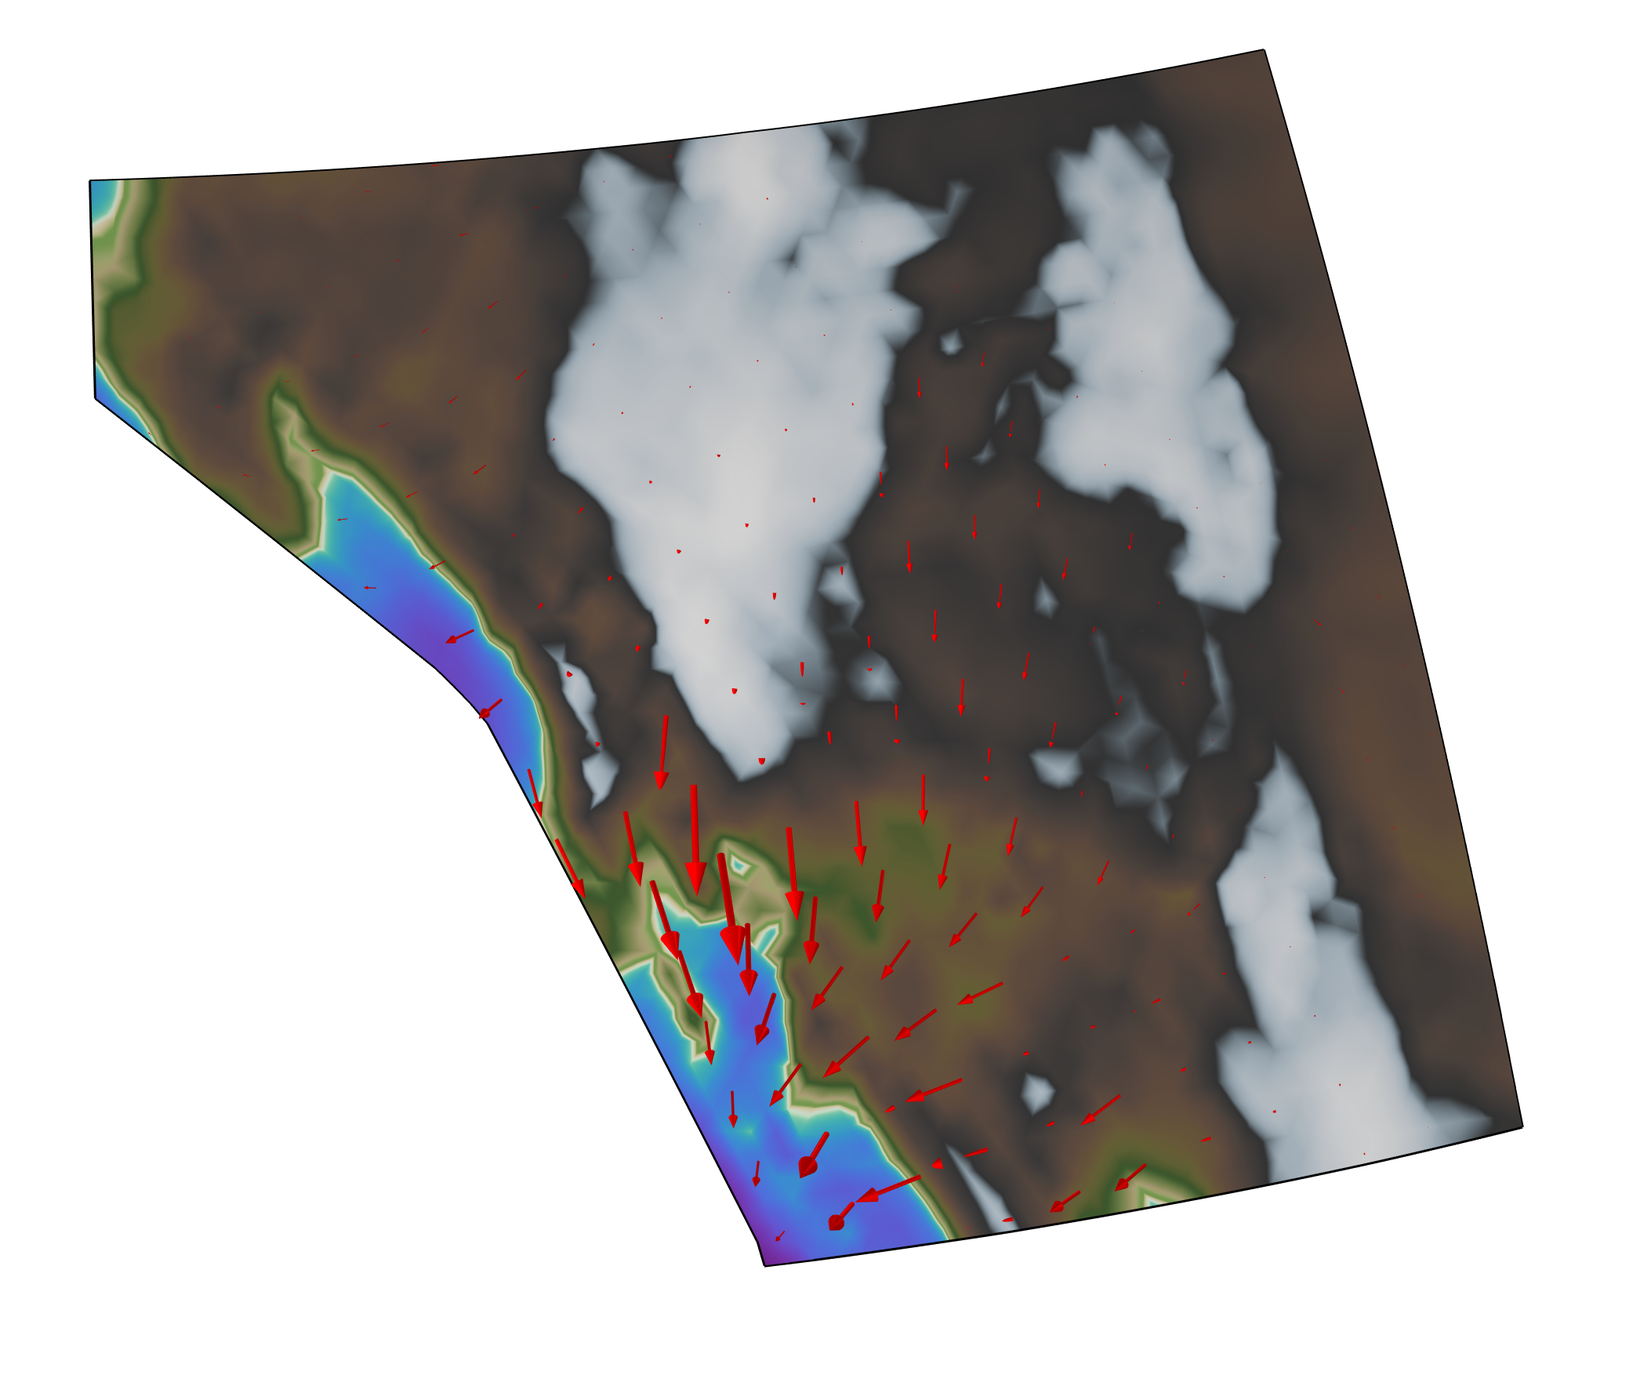
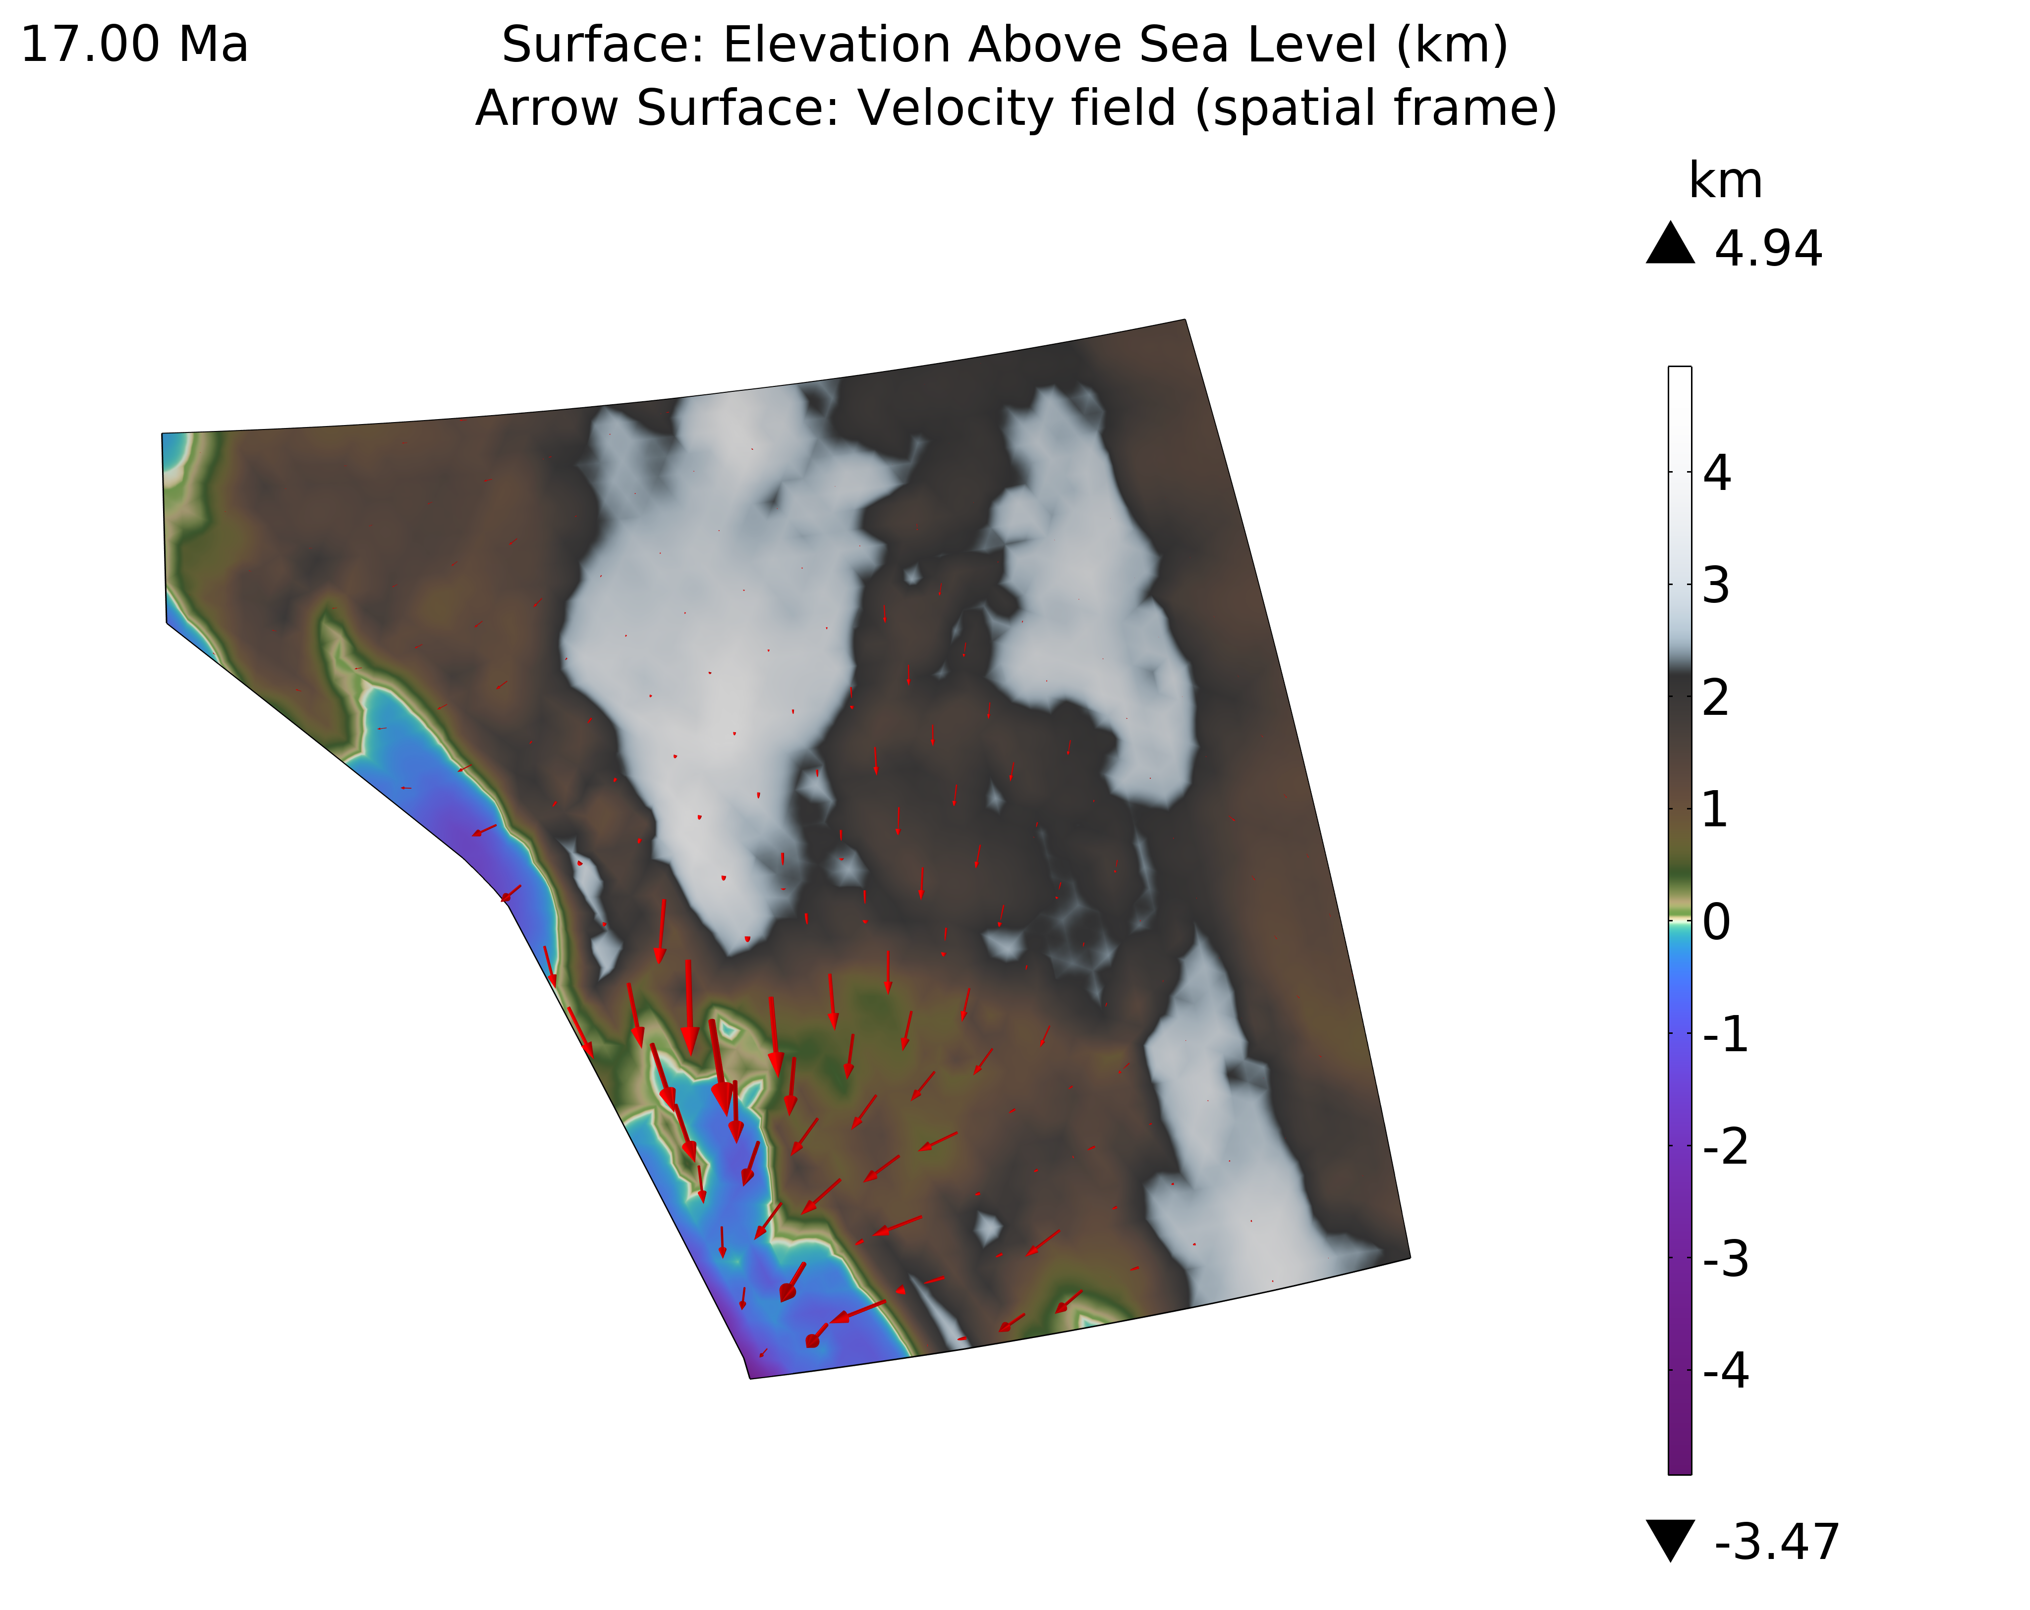
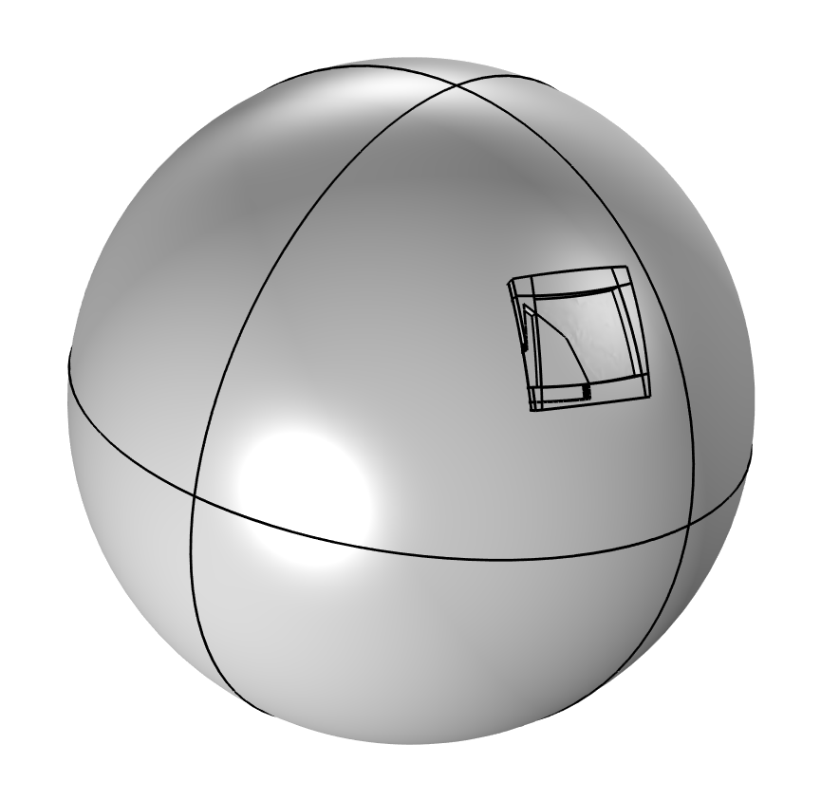
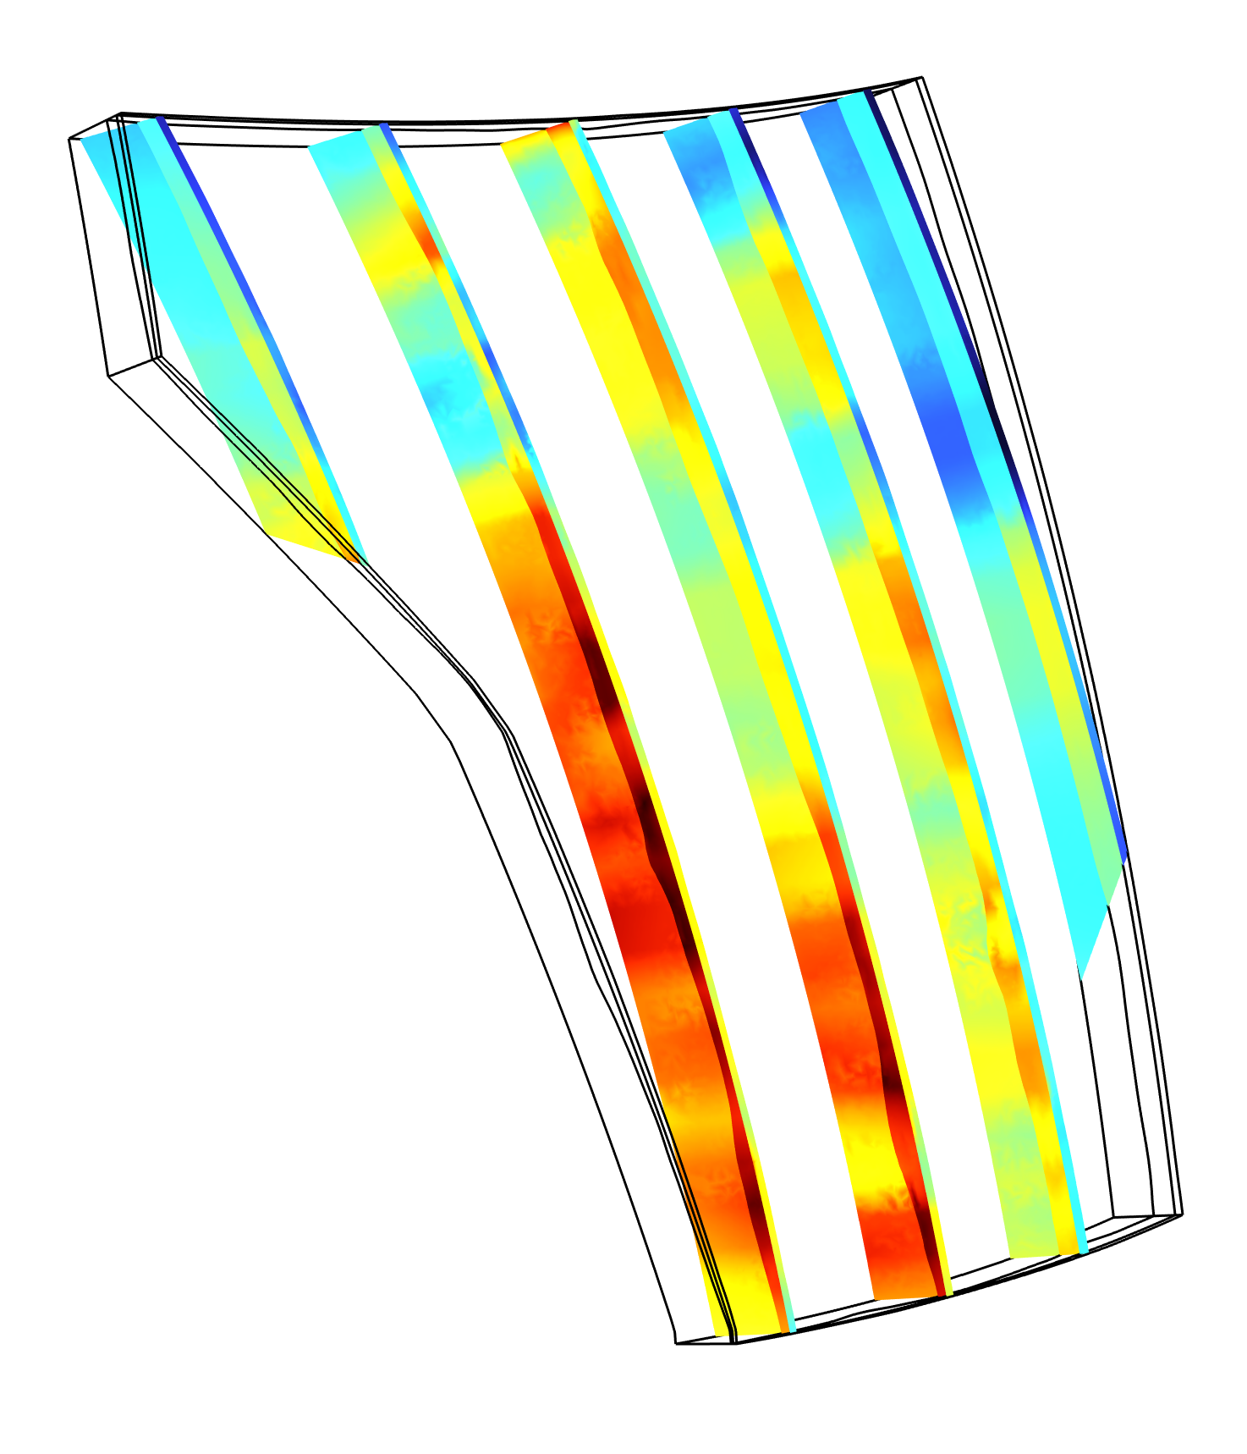
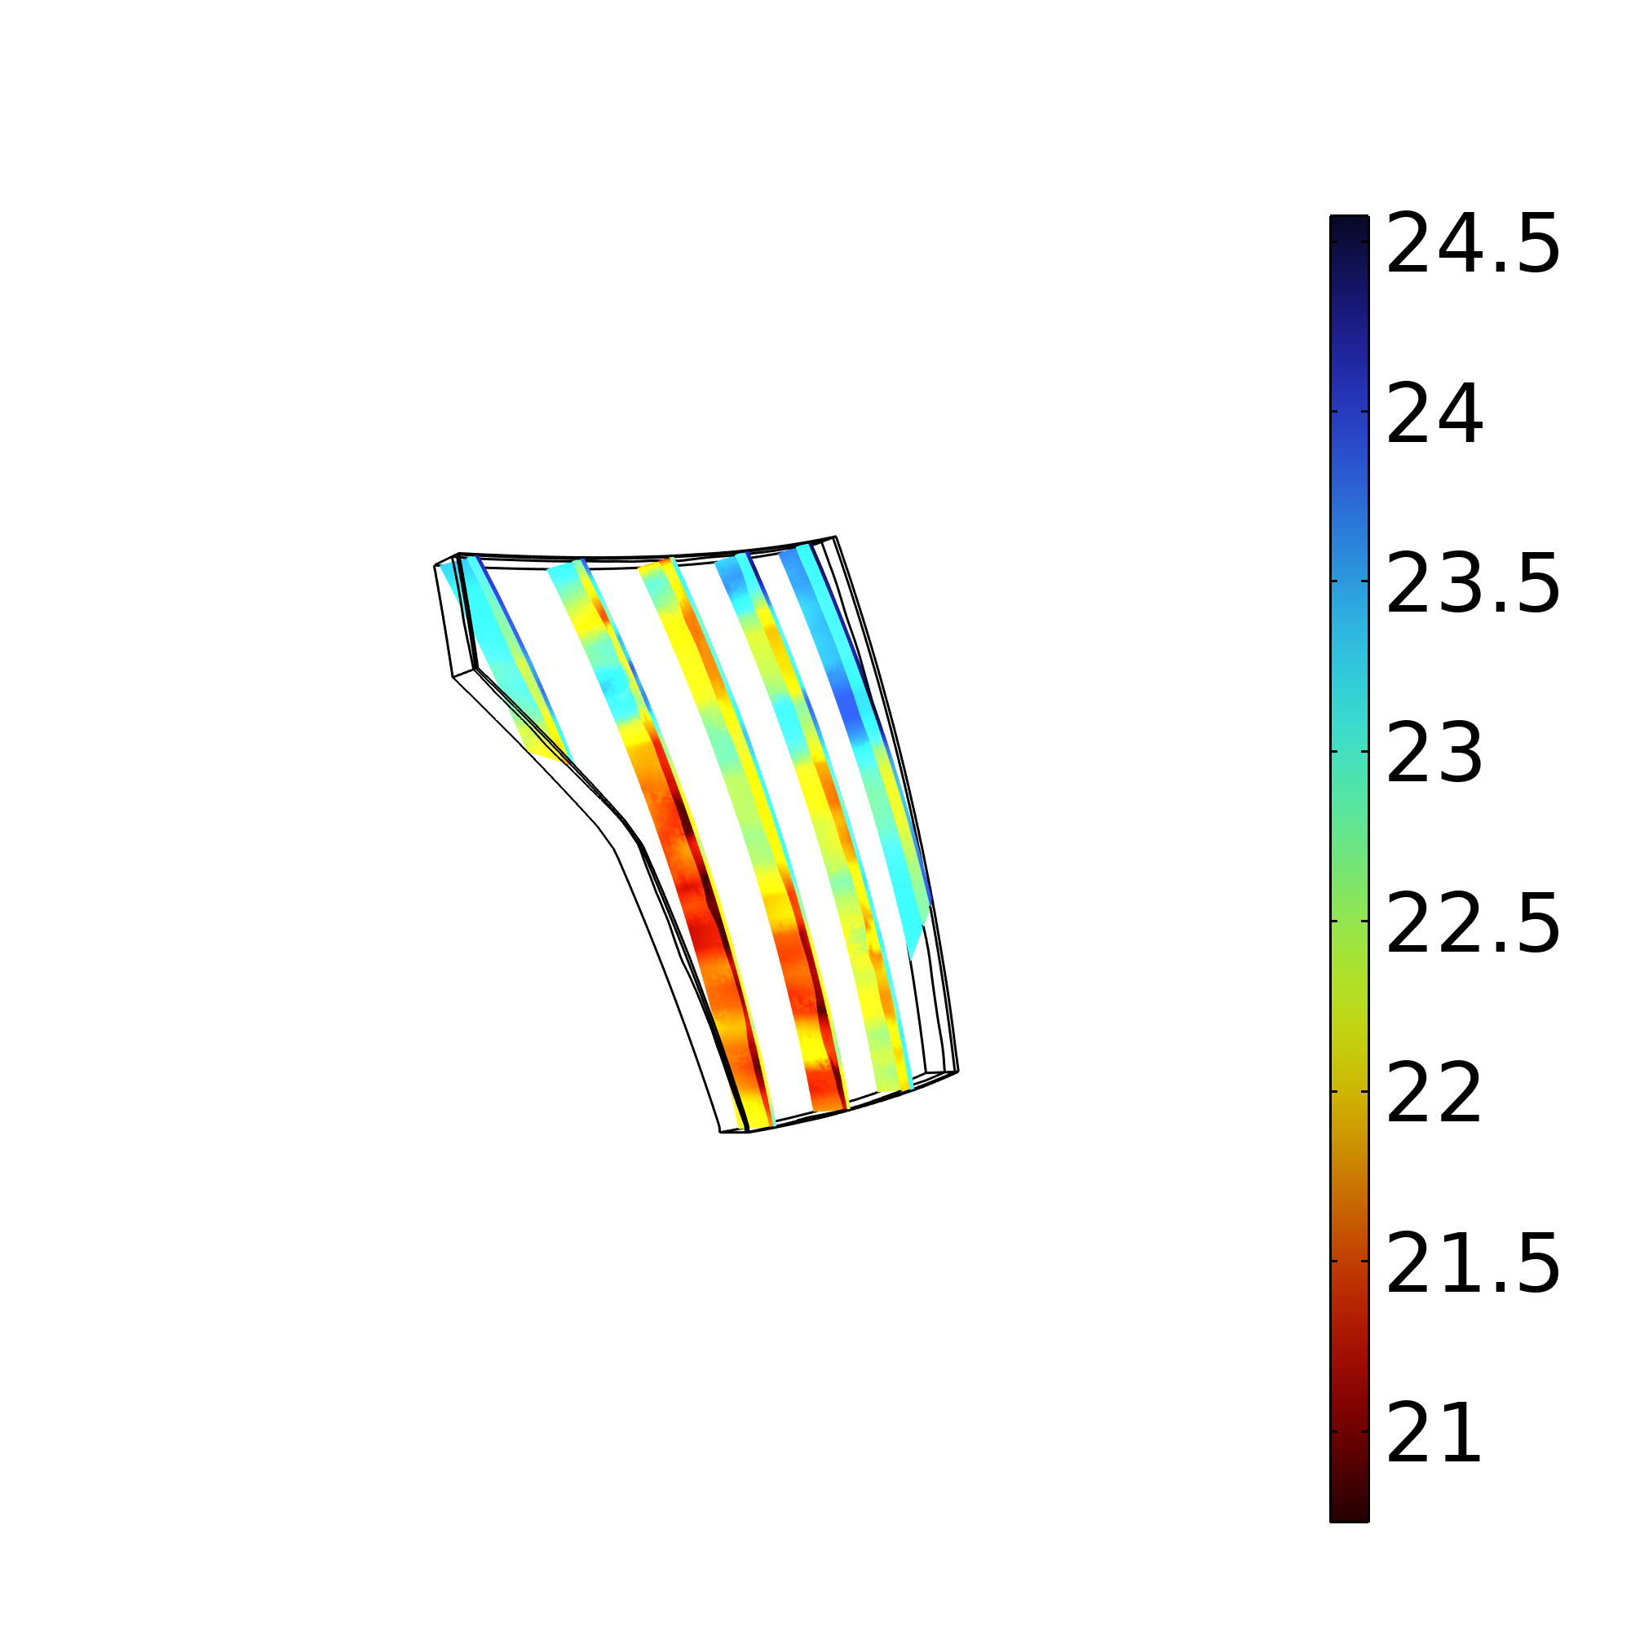
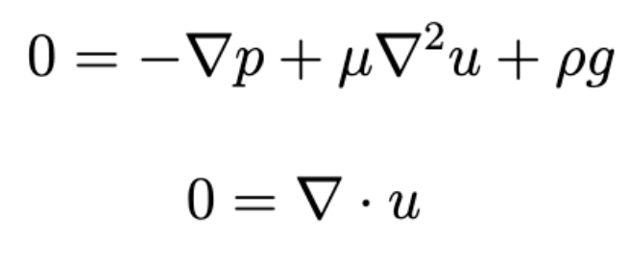
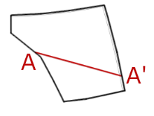
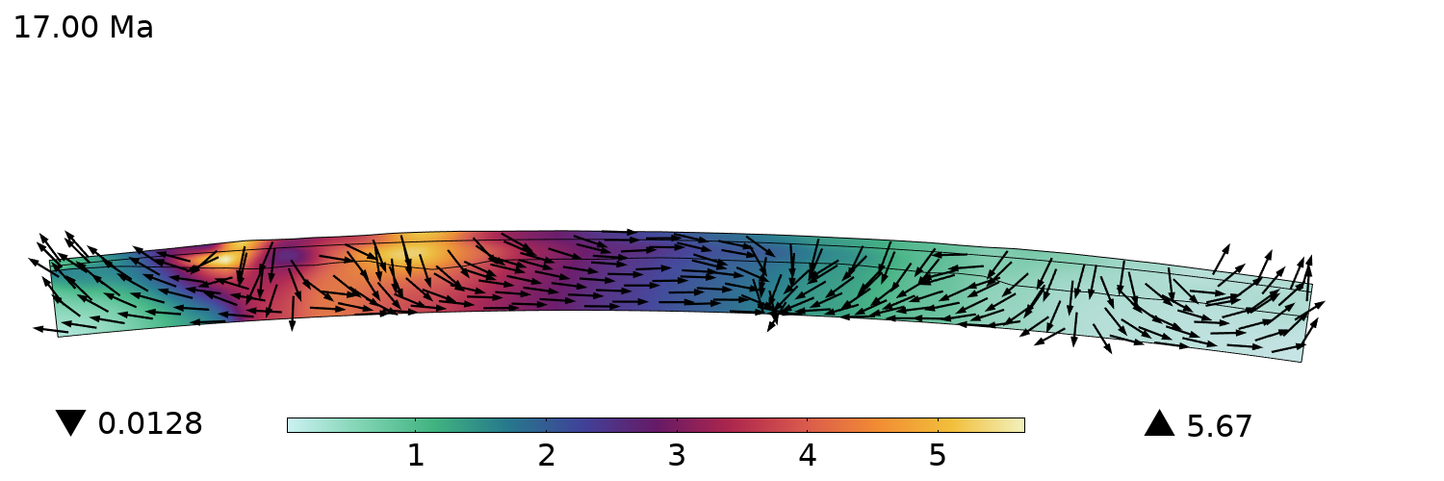
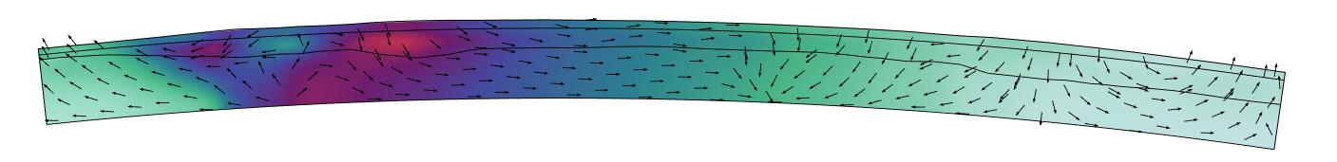
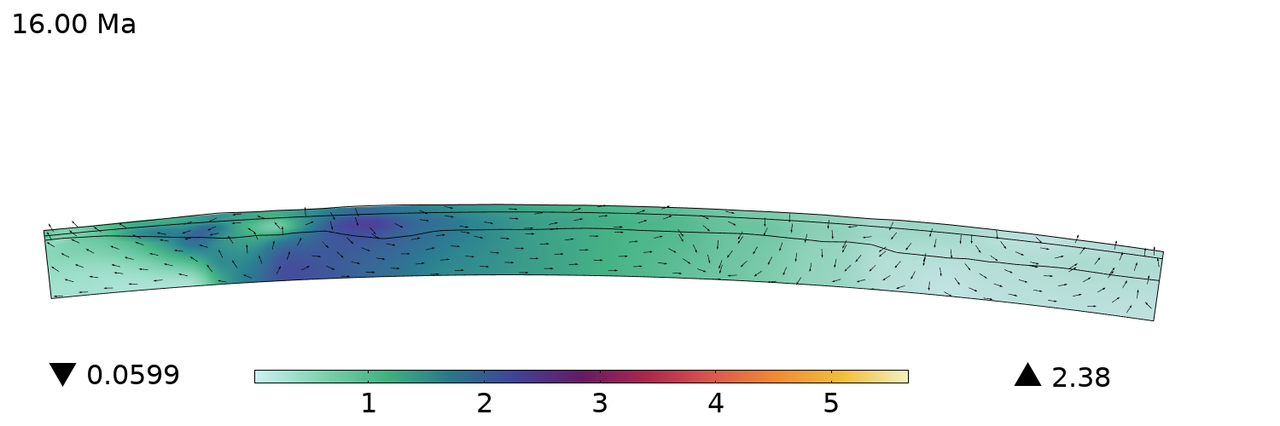

Geophysical Modeling of the American Southwest
Creating a functional model for large-scale geophysical analysis of gravitational collapse, crustal extension, and deformation
Ilana S. Bromberg₁, Lucy M. Flesch₁, Saad Haq₁, Christopher M. Calvelage₂, William E. Holt₃, Alireza Bahadori₄
1.Purdue University, 2. Earthscope Consortium, 3. Stony Brook University, 4. Springer Nature
Introduction
Southwestern North America contains features like the Basin and Range Province, Colorado Plateau, and Rio Grande Rift, all of which experienced relatively recent large-scale deformation that affected the overall landscape. Geophysical phenomena occur on much larger scales of length (thousands of kilometers) and time (millions of years) than is typically modeled in software like COMSOL; despite this, finite element analysis presents a unique opportunity to analyze how large systems like this, with many interconnected parts, behave under different initial conditions and material properties. Challenges in modeling have included forcing isostatic equilibrium adjustment (as the topography collapses due to gravity, the boundary between the crust and mantle adjusts upwards to compensate and maintain a constant pressure at the base of the model), determining boundary conditions that are both stable and accurately reflect geophysical realities, and creating spherical systems in software normally set in cartesian or cylindrical.
Methods
Model carved out from a spherical shell using pre-calculated paleotopography, crustal thickness, 3D viscosity and density profiles
Crust is split into two domains to separate upper and lower crust
Parameter space examined is the strength (viscosity) of the lower crust, and the ratio of strength between the upper crust and the mantle
  Model parameters chosen by comparing surface velocity outputs
Instantaneous physics computed using Stokes/creeping flow
Time dependence with moving mesh
log10(μ)
~12,000 km
~3,000 km
Figure 1. Left: Carving the volume out of a spherical shell. Right: Viscosity magnitude slices through the model.
Results
Nevadaplano
Colorado
Plateau
Rio Grande
Rift
Particle tracing module: placed massless particles along the boundary between the upper and lower crust, traced them through the duration of the model to examine how material in the lower crust moves over time in relation to the topography collapsing
  Currently cannot cross into the upper crust due to different domains
Extension and uplift necessary for key geologic features can be created solely with a weak layer in the lower crust and the impact of gravity acting on high topography, even without inclusion of tectonic plate motion velocity boundary conditions
  Next steps: adding the velocity boundary conditions to evaluate the impact on development of the model
17.0 Ma
16.5 Ma
16.0 Ma
Velocity (mm/yr)
Figure 2. Cross section A, showcasing the collapse of the Nevadaplano and lateral movement in the lower crust over 1 million years in simulation
Bahadori, A., Holt, W. E. & Rasbury, E. T. Reconstruction modeling of crustal thickness and paleotopography of western North America since 36 Ma. Geosphere 14, 1207–1231 (2018).
Bahadori, A. & Holt, W. E. Geodynamic evolution of southwestern North America since the Late Eocene. Nature Communications 10, 5213 (2019).
Calvelage, C. M. INVESTIGATING THE EFFECTS OF A WEAK LOWER CRUST ON BASIN AND RANGE EXTENSIONAL HISTORY. (2021).

Slide 2
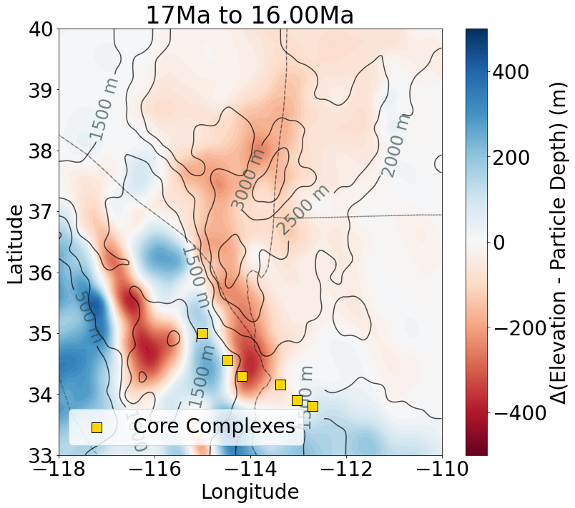
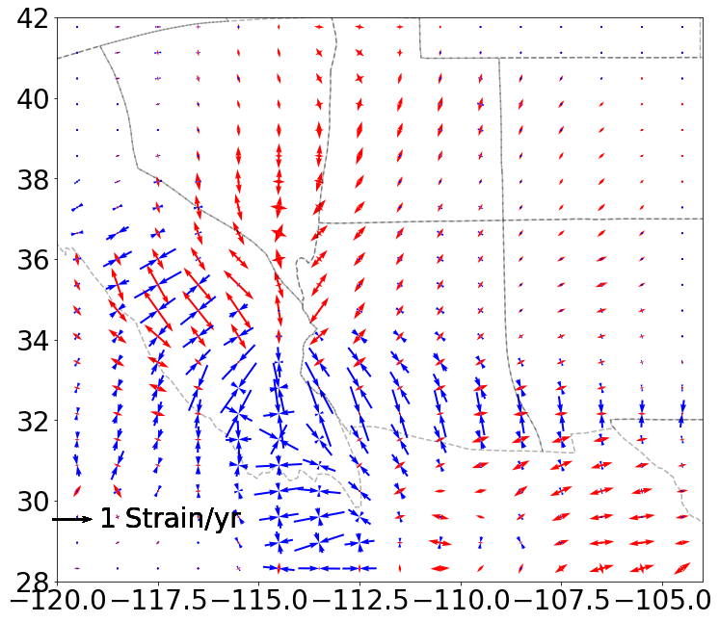
Metamorphic Core Complex Evolution in the American Southwest
Can we create conditions favorable for metamorphic core complex development using only high topography, gravitational potential energy, and a weak layer in the lower crust?
Ilana S. Bromberg₁, Lucy M. Flesch₁, Saad Haq₁, Christopher M. Calvelage₂, William E. Holt₃, Alireza Bahadori₄
1.Purdue University, 2. Earthscope Consortium, 3. Stony Brook University, 4. Springer Nature
Introduction
The Basin and Range Province spans from southern Idaho to northern Mexico and is known for its unique topography characterized by sharp changes in elevation and long strings of parallel alternating basins and mountain ranges. A feature relatively unique to this region are metamorphic core complexes (MCCs); these are large areas of metamorphic rock adjacent to sedimentary rock, indicating uplift of the lower crust towards the surface. While there is general agreement that these MCCs can be used as proxies for lower crustal flow and extension at the surface, there is controversy surrounding which physical factors are most influential on the development of these features. When considered on a time scale of millions of years, rock can be approximated as a slow-moving fluid due to the high viscosities at play; to that end, COMSOL's creeping flow is used to set the physics for the instantaneous state and a moving mesh is used to evolve it through time. Through our models, we sought to determine the importance of various viscosity profiles and boundary conditions on MCC development.
Nevadaplano
Colorado
Plateau
Rio Grande
Rift
Methods
17.0 Ma
The model is carved out from a spherical shell using pre-calculated paleotopography and crustal thickness, with assigned viscosity and density profiles loaded in. The crust is then split into two domains to approximate the upper and lower crust. The parameter space examined is the strength (viscosity) of the lower crust, and the ratio of strength between the upper crust and the mantle. A best fit model was chosen by comparing model outputs to known physical limitations.
The instantaneous physics is computed using Stokes flow:
16.5 Ma
16.0 Ma
Velocity (mm/yr)
Figure 1: Cross section A, showcasing the collapse of the Nevadaplano and lateral movement in the lower crust in areas of known core complex formation.
Results
By seeding particles along the boundary between the upper and lower crust and tracing them through the duration of the model, we can examine how material in the lower crust moves over time in relation to the topography.
We found that the extension and uplift necessary for metamorphic core complex formation can be created solely with the inclusion of a weak layer in the lower crust and the impact of gravity acting on high topography, even without inclusion of tectonic plate motion velocity boundary conditions.
Figure 2: exhumation and strain (clean up plots, add CCs to strain, move arrow key, etc)

Slide 3
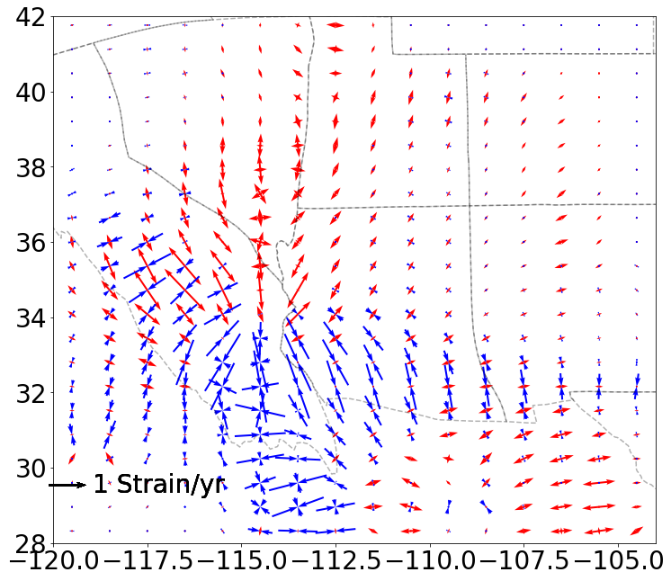
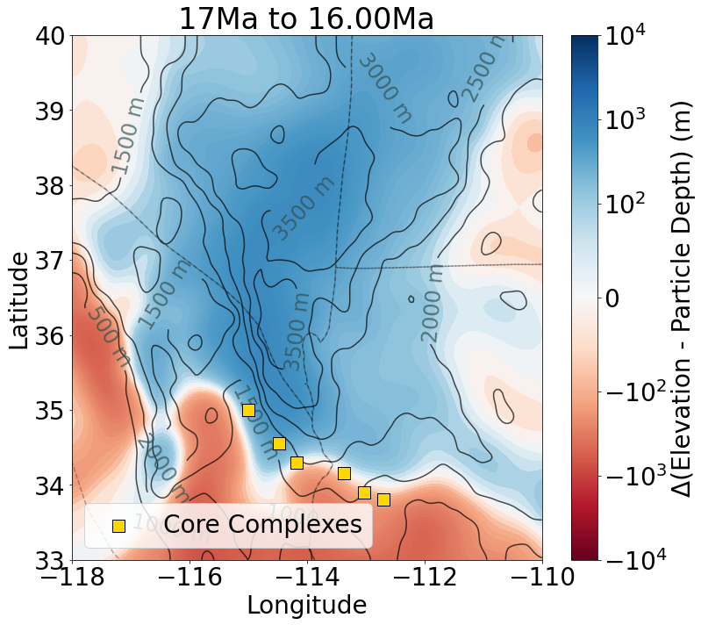

Slide 4
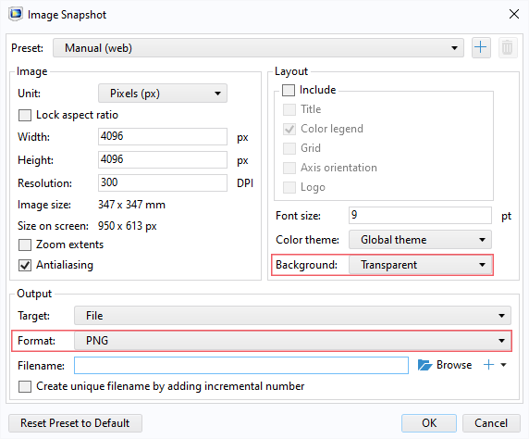
Guidelines
General Notes for Using the Template
Do not adjust the template; work within it. See the examples provided.
Left align text within textboxes, and do not justify your text.
Titles are the largest font on the slide (90–120 pt.), then subtitles (70–80 pt.). Captions, references, and affiliation are the smallest text (18–40 pt.).
Titles and subtitles are bold; any other use of bold should be for emphasis.
Text is either black or grey and should only be adjusted for diagrams.
Images can be adjusted and fitted into the boxes using the Crop feature. (In PowerPoint: Format tab → Size section on the right → Crop.)
Please keep in mind:
The solid red lines are the 3 mm that will be cut off during printing.
The dotted lines represent a small margin that may or may not be cut off during printing.
Exporting an Image for the Header
The settings shown on the right export the highest quality image with a transparent background.
The most important settings to use are the two outlined in pink. This will export an image that can be placed in the blue space of the header.

Slide 5
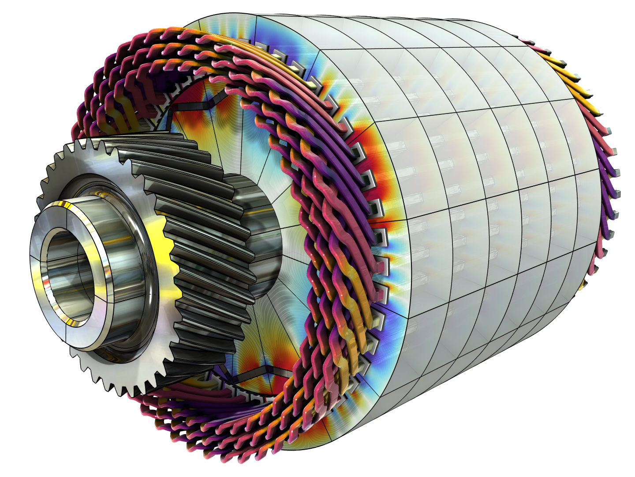
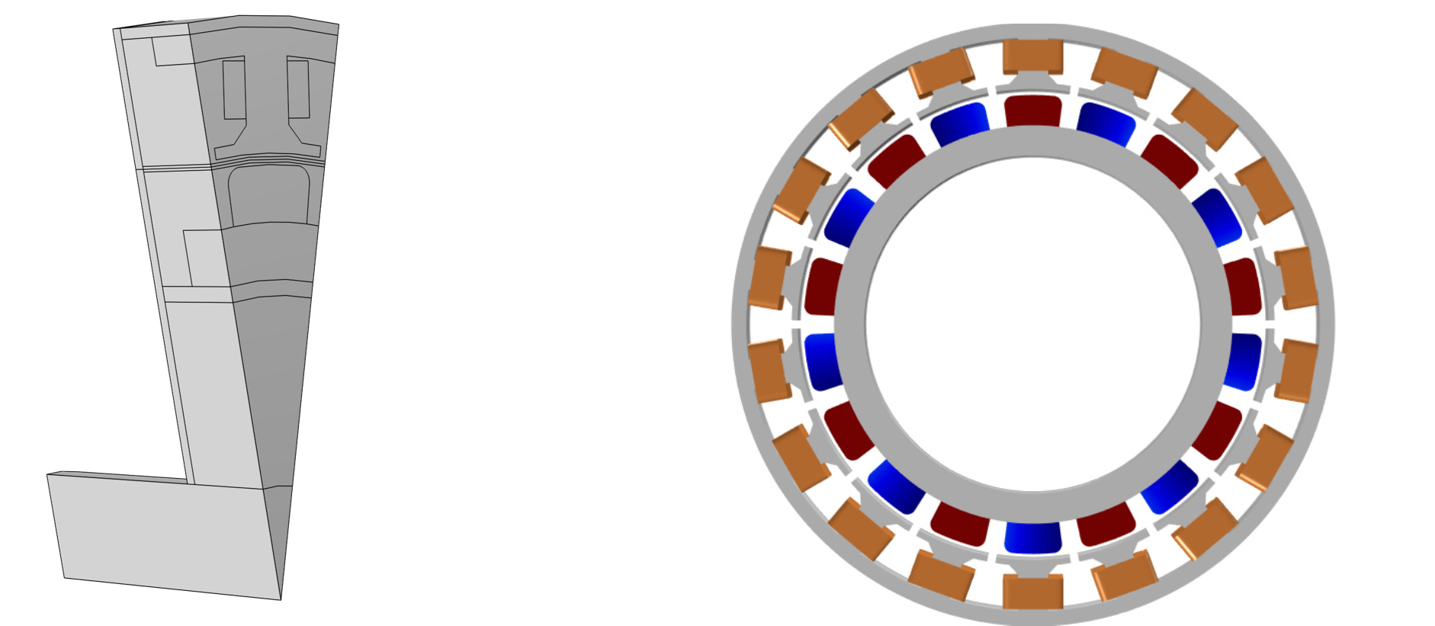
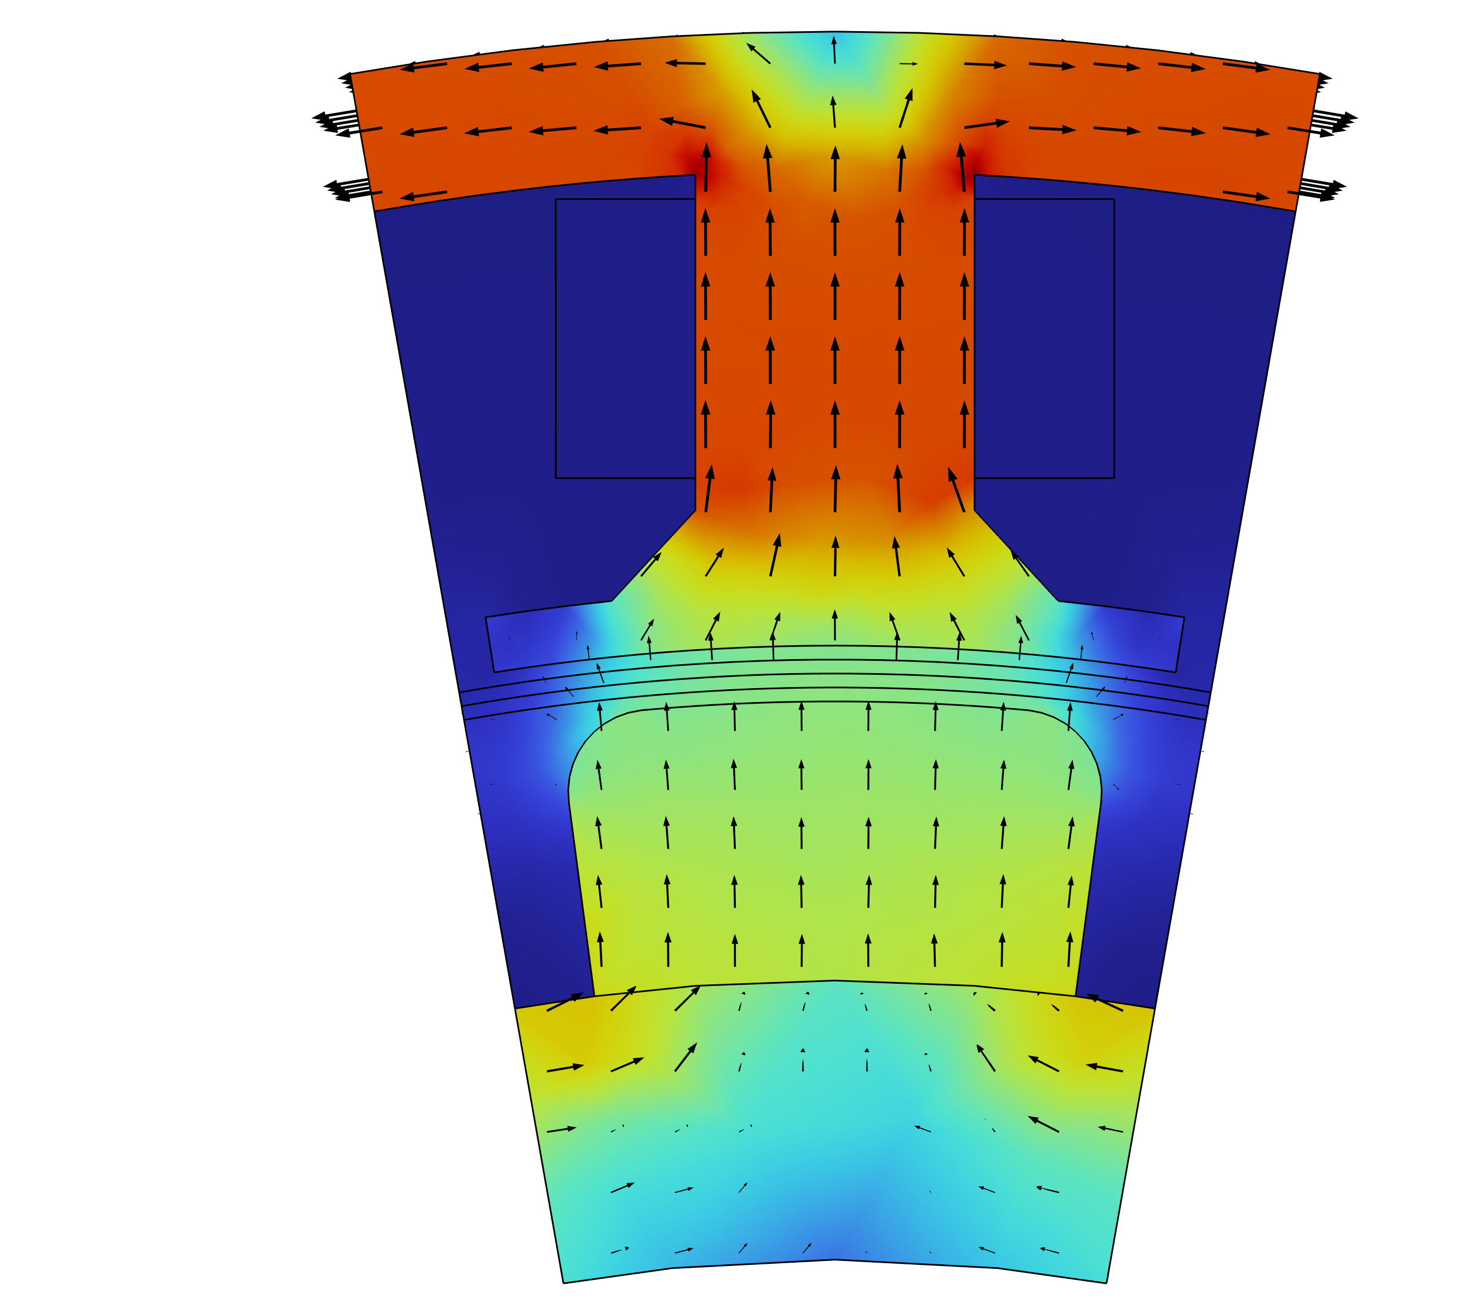
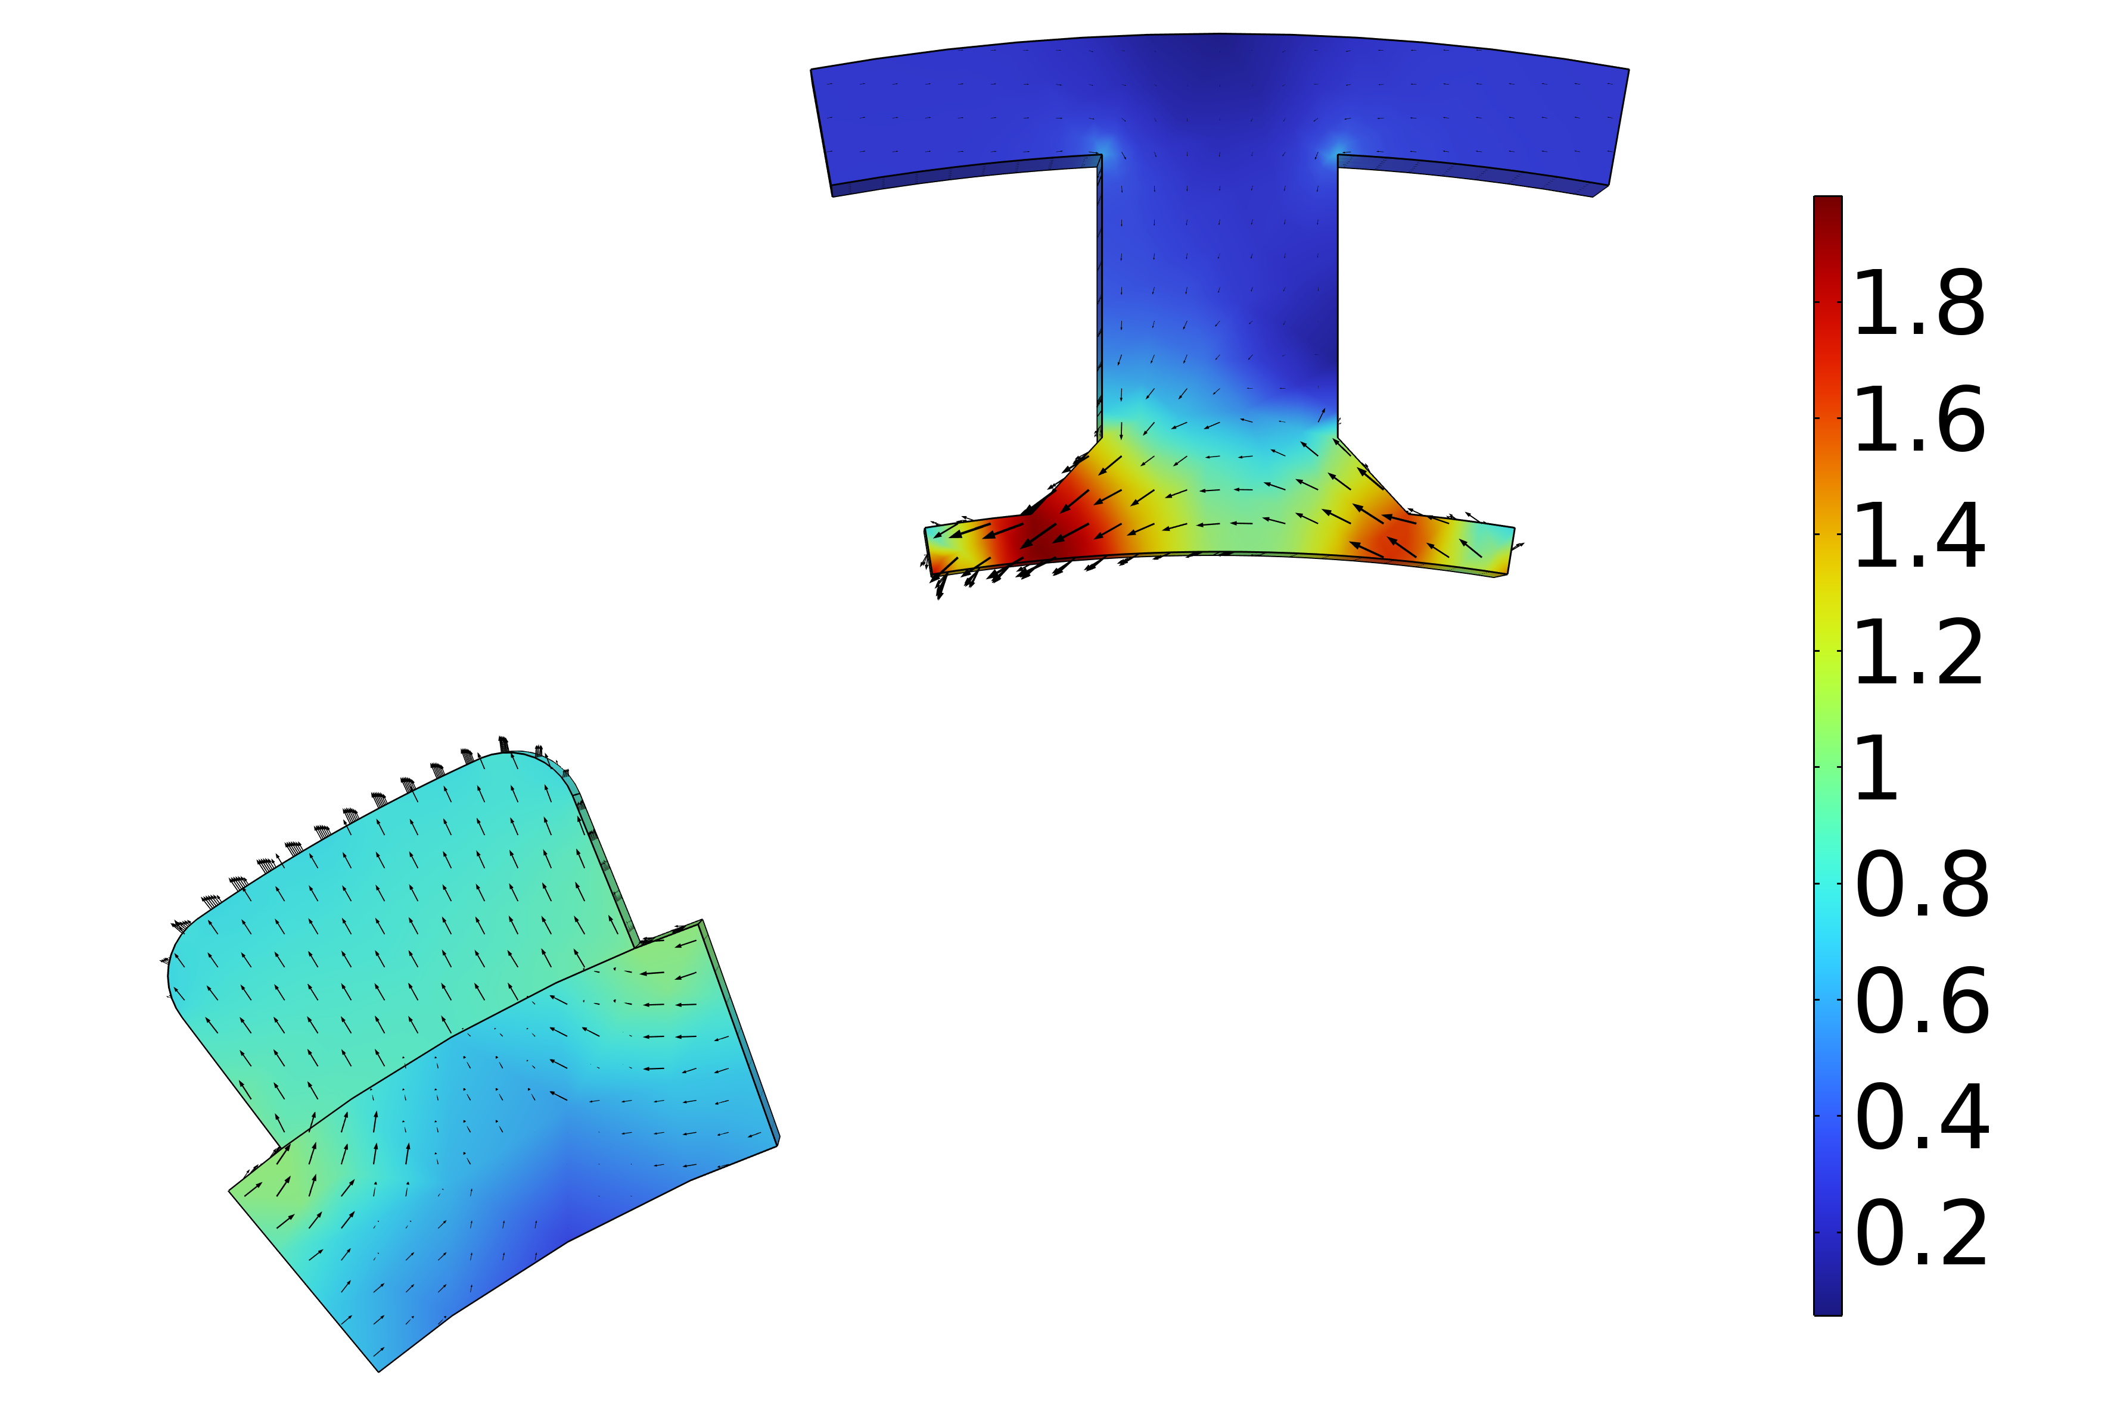

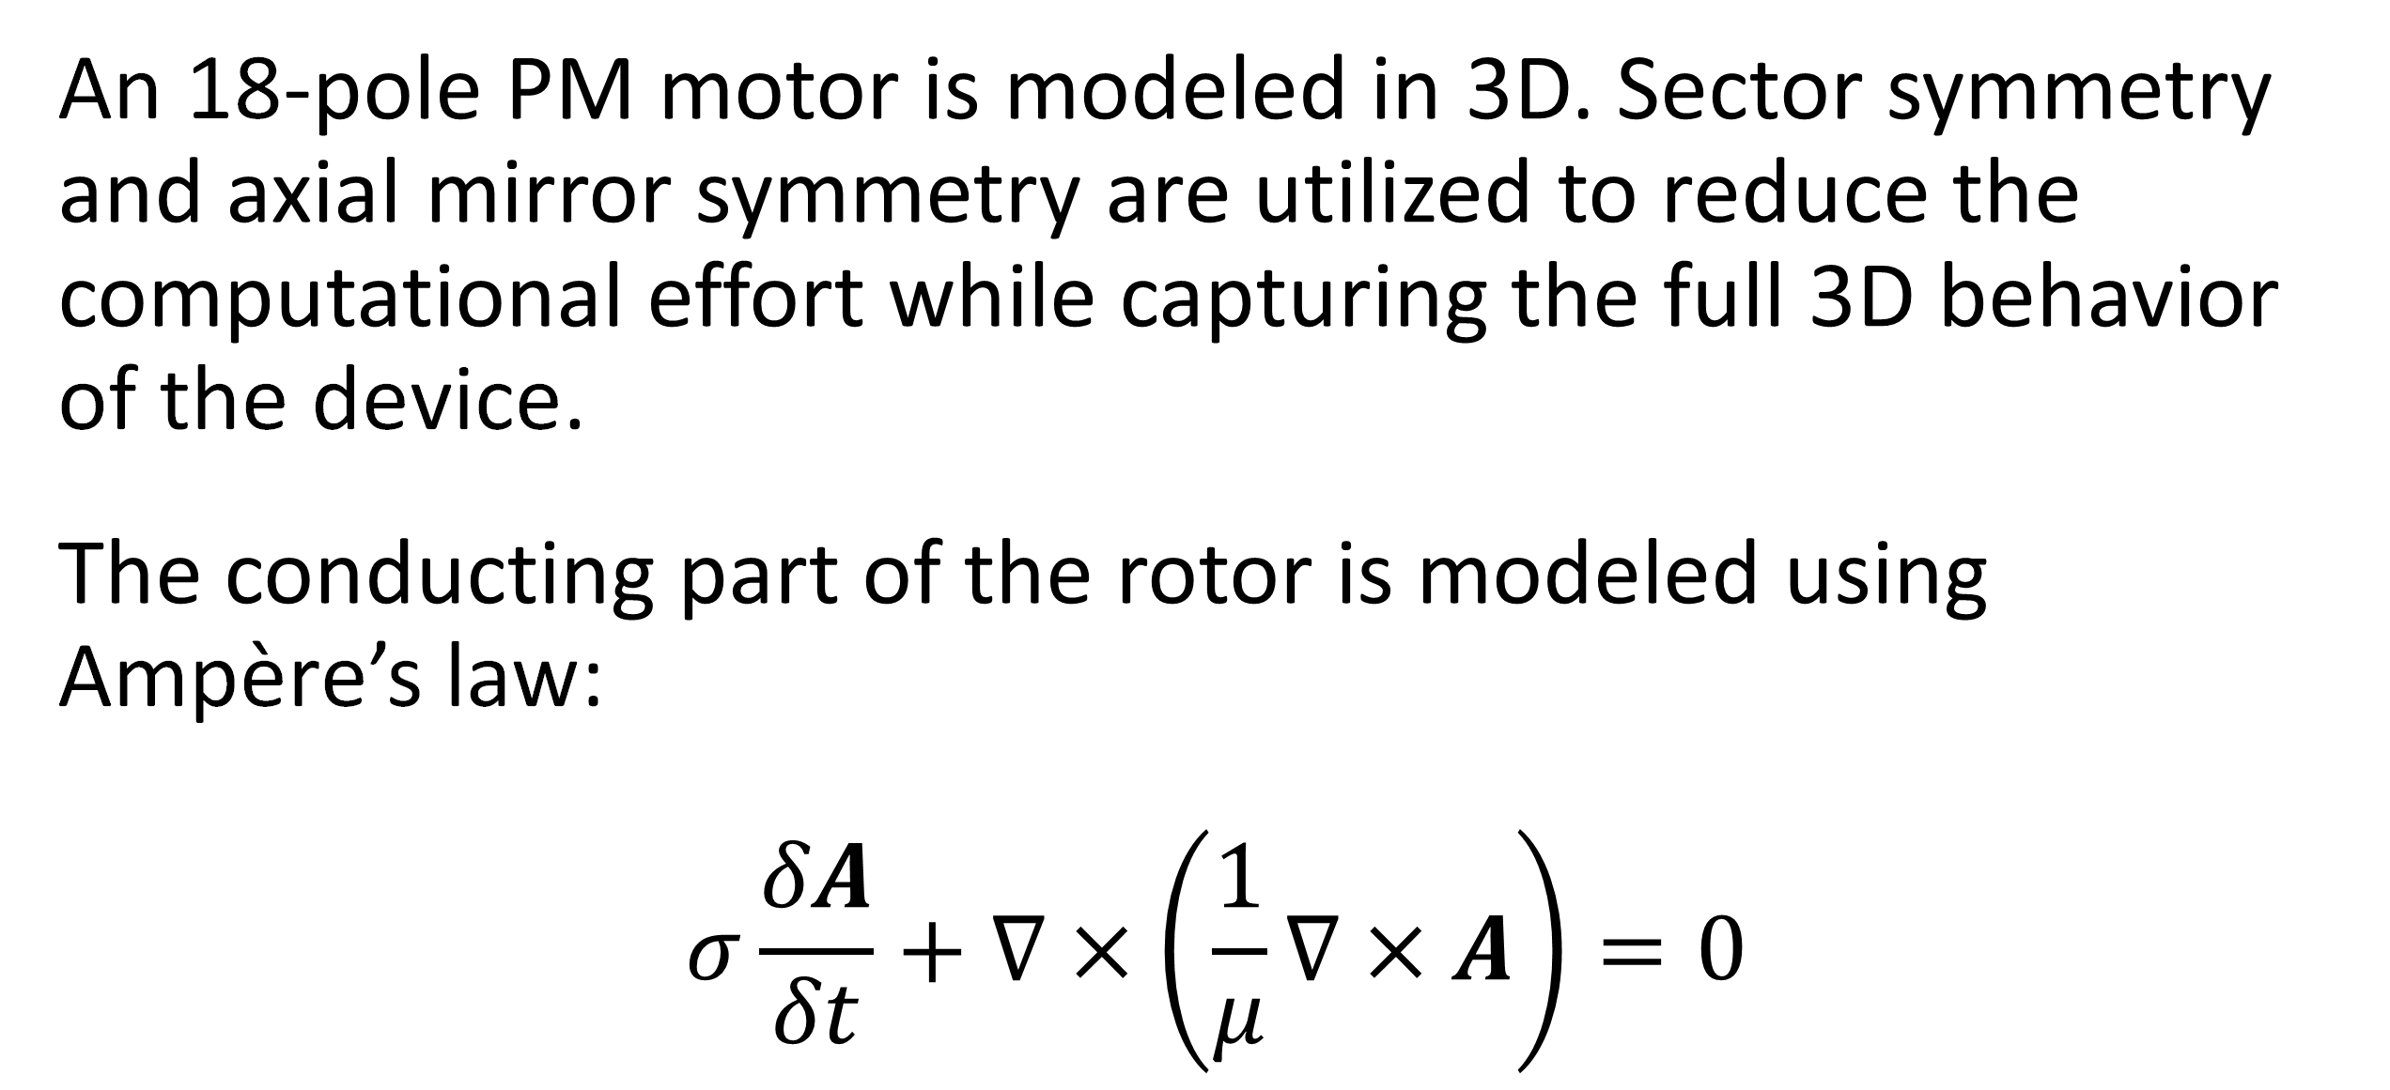
Analysis of a Permanent Magnet Motor in 3D
Optimize permanent magnet (PM) motor performance by understanding their full behavior, including sensitivity to high temperatures.
J. A. Smith¹, M. B. Smith²
1. Department (if applicable), Organization, City, Country.
2. Department (if applicable), Organization, City, Country.
Abstract
While PM motors are valued for the energy savings that they provide, there are some design limitations to address. For example, permanent magnets are sensitive to high temperatures. Such temperatures can occur when currents, particularly eddy currents, generate heat losses.
The findings offer greater insight into the behavior of PM motors, particularly by capturing the eddy current losses that occur within the magnets. This information serves as a useful resource for improving the design of PM motors, and therefore the technology they help power.
Methodology
An 18-pole PM motor is modeled in 3D. Sector symmetry and axial mirror symmetry are utilized to reduce the computational effort while capturing the full 3D behavior of the device.
The conducting part of the rotor is modeled using Ampère’s law:
$$σ\frac{δA}{δt}+∇×\left(\frac{1}{μ}∇×A\right)=0$$
FIGURE 1. Left: Permanent motor sector. Right: Drawing of the PM motor.
Results
The results can be seen in Figure 2, which shows the magnetic flux density for the motor in it’s stationary state, that is, the initial conditions for the time-dependent simulation. In this state, the coil current is zero. It also shows the magnetic flux density for the motor after revolving one sector angle. In this plot, the air and coil domains are excluded in order to get a better view.
FIGURE 2. Left: Magnetic flux density from the permanent magnets with only the rotor at rest. Right: Magnetic flux density after revolving one sector angle.
1. Author first initial and last name, “Article Title”, Journal, Volume (vol.), Page numbers (pp.), Year.
2. Author first initial and last name, “Article Title”, Journal, Volume (vol.), Page numbers (pp.), Year.
3. Author first initial and last name, “Article Title”, Journal, Volume (vol.), Page numbers (pp.), Year.

Slide 6
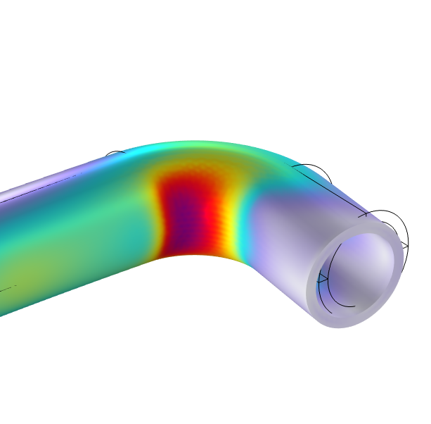
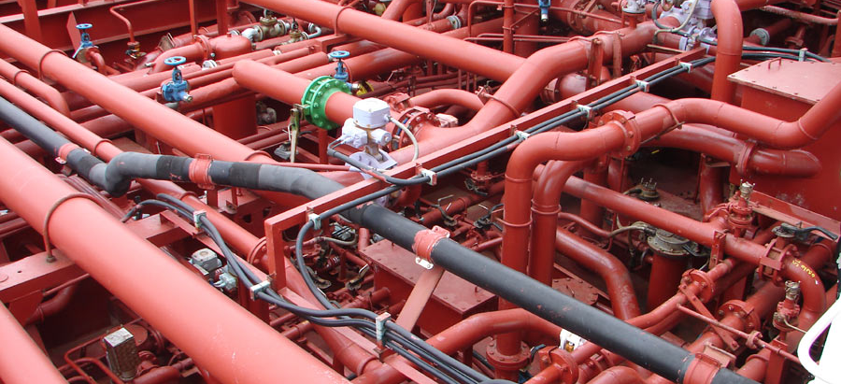
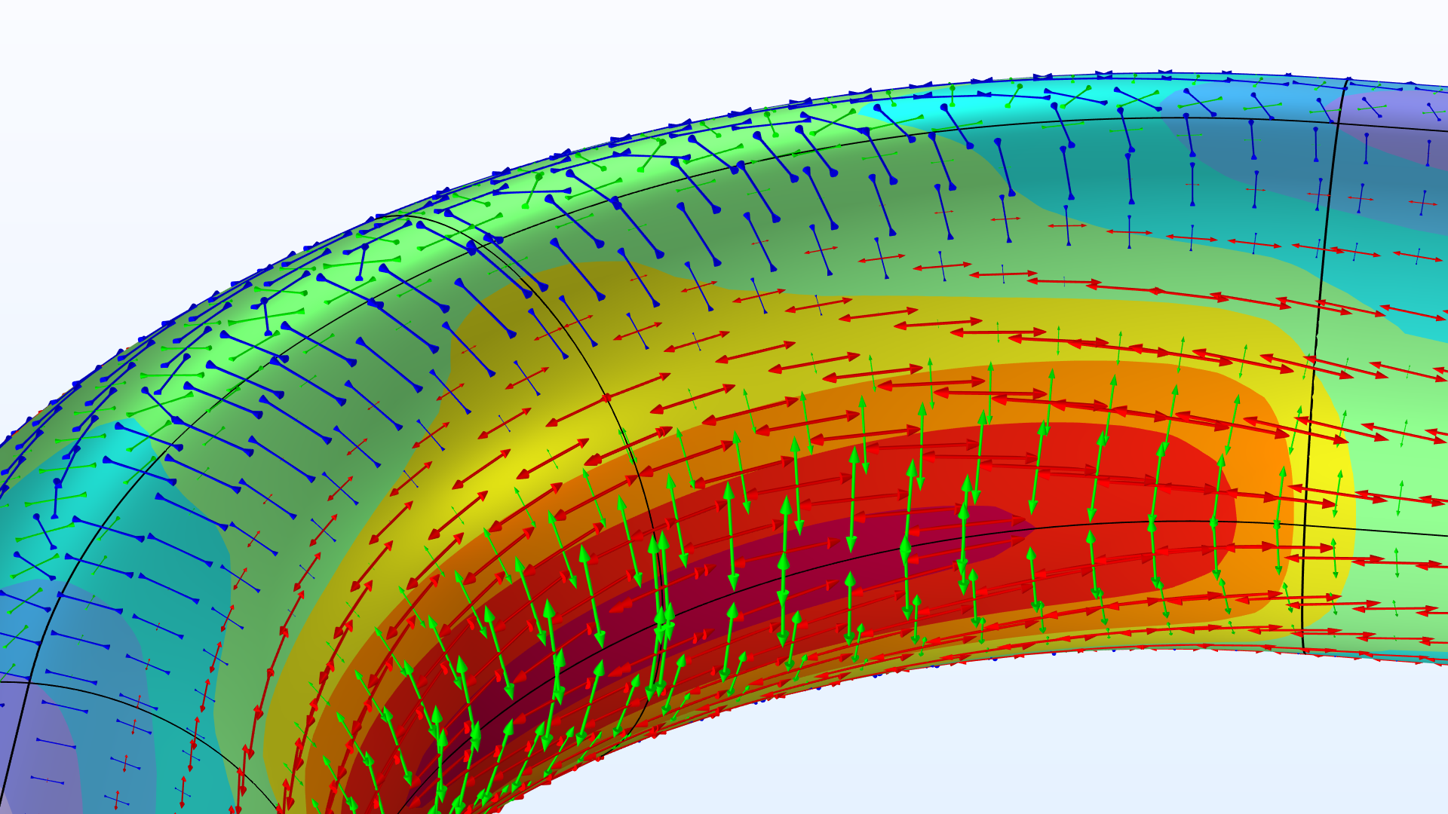
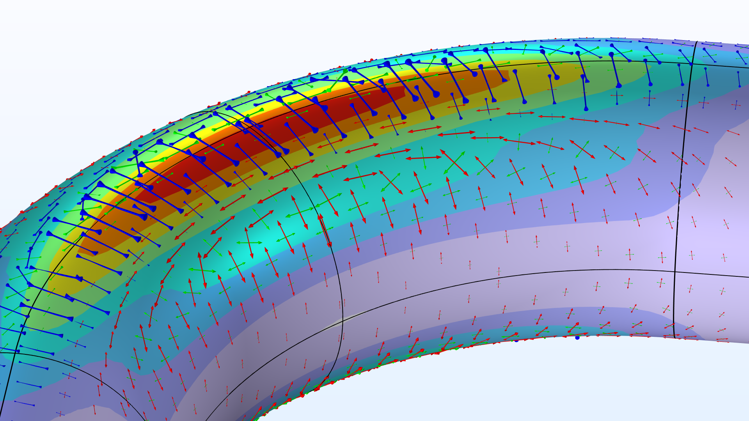
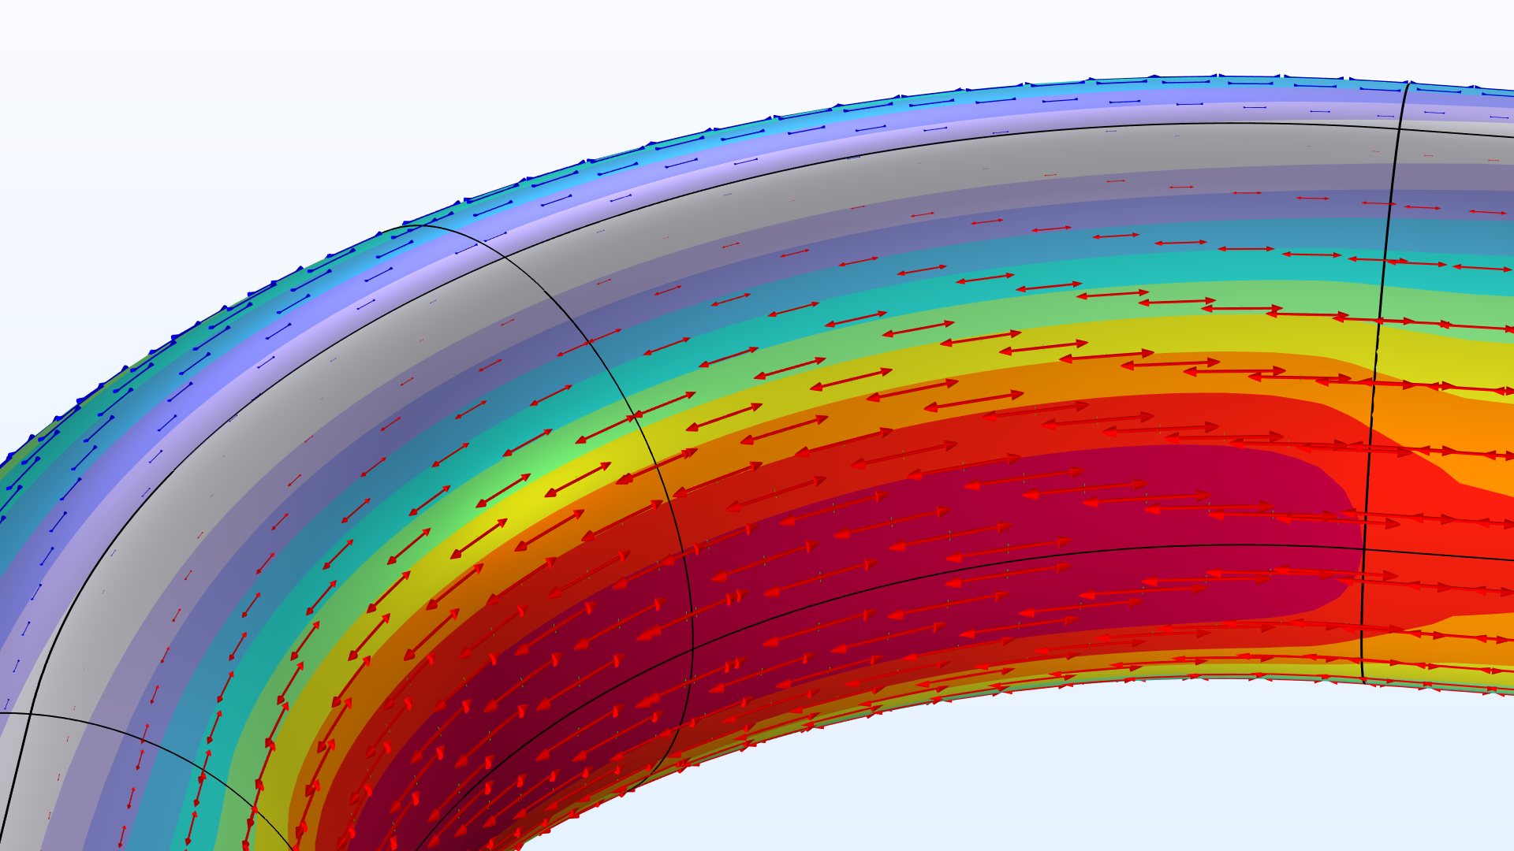
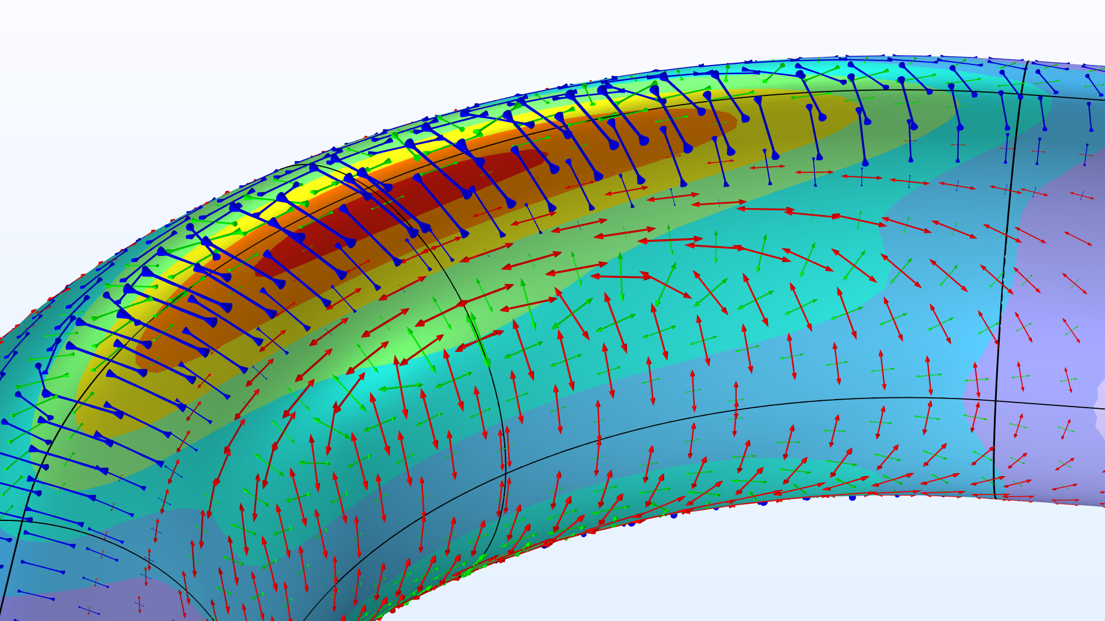
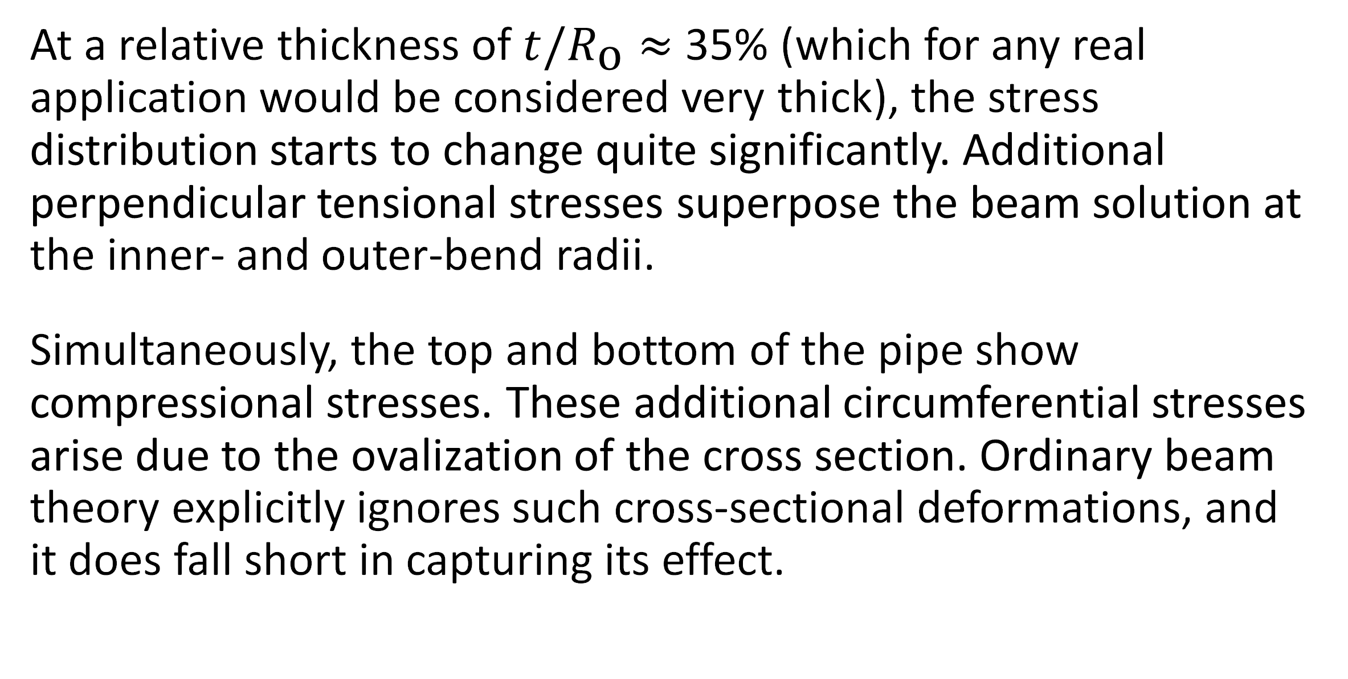
The Intriguing Stresses in Pipe Bends
For many structural engineers, beam theory is a popular analysis tool. Using the equations can be beneficial when considering structural behavior, as they are easy to apply and provide useful results. This work investigates one such case.
J. A. Smith¹, M. B. Smith²
1. Department (if applicable), Organization, City, Country.
2. Department (if applicable), Organization, City, Country.
Introduction & Goals
Pipe bends are common in piping systems, which typically transport liquids or gas, often under high pressure. One place where you may find a lot of pipes are oil tankers. The labyrinthine piping systems can look pretty fascinating.
Many piping standards (or codes) used for industrial applications are based on beam theory when it comes to the structural analysis. But, as we have already discovered, pipe bends generally do not behave like beams. When digging into piping standards, you will find a lot of information dedicated to pipe bends. In particular, piping standards recommend to apply correction factors to the stiffness and stresses for curved pipe sections. (Ref. 1)
Methodology
The pipe is slender with a constant cross section, so it would seem like a natural choice to treat such a structure as a beam in a simplified analysis. The bending moment is the only load acting on the structure, and it’s thus constant for any given section along the entire beam axis.
The maximum stress even occurs on the inside of the pipe. The cross section of the bend also deforms significantly, and, more specifically, it ovalizes with the major axis either being oriented in the bend plane or perpendicular to it depending on the direction of the bending moment.
FIGURE 1. Piping systems on an oil/chemical tanker. Image licensed under CC BY-SA 3.0 via Wikimedia Commons.
Results
At a relative thickness of $t/R_{\text{o}}≈$ 35% (which for any real application would be considered very thick), the stress distribution starts to change quite significantly. Additional perpendicular tensional stresses superpose the beam solution at the inner- and outer-bend radii.
Simultaneously, the top and bottom of the pipe show compressional stresses. These additional circumferential stresses arise due to the ovalization of the cross section. Ordinary beam theory explicitly ignores such cross-sectional deformations, and it does fall short in capturing its effect.
FIGURE 2. View of the pipe bend showing the von Mises stress (normalized) and principal stresses for different wall thicknesses.
E.A. Wais and E.C. Rodabaugh, “Background of SIFs and Stress Indices for Moment Loadings of Piping Components”, United States, 2005; https://www.osti.gov/biblio/841246
“Stress Intensification Factors (i-Factors), Flexibility Factors (k-Factors), and Their Determination for Metallic Piping Components”, ASME, 2017; https://www.asme.org/codes-standards/find-codes-standards/b31j-stress-intensification-factors-flexibility-factors-determination-metallic-piping-components/2017/drm-enabled-pdf

Slide 7
Metamorphic Core Complex Evolution in the American Southwest (backup, don’t edit)
Can we create conditions favorable for metamorphic core complex development using only high topography, gravitational potential energy, and a weak layer in the lower crust?
Ilana S. Bromberg₁, Lucy M. Flesch₁, Saad Haq₁, Christopher M. Calvelage₂, William E. Holt₃, Alireza Bahadori₄
1.Purdue University, 2. Earthscope Consortium, 3. Stony Brook University, 4. Springer Nature
Introduction
The Basin and Range Province spans from southern Idaho to northern Mexico and is known for its unique topography characterized by sharp changes in elevation and long strings of parallel alternating basins and mountain ranges. A feature relatively unique to this region are metamorphic core complexes (MCCs); these are large areas of metamorphic rock adjacent to sedimentary rock, indicating uplift of the lower crust towards the surface. While there is general agreement that these MCCs can be used as proxies for lower crustal flow and extension at the surface, there is controversy surrounding which physical factors are most influential on the development of these features. When considered on a time scale of millions of years, rock can be approximated as a slow-moving fluid due to the high viscosities at play; to that end, COMSOL's creeping flow is used to set the physics for the instantaneous state and a moving mesh is used to evolve it through time. Through our models, we sought to determine the importance of various viscosity profiles and boundary conditions on MCC development.
Nevadaplano
Colorado
Plateau
Rio Grande
Rift
Methods
17.0 Ma
The model is carved out from a spherical shell using pre-calculated paleotopography and crustal thickness, with assigned viscosity and density profiles loaded in. The crust is then split into two domains to approximate the upper and lower crust. The parameter space examined is the strength (viscosity) of the lower crust, and the ratio of strength between the upper crust and the mantle. A best fit model was chosen by comparing model outputs to known physical limitations.
The instantaneous physics is computed using Stokes flow:
16.5 Ma
16.0 Ma
Velocity (mm/yr)
Figure 1: Cross section A, showcasing the collapse of the Nevadaplano and lateral movement in the lower crust in areas of known core complex formation.
Results
By seeding particles along the boundary between the upper and lower crust and tracing them through the duration of the model, we can examine how material in the lower crust moves over time in relation to the topography.
We found that the extension and uplift necessary for metamorphic core complex formation can be created solely with the inclusion of a weak layer in the lower crust and the impact of gravity acting on high topography, even without inclusion of tectonic plate motion velocity boundary conditions.
Figure 2: exhumation and strain (clean up plots, add CCs to strain, move arrow key, etc)

