Slide 1
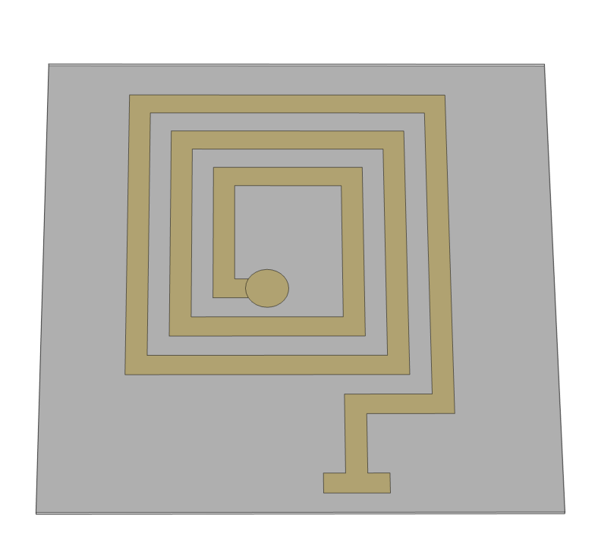
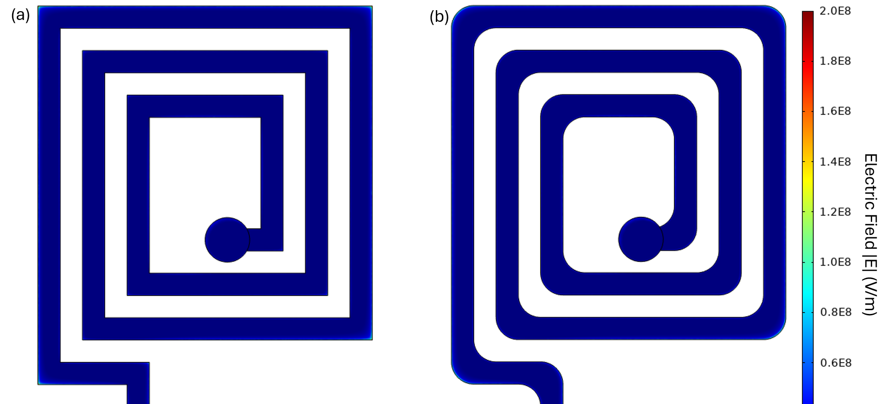
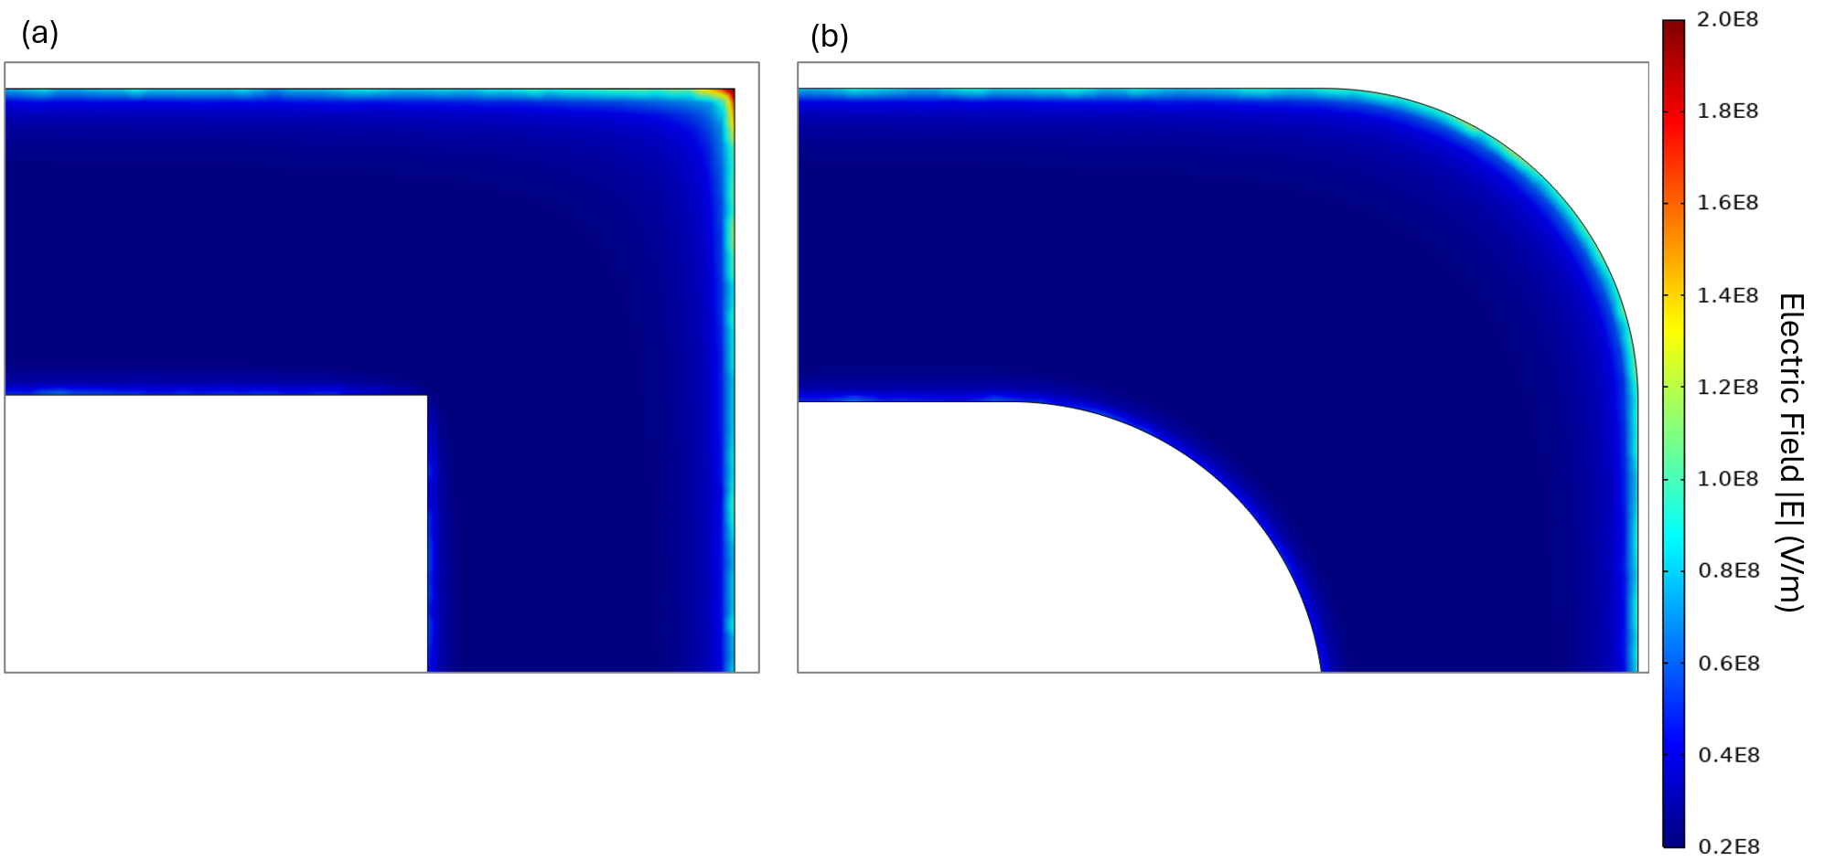

Geometry Induced Electric Field Enhancement in Printed Circuit Board
Investigate electric field enhancement due to geometry effects and improve the design of the trace at critical locations to enhance the device electrostatics discharge (ESD) immunity.
Susan Han, Ph.D., CFEI
Electrical Engineering and Computer Science Practice, Exponent, Inc.
Abstract
Printed circuit boards (PCBs) incorporating a single layer of copper traces are commonly used to route power and signals to light-emitting diodes (LED). These boards were evaluated using the 15 kV air discharge test in according to IEC 61000-4-2 Electromagnetic compatibility (EMC) - Part 4-2: Testing and measurement techniques - Electrostatic discharge immunity test. Testing revealed ESD-induced damage concentrated near a specific region of the copper traces.
To investigate the failure mechanism, finite element simulations were performed using COMSOL Electrostatics module to model the electric field distribution on the PCB when subject to 15 kV. Electric field strengths at multiple locations along the traces were compared to identify regions experiencing enhanced electric field. The simulation showed that the highest electric field strength occurred at trace corners, consistent with the observed locations of the ESD damage.
Methodology
The copper trace was grounded while being placed adjacent to a 15 kV electric potential. The Electrostatics (es) in the AC/DC module is used to solve the electric field distribution in the copper traces.
The above geometry was placed in air domain. Free Triangular was used to mesh the planar copper trace. The remaining of the geometry was meshed with Free Tetrahedral.
Figure 1. Electric field distribution in the (a) original copper trace, and (b) modified copper trace geometry with 0.5 mm fillet.
Results
The COMSOL simulation was subsequently used to evaluate alternative trace geometries and their corresponding electric field distributions. The results were compared to the original geometry.
Concentration of electric field, approximately 2 × 10⁸ V/m, at the outer vertex of a representative corner in the trace was observed in the original geometry. The corner was replaced with a 0.5 mm radius fillet. The calculated electric field was reduced to approximately 1 × 10⁸ V/m around the original corner. An alternative trace design can be developed to reduce electric field concentration at critical locations and enhance the ESD immunity of the PCB.
Figure 2. Electric field distribution at one of the corners in the (a) original copper trace geometry showing concentration of electric field, and (b) modified copper trace geometry with 0.5 mm fillet, showing reduced concentration of electric field.
IEC 61000-4-2:2025. Electromagnetic compatibility (EMC) - Part 4-2: Testing and measurement techniques - Electrostatic discharge immunity test.
Dahak and Bendaoud, Experimental Study and Simulation of Electrostatic Discharge (ESD) in PCB. J. of Electrical Engineering 17 (1): 205-210.

