Slide 1
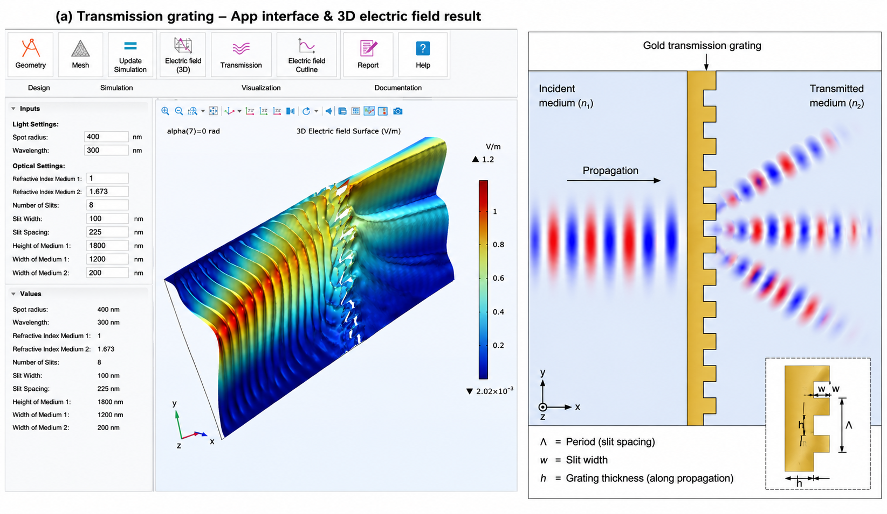
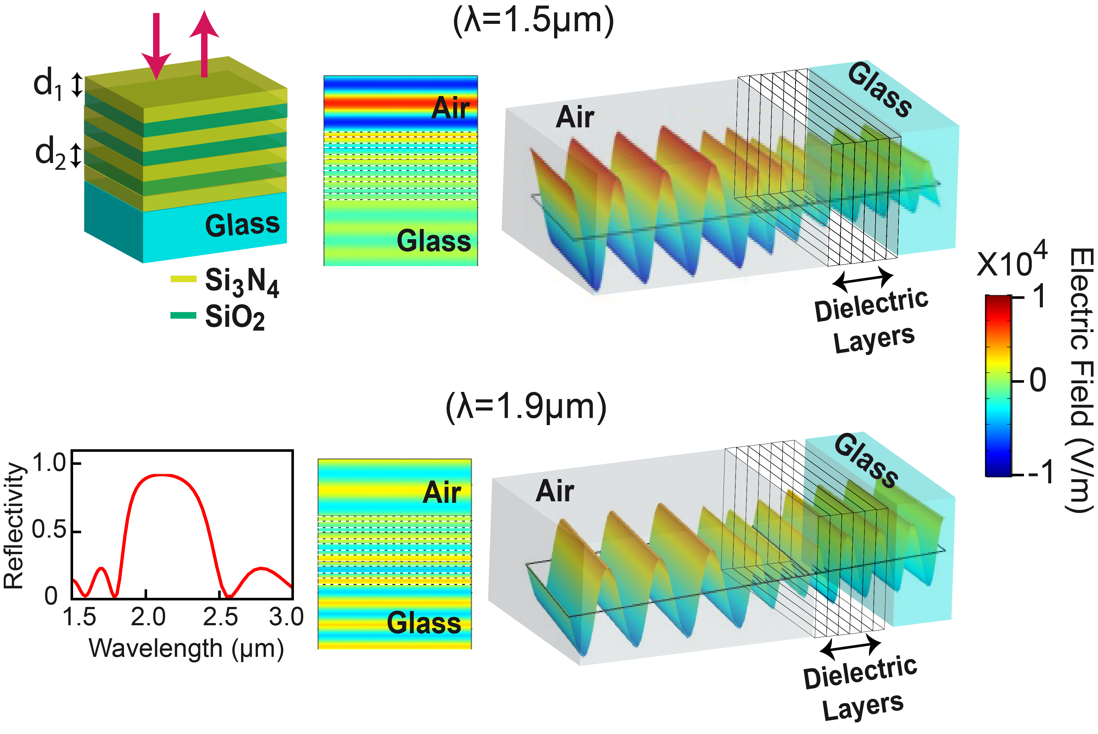
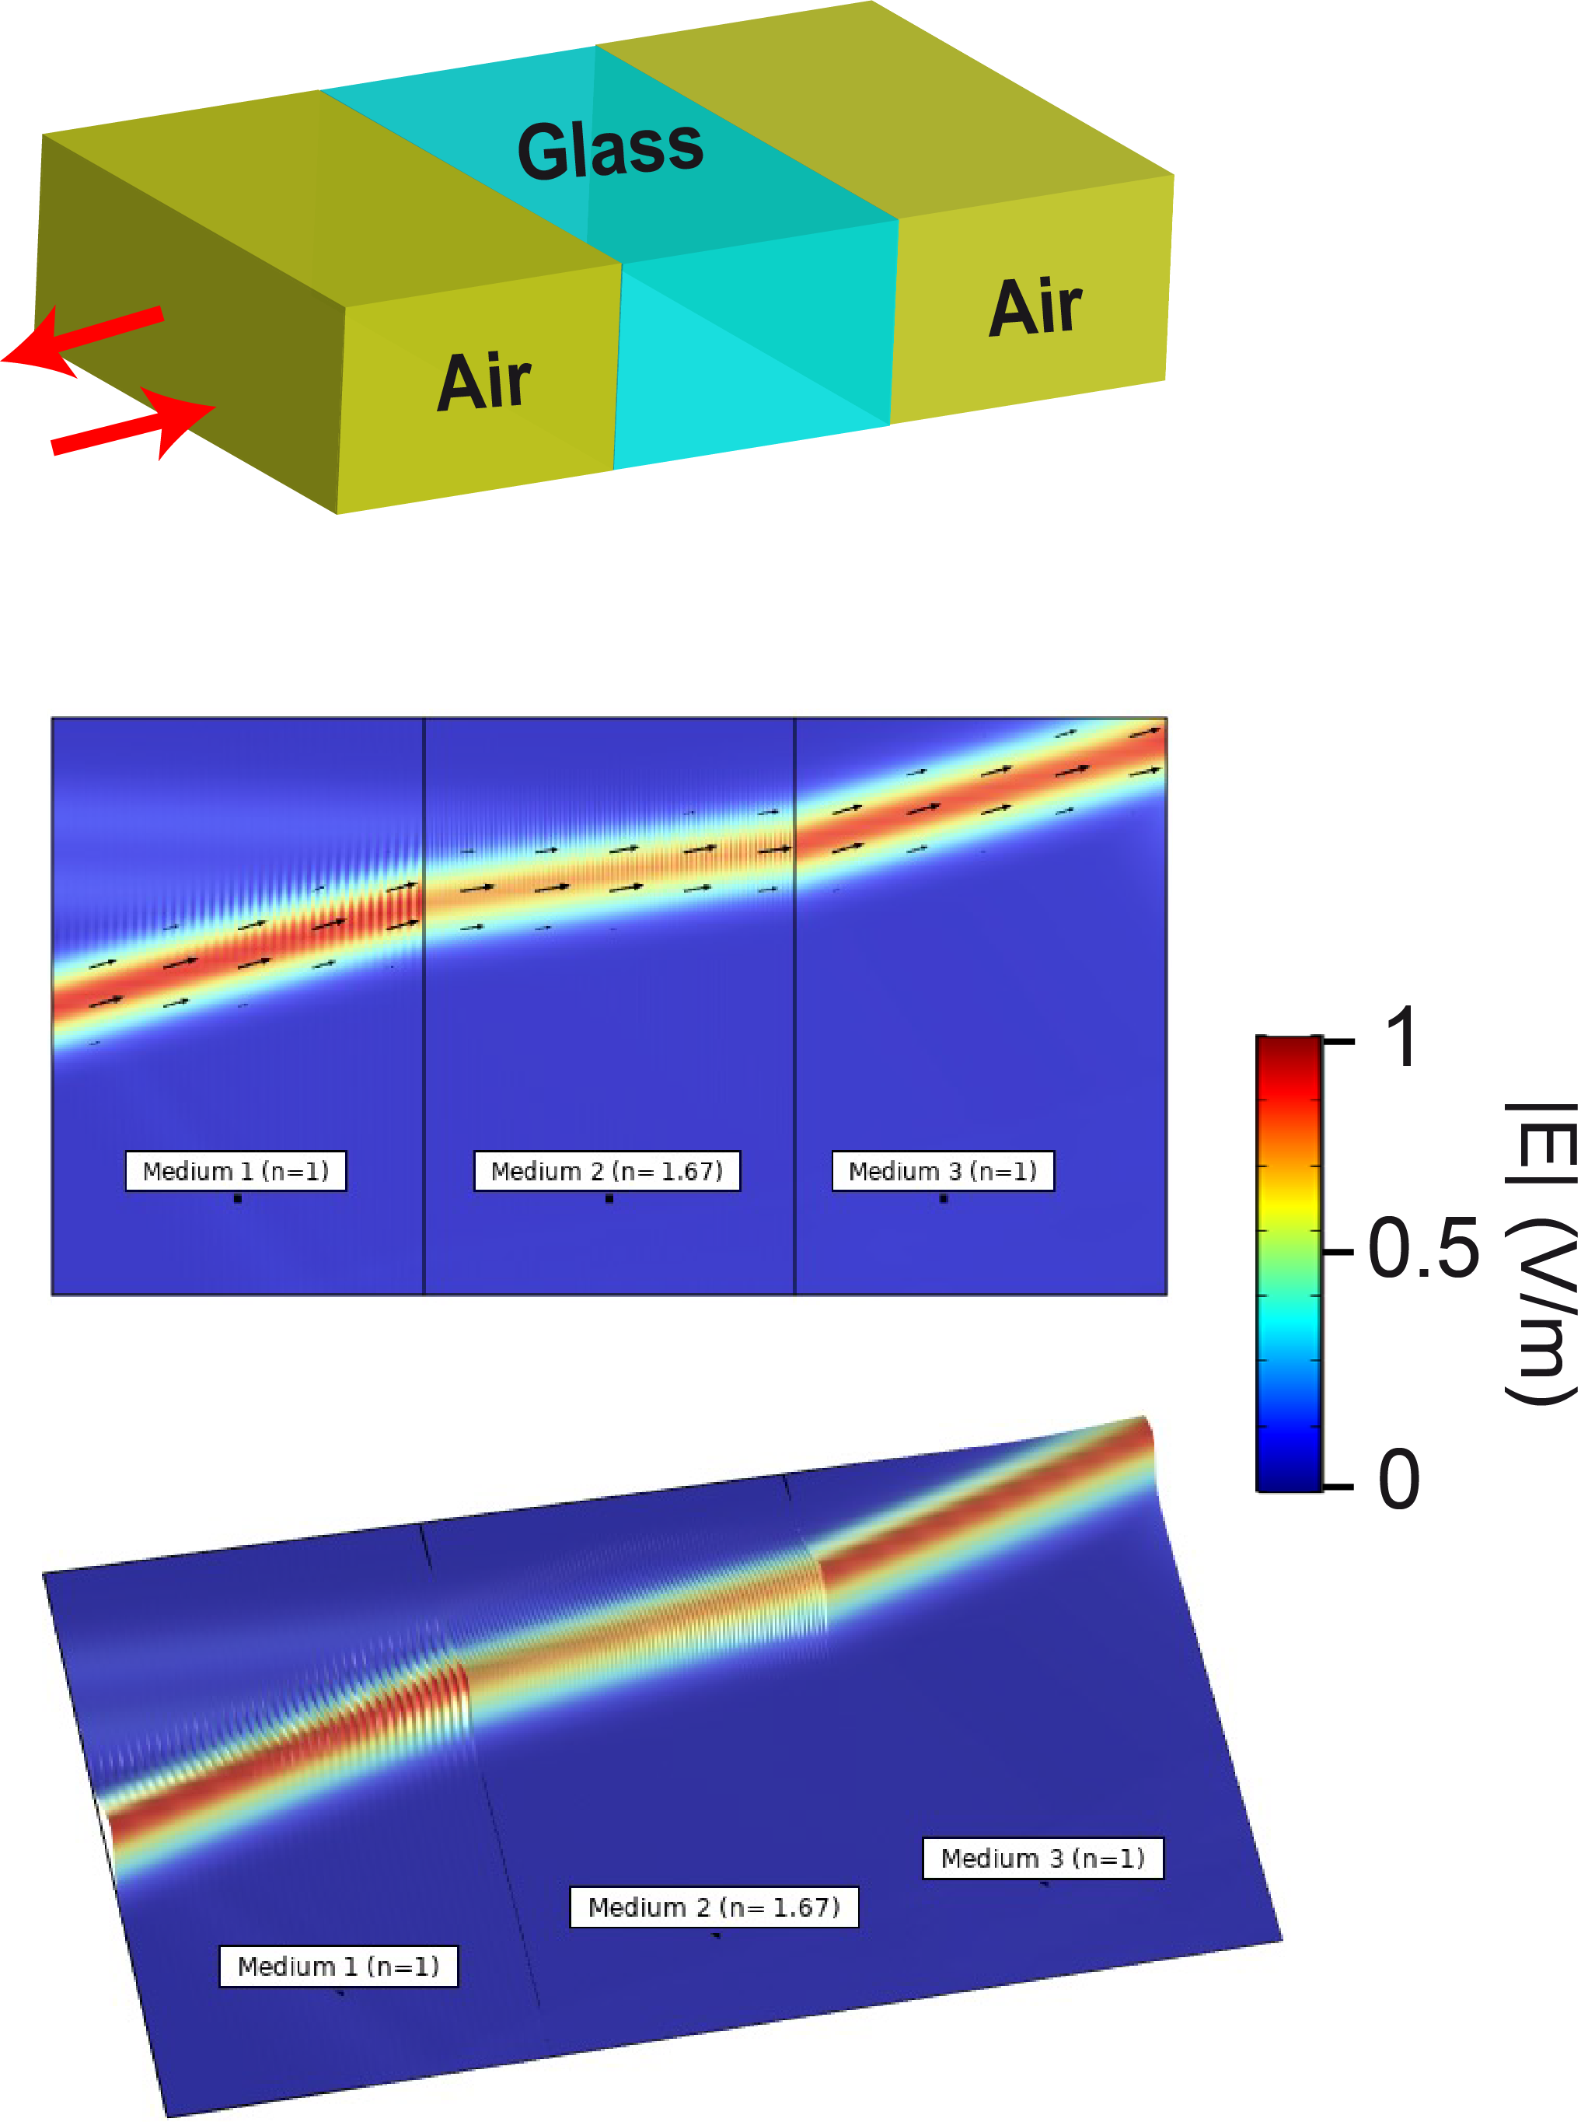
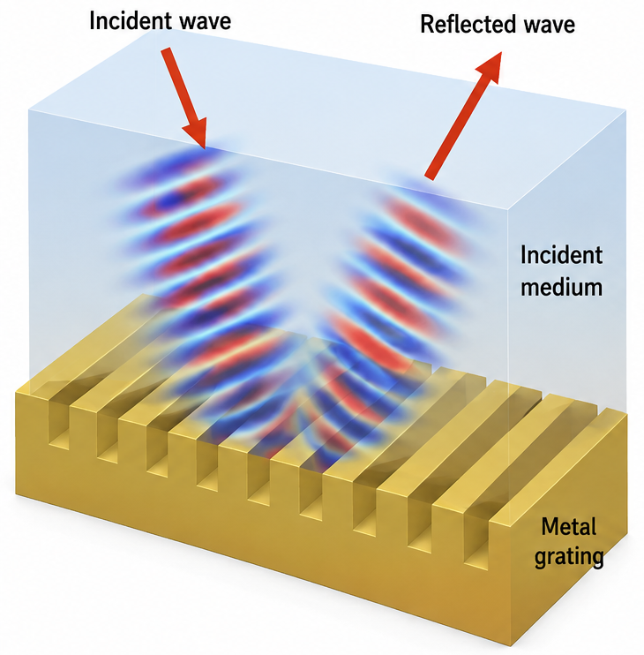
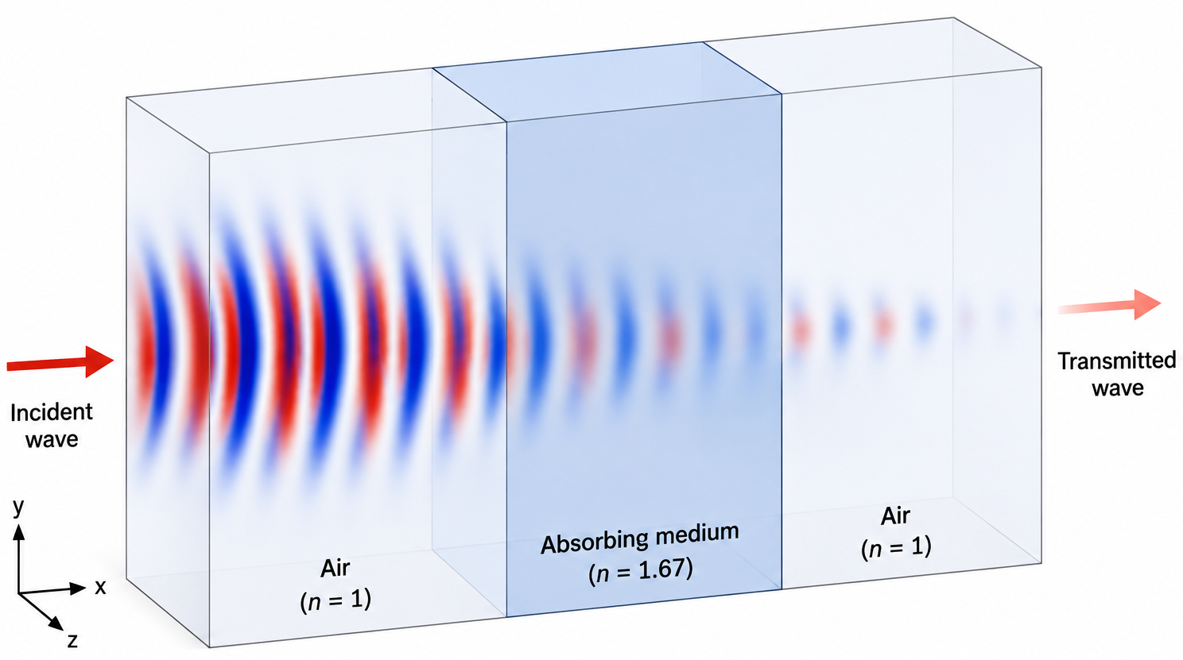
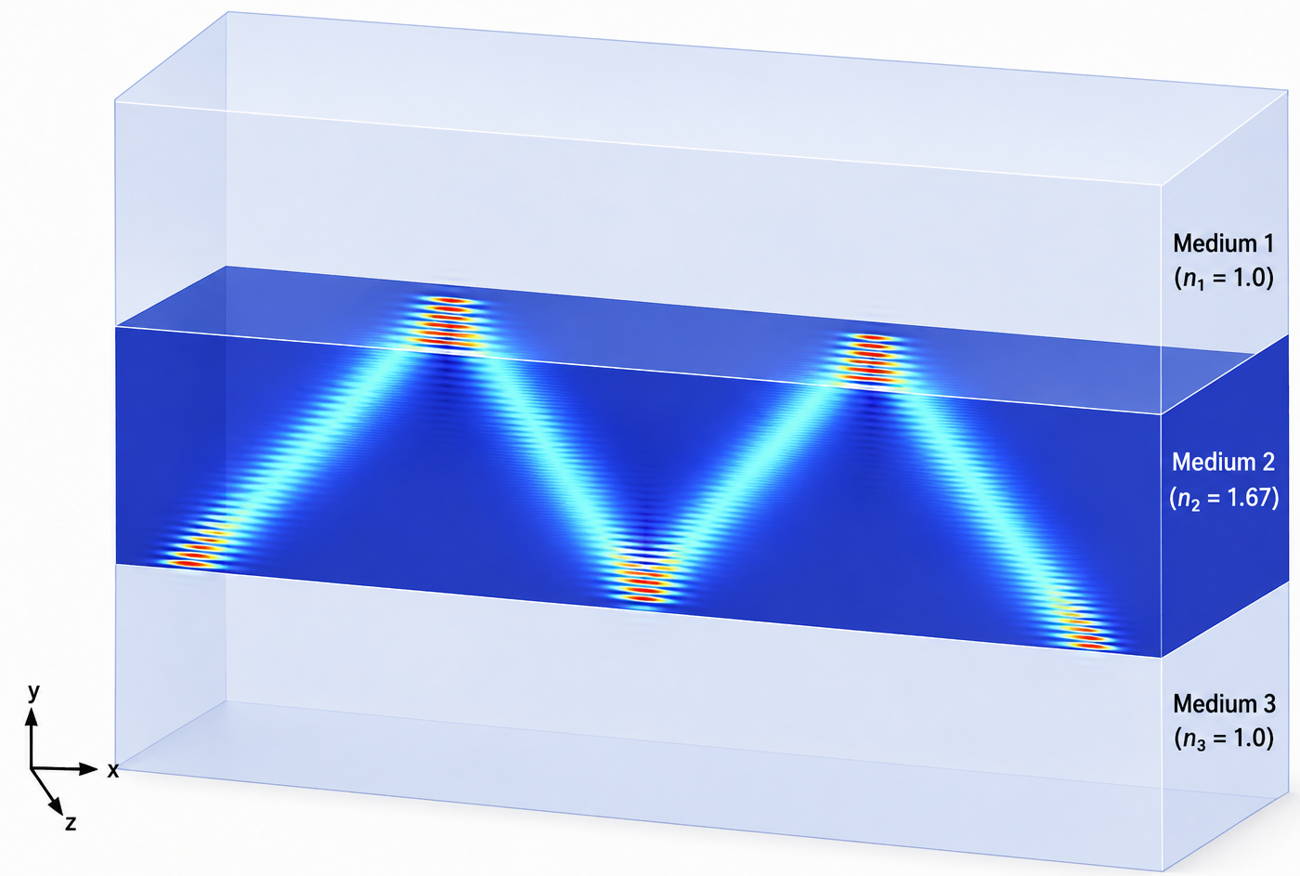
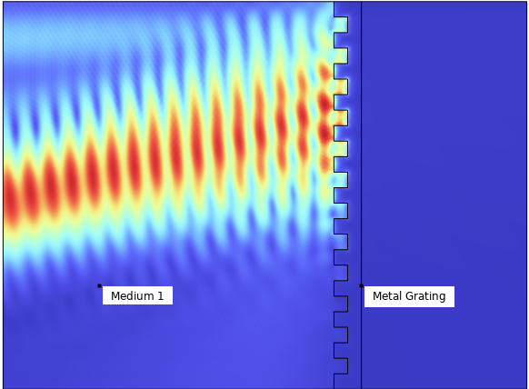
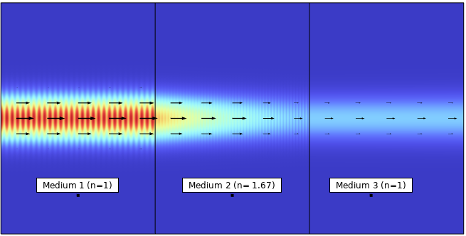
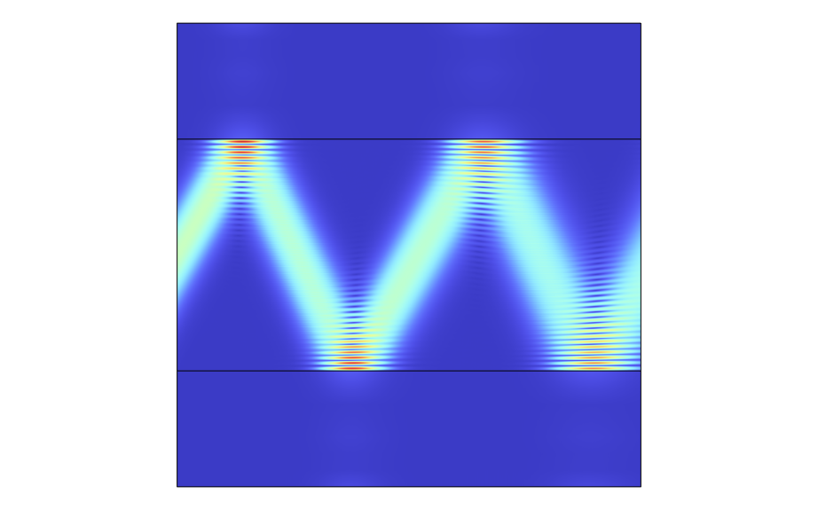
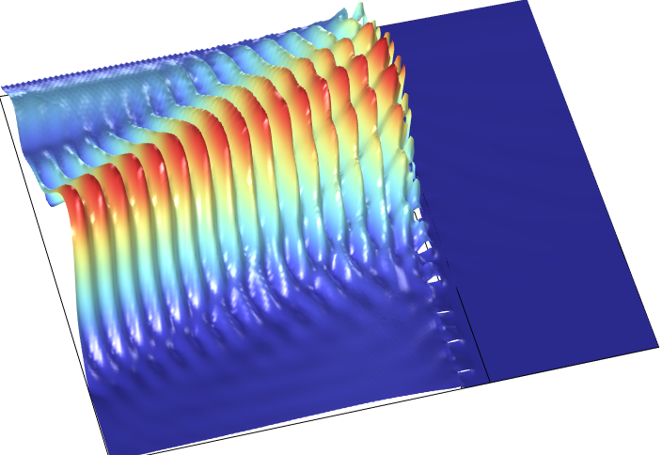
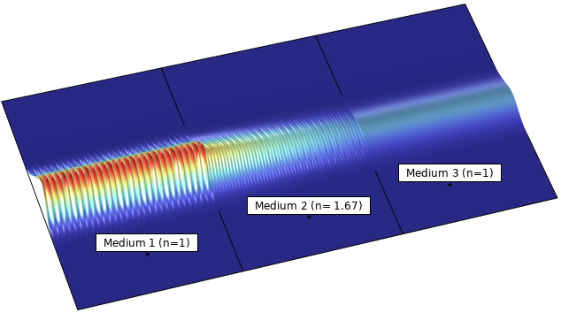
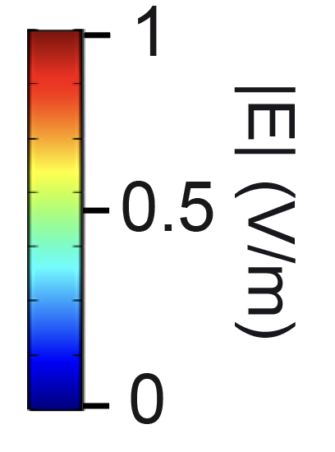
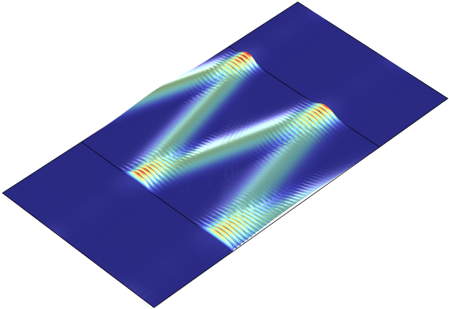


Interactive COMSOL Server™ Apps for Visualizing Fundamental Optics Concepts and Active Learning
This project develops interactive COMSOL Server™ apps to visualize fundamental optics concepts and support active learning. Students can vary key parameters and immediately observe changes in optical behavior.
Collin Cole¹, Raj K. Vinnakota¹, Sai Radavaram², and Shaimum Shahriar¹
1. Electrical and Electronics Engineering, Troy University, Troy, USA.
2. Electrical and Computer Engineering, Utah Tech University, St. George, USA.
Abstract
Fundamental optics concepts can be difficult for students to visualize using analytical equations and static diagrams alone [1].
We developed a suite of interactive COMSOL Server™ applications for reflection, refraction, total internal reflection, absorption, thin-film optics, interference, and diffraction.
The apps allow students to vary optical and geometric parameters and immediately visualize changes in electromagnetic-field distributions and wave behavior.
The models were converted into user-friendly applications using Application Builder and deployed through COMSOL Server™ for browser-based access.
Representative activities include verifying Snell’s law, identifying critical-angle behavior, examining optical attenuation, and studying interference and diffraction [1,4].
By connecting analytical theory with interactive numerical simulation, these applications support active learning, student engagement, and improved conceptual understanding [2–4].
Methodology
Optical models were developed in COMSOL Multiphysics® using the Wave Optics Module, employing Frequency Domain or Beam Envelopes interfaces as appropriate.
Maxwell’s equations were solved to simulate light propagation, reflection, transmission, absorption, interference, and diffraction. Key parameters such as wavelength, refractive index, incidence angle, layer thickness, slit spacing, and grating period were varied to study their effects on optical behavior.
The models were converted into interactive apps using COMSOL Application Builder and deployed through COMSOL Server™ for browser-based student use.
(a)
(b)
Fig 1. Electric-field visualizations from the interactive optics applications: (a) field distribution in a multilayer dielectric mirror and (b) wave propagation and refraction across dielectric interfaces.
Results
(a)
(b)
(C)
The apps successfully visualize electromagnetic-field distributions and optical energy propagation for a range of fundamental optics phenomena.
The absorption model demonstrates progressive attenuation of the optical field as light propagates through a lossy medium.
Refraction and total internal reflection apps clearly illustrate beam bending, critical-angle behavior, and field confinement at dielectric interfaces.
Anti-reflecting coating and dielectric-mirror models show how refractive index and layer thickness influence reflection and transmission.
Grating simulations reveal scattering, diffraction, and constructive and destructive interference patterns, allowing students to explore geometry-dependent optical behavior.
Fig 2. Light interactions from the interactive optics applications: (a) reflection grating, (b) optical absorption, and (c) total internal reflection.
[1] K. Matejak Cvenic et al., “Probing high school students’ understanding of interference and diffraction of light using standard wave optics experiments,” Phys. Rev. Phys. Educ. Res., 19, 020118 (2023).
[2] S. Freeman et al., “Active learning increases student performance in science, engineering, and mathematics,” PNAS, 111, 8410–8415 (2014).
[3] K. Perkins et al., “PhET: Interactive Simulations for Teaching and Learning Physics,” The Physics Teacher, 44, 18–23 (2006).
[4] N. D. Finkelstein et al., “When learning about the real world is better done virtually: A study of substituting computer simulations for laboratory equipment,” Phys. Rev. ST Phys. Educ. Res., 1, 010103 (2005).
NSF Award No. DUE-2417383

