Slide 1
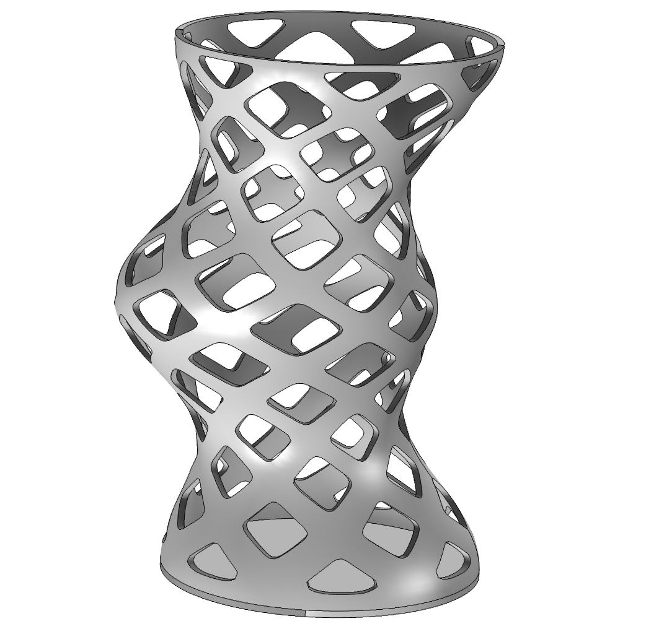
Field-Driven Design of a Pencil Holder

Slide 2
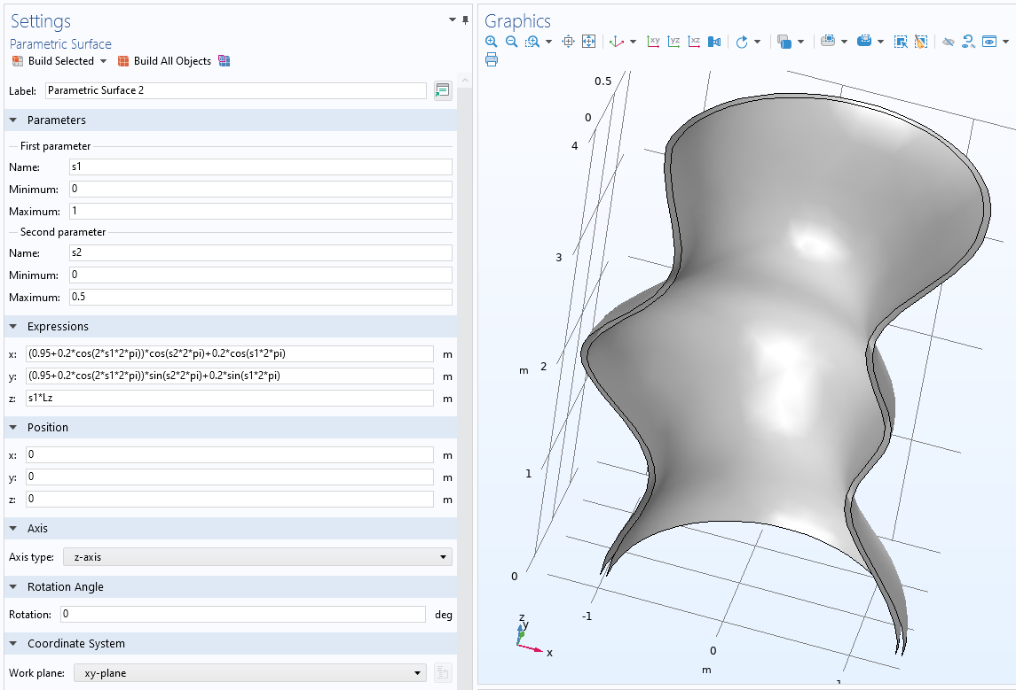
Field-Driven Design of a Pencil Holder
Geometry
Six parametric surfaces are used to construct a domain
The rest of the geometry construction is done based on equation-based modeling
Field-Driven Design of a Pencil Holder

Slide 3
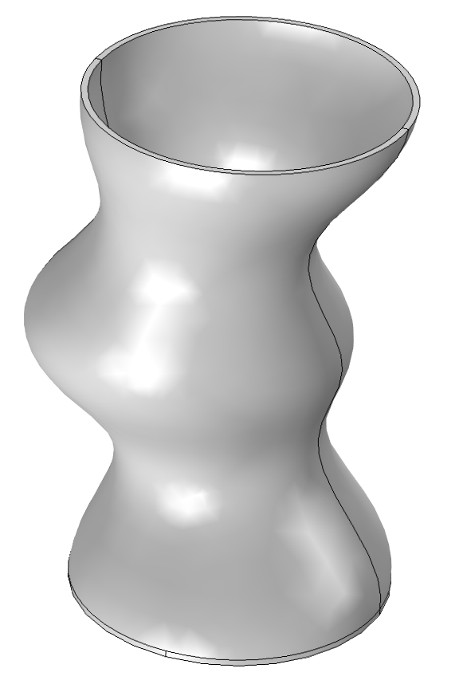
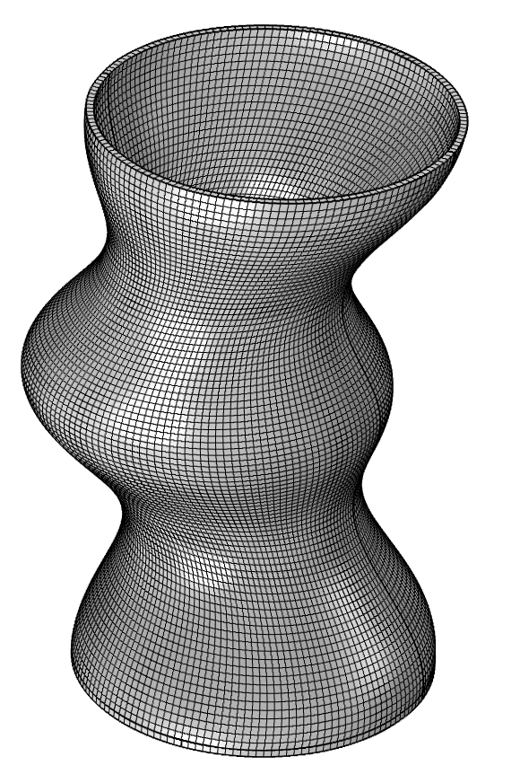
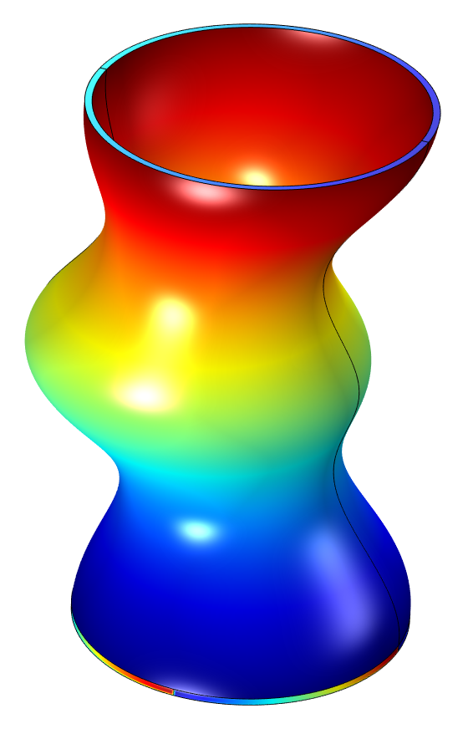
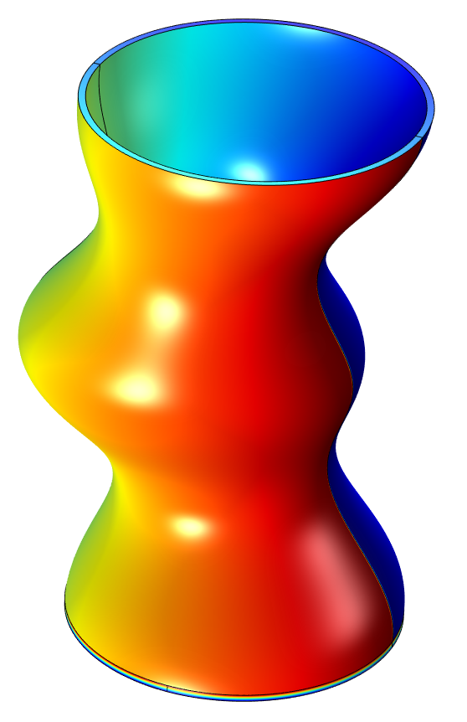
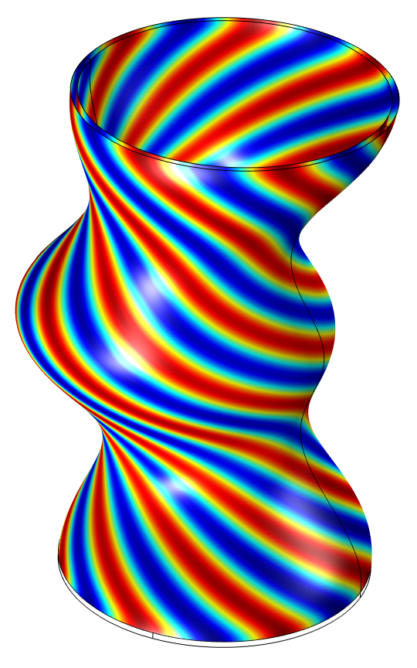
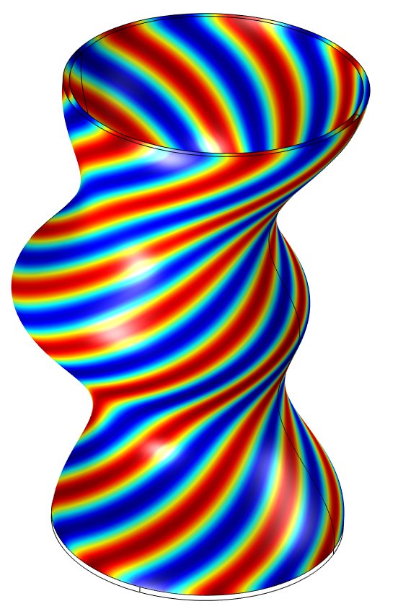
EQUATION-BASED MODELING
Field-Driven Design of a Pencil Holder
Mesh
s1
s2
u3
u4
+
=
+
The geometry is meshed by extruding a mapped mesh.
The s1 and s2 parameterization will be rotated and modulated to the u3 and u4 parametrization.
Field-Driven Design of a Pencil Holder

Slide 4
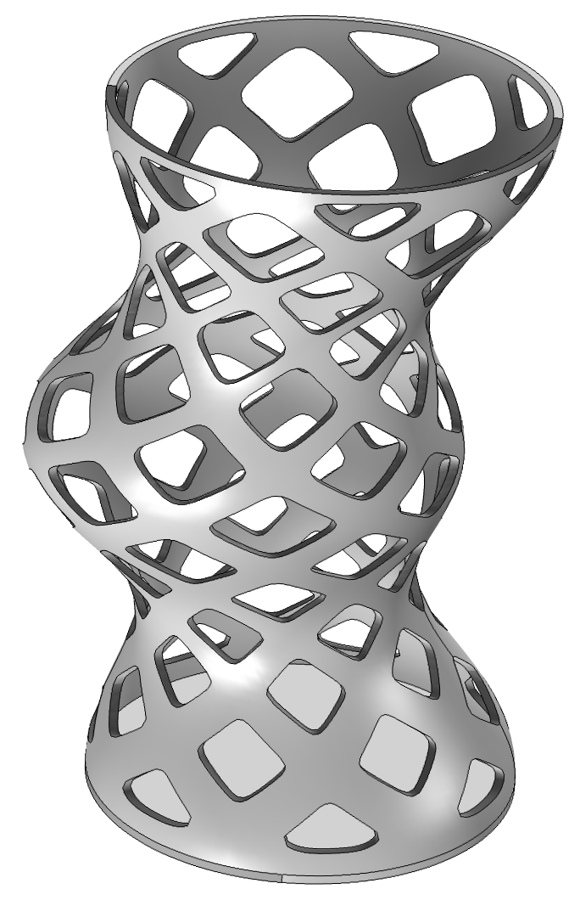
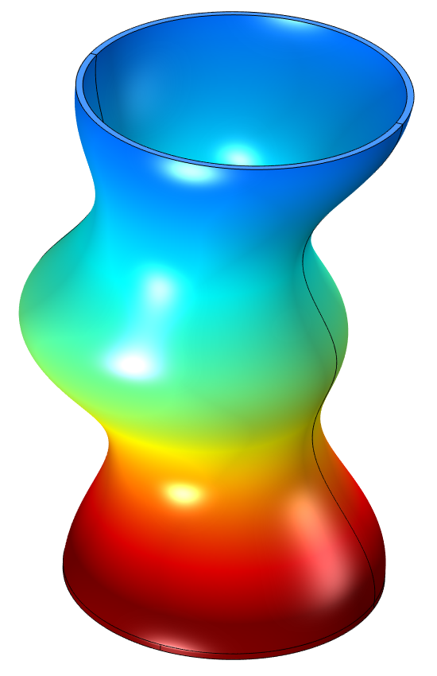
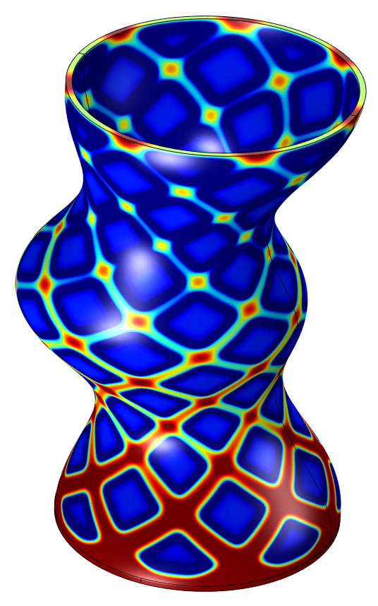
EQUATION-BASED MODELING
Field-Driven Design of a Pencil Holder
u3
u4
+
+
=
Then u3 and u4 are combined with a function varying in the vertical direction.
The final field is thresholded and imported as a mesh part.
Field-Driven Design of a Pencil Holder

