Slide 1
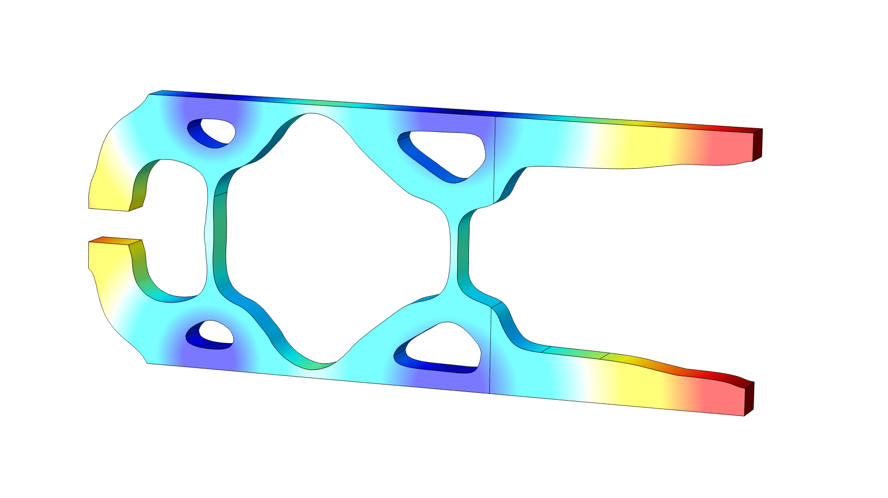
Shape and Topology Optimization of Compliant Pliers

Slide 2
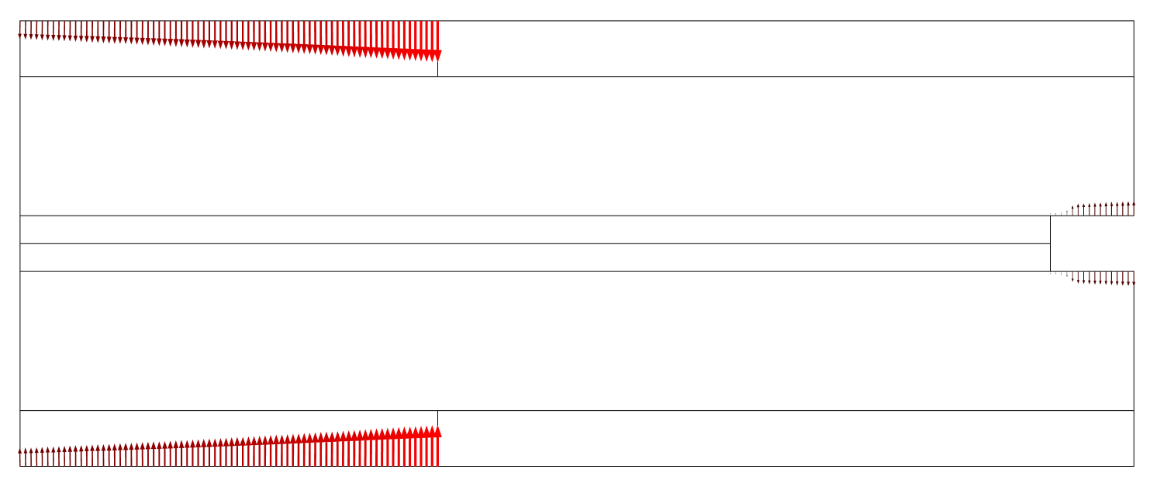
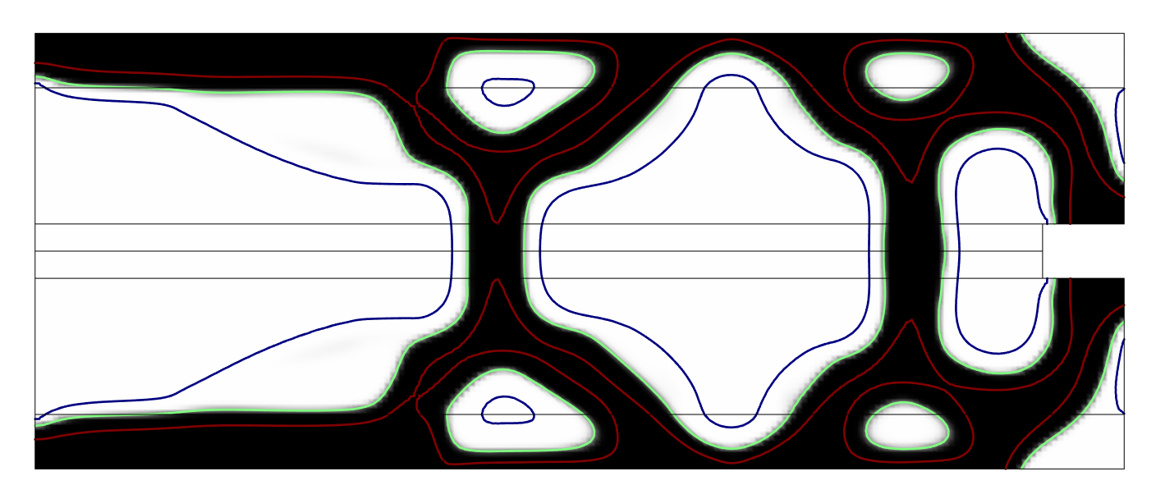
Shape and Topology Optimization of Compliant Pliers
Topology Optimization
The objective is to maximize the displacement in the gap, when the handles are pushed together.
Springs are used to control the gearing.
A volume constraint is imposed to prevent thin cracks in the design.
Three realizations (green, red, and blue) are generated and the worst is used to drive the optimization.
The resulting design is transferred to a new component for further analysis via a filter dataset.

Slide 3
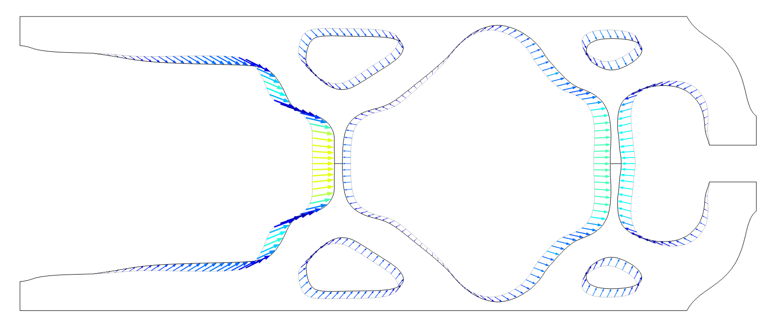
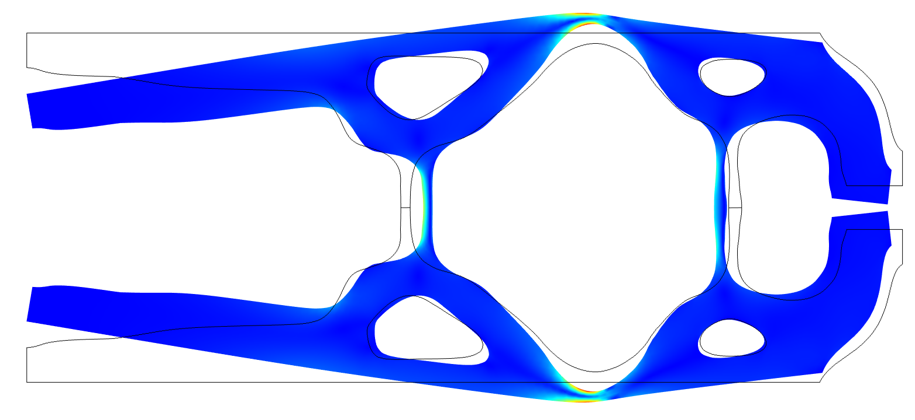
Shape and Topology Optimization of Compliant Pliers
Shape Optimization
The boundaries are allowed to move 1 cm, and the Free Shape Boundary feature is used to regularize the displacement.
The maximum stress is approximated with a
P-norm (p=10), and this is allowed to increase by a factor of 2.
The shape optimization improves the objective function by a factor of 3.
The result is exported to a new (3D) component for further analysis via a filter dataset.
A volume plot is created, so that a STL file can be exported.
Shape and Topology Optimization of Compliant Pliers

