Slide 1
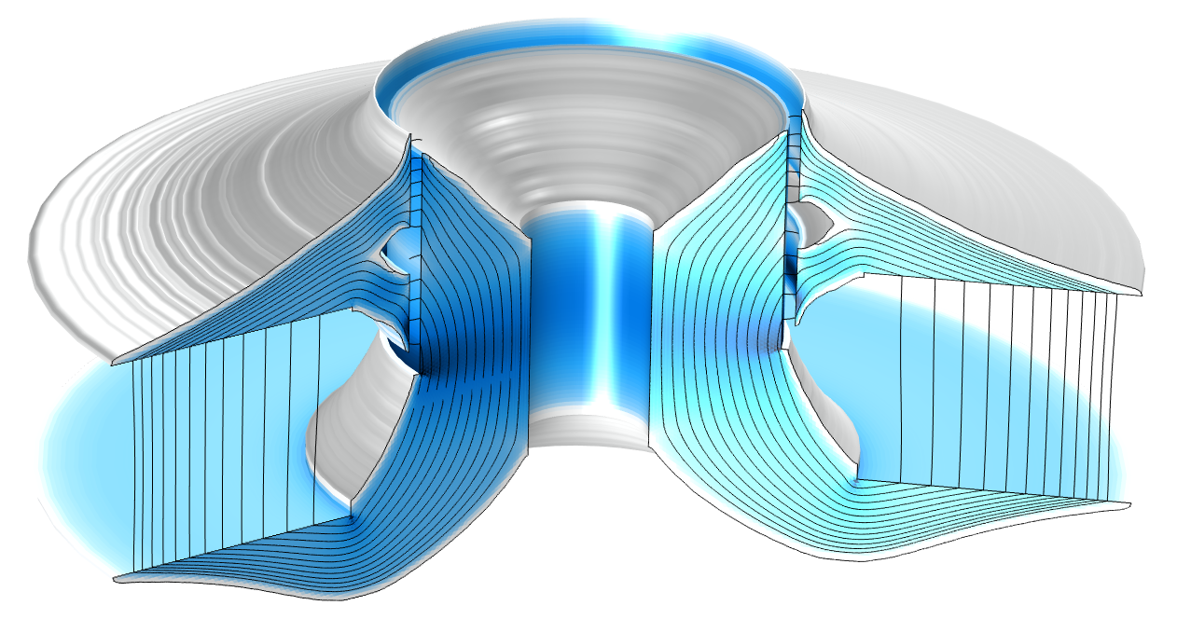
Topology Optimization of a
Magnetic Circuit

Slide 2
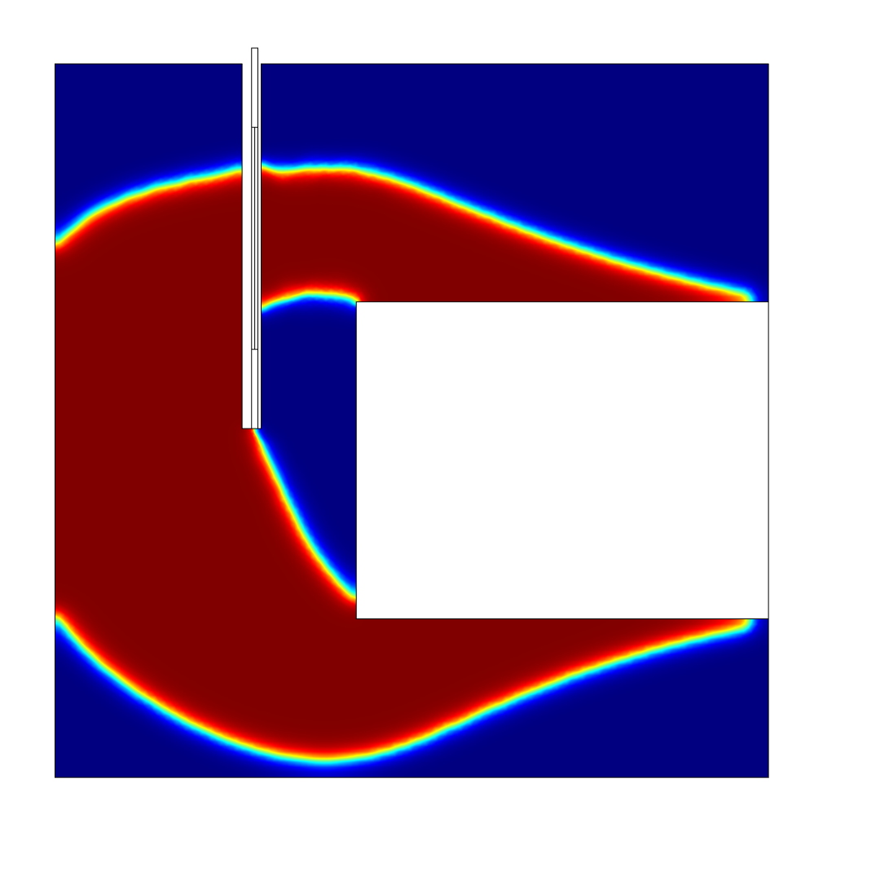
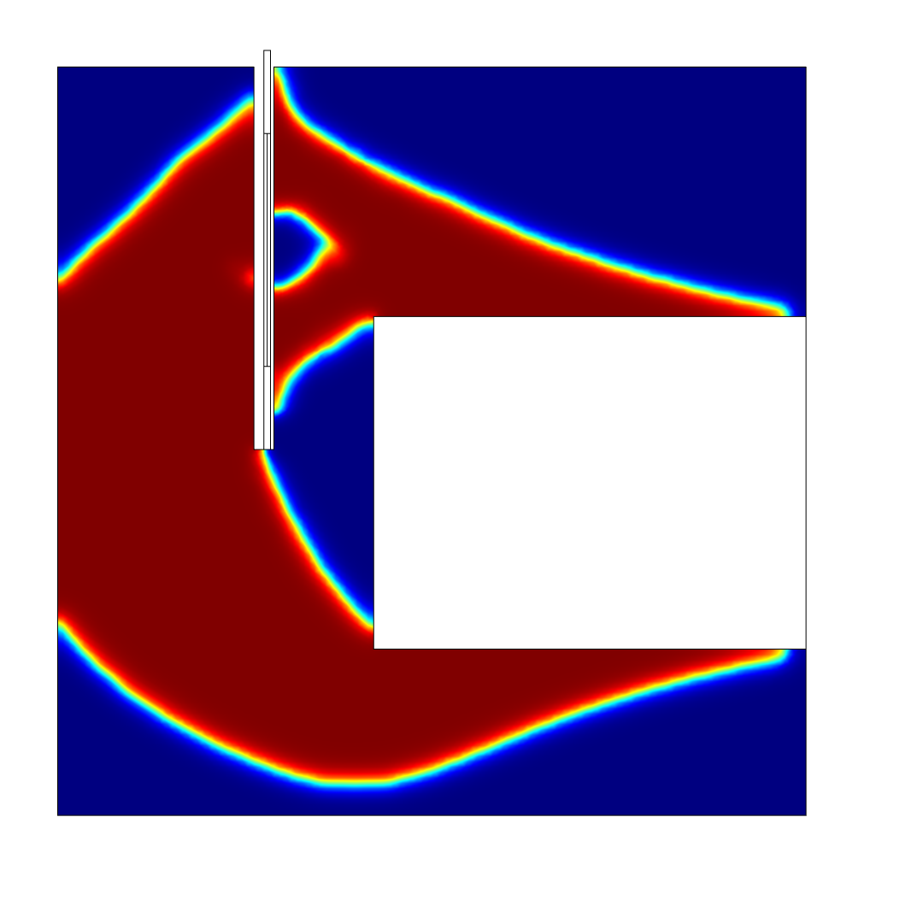
Topology Optimization of a Magnetic Circuit
Introduction
The topology is optimized by varying a spatial field controlling the relative permeability.
The mass is constrained while
  maximizing the magnetic field in the air gap, or
  minimizes the squared deviation from a flat BL curve
The performance of the latter optimization result is verified in a separate component.
Topology Optimization of a Magnetic Circuit

Slide 3
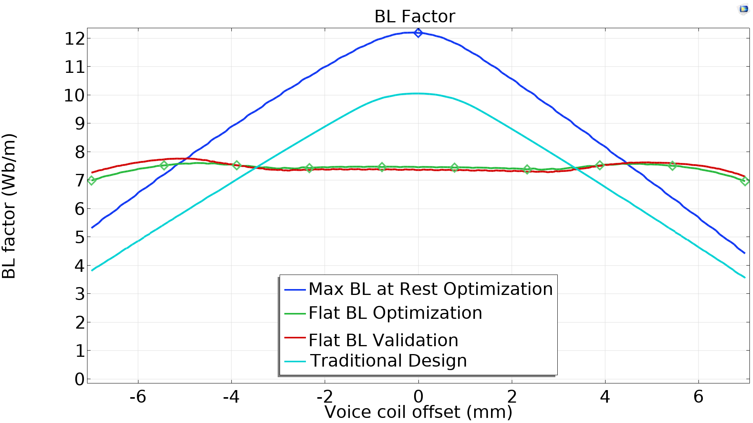
Topology Optimization of a Magnetic Circuit
Topology Optimization of a Magnetic Circuit

