Slide 1
Natural Convection in Free Flow:
Boussinesq Fluid in a Square Cavity
Model provided by:
John Kamel of University of Notre Dame

Slide 2
Introduction
This model demonstrates COMSOL Multiphysics natural convection modeling of a varying-density fluid using a Boussinesq approach.
Multiphysics coupling between the incompressible Navier Stokes equations and heat transfer through convection and conduction.
The model is relevant for simulation in:
  Geophysics
  Chemical engineering
A benchmark problem from G. De Vahl Davis (1983) and has been used to test a number of dedicated fluid dynamics codes.

Slide 3
Problem Definition
Cavity With Hot and Cold Walls
insulation
Fluid fills square cavity in solid
No flow across walls
Side walls are heating or cooling surfaces
Top and bottom walls are insulating
The heating produces density variations
The density variations drive fluid flow
cold
hot
T₀ = T_{cold}
insulation

Slide 4
Fluid Flow and Heat Transfer Equations
Free flow – Navier-Stokes equations with Boussinesq buoyancy force:
Convection and conduction:
Non-dimensionalized using Rayleigh (Ra) and Prandtl (Pr) numbers:
$$ρ(u⋅∇u)=−∇p+∇⋅\left[η \left(∇u+{\left(∇u\right)}^{T}\right)\right]+F$$
u velocity, p pressure, ρ density, η viscosity, F = g ∂r/∂T (T-T₀) buoyancy
T temperature, k thermal conductivity, c_{L} heat capacity
ρ = (Ra/Pr)^{1/2}, η = Pr, F = -T (Ra/Pr)^{1/2}, k = 1, c_{L} = ρη

Slide 5
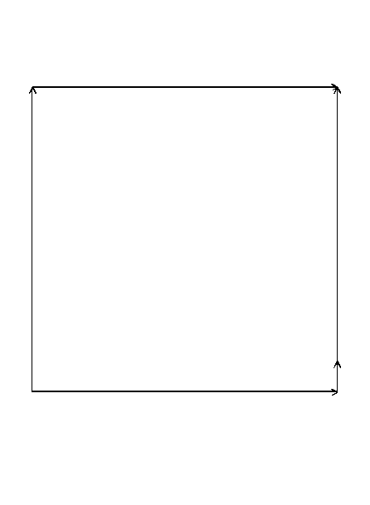

Boundary Conditions
Fluid flow:
  $u=\bar{0}$ walls – no slip
  $p=p_{ref}$ condition at a point
Heat balance:
  n⋅(k ∇ T + c_{L}uT ) = 0
  $T=T_{0}$
  $T=T_{h}$

Slide 6
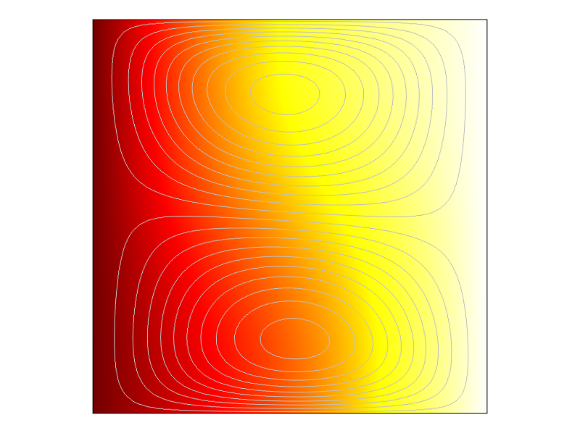
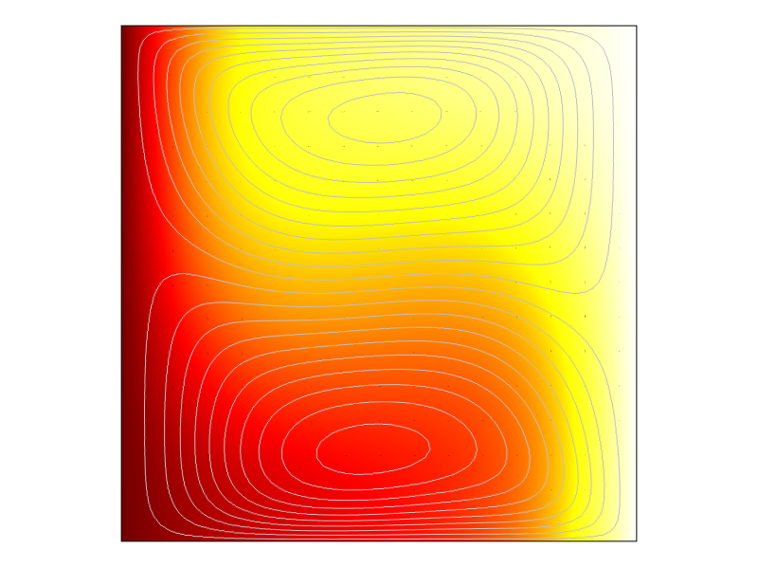
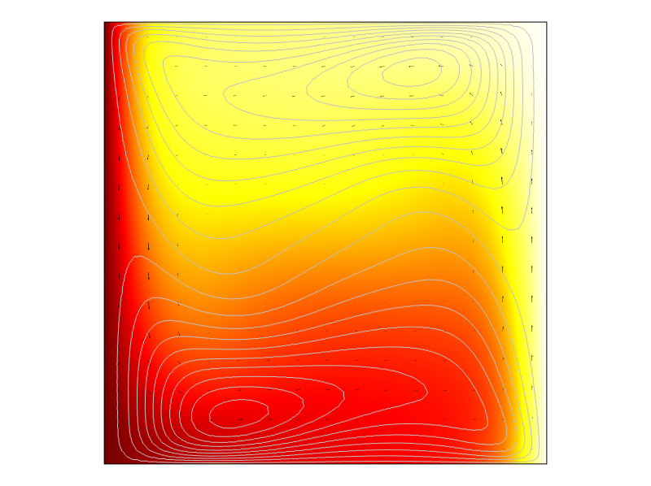
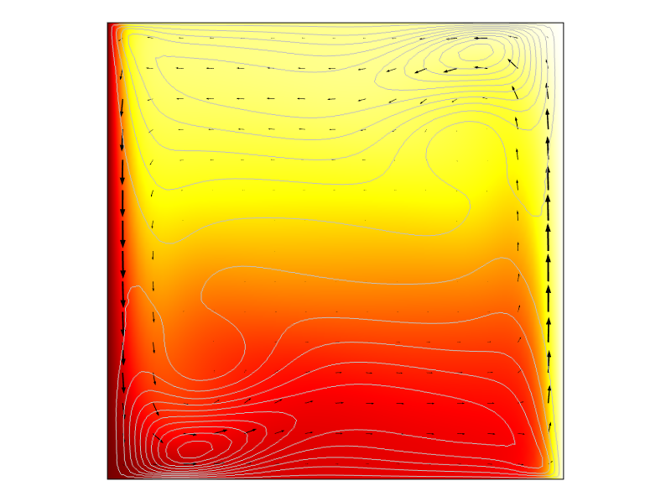
Results for Varying Ra Number
Surface plot: T
Contours: x-velocity
Arrows: velocity
1,000
10,000
100,000
1,000,000

Slide 7
References
De Vahl Davis, G. Natural convection in a Square Cavity – A Benchmark Solution. International Journal for Numerical Methods in Fluids, 1, (1984) 171-204.
De Vahl Davis, G. Natural convection in a square cavity a comparison exercise. International Journal for Numerical Methods in Fluids, 1, (1983) 227-248.
De Vahl Davis, G. Natural convection in a square cavity a bench mark numerical solution. International Journal for Numerical Methods in Fluids, 1, (1983) 249-264.

