Slide 1
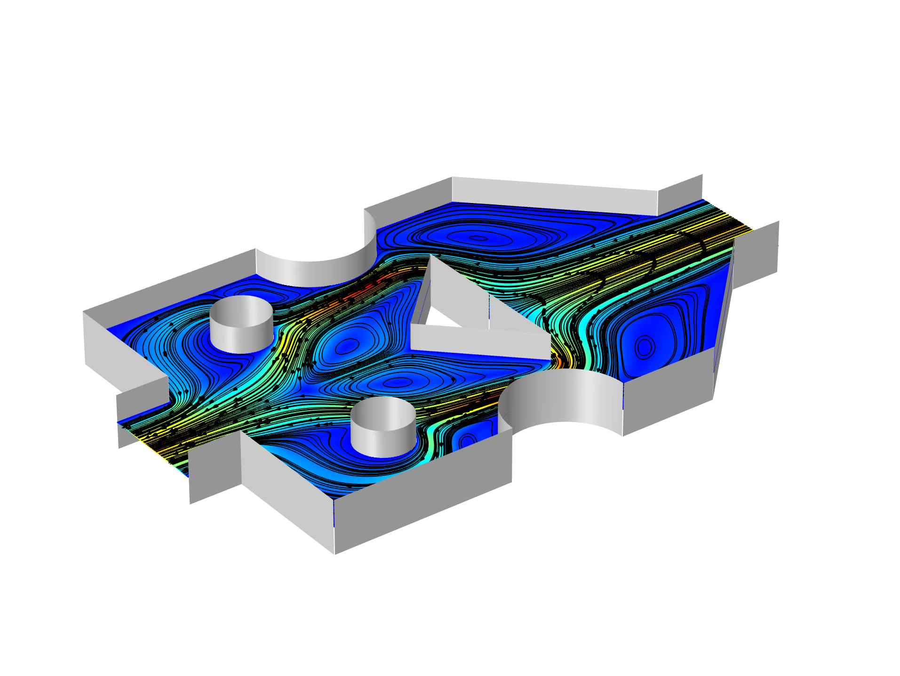
Parameter Optimization of a
Tesla Microvalve

Slide 2
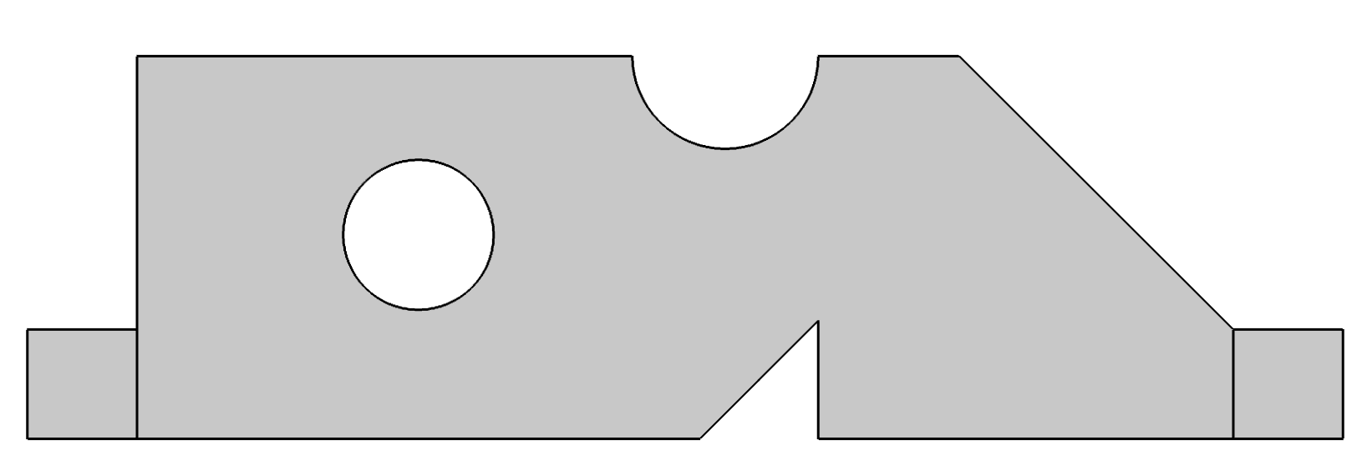
Introduction
Setup and solve the optimization problem
Use the imported parameters as control variables and choose bounds that prevent topological changes.
Use the BOBYQA solver over a parametric sweep, which
controls the geometry. Optimize for the worst case scenario.
R
XT
LT

Slide 3
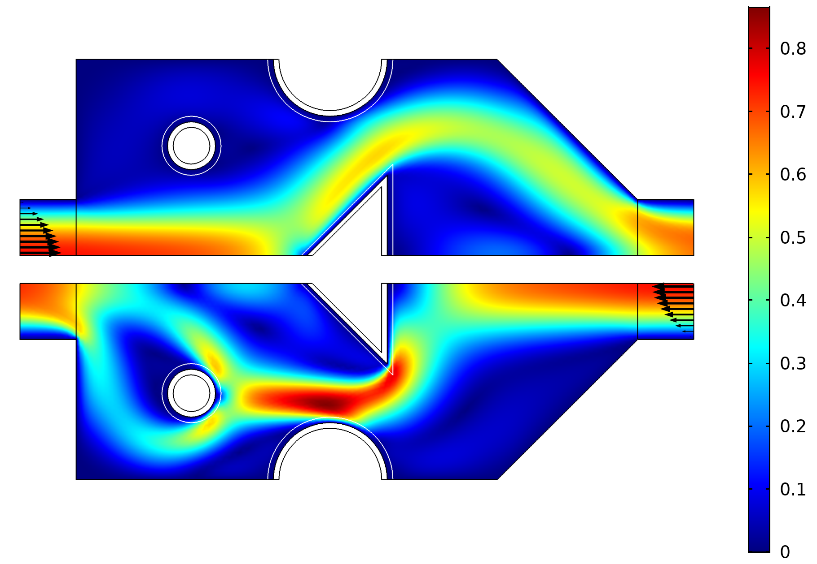
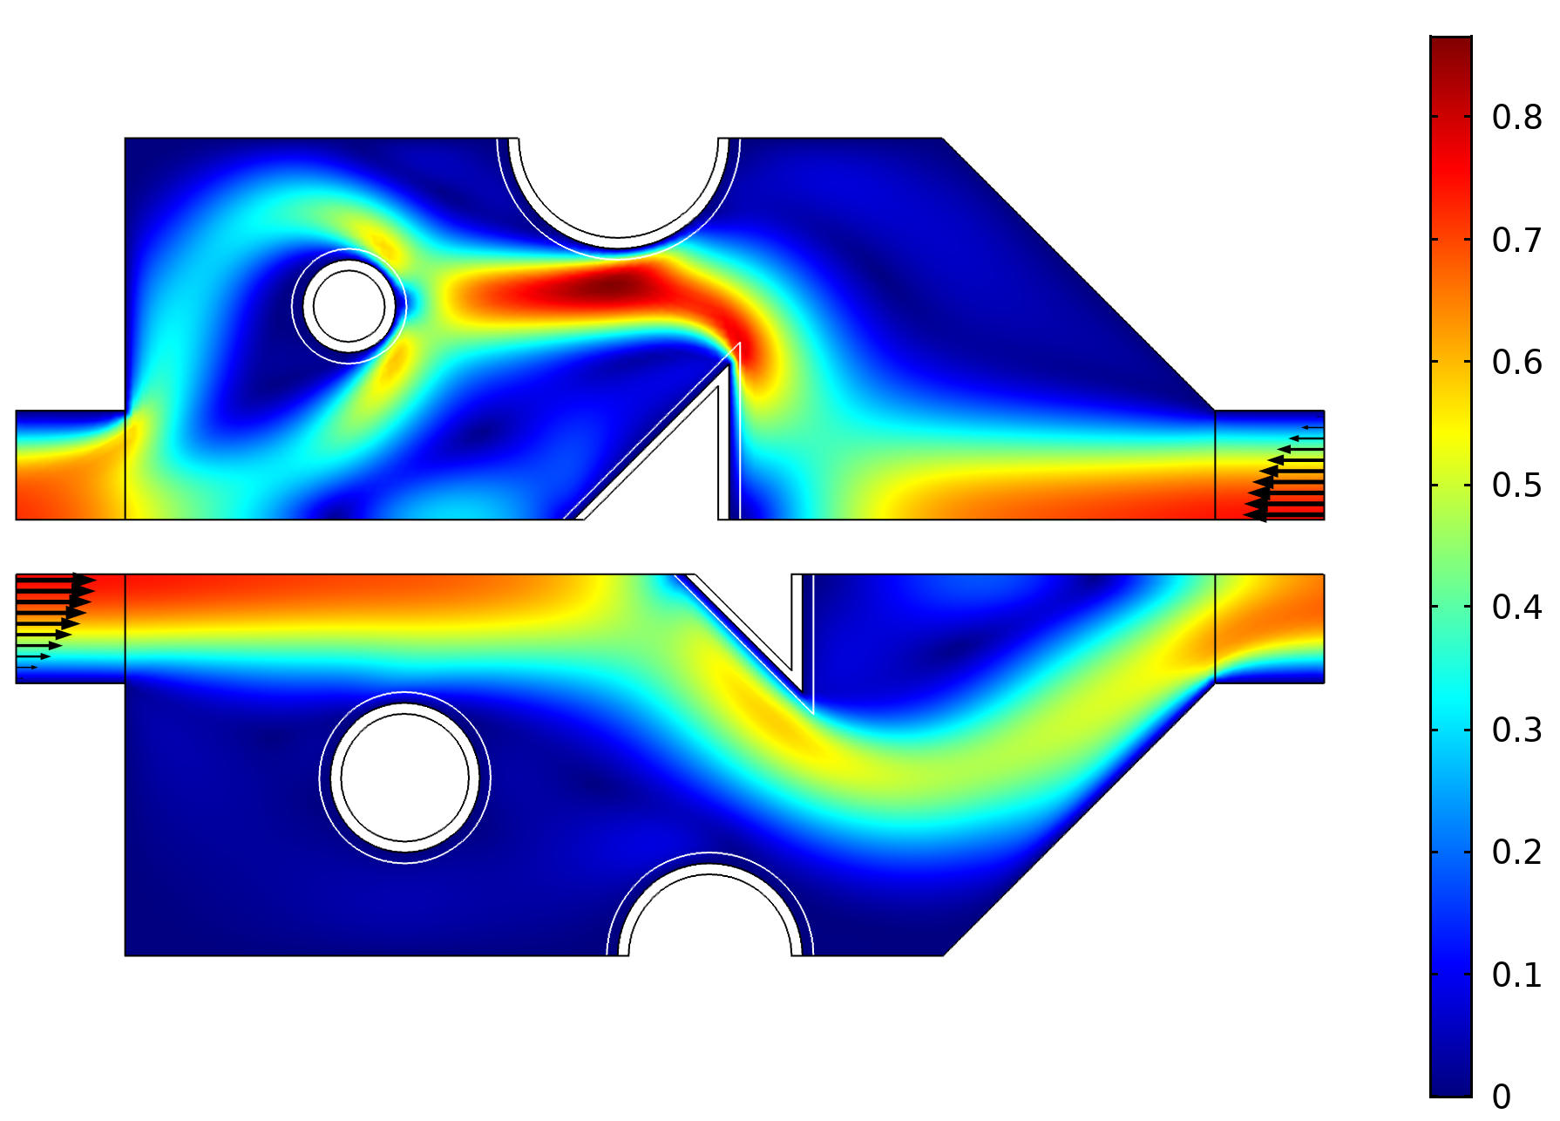
Results
Interpretation
Circle radius is reduced to decrease resistance for the forward flow.
Controls
Triangle and one circle is enlarged, while other circle is smaller. All objects are moved.
Initial design

