Slide 1
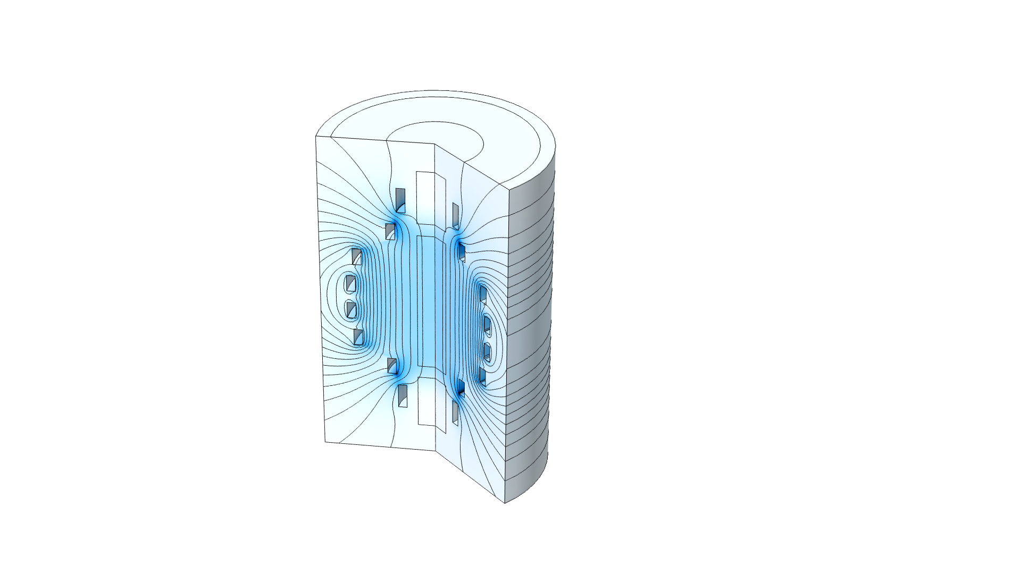
Shape Optimization of Coils

Slide 2
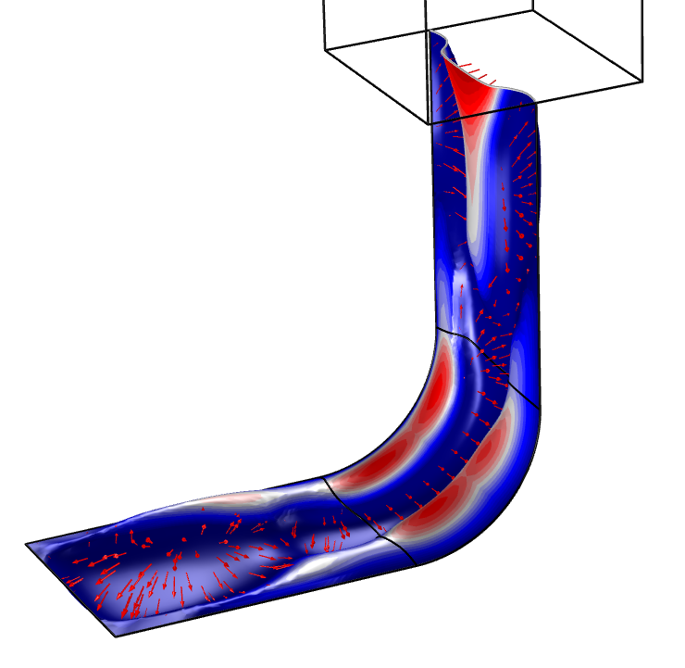
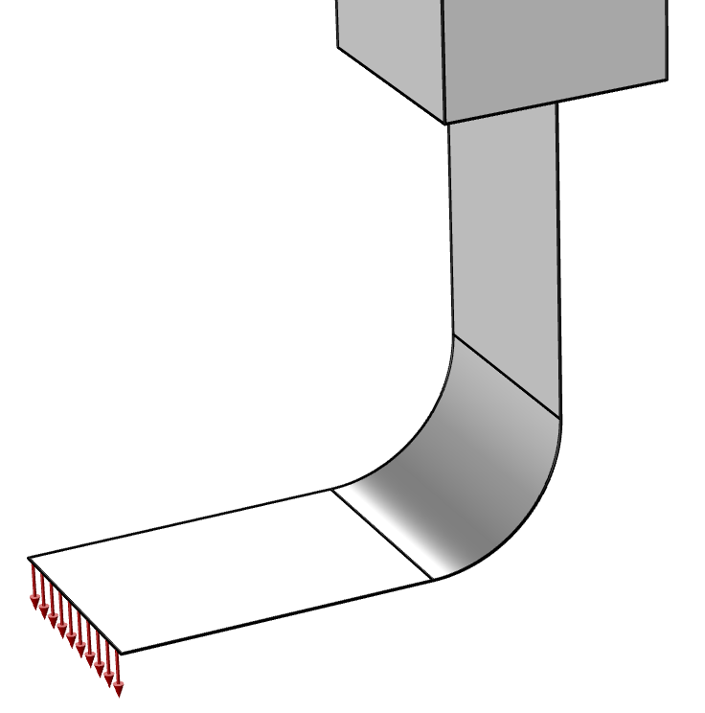

Shape Optimization of Coils
Introduction
The Transformation feature can be used to translate, scale and rotate domain groups using gradient based optimization.
This model considers the optimization of a coil geometry to ensure uniform magnetic field on the axis (φ₁ ) and minimum field at the axis ends (φ₂).
$$\begin{matrix}\begin{matrix}φ & = & φ_{1}+φ_{2} \\ φ_{1} & = & {\int_{Ω_{inner}}{{\left(\left|B\right|−B_{avg}\right)}^{2}dΩ}}/{\int_{Ω_{inner}}{dΩ}} \\ φ_{2} & = & {\int_{Ω_{outer}}{\left|B\right|dΩ}}/{\int_{Ω_{outer}}{dΩ}}\end{matrix} \\ \begin{matrix}B_{avg} & = & {\int_{Ω_{inner}}{\left|B\right|dΩ}}/{\int_{Ω_{inner}}{dΩ}}\end{matrix}\end{matrix}$$
The power at the coil ends has the opposite sign to mimic opposite winding, and the actual current value is also optimized to mimic partial turns.
The objectives decrease with 90 and 50 %, respectively.
Shape Optimization of Coils

