Slide 1
Freeze Drying

Slide 2
Introduction
Freeze drying is a dehydration process that is often used to preserve high value products in the pharmaceutical and food industry.
It is also frequently used as a way to remove water from goods to reduce weight.
Freeze drying relies on sublimation, where a frozen liquid undergoes phase change directly from a solid frozen state into a gaseous state. The vapor flows through the pores of the dried product before leaving the vial.
Heat and mass transfer mechanisms are considered.
This models demonstrates the process of primary freeze drying in a vial under vacuum-chamber conditions.

Slide 3
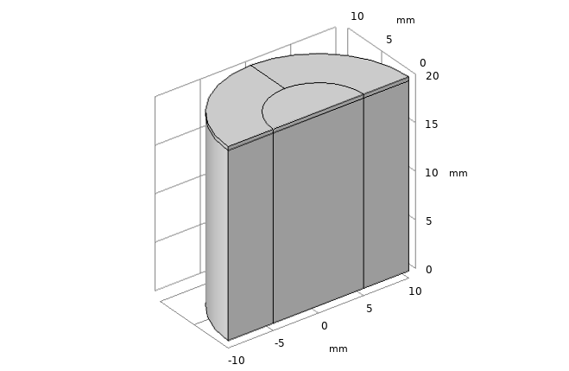
Geometry
The geometry and the boundary conditions are axisymmetric. For demonstration purposes, the model is solved in 3D.
The vial is initially filled at 98% with a frozen product, here skim milk. On the top of it, lies a domain of dried product.

Slide 4
Model schematic
Vapor flow
Convective and radiative heat fluxes from ambient
Symmetry axis
Dried Porous product
Sublimation front
Convective heat flux from ambient
Vial
Frozen product
Air gap
Convective heat flux from shelf

Slide 5
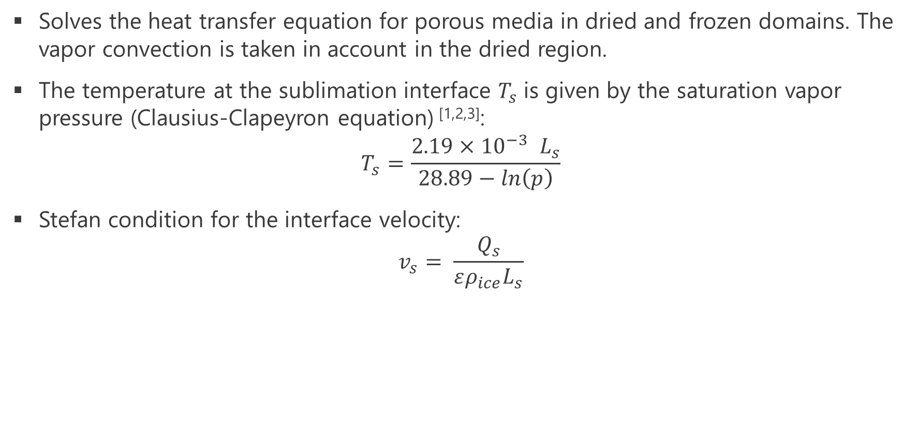
Model Definition: Heat Transfer equations
Solves the heat transfer equation for porous media in dried and frozen domains. The vapor convection is taken in account in the dried region.
The temperature at the sublimation interface $T_{s}$is given by the saturation vapor pressure (Clausius-Clapeyron equation) ^{[1,2,3]}:
$$T_{s}=\frac{2.19×{10}^{−3} L_{s}}{28.89−ln\left(p\right)}$$
Stefan condition for the interface velocity:
$$v_{s}= \frac{Q_{s}}{ερ_{ice}L_{s}}$$

Slide 6
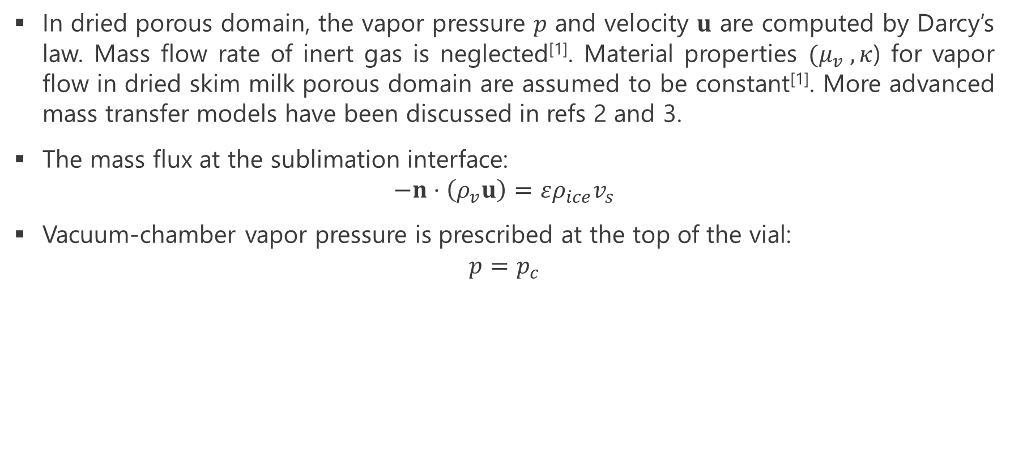
Model Definition: Mass Transfer equations
In dried porous domain, the vapor pressure $p$ and velocity $u$ are computed by Darcy’s law. Mass flow rate of inert gas is neglected^{[1]}. Material properties $(μ_{v} ,κ$) for vapor flow in dried skim milk porous domain are assumed to be constant^{[1]}. More advanced mass transfer models have been discussed in refs 2 and 3.
The mass flux at the sublimation interface:
$$−n⋅\left(ρ_{v}u\right)=ερ_{ice}v_{s}$$
Vacuum-chamber vapor pressure is prescribed at the top of the vial:
$$p=p_{c}$$

Slide 7
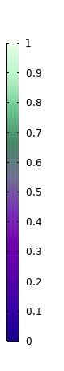
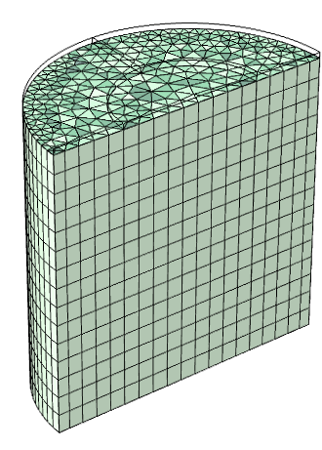
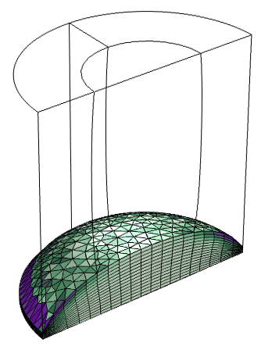
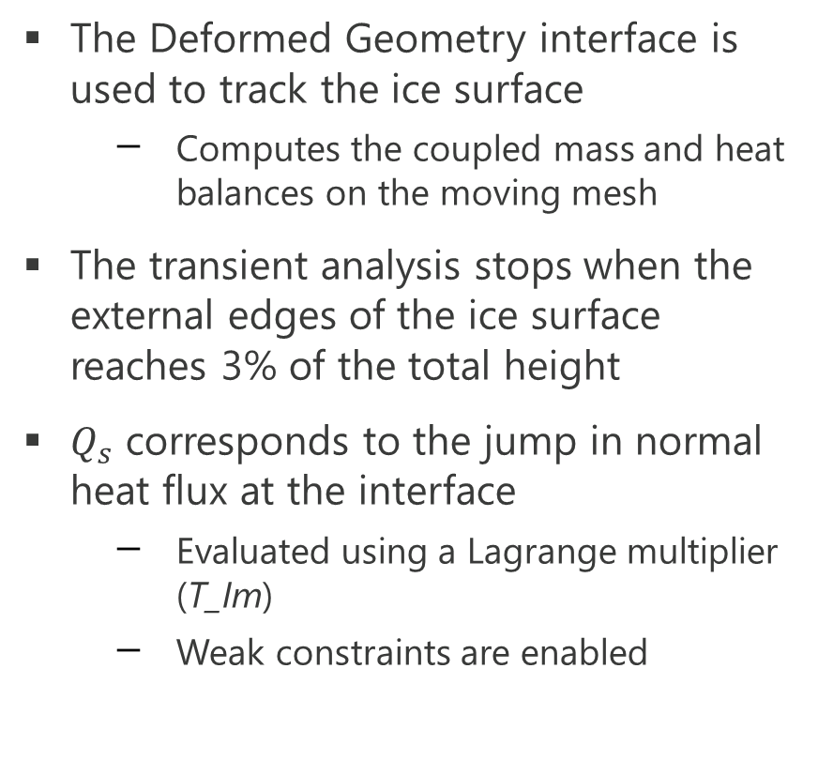
Implementation
The Deformed Geometry interface is used to track the ice surface
  Computes the coupled mass and heat balances on the moving mesh
The transient analysis stops when the external edges of the ice surface reaches 3% of the total height
$Q_{s}$ corresponds to the jump in normal heat flux at the interface
  Evaluated using a Lagrange multiplier (T_Im)
  Weak constraints are enabled
Initial mesh
Final mesh, with skewness quality

Slide 8
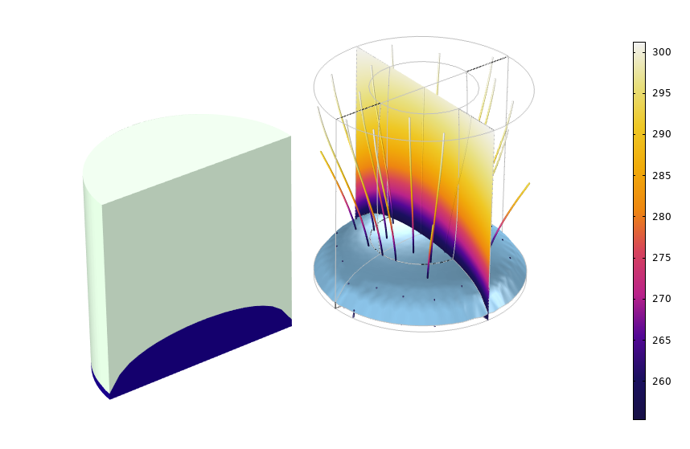
Results
About 10 h are necessary to sublimate 85% of initial ice amount. The sublimation front reaches the bottom of the vial with a convex shape, lower around the vial walls.
About 3.3 g of water has been sublimated.
Left: Final interface position Right: Temperature and heat flux.

Slide 9
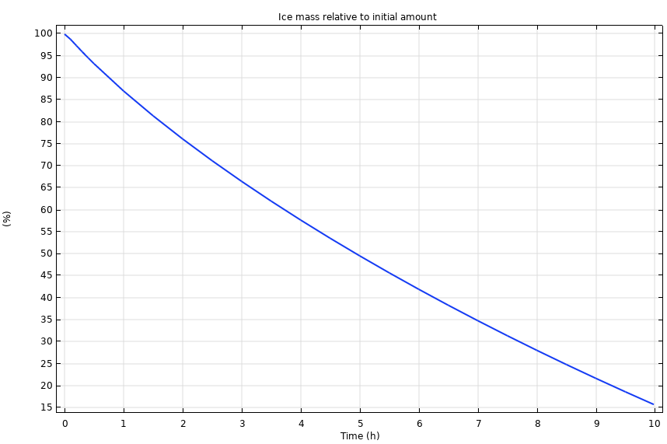
Results
The figure on the right shows the ice mass in the vial, in percentage of the initial amount.

Slide 10
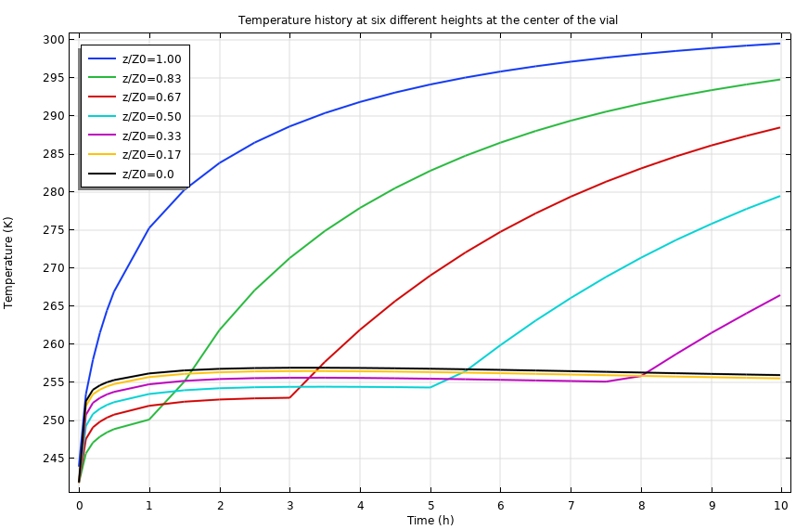
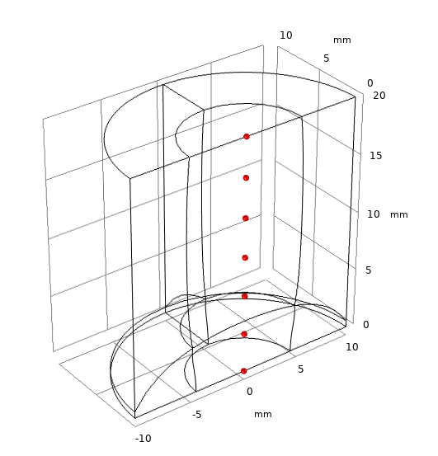
Results
The figure on the right shows the temperature variation with time during the primary drying stage at six fixed locations, plotted below.

Slide 11
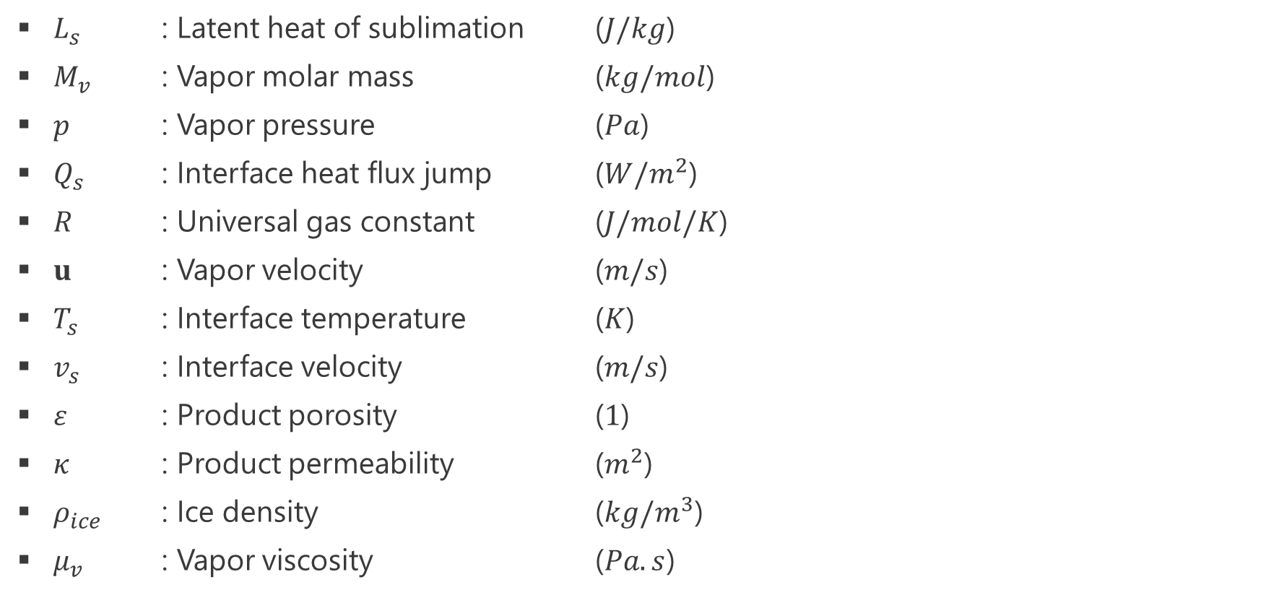
Notations
$L_{s}$ : Latent heat of sublimation ($J/kg$)
$M_{v}$ : Vapor molar mass ($kg/mol$)
$p$ : Vapor pressure ($Pa$)
$Q_{s}$ : Interface heat flux jump ($W/m^{2}$)
$R$ : Universal gas constant ($J/mol/K$)
$u$ : Vapor velocity ($m/s$)
$T_{s}$ : Interface temperature ($K$)
$v_{s}$ : Interface velocity ($m/s$)
$ε$ : Product porosity ($1$)
$κ$ : Product permeability ($m^{2}$)
$ρ_{ice}$ : Ice density ($kg/m^{3}$)
$μ_{v}$ : Vapor viscosity ($Pa.s$)

Slide 12
References
[1] Alonso A. et al. (2012). Time-scale modeling and optimal control of freeze-drying. Journal of Food Engineering, 111, 655-666
[2] Mascarenhas, W. J., Akay, H. U., & Pikal, M. J. (1997). A computational model for for finite element analysis of the freeze-drying process. Computer Methods on Applied Mechanics and Engineering, 148 , 105–124
[3] Hriberšek et al., (2018). Lyophilization model of mannitol water solution in a laboratory scale lyophilizer. Journal of Drug Delivery Science and Technology, 45, 28-38

