Slide 1
W-band Waveguide to Microstrip Transition

Slide 2
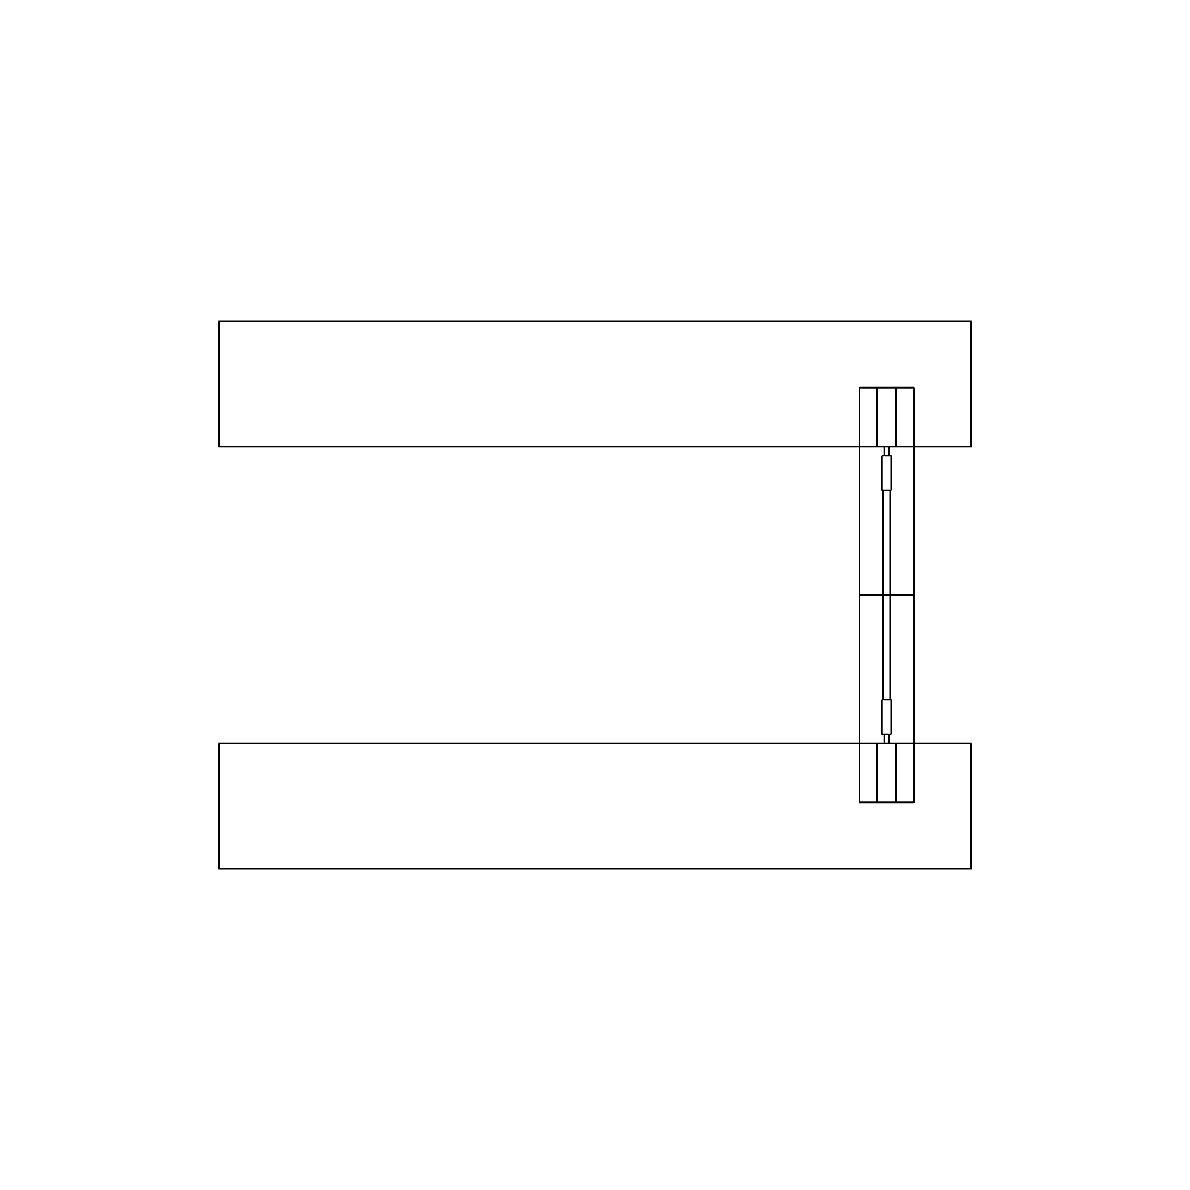
Model Setup: Longitudinal Probe
Microstrip line is used as probe which is transverse to the propagation of direction wave inside the waveguide.
Longitudinal robe configuration is adopted. In this configuration the microstrip probe is entered the broad wall of the waveguide such that the substrate surface on which microstrip line patterned is aligned with the direction of propagation of wave inside the waveguide.
P_{out}
shorted
P_{in}
shorted
Back-to-back transition

Slide 3
Implementation in COMSOL Multiphysics
WR-10 waveguide for W-band.
Microstrip line on Rogers RT/duroid® 6010LM laminate substrate along with quarter-wave transformer to match the impedance to 50Ω .
Back-to-back transition:
  Extended version of single transition.
  50Ω Microstrip line again converted to microstrip probe and act as feeder for second WR-10 waveguide.
Boundary conditions used:
  Impedance boundary condition (IBC) applied to the walls of waveguides.
  Transition boundary condition (TBC) applied to the microstrip line.
  Rectangular port with TE₁₀ mode applied to the port of waveguides.
Rogers RT/duroid® 6010LM laminate substrate properties:
  ε_{r} =10.2
  μ_{r}= 1
RT/duroid® is a registered trademark of Rogers corporation or one of its subsidiaries.

Slide 4
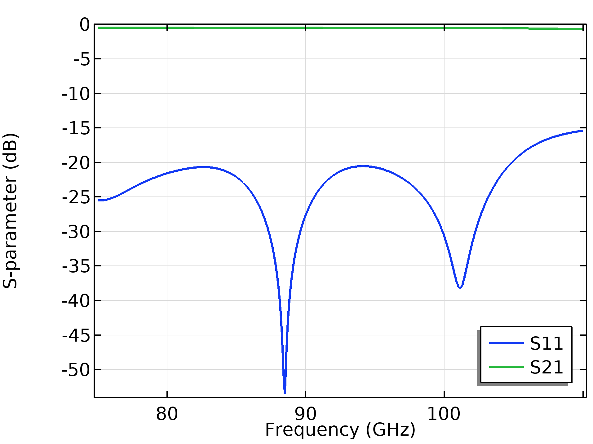
Result: Back-to-Back Transition
S₁₁ is below the -15dB through out the band.
Maximum transmission loss is 0.7dB.
S-parameter performance

Slide 5
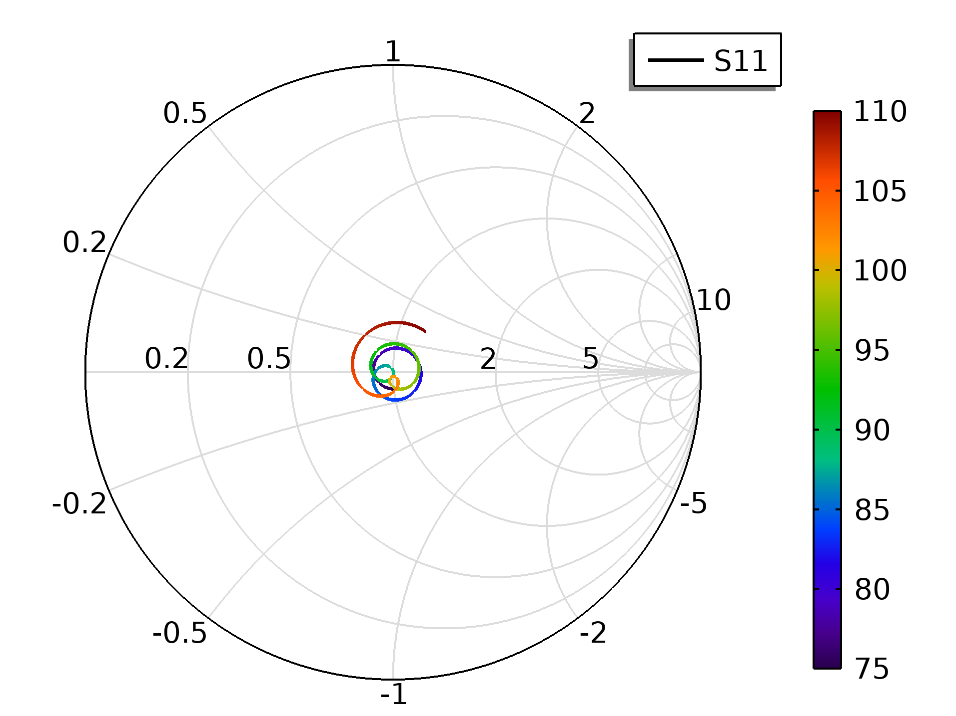
Result: Back-to-Back Transition
Matching at input port.
Reflection graph

