Slide 1
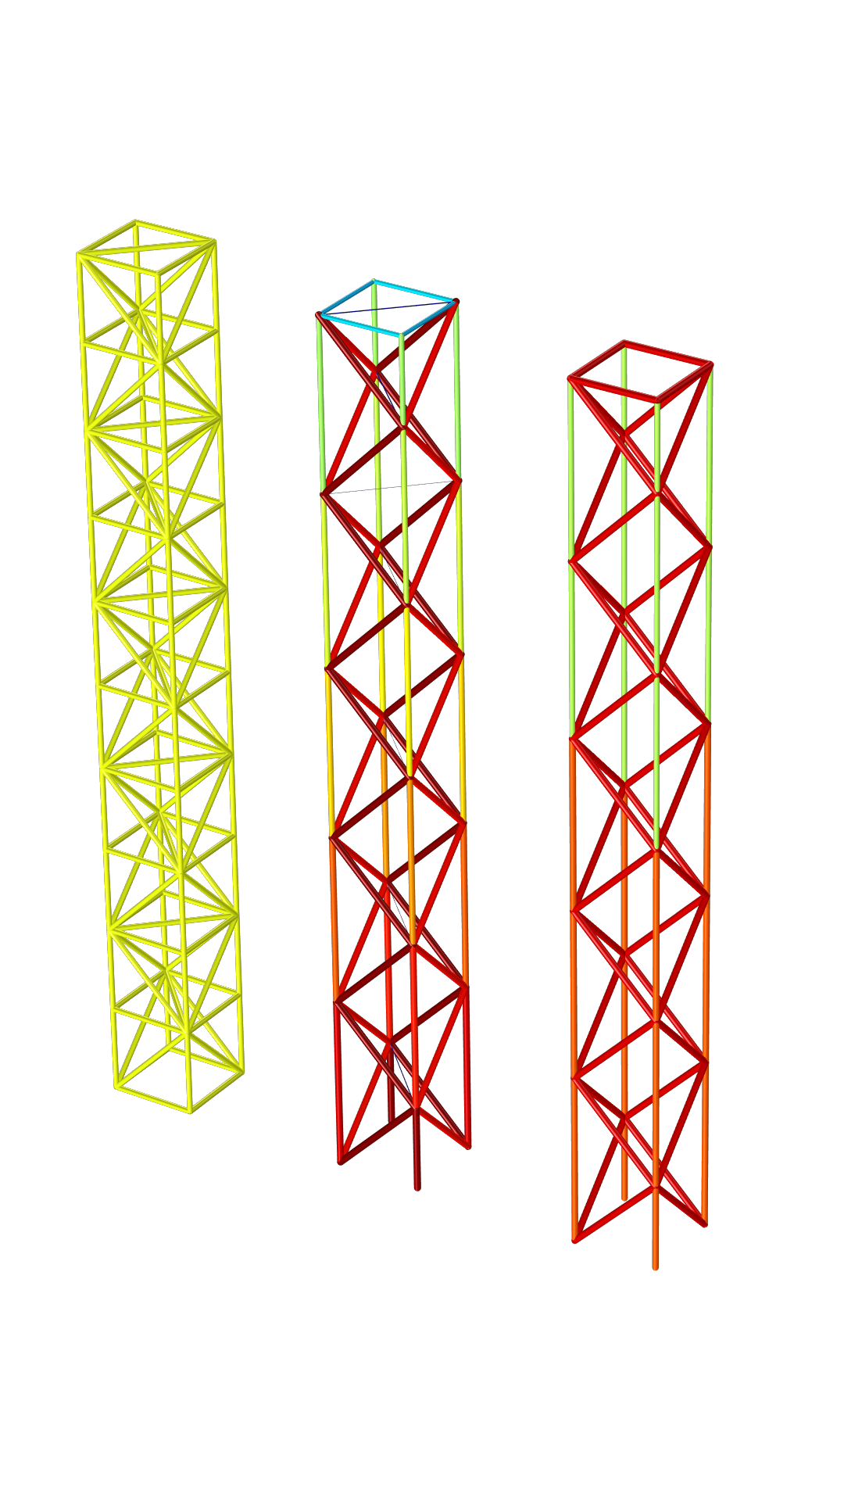
Optimization of a Truss Tower

Slide 2
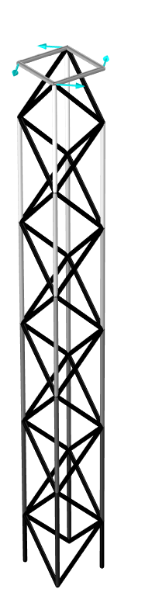

Optimize for Two and Three Load Cases
Two load cases
Most horizontal members are removed
The tower seems susceptible to compression due to lack of a compressive load case.
Three load cases
Most horizontal members are removed
Optimization seems to result in outside diagonal members with the same size.
Optimization of a Truss Tower

Slide 3
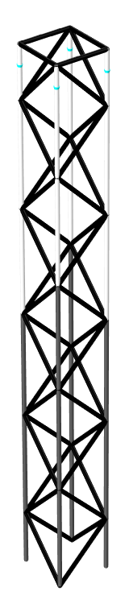
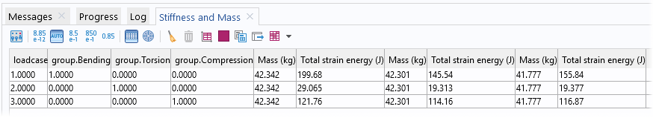
Simplify Design
Reduce number of member size to three
Create new variable feature
Use if statements
Create study to evaluate simplified design
Initial design
Optimized design
Simple design
Optimization of a Truss Tower

