Slide 1
Model of a NiCd Battery
COMSOL

Slide 2
Background
The model is based on the following publication:
  P. De Vidts, R. E. White, “Mathematical Modeling of a Nickel-Cadmium Cell: Proton Diffusion in the Nickel Electrode”, J. Electrochem. Soc, Vol. 142, No. 5, May 1995.
The phenomena that are accounted for are the following:
  Oxygen diffusion in the electrolyte
  Charge and mass transfer of aqueous K⁺/OH⁻ in the electrolyte
  Proton transport in the Ni electrode
  Charge transfer reactions
    Also the dissolution and deposition of Cd at the negative electrode
  The dissolution and deposition of Cd also means that the porosity is a variable in the model

Slide 3
Model Definition
Positive
Nickel
electrode
Negative
Cadmium
electrode
Separator
Current
collector
Current
collector
1D model assuming no variations along the length of the electrodes
  Only on space variable: along the thickness, x , of the cell
  Time dependent model for charge and discharge
Microstructure
  Substrate covered by an active material in both electrodes
  Pore electrolyte fills the void in both electrodes
  Note: only shown for positive electrode but the same structure is assumed in the negative electrode
x
Substrate
Pore electrolyte
Active material

Slide 4
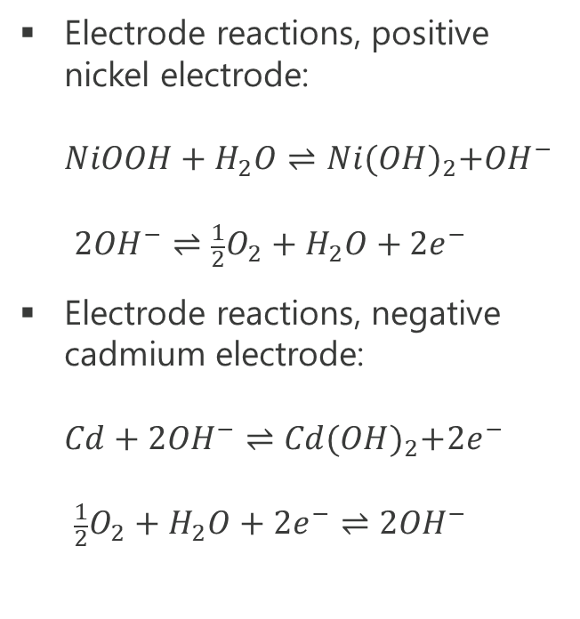
Model Definition
Positive
Nickel
electrode
Negative
Cadmium
electrode
Separator
Current
collector
Current
collector
Electrode reactions, positive nickel electrode:
$NiOOH+H_{2}O⇌Ni{(OH)}_{2}+{OH}^{−}$
$2{OH}^{−}⇌\frac{1}{2}O_{2}+H_{2}O+{2e}^{−}$
Electrode reactions, negative cadmium electrode:
$Cd+2{OH}^{−}⇌Cd{(OH)}_{2}+{2e}^{−}$
$\frac{1}{2}O_{2}+H_{2}O+2e^{−}⇌2{OH}^{−}$
x
Substrate
Pore electrolyte
Active material

Slide 5
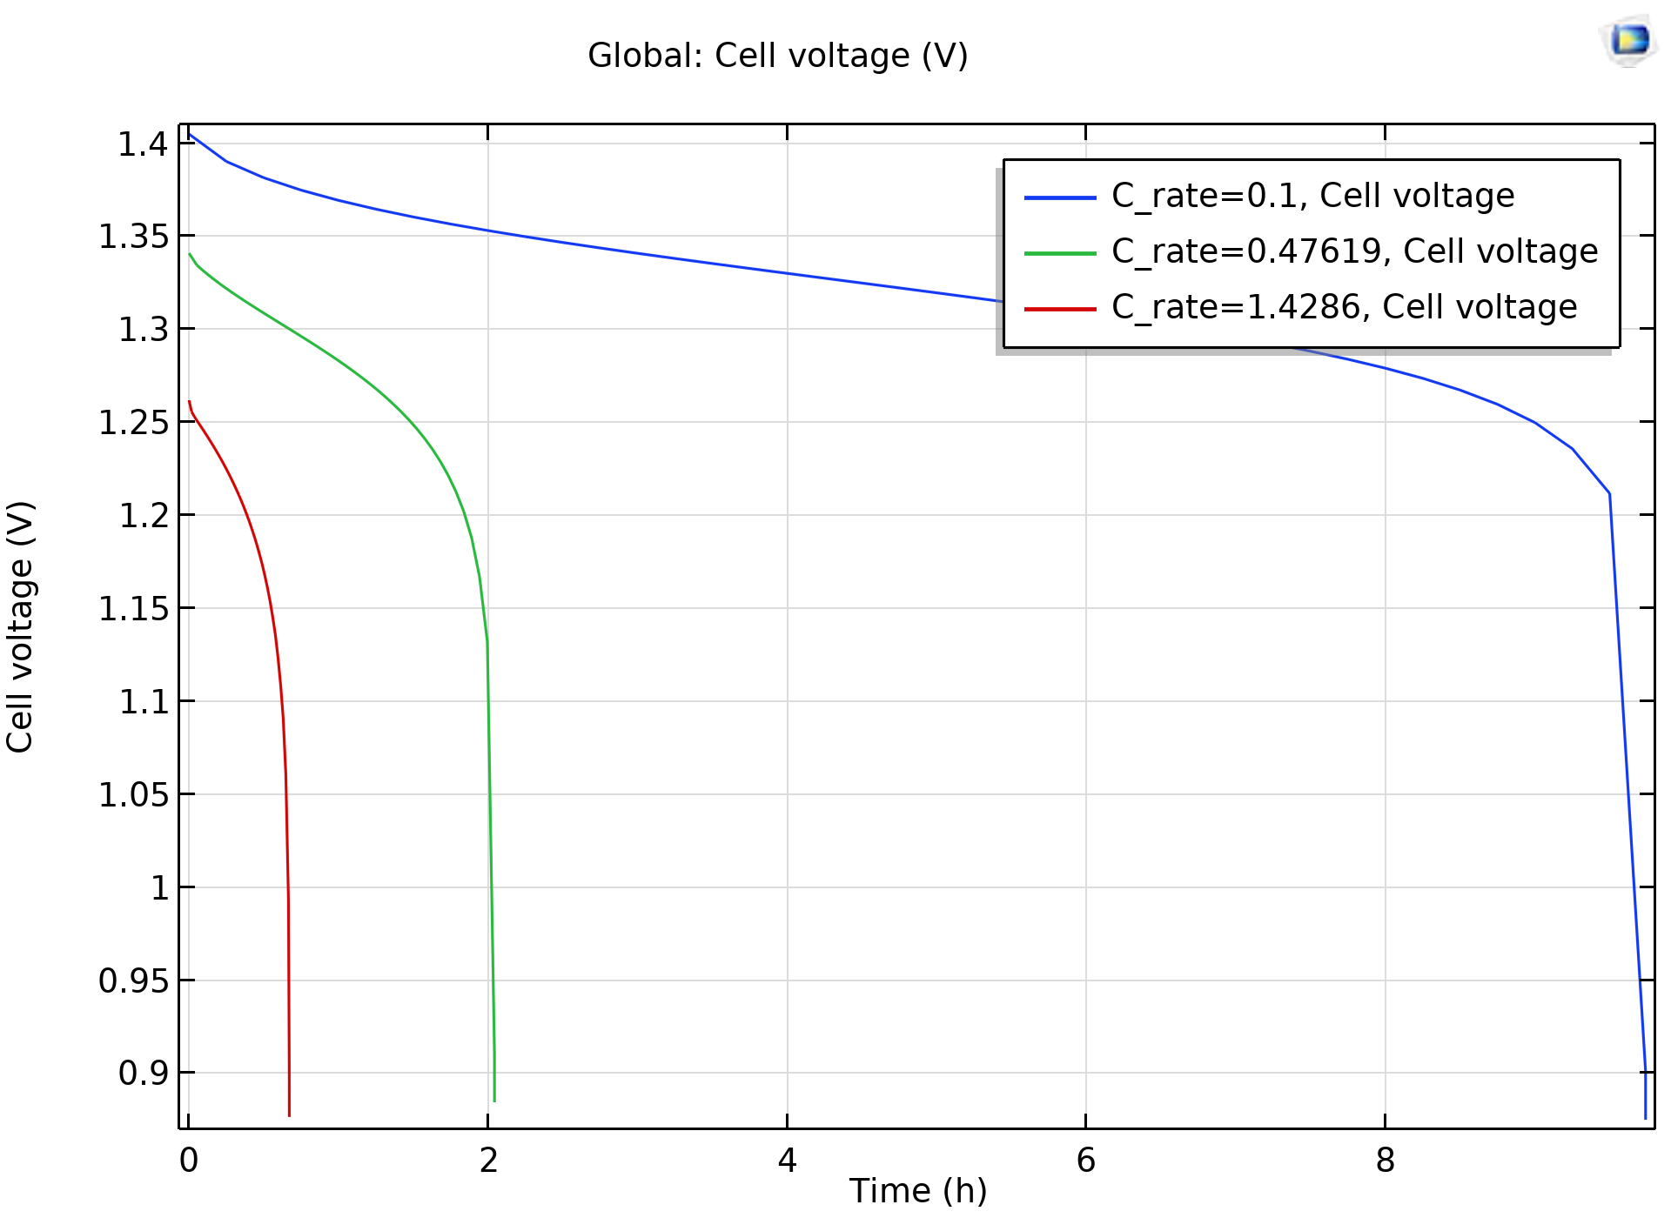
Results
Cell voltage as a function of time
Excellent agreement with De Vidts’ and White’s paper

Slide 6
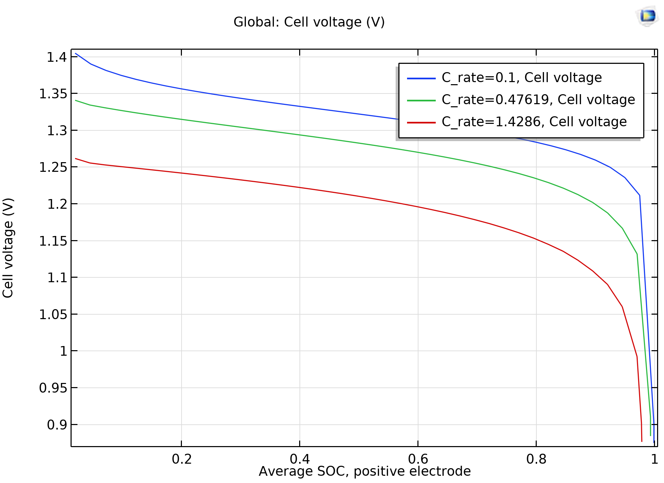
Results
Cell voltage as a function of SOC
Excellent agreement with De Vidts’ and White’s paper

Slide 7
Concluding Remarks
Excellent agreement with scientific literature
Possible extensions:
  Thermal analysis, which is very straightforward
  2D or 3D to investigate effects of current collector geometry?

