Slide 1
Multi-Turn Coil Winding around a Rectangular Ferromagnet

Slide 2
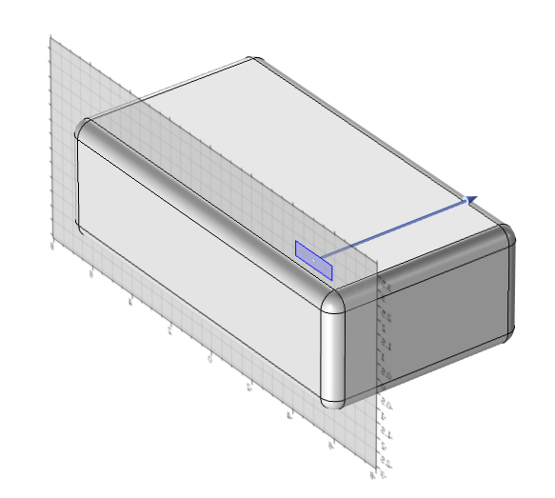
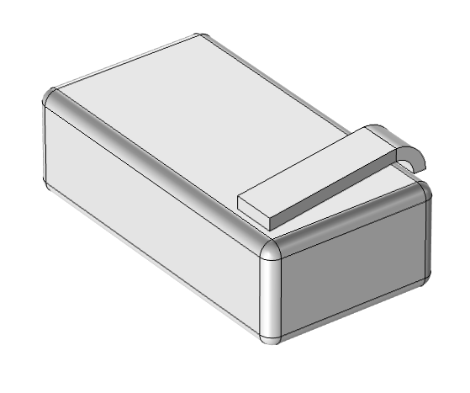
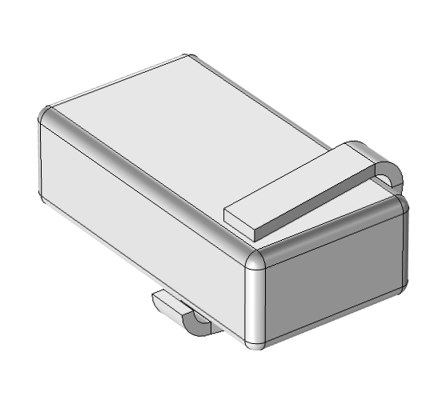
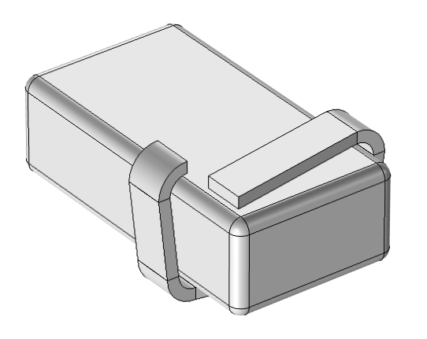
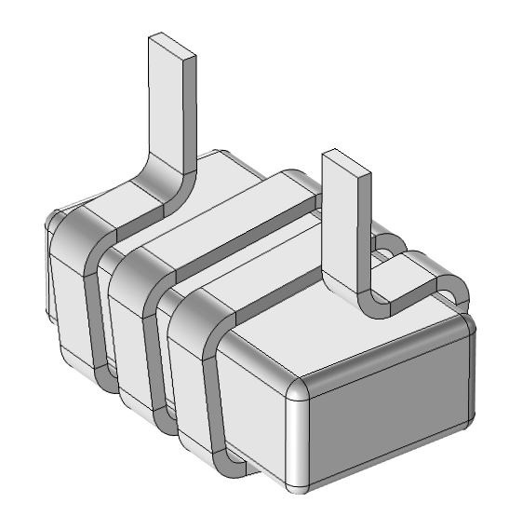
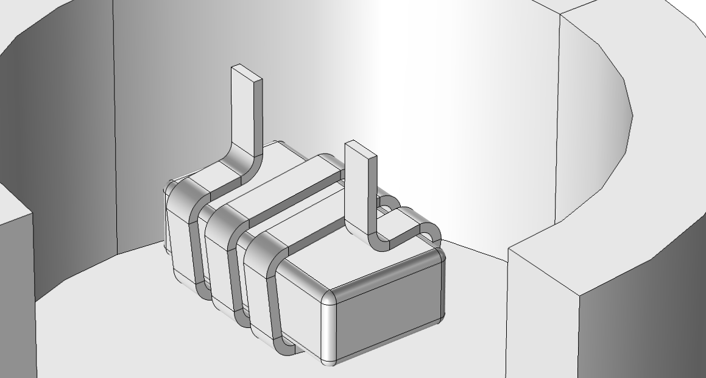
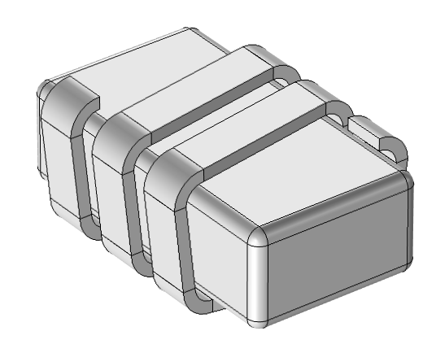
Geometry
Block and Fillet are used to create the ferromagnetic block
Extrude, Revolve, Array and Delete Entities operations used to generate solid coil
Cylinder with layers used to create air cavity with infinite element domains

Slide 3
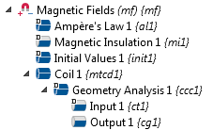
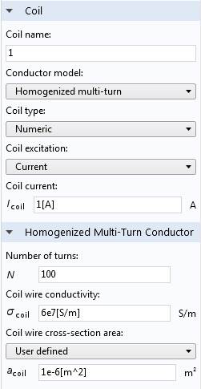
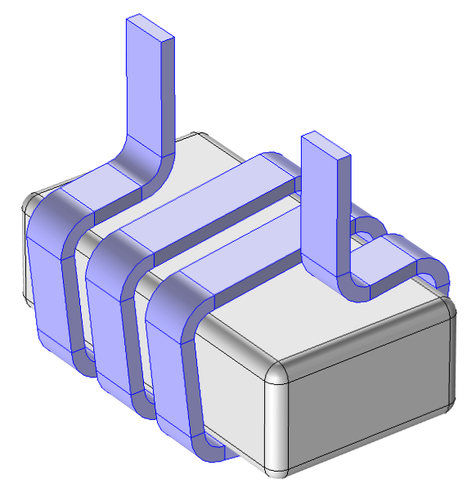
Physics Set Up
A winding of many mutually-insulated thin wires is too detailed to resolve explicitly in the geometry
Using the Homogenized multi-turn conductor model for a Coil domain produces a homogenized approximation
The Geometry Analysis attribute allows the user to specify the connectivity and direction of the windings. For an open coil (one that extends to the external boundary) this includes an Input and an Output

Slide 4

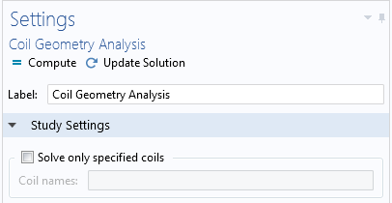
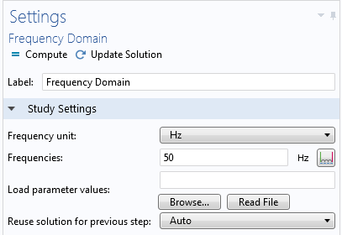
Study Steps
The exact current direction in a general Multi-Turn Coil is not known a priori but can be calculated in a pre-processing step called Coil Geometry Analysis
  This uses the settings specified in Geometry Analysis to calculate the current direction
  A single Coil Geometry Analysis study step can be used for multiple Multi-Turn Coils in a model
This information is automatically fed into a subsequent study step that uses the Multi-Turn Coil feature
The subsequent Frequency Domain solves a frequency-domain form of Ampere’s law to seek a harmonic solution at a specified frequency

Slide 5
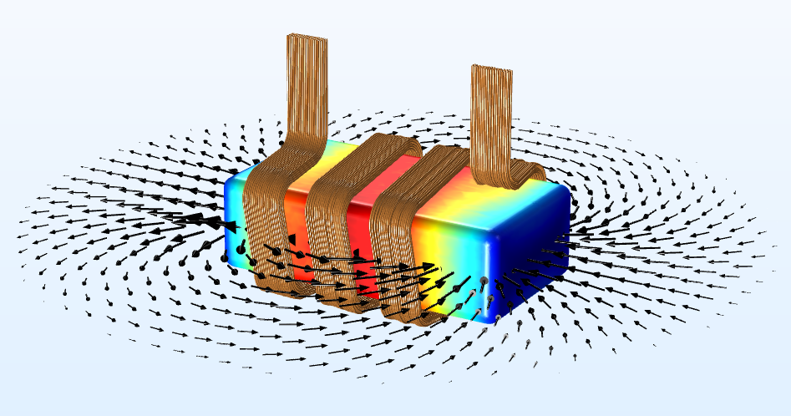
Results

Slide 6
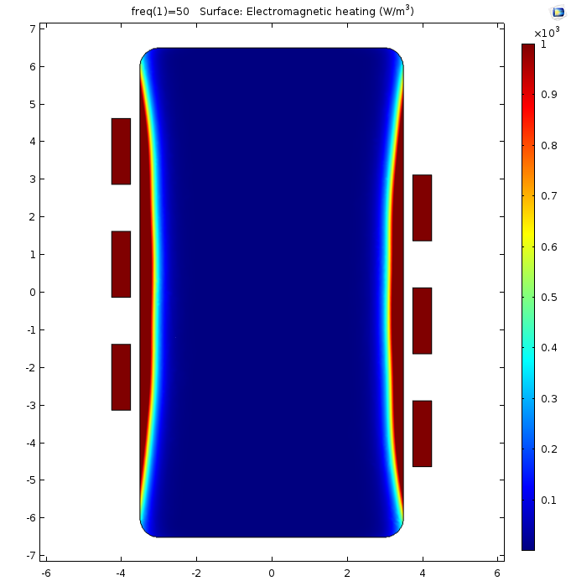
Results
Total power loss delivered to Multi-Turn Coil is extracted using a Global Evaluation of mf.PCoil_1 = 0.834 W
Power dissipated by Joule Heating in coil and ferromagnetic domain is extracted using a Volume Integration of mf.Qh, returning 0.834 W
Power in = power out

