Slide 1
Single Mode Fiber-to-Fiber Coupling
Application database model 75051
Notes:
You can use the heading from the application documentation for the title.

Slide 2
Background and Motivation
Optical fibers can be used to efficiently transmit optical field over large distances with minimal losses. When moving from a free space beam to a fiber-guided beam, we have to ensure a good mode overlap to avoid unnecessary losses.
This model illustrates how to setup a full wave model of a fiber-freespace-fiber coupling with high coupling efficiency using the beam envelopes interface in the unidirectional formulation.

Slide 3
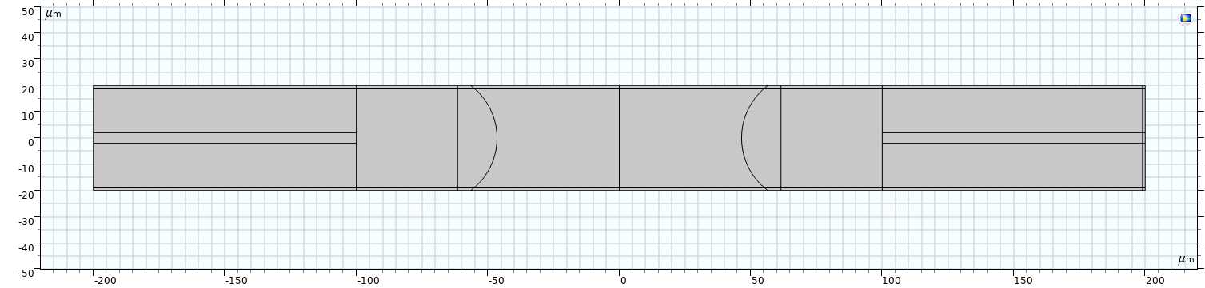
Geometry and Operating Conditions
The geometry consists of two identical single mode fibers, each one with a planar concave coupling lens.
The beam is emitted from the left fiber and collimated by the first lens. The second lens focusses the beam into the second fiber.

Slide 4
Boundary Conditions
The model uses a port boundary condition on the left fiber to compute the spatial mode of the fiber and excite the system.
Transition boundary conditions which correspond to a λ/4 single layer AR coating are used to reduce reflections on the fiber ends and the lenses.
The coupling efficiency is derived using a slit port on the right fiber. The part of the transmitted field in this spatial mode will be efficiently transmitted in the fiber.

Slide 5
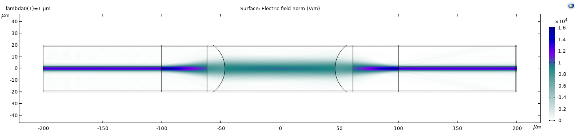
Results
Looking at the electric field, we observe very little reflection due to the AR coating of all optical surfaces
The field is collimated by the first lens and coupled into the right fiber.

Slide 6
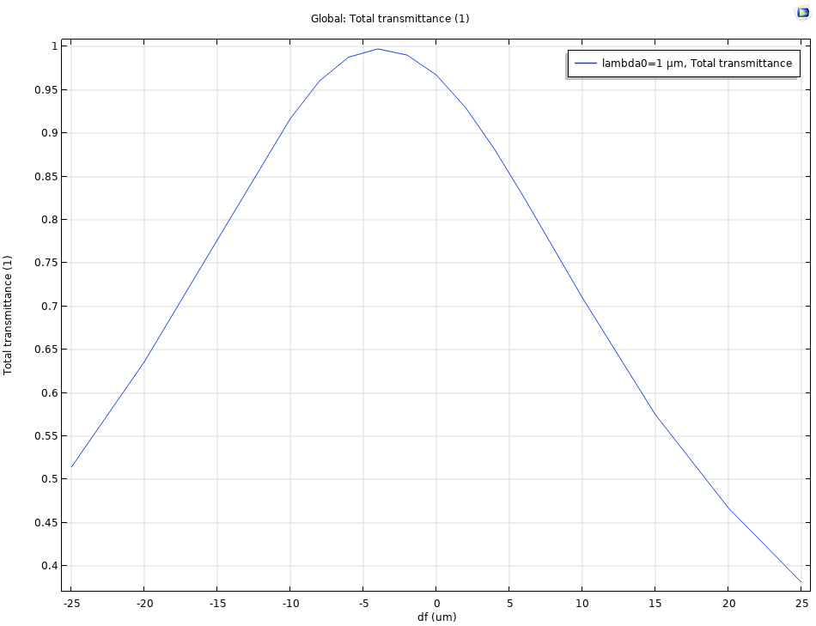
Results
Changing the position of the second lens allows us to optimize the coupling efficiency

Slide 7
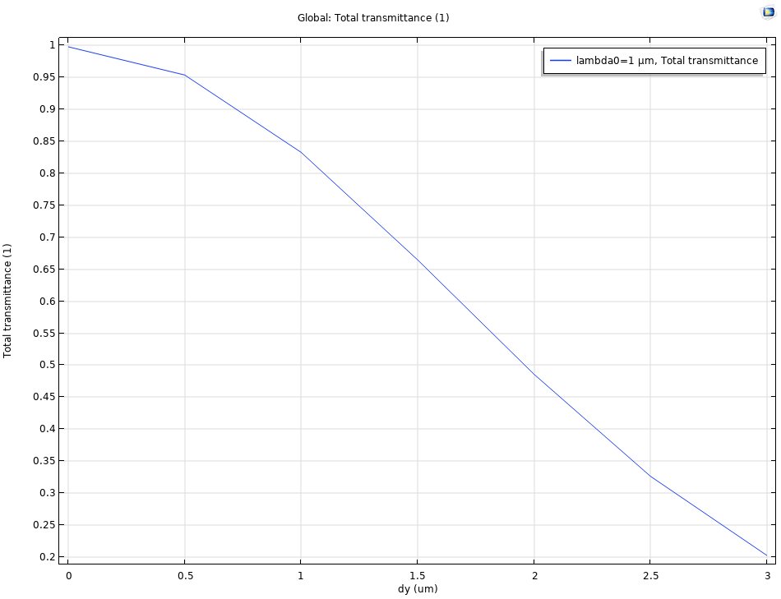
Results
To ensure a good coupling efficiency the fibers need to be aligned on the optical axis. Shifting the second fiber away from the optical axis leads to a decrease in coupling efficiency.

