Slide 1
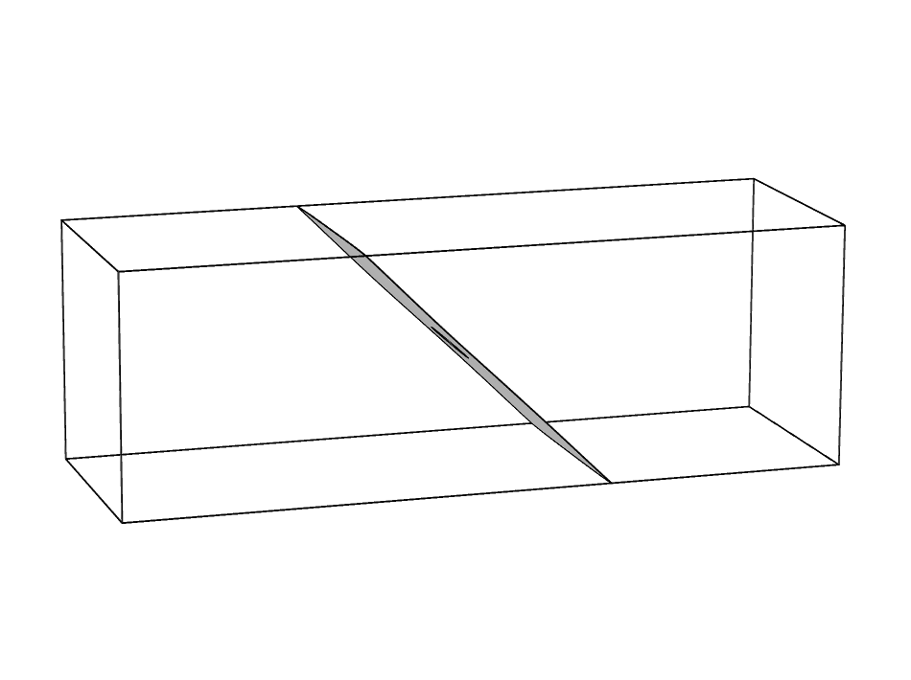
Minimizing the Flow Velocity in a 3D Microchannel

Slide 2
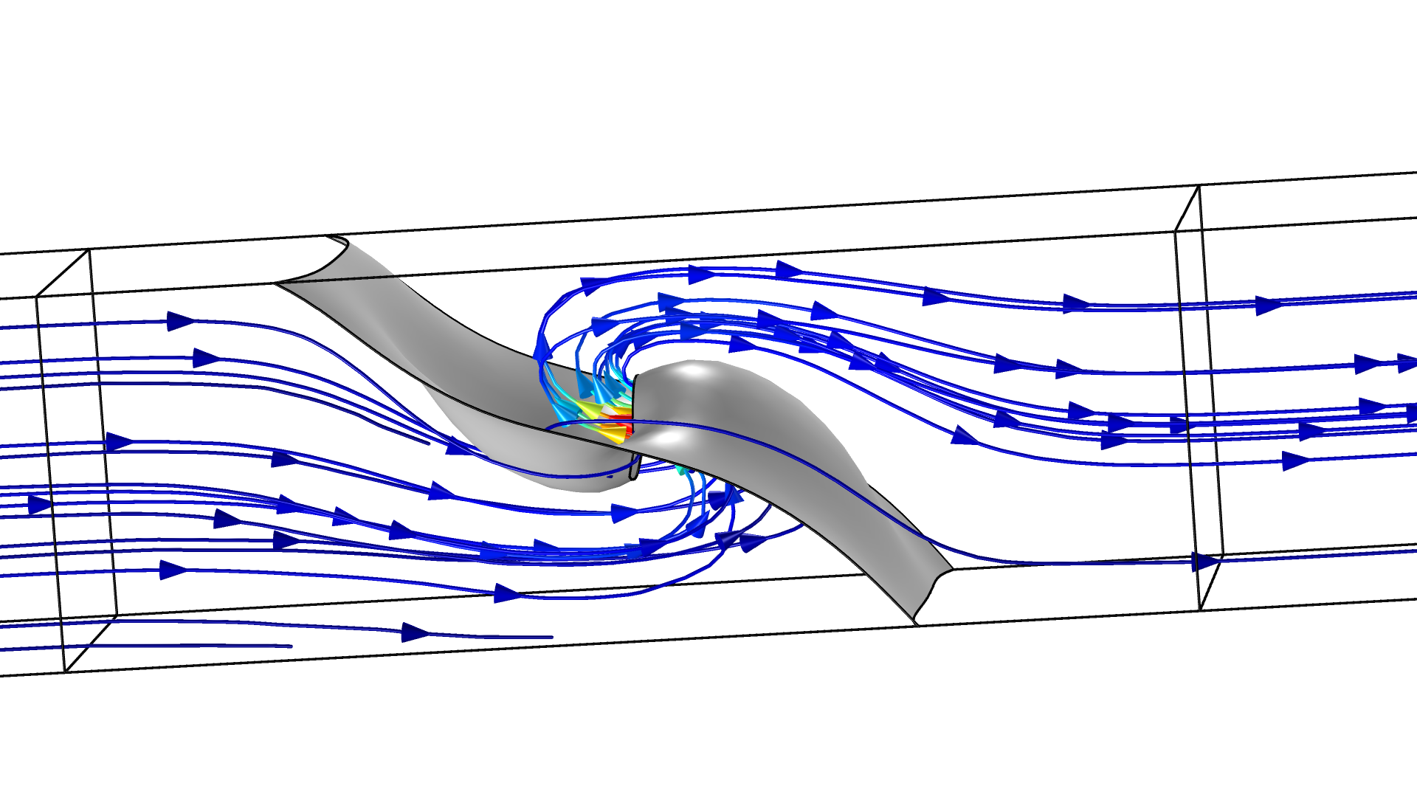
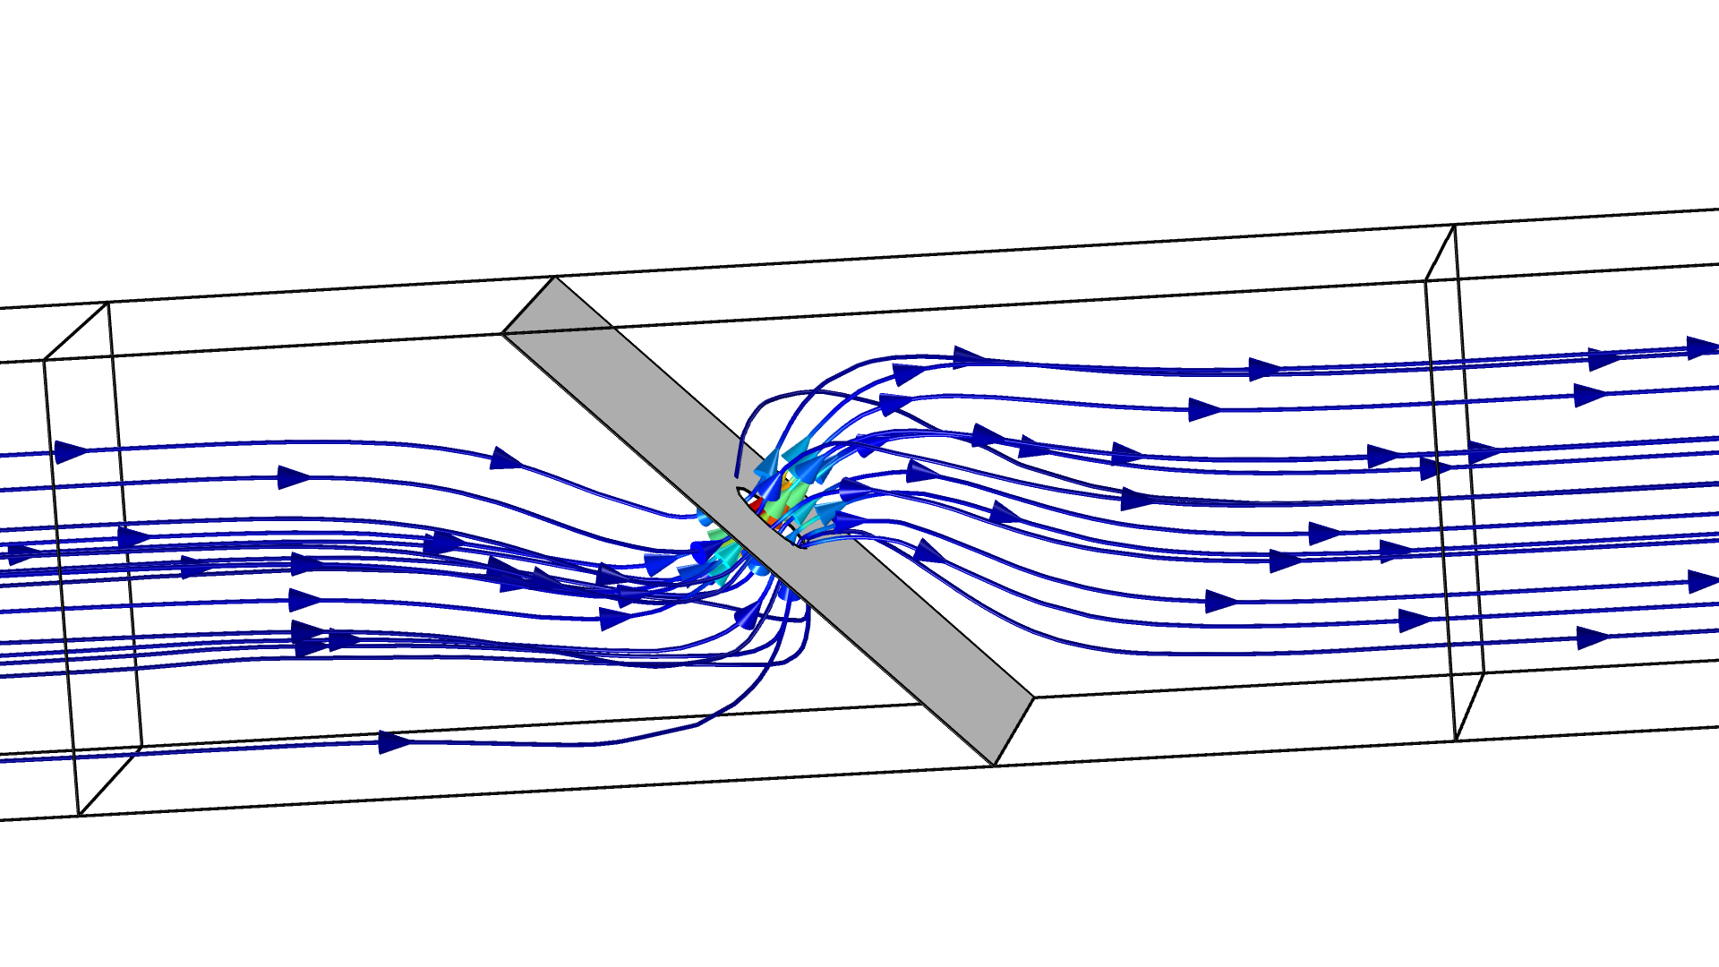
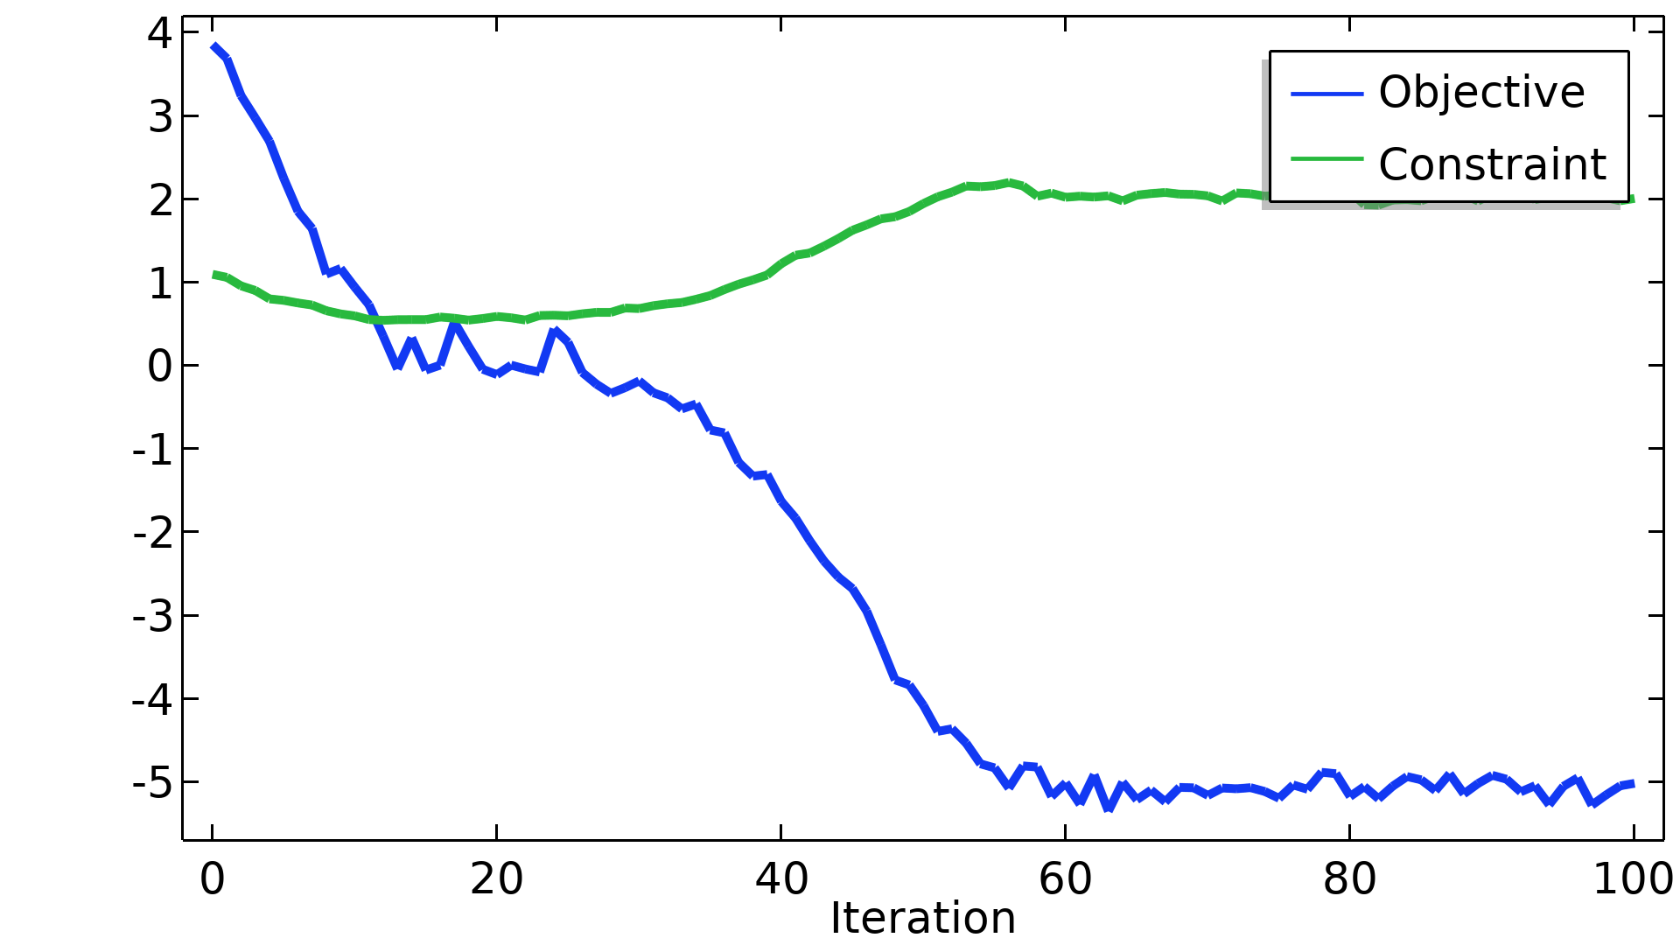
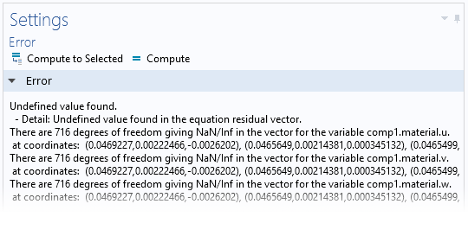
Minimizing the Flow Velocity in a 3D Microchannel
Introduction
Shape optimization can be used to improve the
performance of products.
In this model we will use it to solve an academic
benchmark problem.
This requires large deformations, which normally
results in NaN/Inf error messages due to
inverted elements.
The issue can be circumvented using a model method
that imports and exports the design between restarts
of the optimization solver.
Oscillations in the objective function due to remeshing
is to be expected
https://www.comsol.com/model/72401

