Slide 1
Homogeneous Charge Compression Ignition of Methane
Notes:
You can use the heading from the application documentation for the title.

Slide 2
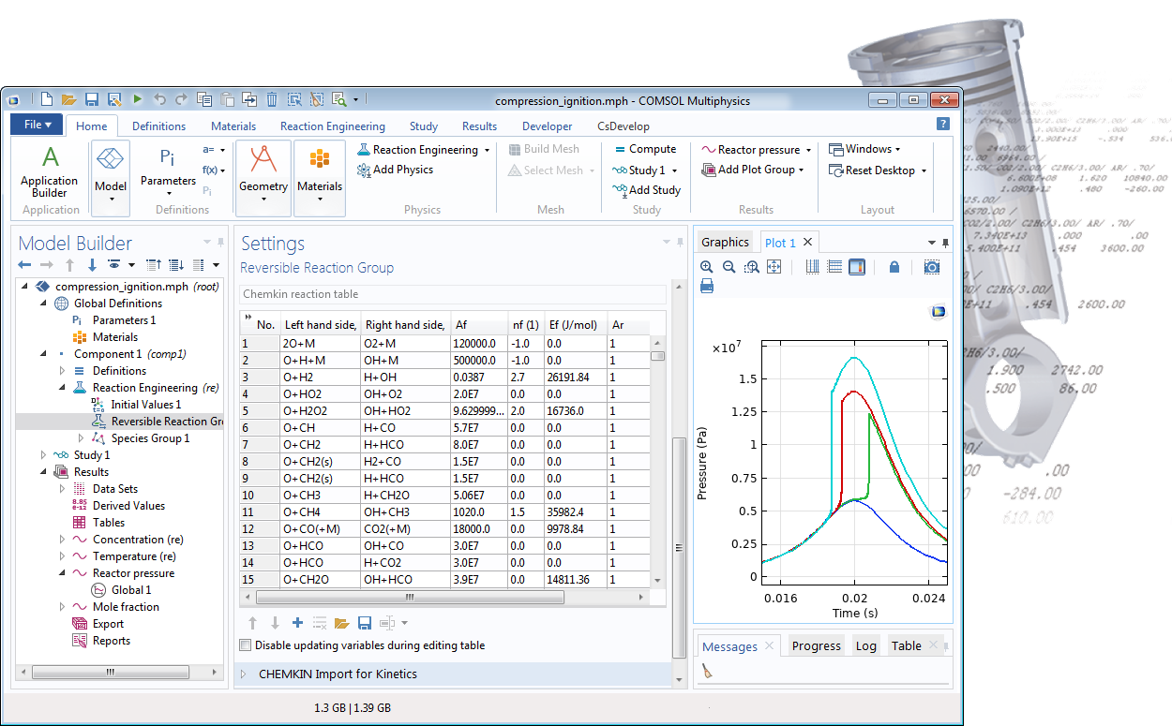
CHEMKIN kinetics import

Slide 3
Homogeneous Charge Compression Ignition of Methane
Alternative to traditional spark and compression-ignition engines
Low combustion temperatures
  Low levels of NOx emissions
Homogeneous nature of the fuel
  Low levels of particulate matter
One important issue, timing of the ignition
Examine the HCCI of methane
  Import data from CHEMKIN Kinetics and Thermo input files
  Calculate the mass and energy balances
  Solve for different initial temperatures
  Investigate the effect of Formaldehyde on the ignition

Slide 4
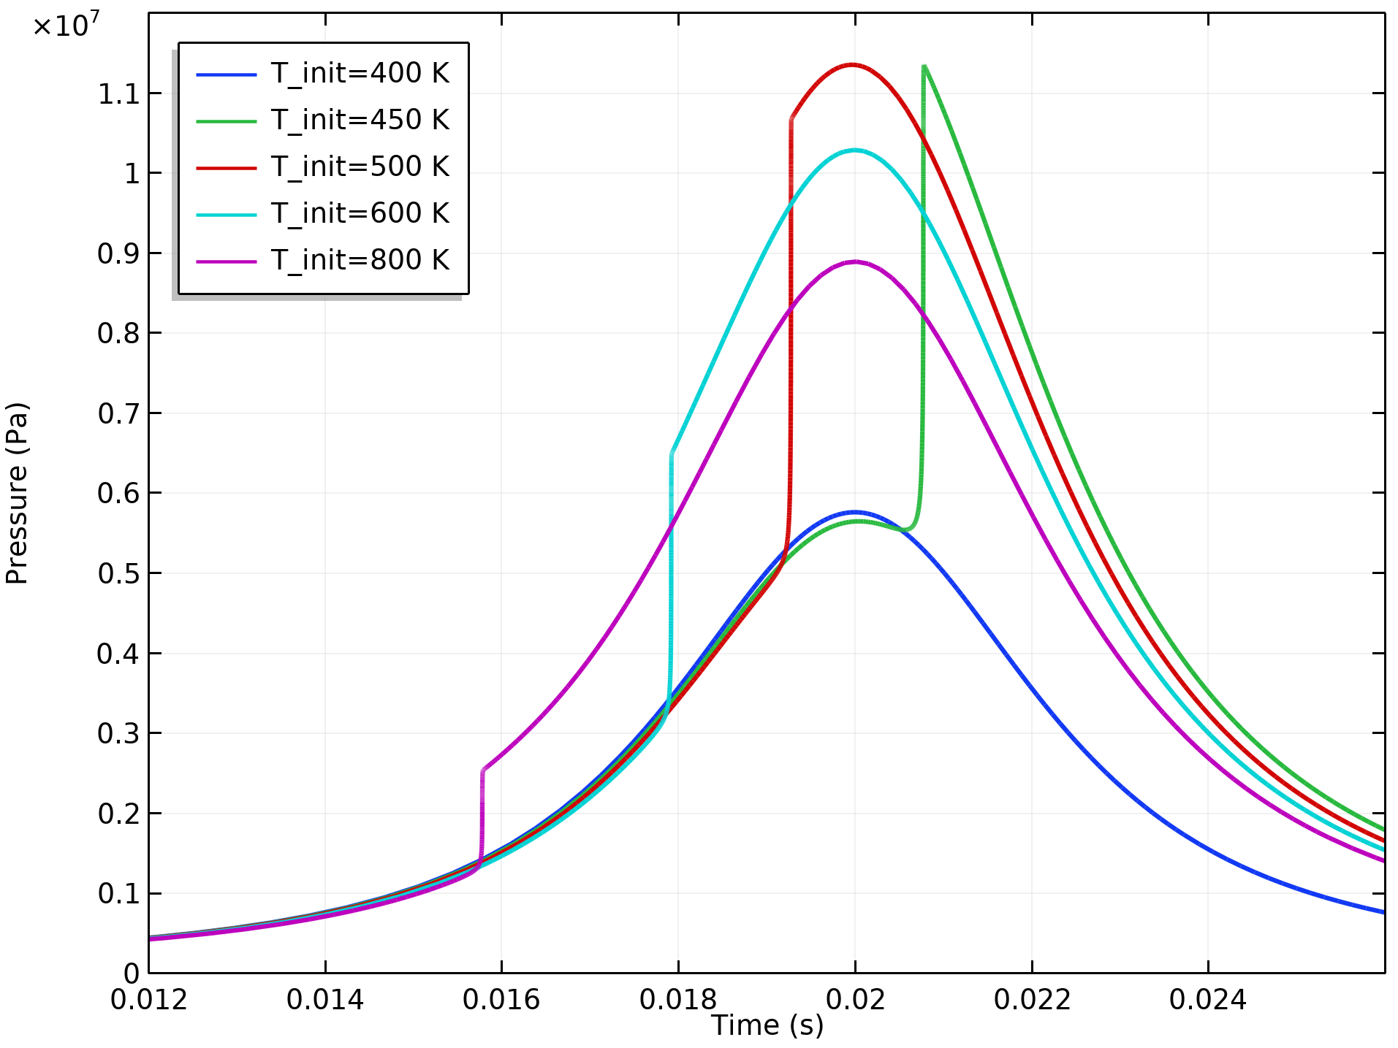
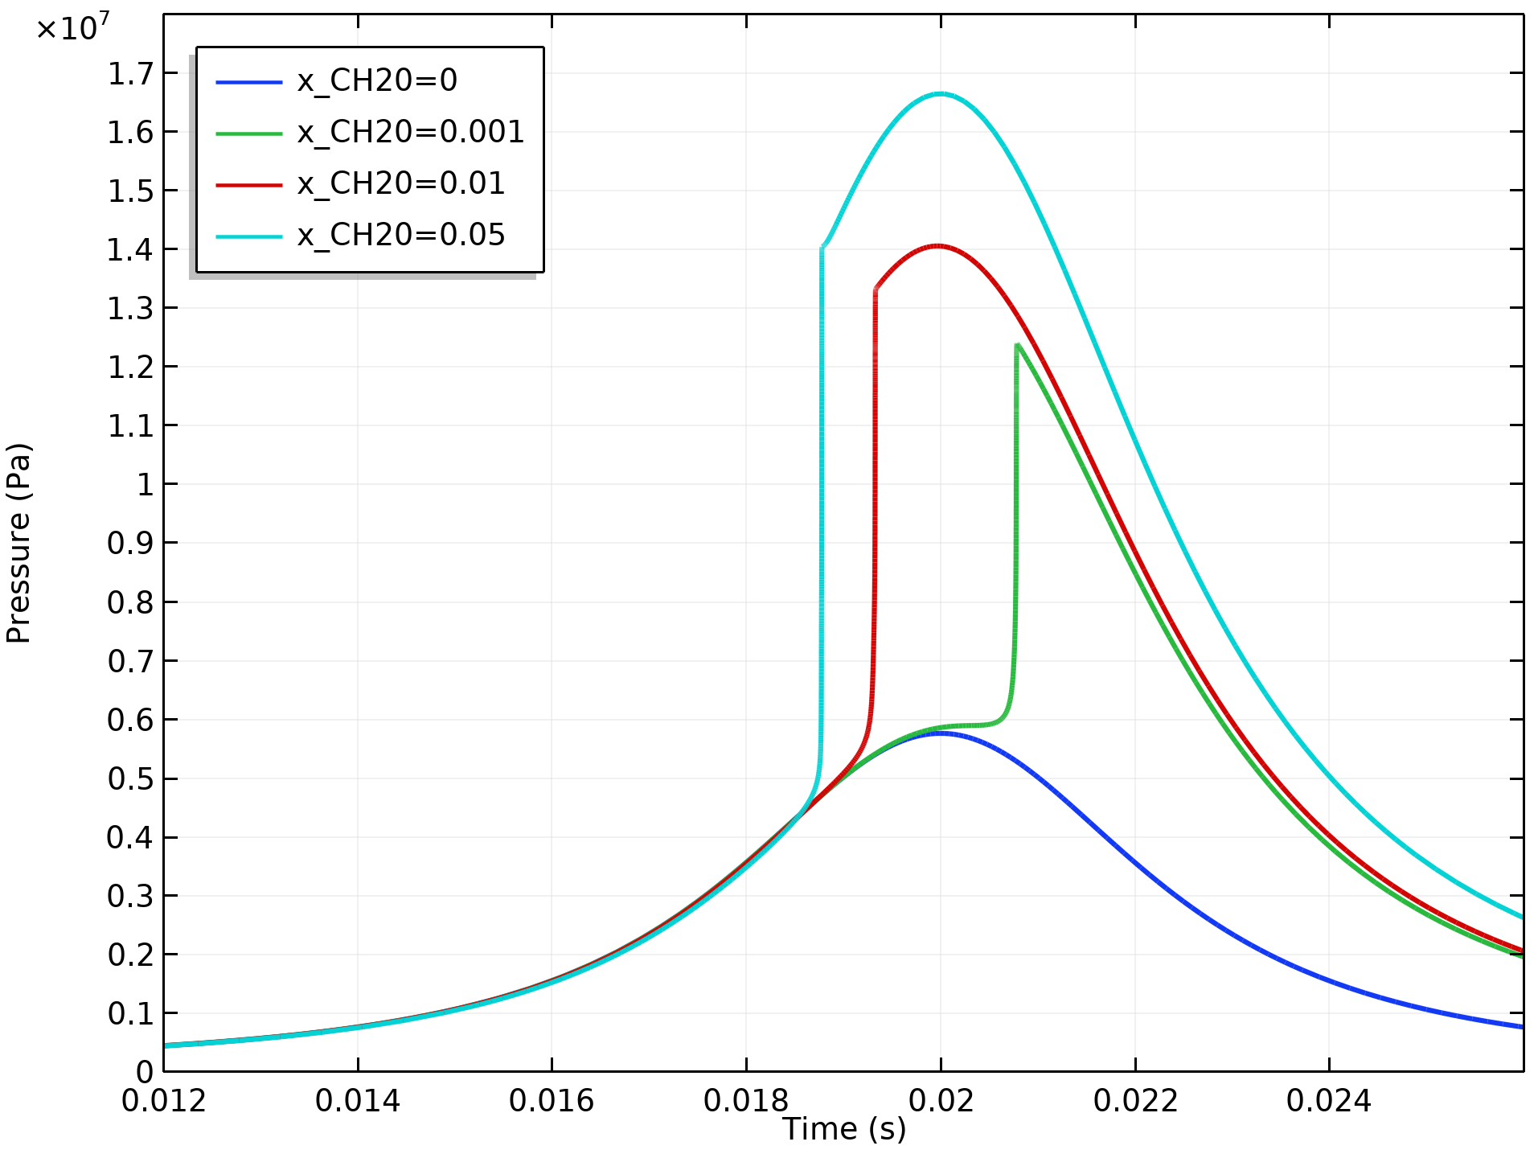
Homogeneous Charge Compression Ignition of Methane
Pressure traces from compression and ignition using different initial temperatures
Small amounts of formaldehyde stimulate the ignition

