Slide 1
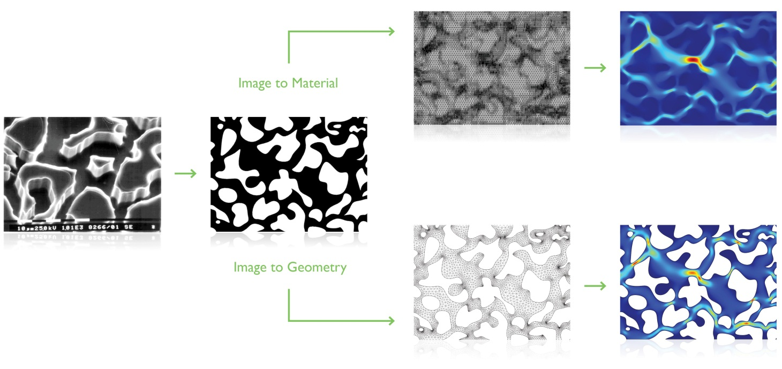
Image to Material Import

Slide 2
Image Import
You can now use image data to represent 2D material distributions or to identify regions with different materials by their color or gray scale. Images used in this way can have many origins such as scanning electron microscope (SEM), computed tomography (CT), or magnetic resonance imaging (MRI).
An important application of image import is for easy computation of equivalent volume-averaged material properties for highly inhomogeneous or porous materials. This includes properties such as conductivity, permittivity, elasticity, or porosity and allows for converting spatially distributed values to a single representative averaged value. Such equivalent material properties can then be used for simulations of larger structures avoiding detailed microscopic information. This modeling approach has several advantages such as avoiding the often difficult operations of image segmenting and image-to-geometry conversion. It also brings greatly simplified meshing, less memory usage, and shorter computation times--this can be particularly important when the same type of analysis needs to be repeated many times for different images.
An imported image is made available as a general COMSOL interpolation function that can be used for any modeling purposes. Certain 3D analyses are made possible by importing multiple images representing sections of a 3D structure.
Supported image formats are: JPG, JPEG, BMP, PNG, GIF

Slide 3
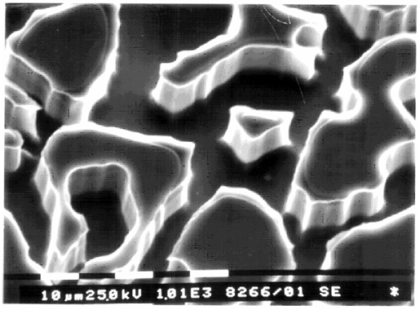
Scanning electron microscope (SEM) image of the repeat pattern in a silicon wafer. The scale at the bottom indicates that pore throat and body dimensions are on the order of 1-100 microns. The new image import feature makes it easier to use such images to represent 2D material distributions or to identify regions with different materials by their color or gray scale.
Image from 1. M. Auset and A.A. Keller, “Pore-scale Processes that Control Dispersion of Colloids in Saturated Porous Media,” Water Resources Research, vol. 40, no. 3, 2004.

Slide 4
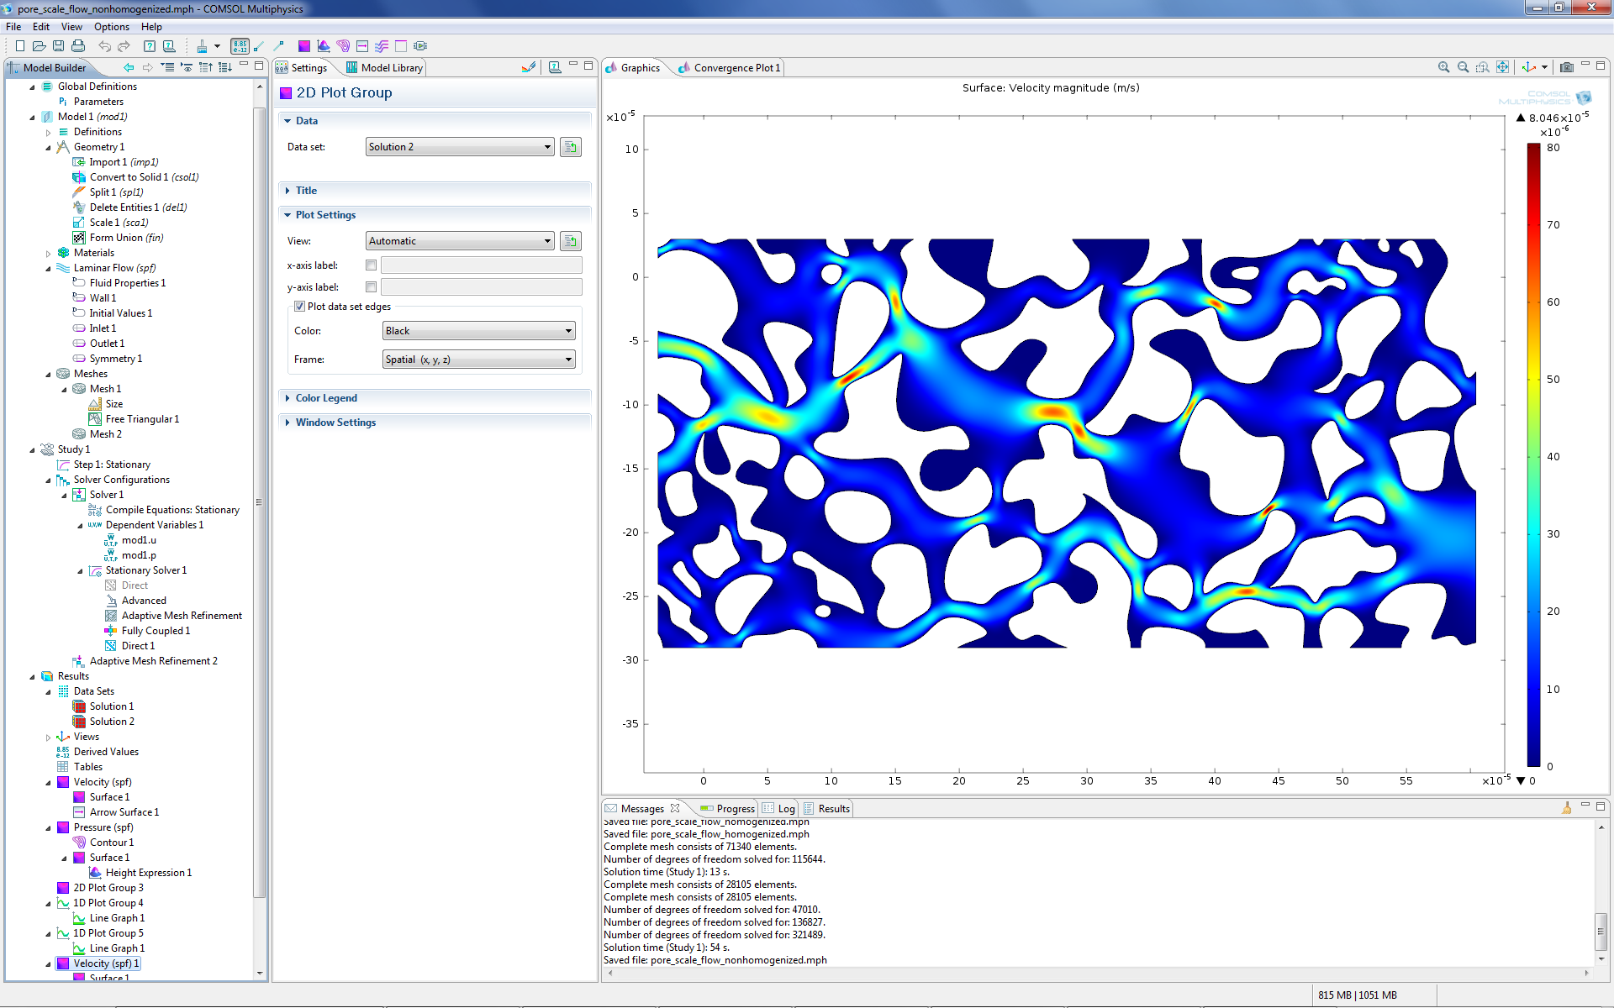
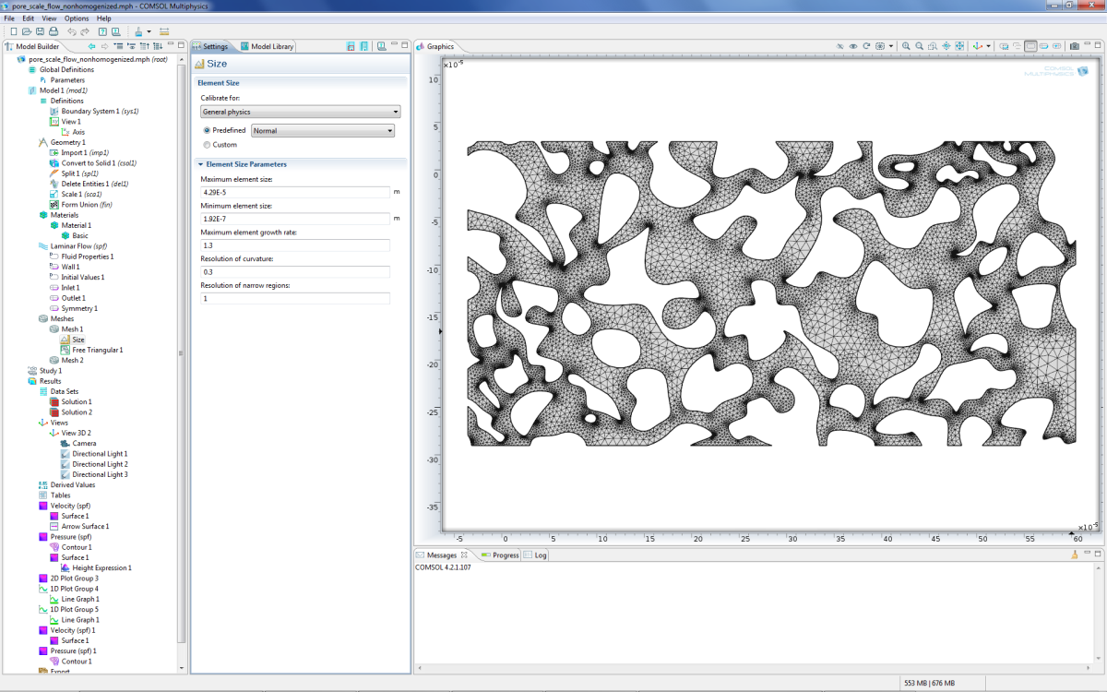
The pictures illustrates a traditional modeling technique where the detailed outline of a geometry, based on image data, is represented in the simulation. This method is sometimes laborious since it may require manual cleaning and filtering of the image and geometry model in order to convert it to a format suitable for simulation. This model is available in the Model Library of the Subsurface Flow Module.

Slide 5
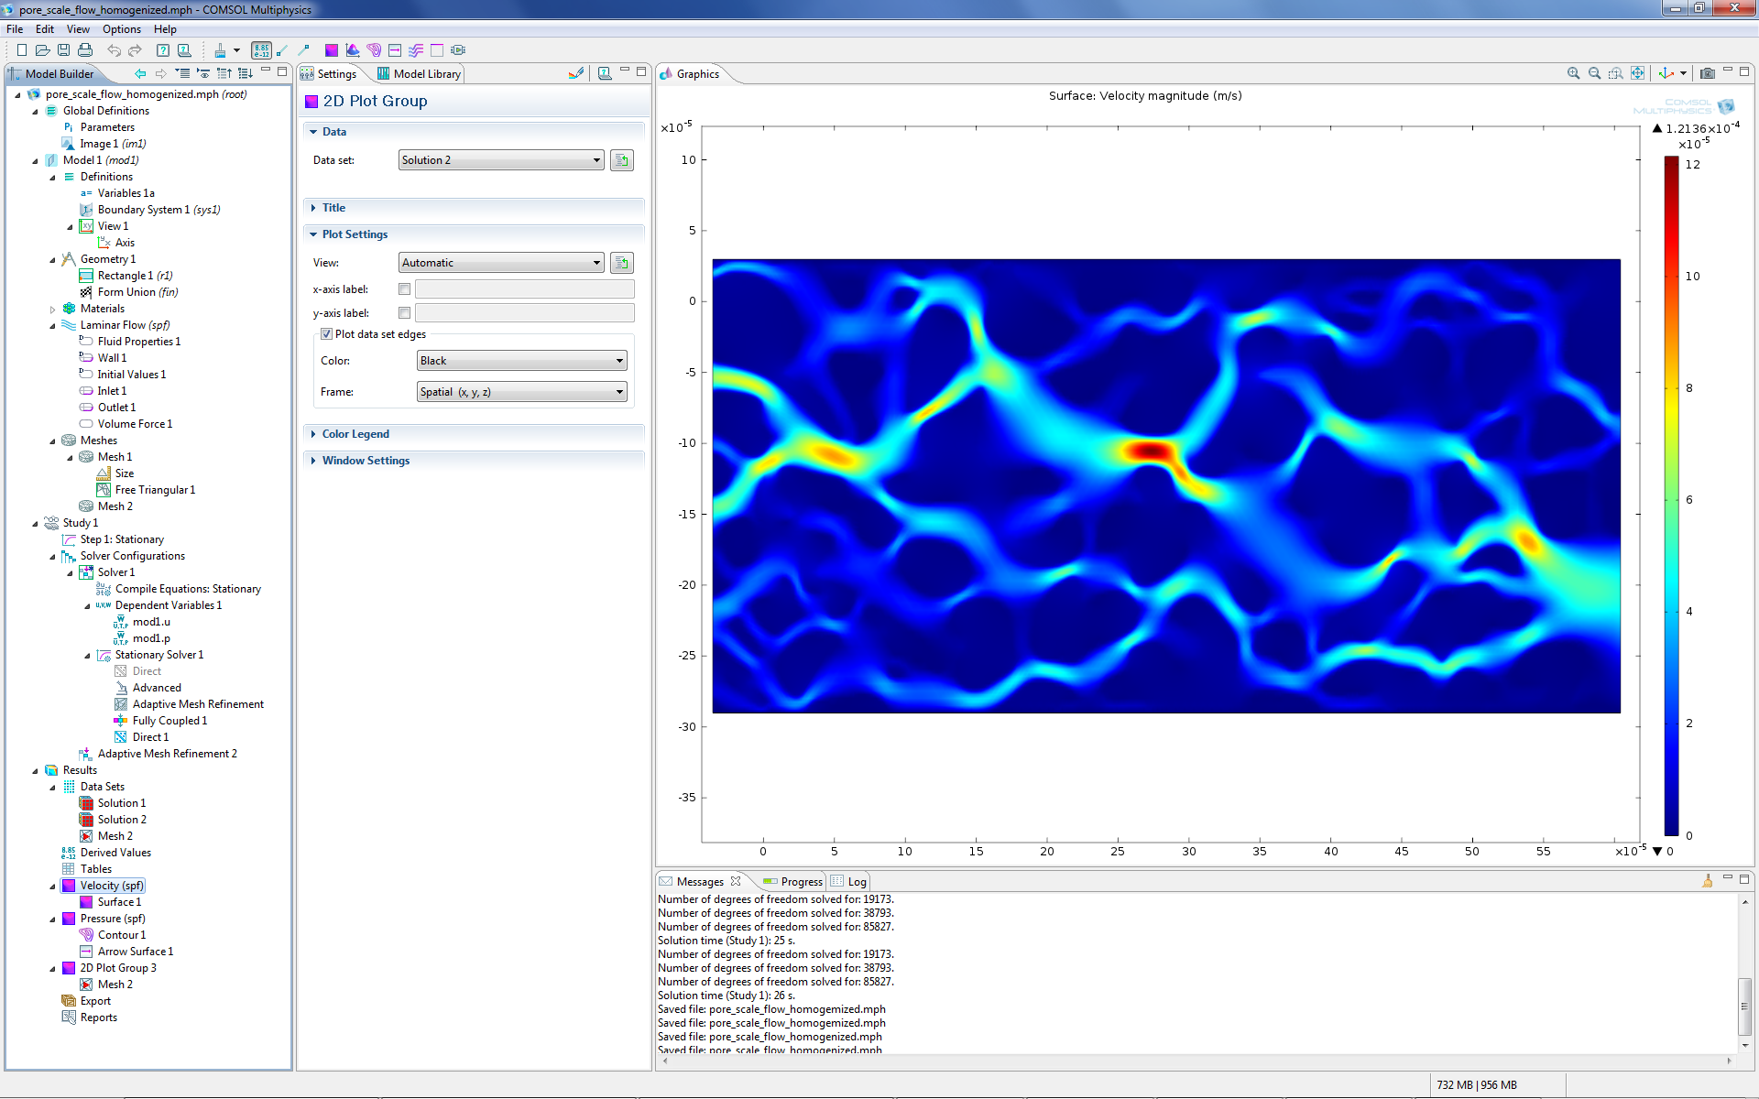
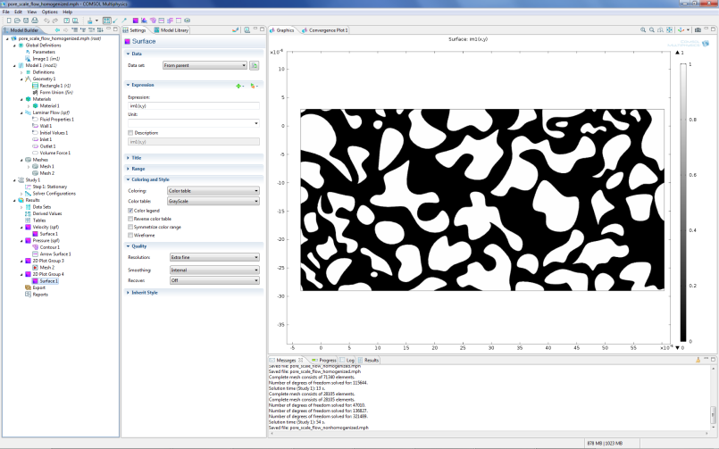
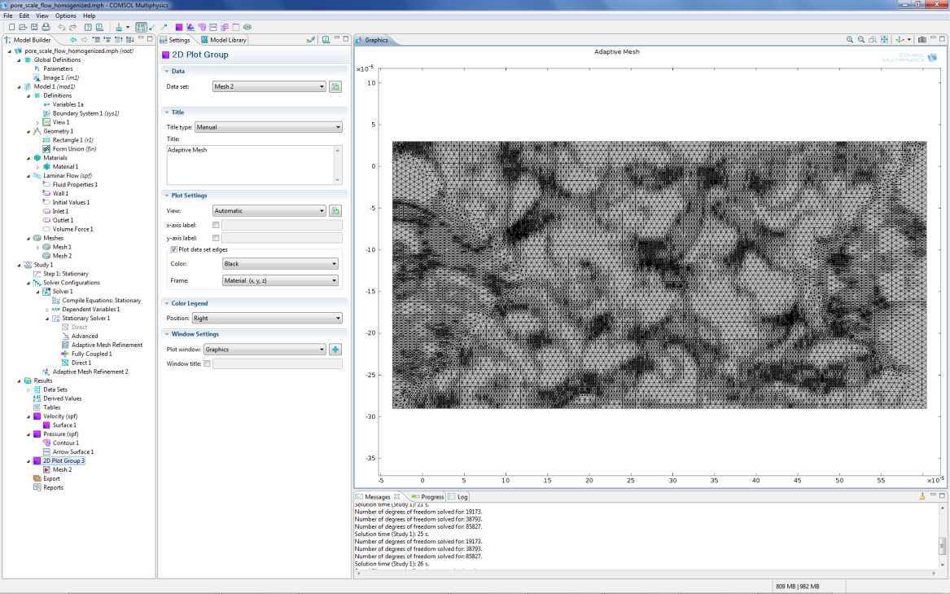
The pictures shows a simulation where the pore structure is represented implicitly by a gray-scale picture instead of explicitly by a CAD geometry. A flow simulation of the structure is run against a mesh generated on a single rectangle. Such meshes can be generated very quickly and without human intervention. An adaptive mesh was used to increase accuracy. The level of detail of the simulation result can be controlled very easily by coarsening or refining the mesh and be set to meet specified solution time goals where accuracy is traded against speed.

Slide 6
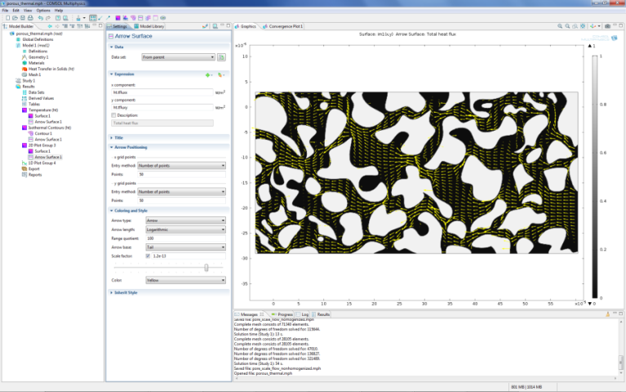
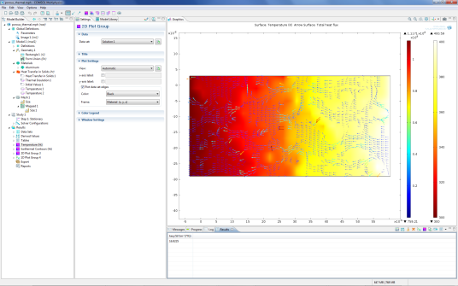
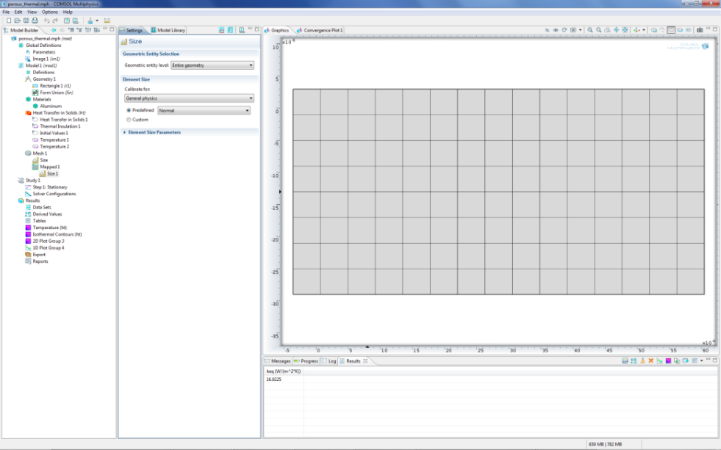
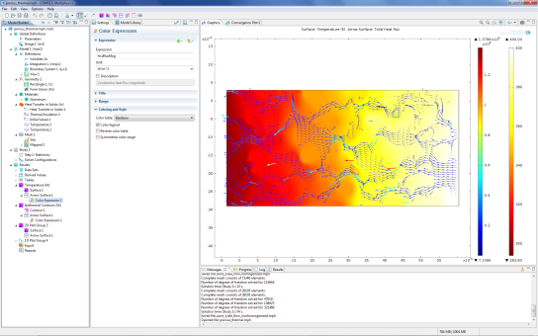
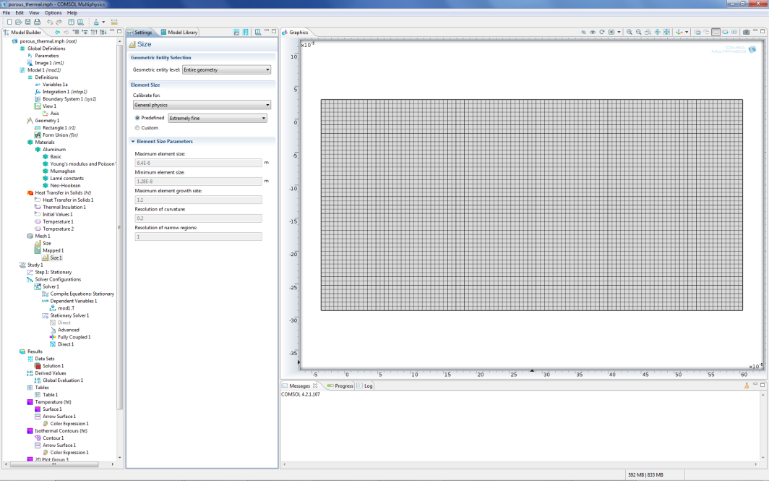
The picture shows a heat transfer simulation where image-to-material conversion was used to represent a porous structure. The goal is to efficiently compute the equivalent thermal conductivity of the structure.
The mesh refinement controls the granularity of the material representation and is easily controlled by the user. A coarser mesh results in faster and less memory intensive calculations. A finer mesh results in higher accuracy and resolves geometric detail.
When thousands of similar computations are needed on different images such trade-offs between accuracy and speed can be critical to bring down total compute-times to manageable levels.

Slide 7
An Example
This is a basic example of image import for a thermal simulation based on an image of a porous Aluminum structure.
In this case, the image is binary and its pixels take the values 1 or 0 depending on if a material is present or not. The method shown is applicable also to gray scale images.
We will here, to make it simple, assume that pixel values 1 represent Aluminum and 0 represent Air.
In addition, since this is a thermal conductivity representation, it is assumed that the Air material has a significantly lower conductivity (kAir) than Aluminum (kAl) and is represented with an arbitrary low-enough value. Here, kAl=160 W/(m*K) and kAir=0.1 W/(m*K). This is to achieve kAl>>kAir.
  Keeping this value low approximates that there is no conduction at all in the Air domain. At the same time, keeping it not too low ensures faster and more robust convergence of the solvers. A zero value would make a singular problem that cannot be solved.

Slide 8
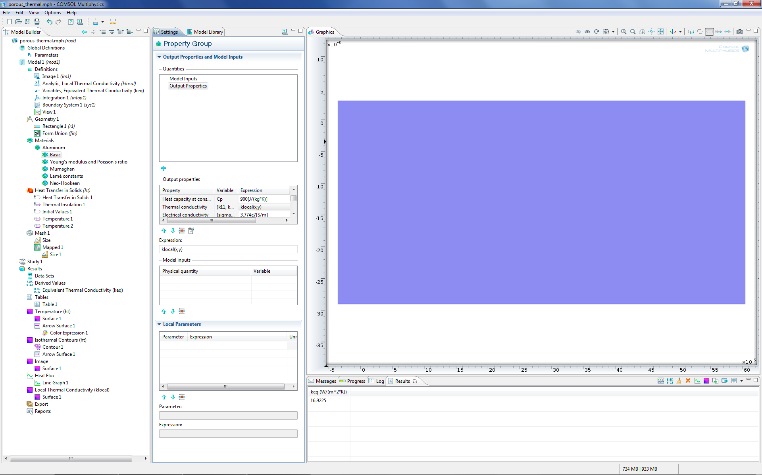
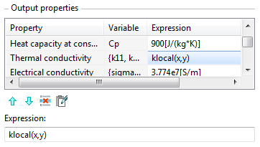
The geometry is a rectangle and the thermal conductivity of the highly heterogeneous material is represented by the function klocal(x,y).

Slide 9
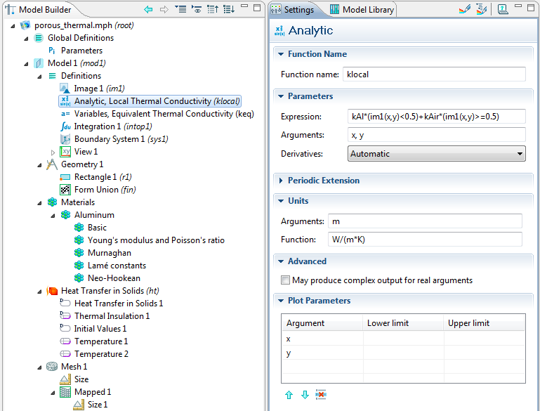
The function klocal(x,y) is defined in terms of the imported image im1(x,y). Where the image value is below a threshold 0.5 (black), the material is set to kAl and above 0.5 (white) it is set to kAir.

Slide 10
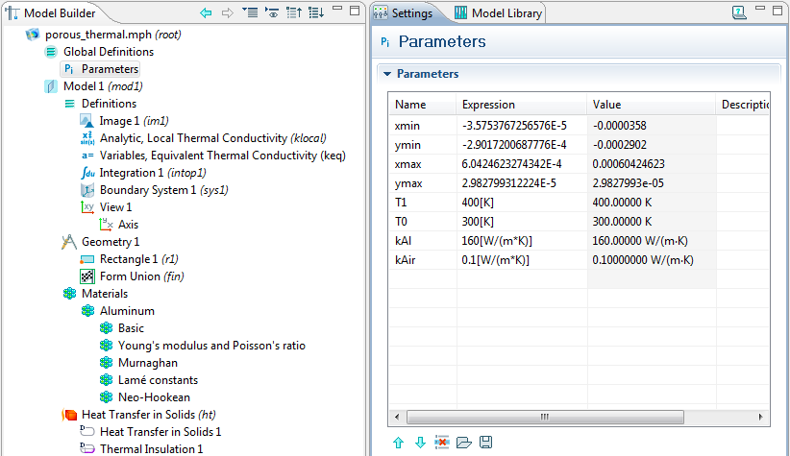
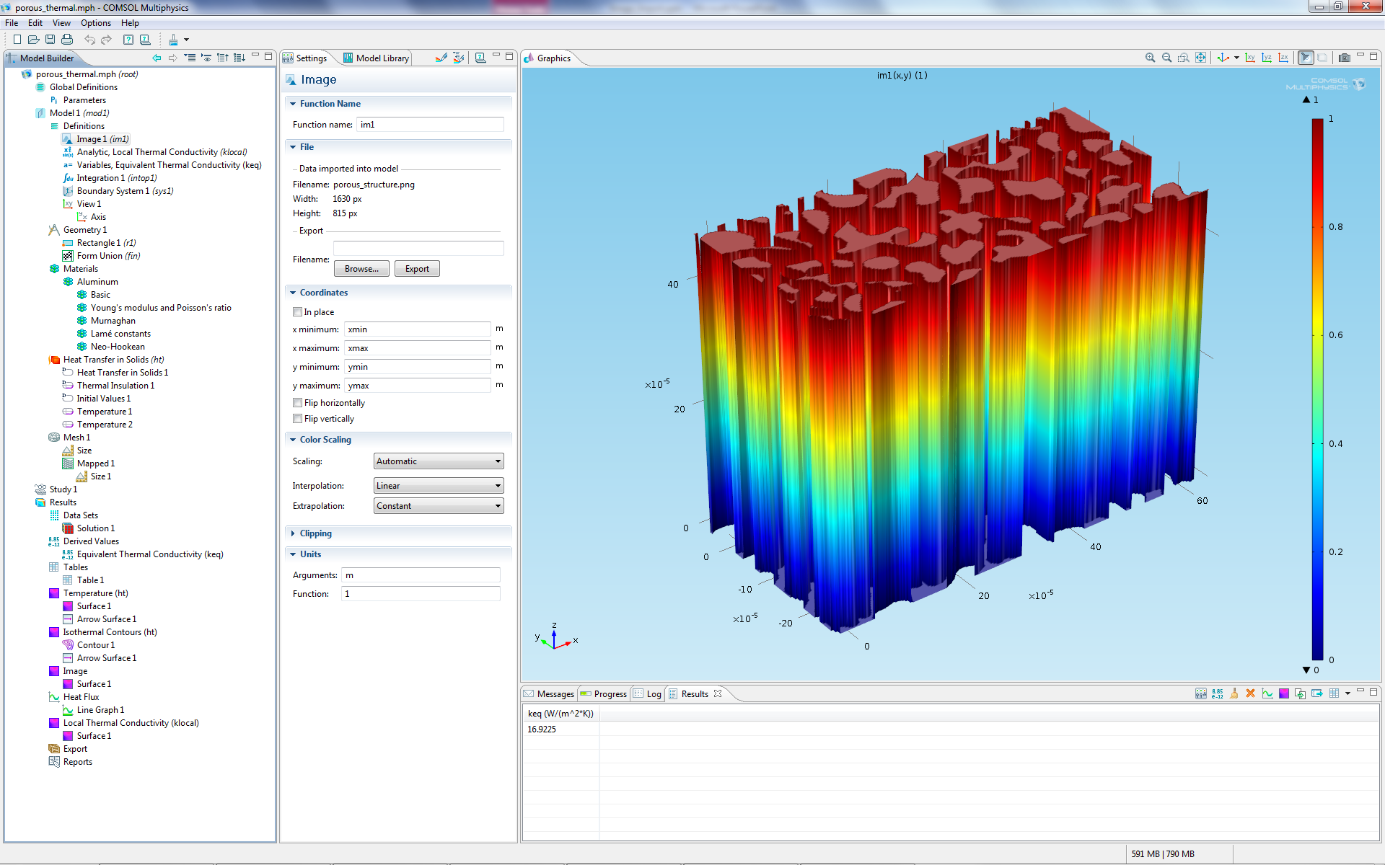
The function im1(x,y) creates a 2D interpolation table based on the image porous_structure.png. The coordinate values of its bounding rectangle is given by the parameters xmin, xmax, ymin, ymax. The image will be fit to this rectangle and can be visualized as, for example, the shown height plot.

Slide 11
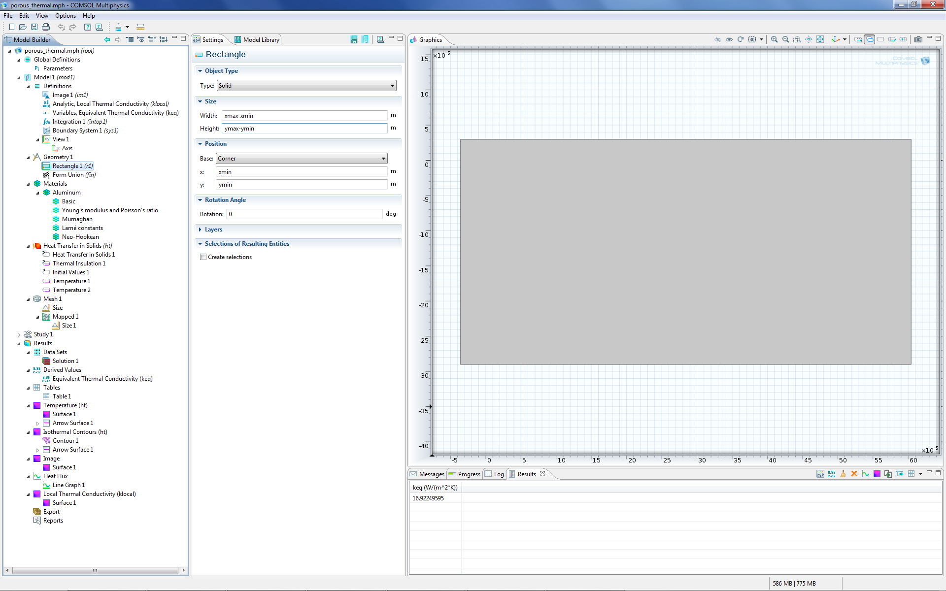
The geometry is a rectangle with lower left corner at xmin, xmax (defined as Parameters) and Width: xmax-xmin and Height: ymax-ymin.

Slide 12
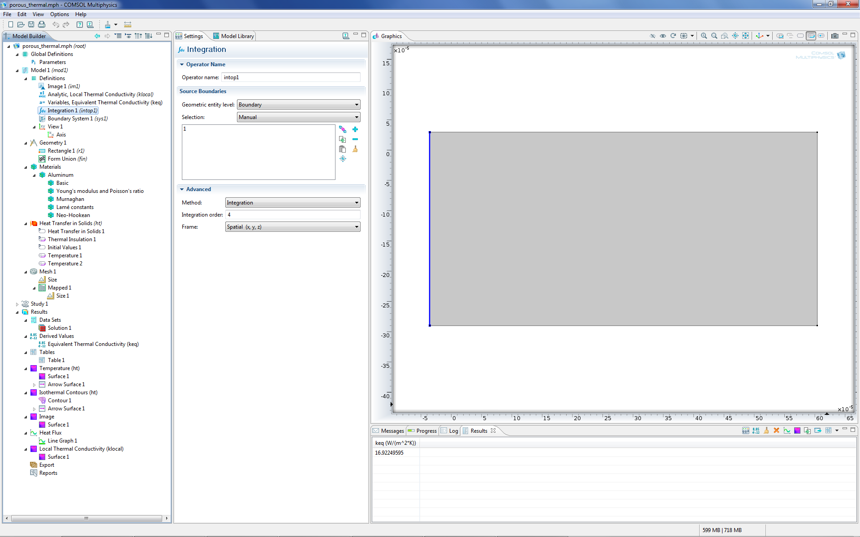
To integrate the total heat flux on the left boundary, an integration operator intop1() is needed.

Slide 13
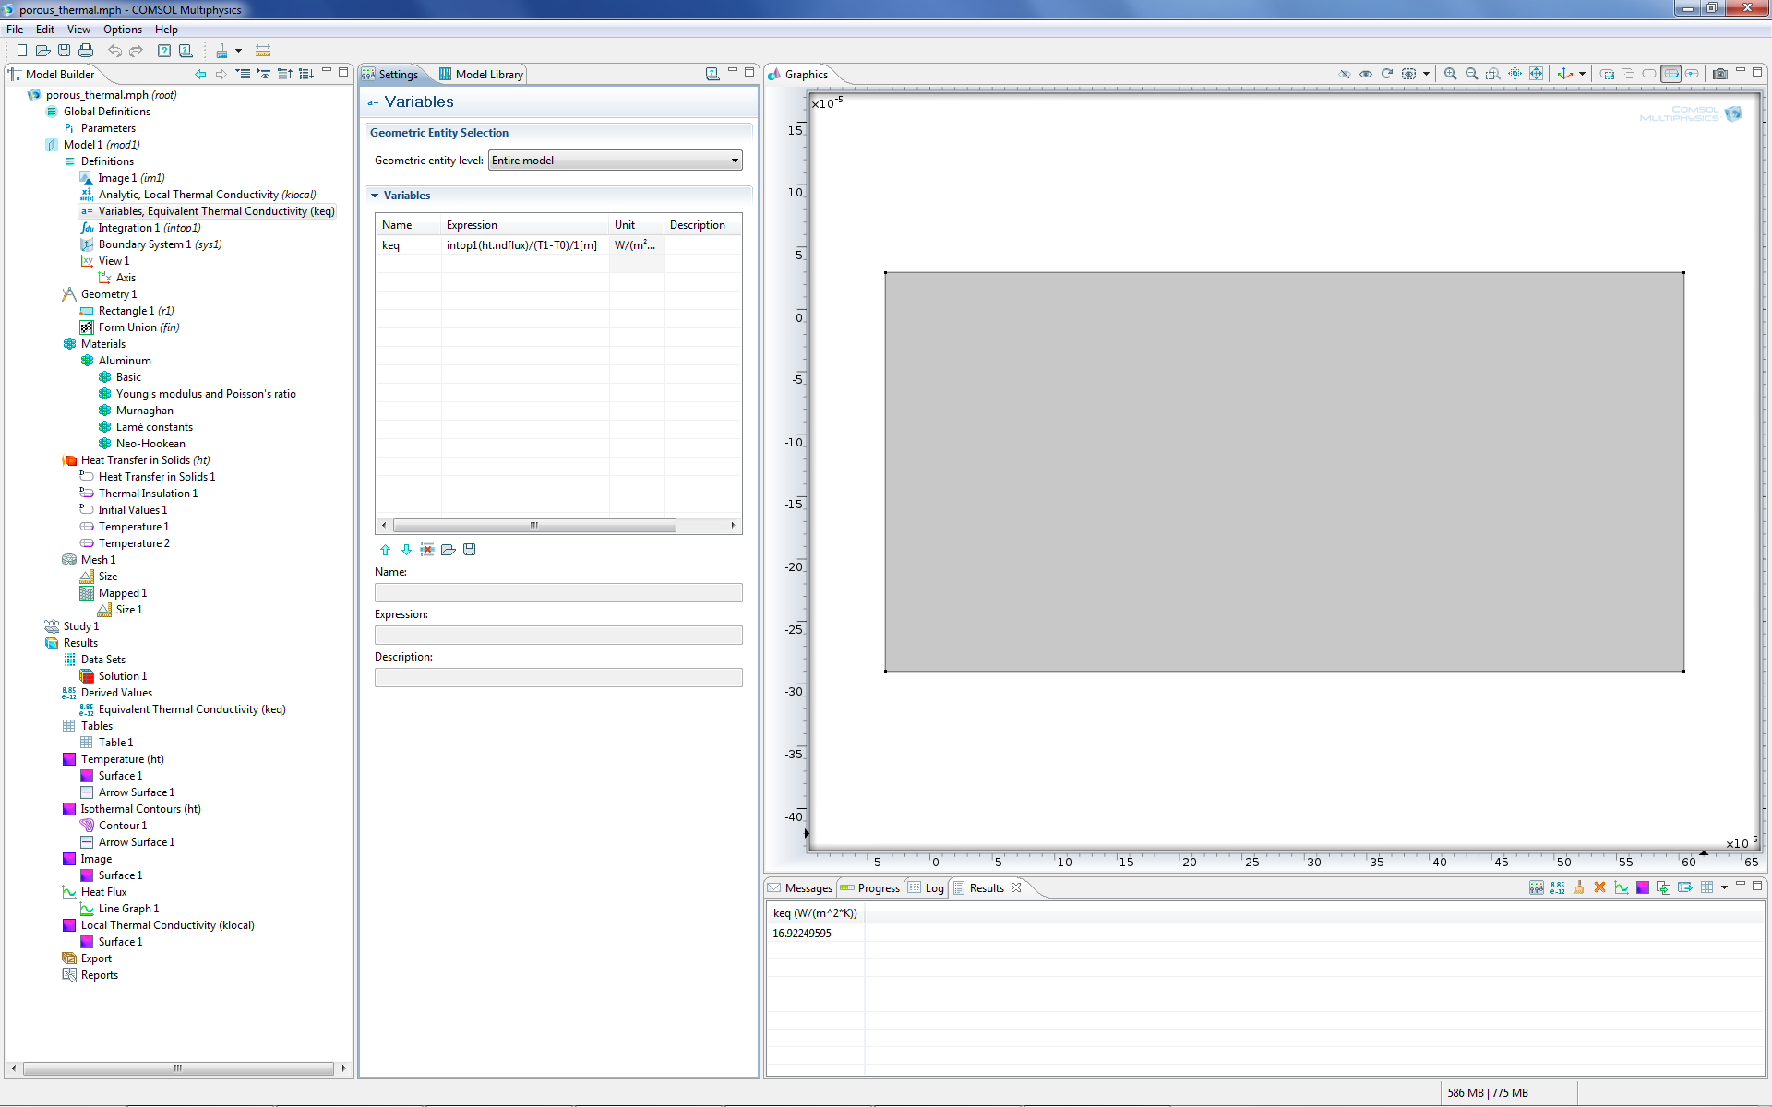
The variable keq is defined as intop1(ht.ndflux)/(T1-T0)/1[m] and computes the equivalent thermal flux through the structure: flux/temperature difference/thickness.

Slide 14
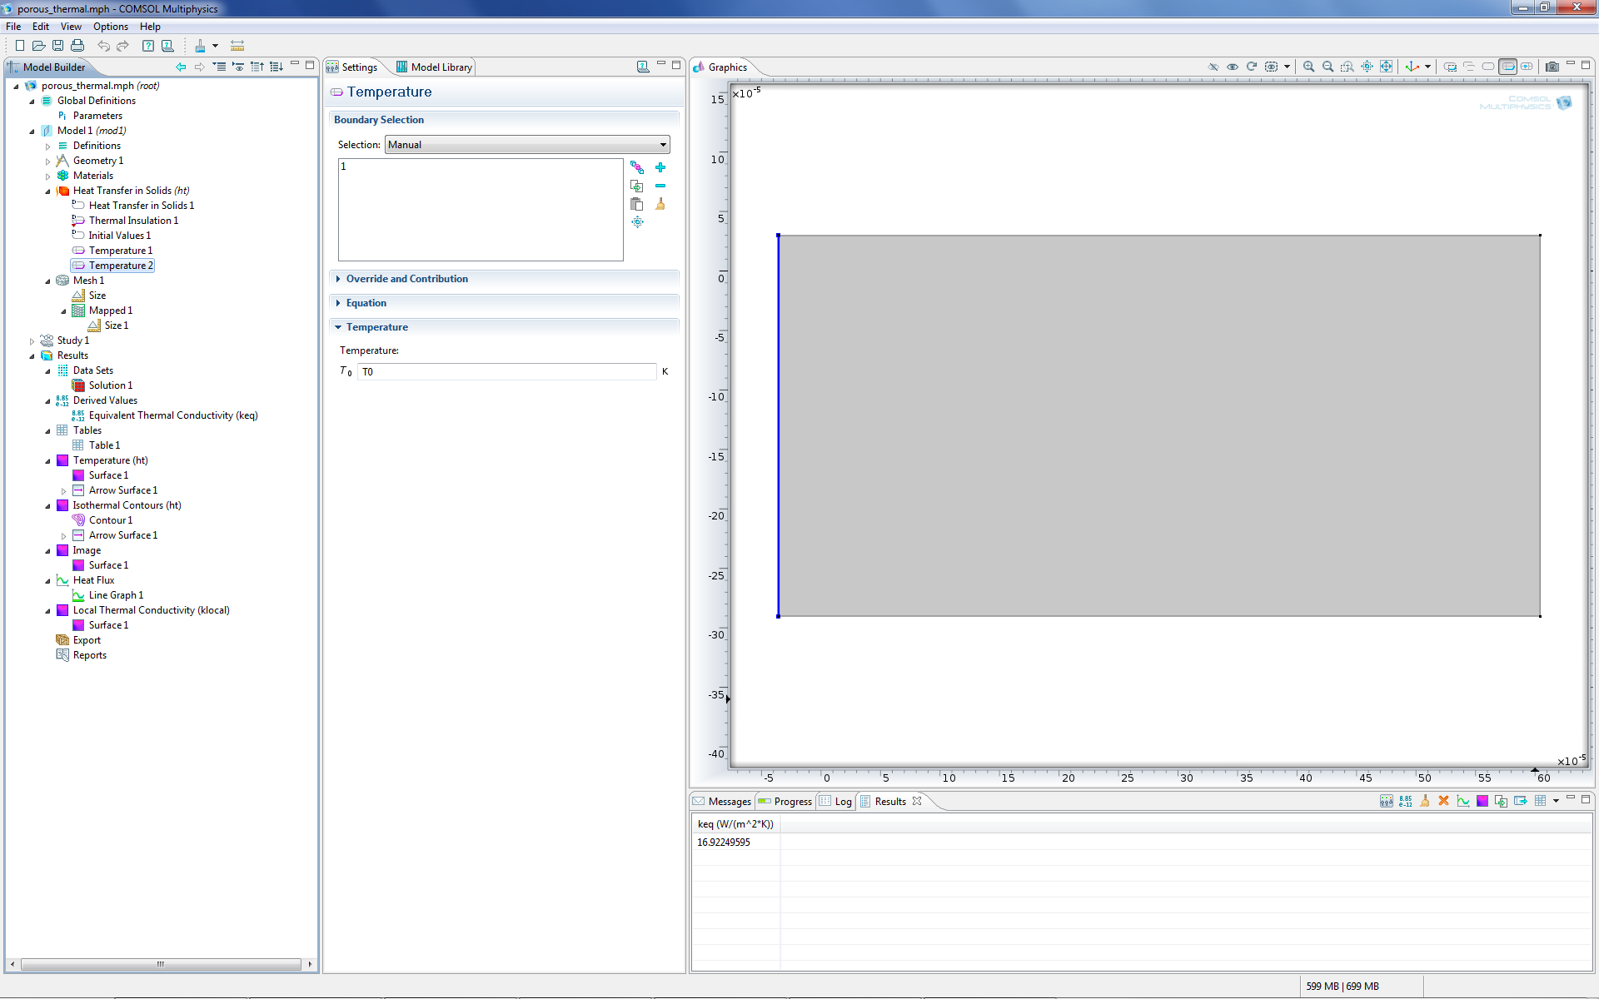
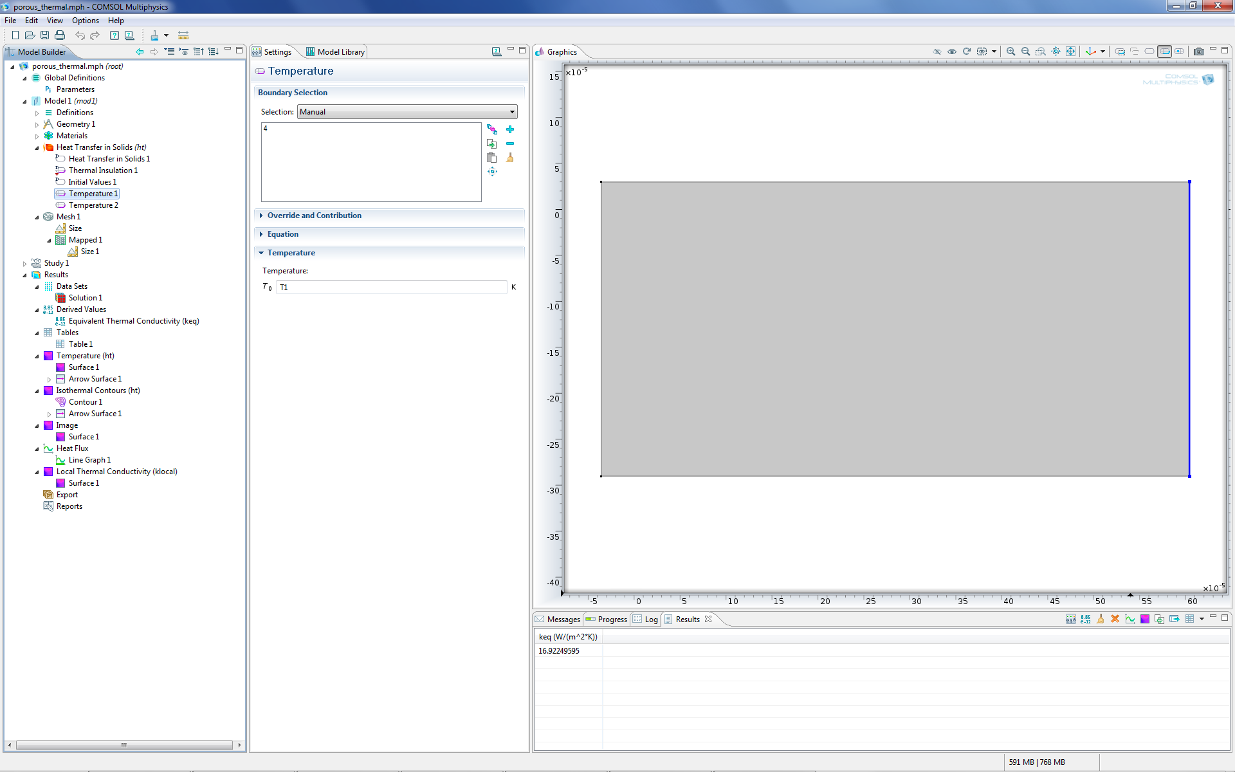
The heat transfer problem has fixed temperature T0 on the leftmost boundary, T1 on the rightmost boundary and the top and bottom boundaries are insulated.

Slide 15
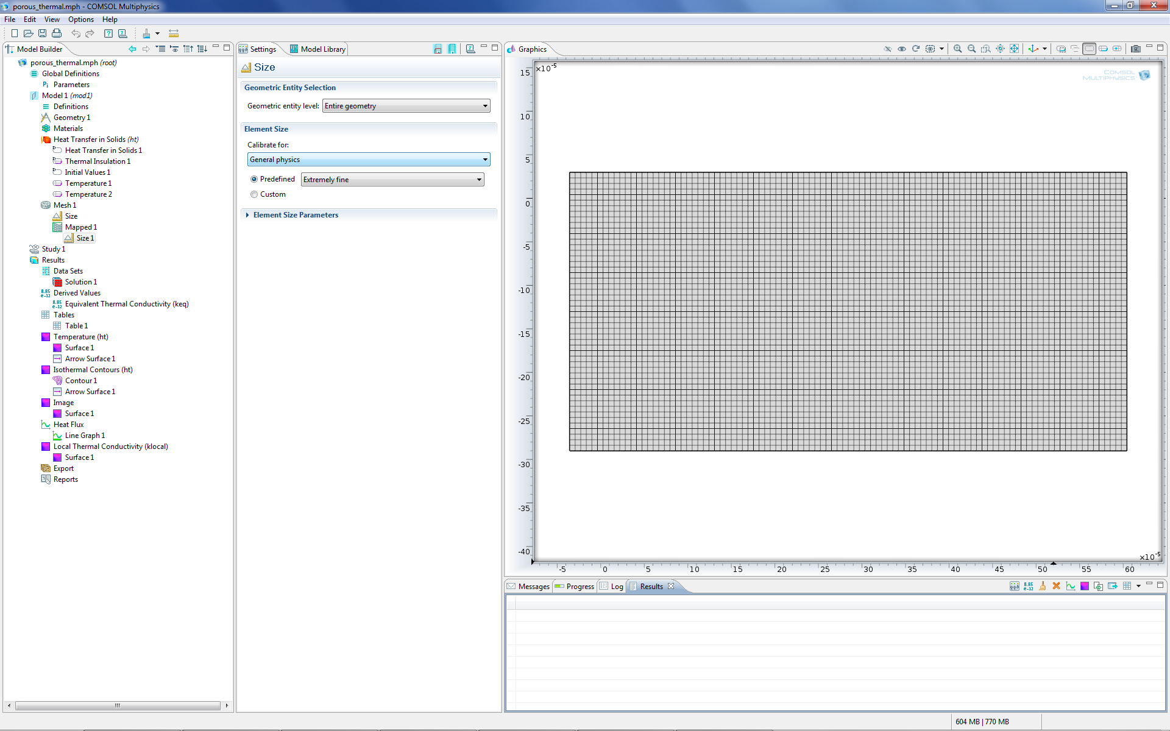
The mesh is in this case a mapped mesh with Predefined Element Size set to Extremely fine.

Slide 16
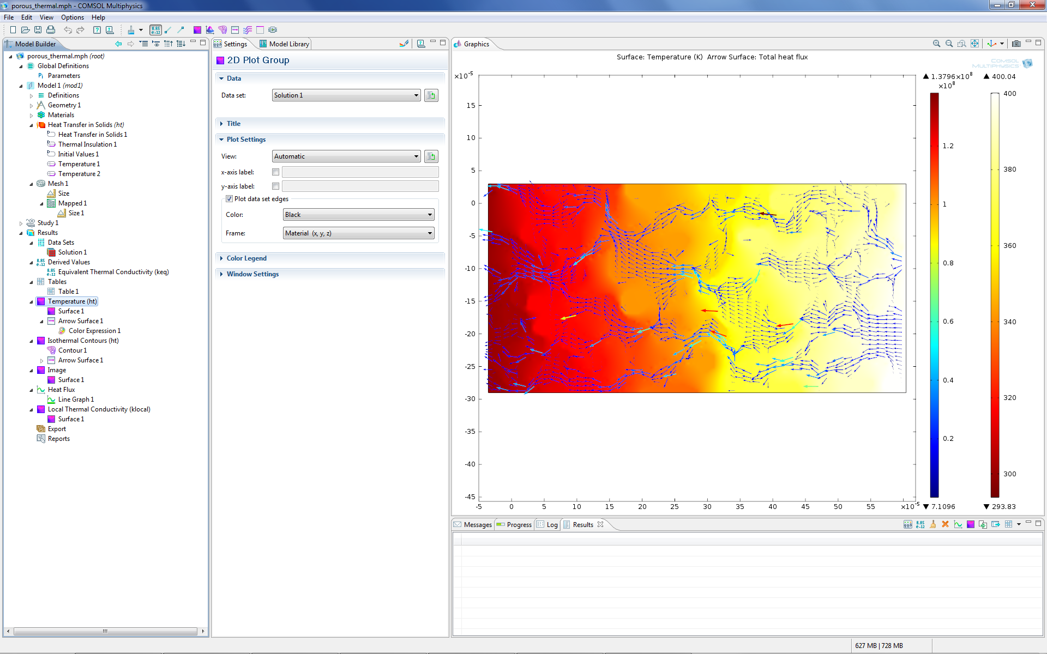
A combination of a Surface Plot of the temperature and an Arrow Surface Plot with the arrows colored by the magnitude of the heat flux.

Slide 17
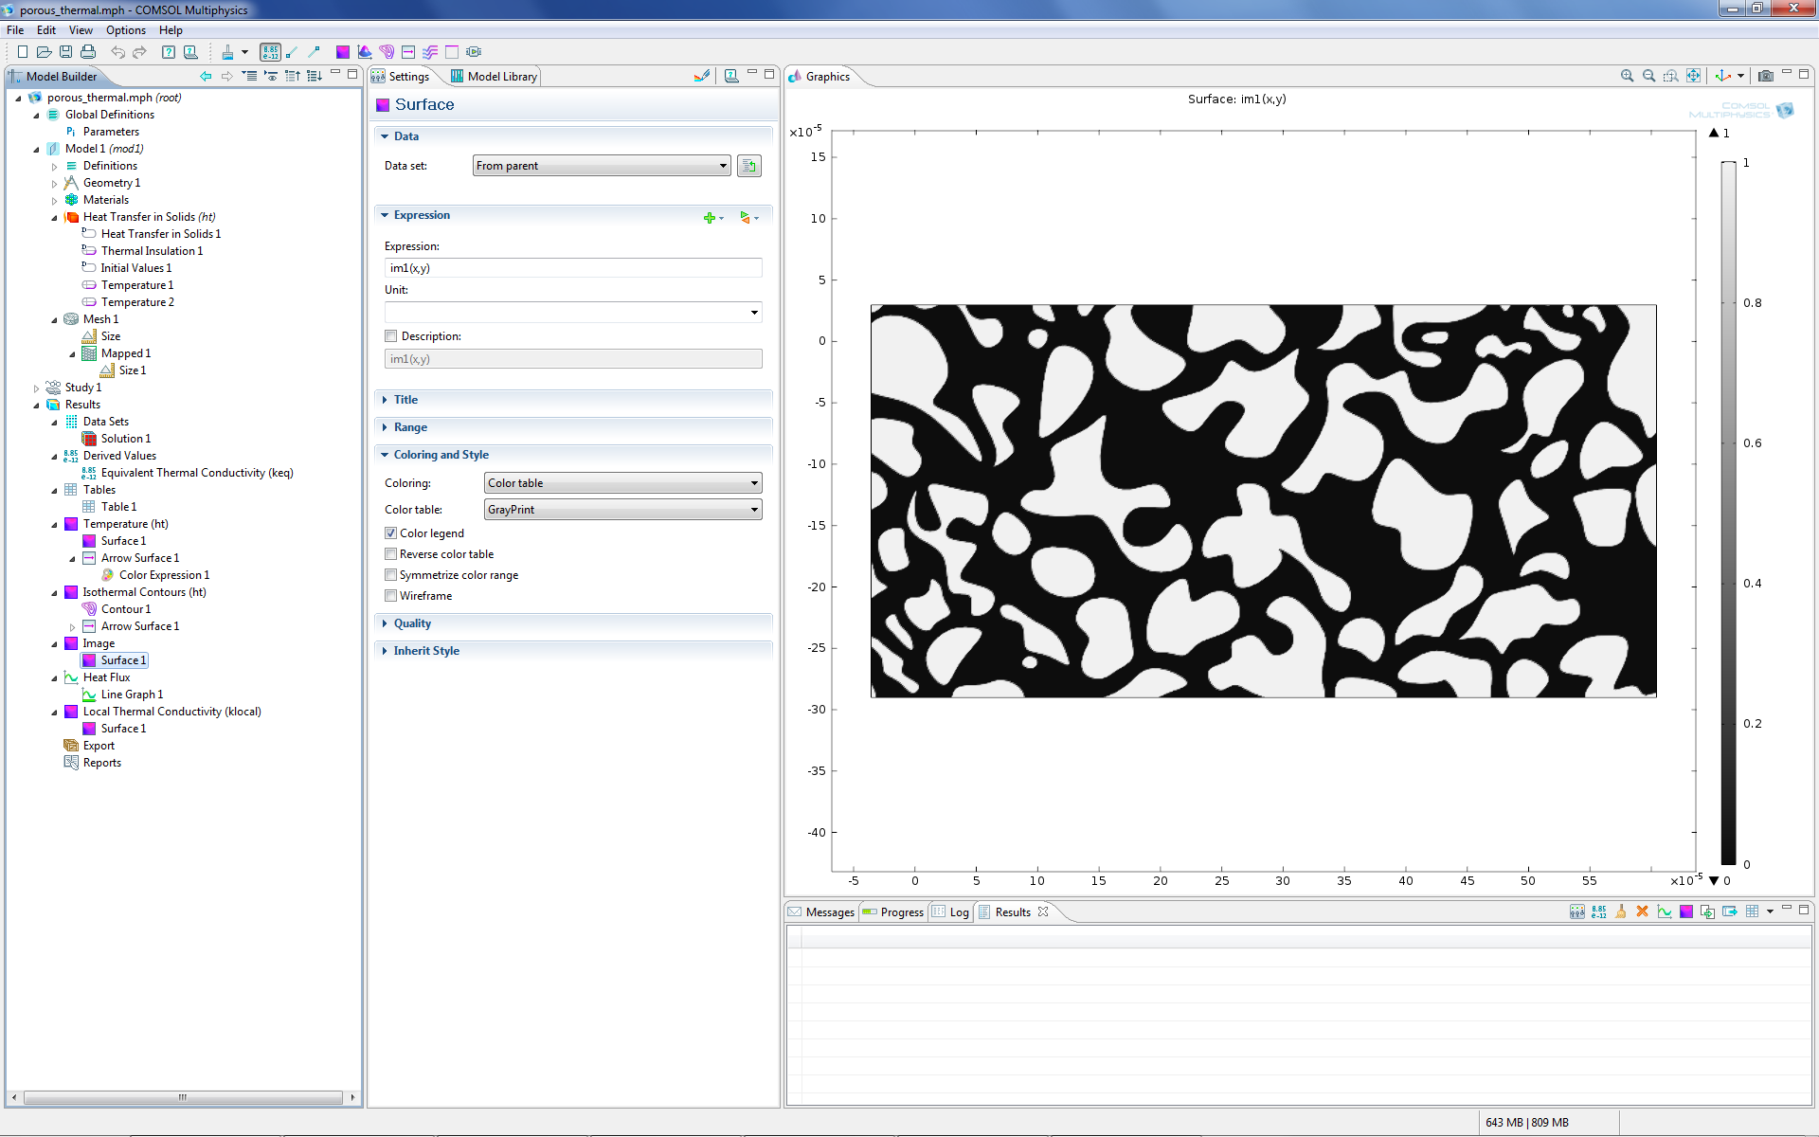
The image function im1(x,y) visualized with a Surface Plot and Color table set to GrayPrint.

Slide 18
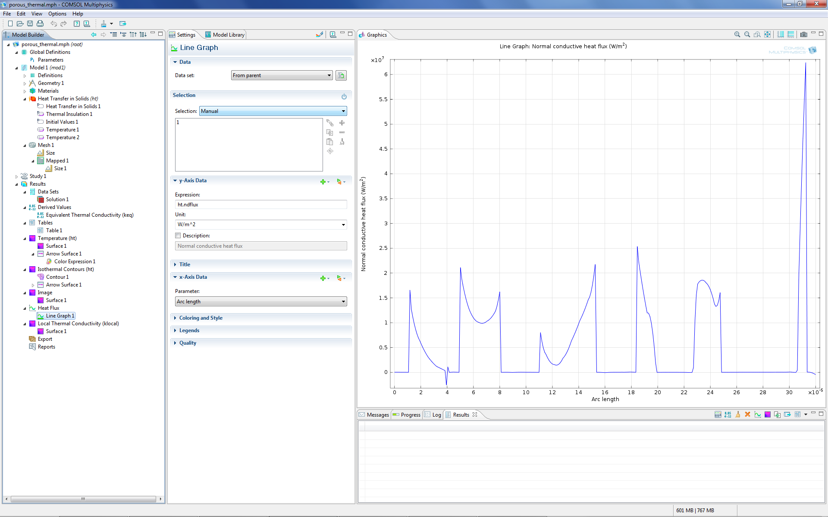
The local heat flux visualized along the leftmost boundary.

Slide 19
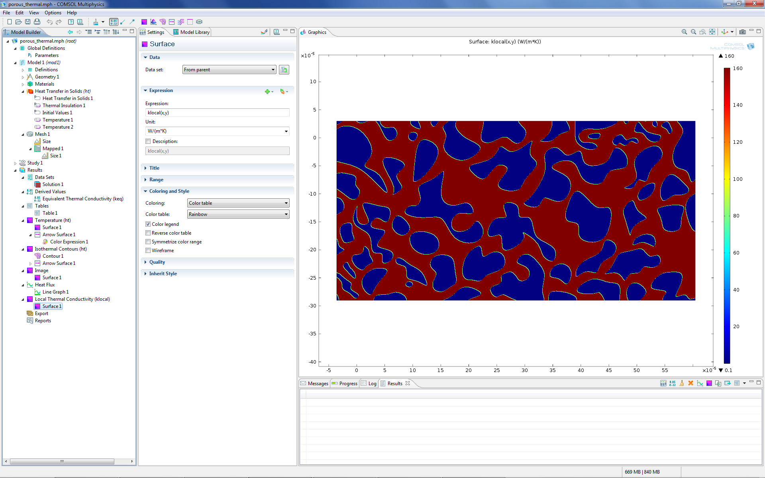
The local thermal conductivity klocal(x,y).

Slide 20

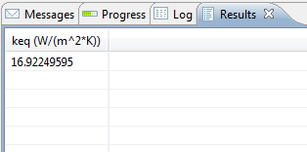
Finally, the equivalent conductivity of the entire structure computed to a value of 16.9 W/(m^2*K). Note that this value is between 160 W/(m^2*K) for solid Aluminum and 0.1 W/(m^2*K) for the Air domain, as expected.

Slide 21
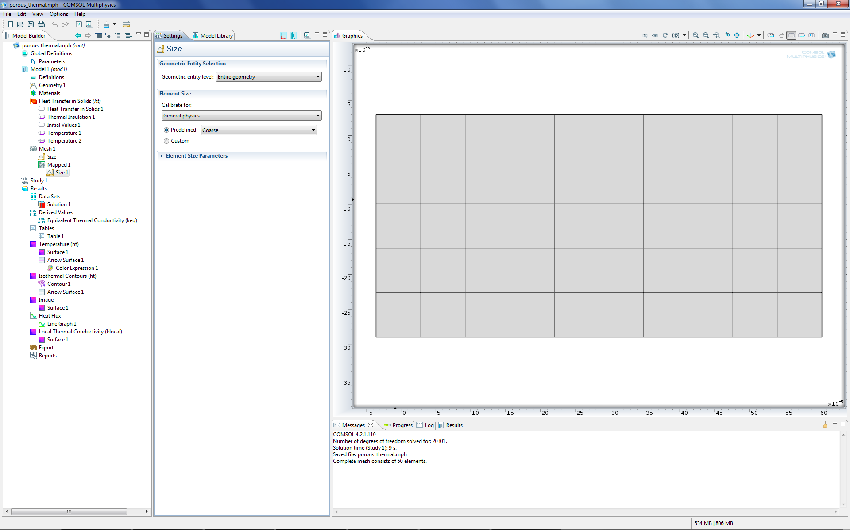
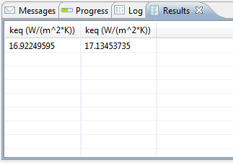
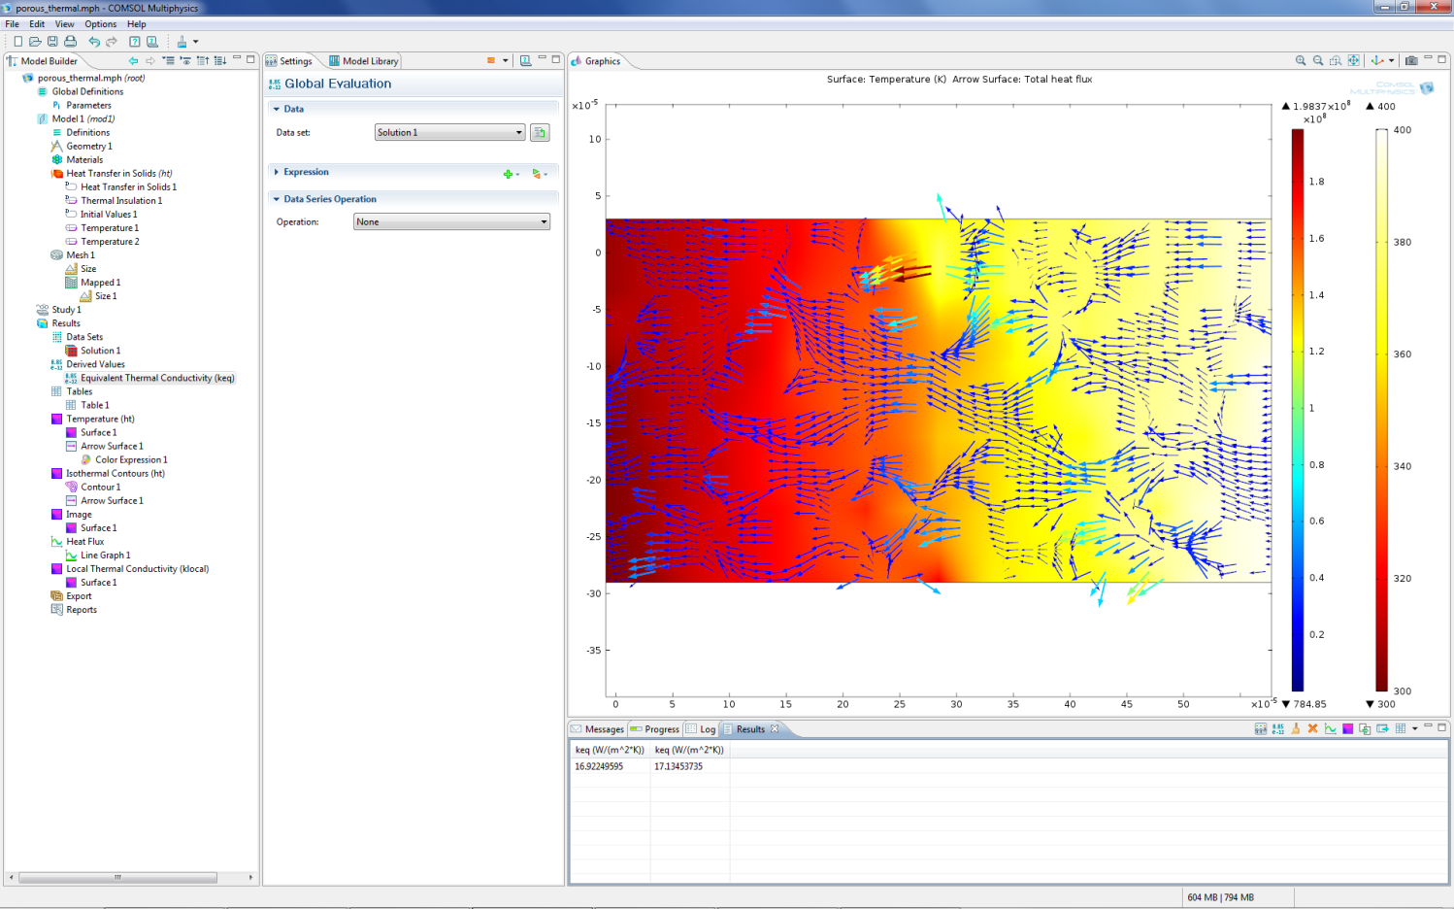
The benefit with image import is that a much coarser mesh can give satisfactory results. Here, the simulation is run for a mesh resulting in 231 degrees of freedom (the side of the sparse finite element system matrix being solved for), compared to the previous 20301 degrees of freedom. The resulting equivalent thermal conductivity is 17.1 W/(m^2*K). When running thousands of simulations in a parametric sweep, such computational cost savings can be very valuable.

