Slide 1
Modeling of Stray Current Corrosion in Buried Pipelines
© Copyright 2015 COMSOL. Any of the images, text, and equations here may be copied and modified for your own internal use. All trademarks are the property of their respective owners. See www.comsol.com/trademarks.

Slide 2
Background and Motivation
The impressed current cathodic protection (ICCP) system is often employed to mitigate corrosion of buried pipelines in oil and gas industry.
Metallic objects such as buried pipelines, which are present within the current flow of the ICCP system, may suffer from the stray current interactions leading to accelerated corrosion.
This model example demonstrates stray current corrosion of a buried pipeline, which is in vicinity of the ICCP system, using the Current Distribution, Boundary Elements interface.
Two crossing pipelines: a protected pipeline, an interference pipeline and an anode are considered to be edge electrodes.
The kinetics of electrochemical reactions occurring at the pipeline surfaces are accounted for through experimental polarization data.
The interference pipeline is found to be corroding, particularly in the region closer to the pipelines crossing.

Slide 3
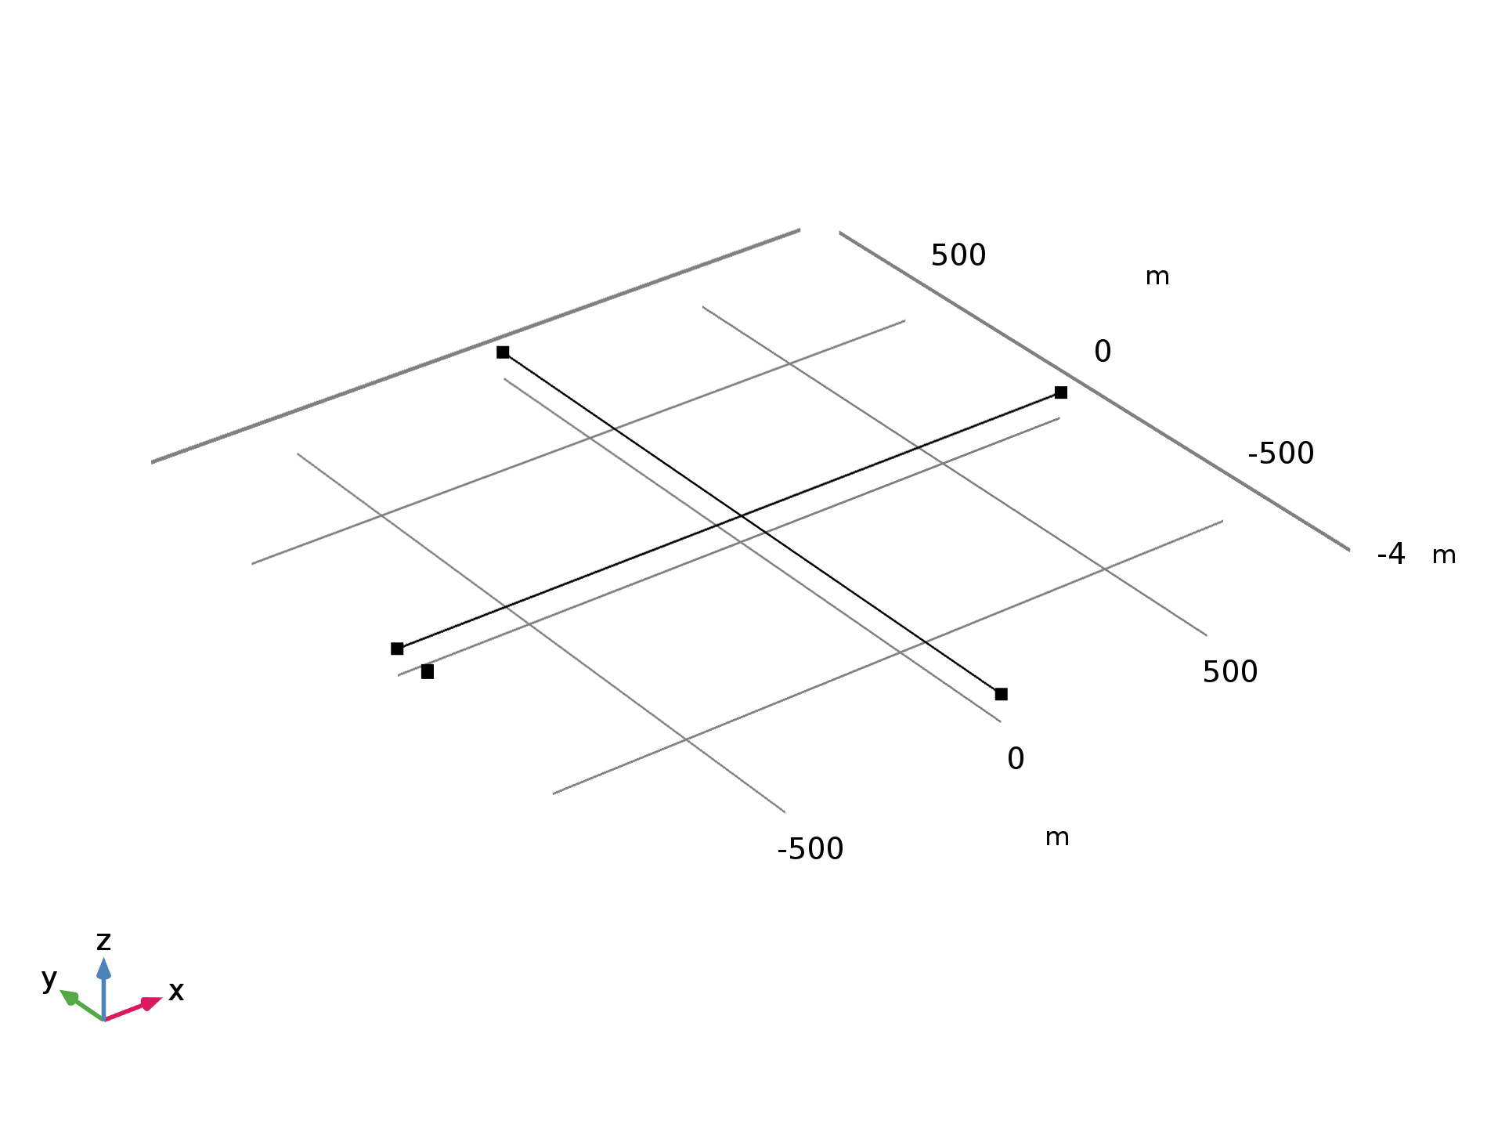
Model Geometry
Soil
Protected pipeline
Interference pipeline
Anode
The model geometry consists of a protected pipeline, an interference pipeline and an anode.
Both the pipelines are 1.6 km long and are crossing each other.
The protected pipeline diameter is 0.762 m, the interference pipeline diameter is 0.4064 m
and the anode diameter is 0.1 m.
The soil conductivity is 0.005 S/m.

Slide 4

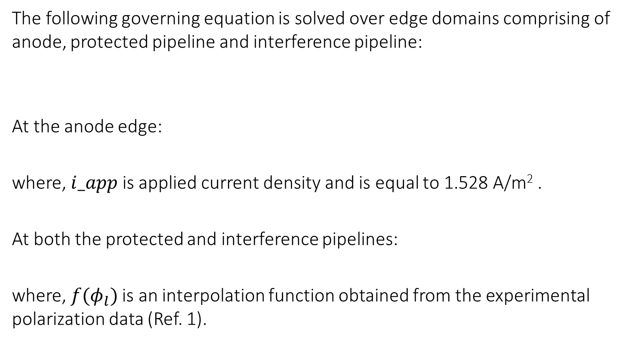


Model Setup
The following governing equation is solved over edge domains comprising of anode, protected pipeline and interference pipeline:
At the anode edge:
where, $i_app$ is applied current density and is equal to 1.528 A/m² .
At both the protected and interference pipelines:
where,$f(φ_{l})$ is an interpolation function obtained from the experimental polarization data (Ref. 1).
∇$·\left(−σ∇φ_{l}\right)=0$
$$n∙\left(−σ∇φ_{l}\right)=i_app$$
$$n∙\left(−σ∇φ_{l}\right)=f(φ_{l})$$

Slide 5
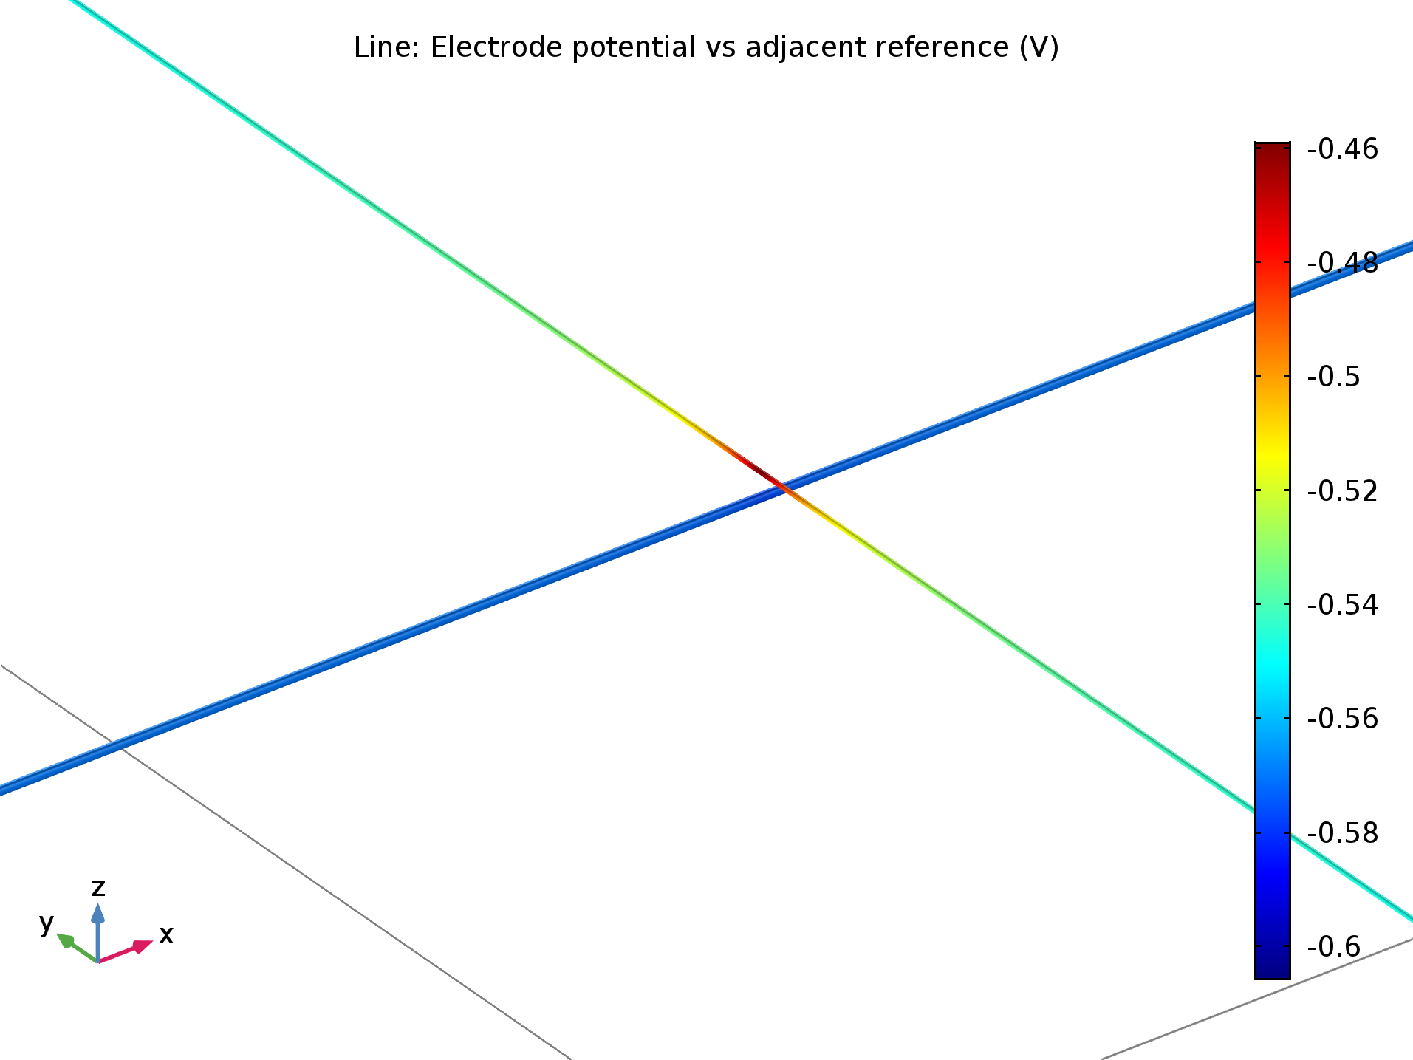
Results: Electrode Potential Distribution
Interference pipeline
Protected pipeline
The electrode potential over the protected pipeline is below its equilibrium potential (-0.56 V) indicating that the pipeline is fully protected.
The electrode potential over the interference pipeline is above its equilibrium potential (-0.56 V), particularly in the region closer to the pipeline crossing, indicating the occurrence of corrosion.

Slide 6
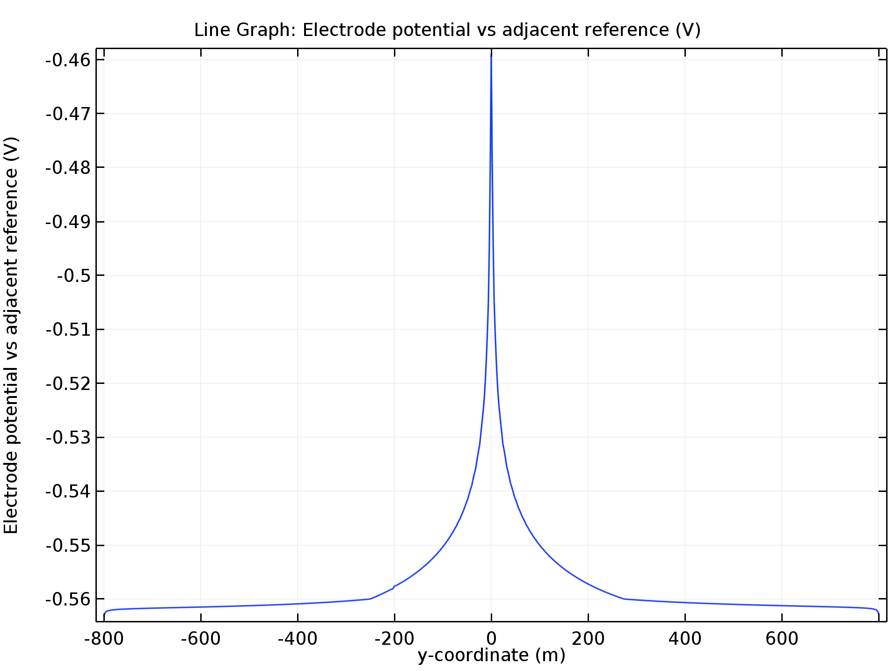
Results: Electrode Potential
The electrode potential variation over the entire length of the interference pipeline is shown above.
The electrode potential is above its equilibrium potential in the region closer to the pipeline crossing (about 200 m on either side), indicating the occurrence of corrosion.
The electrode potential further away from the pipeline crossing is below the equilibrium potential, indicating that the interference pipeline is protected in that region.

Slide 7
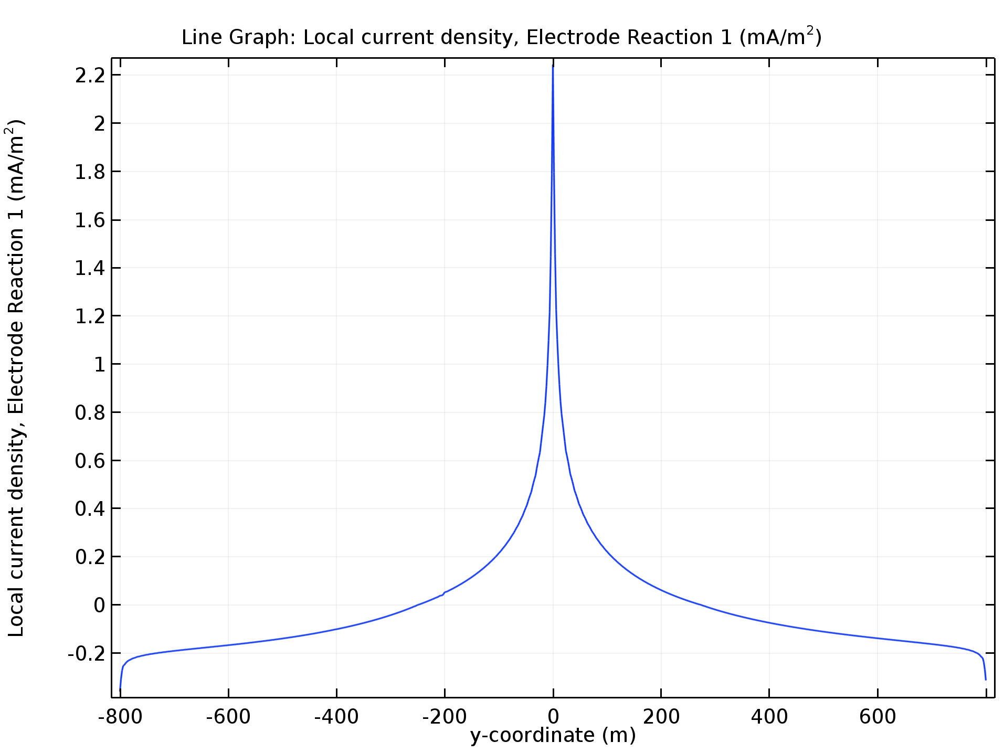
Results: Current Density
The local current density variation over the entire length of the interference pipeline is shown above.
The local current density in the region closer to the pipeline crossing (about 200 m on either side) is positive indicating that the current is leaving the pipeline and hence, corrosion occurs in this region.
The local current density further away from the pipeline crossing is negative, indicating that the current (stray current) enters the interference pipeline and hence, it is protected in that region.

Slide 8
Reference
G. Cui, Z. Li, C. Yang and M. Wang, ”The influence of DC stray current on pipeline corrosion”, Petroleum Science 13 (2016) 135–145.

