Slide 1
Dynamic Model of a Drop Shot from an Inkjet Printer

Slide 2
Inkjet Technology
Devices to eject small droplets of fluids
  Inkjet printers: Produce small dots on a sheet of paper to create images
  Micro droplet deposition for analysis and drug discovery
Simulations to study and improve the inkjet’s performance
  Modify geometry
  Investigate effect of the ink’s fluid properties

Slide 3
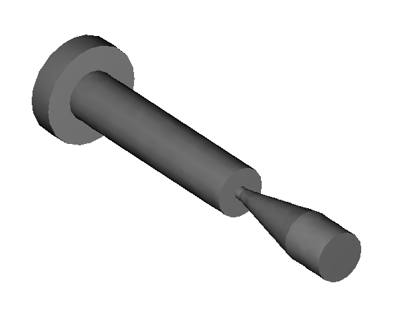
Inkjet Model
Ink and air flow
  Large density and viscosity gradients at
  the fluid interface
  Surface tension at ink/air interface
  Position of the interface part of the solution
Mathematical model
  Incompressible Navier-Stokes equations with variable density, variable viscosity, surface tension and gravitation
  Level set method to track the moving
  ink/air interface in detail
  Axisymmetric model
Part initially filled with air
Inlet
Target
Part initially filled with ink

Slide 4
Fluid Flow Model
Fluid flow is governed by the Navier-Stokes equations:
κ is the interface curvature
δ is the delta function concentrated to the interface
σ is the surface tension coefficient
n is the unit normal to the interface
ρ and μ is the density and viscosity, different for each fluid
External forces or gravity
Surface tension

Slide 5
Representation of Fluid Interface
The fluid interface is modeled with the level set function φ
φ smooth step function: φ < 0.5 in air, φ > 0.5 in ink. φ = 0.5 defines the fluid interface
φ is transported with the velocity of the fluid:
Interface normal, curvature, density and viscosity are computed from φ:

Slide 6
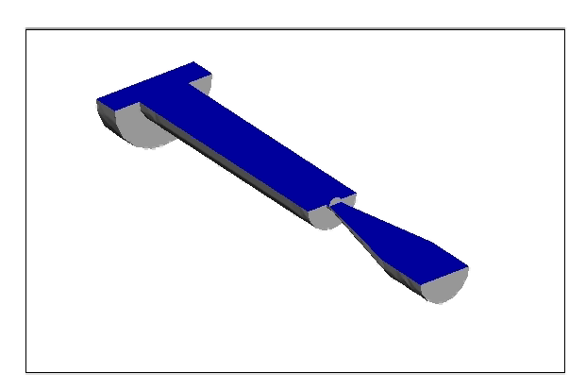
Results
Size and speed of ejected droplet can be calculated
Influence of geometry, fluid properties etc can be studied

Slide 7
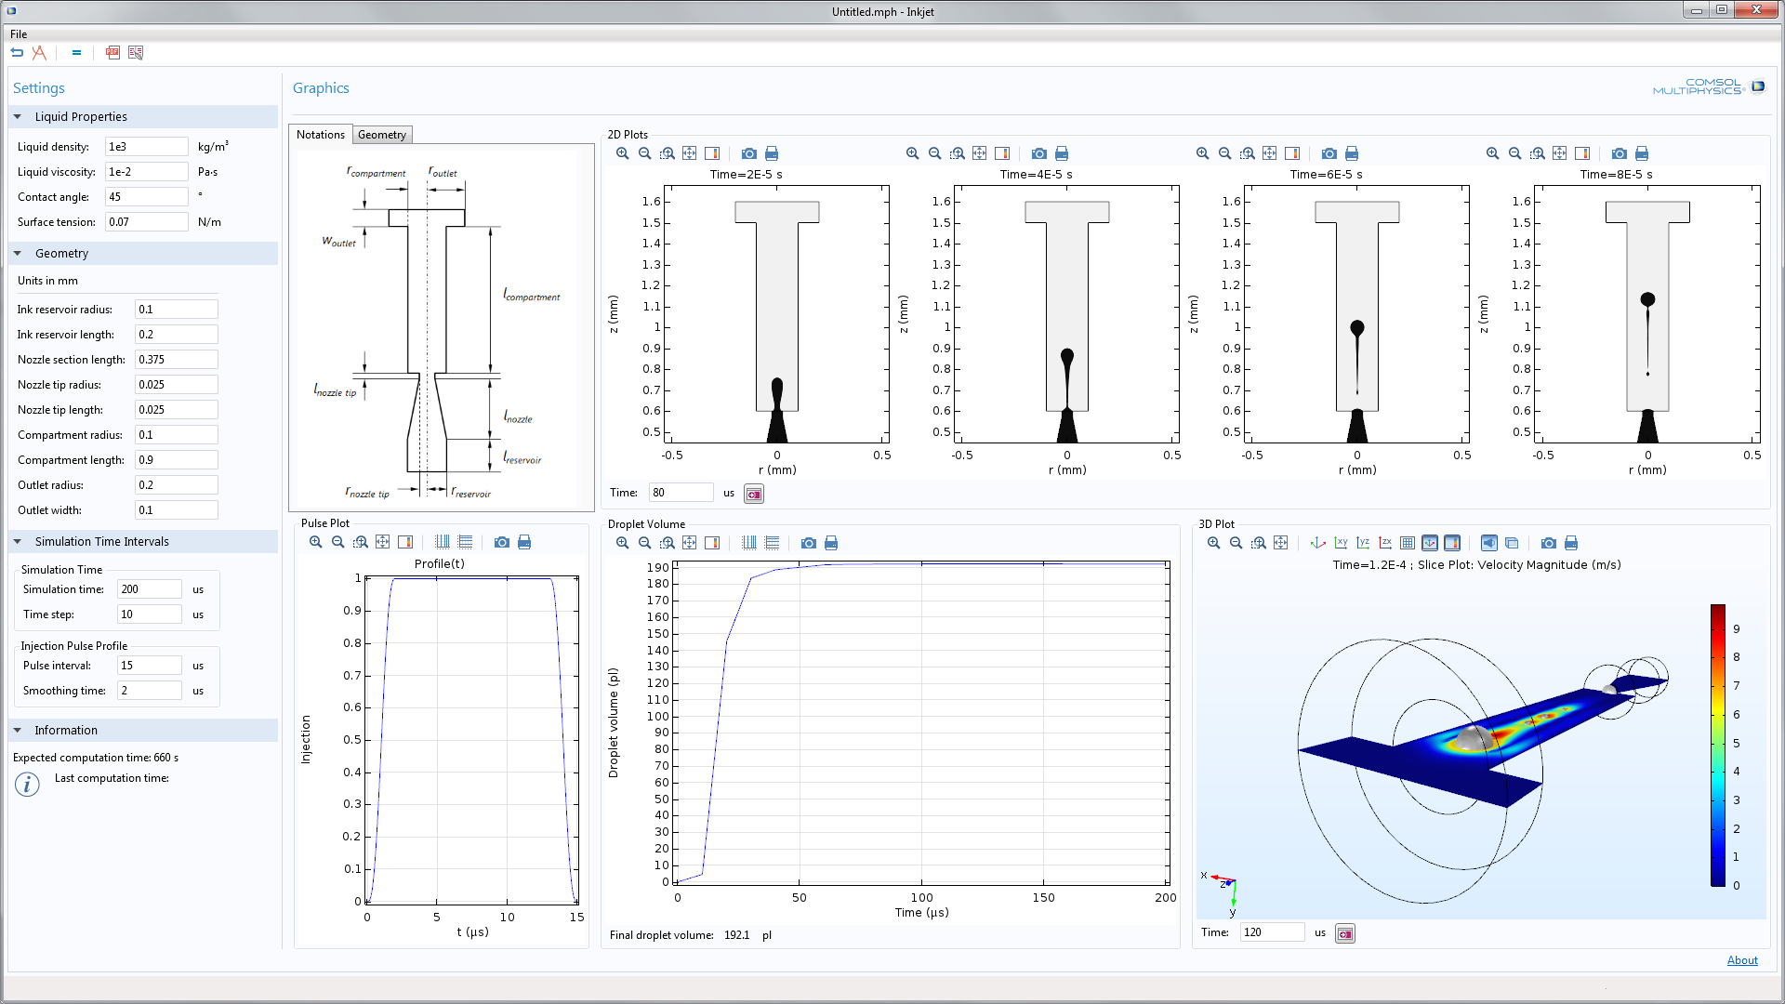
Available as an App

