Slide 1
3D Supersonic Flow in a Channel with a Bump
Notes:
You can use the heading from the application documentation for the title.

Slide 2
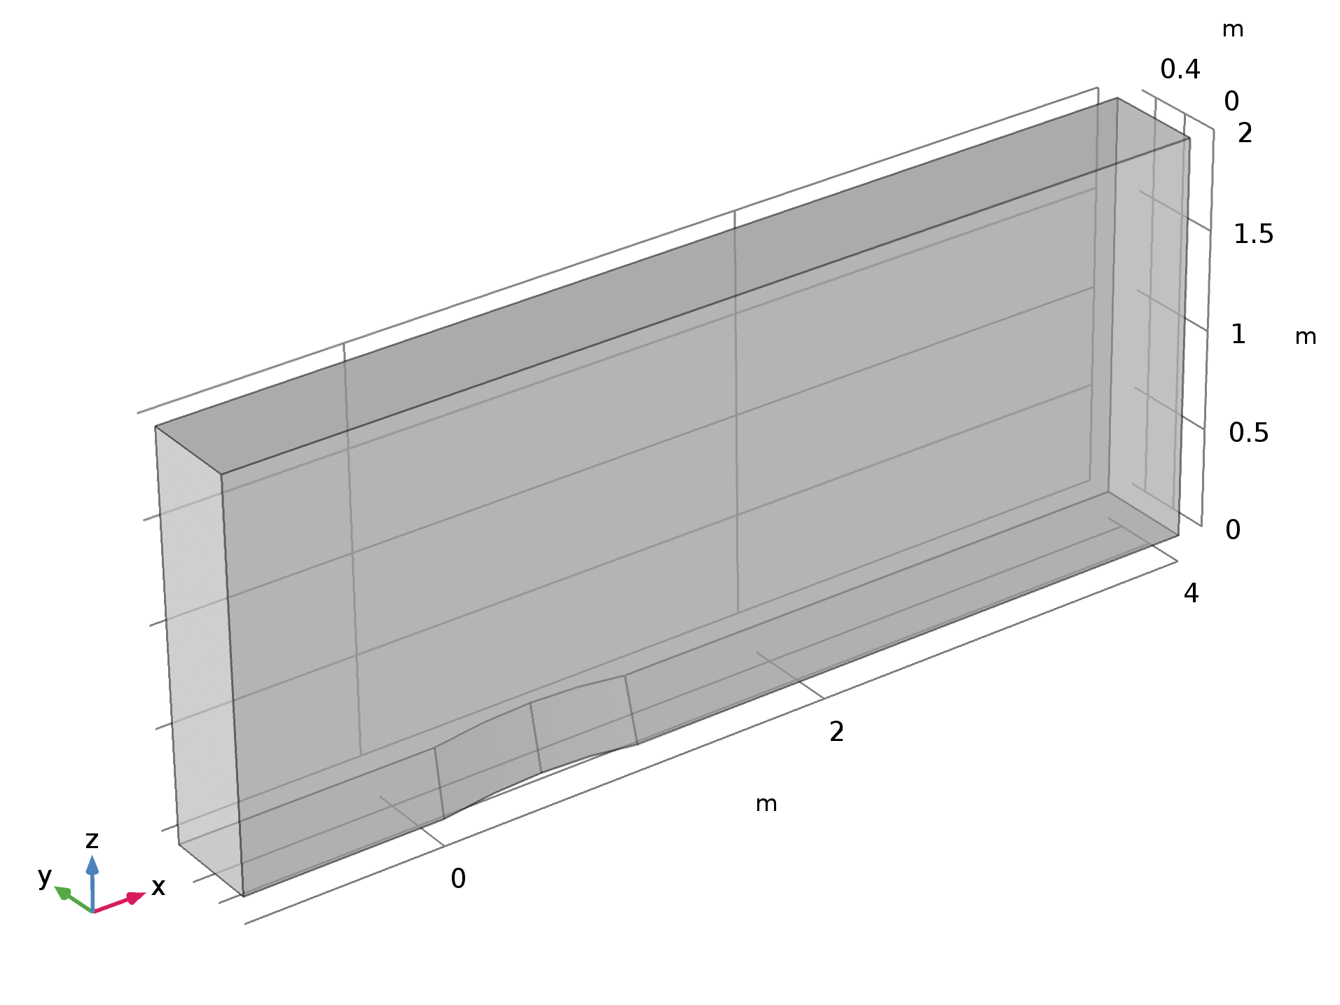
Geometry and Operating Conditions
Oulet
Supersonic Flow
Inlet
Supersonic Flow (M=1.4)
Slip Walls
Disturbance

Slide 3
Model setup
The High Mach Number Flow, Laminar interface in COMSOL Multiphysics is used
Adaptive meshing makes it possible to capture the shock effects in the flow

Slide 4
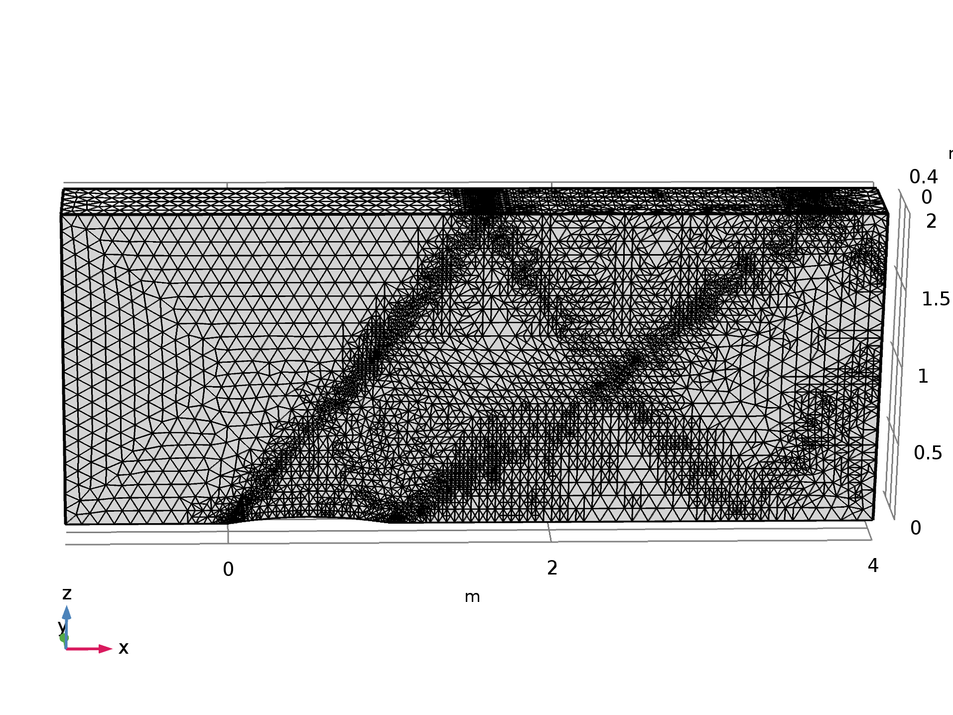
Results
The adaptive mesh feature is able to resolve the mesh in the zones where gradients in Mach number are large

Slide 5
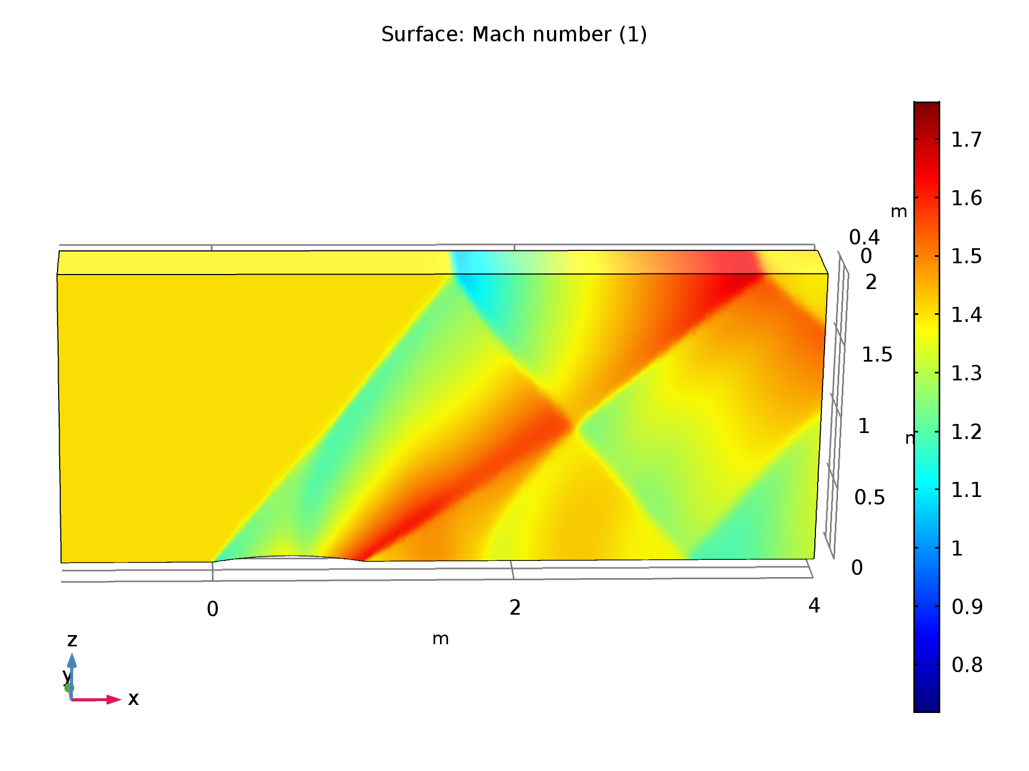
Results
The results are in good agreement with the results published in literature*
Shock wave diffractions are visible on the obstacle and walls
*J.F Lynn, Multigrid Solution of the Euler Equations with Local Preconditioning, Dissertation, University of Michigan, 1995.

