Slide 1
Adhesion and Decohesion of Indenting Ball
Notes:
You can use the heading from the application documentation for the title.

Slide 2
Problem Statement
In this example, a combination of Adhesion and Decohesion is shown.
A semi-spherical steel ball is pressed into a rubber membrane, and when a certain contact pressure is exceeded, the two objects are joined.
When the ball moves back, the ‘glued’ membrane will follow, and tensile forces will develop between the two objects as the ball tries to lift the membrane.
When the stresses become too large, the newly formed bond will break, based on the specified decohesion law.

Slide 3
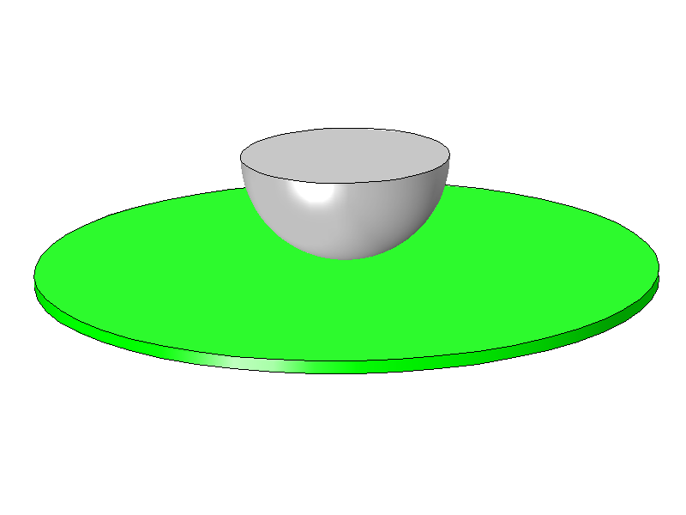
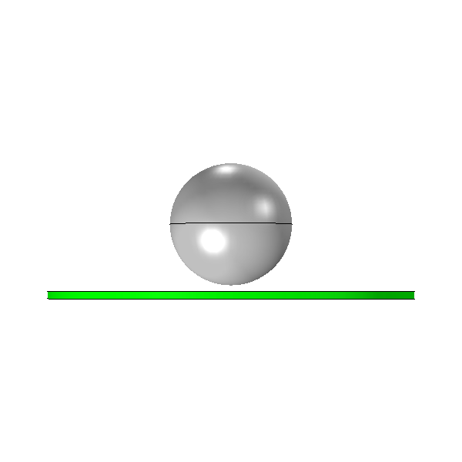
Geometry and Materials
Steel
Rubber
R = 50 mm
R = 150 mm
t = 6 mm
The ball is moved 80 mm down and then back up again
Clearance = 5 mm

Slide 4
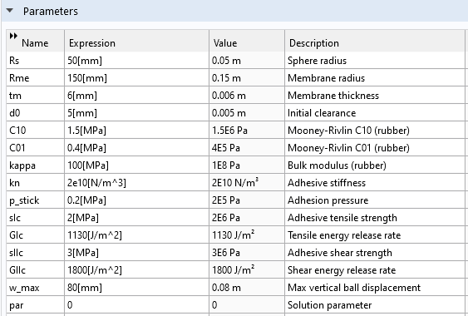
Data Used

Slide 5
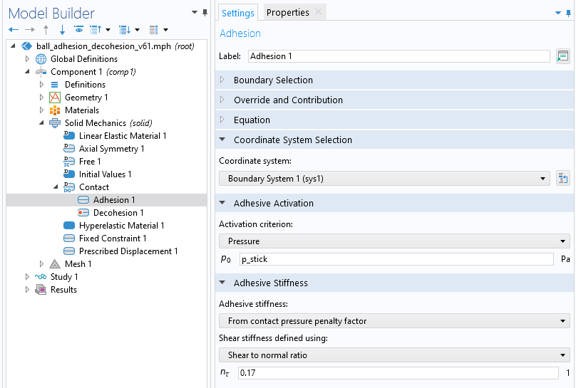
Adhesion Settings

Slide 6
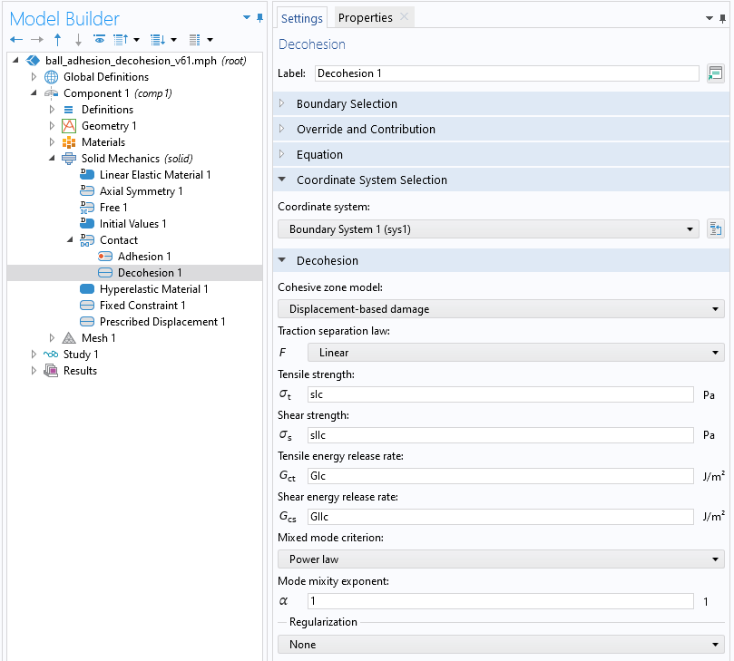
Decohesion Settings

Slide 7
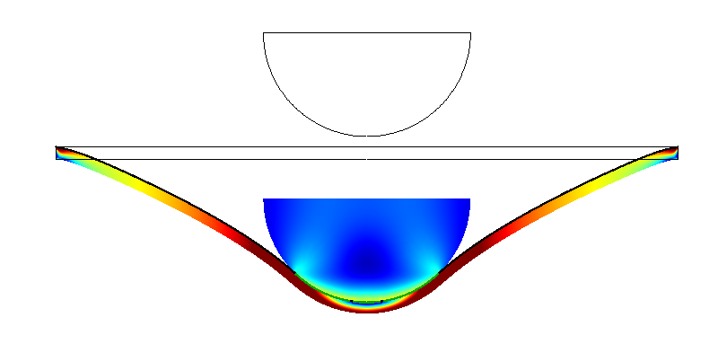
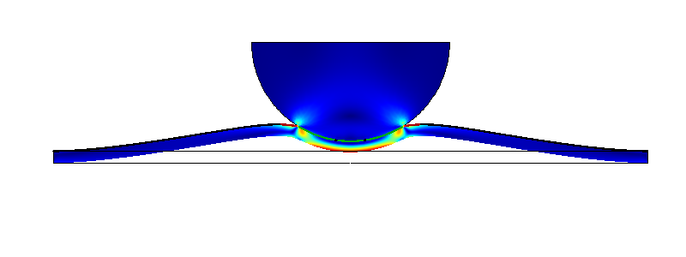
Stresses
At maximum displacement
At end of analysis

Slide 8
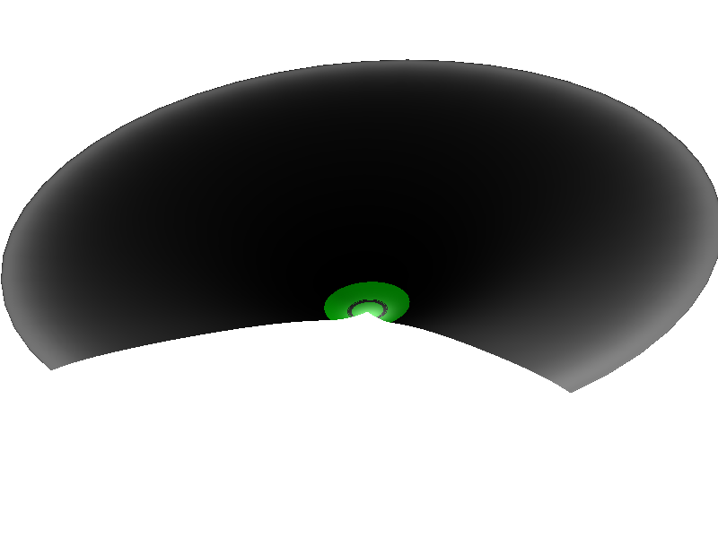
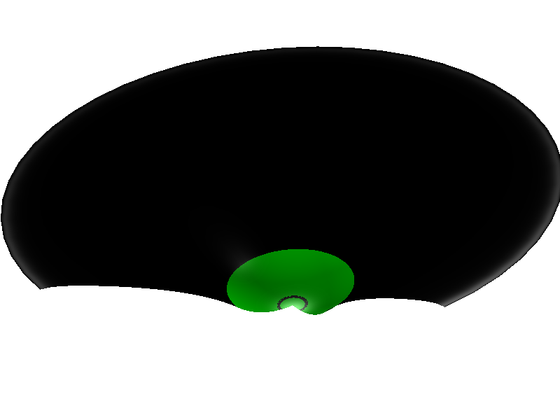
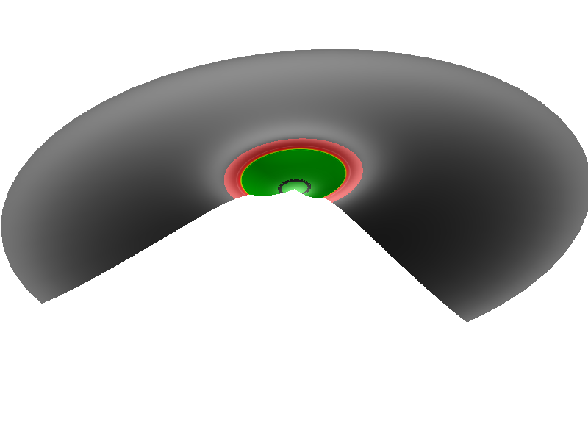
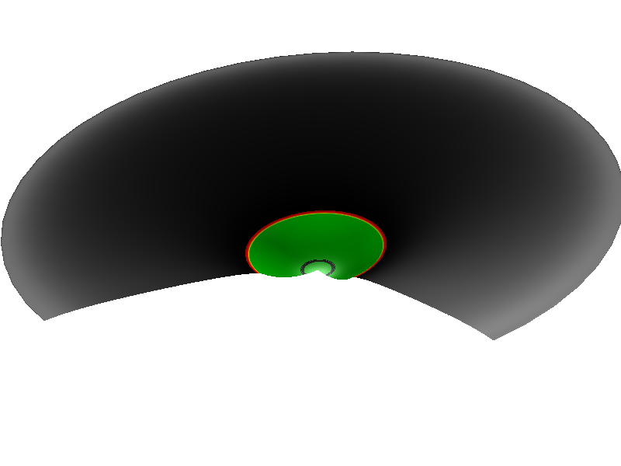
Adhesion and Decohesion State
Adhesion,
pressure limit reached
Decohesion, bond broken
Ball displacement 40 mm, moving down
Ball displacement 80 mm, turning
Ball displacement 40 mm, moving up
Ball displacement 0 mm, back to original position

Slide 9
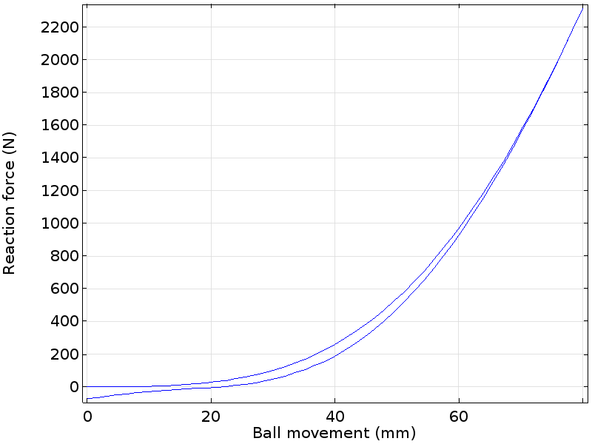
Force vs.Ball Displacement
On the way back, the membrane resists the lifting of the ball over the last 20 mm

