Slide 1
Variably Saturated Flow and Transport: Sorbing Solute
Notes:
You can use the heading from the model documentation for the title.

Slide 2
Variably saturated flow
With variably saturated flow, fluids fill only part of the pore space.
Flow properties depend on degree of saturation, making Richards’ equation nonlinear
Often researchers use analytic expressions (e.g., van Genuchten or Brooks & Corey) to describe how material properties vary with the solution.
This example also shows how to incorporate experimental data directly into the COMSOL Multiphysics model.
Example based upon Hydrus2d Manual (Simunek and Van Genuchten, 1992)

Slide 3
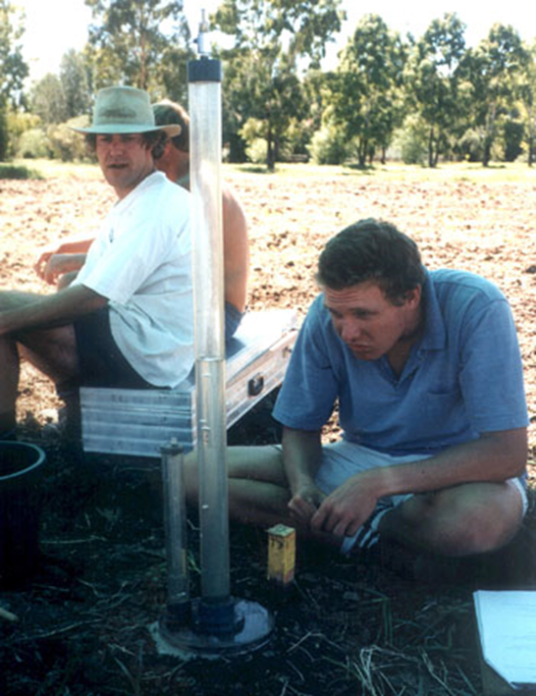
Disc permeameter
Fluid in column moves into “disc” where it is distributed over given radius
Fluid moves from disc into dry soil
With good control on fluid (and contaminant) coming from disc, researchers analyze Subsurface properties and behaviors.
Image from Department of Agriculture and Soil Science University of Sidney, Australia http://www.usyd.edu.au/su/agric/ACSS/sphysic/infiltration.html

Slide 4
Problem set up
Inlet “just ponding” at
known water height
Ground surface
Upper soil layer
2-layer
soil
column
Axisymmetry
initially
unsaturated
to depth of
about 1.2 m
1.3 m
Lower soil layer
Extremely low permeability

Slide 5
Variably saturated flow equation
Hp=0
q, Se, C, K
Hp subscripts to denote
dependency on Hp
→ NONLINEAR
H_{p} = pressure head
Se = effective saturation
S = specific storage
C = specific moisture capacity
K = hydraulic conductivity
D = elevation
θ = fluid volume fraction (constitutive relation)
- Hp +

Slide 6
Variably saturated flow equation
We can set up the permeability and retention formulae three ways:
  Using analytic formulae predefined from van Genuchten or Brooks & Corey
  Defining your own expressions
  By interpolating between experimental data

Slide 7
(1) Van Genuchten
Se (Effective Saturation)
Θ (Volume liquid fraction)
C (Specific capacity)
k_{r} (Relative permeability)

Slide 8
(3) Interpolation from experimental data
Se (Effective Saturation)
Θ (Volume liquid fraction)
C (Specific capacity)
k_{r} (Relative permeability)

Slide 9
Flow: Boundary and Initial Conditions
Specified pressure head
Hp = 0
No flow
Axisymmetry
No flow
Leaky

Slide 10
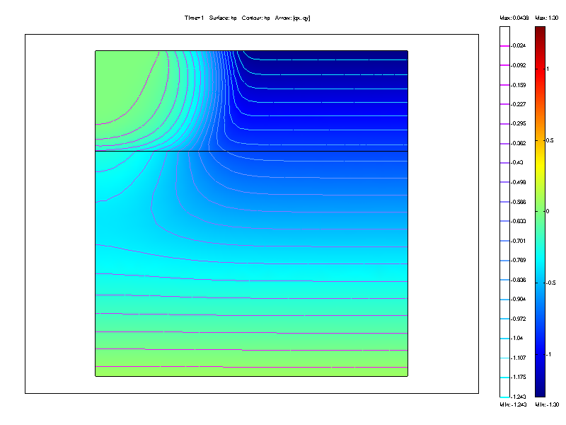
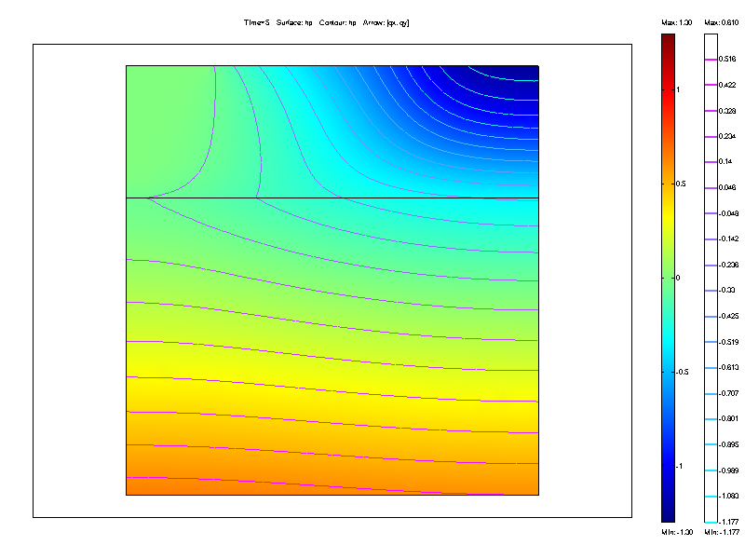
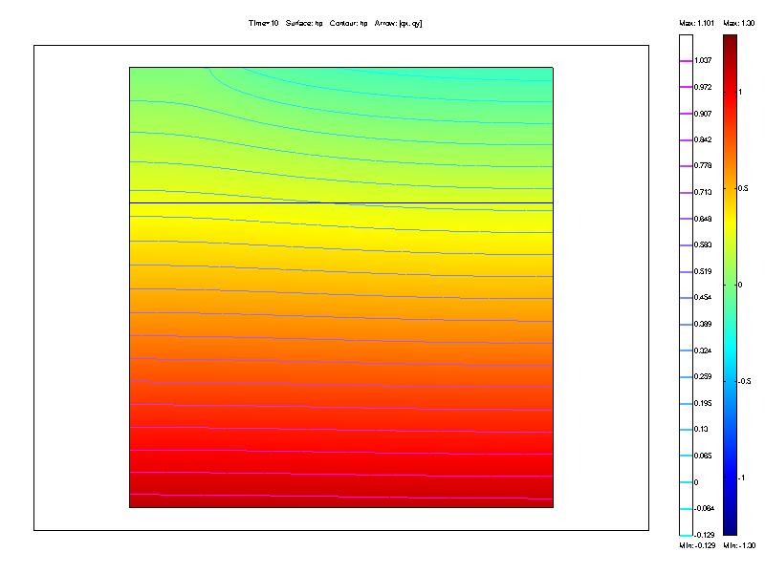
Flow Snapshots
Day 1:
Mostly unsaturated (Hp<0)
Notice wetting front
Day 5:
Soil wetting up, still
dry at surface far from
disc
Day 10:
Almost all pore
space filled with water.

Slide 11
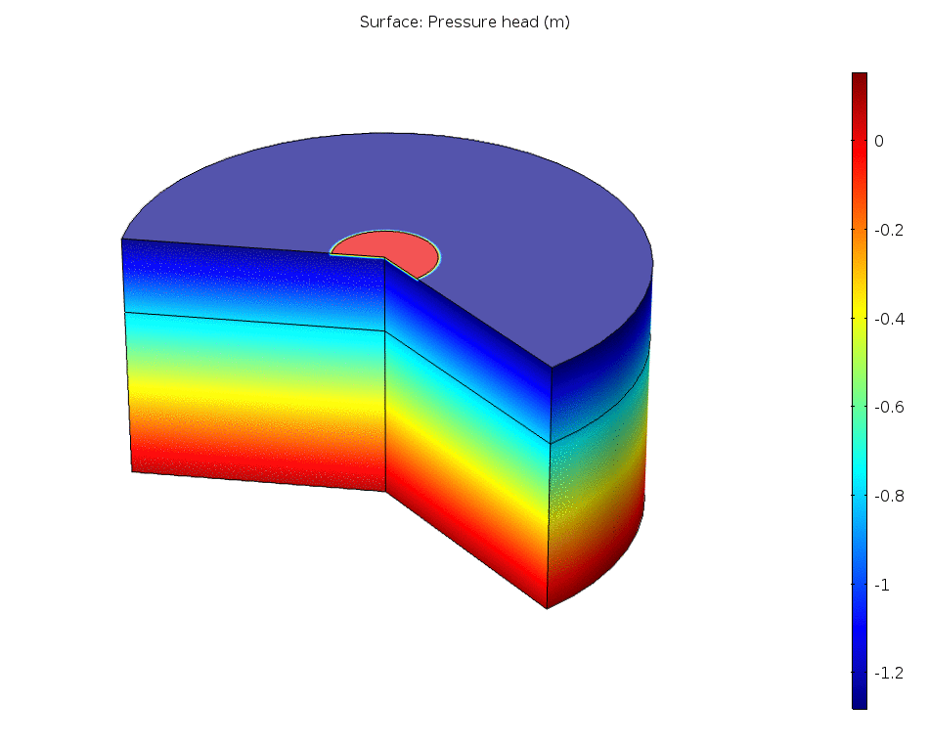
Flow Movie

Slide 12
Variably saturated solute transport
c = concentration
θ = liquid volume fraction
ρ_{b} = bulk density
k_{p} = linear sorption coefficient
C = specific moisture capacity
H_{p} = pressure head
D = dispersion tensor
q = specific discharge
ϕ = decay rate
liquid concentration
c
solid concentration
c_{p} = ρ_{b} k_{p} c

Slide 13
Transport: Boundary and Initial Conditions
Specified concentration
c=1
No flux
Axisymmetry
Free advection
Initially pristine
c (r,z,0)=0

Slide 14
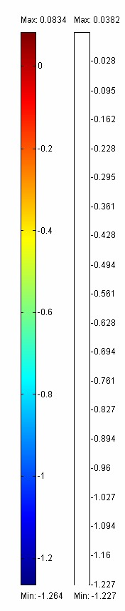
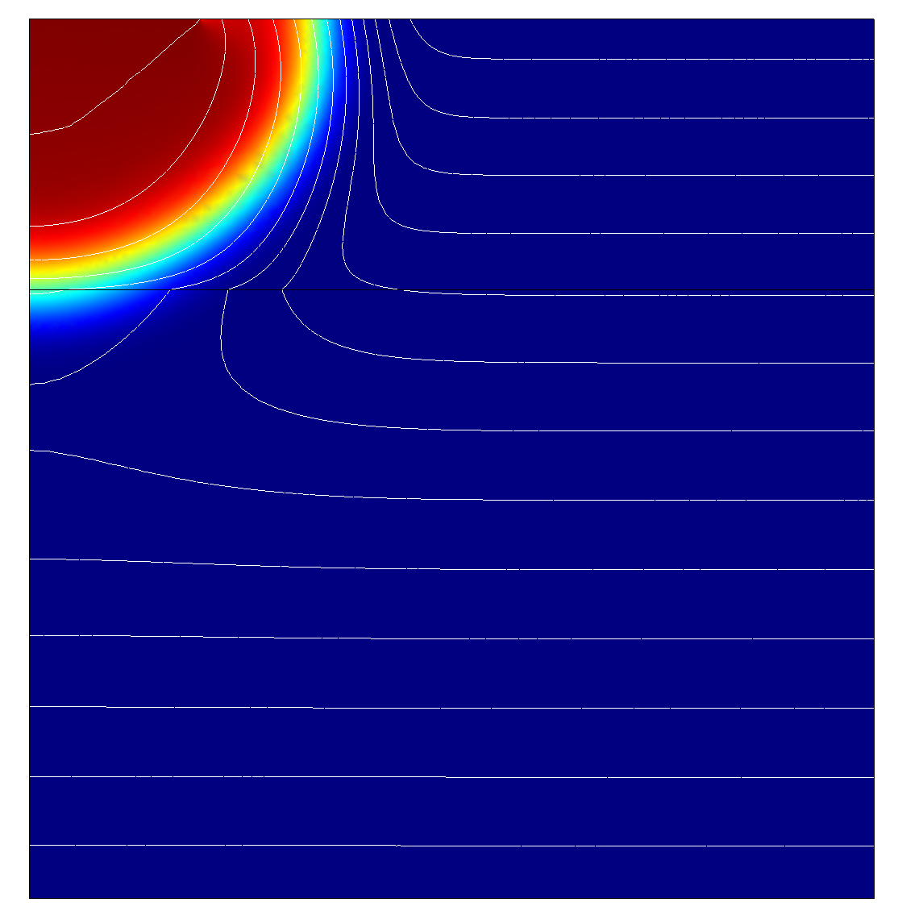
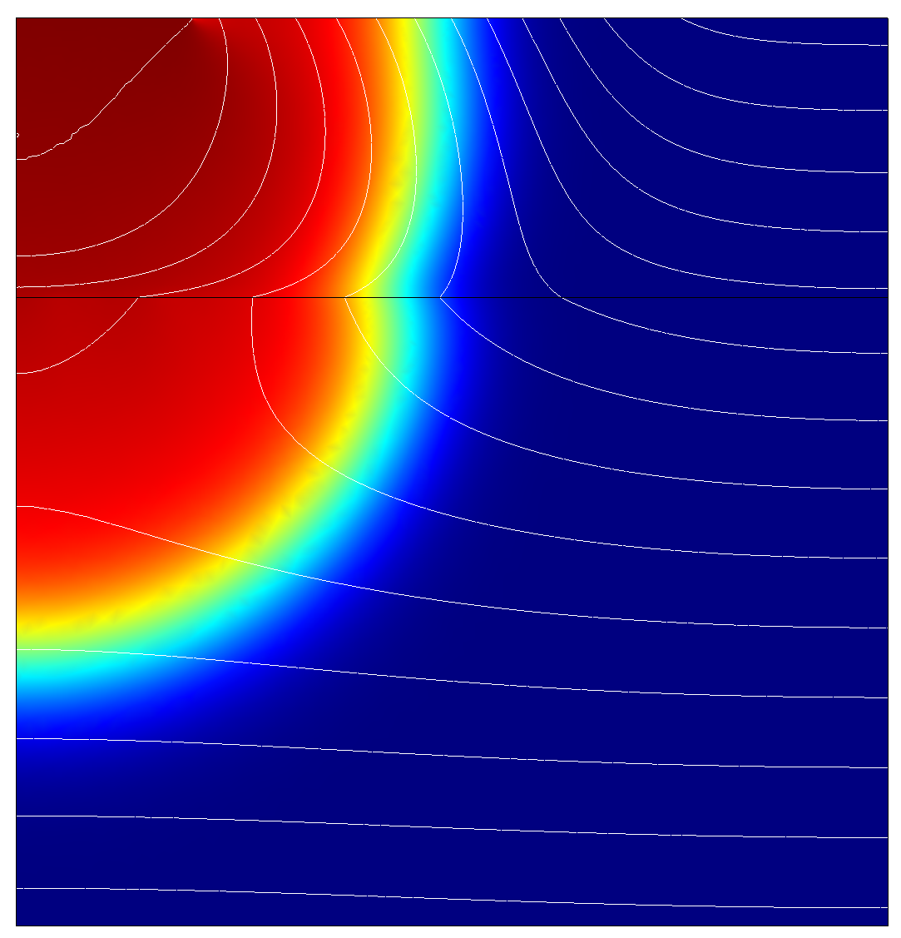
Transport Concentration Snapshots
1 day
5 days
Surface is liquid concentration; contours are pressure head

Slide 15
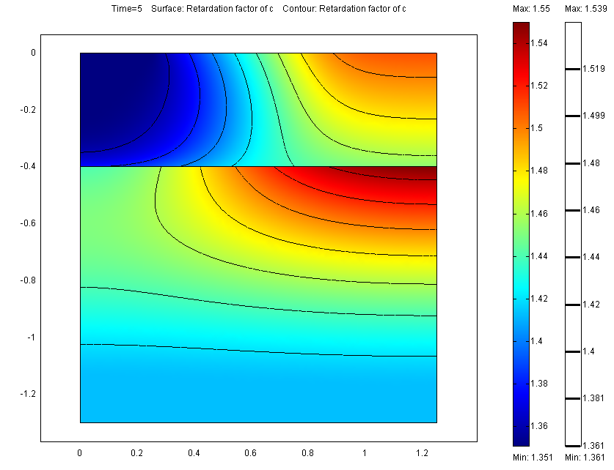
Transport Retardation Factor
Sorption slows contaminant
movement relative to water
u_{solute}=u_{water}/RF
Retardation greatest where
pore space is emptiest

