Slide 1
Permeability Estimation

Slide 2
Introduction
Porous-media flow simulations are mostly performed with homogenized model equations such as Darcy’s law or its extension, the Brinkman equations.
These models do not account for the individual pore geometry shape, but instead uses volume averaging for the macroscopic resistance to flow in the pores.
The permeability, k (m2) is needed for Darcy flow problems.
This example demonstrates a microscopic model to estimate the permability for use in macroscopic models.

Slide 3
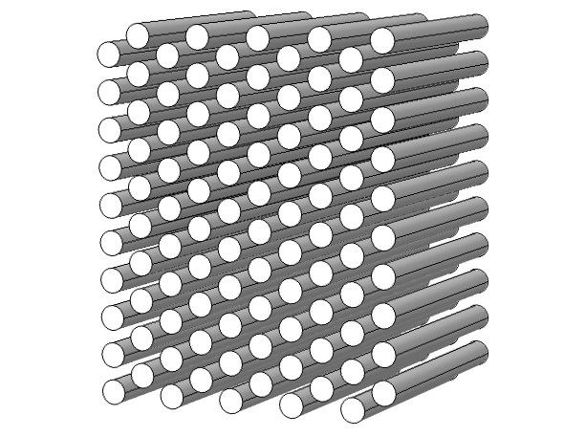
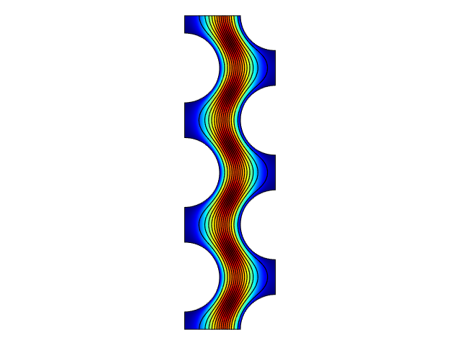




Microscopic model
Periodic structure
of staggered cylinders
$$U$$
$$p_{2}$$
Representative unit cell
is modeled.
Pressure drop Δp is
given as input.
Averaged velocity U is
computed.
L is the cell length.
$$L$$
Flow direction
$$p_{1}$$

Slide 4
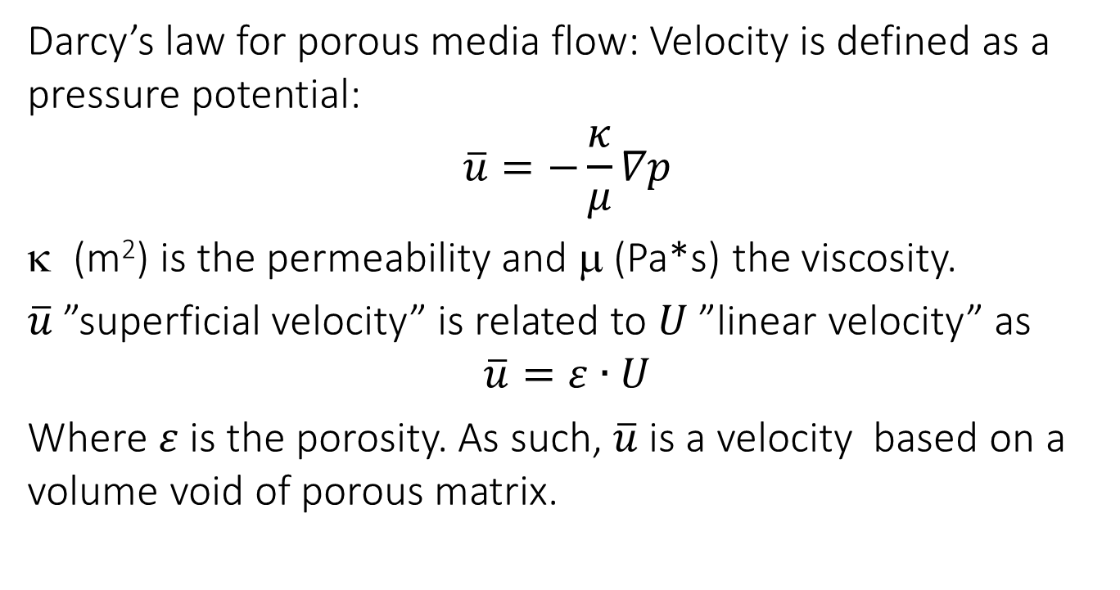
Macroscopic model
Darcy’s law for porous media flow: Velocity is defined as a pressure potential:
$\overline{u}=−\frac{κ}{μ}∇p$
(m2) is the permeability and m (Pa*s) the viscosity.
$\overline{u}$ ”superficial velocity” is related to $U$ ”linear velocity” as
$\overline{u}=ε∙U$
Where $ε$ is the porosity. As such, $\overline{u}$is a velocity based on a volume void of porous matrix.

Slide 5
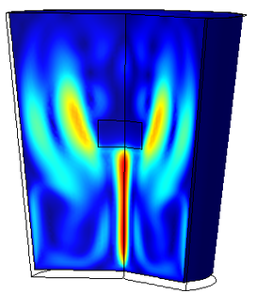
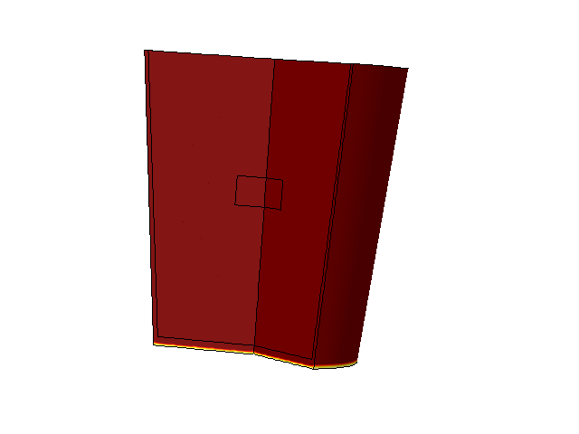
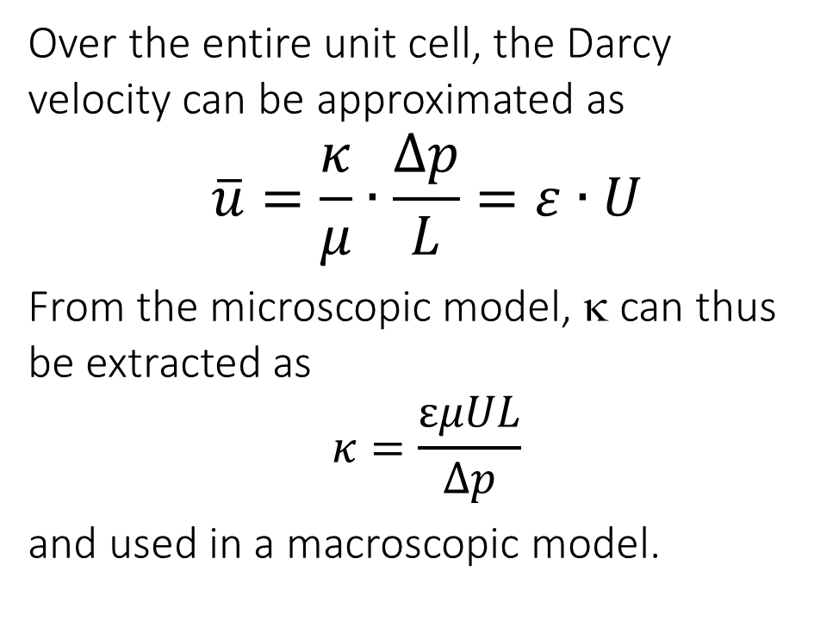
Macroscopic model
Over the entire unit cell, the Darcy velocity can be approximated as
$\overline{u}=\frac{κ}{μ}∙\frac{∆p}{L}=ε∙U$
From the microscopic model, k can thus be extracted as
$κ=\frac{εμUL}{∆p}$
and used in a macroscopic model.
Porous plug
Color: velocity
Color: temperature
maximize slide to animate
See application no 33351

