Slide 1
Pore Scale

Slide 2
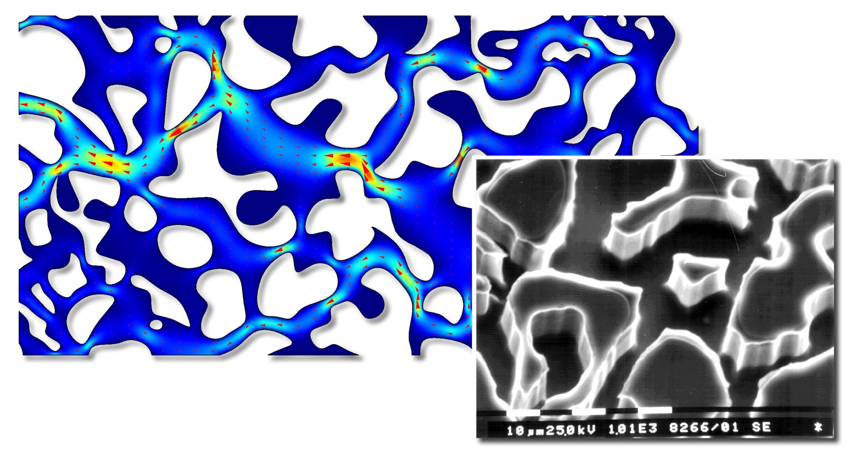
Pore-scale
Contributed by:
Keller, A. A., M. J. Blunt and P. V. Roberts (1997)
Auset, M., and Keller, A. A. (2004)
Sirivithayapakorn, S. and Keller, A. A. (2004)

Slide 3
Pore Scale
Purpose of the model
Demonstrate modeling in COMSOL Multiphysics
Share an interesting example
Model definition
Zoom in on flow within a rock at the pore scale
Stokes equations to get within-pore velocities

Slide 4
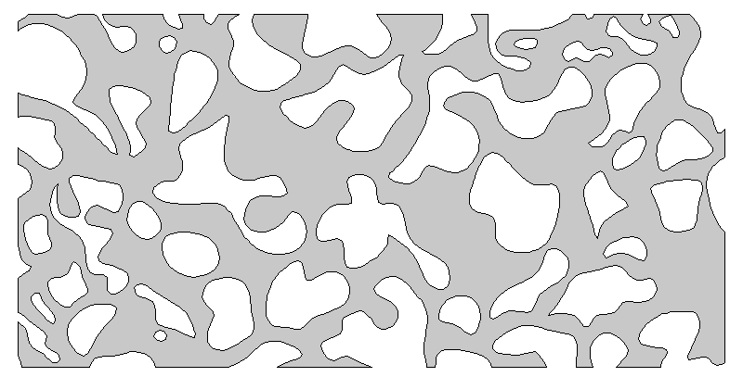
Pressure
p = p_{out}
Slip/Symmetry
n · u = 0
Pressure
p = p_{in}
320 µm
640 µm

Slide 5
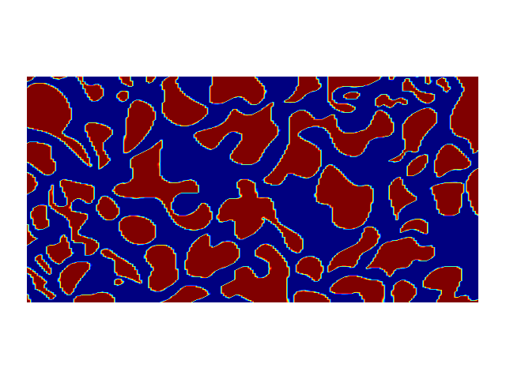
SEM Image

Slide 6
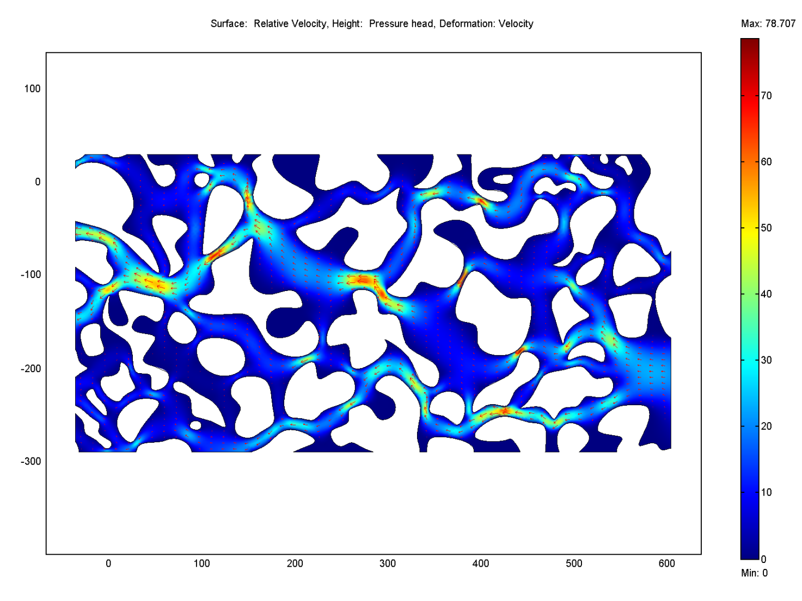
Pore Scale

Slide 7
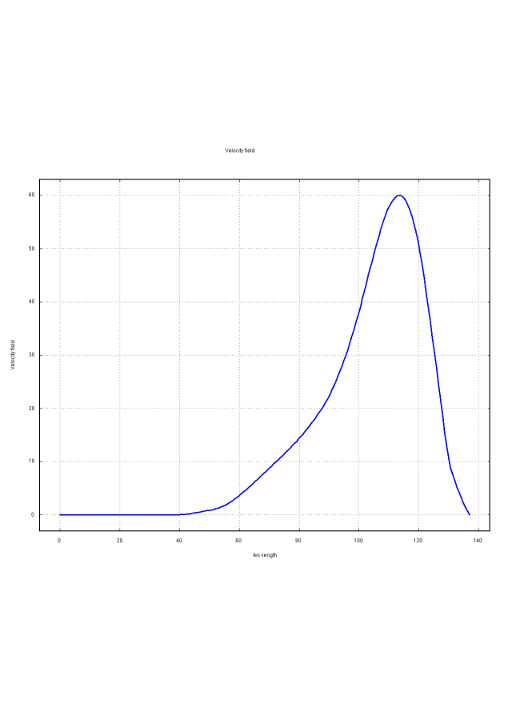

Pore Scale
In-pore velocity profile

Slide 8
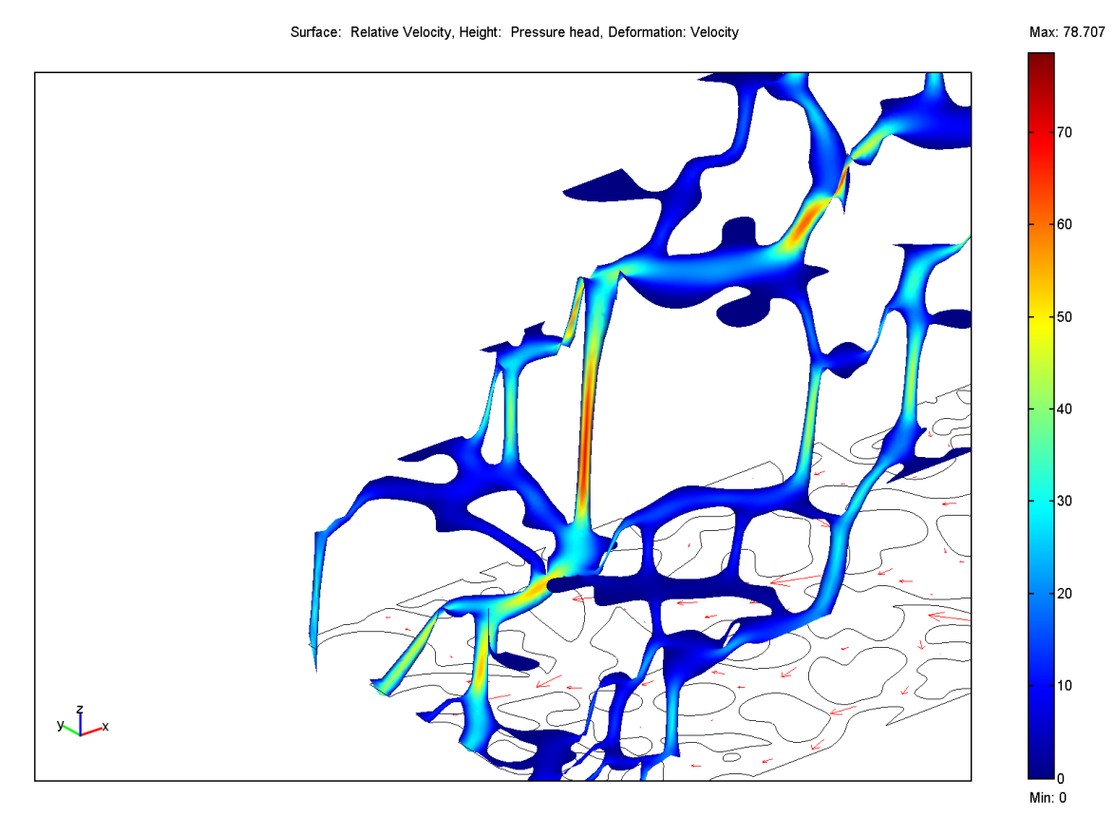
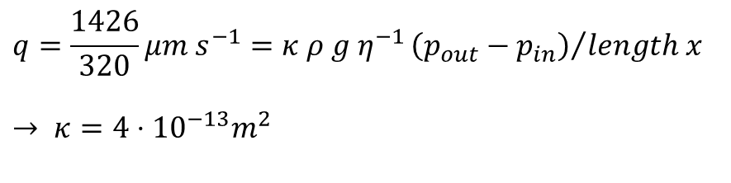
Pore Scale
Boundary integration
to find Darcy velocity
→ permeability
Outflow = 1426 µm² s⁻¹
Length y = 320 µm
Length x = 640 µm
$$q=\frac{1426}{320}μm s^{−1}=κ ρ g η^{−1}{\left(p_{out}−p_{in}\right)}/{length x}$$
$$→ κ=4⋅{10}^{−13}m^{2}$$

Slide 9
References
Keller, A. A., M. J. Blunt and P. V. Roberts (1997). Micromodel observation of the role of oil layers on multiphase flow. Transport in Porous Media 26:
277-297.
Auset, M. and Keller, A. A. (2004). Pore-scale processes that control dispersion of colloids in saturated porous media. Water Resources Research, 40 (3): W03503, 10.1029/2003WR002800.
Sirivithayapakorn, S. and Keller, A. A. (2003). Transport of colloids in saturated porous media: A pore-scale observation of the size exclusion effect and colloid acceleration. Water Resources Research, 39 (4): 1109.

