Slide 1
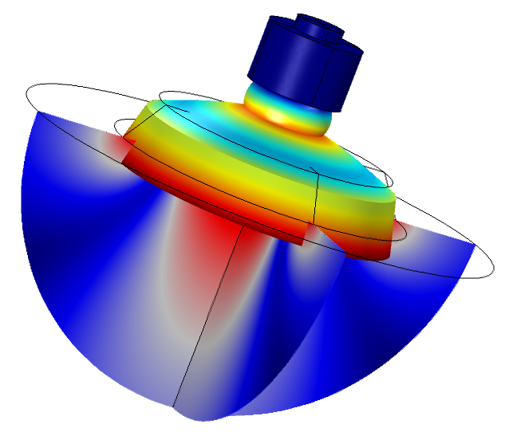
Tonpilz Piezo Transducer
Application ID 11478

Slide 2
Background and Motivation
The tonpilz (sound mushroom) piezo transducer is a transducer for relatively low frequency, high power sound emission. The transducer consists of piezoceramic rings stacked between massive ends and it may be prestressed by a central bolt. The tail and head mass lower the resonance frequency of the device.
In this application the frequency response of the transducer when the bolt is not prestressed is studied. The Acoustic-Piezoelectric Interaction, Frequency Domain Interface of the Acoustics Module is used for the study. This interface has all the predefined multiphysics couplings necessary to model this system:
  Acoustic-structure
  Electric-structure (piezo material)
The application determines the deformation and stresses in the device, the radiated pressure field and sound pressure level, as well as the spatial far-field sensitivity, the transmitting voltage response (TVR) curve of the transducer, and the directivity index (DI) of the sound beam.

Slide 3
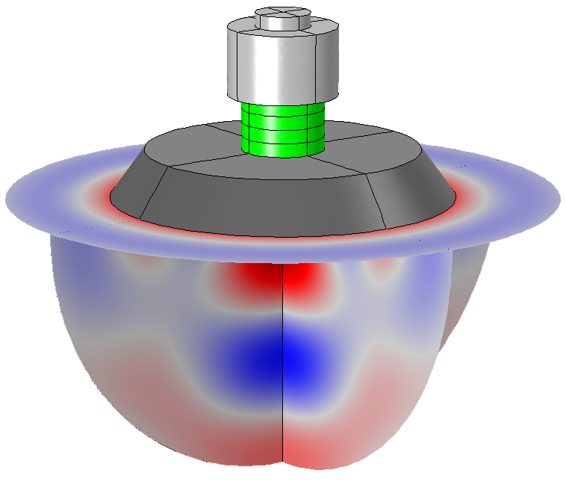
Tonpilz Transducer
Module
  Acoustics Module
Physics interface
  Acoustic-Piezoelectric Interaction
Physics involved
  Electrostatics
  Solid Mechanics
  Pressure Acoustics
Type of analysis
  Frequency Domain

Slide 4
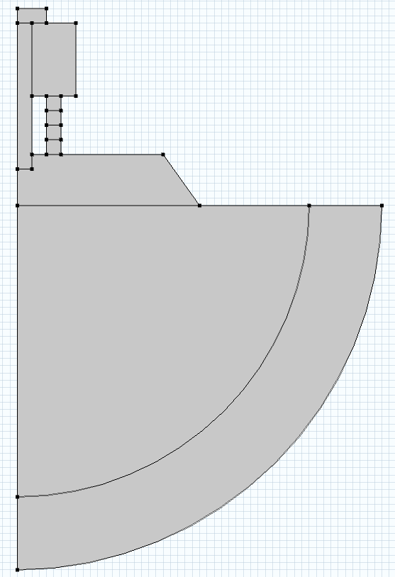
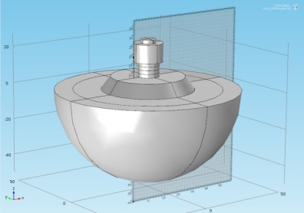
Model Setup
z
Steel tail mass
Fixed
Steel bolt
PZT-4 stack
Aluminum head mass
Rotational symmetry z-axis
Water domain
Perfectly matched
layer (PML)

Slide 5
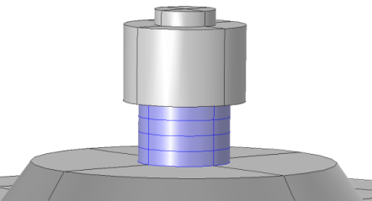

Coordinate System: Poling Direction in Piezo Stack
Opposite poling direction in alternate PZT disk.
Common electrical connection at junction of PZT disks.
Maximize structural displacement when operating in 33-mode.
Ground
1 V (rms)
Ground
1 V (rms)
Ground
Set α = 0, β = π, and γ = 0

Slide 6
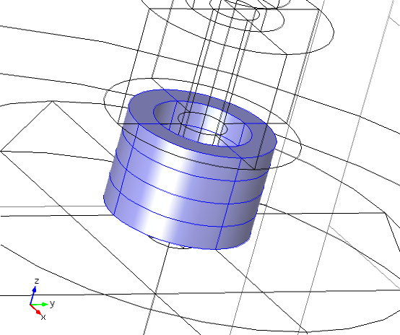
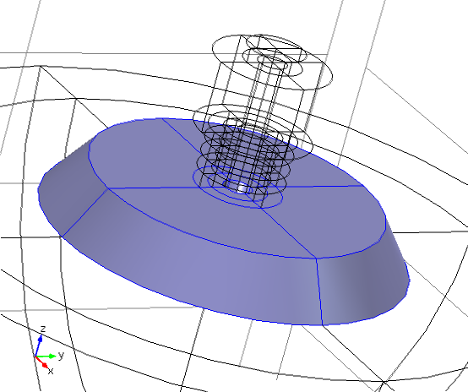

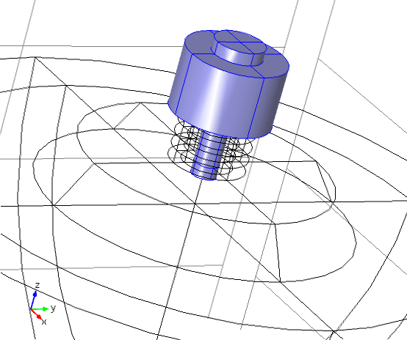
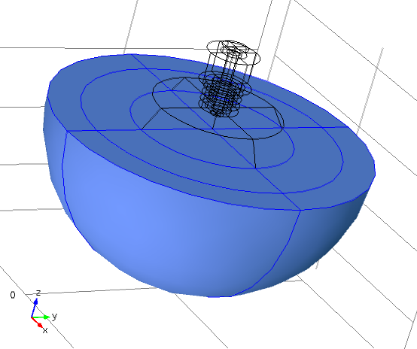
Materials
Set up the materials for the different domains under the Materials node.
PZT-4
Aluminum
Steel
Water

Slide 7
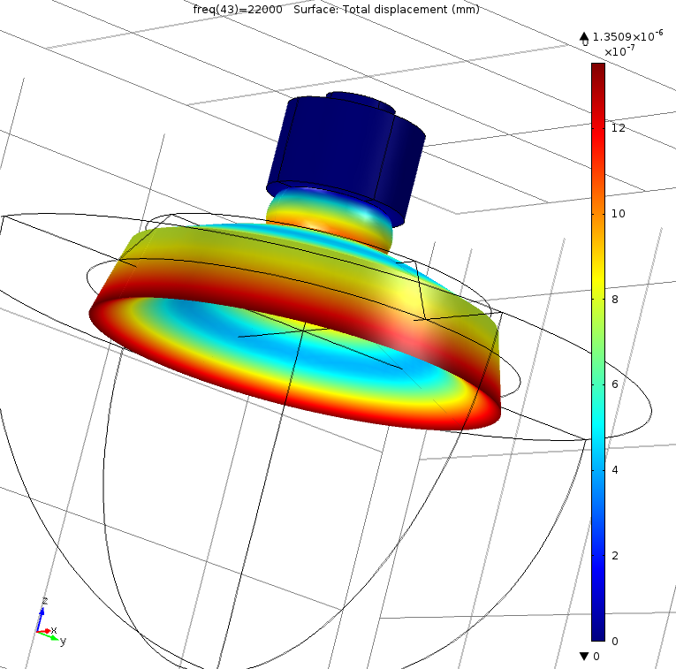
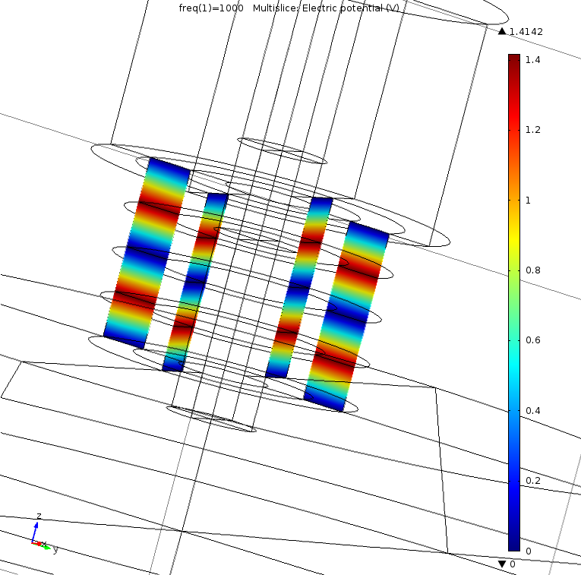
Results
Displacement and the electric potential.

Slide 8
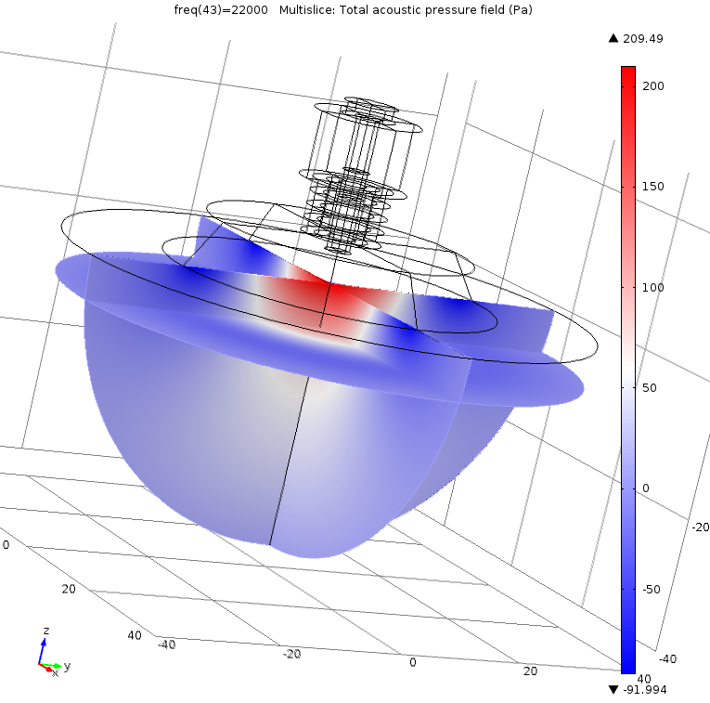
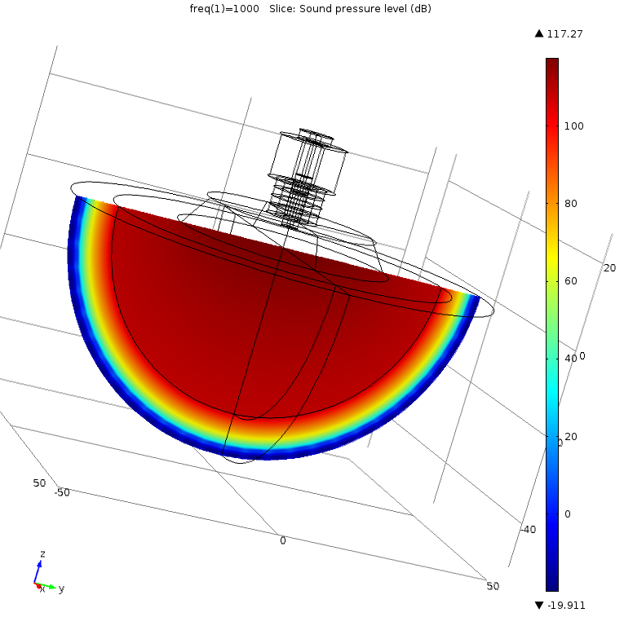
Results
Acoustic pressure and the sound pressure level (SPL).

Slide 9
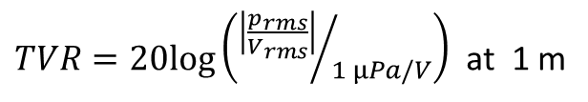
Transmitting Voltage Response (TVR)
The TVR represents the sensitivity of the transducer measured at a distance of 1 m and driven at 1 V rms.
This corresponds to plotting:
where pfar(…) is the far field operator defined in the far-field feature. The expression for the TVR is defined under Definitions > Variables 1.
$TVR=20log⁡\left({\left|\frac{p_{rms}}{V_{rms}}\right|}/{1 µPa/V}\right)$ at 1 m
20*log10(sqrt(0.5*pfar(0,0,-1[m])*conj(pfar(0,0,-1[m])))/Vrms/1[µPa/V])

Slide 10
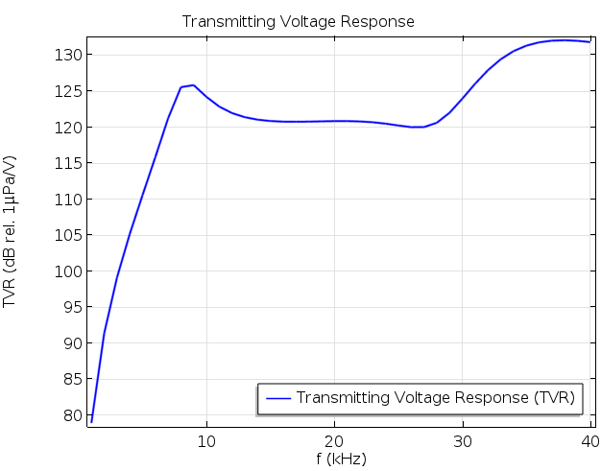
Transmitting Voltage Response (TVR)

Slide 11




Directivity Index (DI)
The directivity index (DI) gives a measure of how directional the transmitted acoustic beam is. It is a measure of the ratio of the intensity transmitted by an omnidirectional source (of same strength) compared to the intensity in front of the transducer (in the far-field, here evaluated at 10 m). The variables defined to calculate the DI are entered under
Definitions > Variables 1
The variables correspond to the expressions:
$$D_{i}=\frac{I_{front}}{I_{average}}$$
$$DI=10log⁡(D_{i})$$
$$I_{front}=\frac{1}{2}\frac{pp^{∗}}{ρc}$$
$$I_{average}=\frac{\int{I∙dS}}{4πr^{2}}$$

Slide 12
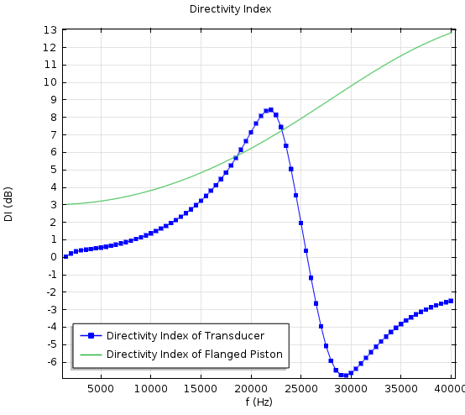
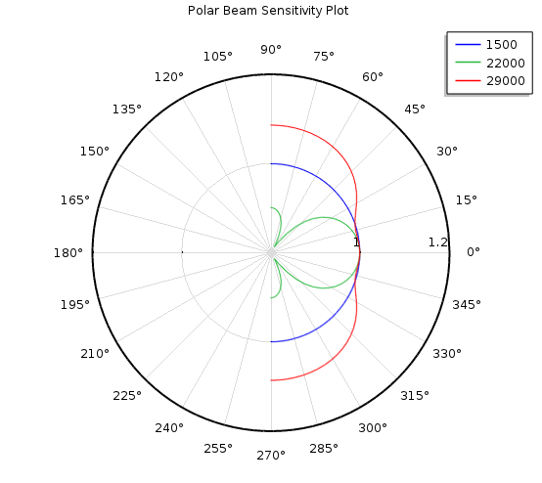
Directivity Index (DI)
-z
DI = 0 dB is a fully omnidirectional beam

Slide 13
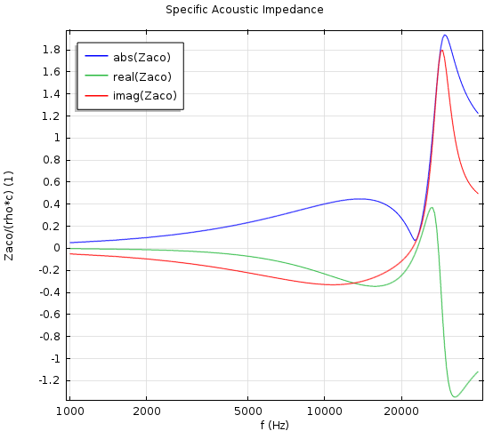
Specific Acoustic Impedance

Slide 14
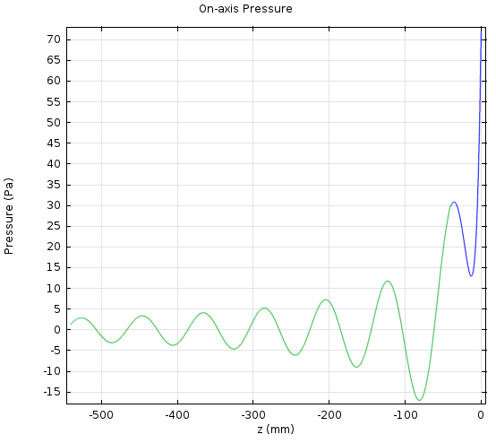
On-axis Pressure (near to far field)
f = 18500 Hz

Slide 15
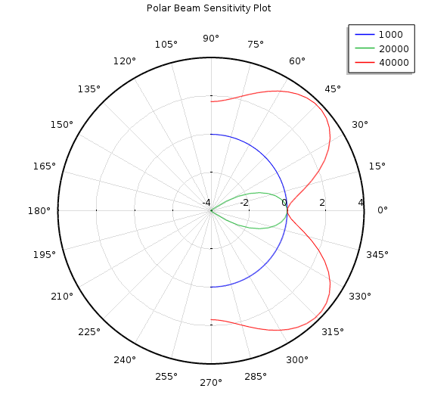
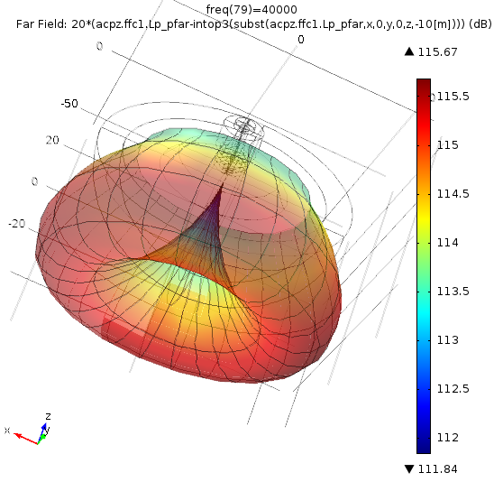
Far-Field Spatial Response
f = 40 kHz

Slide 16
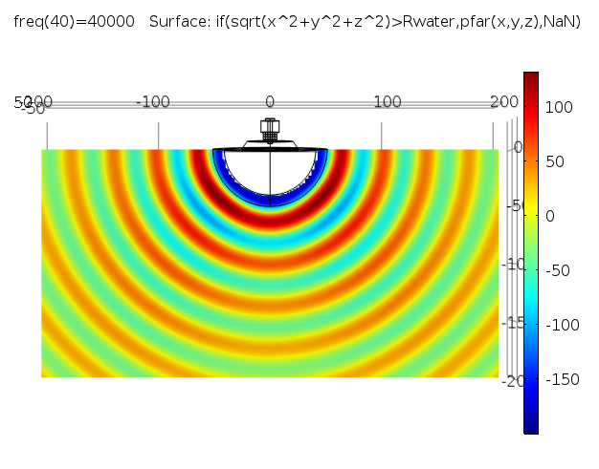
Exterior Field

Slide 17
Conclusions
This model sets up a frequency domain simulation of a tonpilz piezo transducer using the Acoustic-Piezoelectric Interaction, Frequency Domain interface.
All the multiphysics couplings are predefined and easily set up.
The model shows that there exist a frequency range from 10 to 30 kHz where the TVR is nearly constant. In this interval it is possible to control the directivity of the transducer varying the DI from -7 dB to +8 dB making the transducer very versatile.

