Slide 1
Vibrations of an Impeller

Slide 2
Background and Motivation
This application studies small amplitude free and forced vibrations of an impeller.
The application show how to make use of the dynamic cyclic symmetry conditions when analyzing rotationally periodic structures.

Slide 3
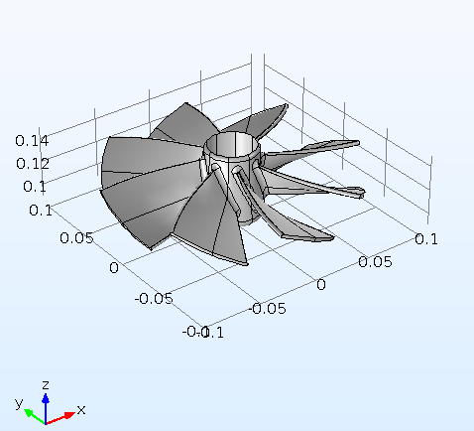
Problem Definition
The impeller is made of aluminum, and it is supposed to be mounted on a shaft
The mounting boundary is modeled via a fixed constraint
All possible effects of the shaft rotation are neglected

Slide 4
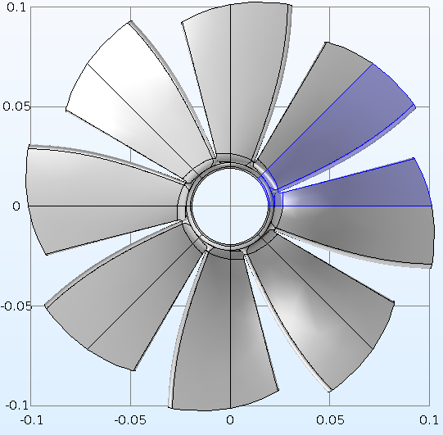
Problem Definition, symmetry
The impeller has eight identical blades
The geometry can be divided into eight identical parts, each represented by a sector with an angle of π/4

Slide 5
Problem Definition, analyses
Eigenfrequency and Frequency analyses are performed on a unit sector geometry with Cyclic symmetry conditions applied on the periodicity boundaries
Cyclic symmetry is an option available within the Periodic Conditions feature under Solid Mechanics physics interface in COMSOL Multiphysics
In order to compare the results and performance, the same type of studies also performed on the whole geometry.

Slide 6
Results, eigenfrequency
In order to use the Cyclic symmetry conditions under an Eigenfrequency study, you need to perform a parametric sweep with respect to the azimuthal mode number from zero to N/2 where N is the total number of sectors.
The eigenfrequency values and eigenmodes computed on a unit sector of the impeller are in perfect agreement with those computed on the whole geometry.

Slide 7
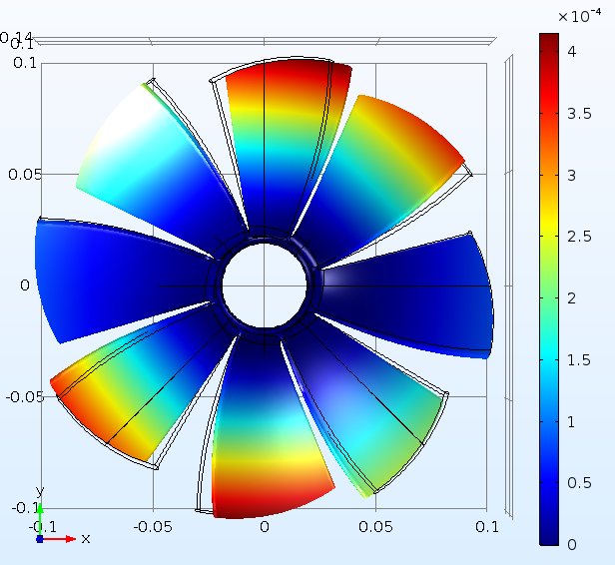

Results, frequency domain
The figures below show the total displacement at excitation frequency of 200 Hz.
The left one shows the result computed on the full geometry. In the right figure, the results computed on the unit sector are visualized over the whole geometry via a sector data set.

Slide 8
Conclusions
The results obtained using a unit sector are in very good agreement with that computed on the full geometry of the impeller. Both the computational time and memory requirements are significantly reduced when using a unit sector geometry.
Cyclic symmetry conditions allow to efficiently perform both eigenfrequency and frequency response analyses by using a unit sector geometry for a rotationally periodic structure.

