Slide 1
Superconducting Wire
Specialized Model to Handle Zero Resistivity
based on a suggestion by
Dr. Roberto Brambilla
CESI - Superconductivity Dept.
Milano, Italy

Slide 2
Introduction
The superconducting phenomena was discovered in 1911. The superconductive state of a material is limited by the temperature, current density, and magnetic field.
The race towards room-temperature superconductors has stagnated, but the possibility to cool with liquid nitrogen has made commercial applications feasible.
This is the model of a wire cross-section, where the current increases to current levels above the critical current density.

Slide 3
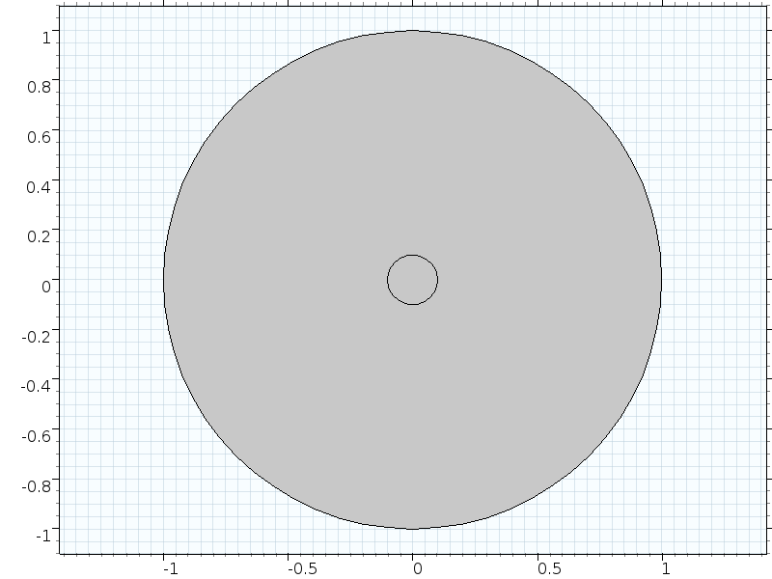
Model Definition – Geometry
The geometry is a cross-section of a wire surrounded by air.

Slide 4
Model Definition – Equations
The current dependent conductivity is model with a relationship between electric field and current:
Faraday’s law and Ampère's law are used to form the complete system:
The Magnetic Field Formulation interface is used for this model.

Slide 5
Model Definition – Boundary
The current in the conductor is defined by forcing the line integral around the wire to a time-dependent current:
This is equal to a boundary condition of the tangential H-field at the outer boundary.

Slide 6
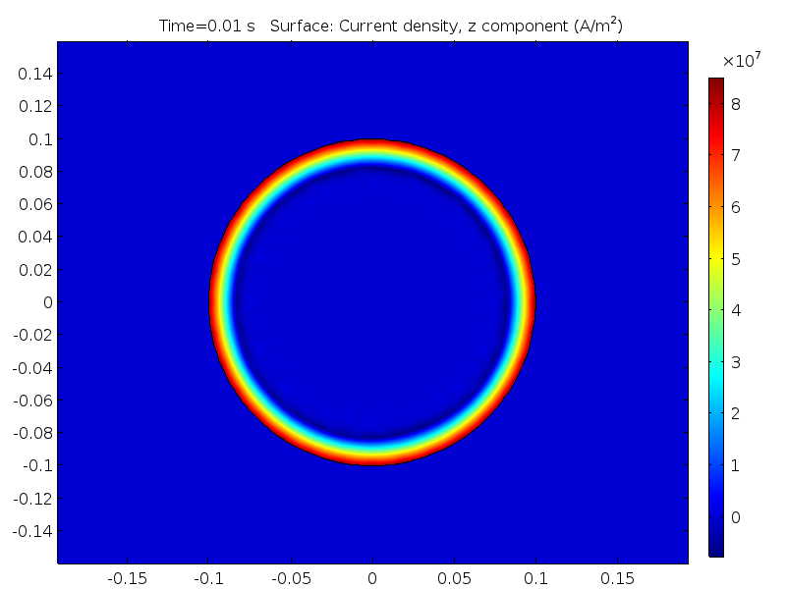
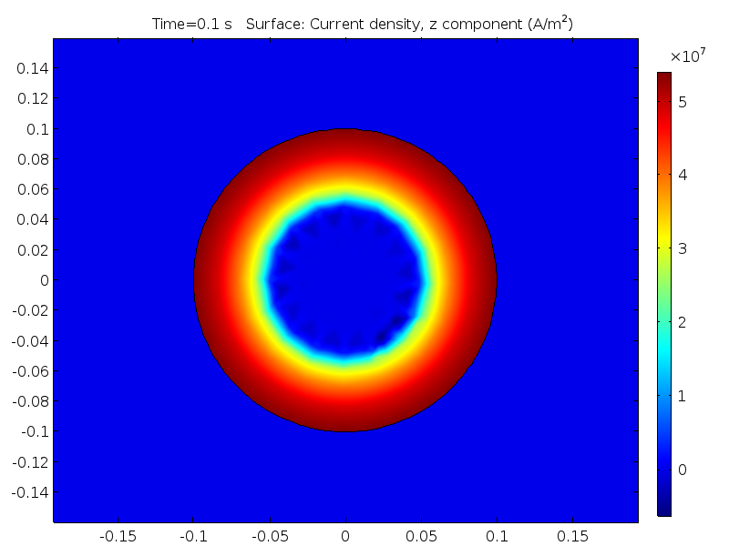
Results
The current increases in a smooth step to the final value. The current density plot at t=0.01s and t=0.1s shows how the
non-superconducting state spreads from the edge of the wire.
t = 0.01s
t = 0.1s

