Slide 1
Modeling in
Electrochemical Engineering

Slide 2
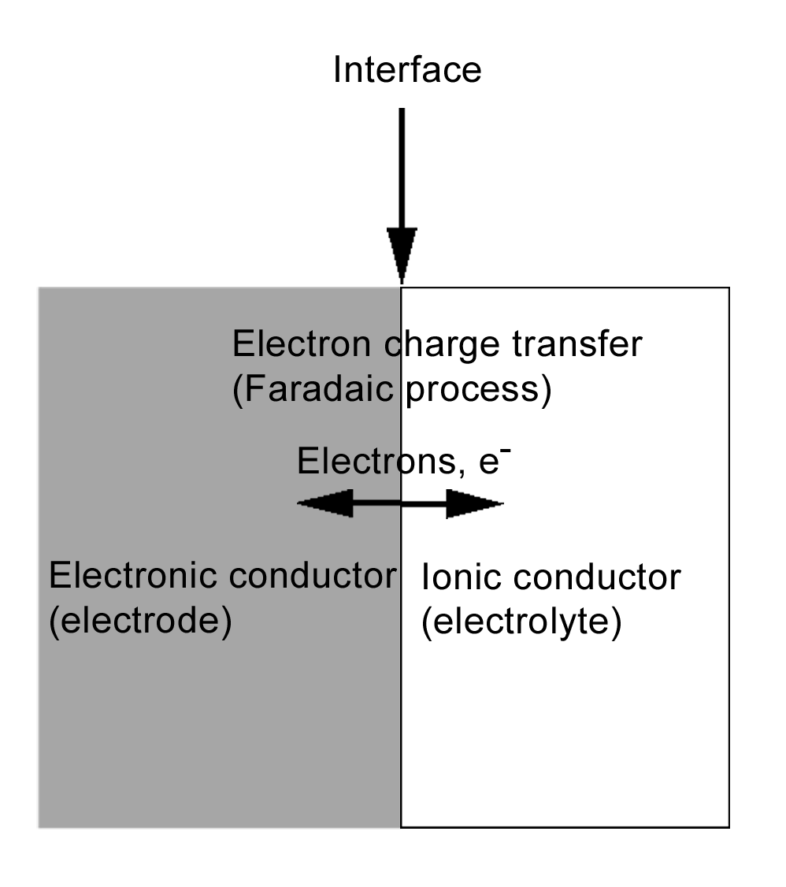
Introduction: Electrochemical Systems
Electrochemical systems are devices or processes in which an ionic conductor mediates the inter-conversion of chemical and electrical energy
The reactions by which this inter-conversion of energy occurs involve the transfer of charge (electrons) at the interface between an electronic conductor (the electrode) and an ionic conductor (the electrolyte)

Slide 3
Introduction: Redox Reactions
Individual electrode reactions are symbolized as reduction-oxidation (redox) processes with electrons as one of the reactants:
Ox = oxidized species
Red = reduced species
e⁻ = electron
n = electron stoichiometry coefficient

Slide 4
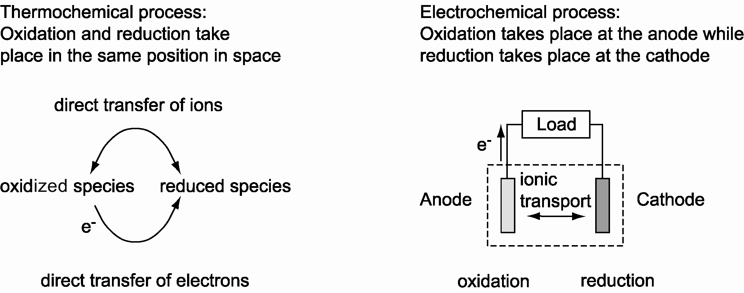
Introduction: Thermochemical and Electrochemical Processes

Slide 5
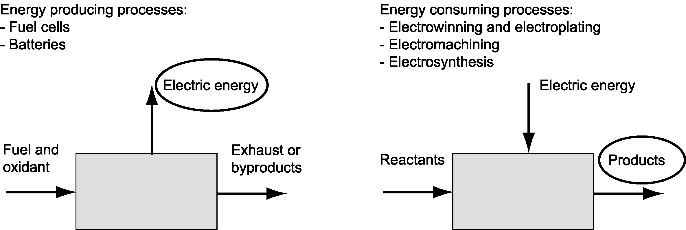
Introduction: Energy Producing and Energy Consuming Electrochemical Processes

Slide 6
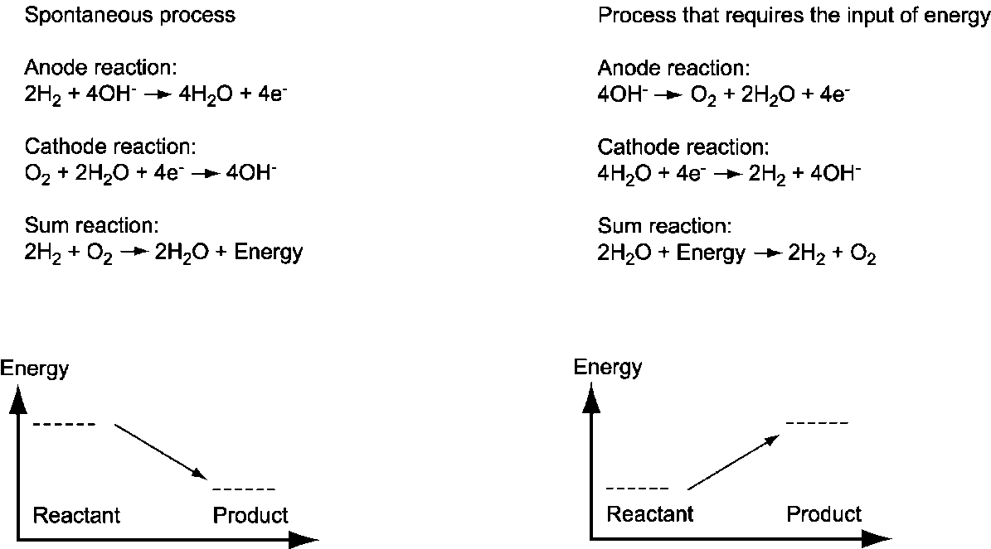
Introduction: Spontaneous Processes and Processes that Require Energy Input

Slide 7
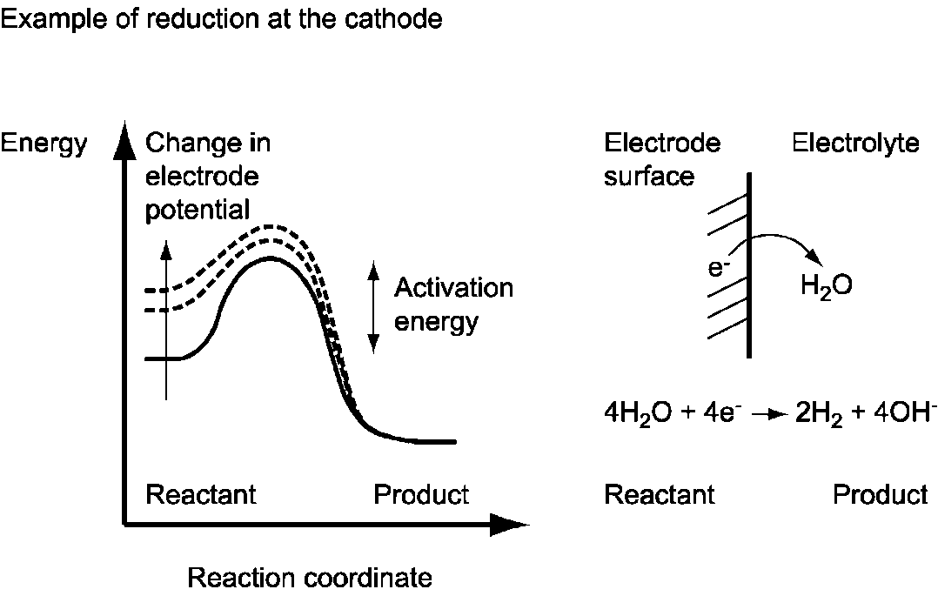
Introduction: Electrocatalysis

Slide 8
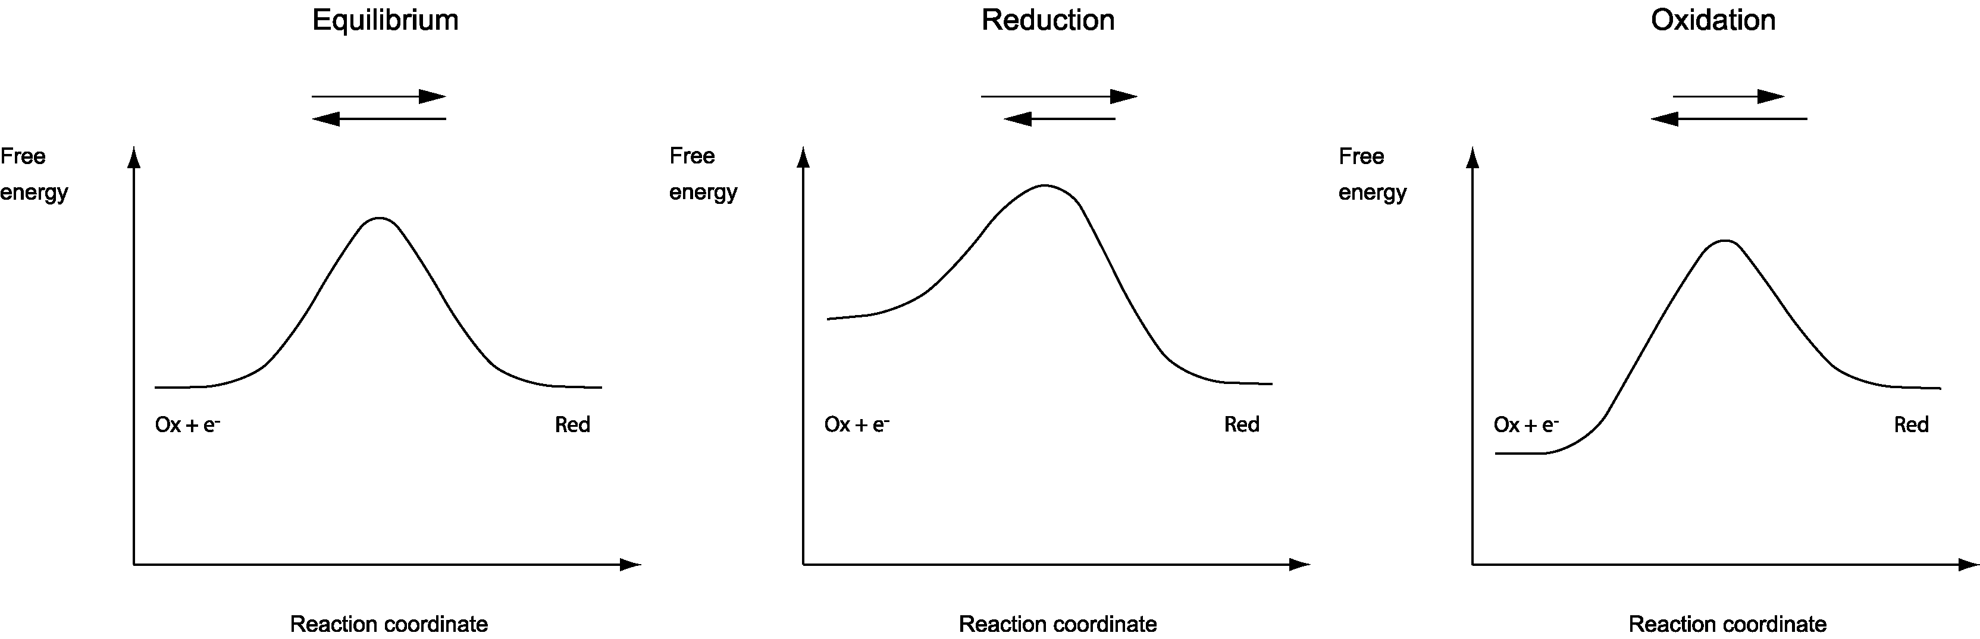
Introduction: Anodic and
Cathodic Reactions

Slide 9
Introduction: Transport and
Electrochemical Reactions
Transport
  Diffusion, convection, migration, which is an electrophoretic effect on ions. The mobility and concentration of ions yields the mass transfer and Ohmic resistances in the electrolyte
Electrochemical reaction
  Electrode kinetics for an electron charge transfer step as rate determining step (RDS) yields potential-dependent reaction rate. The overpotential is a measure of the activation energy (Arrhenius equation -> Butler-Volmer equation)

Slide 10
Introduction: Transport
Flow velocity
Charge
Mobility
Transport
  Flux = diff. + conv. + migration
  Current density
  Electroneutrality sum of charges = 0
  Perfectly mixed primary and secondary
Diffusivity
Concentration
Faraday’s constant
Ionic potential

Slide 11
Introduction: Conservation of
Species and Charge
Conservation of species n-1 species, n:th through charge conservation
Conservation of charge
Net charge is not accumulated, produced or consumed in the
bulk electrolyte
For primary and secondary cases
Reaction rate

Slide 12
Modeling of Electrochemical Cells
Primary current distribution
  Accounts only for Ohmic effects in the simulation of current density distribution and performance of the cell:
    Neglects the influence of concentration variations in the electrolyte
    Neglects the influence of electrode kinetics on the performance of the cell, i.e. activation overpotential is neglected (losses due to activation energy)
Secondary current distribution
  Accounts only for Ohmic effects and the effect of electrode kinetics in the simulation of current density distribution and performance of the cell:
    Neglects the influence of concentration variations in the electrolyte
Tertiary current distribution
  Accounts for Ohmic effects, effects of electrode kinetics, and the effects of concentration variations on the performance of a cell

Slide 13
Modeling of Electrochemical Cells
Non-porous electrodes
  Heterogeneous reactions
  Typically used for electrolysis, metal winning, and electrodeposition
Porous electrodes
  Reactions treated as homogeneous reaction in models although they are heterogeneous in reality
  Typically used for batteries, fuel cells, and in some cases also for electrolysis
Electrolytes
  Diluted and supporting electrolytes
  Concentrated electrolytes
  ”Free” electrolytes with forced and free convection
  ”Immobilized” electrolytes through the use of porous matrixes, negligible free convection, rarely forced convection
  Solid electrolytes, no convection

Slide 14
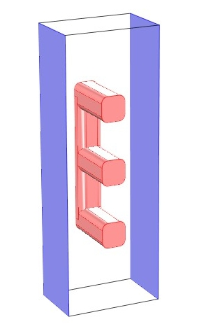
A First Example:
Primary Current Distribution
Assumptions:
  Perfectly mixed electrolyte
  Negligible activation overpotential
  Negligible ohmic losses in the anode
  structure
Anode:
Wire electrode
Cathodes:
Flat-plate electrodes
Electrolyte
Cathodes:
Flat-plate electrodes

Slide 15
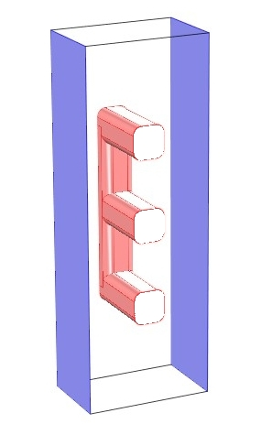
A First Example:
Subdomain and Boundary Settings
Subdomain:
  Charge continuity
Boundary
  Electrode potentials
  at electrode surfaces
  Insulation elsewhere
Anode:
Cell voltage = 1.3 V
E₀ = 1.2 V
Total cell (in this case ohmic)
polarization = 100 mV
Cathodes: 0 V
Electrolyte:
Cathodes:
Electrode potential = 0 V
E₀ = 0 V
(negligible overpotential)
Ionic potential

Slide 16
A First Example: Some Definitions
Activation and concentration overpotential = 0
Select the cathode as
reference point
Ionic potential
Electronic potential
Cell voltage
At anode, index
At cathode, index

Slide 17
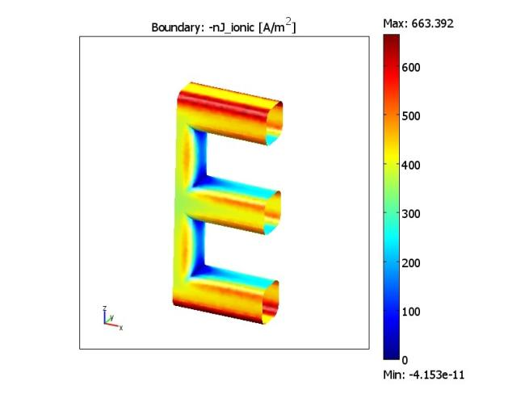
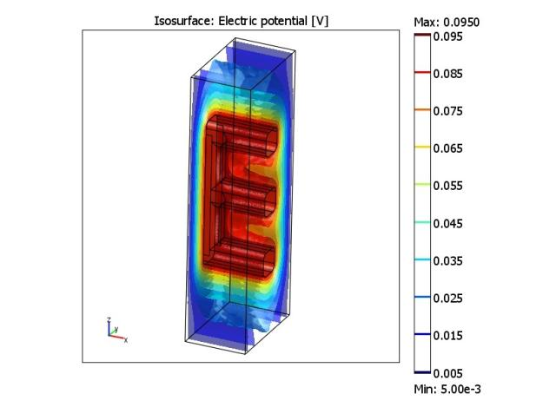
A First Example: Some Results
Current density distribution at the anode surface
Potential distribution in the electrolyte
Inactive catalyst
Highly active catalyst

Slide 18
A Second Example:
Secondary Current Distribution
Activation overpotential
taken into account
Charge transfer current at the electrode surfaces
New boundary conditions
Faraday’s constant
Charge transfer coefficient
Exchange current density
Gas constant

Slide 19
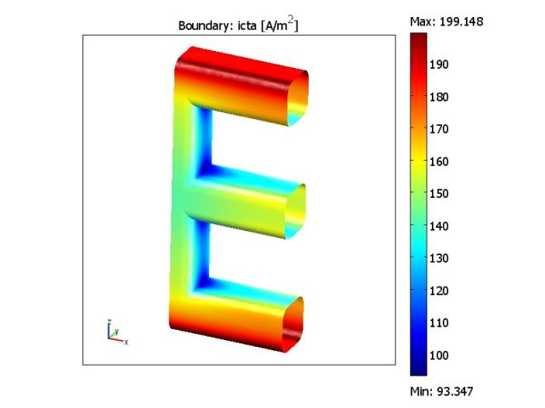
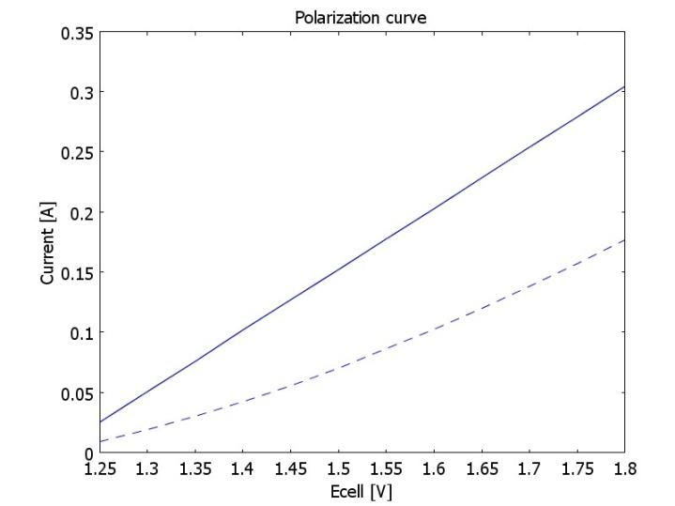
Comparison: Primary and Secondary
Current Distributions
Current density distribution at
the anode surface
Polarization curves
Solid line = Primary
Dashed line = Secondary
Effect of
Activation
overpotential
Lower current density with equal cell voltage (1.3V) compared to primary case

Slide 20
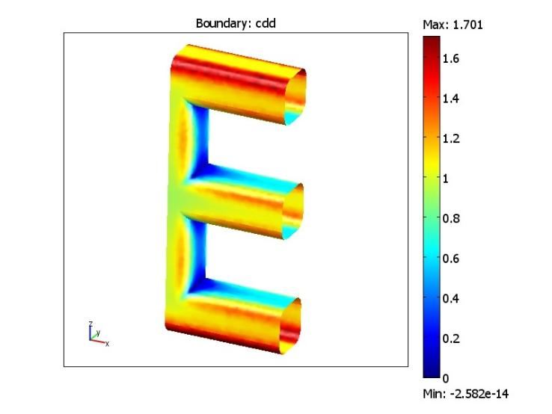
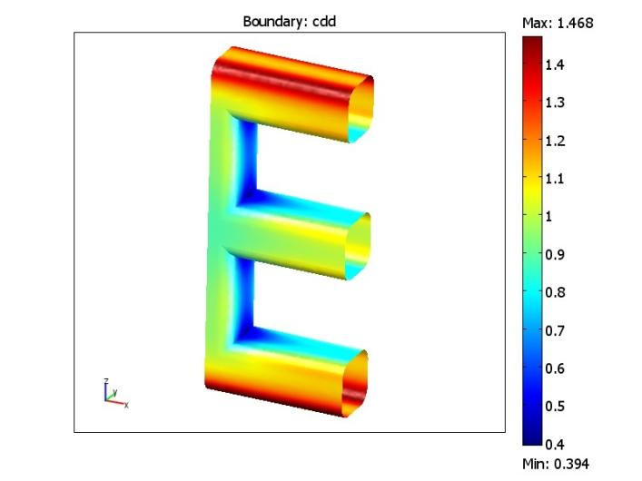
Comparison: Primary and Secondary Current Density Distribution, 0.1 A Total Current
Dimensionless current density distribution, primary case
Dimensionless current density distribution, secondary case
Independent of total current
Dependent of total current

Slide 21
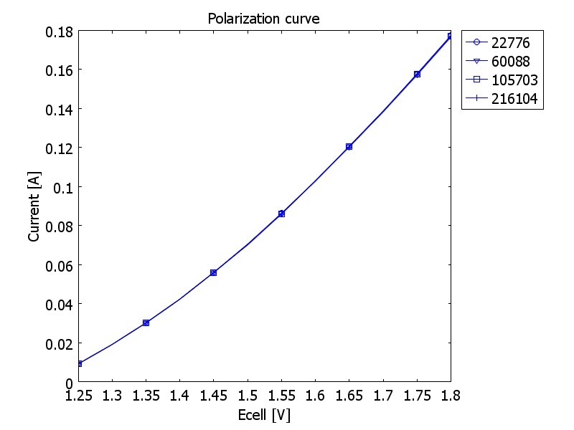
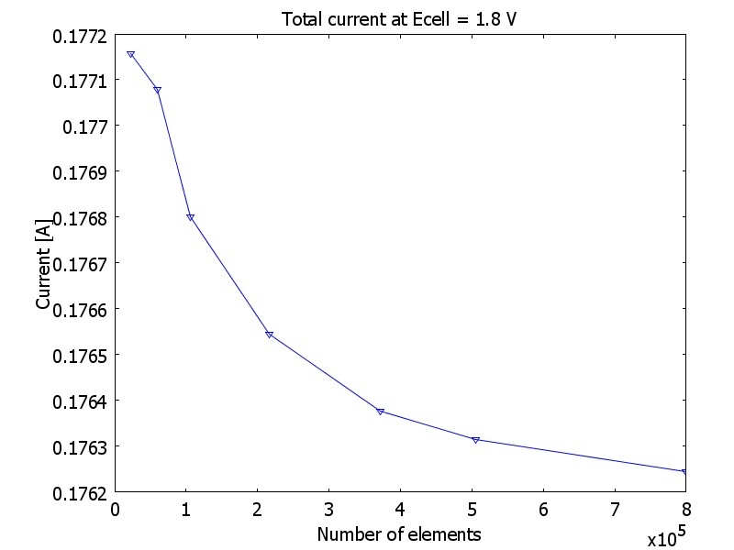
Some Results: Mesh Convergence
Polarization curves for three mesh refinements (four mesh cases)
Total current, seven mesh cases (up to 799,186 elements)

Slide 22
Primary and Secondary Current Distributions: Summary and Remarks
Primary case gives less uniform current distribution than the secondary case:
  The addition of charge transfer resistance through the activation overpotential forces the current to become more uniform
Secondary current density distribution is not independent of total current:
  The charge transfer resistance decreases with increasing current density (overpotential increases proportional to the logarithm of current density for high current density)
Home work:
  The geometry is symmetric in this example. Use this geometry and treat the wire electrode as a bipolar electrode placed in between an anode and a cathode

Slide 23
Tertiary Current Density Distribution
Use the secondary current distribution case as starting point
Add the flow equations, in this case from single phase laminar flow
Navier-Stokes
Solve only for the flow
Add equations for mass transport, in this chase the Nernst-Planck equations
Introduce the concentration dependence on the reaction kinetics
Solve the fully coupled material and charge balances using the already solved flow field

Slide 24
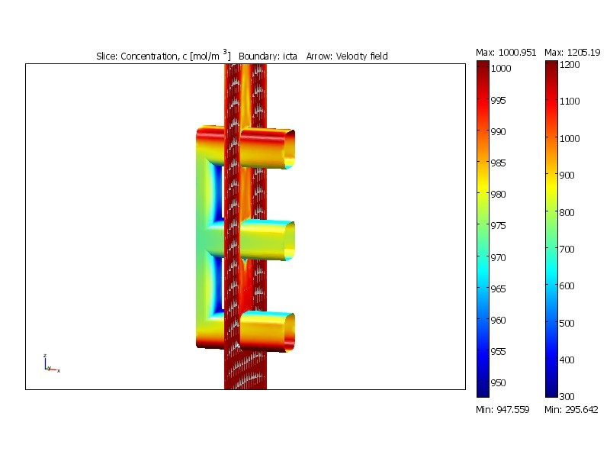
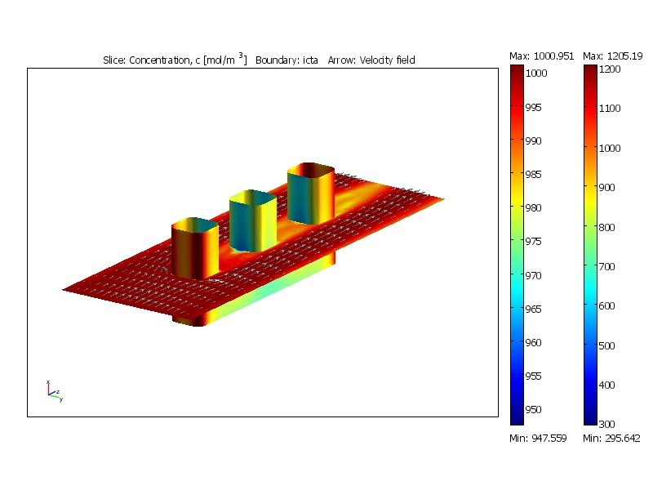
Results: Concentration and
Current Density Distribution
Stagnation in the flow
results in lower concentration
Main direction of the flow

Slide 25
Concluding Remarks
Use a primary current distribution as the starting point
Introduce reaction kinetics to obtain secondary current distribution
Introduce a decoupled flow field
Introduce material balances and concentration dependency in the reaction kinetics to obtain a tertiary current distribution
  Several options:
    Supporting electrolyte where the conductivity is independent of concentration
    All charged species are balanced and are combined in the electroneutrality condition
    All charged species are balanced but they are combined using Poisson’s equation

