Slide 1
The Mixer App
Mixer Module

Slide 2
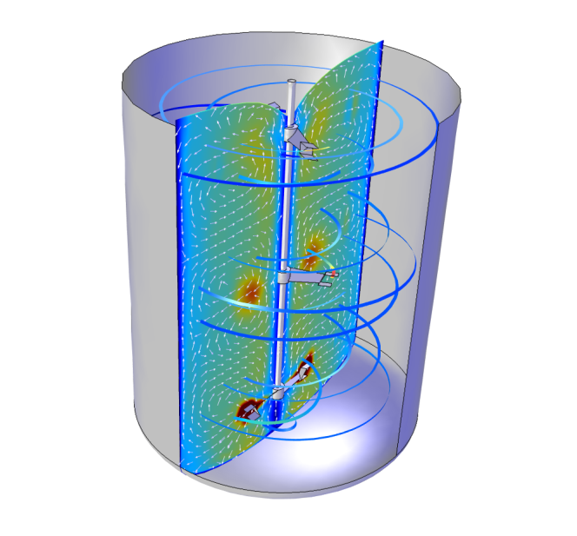
Contents
Purpose
About the app
  User interface
  Tank types
  Impeller types
Some example results
The mixer app computes the flow field and
eddy diffusivity in mixers and tank reactors

Slide 3
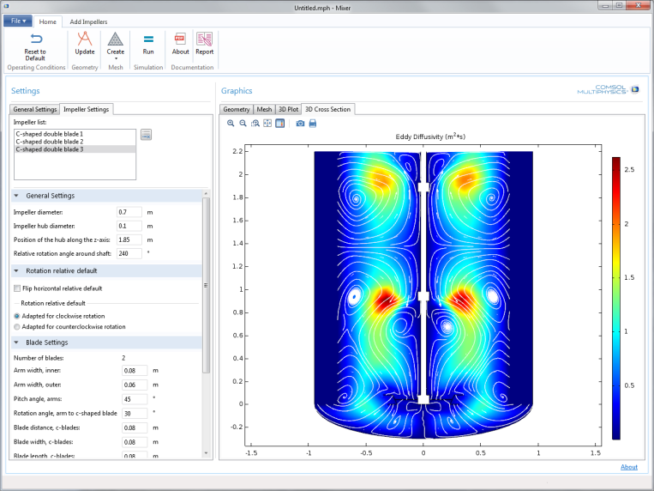
Purpose
Simulate mixing efficiency in mixers and tank reactors
Select impellers, tank type, and baffles
Investigate operating conditions
Provide a starting point for own apps, for example to:
  Expand with more impellers and tank types
  Include non-Newtonian fluids
  Include two-phase flow
Results displayed in the apps user interface

Slide 4
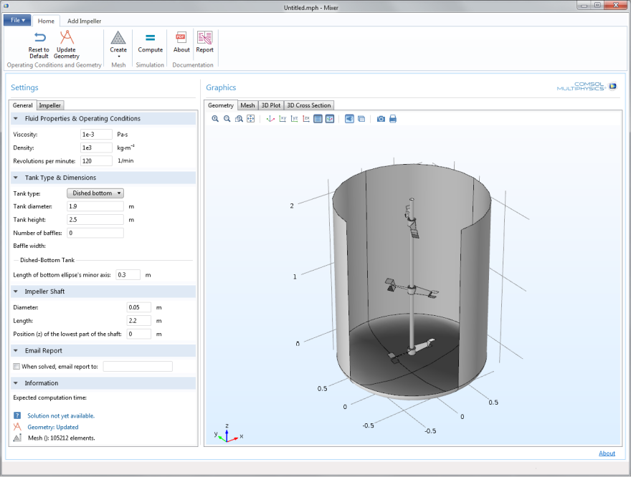
The User Interface
Reset all
Update geometry
Mesh
Run simulation
Read documentation
Create report
Set fluid properties
and operating conditions
Show graphics
Select tank and enter
tank dimensions
Set shaft dimensions
Send simulation report
by e-mail when done
Simulation information

Slide 5
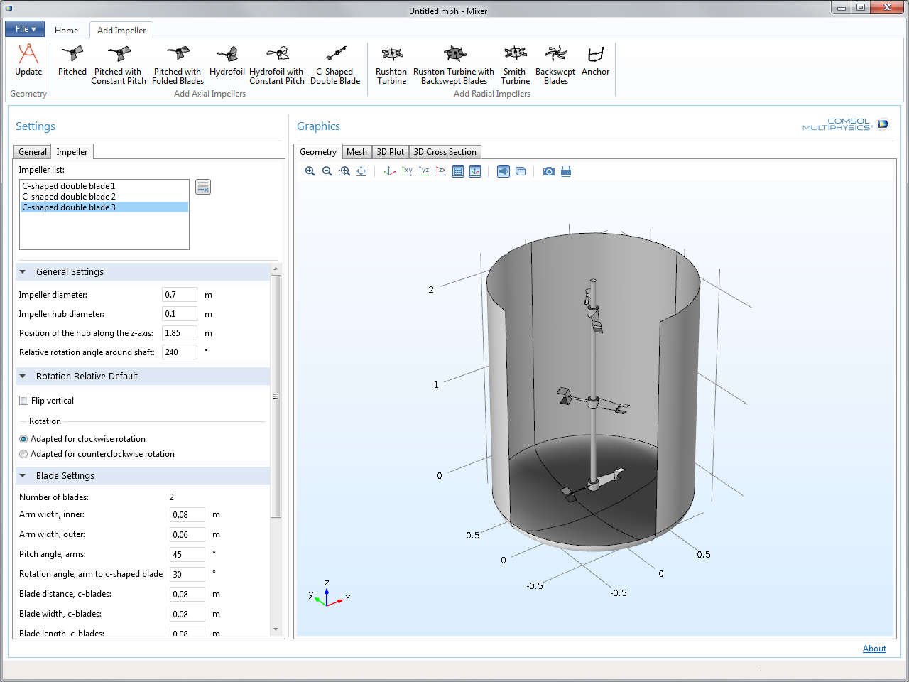
The User Interface
Update geometry
Add impellers
Select existing impellers
to change or remove
Show graphics
Enter impeller dimensions
Flip impeller
Enter number of blades,
cut, and fold blades

Slide 6
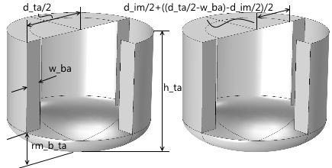
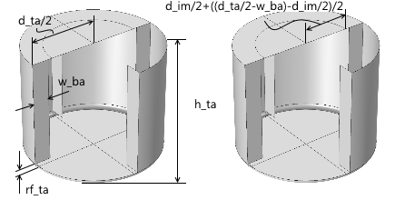
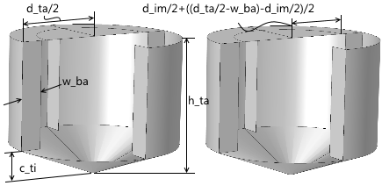
Tank Types
All tanks can be equipped with an arbitrary number of rectangular baffles attached to the tank walls
Dished bottom
Flat bottom
Cone bottom

Slide 7
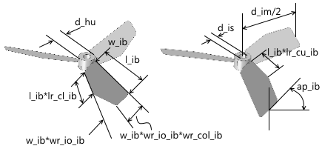
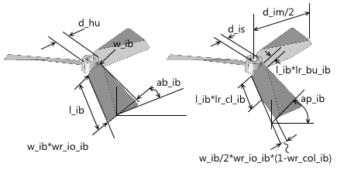
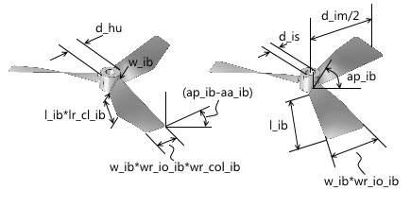
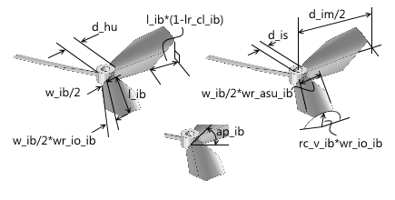
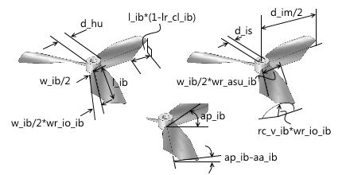
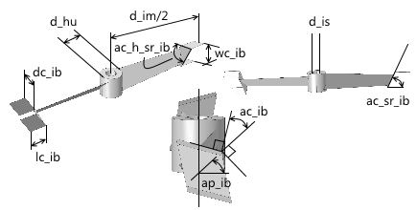
Axial Impellers
Pitched
Pitched with folded blades
Pitched with constant pitch
Hydrofoil
Hydrofoil with constant pitch
C-shaped (Intermig®)
Intermig is a registered trademark of Ekato Holding GmbH

Slide 8
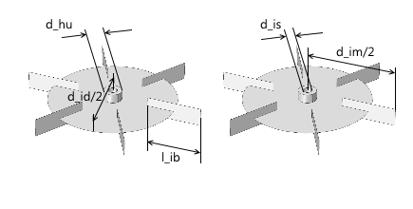
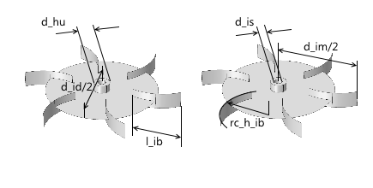
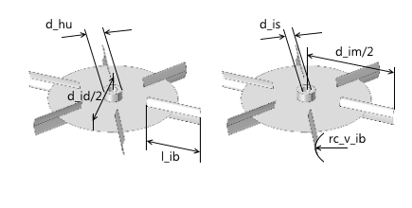
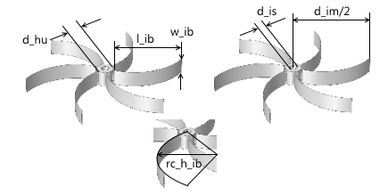
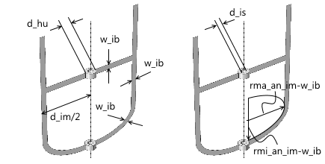
Radial Impellers
Rushton turbine
Rushton with backswept blades
Smith turbine
Backswept
Anchor

Slide 9
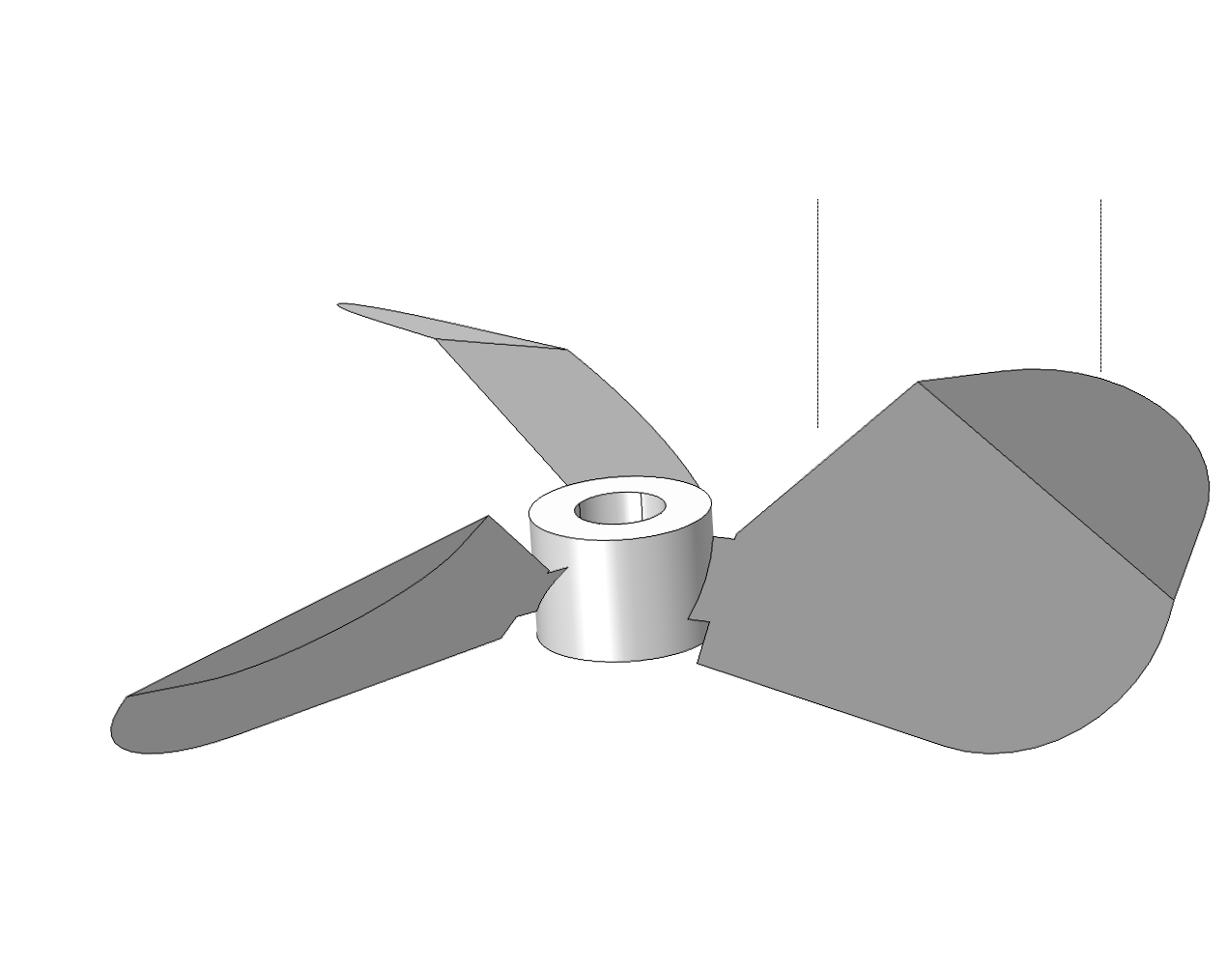
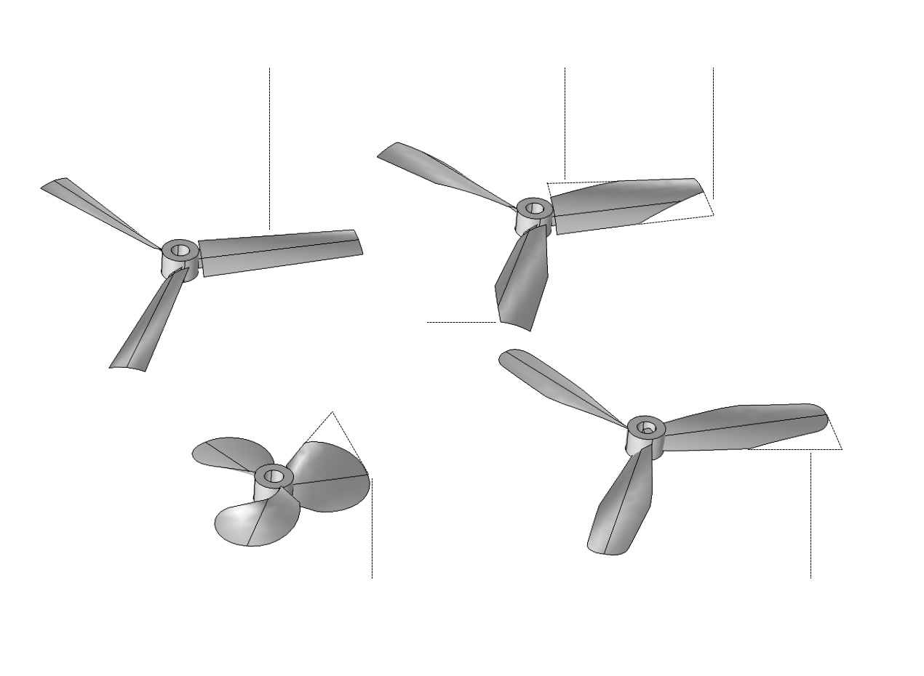
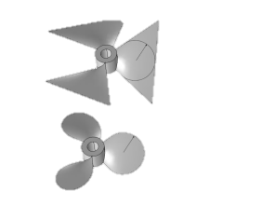
Great variety of Designs Possible for
Pitched and Hydrofoil Impellers
Cut
Fillet and fold
Straight hydrofoil
Cut inner
Cut outer
Propeller type impeller using cuts and fillets
Fillets

Slide 10
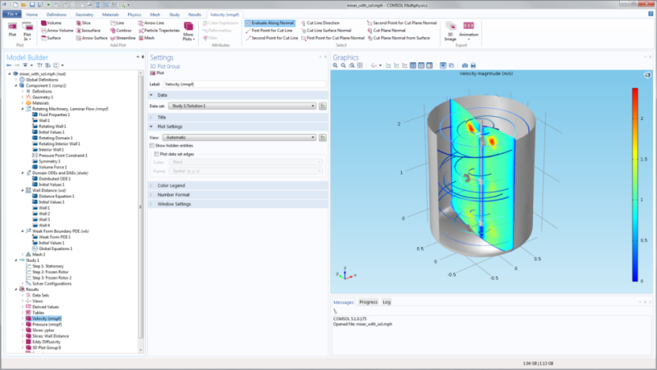
Embedded Model
Flow in rotating machinery using a y+ algebraic turbulence model
Frozen rotor approximation using arbitrary Lagrangian-Eulerian (ALE) formulation
Wall distance function and shear stress determines the eddy diffusivity
Free surface computation for small surface deformations

Slide 11
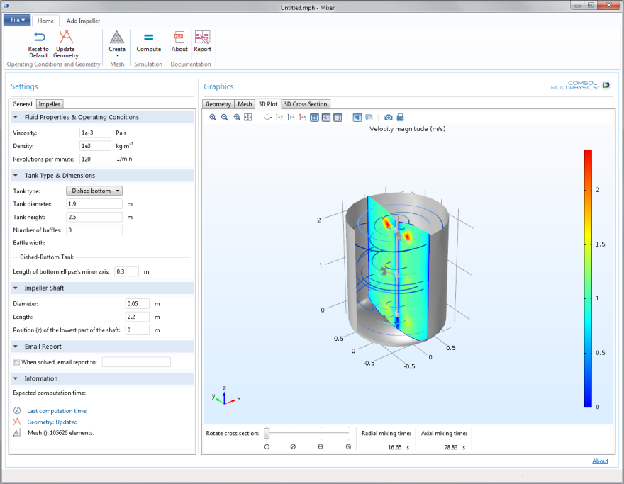
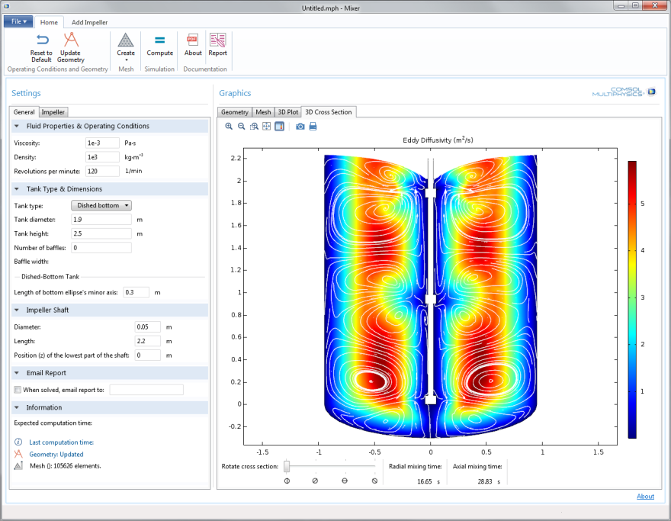
Example Results
Shape of free surface
Eddy diffusivity, streamlines, and mixing time scales

