Slide 1
Geothermal Heating from a Pond Loop

Slide 2
Background and Motivation
Ponds and lakes can serve as thermal reservoirs in geothermal heating applications
Modeling can be used to calculate the pressure losses and temperature increase as fluid circulates through a pipe system
COMSOL’s Pipe Flow interfaces allow you to efficiently model pipe systems in 3D

Slide 3


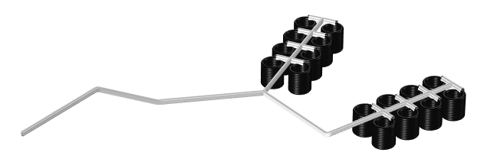
Application Geometry and
Operating Principles
High density polyethylene pipe (∅ 20 mm) is rolled into sixteen coils that are mounted on two sleds. The coil groups are connected to feed and return piping with ∅ 50 mm. Total piping is 1446 m
Geometry drawn as lines in 3D
Heat exchange with the pond increases the fluid temperature in the loop

Slide 4
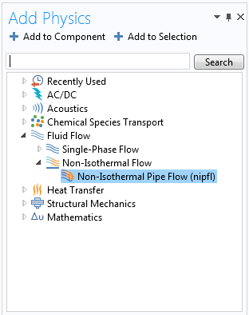
The Non-Isothermal Pipe Flow Interface
Provides a 1D model for fluid flow to solve for the velocity, pressure, and temperature in 3D pipe systems

Slide 5
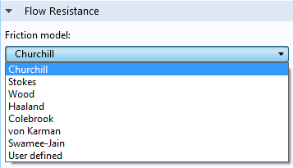

The Non-Isothermal Pipe Flow Interface
Flow equations account for friction losses through the Darcy friction factor, f_{D}
Expressions for f_{D} are predefined
$$ρ\frac{∂u}{∂t}=−∇p−f_{D}\frac{ρ}{2d_{h}}u\left|u\right|$$
$$\frac{∂Aρ}{∂t}+∇∙\left(Aρu\right)=0$$

Slide 6
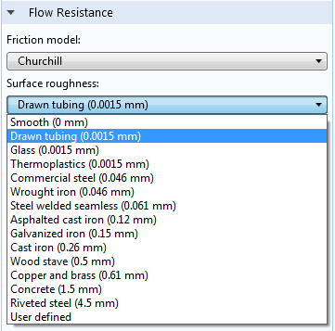
Model Setup
Select surface roughness values from a list
Fluid properties are available from a built-in material library

Slide 7
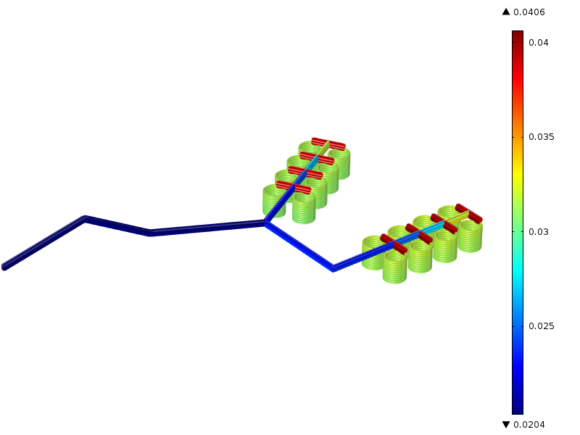
Results
Friction is evaluated locally. Plot of Darcy friction factor
(f_{D,} dimensionless).

Slide 8
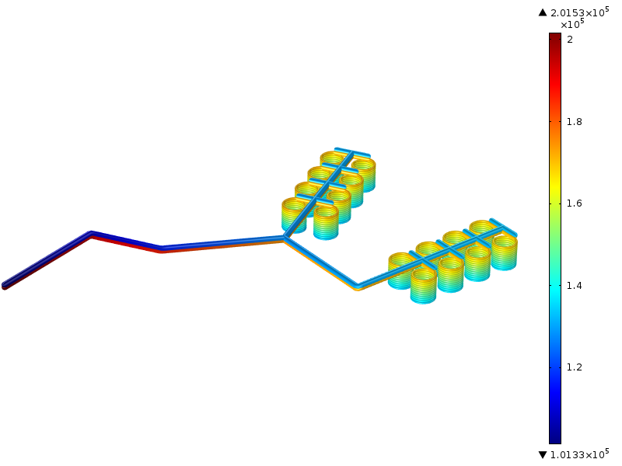
Results – Pressure Losses
The pressure loss over the pipe system is 100 kPa
Pa

Slide 9
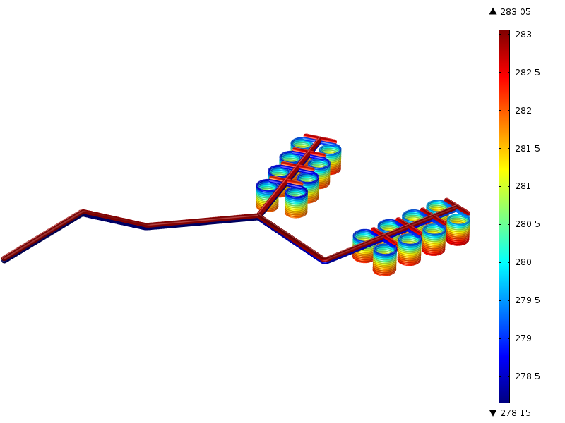
Results – Temperature Increase
The temperature in the fluid increases by 5 °C
K

