Slide 1
Modeling of Zinc-Silver oxide Batteries
© 2014 COMSOL. All rights reserved.
Notes:
You can use the heading from the model documentation for the title.

Slide 2
Background and Motivation
Zinc-Silver oxide (Zn-AgO) batteries are used in different industries due to their high capacity per unit weight.
In this work, discharge of a Zn-AgO battery is simulated using the Battery with Binary Electrolyte interface.
The electrochemical reactions in the positive and negative electrodes lead to changes in porosity and species concentration in the electrodes. This is modeled using ’Domain ODEs and DAEs’ interfaces.
The model can be used for studying the performance of Zn-AgO batteries and for providing insights towards cell design.
In this work, model analysis is done to relate the drop in cell voltage at the end of discharge to the spcecies concentration in the electrodes, thereby indicating the limiting electrode in the cell.
Additionally, the model provides a motivation for a new feature in the battery interfaces for describing changes in porosity and species concentration in the electrodes.

Slide 3
Model
A 1D isothermal cell model for Zn-AgO battery is presented.
The negative electrode is made of zinc powder and the positive electrode is composed of a mixture of AgO and Ag₂O. A separator material is used between the electrodes. This unit cell is filled with a solution of concentrated potassium hydroxide KOH.
The reactions considered in the porous electrodes are as follows,
  Positive: Ag₂O + H₂O + 2e⁻ → 2Ag + 2OH⁻
  2AgO + H₂O + 2e⁻ → Ag₂O + 2OH⁻
  Negative: Zn + 2OH⁻ → ZnO + H₂O + 2e⁻
The reactants and products of the above reactions have different densities, thereby leading to porosity changes in the electrodes.
The model is based on a study presented in J. Electrochem. Soc., 159, A1986 2012

Slide 4
Model Equations
The Battery with Binary Electrolyte interface describes the following processes,
  Electronic current conduction in the electrodes
  Ionic charge transport in the electrodes and electrolyte/separator
  Material transport in the electrolyte
  Electrochemical reaction kinetics in the electrodes.
The kinetic expressions for the electrode reactions (described in the previous slides) are as follows,

Slide 5
Model Equations
The porosity change in the positive electrode is,
Similarly, the porosity change in the negative electrode is,
The expressions for change in concentration of species in the positive electrode are,
The expressions for change in concentration of species in the negative electrode are,

Slide 6
Model Setup
The ’Battery with Binary Electrolyte’ interface is used with Concentration dependent kinetics for the electrode kinetics.
’Domain ODEs and DAEs’ interfaces are used for modeling the porosity changes and change in concentration of species in the electrodes.
A discharge current density pulse is applied. A stop condition with a minimum voltage of 1.2V is imposed.
A parametric study is done with two different initial concentrations of Zn in the negative electrode, to demonstrate the limiting electrode in the cell for each case.

Slide 7
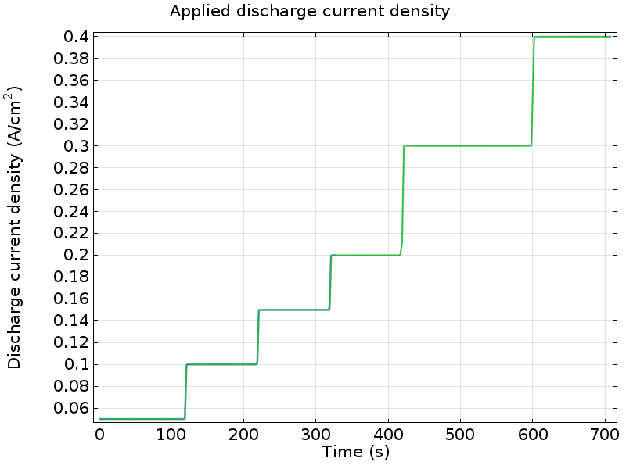
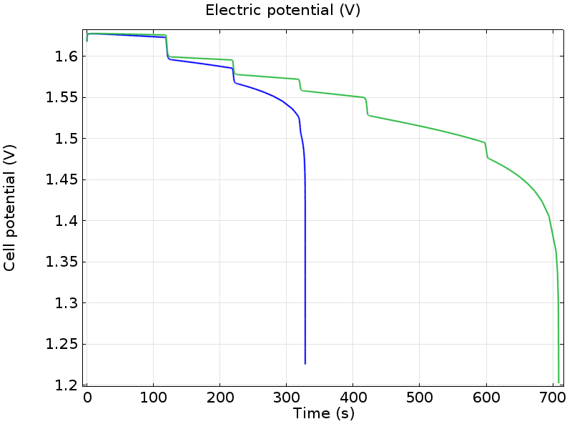
Results: Discharge Current density and Cell voltage
Cell voltage
(for two different initial Zn concentrations)
Applied discharge current density profile
The cell voltage profiles show that for a higher value of the initial Zn concentration, the cell lasts for a longer time before reaching the minimum voltage value.

Slide 8
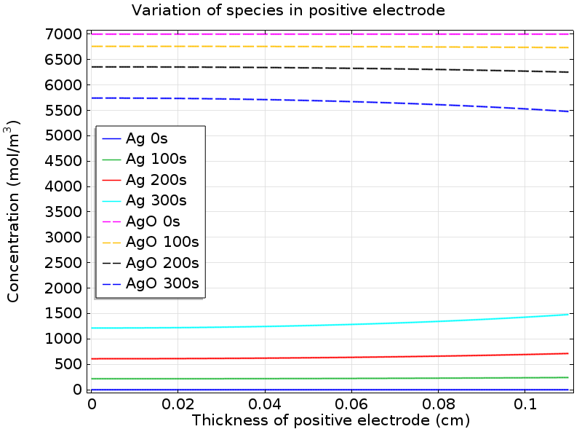
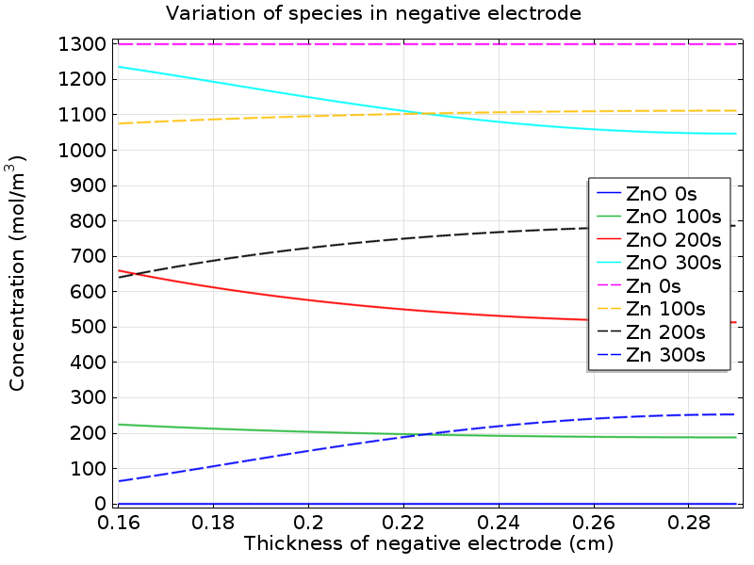
Results: Species concentration variation in electrodes (low value of initial Zn concentration)
For a low value of initial Zn concentration in the negative electrode, concentration of Zn drops close to 0 at the separator/negative electrode edge, at the end of discharge.
The sharp drop in cell voltage towards the end of discharge is due to the limitation of the negative electrode.

Slide 9
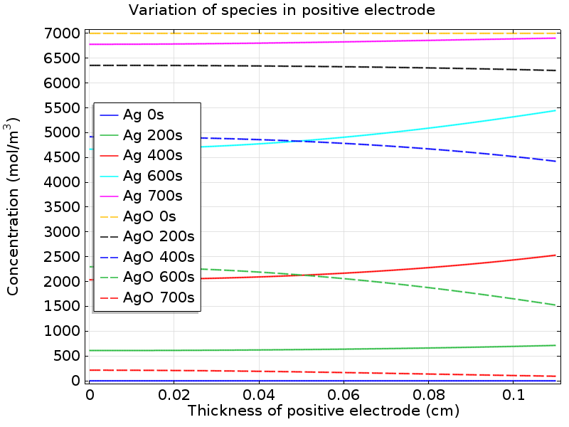
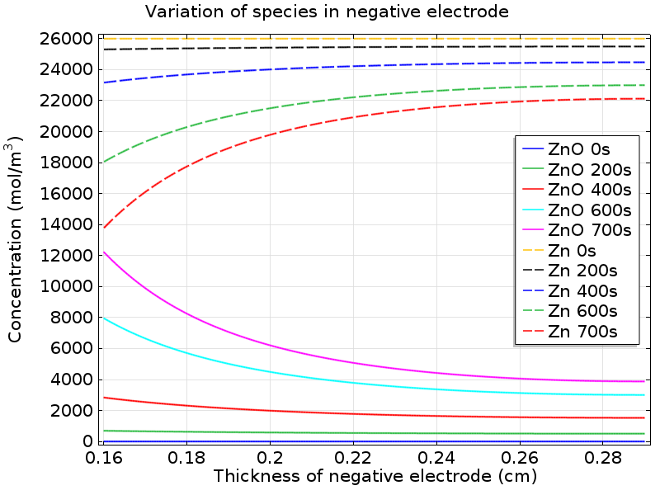
Results: Species concentration variation in electrodes (high value of initial Zn concentration)
For a high value of initial Zn concentration in the negative electrode, concentration of AgO drops close to 0 at the positive electrode/separator edge, at the end of discharge.
The sharp drop in cell voltage towards the end of discharge is due to the limitation of the positive electrode.

