Slide 1
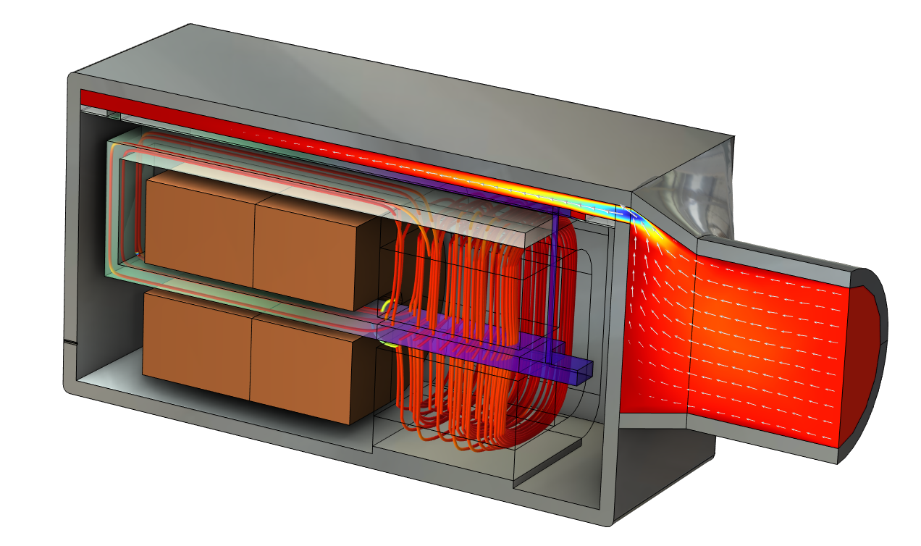
Balanced Armature Transducer —
Time Domain Analysis

Slide 2
Background
This is a full vibro-electroacoustic simulation of a balanced armature transducer (BAT or also known as a receiver in some industries) which is a high-performance miniature loudspeaker often used in hearing aids and other in-ear audio products such as earbuds.
The model is set up and solved in the time domain using a DC analysis of the magnetic system as initial condition for the AC transient problem. The electromagnetic coupling to the armature is done using the built-in Magnetomechanics multiphysics coupling. Moving Mesh is used to capture any nonlinear effects that are due to changes in the geometry such as magnetic gaps and nonlinear thin-film damping. The Moving Mesh also captures the structure to EM coupling (back EMC) which comes from the varying air gap in the magnetic flux circuit, that is, a varying reluctance
The vibrating armature is part of a magnetic circuit with alternating flux imposed by the AC coil – causing a strong interaction with the unidirectional permanent (DC) magnetic field in the gap.
The measurement setup that consists of a tube and an ear canal simulator (a so-called 711 coupler) is modeled through a time-domain MOR where the input impedance to the system is expressed in terms of it sum of partial fractions. This results in a detailed electrical circuit representation of the test setup. See the Input Impedance of a Tube and Coupler Measurement Setup: Time-Domain MOR Using Partial Fraction Fit model for details. Moreover, the radiation impedance of the small vent, connecting the back-volume to the exterior, is based on a sub-model, computed in Radiation Impedance of a Small Vent.
The geometry of the transducer is generic and based on typical dimensions. The material properties used are also generic materials.
Useful reference:
  R. Christensen, “Lumped Element Modeling of Transducers,” audioXpress, March 2023.
  M. Herring Jensen, “Full Multiphysics Electro-Vibroacoustic Analysis of a Balanced Armature Transducer,” InterNoise 2022.

Slide 3
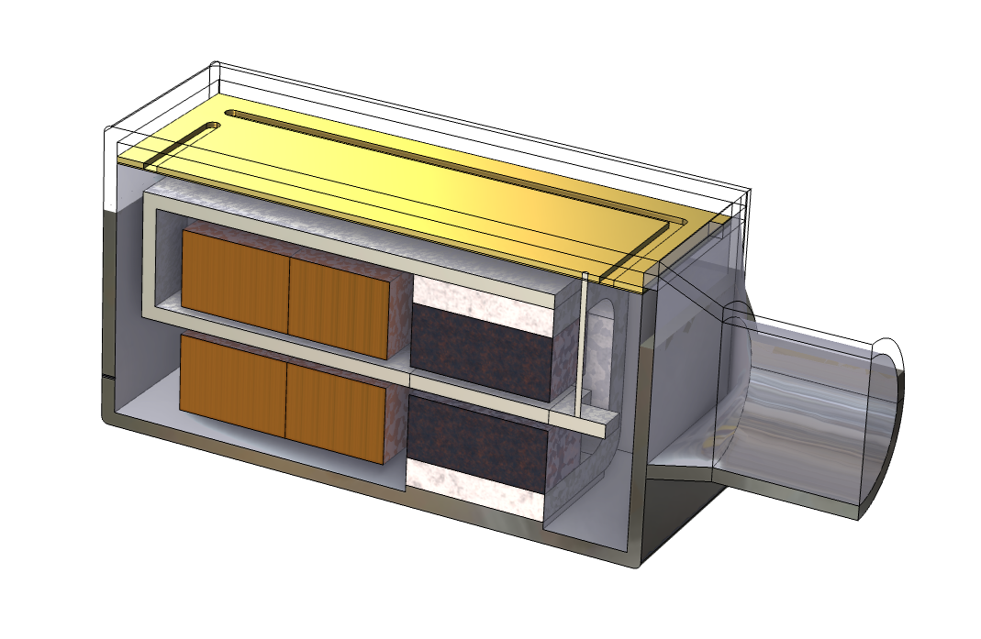
Model Definition: Transducer
Diaphragm (or membrane)
Front volume
Foil
Drive rod/pin
Vent
Spout
Back volume
Magnet
Magnetic Gap
Armature
(magnetic alloy)
Coil
Pole piece

Slide 4
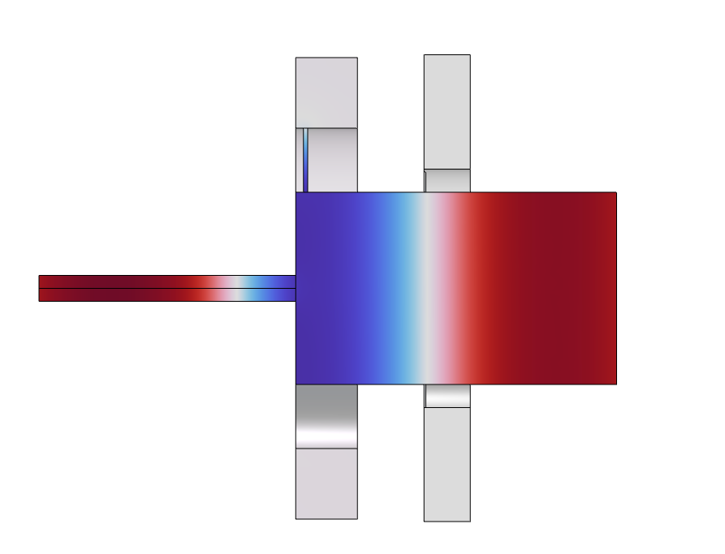
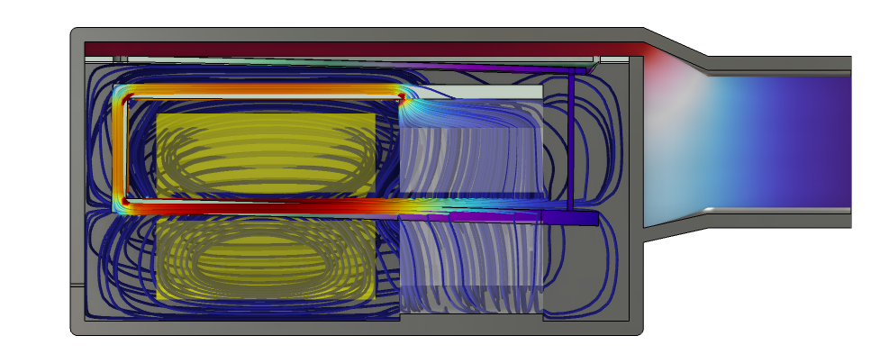
Model Definition: Test Setup
711 Coupler
Velocity (coupling
to Electrical Circuit)
Balanced armature transducer
Microphone
Tube
Detailed multiphysics FEM model
Test setup replaced by: Electrical Circuit lumped model.*
* Input Impedance of a Tube and Coupler Measurement Setup: Time-Domain MOR Using Partial Fraction Fit

Slide 5
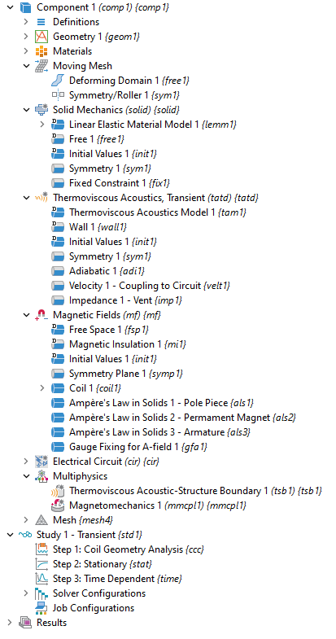
Implementation
Moving Mesh
Solid Mechanics
Thermoviscous Acoustics, Transient
Magnetic Fields
Electrical Circuit
  Lumped representation of the measurement setup
Multiphysics:
  Thermoviscous Acoustic-Structure Boundary
  Magnetomechanical Forces

Slide 6
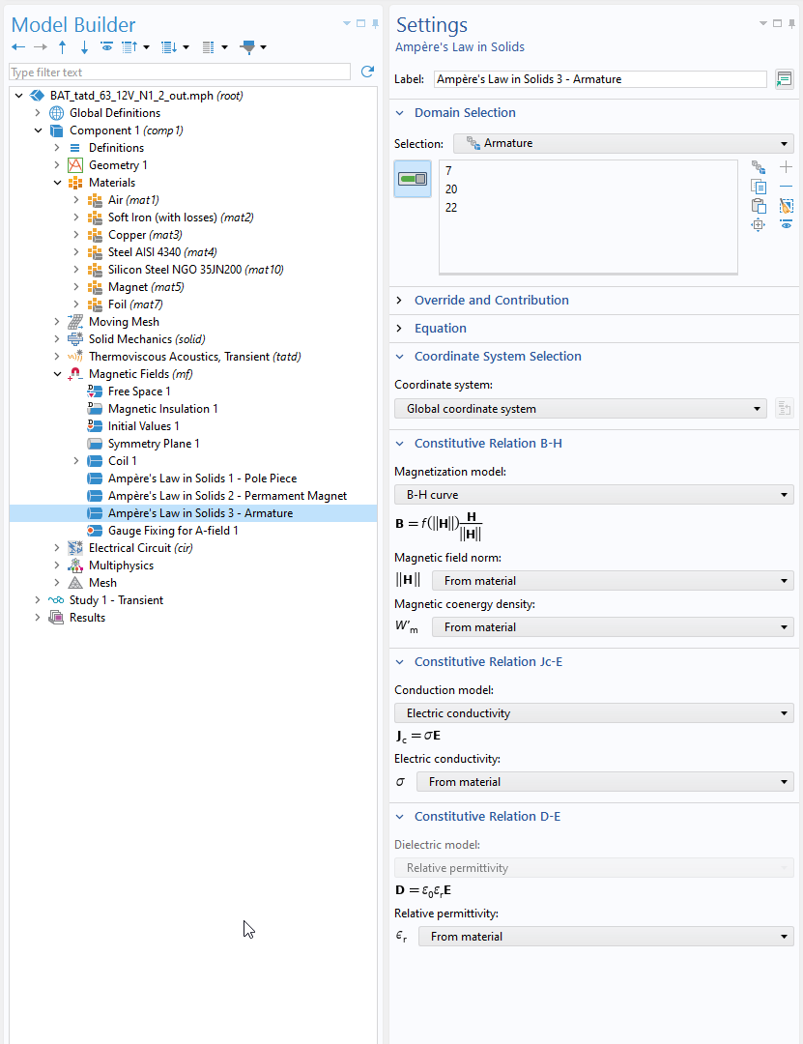
Materials
The Armature and Pole Piece both use a material with nonlinear magnetic properties based on a BH-curve.
Materials from the COMSOL Material Library:
  Nonlinear Magnetic > Silicon Steel NGO > Silicon Steel NGO 35JN200
  AC/DC > Soft Iron (with losses)
The Foil is a very soft material that has generic properties similar to those used in real devices.

Slide 7
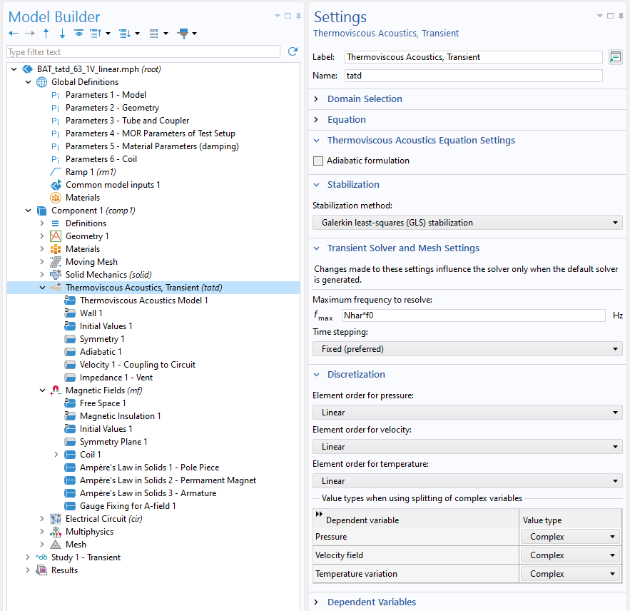
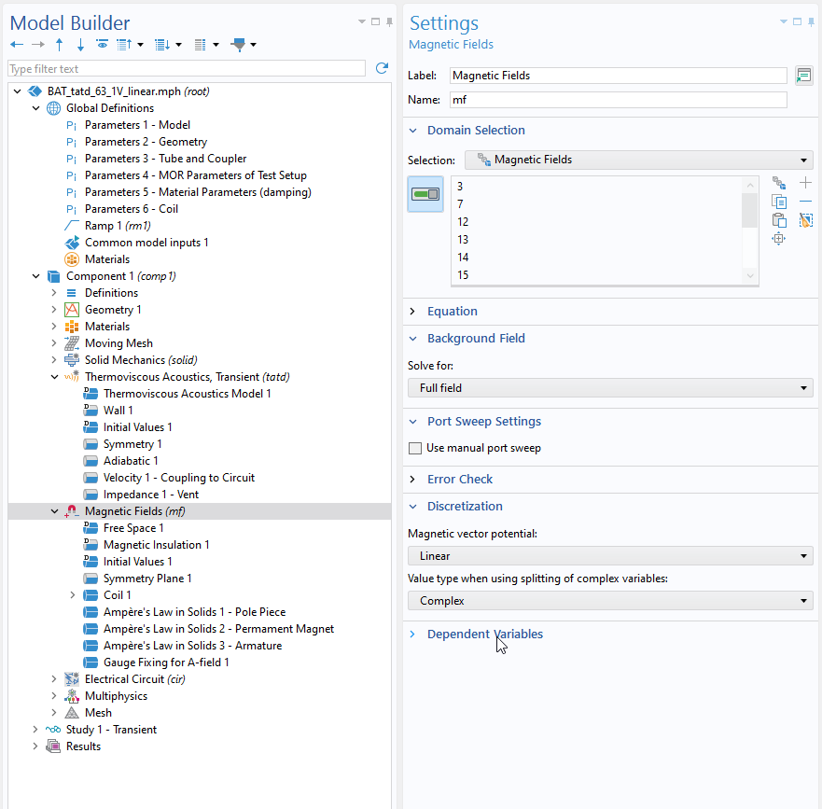
Solver and Model Setup
For optimal solution performance use linear discretization for the acoustic and magnetic dependent variables.
Thermoviscous Acoustics
Magnetic Fields
Use linear discretization for all fields and turn on the GLS stabilization.
Use linear discretization for the magnetic vector potential.

Slide 8
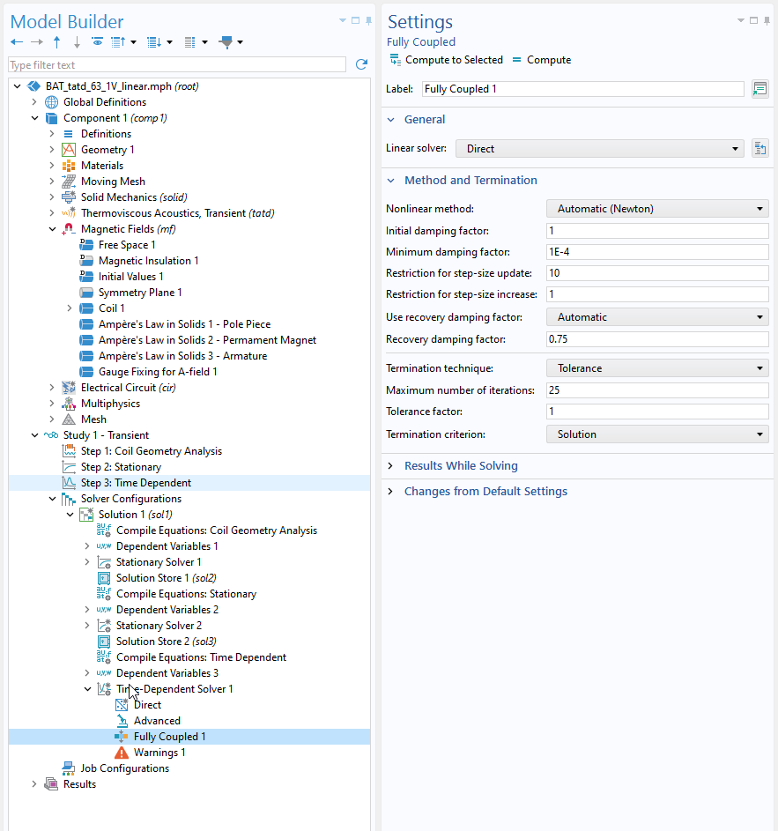
Solver and Model Setup
❶
To ensure convergence of the iterative solver, use the Stabilized conductivity option in the Free Space.
  Select Automatic
  Set the Fallback frequency to Nhar*f0
In the Time Dependent Solver use:
  Fully Coupled with Automatic (Newton)
  Direct solver with PARDISO
❶
❷
❷

Slide 9
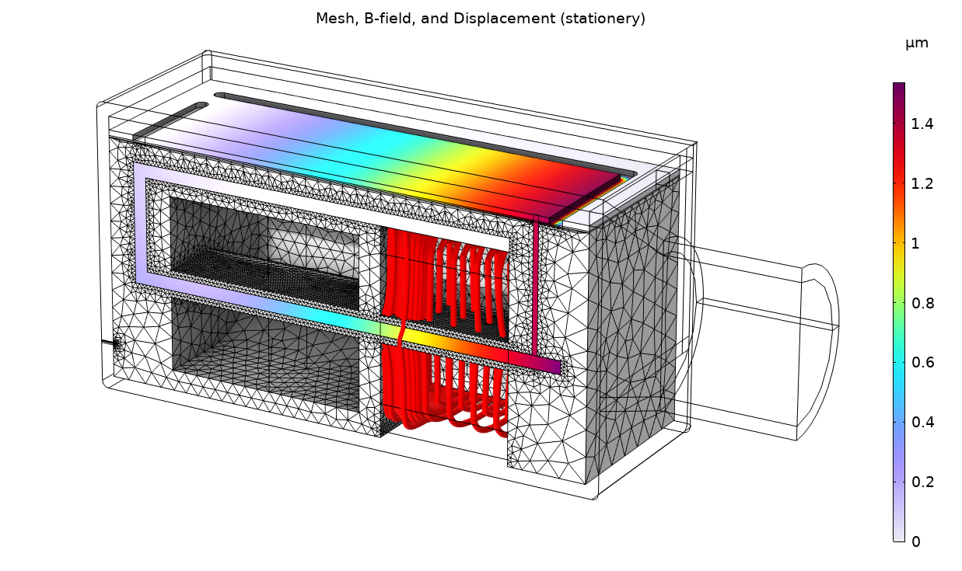
Results
The stationary solution is used as initial condition for the time domain simulation.
The magnetic field is generated by the permanent magnet. The armature rests in the balanced position.
Stationary deformation and B-field for 0 V applied to the coil. The magnetic field is generated by the permanent magnet.

Slide 10
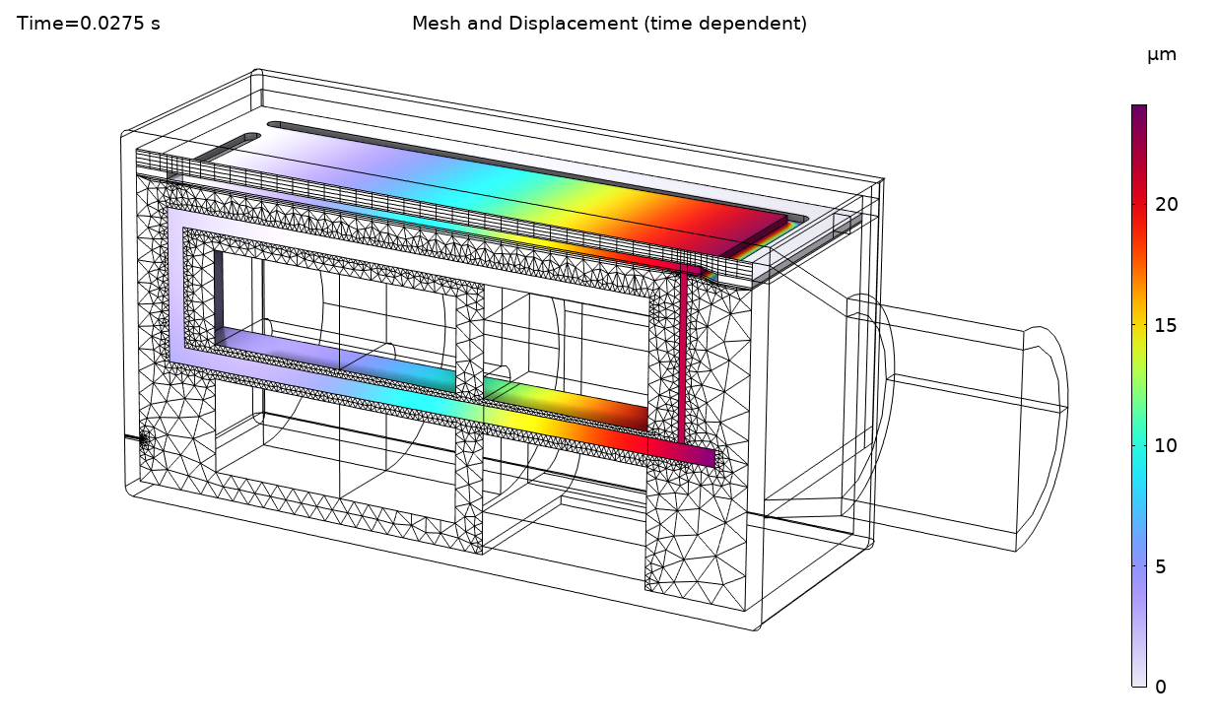
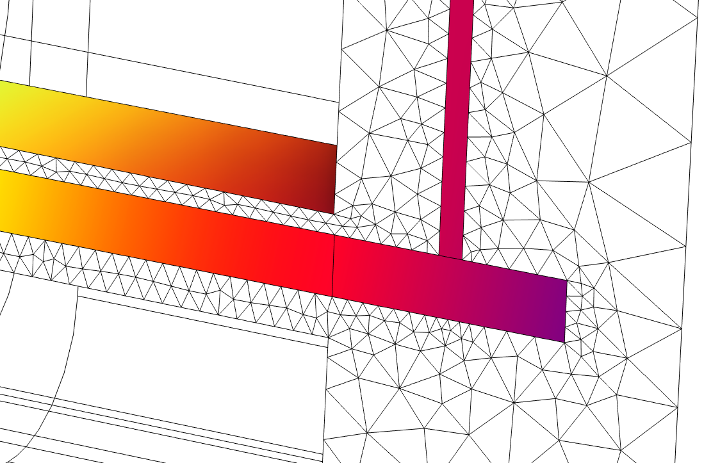
Results
The model is excited with a sinusoidal 100 Hz voltage with an RMS amplitude between 0.5 V and 1.2 V (parameter V0rms in the model).
The plot of the displacement at maximum deformation is shown together with the mesh.
The zoomed plot shows the mesh deformation in the magnetic gap.
V_{0,RMS} = 1.2 V

Slide 11
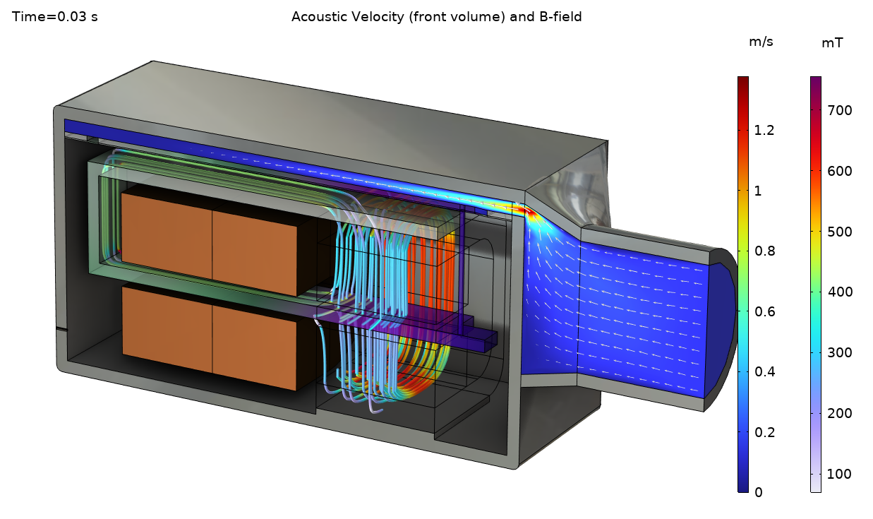
Results
The model is excited with a sinusoidal 100 Hz voltage with an RMS amplitude between 0.5 V and 1.2 V (parameter V0rms in the model).
The instantaneous acoustic velocity is plotted in the front volume and the spout.
The image also shows the magnetic field lines in the magnetic circuit composed of the armature, permanent magnet, and pole piece.
V_{0,RMS} = 1.2 V

Slide 12
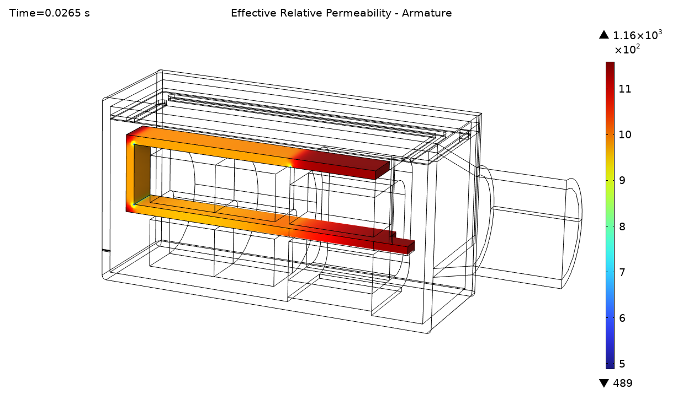
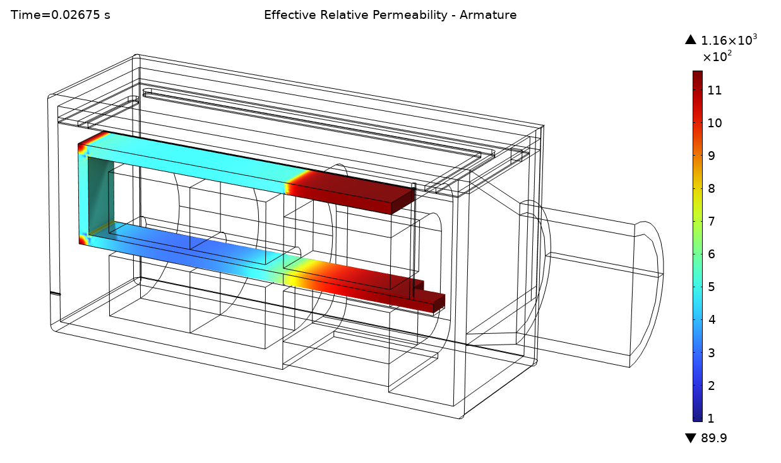
Results
The model is excited with a sinusoidal 100 Hz voltage with an RMS amplitude between 0.5 V and 1.2 V (parameter V0rms in the model).
The effective relative permeability is plotted in the armature.
The low values appear where the material has become saturated and behaves nonlinearly. The linear regions are with a value of 1160 (the differential permeability for this silicon steel variant).
V_{0,RMS} = 0.5 V
V_{0,RMS} = 1.2 V

Slide 13
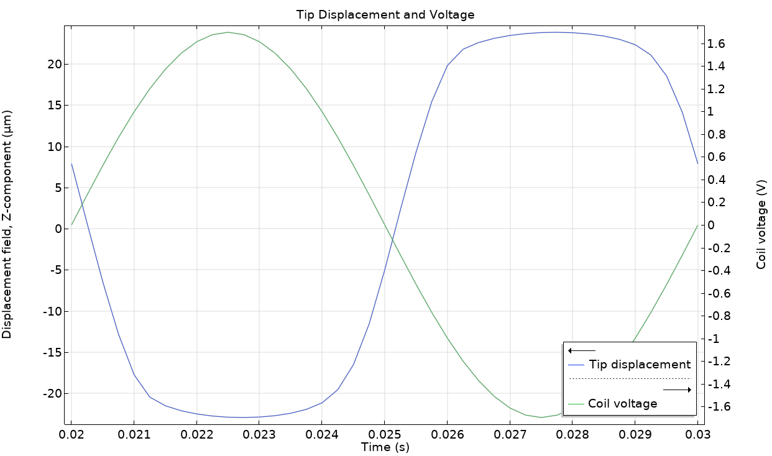
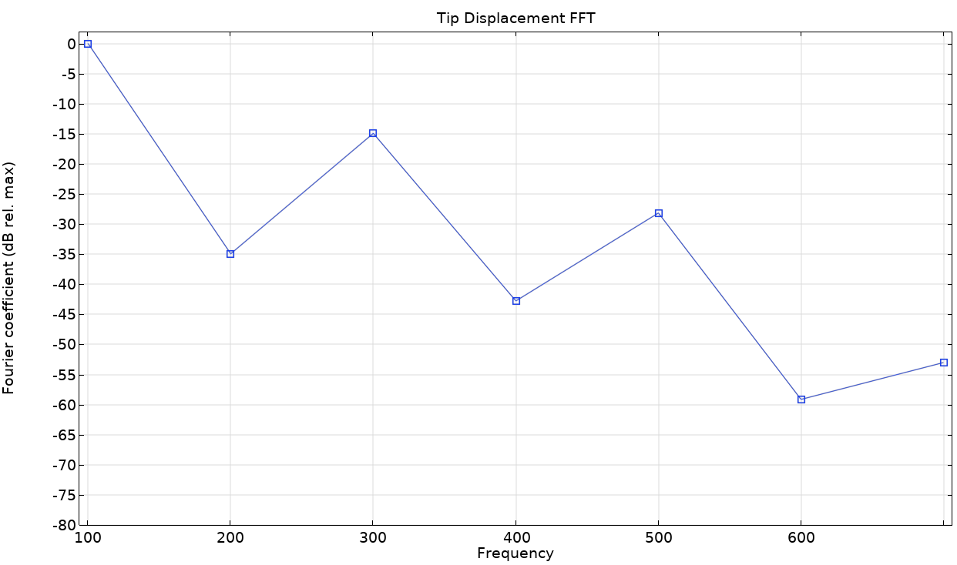
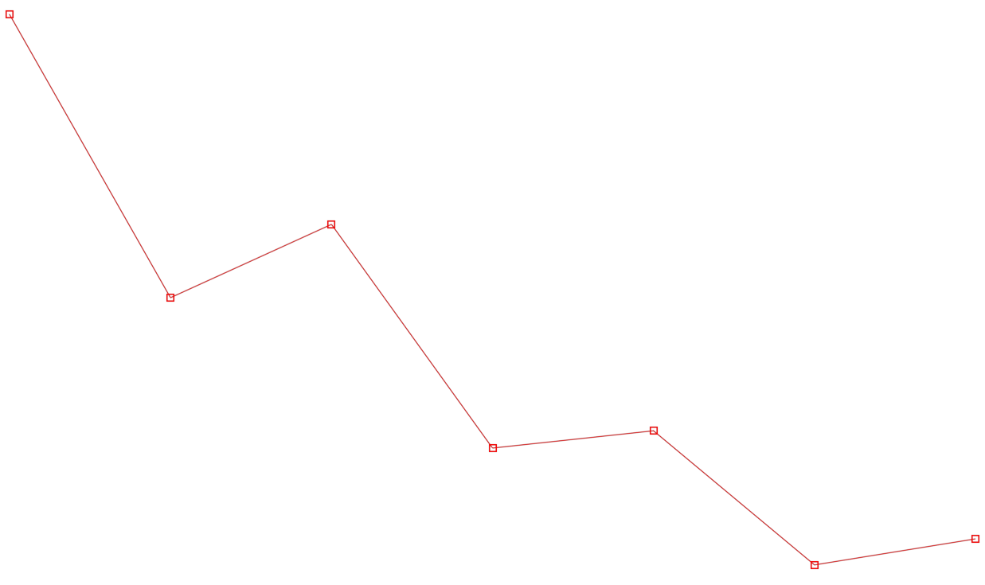
Results
V_{0,RMS} = 1.2 V
The displacement of the tip of the armature and the applied voltage is plotted in the last period, from 2⋅T₀ to 3⋅T₀.
The second plots shows the the FFT of the displacment in dB relative to the maximal displacement. Here depicted for 0.5 V RMS and 1.2 V RMS.
V_{0,RMS} = 1.2 V
V_{0,RMS} = 0.5 V

Slide 14
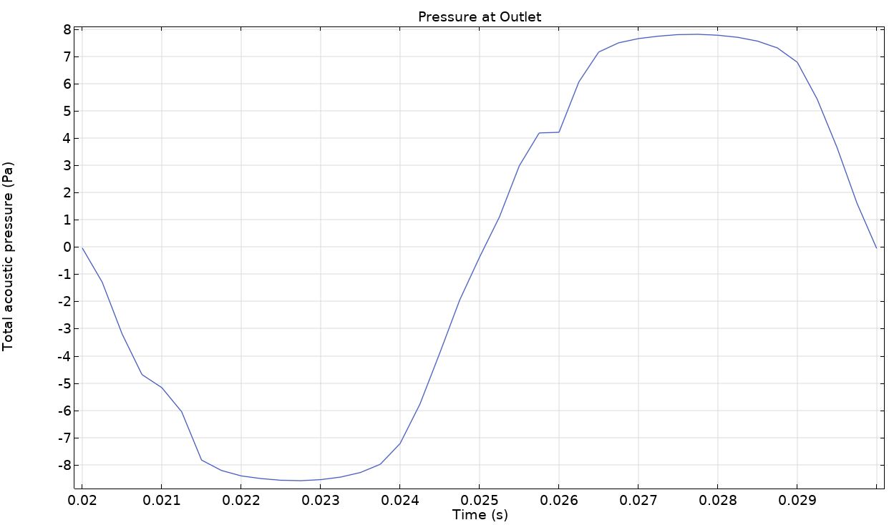
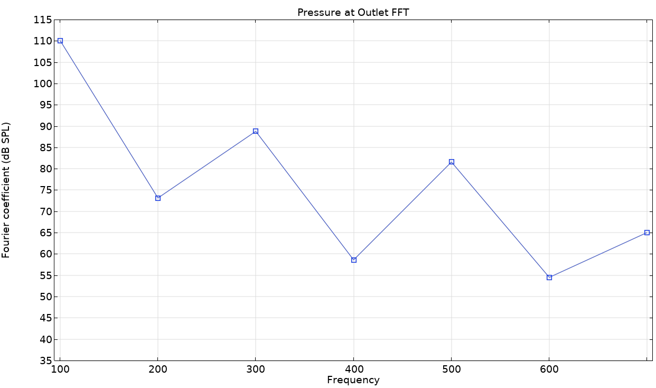
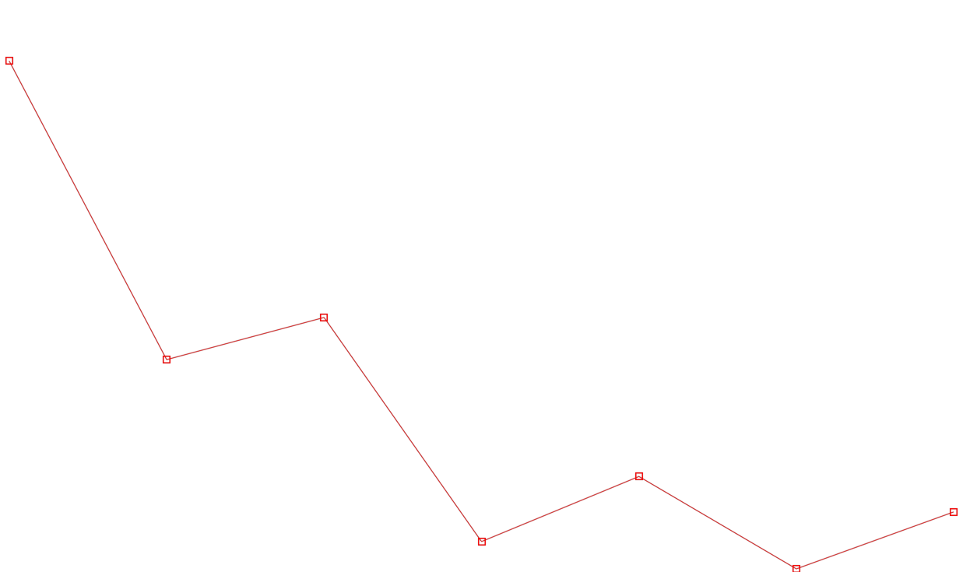
Results
V_{0,RMS} = 1.2 V
The pressure at the outlet is plotted in the last period, from 2⋅T₀ to 3⋅T₀.
The second plot shows the pressure FFT in dB SPL.
V_{0,RMS} = 1.2 V
V_{0,RMS} = 0.5 V

Slide 15
comsol.com/contact

