Slide 1
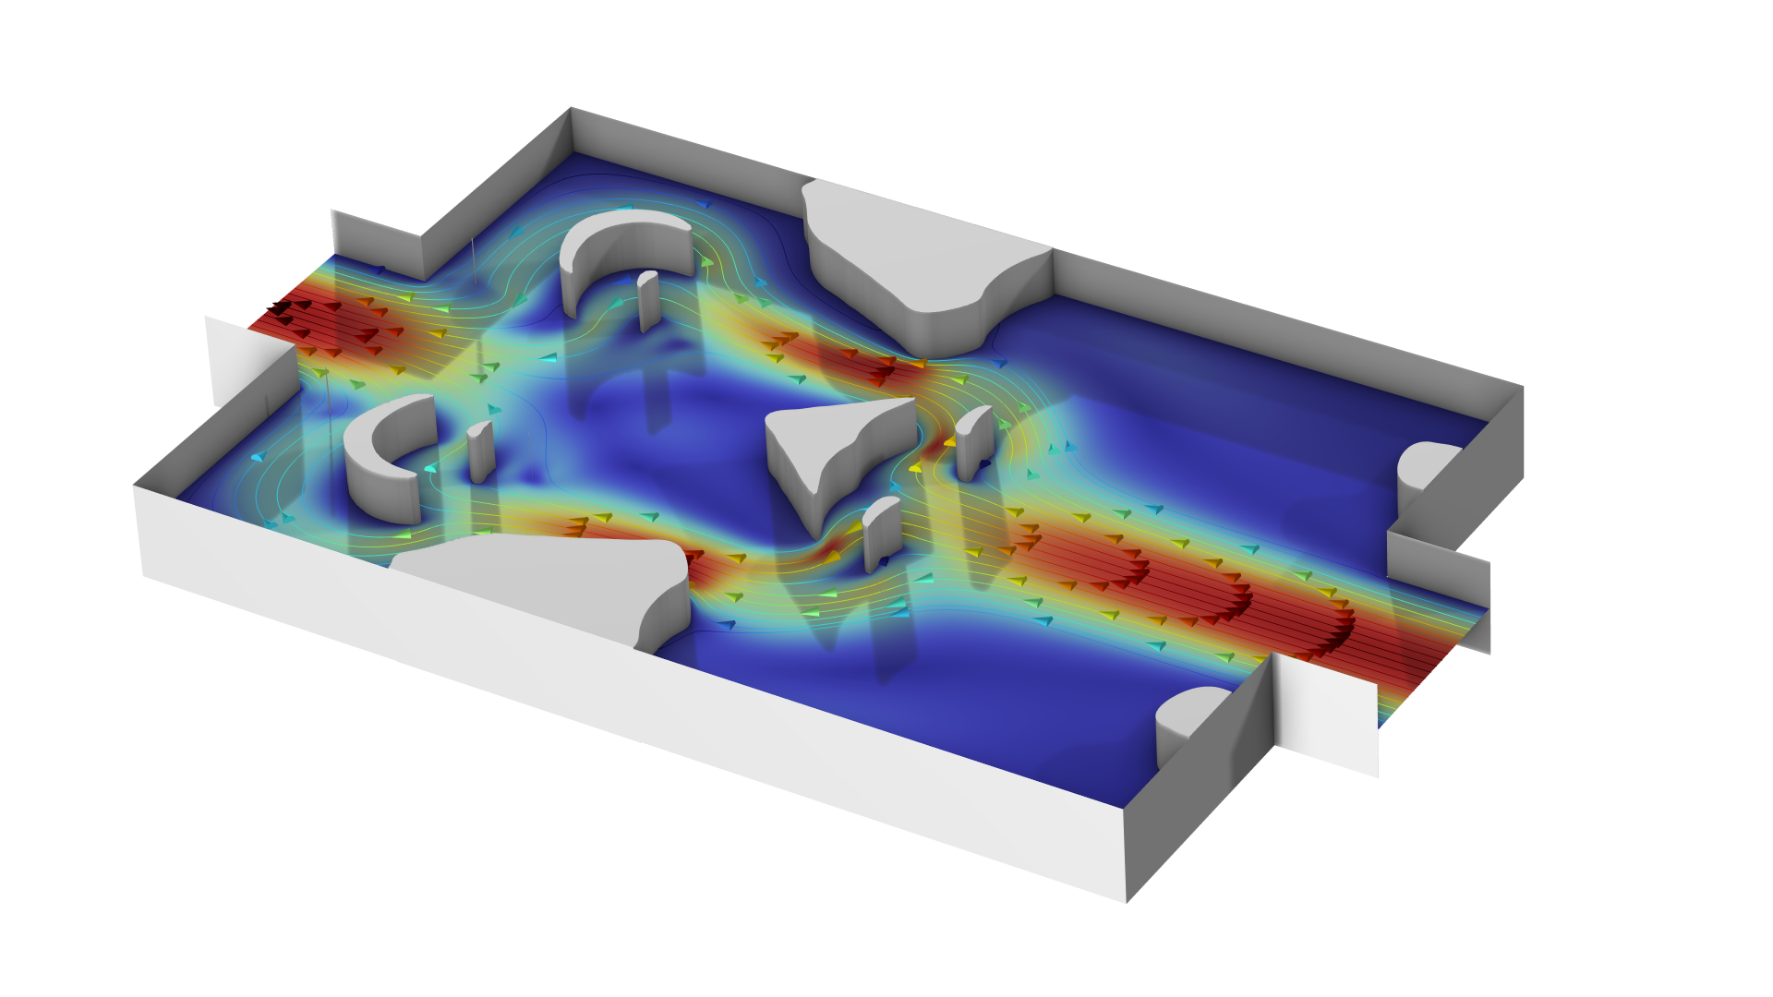
Optimization of a Tesla Microvalve

Slide 2
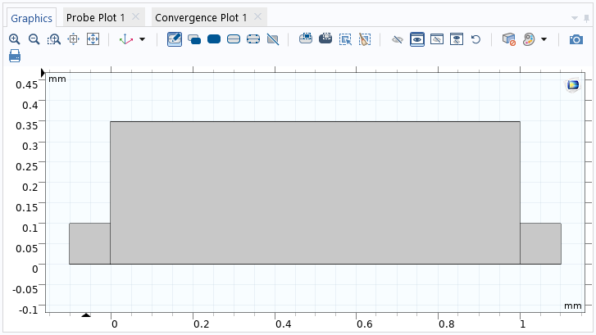
Introduction
A tesla valve is a fluid device exhibiting anisotropic flow resistance due to inertial effects, i.e. it is a fluid diode.
The behavior is due to the geometry of the device and it gets stronger at higher flow rates.
We will design a device for the steady state regime using topology optimization.
Optimization of a Tesla Microvalve

Slide 3
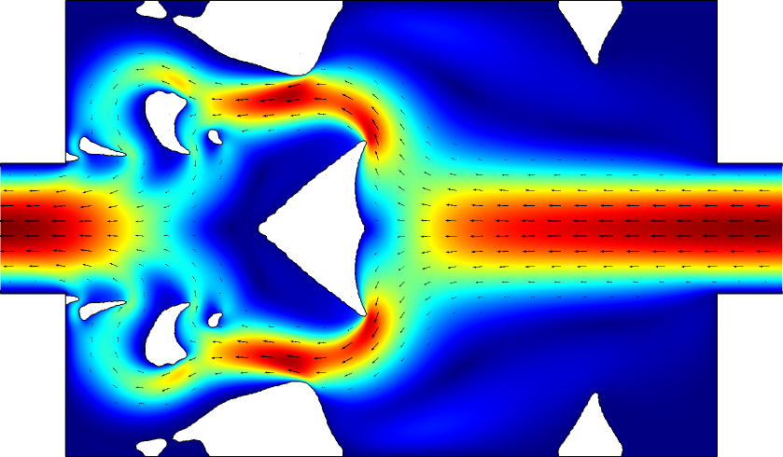
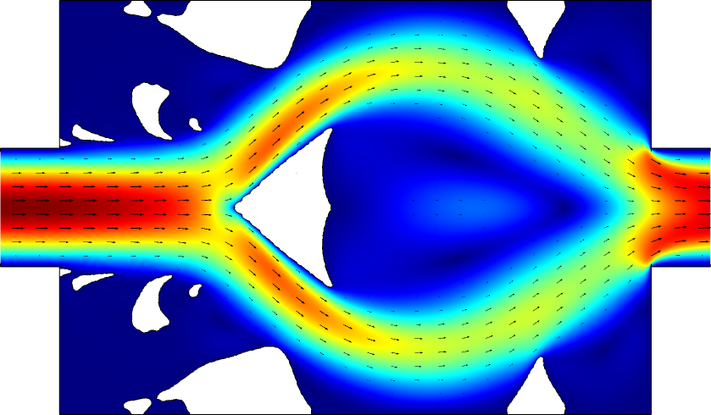
Setup and solve the optimization problem
Define the parameters and the geometry
Setup a density model feature under
Component > Definitions > Topology Optimization.
Setup up a laminar flow interfaces for each direction
Add a damping term proportional to the
penalized material volume factor, dtopo1.theta_p
Compute the viscous dissipation and use it to define the diodicity
Setup mirror datasets for use in plots and enable plot while solving.
Run the optimization
Optimization of a Tesla Microvalve

Slide 4
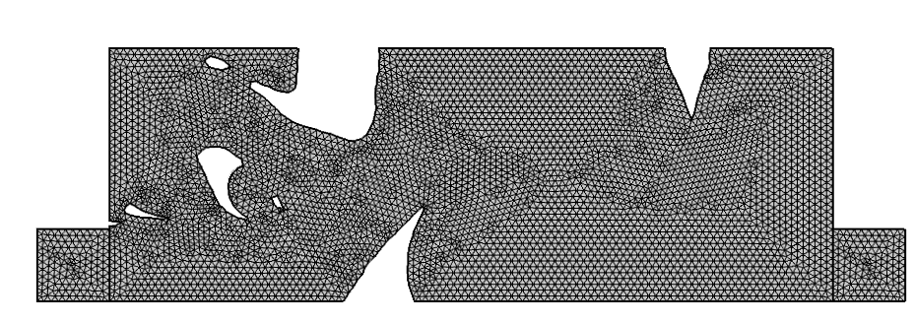
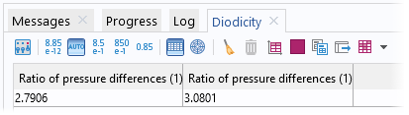
Evaluate the influence of the damping term
Threshold the design and export the result to a new component.
Copy/paste the physics to the component.
Recompute the flow
Evaluate the objective function
(it increases slightly).
Optimization of a Tesla Microvalve

