Slide 1
Micromixing by Acoustic Streaming using Transport of Diluted Species

Slide 2
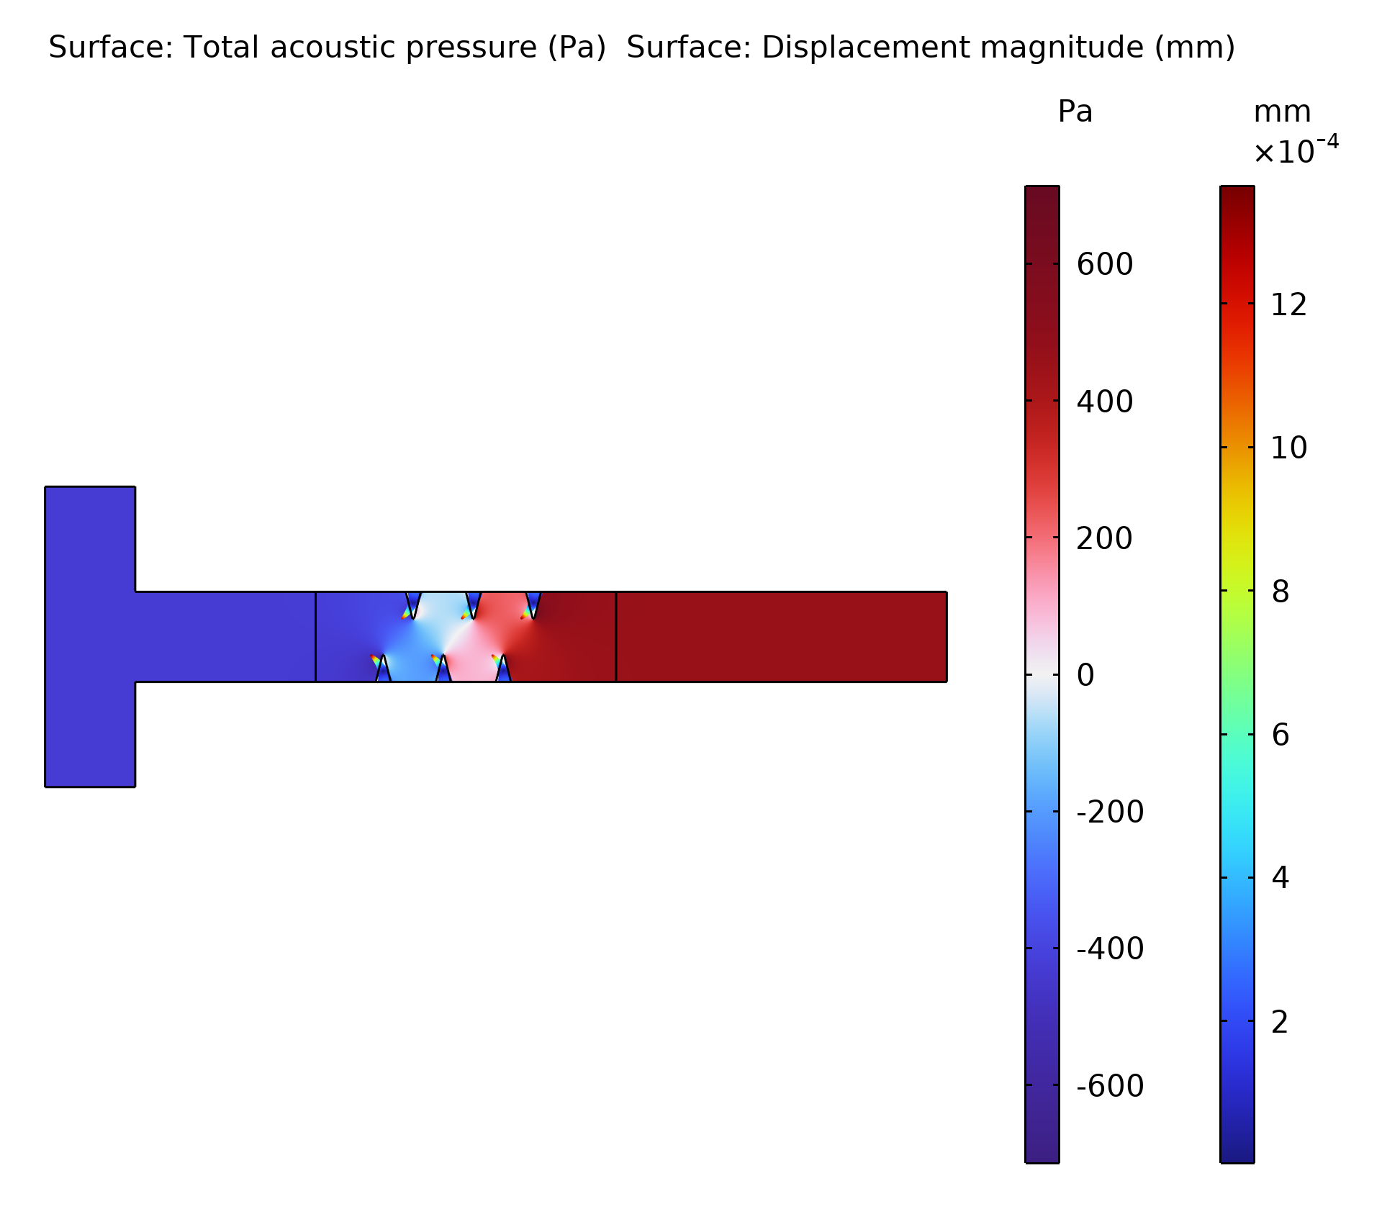
System and Acoustics Setup
Simple 2D system with two inlets and one outlet
The system is driven by vibrating solid structures modeled with the Solid Mechanics interface
The solid structures are coupled to a Thermoviscous Acoustics, Frequency Domain interface
Thermoviscous acoustics is used in the domain around the solid structures and a coupled to a Pressure Acoustics, Frequency Domain interface.
Top: Acoustic pressure and displacement of vibrating solid.

Slide 3
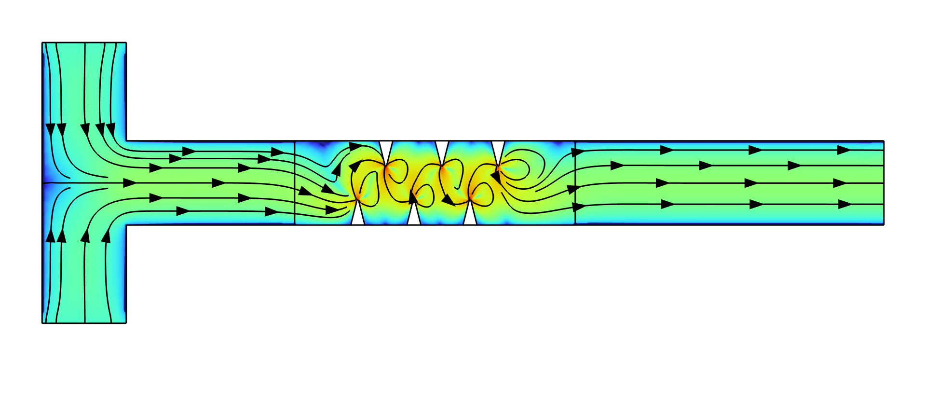
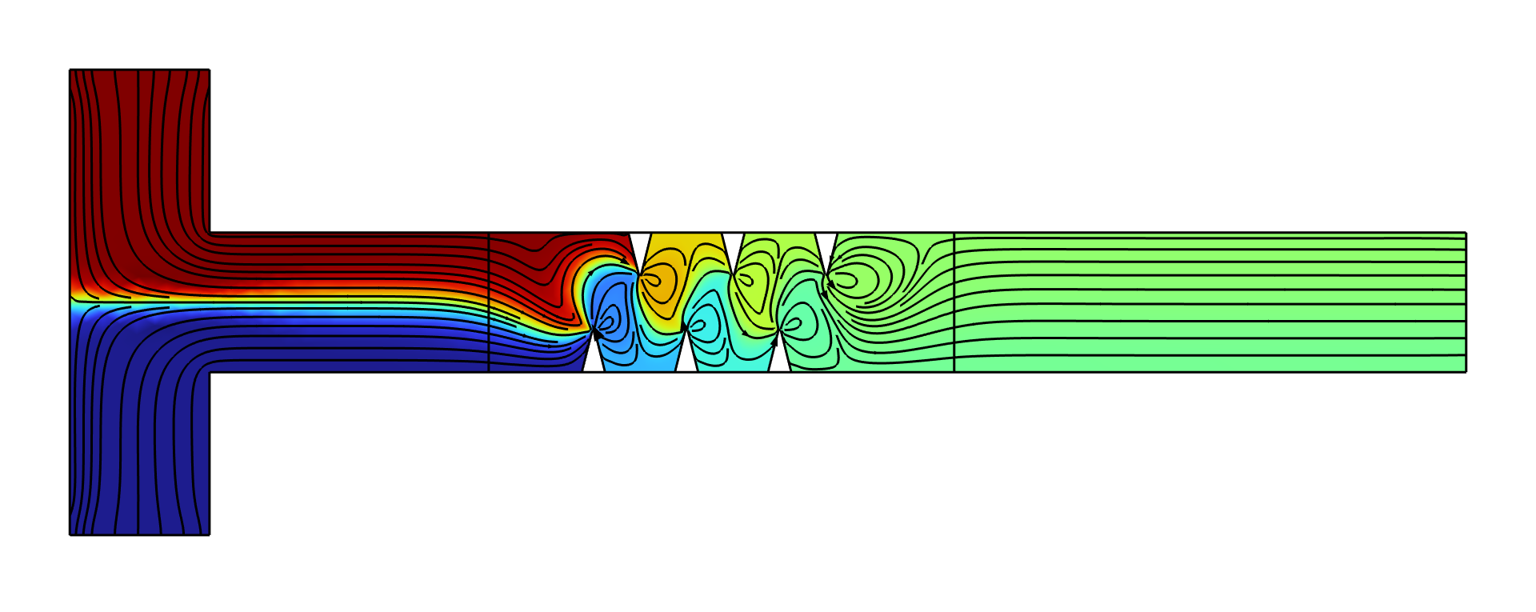
Acoustic Streaming and Concentration
outflow
inflow
Two inlets with different concentration
The fluid is mixed by the fast acoustic streaming generated by the edges of the vibrating solid structure
Top: Magnitude of flow velocity on logarithmic scale with streamlines. Bottom: Concentration profile with streamlines from fluid flow.

Slide 4
comsol.com/contact

