Slide 1
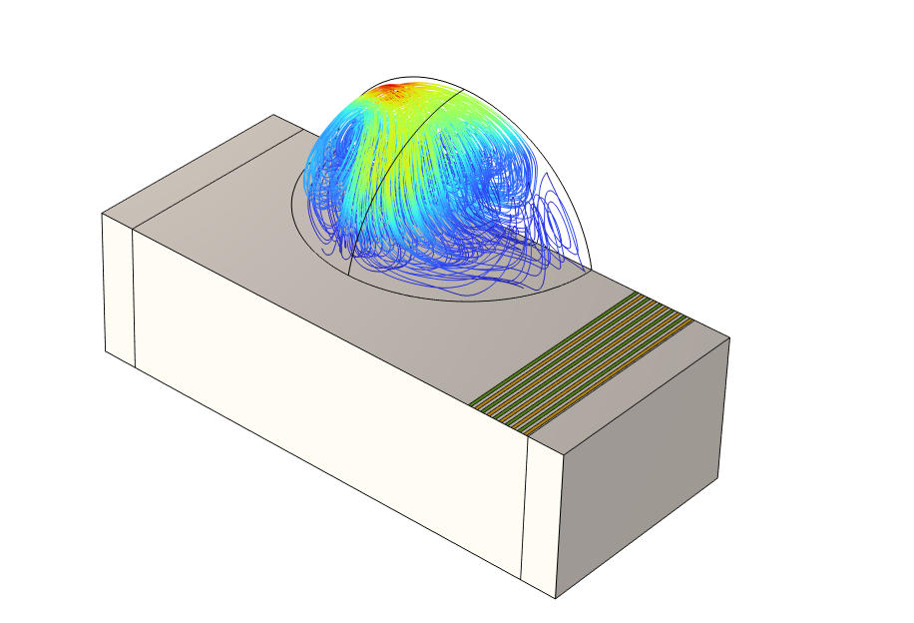
SAW-Induced
Streaming in a Droplet:
3D Setup

Slide 2
Surface Acoustic Waves and Streaming
Droplet
Surface acoustic waves (SAWs) are generated by applying alternating voltage on a piezoelectric material.
The energy of SAWs is absorbed in a droplet, resulting in streaming.
The streaming can be used for mixing purposes in microfluidics research.
Interdigital transducer (IDT)
terminals
~
Piezoelectric material

Slide 3
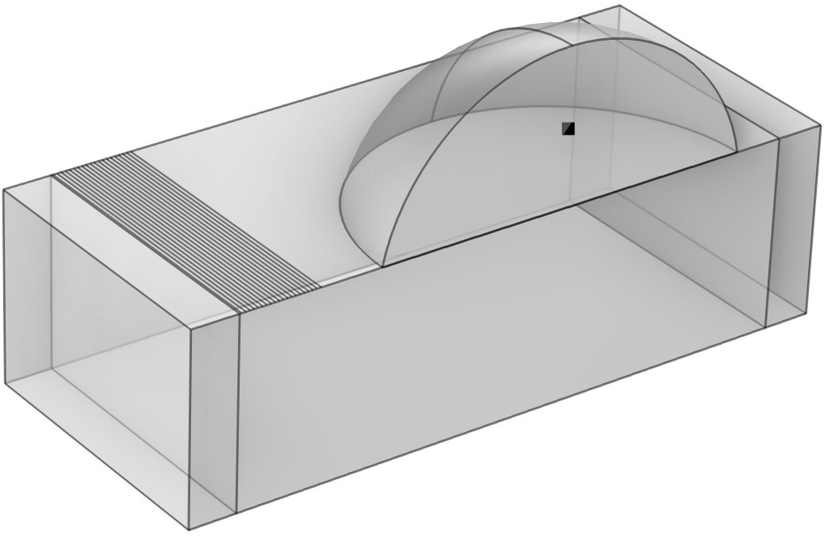
Configurations
Sound soft boundary
(p = 0)
128° YX-cut lithium niobate (LiNbO₃) substrate
Water–glycerol mixture (90wt% glycerol):
  Contact angle: 78°
  Dynamic viscosity: ~200 times as viscous as water
  Ratio of bulk viscosity to dynamic viscosity: 1.17
  Attenuation model: viscous
Perfectly matched layer (PML) for absorbing the wave energy to avoid spurious reflections
Symmetry condition is applied to the transversal boundaries.
Values are taken from the reference †
† A. Riaud et al., “On the Influence of Viscosity and Caustics on Acoustic Streaming in Sessile Droplets: An Experimental and a Numerical Study with a Cost-Effective Method,” Journal of Fluid Mechanics, vol. 821, pp. 384–420, 2017.
Water–glycerol mixture
PML
LiNbO₃ substrate
PML
Low-reflecting boundary

Slide 4
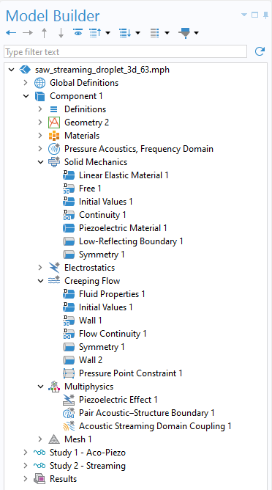
Model Setup
The LiNbO₃ substrate is modeled by using the Piezoelectricity interface to couple electrostatics and solid mechanics. A low-reflecting boundary is used for damping of the P and S waves.
The acoustic streaming in the water–glycerol mixture is modeled with the Acoustic Streaming Domain Coupling multiphysics node to couple the acoustics and fluid flow. A sound soft boundary assigns a pressure of zero at the droplet–air boundary.

Slide 5
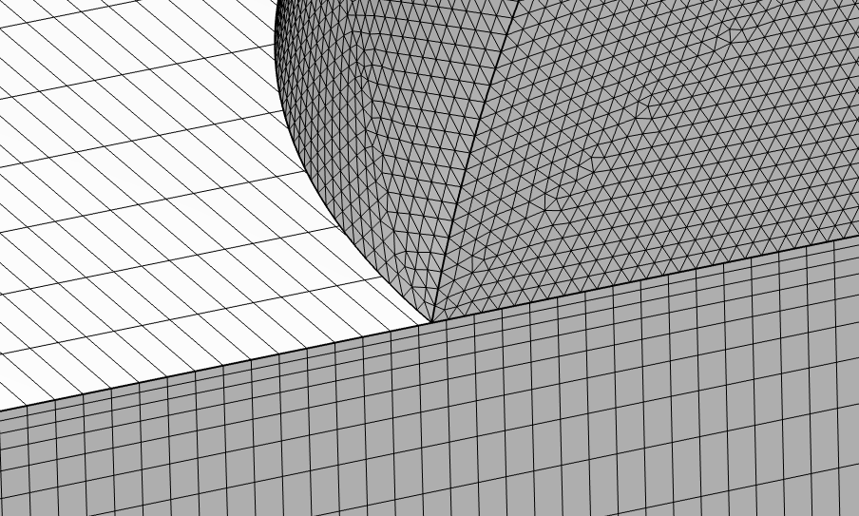
Mesh and Solver
The geometry is constructed using an assembly. Paired coupling conditions can be used, and a nonconforming mesh can be set up to reduce the model size.
An iterative GMRES¹ solver is used, with a GMG² preconditioner (with a shifted Laplace contribution) for the pressure degrees of freedom (DOFs) and a direct preconditioner for the displacement and potential DOFs.
The model solves in about
2 h 30 m using 115 GB of RAM.
Nonconforming mesh using a structured approach in the solid (piezoelectric material) and a free tetrahedral mesh in the fluid.
¹ GMRES = general minimum residual ² GMG = geometric multigrid

Slide 6
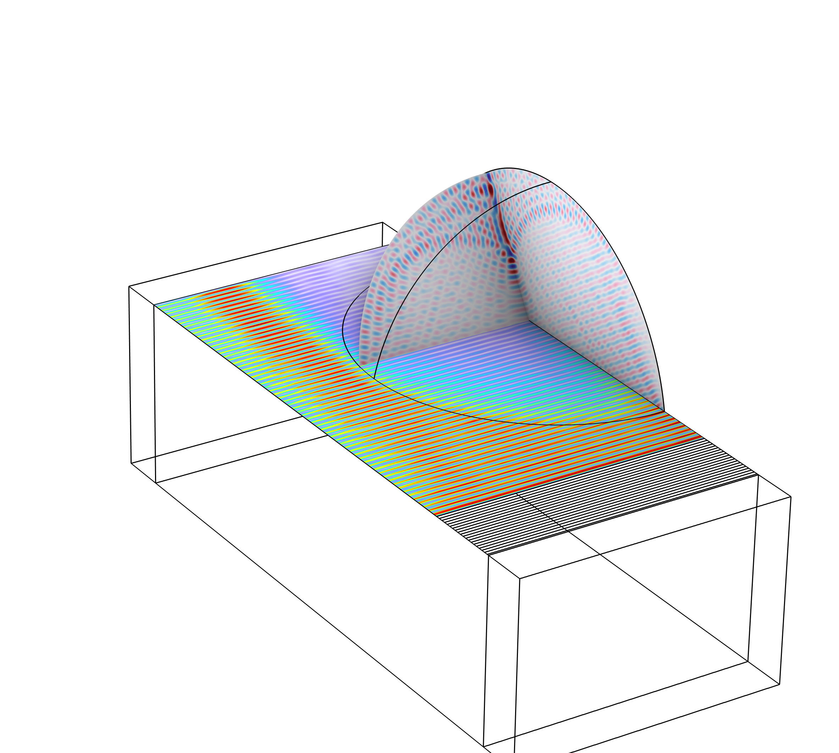
Results —
Frequency Domain
Acoustic pressure
SAWs propagate in both directions but are attenuated in one direction due to the PML.
The energy of the SAWs enters the droplet from the Acoustic–Structure Boundary.
The incident pressure waves travel at the Rayleigh angle and are reflected at the boundaries, which ultimately results in the caustic pattern.
SAW propagation
Stress

Slide 7
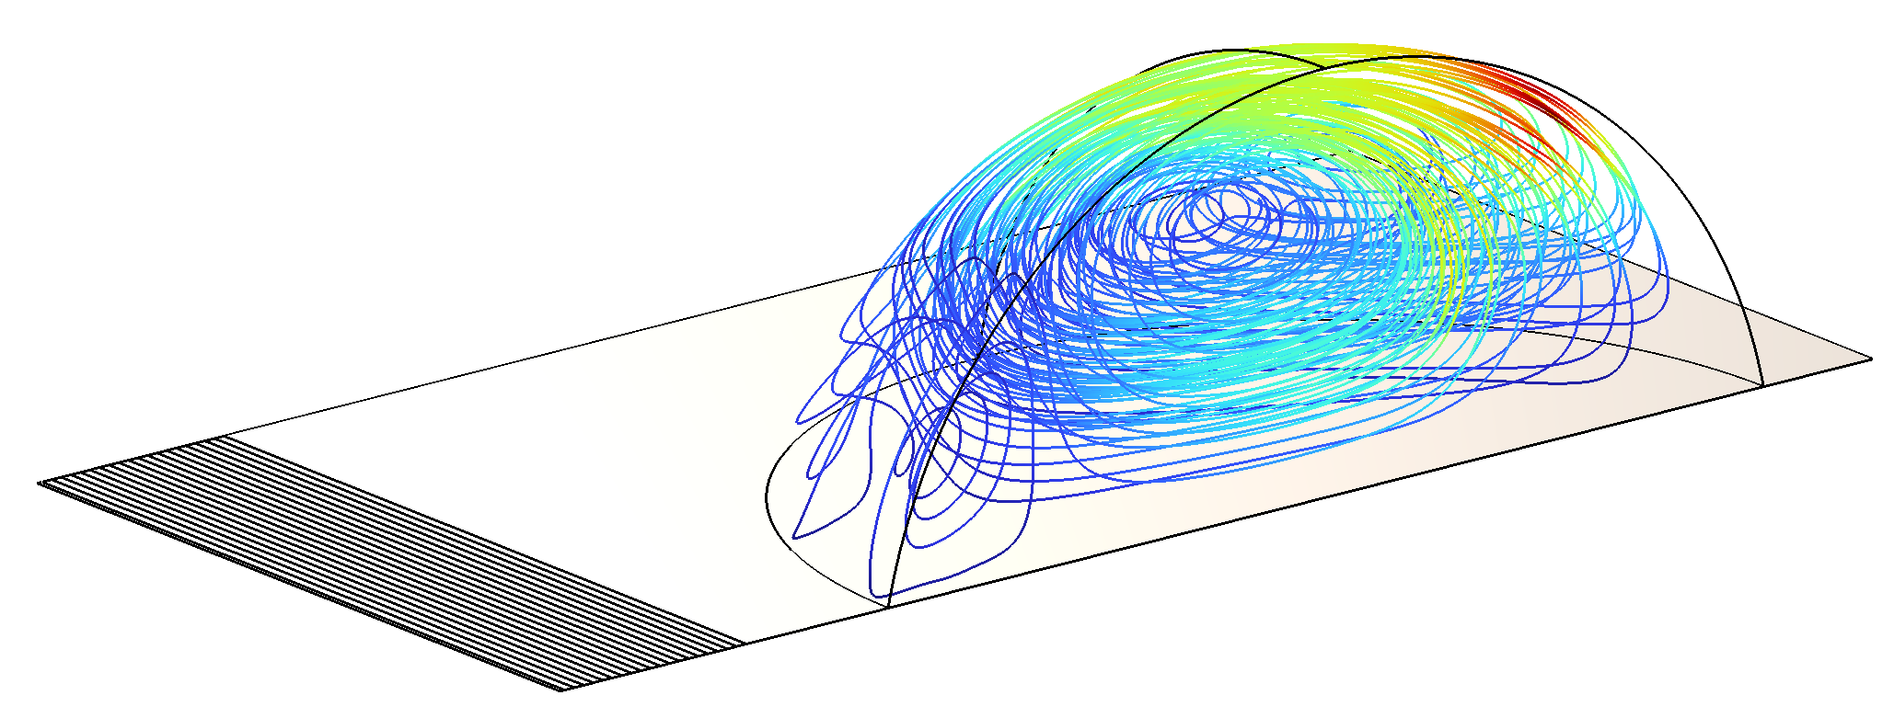
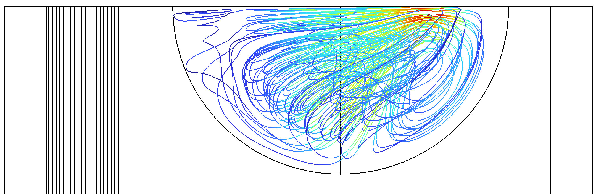
Results — Stationary
Circulating streaming is generated due to the energy dissipated in the acoustic field.
The 3D geometry allows the streamlines to converge and diverge in the transversal direction, which may affect the mixing performance.
The vortex structure shows a good agreement with the reference.
SAW propagation
View from –z direction

Slide 8
comsol.com/contact

