Slide 1
Parameter Estimation of a Time-Dependent Equivalent Circuit Battery Model
COMSOL

Slide 2
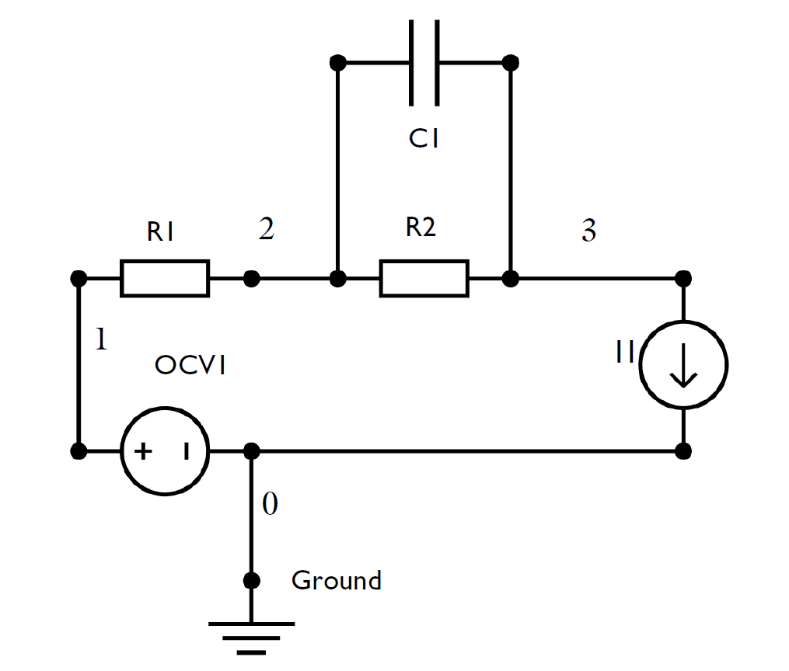
Background
This tutorial uses an equivalent circuit approach for modeling the performance of a lithium-ion battery, requiring no knowledge about the internal chemistry or structure of the battery.
The equivalent circuit approach represents the underlying electrochemical processes in a battery using simple electrical circuit elements.
A 0D equivalent circuit battery model is defined based on a resistor connected in series with a resistor-capacitor couple.
An optimization solver is used for parameter estimation using experimental load cycle and open circuit voltage data.
The equivalent circuit model with the optimized parameter values are subsequently used for predicting the battery performance for an arbitrary load cycle.

Slide 3
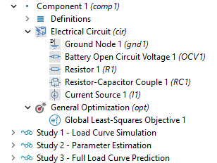
Model Setup
The Battery Equivalent Circuit model wizard entry is used that adds an Electrical Circuit interface with default electrical circuit elements of a resistor connected in series with a resistor-capacitor (RC) couple.
The series resistor represents the ohmic resistance and the RC couple (a resistor and capacitor connected in parallel) represents the charge transfer polarization process.
The inputs to the model are the battery capacity, the initial state-of-charge (SOC), and an open circuit voltage versus SOC curve, in combination with load cycle experimental data.
The model parameters are similar to those used in the Application Library model ‘Parameter Estimation of a Time-Dependent Lumped Battery Model’.

Slide 4
Model Setup
The tutorial consists of three studies. In the first study, an equivalent circuit battery model (of capacity 12 Ah) is set up and run for a time-dependent battery current.
In the second study, parameter estimation of the equivalent circuit parameters R1 (ohmic resistance), R2 (resistance of RC couple) and τ (time constant of RC couple), is performed using experimental data. This is done using the Global Least-Squares Objective feature in the Optimization interface, in combination with the Optimization study step using a Levenberg-Marquardt optimization solver. Note, the second part of the tutorial requires the Optimization module.
In the third study, cell voltage prediction is performed using the optimized equivalent circuit parameter values that were obtained in the previous parameter estimation study, and compared with experimental data.
The first two studies use a 300 s load cycle. The third prediction study uses a full load cycle with additional 300 s.

Slide 5
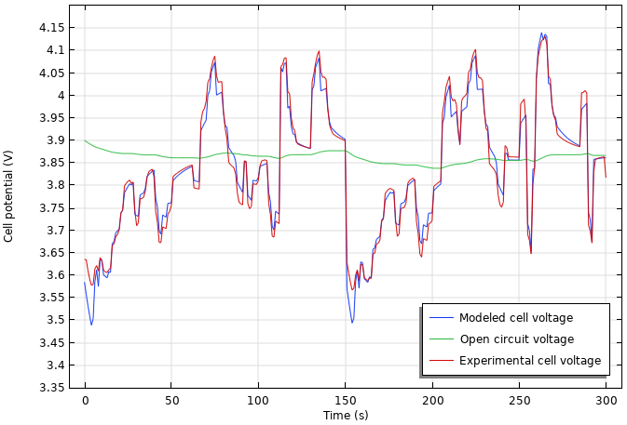
Model Results: Parameter Estimation
Modeled cell voltage using the fitted parameter values, experimental cell voltage, and corresponding open circuit voltage, for the 300 s load cycle.
The standard deviation values of the modeled cell voltage from the experimental values is 0.023.

Slide 6
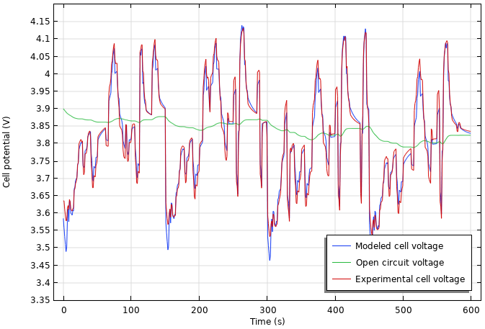
Model Results: Full Load Curve Prediction
Predicted cell voltage using the optimized parameter values, experimental cell voltage, and corresponding open circuit voltage, for the full 600 s load cycle.
The standard deviation values of the modeled cell voltage from the experimental values is 0.025.

Slide 7
Model Results
The optimized equivalent circuit parameter values are shown to the right
The standard deviation value of the Parameter Estimation study (0.023) and the Full Load Curve Prediction study (0.025) are nearly the same. This indicates that the quality of prediction will be only as good as the quality of parameter estimation and optimization.
The standard deviation values obtained using the equivalent circuit model (3 fitting parameters) are slightly higher than those obtained using the lumped battery model, (3 fitting parameters ƞ_{IR, 1C} , J₀, τ, refer to Application Library model ‘Parameter Estimation of a Time-Dependent Lumped Battery Model’) for this set of data.
Parameter | Value | Unit
R1 | 1.31 | mΩ
R2 | 1.21 | mΩ
τ | 11.33 | s
 | Equivalent Circuit | Lumped Battery
Parameter Estimation | 0.023 | 0.015
Full Load Curve Prediction | 0.025 | 0.014

