Slide 1
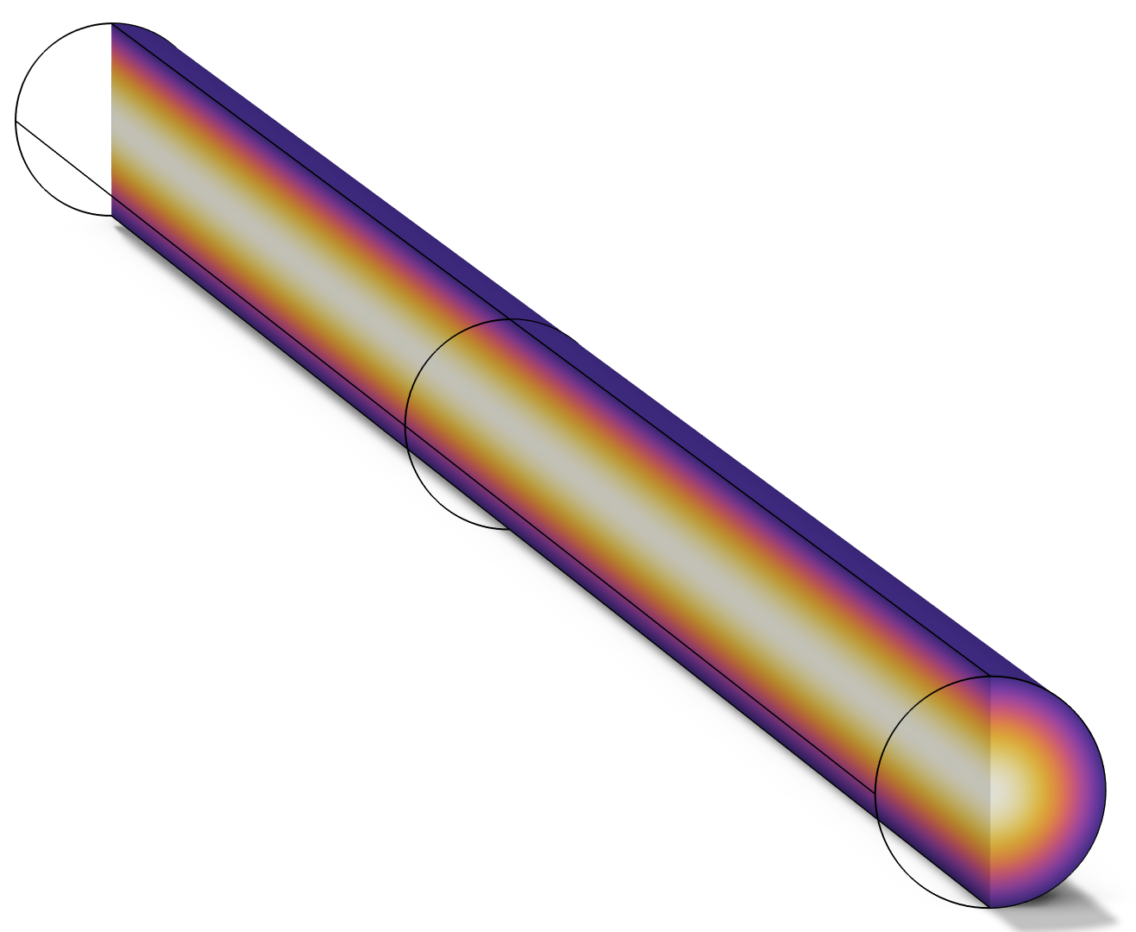
Cooling of a Nickel Cylindrical Rod with Nucleate Boiling of Water

Slide 2
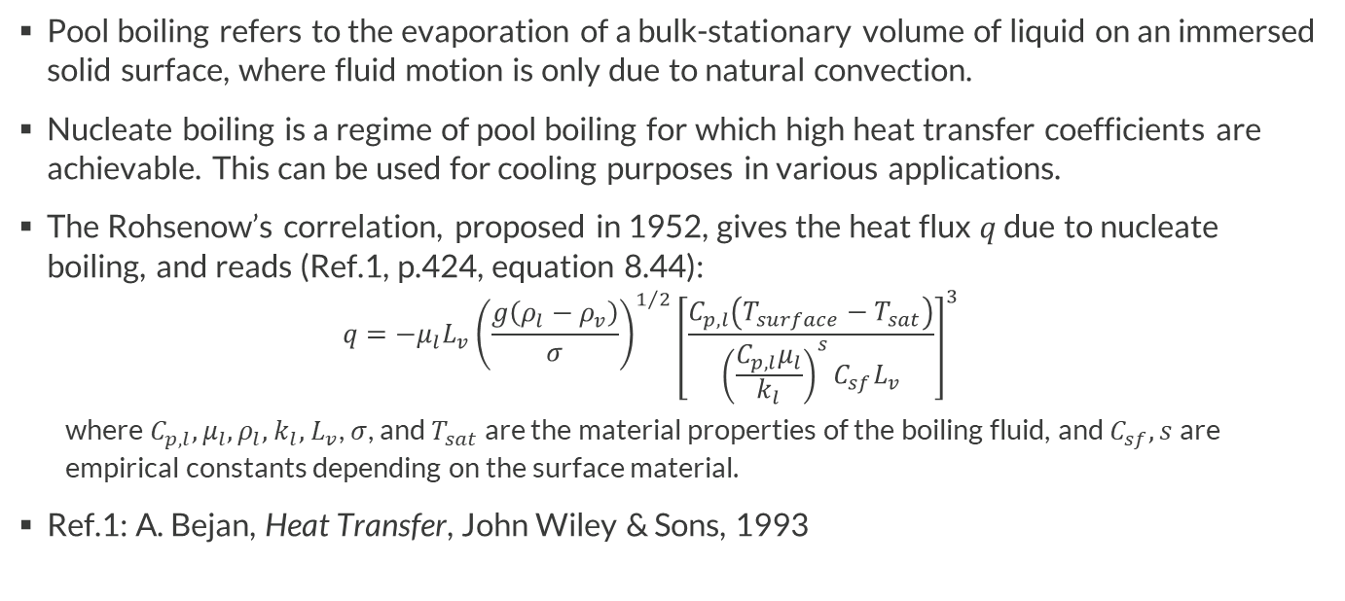
Background
Pool boiling refers to the evaporation of a bulk-stationary volume of liquid on an immersed solid surface, where fluid motion is only due to natural convection.
Nucleate boiling is a regime of pool boiling for which high heat transfer coefficients are achievable. This can be used for cooling purposes in various applications.
The Rohsenow’s correlation, proposed in 1952, gives the heat flux $q$ due to nucleate boiling, and reads (Ref.1, p.424, equation 8.44):
  $$q={−μ}_{l}L_{v}{\left(\frac{g\left(ρ_{l}−ρ_{v}\right)}{σ}\right)}^{1/2}{\left[\frac{C_{p,l}\left(T_{surface}−T_{sat}\right)}{{\left(\frac{C_{p,l}μ_{l}}{k_{l}}\right)}^{s}C_{sf}L_{v}}\right]}^{3}$$
  where $C_{p,l}, μ_{l},$ $ρ_{l},$ $k_{l},$ $L_{v}$, $σ$, and $T_{sat}$ are the material properties of the boiling fluid, and $C_{sf}, s$are empirical constants depending on the surface material.
Ref.1: A. Bejan, Heat Transfer, John Wiley & Sons, 1993

Slide 3
Motivation
This tutorial illustrates the use of the Rohsenow’s correlation implemented in the heat flux features of the Heat Transfer interface.
The example model computes the transient cooling of a cylindrical rod plated with nickel and immersed in boiling water.
The settings are presented for two cases:
  The water and nickel predefined combination of materials is used for the boiling fluid and the solid surface. In this case, all the material properties and correlation’s parameters are predefined, and no further settings are required.
  The boiling fluid is taken from material. In this case, some material properties of water and the correlation’s parameters for the nickel surface have to be set.

Slide 4
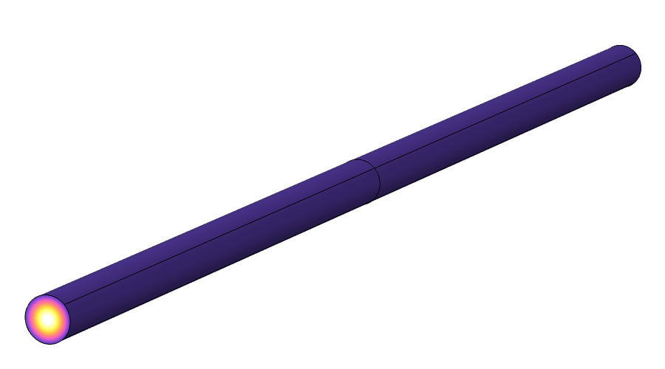
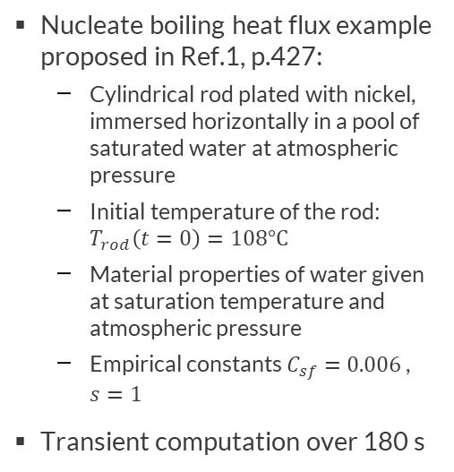


Model Definition
Thermal insulation
Nucleate boiling heat flux example proposed in Ref.1, p.427:
  Cylindrical rod plated with nickel, immersed horizontally in a pool of saturated water at atmospheric pressure
  Initial temperature of the rod: $T_{rod}\left(t=0\right)=108°C$
  Material properties of water given at saturation temperature and atmospheric pressure
  Empirical constants $C_{sf}=0.006$, $s=1$
Transient computation over 180 s
Water pool
$T=100°C$, $p_{A}=1 atm$
Heat flux (nucleate boiling)
Rod plated with nickel, $T_{rod}\left(t=0\right)=108°C$

Slide 5
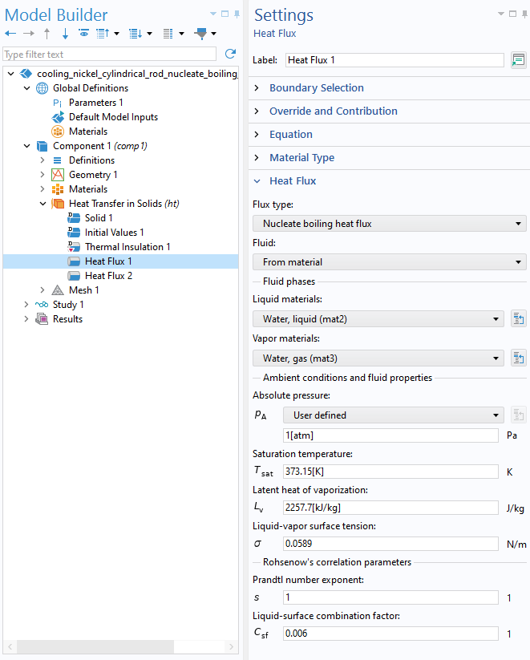
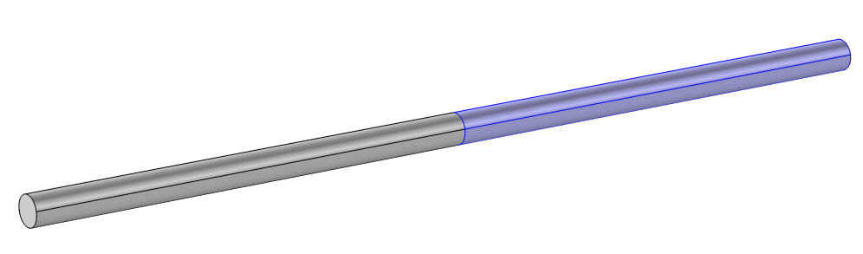
Implementation
From material option
The Heat Flux 1 feature uses the From material option in the Fluid list. The following settings are required:
  Link to materials in the Materials node for the liquid and gas properties
  Setting of the ambient conditions (absolute pressure and saturation temperature)
  Setting of latent heat of vaporization and liquid-vapor surface tension
  Setting of the empirical constants
Link to materials
Heat Flux 1
Settings window and selection of Heat Flux 1 feature

Slide 6
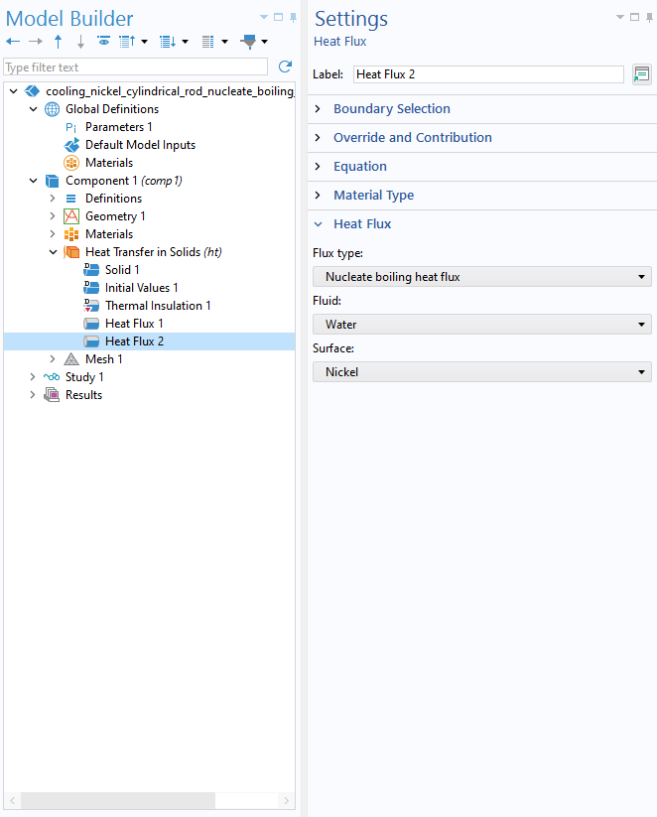
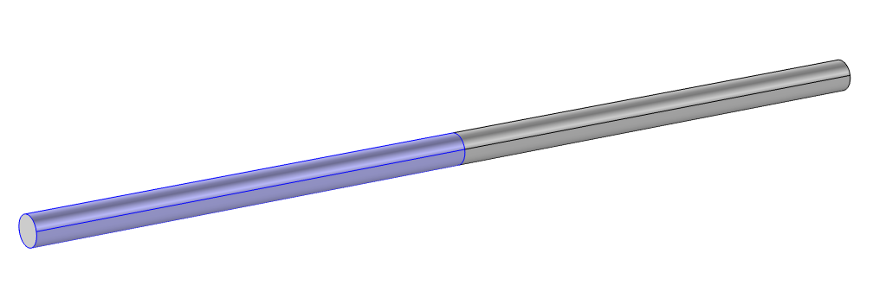
Implementation
Water and Nickel combination
The Heat Flux 2 feature uses the Water and Nickel predefined materials for the boiling fluid and solid surface. No additional setting is required.
The material properties are defined in the feature, at saturation temperature and atmospheric pressure.
Heat Flux 2
Settings window and selection of Heat Flux 2 feature

Slide 7
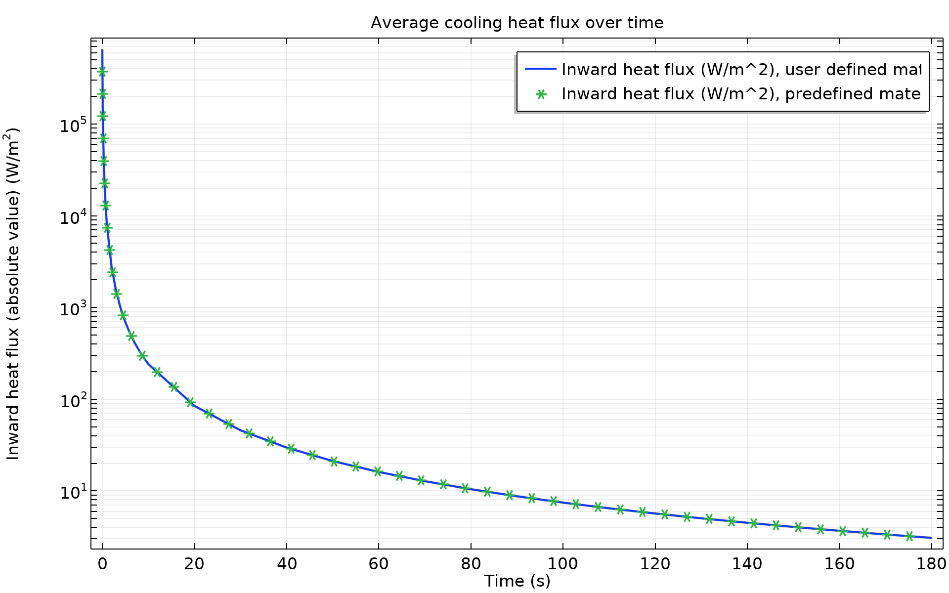
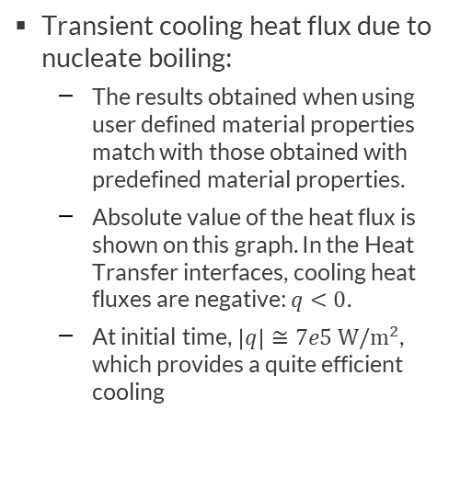
Results
Transient cooling heat flux due to nucleate boiling:
  The results obtained when using user defined material properties match with those obtained with predefined material properties.
  Absolute value of the heat flux is shown on this graph. In the Heat Transfer interfaces, cooling heat fluxes are negative: $q<0$.
  At initial time, $\left|q\right|≅7e5 W/m^{2}$, which provides a quite efficient cooling
Comparison of average heat flux obtained with the user defined and predefined material settings

Slide 8
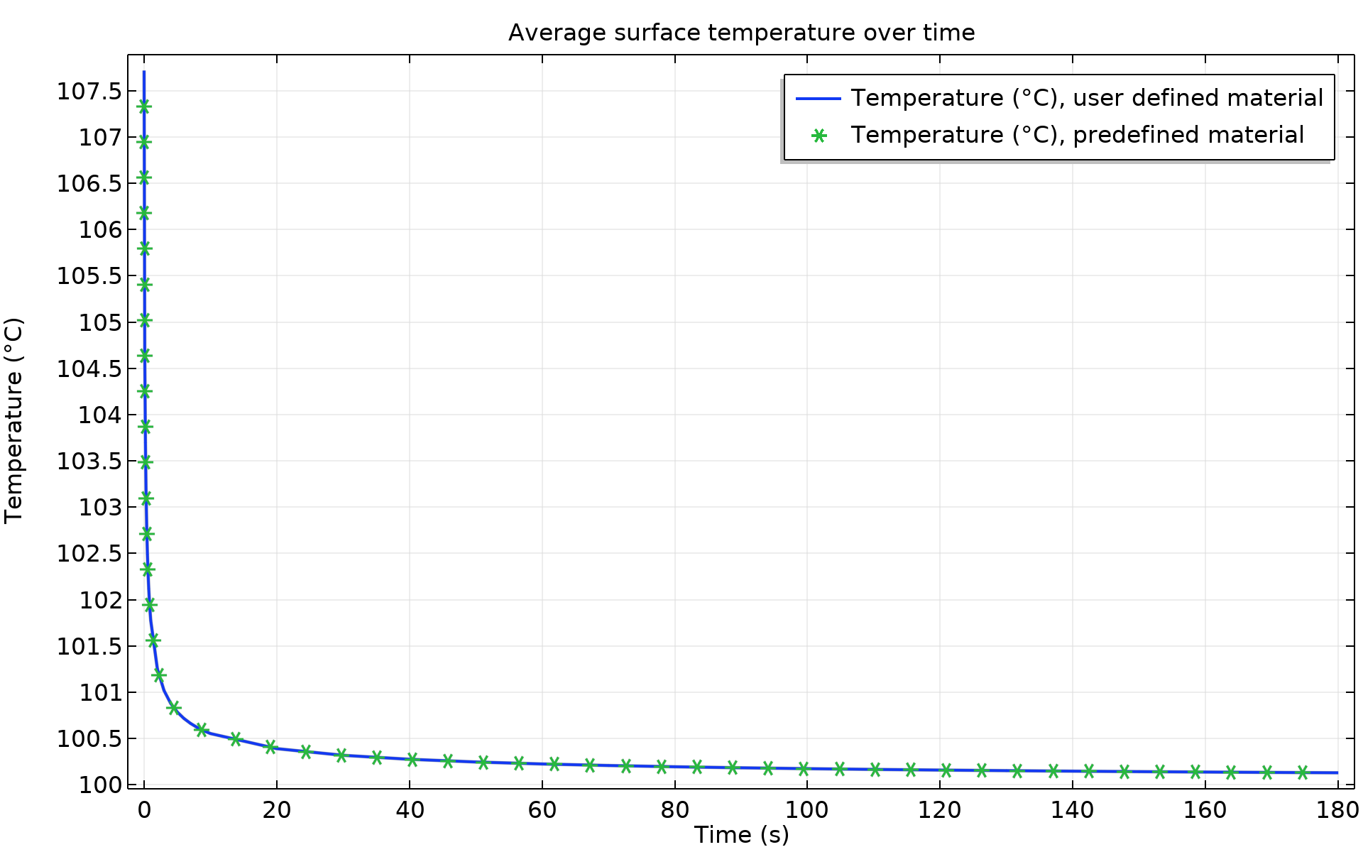
Results
Transient surface temperature of the rod:
  The results obtained when using user defined material properties match with those obtained with predefined material properties.
  The stationary state is reached after 180 s of cooling.
Comparison of average temperature obtained with the user defined and predefined material settings

Slide 9
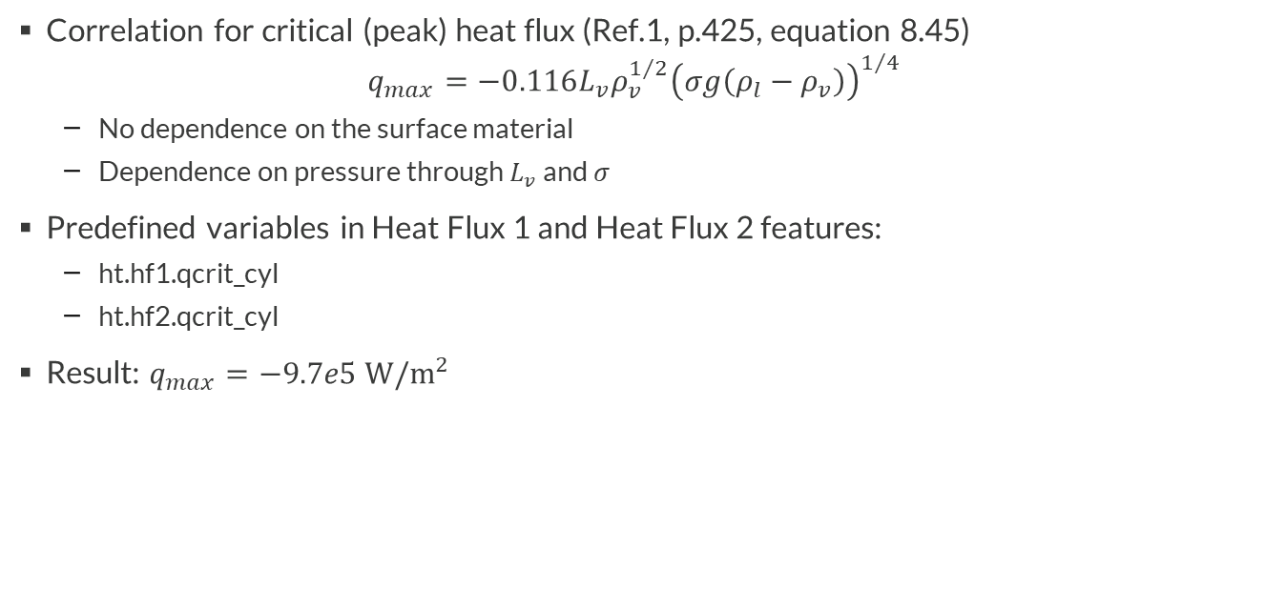
Results
Correlation for critical (peak) heat flux (Ref.1, p.425, equation 8.45)
$$q_{max}=−0.116L_{v}ρ_{v}^{1/2}{\left(σg\left(ρ_{l}−ρ_{v}\right)\right)}^{1/4}$$
  No dependence on the surface material
  Dependence on pressure through $L_{v}$ and $σ$
Predefined variables in Heat Flux 1 and Heat Flux 2 features:
  ht.hf1.qcrit_cyl
  ht.hf2.qcrit_cyl
Result: $q_{max}=−9.7e5 W/m^{2}$

Slide 10
Other Features where Nucleate Boiling Heat Flux is Available
In the Heat Transfer interface:
  Domain feature : Out-of-Plane Heat Flux
  Boundary feature : Isothermal Domain Interface
  Edge feature : Heat Flux (subfeature of Thin Layer, Thin Film, and Fracture)
  Point feature : Point Heat Flux (subfeature of Thin Rod)
In the Heat Transfer in Shells interface:
  Edge feature : Heat Flux
  Boundary interface feature: Heat Flux, Interface
In the Lumped Thermal System interface:
  Global features: Nucleate Boiling Heat Rate, Heat Rate

