Slide 1
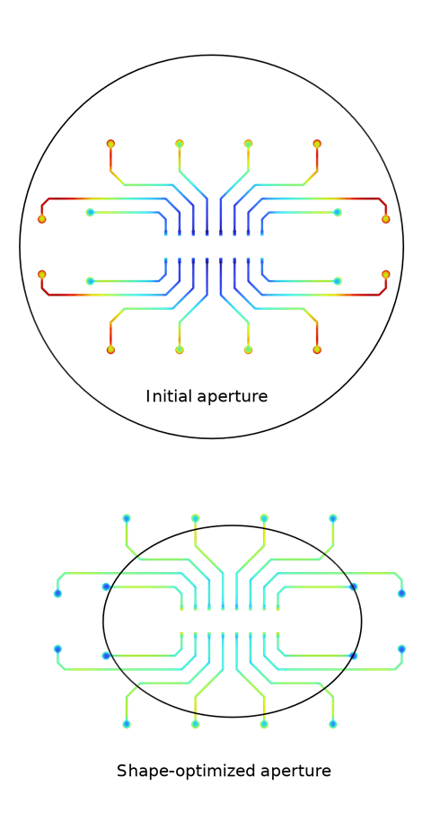
Aperture Shape Optimization for Electroplating of a Printed Circuit Board
COMSOL

Slide 2
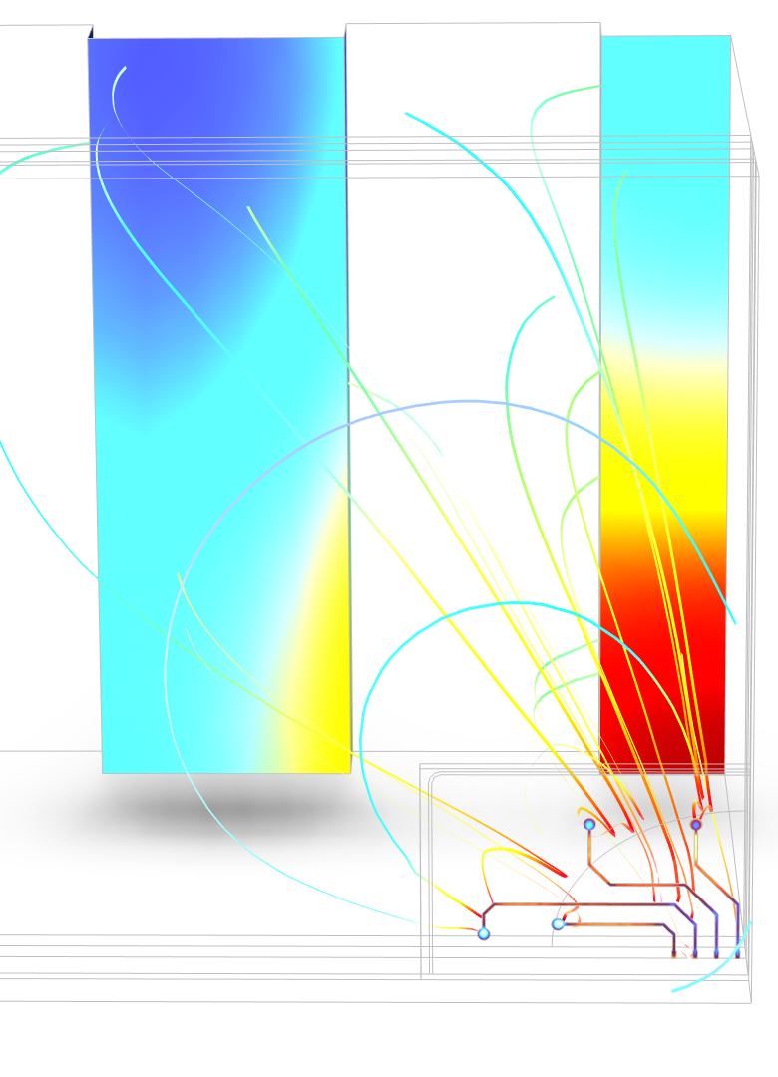
Overview
This example simulates electroplating of a printed circuit board (PCB) in 3D using the Secondary Current Distribution and Shape Optimization interfaces
An aperture is typically used in the electroplating bath in order to achieve uniform deposition thickness across the PCB
The size and aspect ratio of the aperture is optimized using the Shape Optimization interface
Due to mirror symmetry, only one-forth of the actual geometry is used
The model demonstrates the change in size and shape of the aperture in order to achieve uniform deposition thickness across the PCB

Slide 3
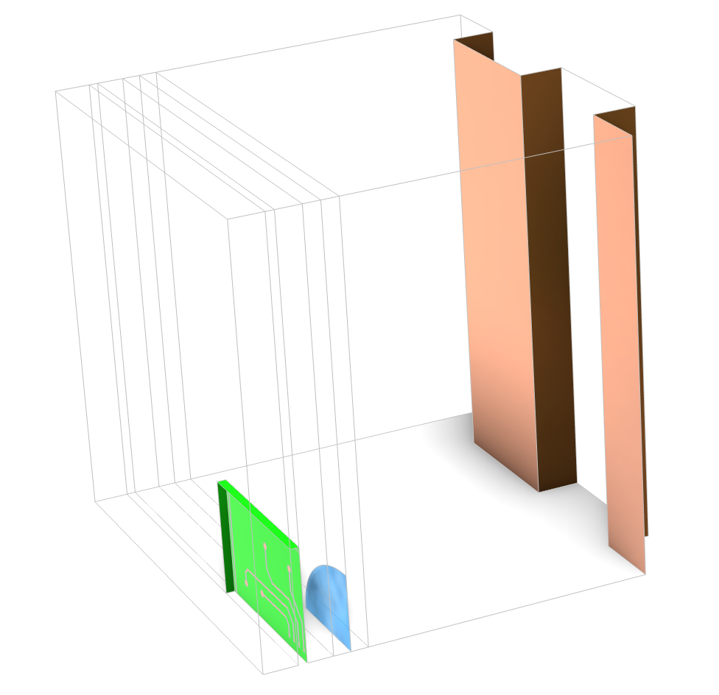
Model Geometry
Symmetry
Anode
PCB Cathode
Aperture
Geometry of the electroplating bath using one-fourth mirror symmetry

Slide 4
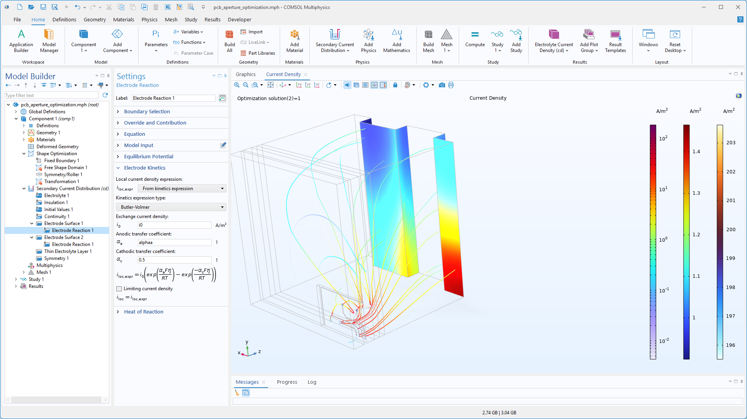
Electrochemistry
The Secondary Current Distribution interface is used to solve for charge transport in the electroplating bath
Butler-Volmer electrode kinetics is used to model copper dissolution and deposition at the anode and cathode, respectively
A Total Current boundary condition is used at the Cathode whereas the anode is grounded
The Thin Electrolyte Layer feature is used at the aperture screen
The Symmetry feature is set at the highlighted boundaries

Slide 5
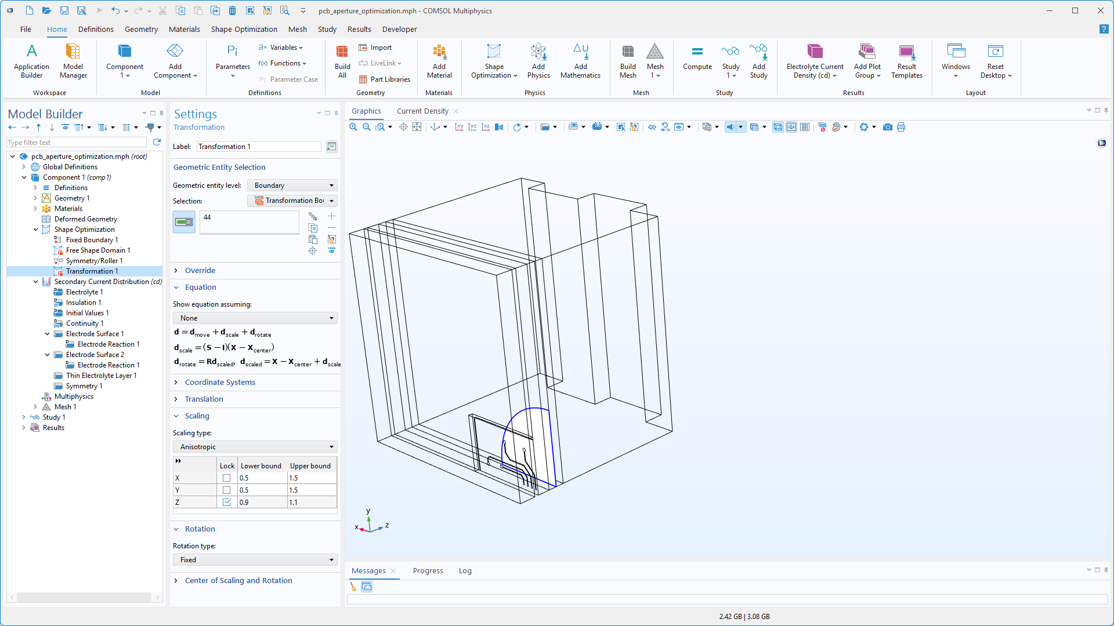
Shape Optimization
The Shape Optimization is solved over a narrow domain next to the aperture, as highlighted
The Transformation feature used at the aperture is set to allow anisotropic scaling in x- and y- directions
The objective function is set using P-norm feature which is defined in terms of normalized current density over the PCB cathode boundaries

Slide 6
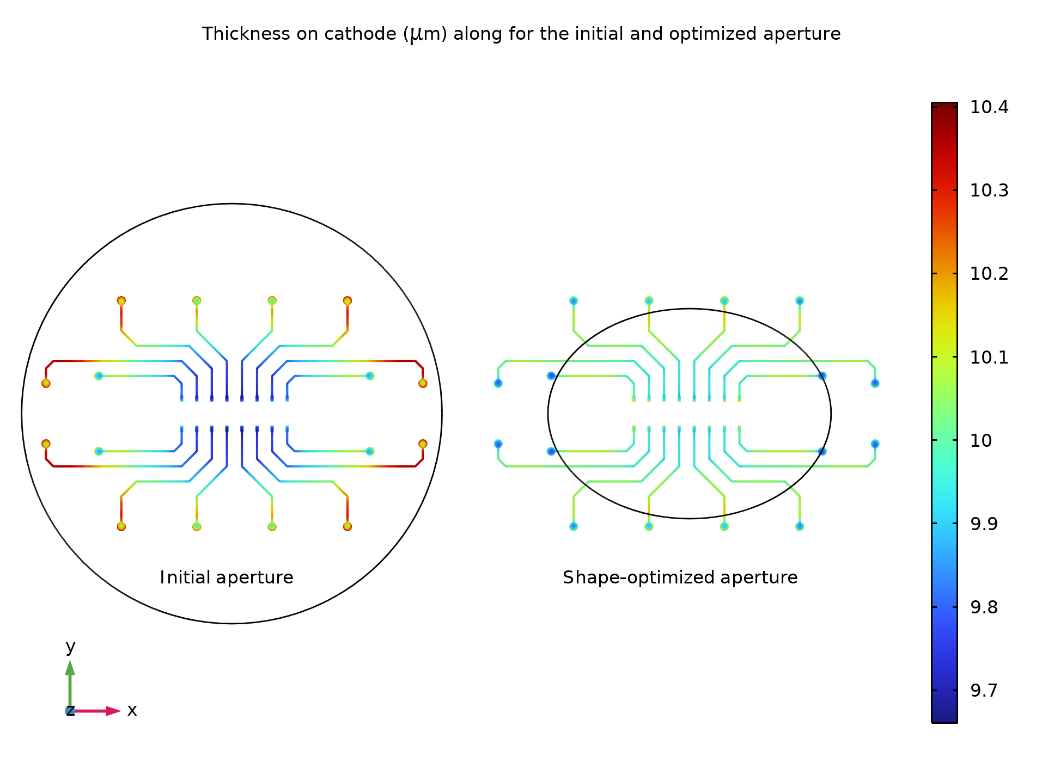
Thickness and Aperture Shape
The initial and shape-optimized aperture along with deposition thickness across the PCB are shown
The deposition is found to be fairly uniform with the shape-optimized aperture
The aperture size is reduced in order to get uniform deposition across PCB
The aspect ratio of the aperture is also changed from circle to ellipse after shape optimization
Initial and shape-optimized aperture along with deposition thickness across PCB

Slide 7
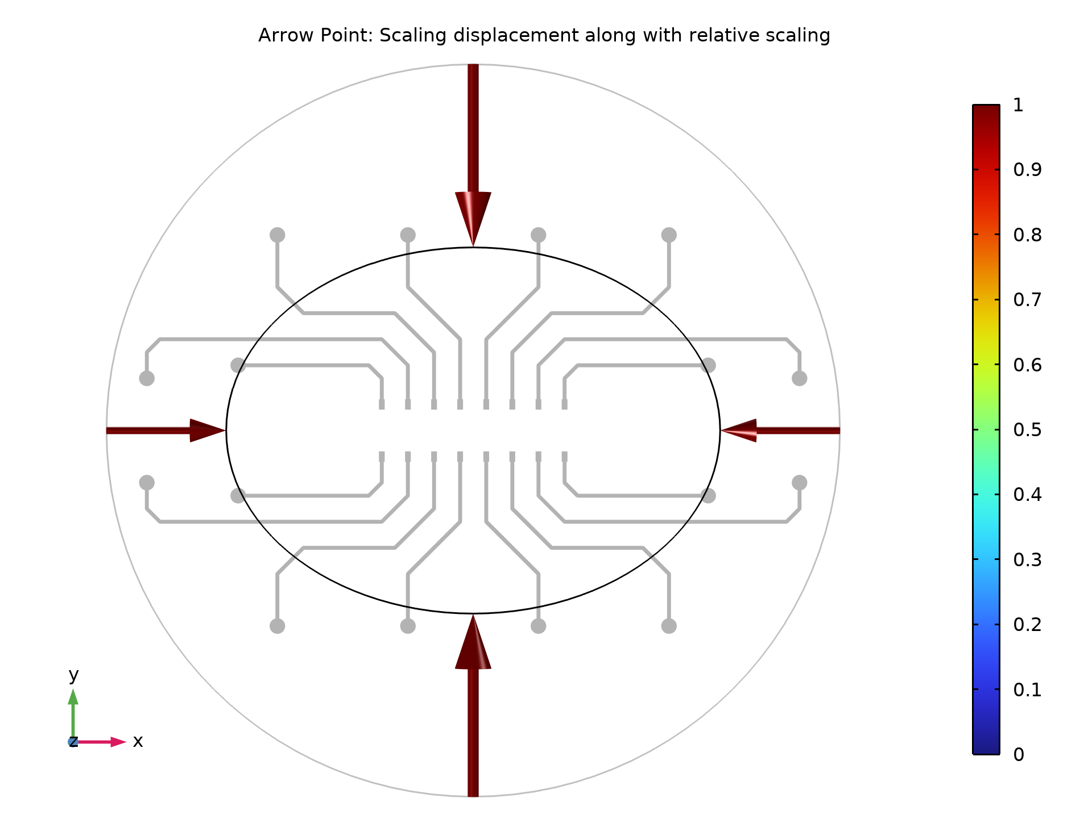
Aperture Shape and Scaling
The initial and shape-optimized aperture along with the PCB, scaling displacement and relative scaling are shown here
Arrows indicate the scaling displacement in x- and y-directions along with the magnitude of relative scaling
The scaling displacement is found to be larger in the y-direction compared to the x-direction, which is expected considering the PCB size
The magnitude of relative scaling is also found to be well within the lower and upper bounds set in the Transformation feature
Initial and shape-optimized aperture along with the scaling displacement and relative scaling

