Slide 1
Characteristic Parameters of a Coaxial Cable
Notes:
This model is also discussed in the following post on the COMSOL Blog:
https://www.comsol.com/blogs/model-cables-and-transmission-lines-in-comsol-multiphysics/

Slide 2
Characteristic Parameters
There are a number of characteristic parameters (R, L, Z, etc) that are commonly used to classify cables.
The parameters themselves are determined from various electromagnetic quantities.
This simulation calculates the a number of characteristic parameters for a coaxial cable and compares them to the analytical solutions in the DC and high frequency limit. Two different approaches are shown:
  One using fully user-defined equations
  One using built-in variables from the Coil and Terminal features and requires substantially less user-effort.
For additional information refer to COMSOL Blog post “Model Cables and Transmission Lines in COMSOL Multiphyiscs”

Slide 3
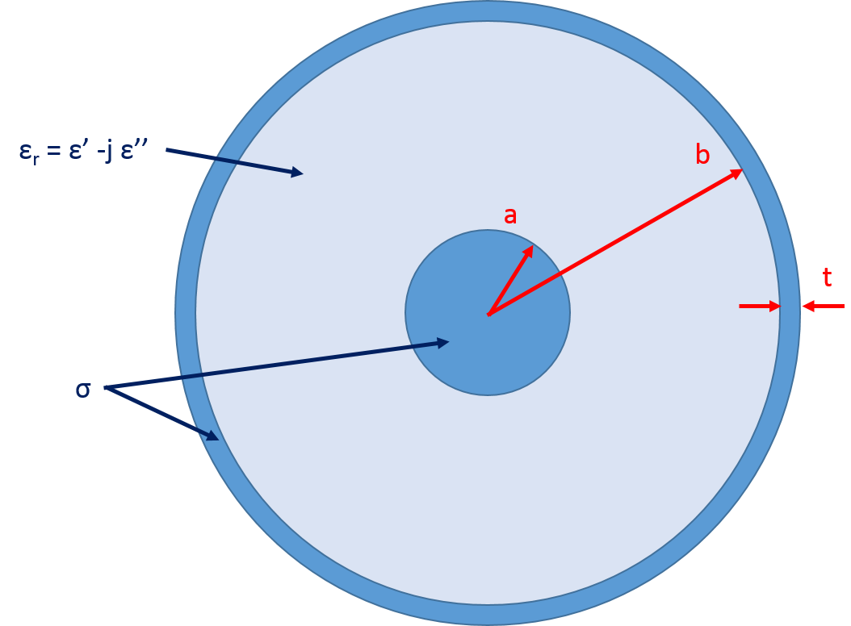
The Simulation Geometry is the Cross Section of a Coaxial Cable
a = 0.405 mm
b = 1.45 mm
t = 0.1 mm
ε_{r} = 2.25 – j*0.01
σ = 5.98e7 S/m

Slide 4
Analytical Solutions for Various Parameters of a Coaxial Cable
Valid at DC limit:
Valid when skin depth (δ) << t:
Valid at any frequency:

Slide 5
RLGC from User-Defined Parameters
Capacitance:
Inductance:
Resistance:
Impedance and
Propagation constant:
Conductance:
Notes:
For more details and discussion, refer to the COMSOL Blog post:
https://www.comsol.com/blogs/model-cables-and-transmission-lines-in-comsol-multiphysics/

Slide 6
RLGC using built-in Coil and Terminal features
The Coil feature in the Magnetic Fields interface will calculate the impedance, inductance, and resistance of the coil. The resistance and inductance of the coil correspond to the series resistance and inductance of the coil, however, the impedance of the Coil is NOT the impedance of the transmission line because G and C need to be factored in.
  The Coil impedance is Z_{coil} = R_{TL} + jωL_{TL} ≠ Z_{TL}
In a similar fashion, the Terminal feature in the Electric Currents interface will calculate the admittance of the terminal when using a voltage excitation.
  This Terminal impedance is Y_{terminal} = G_{TL} + jωC_{TL}.
We can then impedance and propagation constant of the transmission line as
  Z_{TL} = (Z_{coil} / Y_{terminal}) ^{½}
  γ_{TL} = (Z_{coil} * Y_{terminal}) ^{½}

Slide 7
At Higher Frequencies
At higher frequencies the coaxial cable will have higher order modes.
  The propagation constant for the first higher order mode can be read off from a plot of the transcendental equation (See Results>Plot of Transcendental Eq).
The RF Module is used to solve for the fundamental and first higher order mode, as well as the propagation and attenuation constants and effective refractive index.
  The lumped parameters are extracted for the fundamental mode and agree with theory in the high
  frequency limit.
  The first higher order mode has its onset at the predicted frequency.

Slide 8
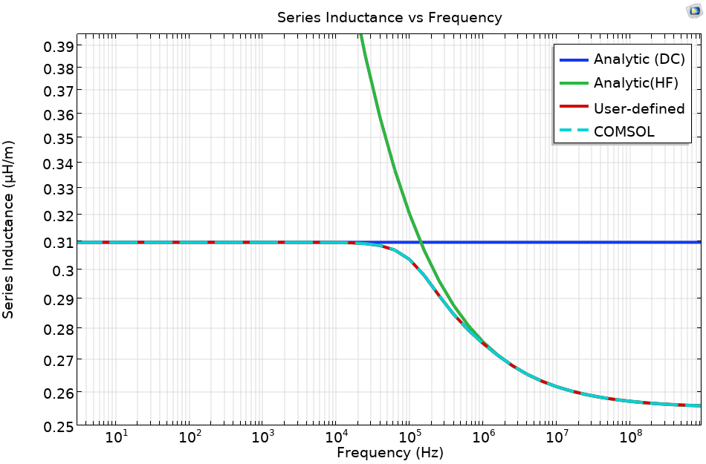
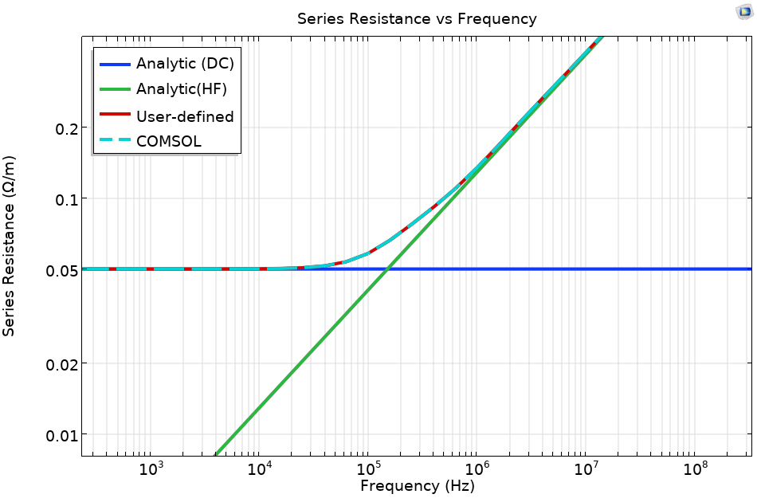
Distributed Inductance and Resistance

Slide 9
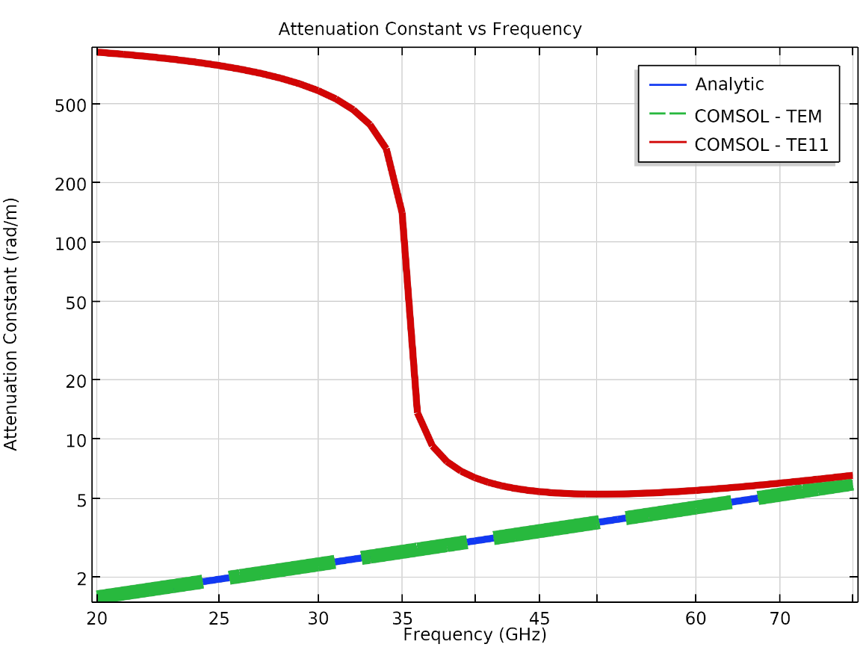
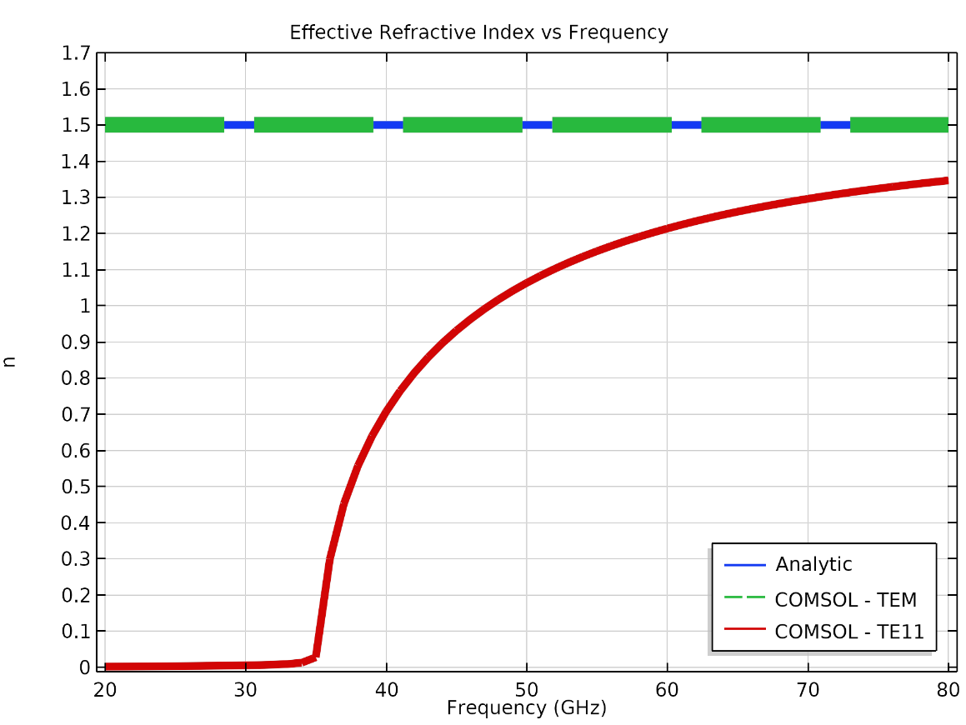
Results for Fundamental and First Higher Order Mode

