Slide 1
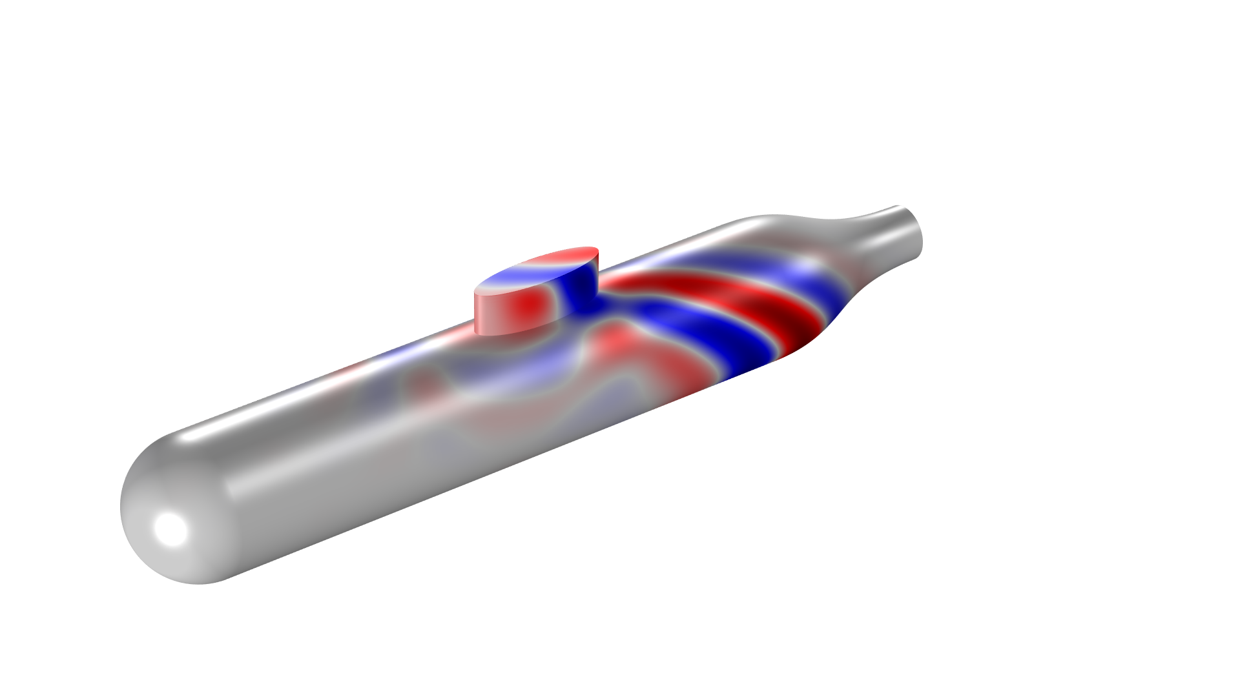
Submarine Scattering: Time Domain Simulation and FFT

Slide 2
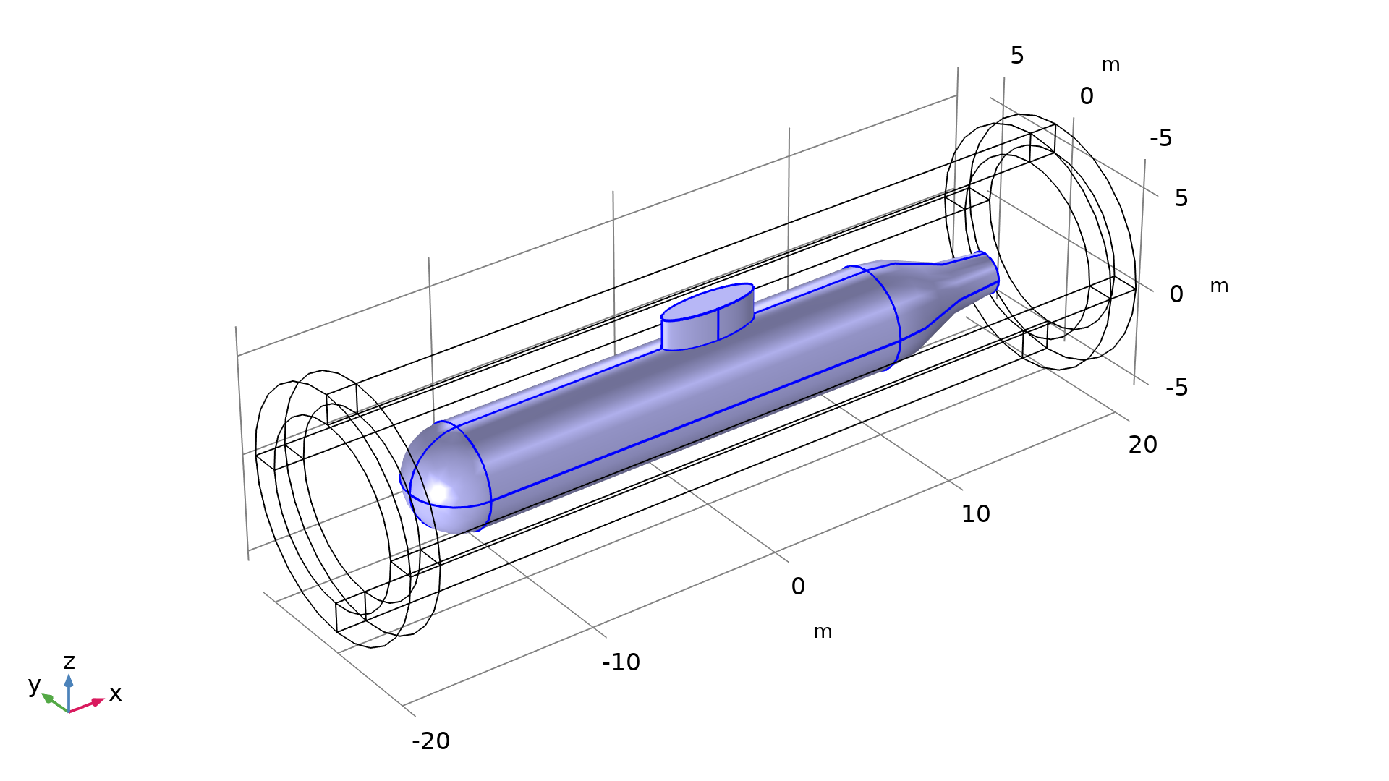
Abstract
This model illustrates how to treat large-scale transient acoustic scattering problems
The background field is given as a Gaussian modulated sine pulse with a plane-wave front
The traditional FEM approach becomes inefficient due to the large number of degrees of freedom. Thus, it is advantageous to use the time-explicit discontinuous Galerkin FEM
Background wave propagation direction

Slide 3
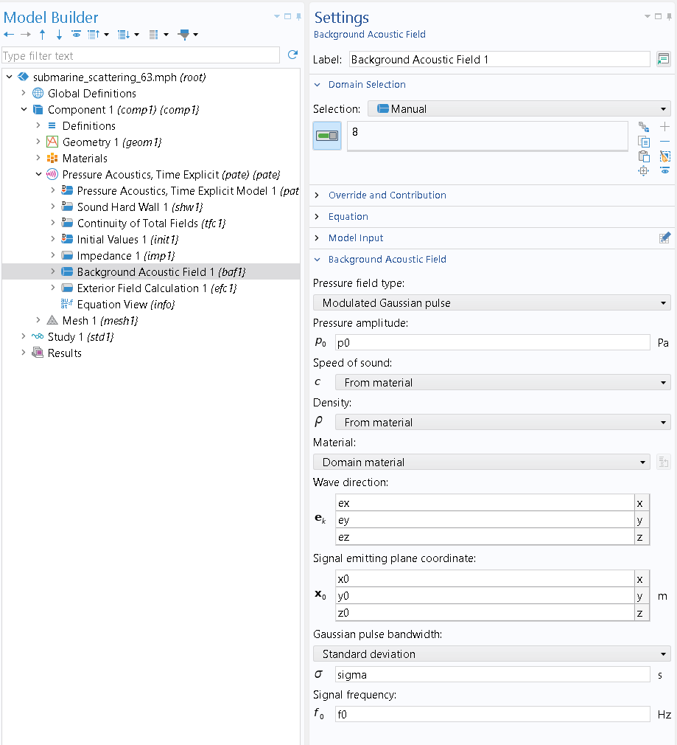
Geometry and Model Setup
The geometry contains a scatterer (submarine) surrounded by a fluid (water)
The computational domain is truncated by absorbing layers to mimic wave propagation in the open domain without reflections
The scattered acoustic field is computed through the Pressure Acoustics, Time Explicit interface
The Exterior Field Calculation feature computes the scattered field outside the computational domain, which is enabled by the Time to Frequency FFT study step

Slide 4
Geometry and Model Setup
The geometry contains a scatterer (submarine) surrounded by a fluid (water)
The computational domain is truncated by absorbing layers to mimic wave propagation in the open domain without reflections
The scattered acoustic field is computed through the Pressure Acoustics, Time Explicit interface
The Exterior Field Calculation feature computes the scattered field outside the computational domain, which is enabled by the Time to Frequency FFT study step

Slide 5
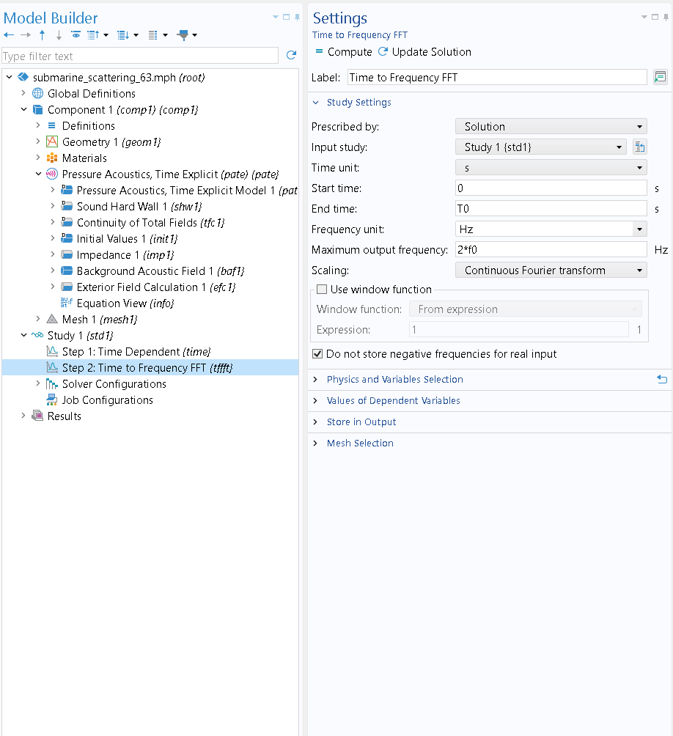
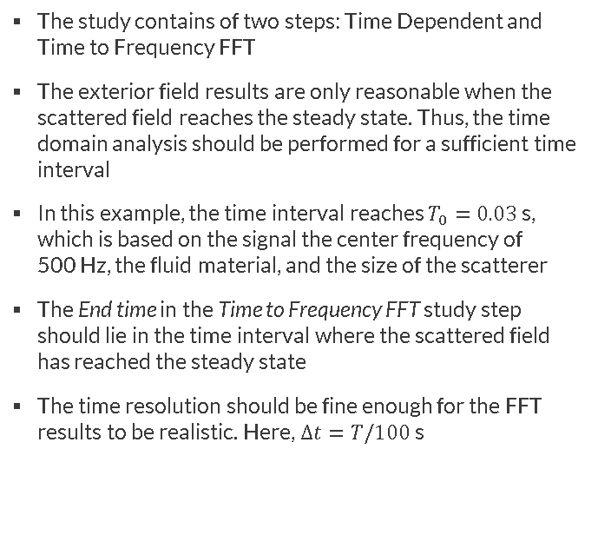
Study Setup
The study contains of two steps: Time Dependent and Time to Frequency FFT
The exterior field results are only reasonable when the scattered field reaches the steady state. Thus, the time domain analysis should be performed for a sufficient time interval
In this example, the time interval reaches $T_{0}=0.03$ s, which is based on the signal the center frequency of 500 Hz, the fluid material, and the size of the scatterer
The End time in the Time to Frequency FFT study step should lie in the time interval where the scattered field has reached the steady state
The time resolution should be fine enough for the FFT results to be realistic. Here, $∆t=T/100$ s

Slide 6
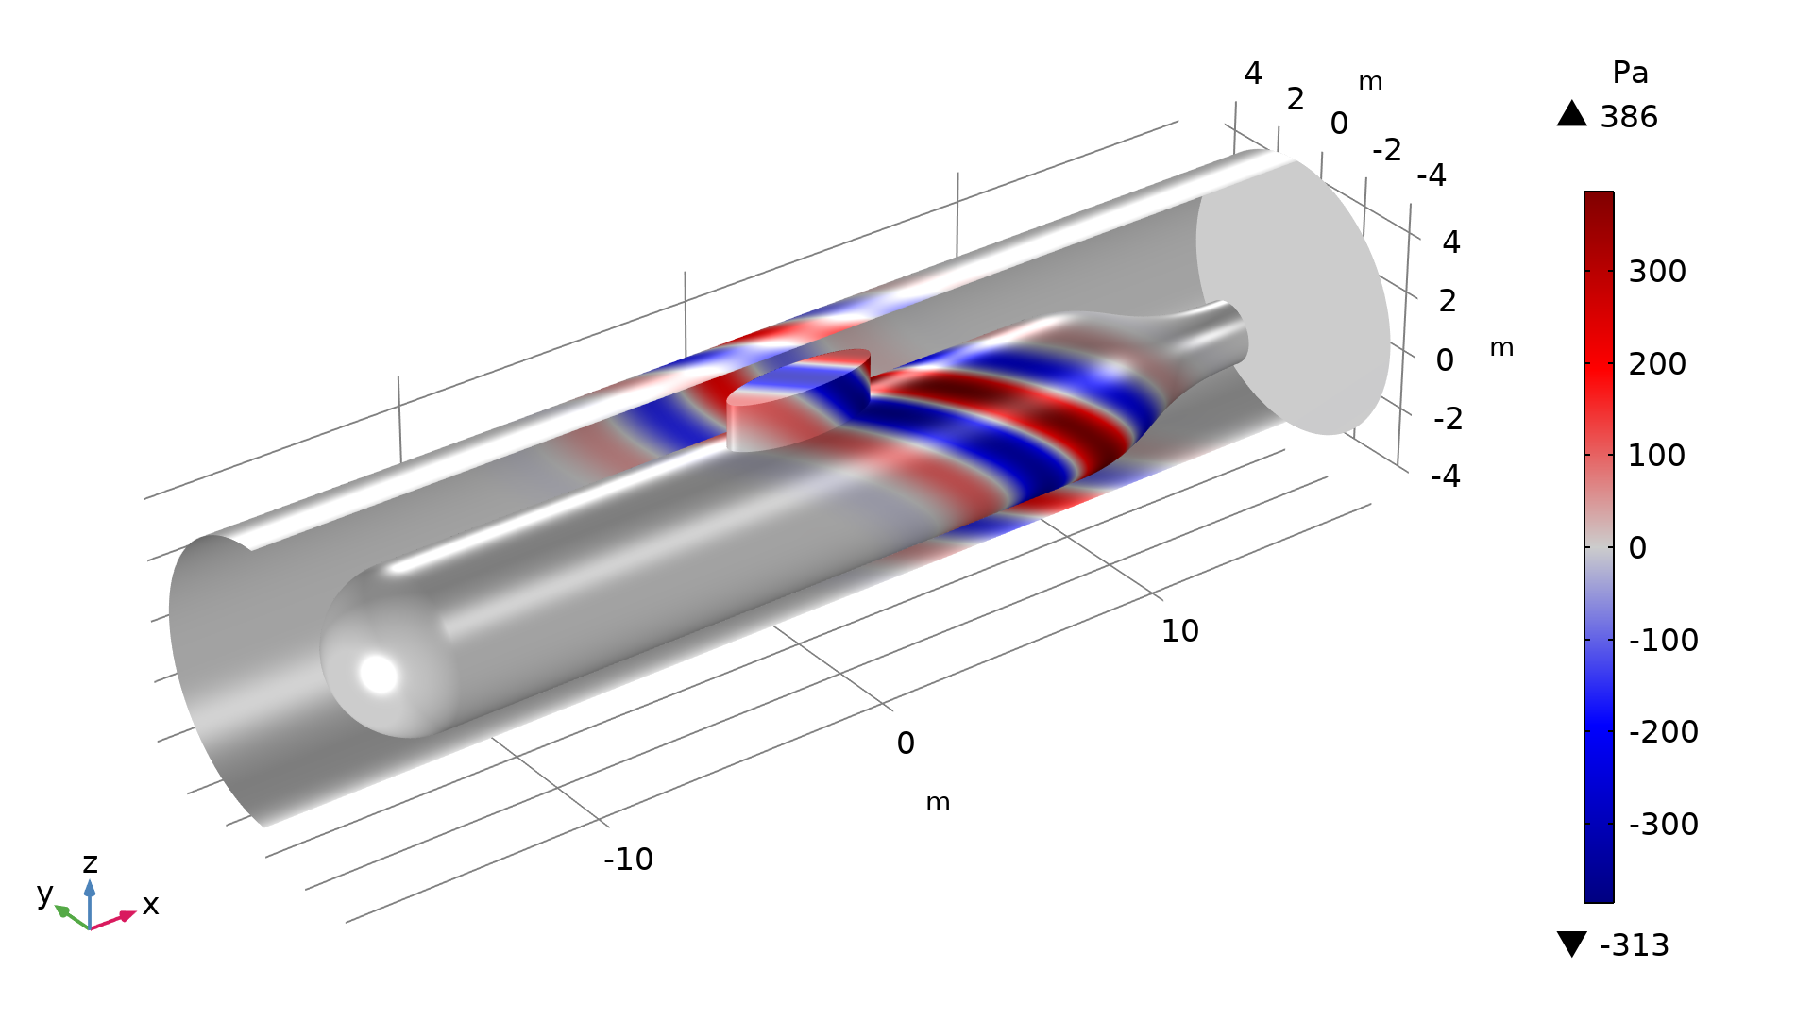
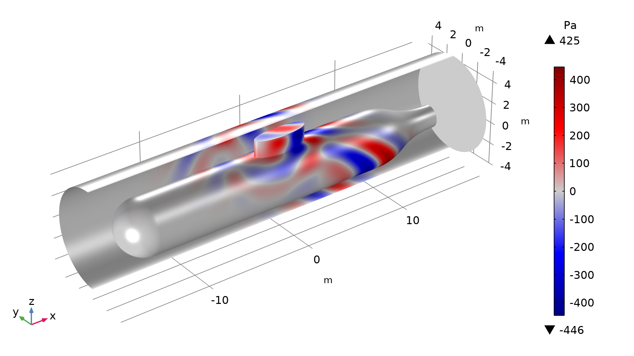
Results: Background and Scattered Fields
Background acoustic pressure at t = 0.015 s
Scattered acoustic pressure at t = 0.015 s

Slide 7
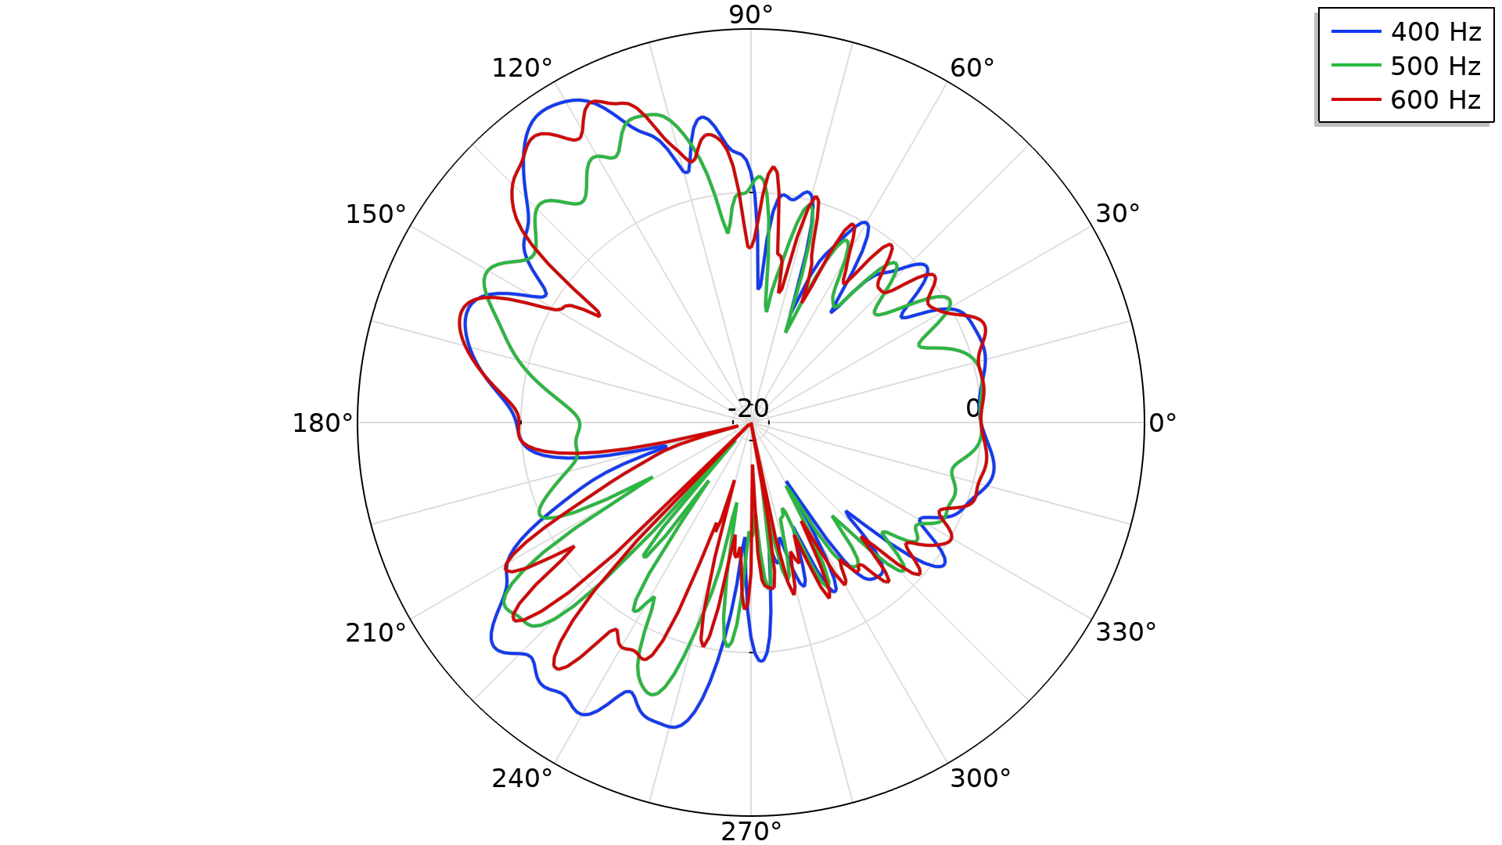
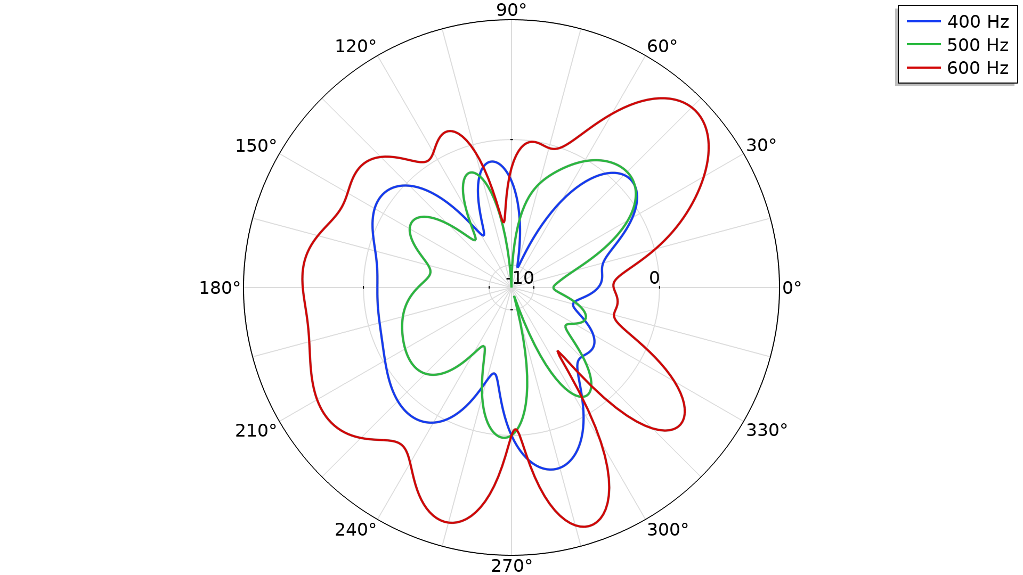
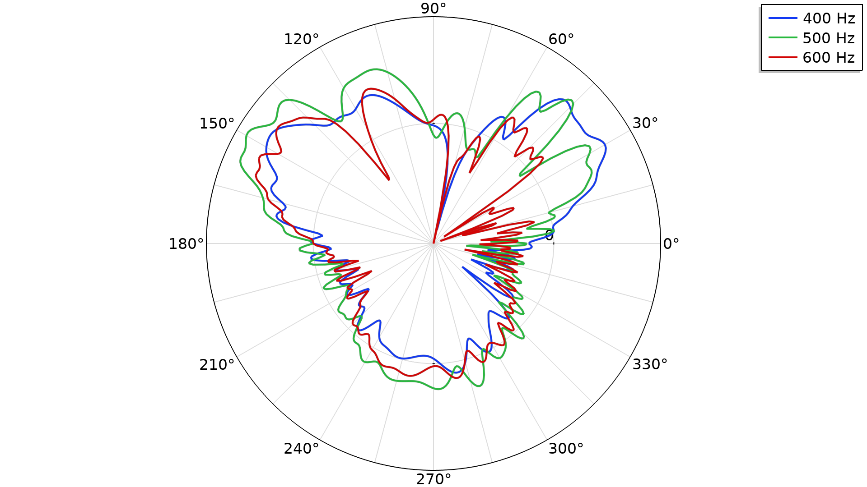
Results: Exterior Field Profiles
Exterior field SPL
Exterior field SPL
Exterior field SPL
xy-plane
30 m away from the scatterer
yz-plane
30 m away from the scatterer
xz-plane
30 m away from the scatterer

Slide 8
comsol.com

