Slide 1
EM Force Calculation of an Axial Magnetic Bearing
Electromagnetic Force Calculation using Virtual Work & Maxwell Stress Tensor
COMSOL

Slide 2
Modeling Approach
Magnetic Fields
  The Magnetic Fields interface is used to model the magnets and the surrounding air
  The Maxwell Stress Tensor force is calculated using the Force Calculation feature
Moving Mesh
  Prescribed Mesh Displacement is used to model the perturbation dZ of the inner magnets
  The macroscopic displacement Z0 is introduced in the geometry definition
Sensitivity
  The Global Control Variable is the virtual z-displacement (perturbation parameter, dZ)
  The Global Objective function is the total magnetic energy density (mf.intWm)
  Fsens(dZ) then gives the electromagnetic force using the Virtual Work method

Slide 3
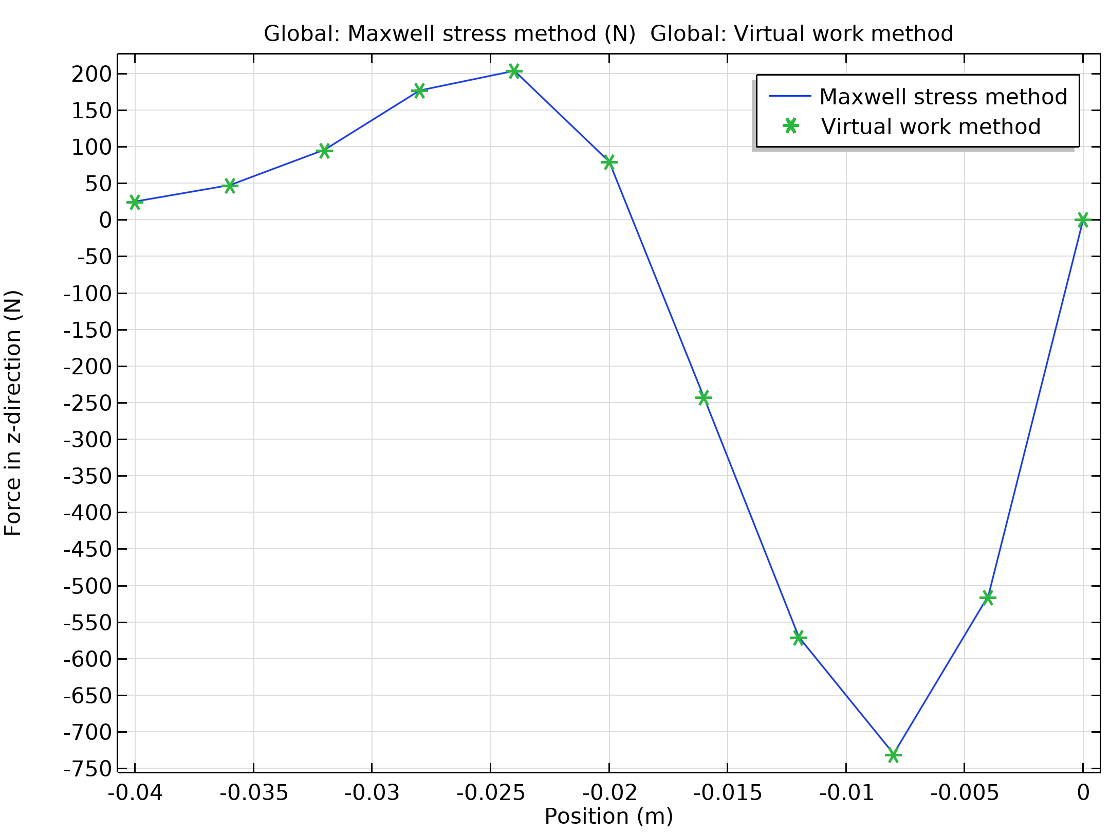
Comparison Of Methods
The Force Calculation feature integrates the Maxwell Surface Stress tensor over the magnets’ exterior boundaries: it determines the force by direct evaluation of the fields
The Sensitivity Analysis probes the influence of a small displacement on the total magnetic energy density in the system: it uses the principle of Virtual Work
See the AC/DC Module User’s Guide for more information on force computation

Slide 4
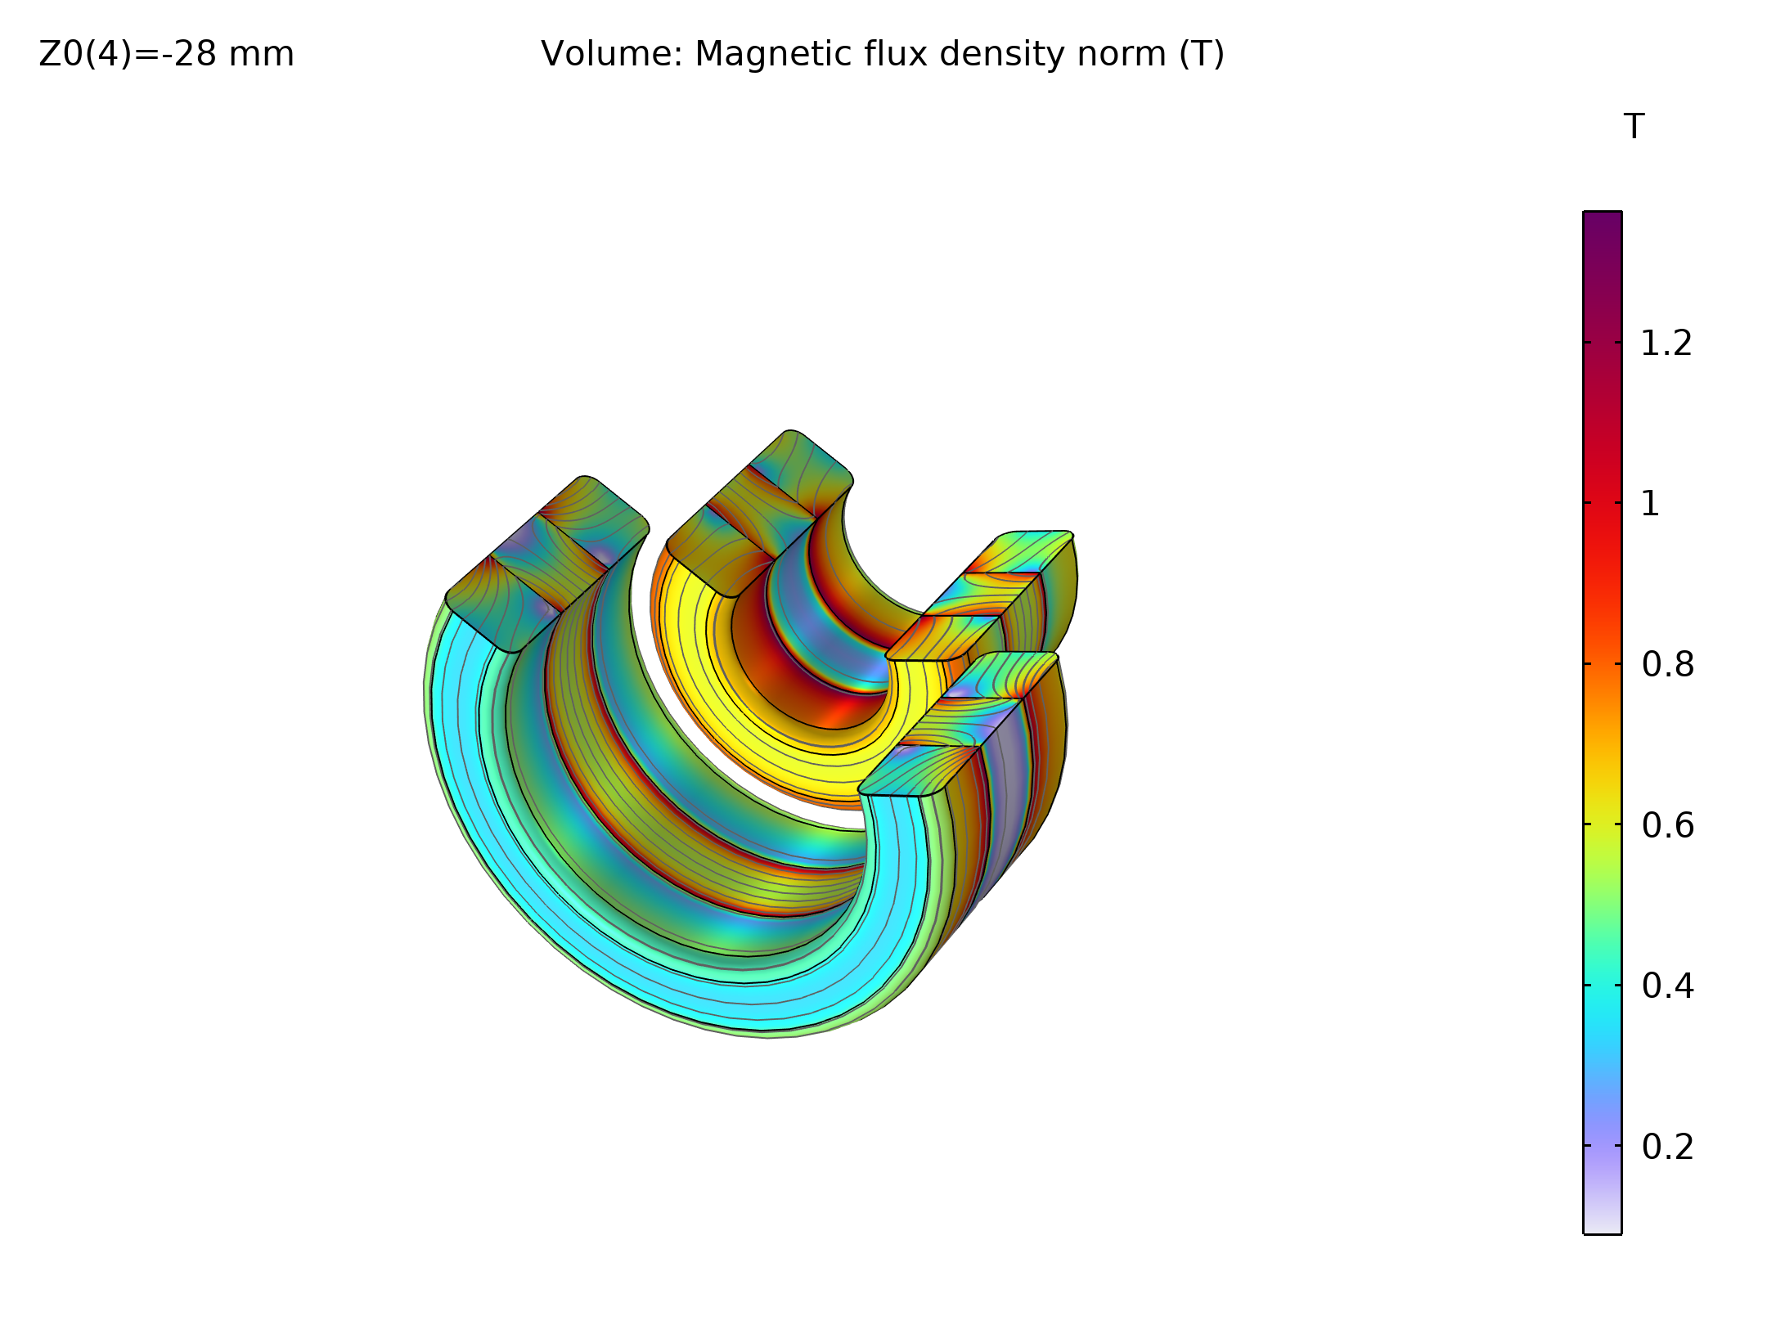
Comparison Of Methods
The stress tensor approach requires a finer mesh and smooth corners, but allows for evaluating distributed forces: it allows for a local magnetomechanical coupling
The principle of virtual work is more accurate for coarse meshes (less mesh dependent), but requires a more complicated model setup. Also, it only allows for computing forces in a global sense

