Slide 1
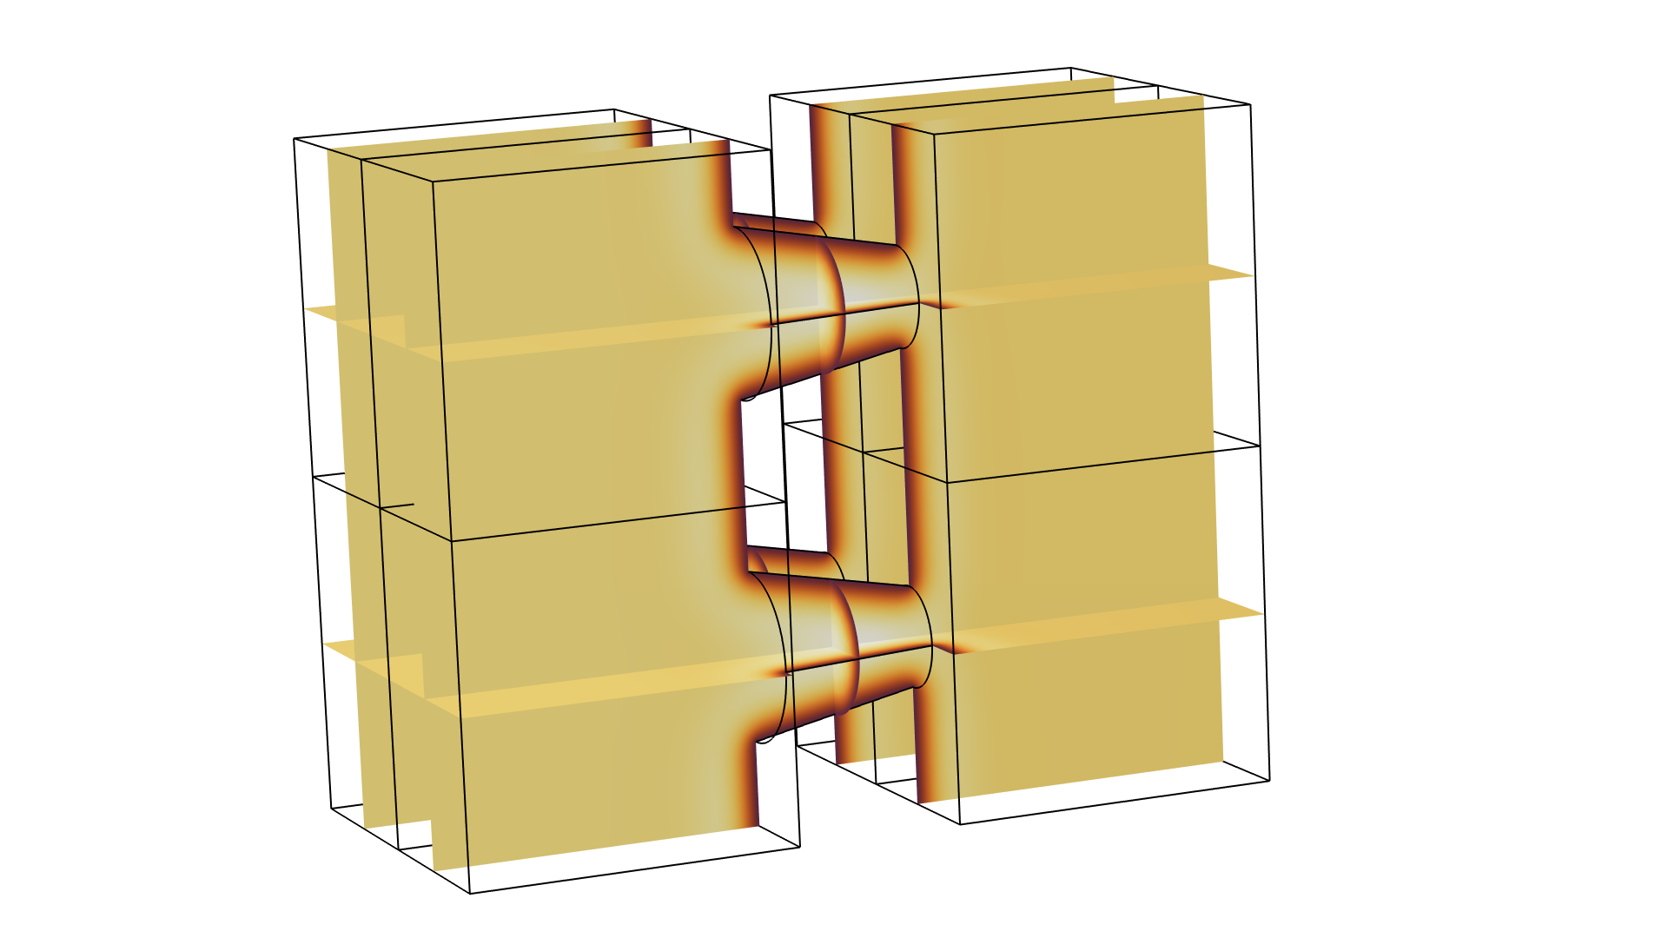
Transfer Impedance of a Perforate:
Solved using Domain Decomposition
Extension of the Application Library Model
Notes:
You can use the heading from the application documentation for the title.

Slide 2
Background and Motivation
The Transfer Impedance of a Perforate model exists in its original version in the Application Library of the Acoustics Module. The model can also be downloaded here (in the Application Gallery) along with the model documentation (.pdf file).
The version transfer_impedance_perforate_withDD_63. mph shows how the model can be solved using the Domain Decomposition solver. The built-in Iterative Solver Suggestion is enabled and used. The geometry is modified to model four full tapered perforations in order to increase the model size and challenge the solvers. This version of the model solves for 1.74⋅10⁶ DOFs.
References:
  COMSOL blog post: www.comsol.com/blogs/using-the-domain-decomposition-solver-for-thermoviscous-acoustics/
  COMSOL Multiphysics Reference Manual, under the Studies and Solvers section
  Acoustic Modules User’s Guide, under the Modeling with Thermoviscous Acoustics section

Slide 3
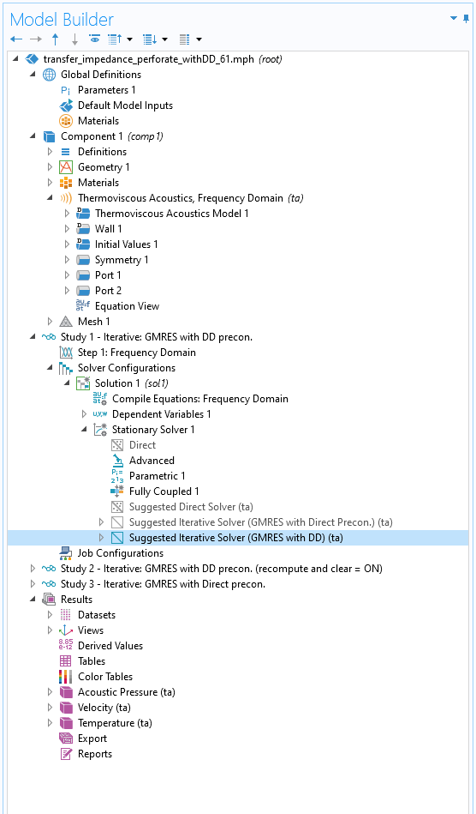
Iterative Solver Suggestions
When generating the Default Solver for most physics interfaces of the Acoustics Module one or more Iterative Solver Suggestions are generated automatically. These can be enabled when solving large computationally intensive models.
Expand the Solver Configuration nodes and enable one of the suggestions by clicking on it and pressing F4.

Slide 4
Results
Results when running the model on a desktop workstation PC with 4 cores and 128 GB RAM. Only solving for a single frequency.
Configuration | Memory | Time
Suggested Iterative Solver (GMRES with DD) (ta) Recompute and clear subdomain data is set to Off (the default). | 71.5 GB | 3min 45s
Modified: Suggested Iterative Solver (GMRES with DD) (ta) Recompute and clear subdomain data is set to On.* | 23.0 GB | 50min 25s
Suggested Iterative Solver (GMRES with Direct Precon.) (ta)** | 76.5 GB | 5min 45s
Suggested Direct Solver (ta) | 99.5 GB | 11min 20s
* Very memory efficient but slower than the default DD suggestion.
** This iterative solver suggestion is used in the original Application Library model. This method is scaling less well than the DD for even larger problems.

